Slide 1
Projects Better Together: Text + Context
Kenneth Church
Wednesday, June 26
https://github.com/kwchurch/JSALT_Better_Together
Meeting Notes

Slide 2
Four Use Cases from Proposal
Recommendations
What should I read?
What should I cite?
Finding experts
Similar to above,
except answer is a contact
(as opposed to a paper)
Routing papers to reviewers
Similar to above,
except query docs are not in training data
Summarization
Compare & Contrast Clusters
(Do not summarize docs
one at a time)

Slide 3
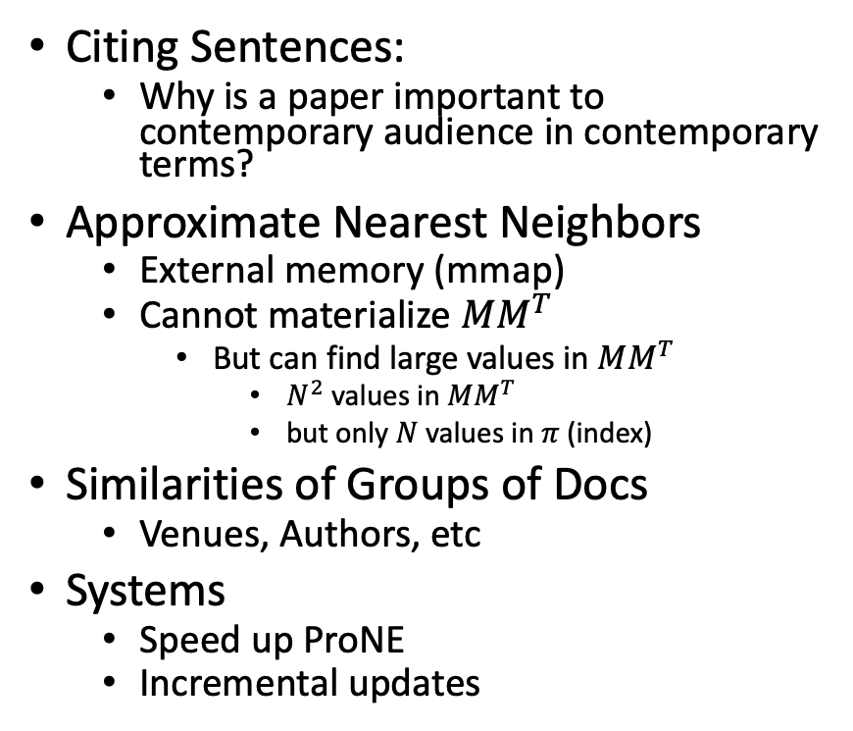
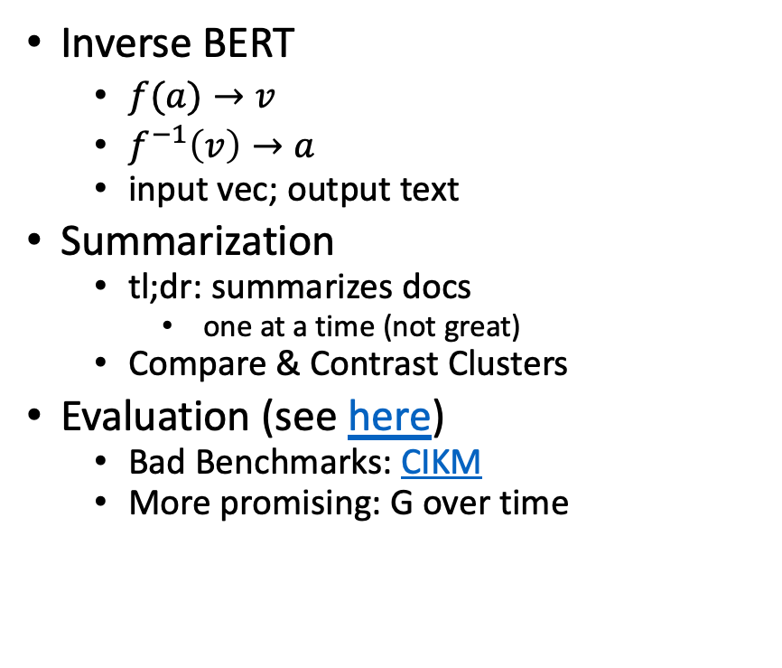
Overview of Project Suggestions
Inverse BERT
$f(a)→v$
$f^{−1}\left(v\right)→a$
input vec; output text
Summarization
tl;dr: summarizes docs
one at a time (not great)
Compare & Contrast Clusters
Evaluation (see here)
Bad Benchmarks: CIKM
More promising: G over time
Citing Sentences:
Why is a paper important to contemporary audience in contemporary terms?
Approximate Nearest Neighbors
External memory (mmap)
Cannot materialize $MM^{T}$
But can find large values in $MM^{T}$
$N^{2}$ values in $MM^{T}$
but only $N$ values in $π$ (index)
Similarities of Groups of Docs
Venues, Authors, etc
Systems
Speed up ProNE
Incremental updates

Slide 4
Summarization of 348 Docs
348 Docs
See here
Desiderata/Task
Input: set of docs
Output: clusters
Plus compare & contrast
Inverse BERT of clusters
Method
Map docs to vectors
kmeans clustering
compare & contrast centroids
inverse BERT on centroids

Slide 5
What should I cite? https://github.com/kwchurch/JSALT_Better_Together/blob/main/examples/similar_documents/minigpt4/ids.txt
cat ids.txt | $JSALTsrc/fetch_from_semantic_scholar_api.py --fields year
{'paperId': '8bd6a2a89503be083176f2cc26fabedb79238cbd', 'year': 2023}
{'paperId': 'f44ad7ad67ddd5fe74598fe491ca75c5221380df', 'year': 2023}
{'paperId': '1a8eb2cae1833df3bf12fe3b41b03d60b4a4a98d', 'year': 2023}
{'paperId': '44087314eec67a06bc68625cb8cb2fda29c3b8aa', 'year': 2022}
{'paperId': '6b85b63579a916f705a8e10a49bd8d849d91b1fc', 'year': 2020}
{'paperId': '8ca62fdf4c276ea3052dc96dcfd8ee96ca425a48', 'year': 2023}
{'paperId': '710d50e2a072d4dfc85d76de6684400c80ea59ce', 'year': 2022}
{'paperId': '3f5b31c4f7350dc88002c121aecbdc82f86eb5bb', 'year': 2023}
{'paperId': 'a3b42a83669998f65df60d7c065a70d07ca95e99', 'year': 2022}
{'paperId': '26218bdcc3945c7edae7aa2adbfba4cd820a2df3', 'year': 2022}
{'paperId': 'd5caec8107da41ec71fc0bb36d60fc2d8834846e', 'year': 2019}
{'paperId': '4d8f2d14af5991d4f0d050d22216825cac3157bd', 'year': 2015}
{'paperId': '63c74d15940af1af9b386b5762e4445e54c73719', 'year': 2021}
Seeds are too recent to appear in embeddings
Suggestion:
centroid approx. + inverse BERT

Slide 6
Deliverables https://github.com/kwchurch/JSALT_Better_Together/blob/main/doc/deliverables.md
Better access to literature
Resources:
Many embeddings for many papers
Posted models on HuggingFace
Post code on GitHub
Summarization methods to compare and contrast across small (and large) collections of documents
Support incremental updates to embeddings based on citation graphs
Evaluation:
Better numbers,
as well as better benchmarks
Establish that combinations of text and links are better together (than either by itself)
Establish that citing sentences are useful
Improve methods for assigning papers to reviewers
Theory: Unified framework of
Deep nets and
Linear Algebra
Bibliometrics:
Predict citations of a paper over time.
Predict h-index of an author over time.
Find authors that publish too many papers

