Slide 1
Better Together: Text and Context
Team and Individual Updates
Melissa Mitchell
July 21, 2023

Slide 2
Outline
Team Updates (1-2 minutes)
Evaluation updates
Evaluation Plan and Individual Contributions (8-9 minutes)
Intrinsic and extrinsic evaluation
Clustering
Next Steps (3-4 minutes)
Questions

Slide 3
Team Updates

Slide 4
Team Updates – Evaluation
Expanding random walk to all the bins using ProNE embedding
Extrinsic evaluation (on tasks)
Local citation recommendation
Year prediction
Venue prediction
Notes:
pairs of papers with big cosines, what years are they in. nearer in time citation graph closer = higher cosines

Slide 5
Network Effects: Data and Embeddings
Binning by time:
Split graph into 100 subgraphs by time
Cumulative graphs: each graph includes itself and all previous graphs
Embeddings:
Compute ProNE embeddings on cumulative graphs
Bin 99
………
Bin 0
Time
Notes:
mention equal # papers
consider replacing w/ diagram

Slide 6
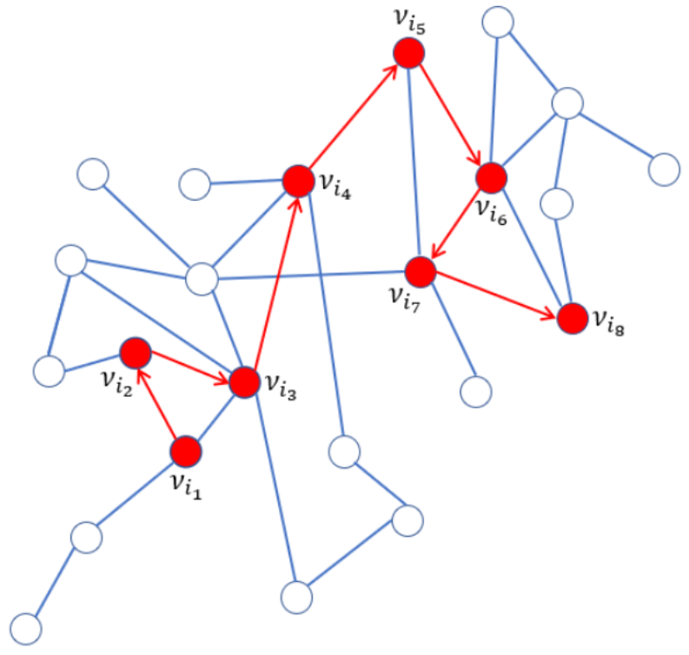
Team Updates – Evaluation
Pick random paper to start, extract all the references, walk to one of those references at random, and so on
There are often multiple paths to a paper – recorded number is the shortest path from starting paper
Limit to 1 to 4 hops away from query paper
Increasing # hops leads to decreasing similarity
Notes:
We believe embeddings in cosine are related to distance in a graph. Evaluation task is predicting references in work, intrinsic eval can be random walk of citations
Use cosine similarity to measure similarity between pairs of papers

Slide 7
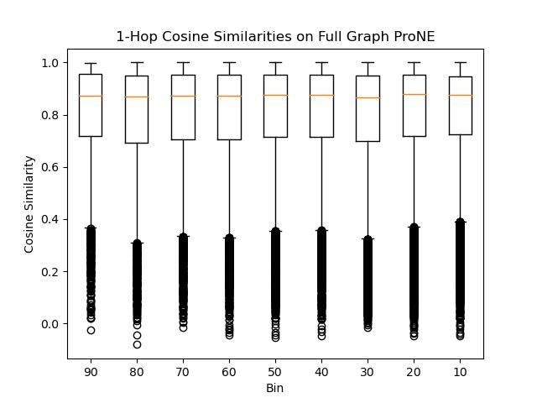
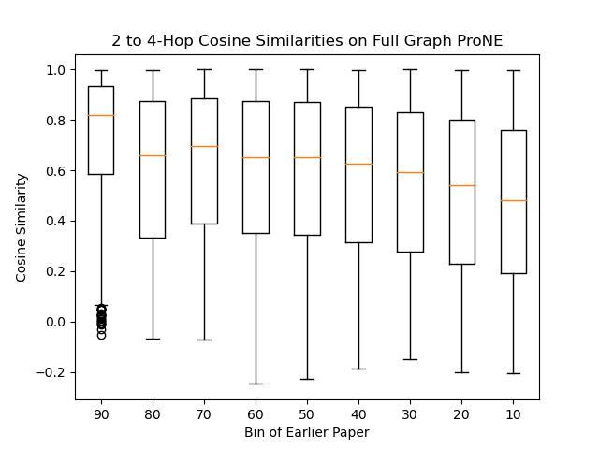
Team Updates – Evaluation
Charts by Peter
Notes:
pairs of papers with big cosines, what years are they in. nearer in time = smaller cosines? citation graph closer = higher cosines

Slide 8
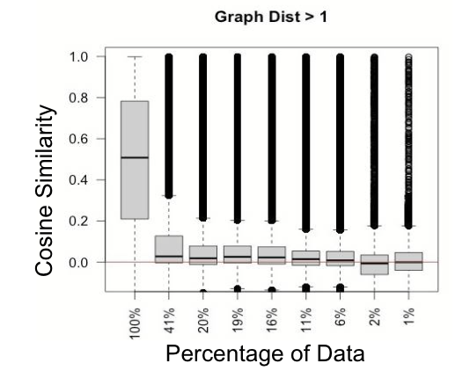
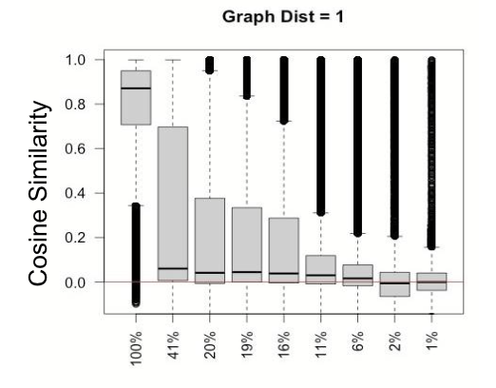
Team Updates – Evaluation
Percentage of Data
Notes:
check understanding of this slide

Slide 9
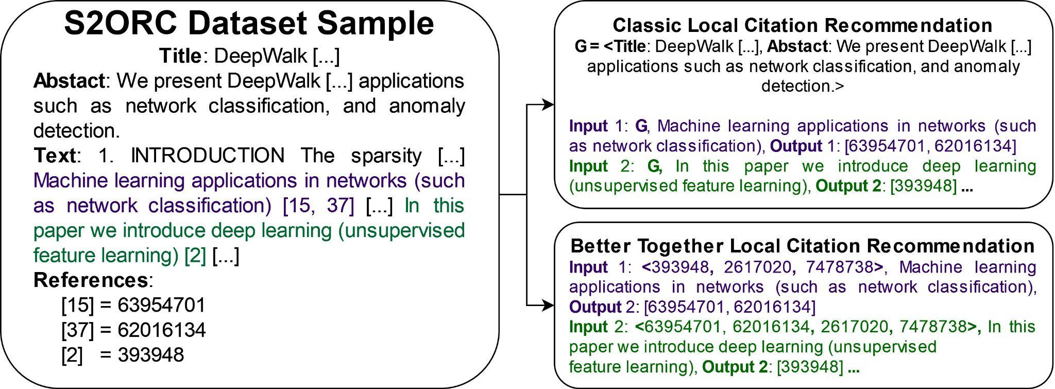
Team Updates – Local Citation Recommendation
Notes:
Refer to original paper before this. Link prediction refers to many things – earlier was one of simpler ones, whether i cites j. Introducing more complex problem
Reduce text
? answer, not q
use animations?
Emphasize task as predicting citations associated with citing sentence

Slide 10
Team Updates – Local Citation Recommendation
Notes:
Refer to original paper before this. Link prediction refers to many things – earlier was one of simpler ones, whether i cites j. Introducing more complex problem
Reduce text
? answer, not q
use animations?
Emphasize task as predicting citations associated with citing sentence

Slide 11
Team Updates – Local Citation Recommendation
Notes:
Refer to original paper before this. Link prediction refers to many things – earlier was one of simpler ones, whether i cites j. Introducing more complex problem
Reduce text
? answer, not q
use animations?
Emphasize task as predicting citations associated with citing sentence

Slide 12
Team Updates – Local Citation Recommendation
Notes:
Refer to original paper before this. Link prediction refers to many things – earlier was one of simpler ones, whether i cites j. Introducing more complex problem
Reduce text
? answer, not q
use animations?
Emphasize task as predicting citations associated with citing sentence

Slide 13
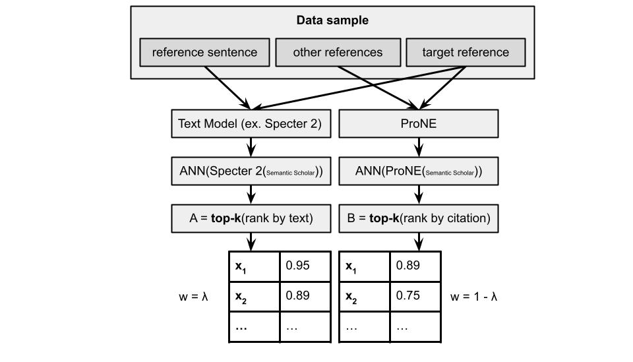
Team Updates – Evaluation

Slide 14
Individual Contributions

Slide 15
Individual Contributions – Evaluation
Processing data and getting ProNE embeddings for citation recommendation task
Publication year prediction (current work)

Slide 16
Individual Contributions – Clustering
Meet with Annika
Exclude papers not in Semantic Scholar
Obscure conferences
Recent work
More similar to one cluster over another (k x k matrix of papers)
Searching for closest centroid from paper collection vs all 200M papers
Compare output with my output from only using 348 documents

Slide 17
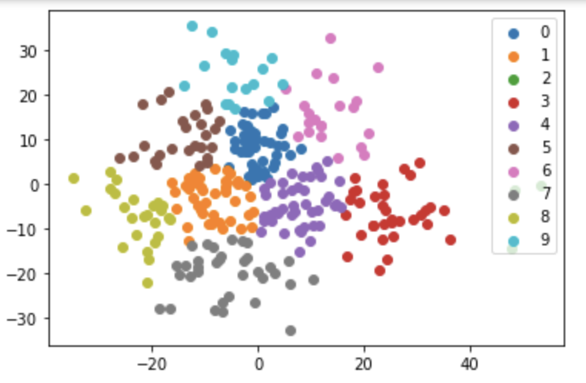
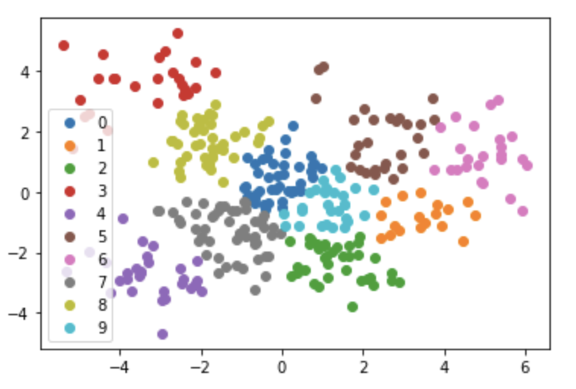
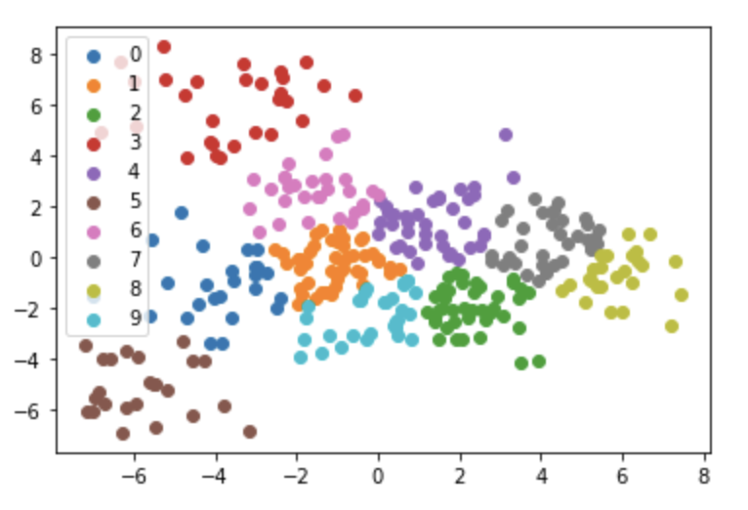
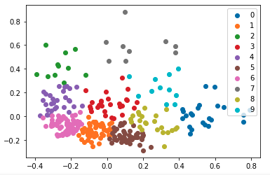
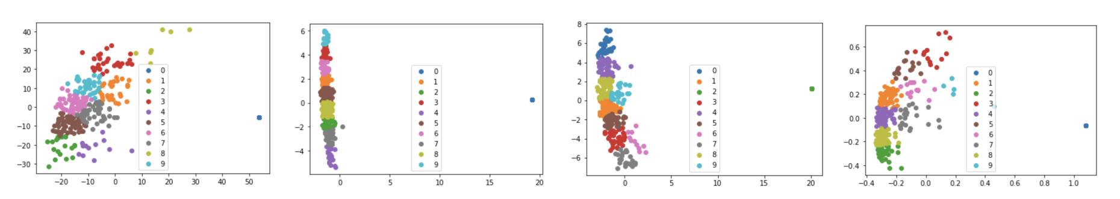
Individual Contributions – Clustering

Slide 18
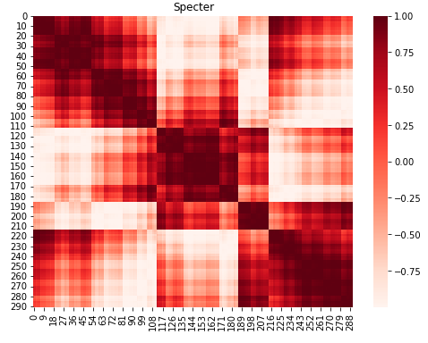
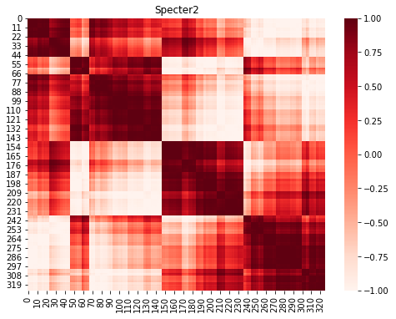
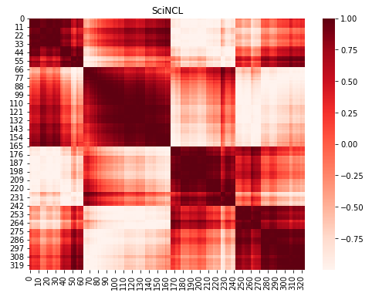
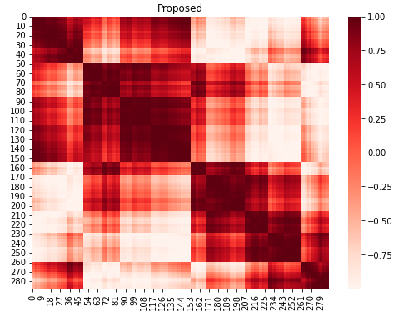
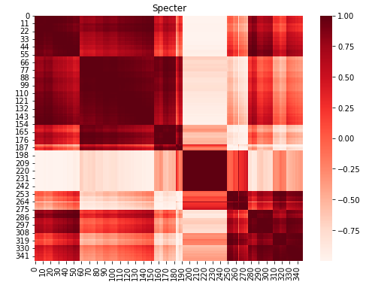
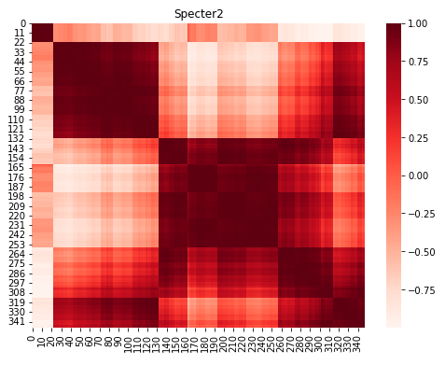
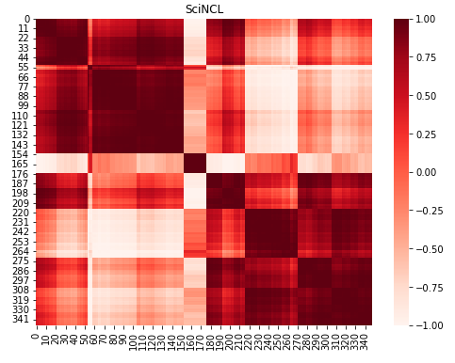
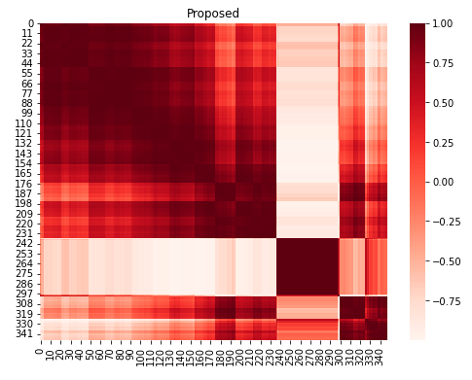
Individual Contributions – Clustering

Slide 19
Current Work / Next Steps
Continue evaluation tasks with team
Publication year
Compare with different embeddings
nearer in time = smaller cosine distance
Venue prediction
More comparison between document cluster and centroid vs all papers and centroid
Large scale better than small but local consideration

Slide 20
Questions?

Slide 21
Thank you!

