Slide 1
GNN
Deep approach to better together
Sandeep Polisetty, Hui Guan

Slide 2
Outline
Basic GNN Training
Basic GNN Inference (Transductive and Inductive must be explained)
Challenges
Solutions
Evaluations
Future tasks

Slide 3
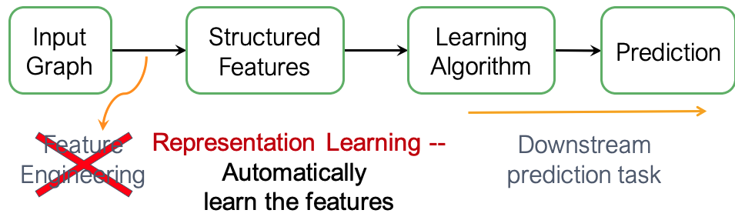
How to combine text and context?
Shallow Encoding
DeepWalk
Node2vec
ProNE
Deep Encoding
GNN
Advantages
Naturally Generalizable
Long range patterns
Notes:
Deep encoding is shallow encoding if depth = 1. Train on multiple hop features. Inductive properties and long range patterns.

Slide 4
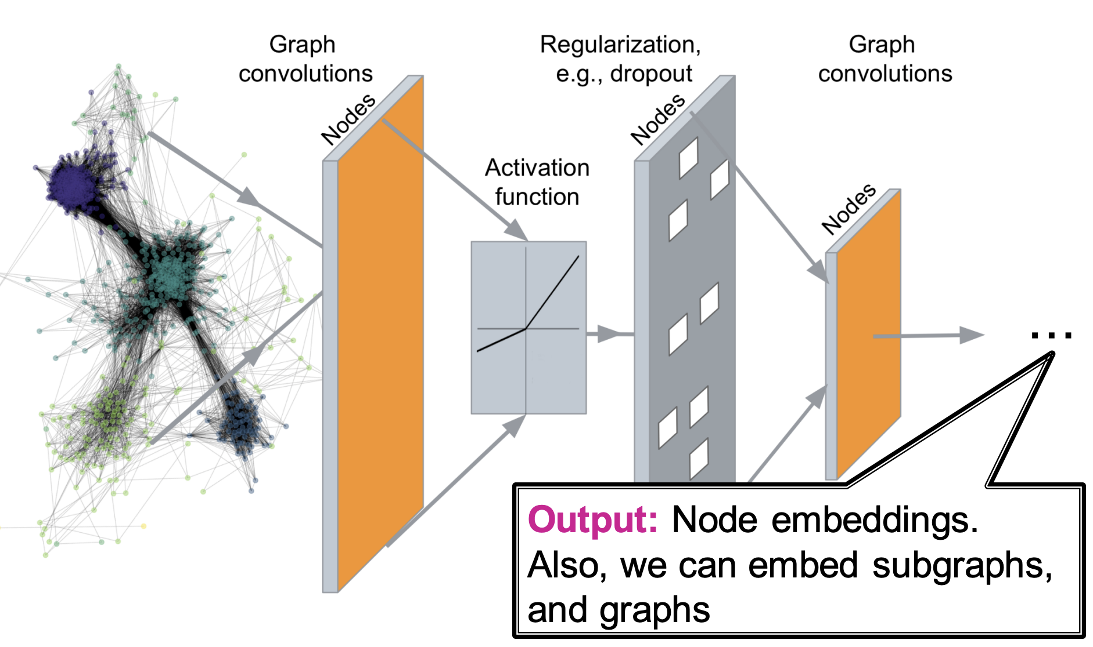
Deep Encoding
Encoder is GNN aggregating over multi-hop
Citation Graph
Node Features (Text)
GNN Encoder
Combined Features (Context + Text)

Slide 5
Transductive vs Inductive Inference
9
4
2
1
7
5
3
6
8
2015
2018
2019
Training Graph
Additional Test
Transductive Edge
Inductive Edge

Slide 6
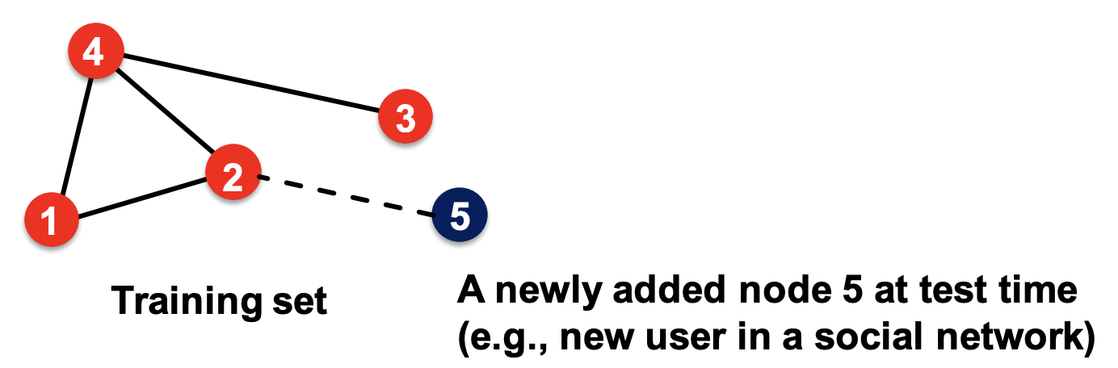
How to use the GNN on a new paper?
Induced graph
of node 5
Node features of the induced graph
a new paper added as node 5
GNN Encoder
Small updates can be handled by inference only.
Combined Feature of node 5
Combined features for nodes 1-4
MLP
Score (i, j)

Slide 7
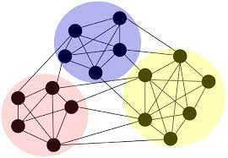
Challenges | Solutions
Scale of graph topology
Problem
Graph Topology Data ~ 30 GB
GNN sampling work best on GPU (shown by NextDoor)
Which are memory limited.
Solution
Graph partitioning to limit active memory required.

Slide 8
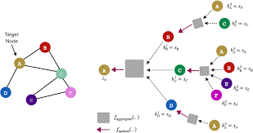
Challenges | Solutions
Scale of graph topology and feature data | Novel Graph Partitioning and Hybrid GPU
Missing node Information
Problem
Not all nodes have input features due to missing text.
Solution
Use a special learnable embedding.

Slide 9
Challenges | Solutions
Scale of graph topology and feature data | Novel Graph Partitioning and Hybrid GPU Memory
Missing node Information | Learnable Embedding
Problem
Not all nodes have input features due to missing text.
Solution
Use a special learnable embedding.

Slide 10
Graph Partitioning based training
function training(partition_list, num_epochs, model, features):
for epoch in num_epochs:
partition_list.shuffle()
for partition in partition_list:
edges = partition.edges()
edges.shuffle().split(batch_size)
for batch_edges in edges:
sample_graph, input_nodes = sample(partition)
sample_features = features.get(input_nodes)
model.train(sample_graph, sample_features)
model.checkpoint()
What are good partitions ?
Fault tolerance for long running jobs

Slide 11
Partitioning
Sampling is done within partition.
Graph samples ranges spanning multiple partitions are ignored
Partitions graph must have high average degree to minimize multi hop information loss.
Our approach
Sort papers by year published
Partition the sorted papers into number of bins
For each paper in the bin include all papers cited by it as edges.
(1 Hop of neighbourhood)
Results in good average degree > 10

Slide 12
Handling missing node information
Input nodes require a tensor of input features
However, some input features has missing values.
We propose to use a learnable embedding
These values are scattered making a tensor with some learnable and some fixed values, complicating gradient flow

Slide 13
Dataflow graph to handle learnable and fixed input features
Nodes W Features
Collected Features
Global Features
Minibatch
Feat || Embedding
Broadcasted
Embedding
Shuffle in order of input
Nodes Without Feature
EMPTY embedding
Notes:
Use From GSplit, add more internal data structures.

Slide 14
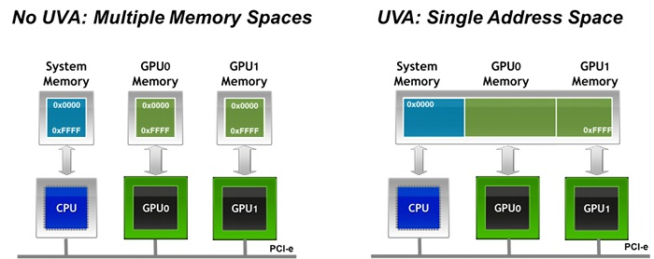
Hybrid Memory to get over GPU bottleneck
Notes:
Without and without unified memory . Add a separate figure

Slide 15
Statistics of Train/ Valid/ Test split
TYPE | Graph Nodes without Text | Graph Nodes With Text | Edges | Target Edges with Text | Target Edges Without Text
Train
Transductive
Inductive
Notes:
Fill up stats

Slide 16
Performance results
 | Inductive | Transductive
With Text | XX | .67
Without Text | XX | XX

Slide 17
Future Work
Inference with models from various bin ranges.
Additional hetero-signals
Embeddings for all nodes.
Using citing sentences

