Slide 1



Comparing Edge-based and Node-based Methods on a Citation Prediction Task https://github.com/petervickers/TimeCite
Peter Vickers
Kenneth Church
Northeastern University

Slide 2
Citation Prediction Task
Predict whether
Paper a cites paper b
Challenges:
5Vs:
Velocity, Volume,
Value, Variety & Veracity
Semantic Scholar is
large (200M papers)
and Growing (doubles in 9 years)
Apps: Recommendations
What should I read?
What should I cite?
Who should review what?
Prediction Challenge:
It’s hard to make predictions, especially about the future
– Yogi Berra & Niels Bohr
Kuhn’s paradigm shifts

Slide 3
Recommendation: More than Word Overlap
Recommendations
What should I read?
What should I cite?
Who should review what?
Many systems focus on “relevance’’ (word overlap)
But we also want credibility
Don’t recommend papers that are buzz-word compliant
But not worth reading
(Most papers are never cited)

Slide 4
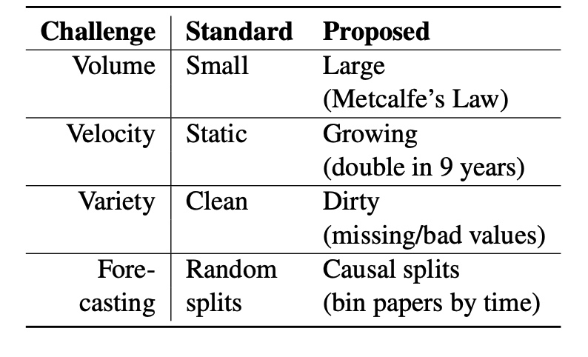
Standard Benchmarks are Small, Static and Clean (Open Graph Benchmark; SciRepEval)

Slide 5
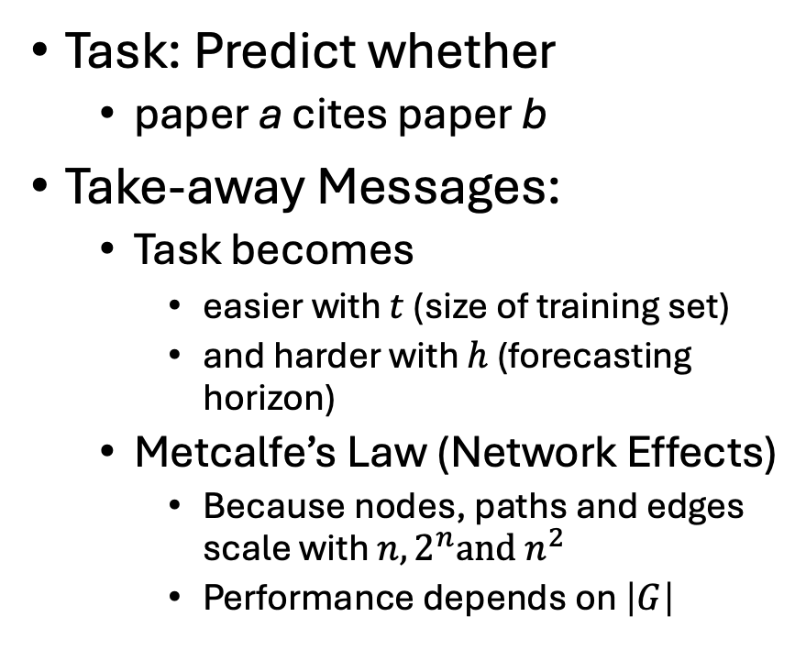

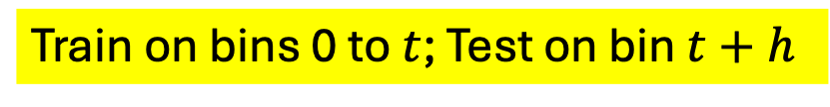
Spoiler Alert
Task: Predict whether
paper a cites paper b
Take-away Messages:
Task becomes
easier with $t$ (size of training set)
and harder with $h$ (forecasting horizon)
Metcalfe’s Law (Network Effects)
Because nodes, paths and edges scale with $n, {2^{n}and n}^{2}$
Performance depends on $\left|G\right|$
$$t$$
Train on bins 0 to $t$; Test on bin $t+h$

Slide 6
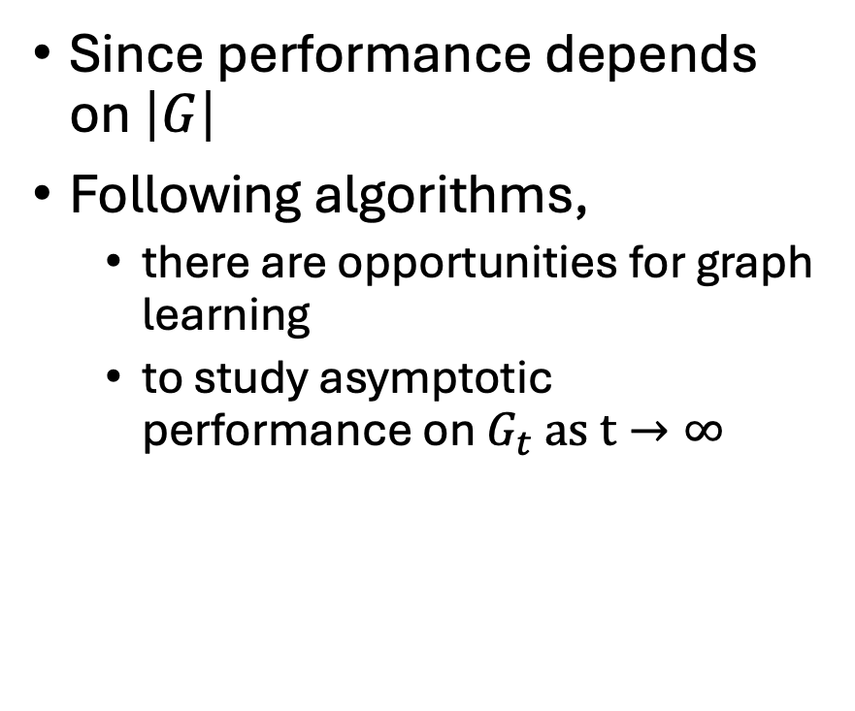
Asymptotic Performance
Since performance depends on $\left|G\right|$
Following algorithms,
there are opportunities for graph learning
to study asymptotic performance on $G_{t} as t→∞$
$$t$$
Train on bins 0 to $t$; Test on bin $t+h$

Slide 7

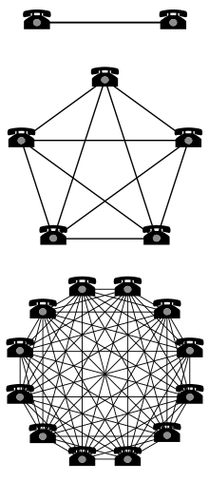
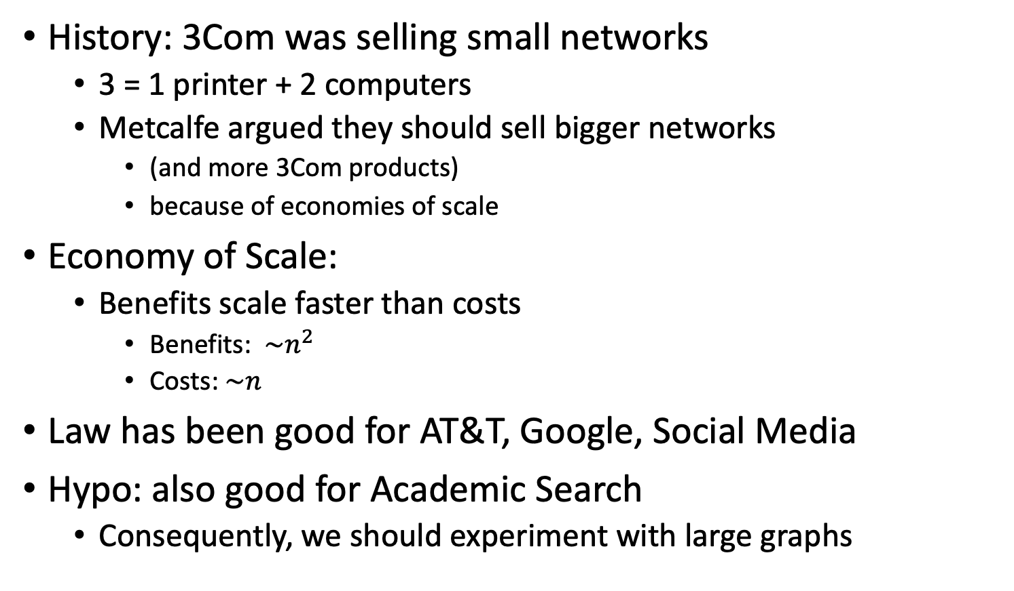
Metcalfe’s Law (Network Effects)
History: 3Com was selling small networks
3 = 1 printer + 2 computers
Metcalfe argued they should sell bigger networks
(and more 3Com products)
because of economies of scale
Economy of Scale:
Benefits scale faster than costs
Benefits: $\sim n^{2}$
Costs:$\sim n$
Law has been good for AT&T, Google, Social Media
Hypo: also good for Academic Search
Consequently, we should experiment with large graphs
Turing Award 2022

Slide 8
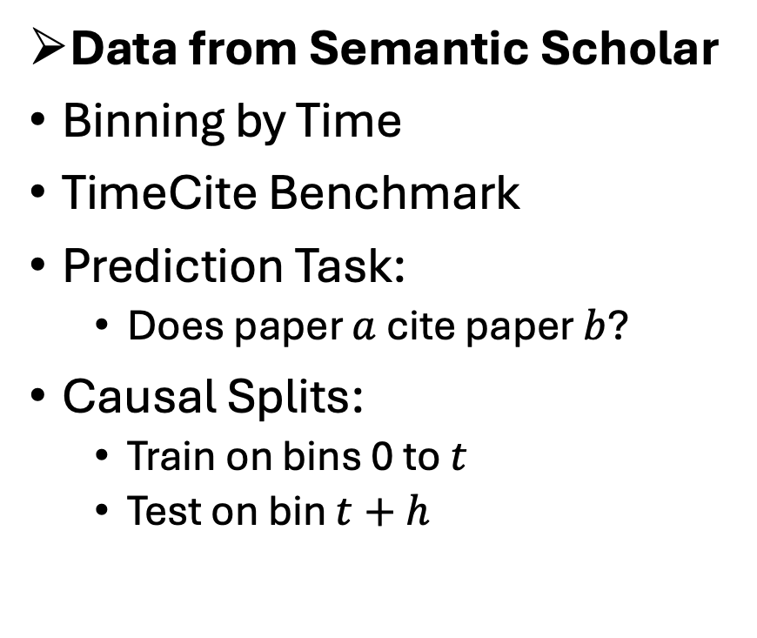
Agenda
Data from Semantic Scholar
Binning by Time
TimeCite Benchmark
Prediction Task:
Does paper $a$ cite paper $b$?
Causal Splits:
Train on bins 0 to $t$
Test on bin $t+h$
Methods:
Node-based:
Specter: BERT encoding of titles & abstracts
Edge-based:
ProNE: spectral clustering of citation graph
Results
Related Work
Conclusions

Slide 9
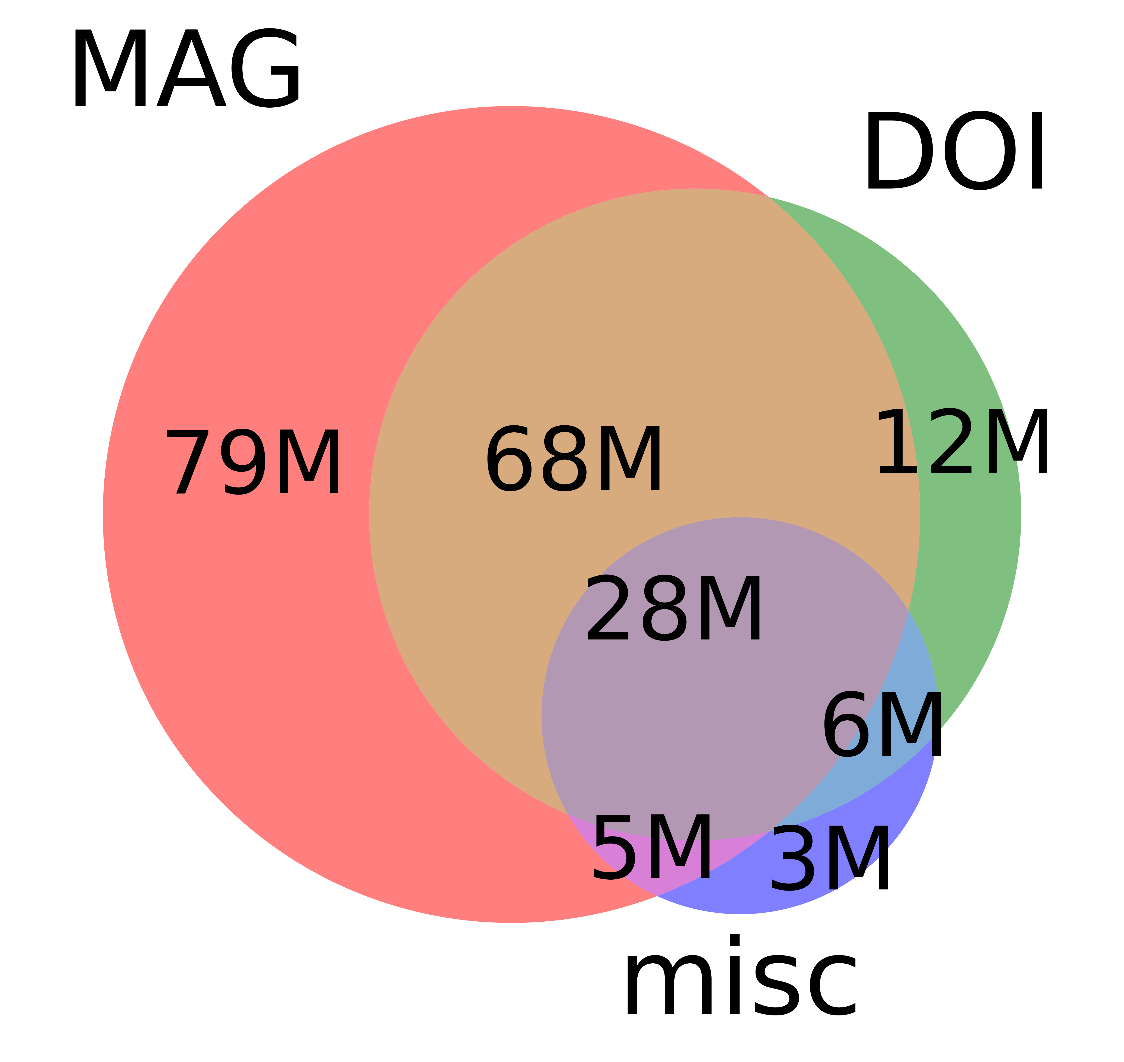
Data from Semantic Scholar
SCALE | SCALE
 | Source | Papers (millions)
1 | CorpusId | 207.80
2 | MAG (Microsoft Academic Graph) | 182.18
3 | DOI | 113.54
4 | PubMed | 35.03
5 | DBLP | 6.06
6 | PubMedCentral | 4.86
7 | ArXiv | 2.15
8 | ACL | 0.08
Seven Sources:
Two Big Sources: MAG, DOI
Five More (misc):
PubMed, PubMedCentral, DBLP, arXiv, ACL
Note: arXiv and ACL are tiny
Many fields of study:
Medicine (45M), Chemistry (13M), CS (13M), Biology (13M), Materials Science (10M), Engineering (8M), Physics (7M), Psychology (7M), Mathematics (5M), Political Science (4M), Business (4M), Sociology (3M), Geography (3M), Economics (3M), Environmental Science (3M), Geology (3M), History (2M), Art (2M), Philosophy (1M)
Not just CS (Computer Science)

Slide 10
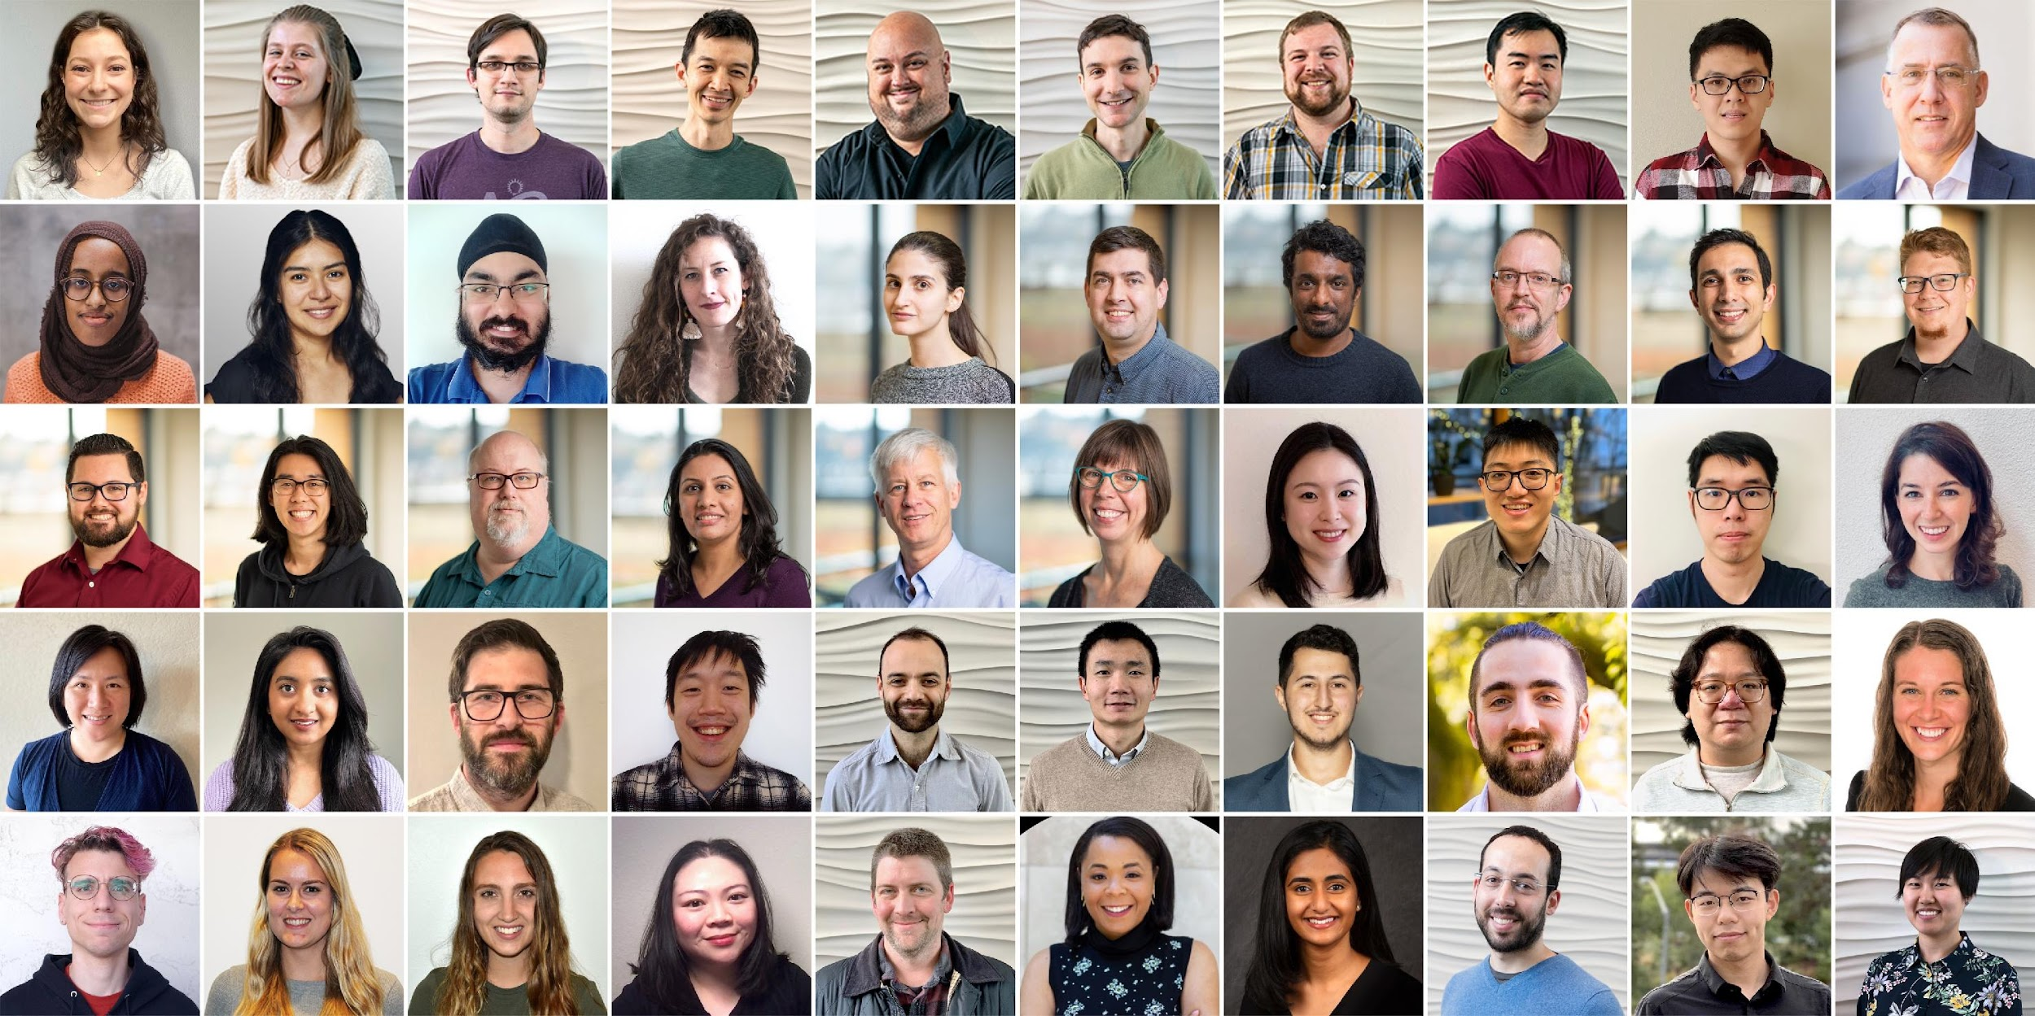
Semantic Scholar: Significant Effort (source: Dan Weld)
50 person team; 7 year project
207M+ papers; 2B Citations
8M+ monthly active users

Slide 11
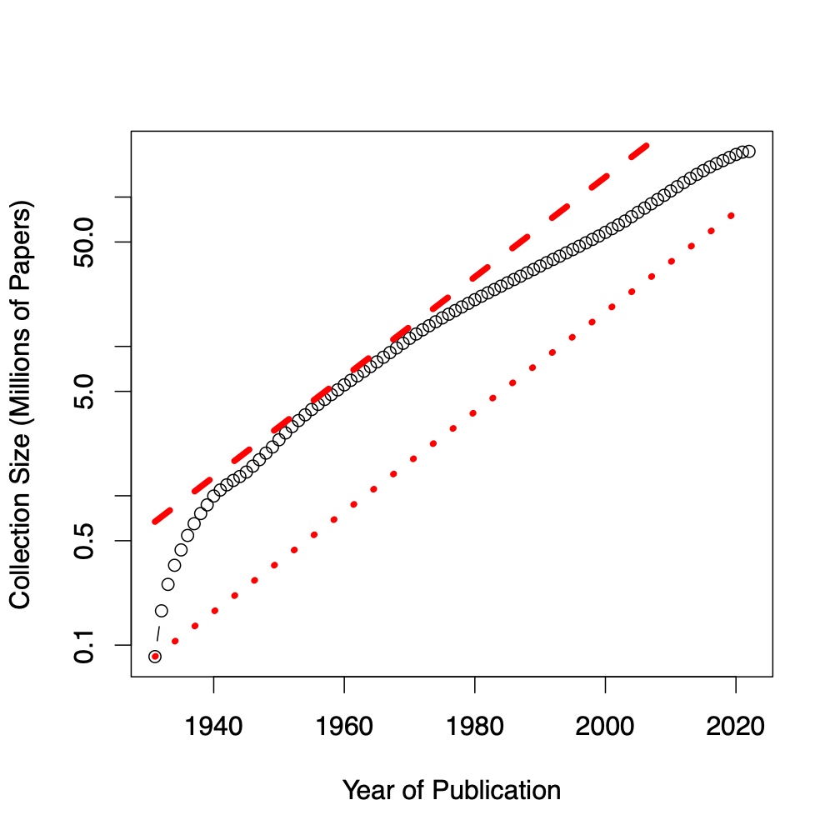
Assign 200M papers to 100 bins (by time)
Sort 200M papers by publication date
Output: Split papers into 100 bins, with 2M papers/bin
Because of exponential growth
(literature doubles every 9 years)
older bins span more time, and
newer bins span less time
Bin 99
………
Bin 0
Time
Notes:
mention equal # papers
consider replacing w/ diagram

Slide 12
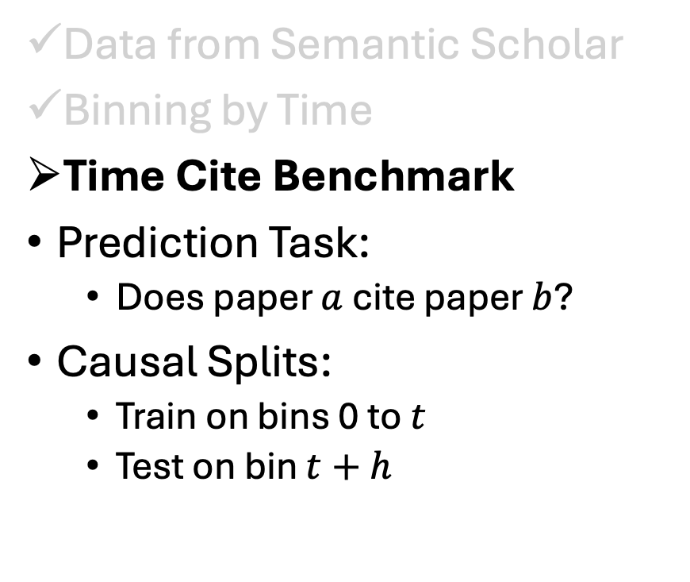
Agenda
Data from Semantic Scholar
Binning by Time
Time Cite Benchmark
Prediction Task:
Does paper $a$ cite paper $b$?
Causal Splits:
Train on bins 0 to $t$
Test on bin $t+h$
Methods:
Node-based:
Specter: BERT encoding of titles & abstracts
Edge-based:
ProNE: spectral clustering of citation graph
Results
Related Work
Conclusions

Slide 13
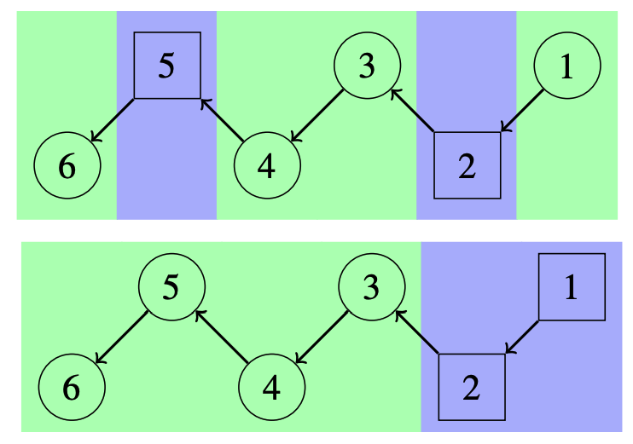
TimeCite Benchmark (Test Set) https://github.com/petervickers/TimeCite
id0 | id1 | bin | split | hops
4040279 | 98515988 | 0 | 0 | 1
5796683 | 33352680 | 0 | 0 | 3
5796683 | 40398219 | 0 | 0 | 2
9018841 | 42374381 | 0 | 0 | 1
9018841 | 84601251 | 0 | 0 | 2
9300584 | 68770408 | 0 | 0 | 2
9300584 | 84323229 | 0 | 0 | 1
9355400 | 36185969 | 0 | 0 | 1
9355400 | 90086442 | 0 | 0 | 2
3M pairs of paper ids
100 Time Bins
2 splits: test vs. train
hops: 1-4
Classification task: hops == 1?

Slide 14
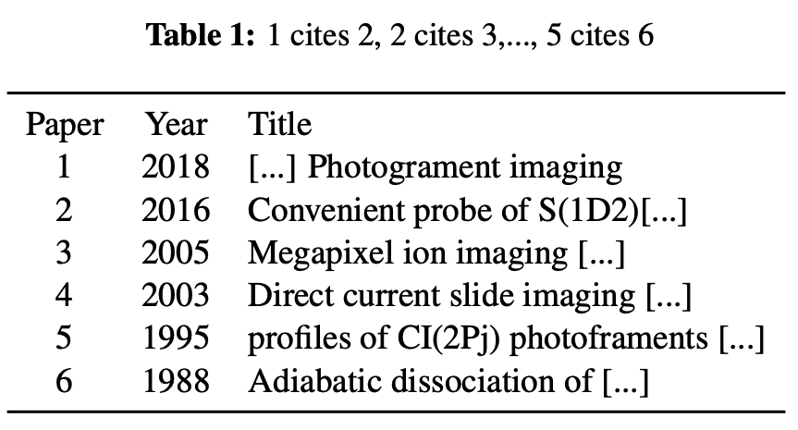
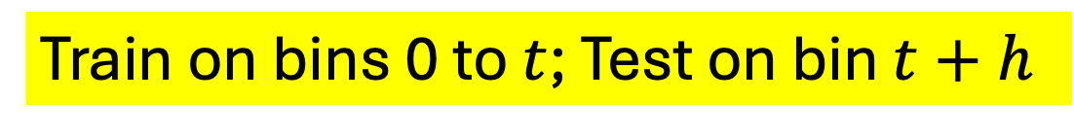

Test/Train Splits: Prediction (Causal) vs. Interpolation (Random)
Random
Causal
$$t=2010$$
Train on bins 0 to $t$; Test on bin $t+h$

Slide 15
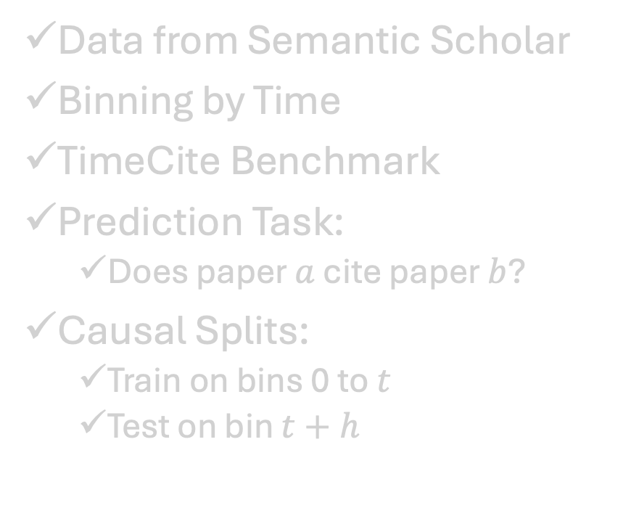
Agenda
Data from Semantic Scholar
Binning by Time
TimeCite Benchmark
Prediction Task:
Does paper $a$ cite paper $b$?
Causal Splits:
Train on bins 0 to $t$
Test on bin $t+h$
Methods:
Node-based:
Specter: BERT encoding of titles & abstracts
Edge-based:
ProNE: spectral clustering of citation graph
Results
Related Work
Conclusions

Slide 16
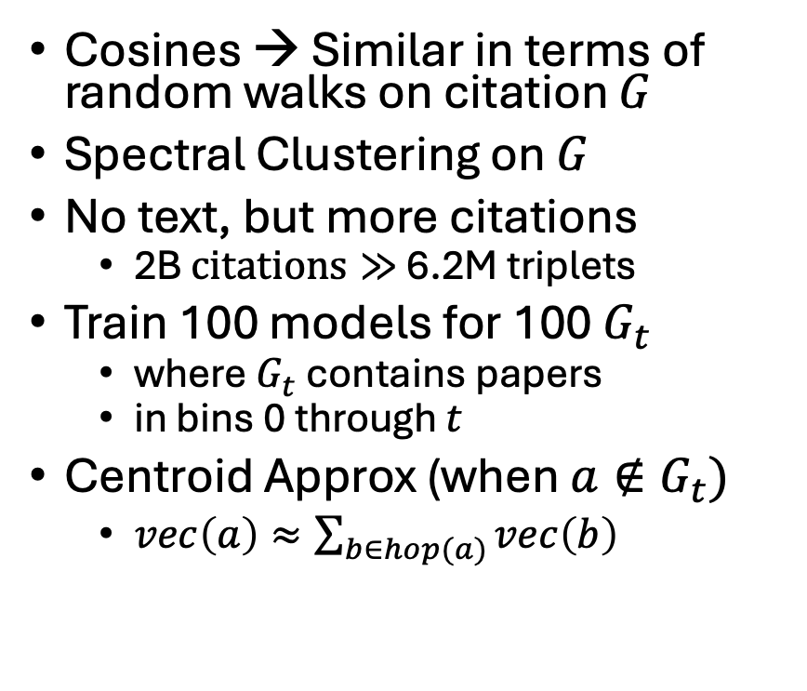
Methods
Specter
ProNE
Cosines → Similar Words
Fine-Tune SciBERT
with triplet loss
6.2M: <paper, pos, neg>
pos: cited in 1-2 hops
neg: random
Cosines → Similar in terms of random walks on citation $G$
Spectral Clustering on $G$
No text, but more citations
2B $citations≫$ 6.2M triplets
Train 100 models for 100 $G_{t}$
where $G_{t}$ contains papers
in bins 0 through $t$
Centroid Approx (when $a∉G_{t})$
$vec\left(a\right)≈\sum_{b∈hop(a)}{vec\left(b\right)}$

Slide 17
Agenda
Data from Semantic Scholar
Binning by Time
TimeCite Benchmark
Prediction Task:
Does paper $a$ cite paper $b$?
Causal Splits:
Train on bins 0 to $t$
Test on bin $t+h$
Methods:
Node-based:
Specter: BERT encoding of titles & abstracts
Edge-based:
ProNE: spectral clustering of citation graph
Results
Related Work
Conclusions

Slide 18
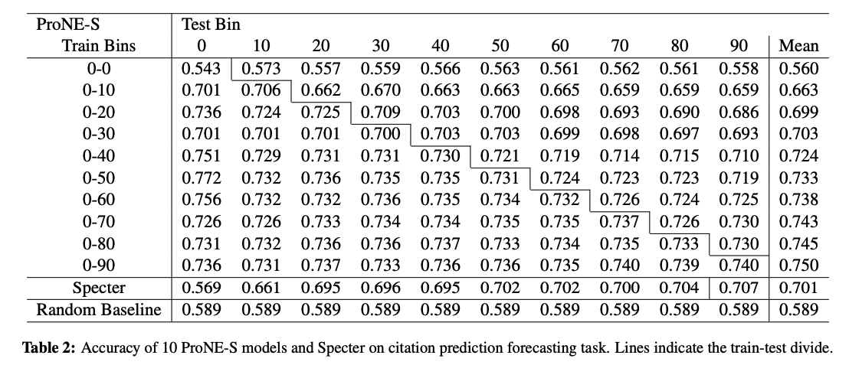
Results

Slide 19
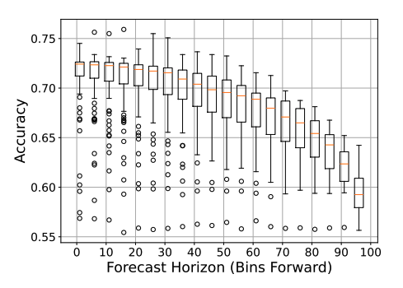
Summaries of Results
Easier with t (Metcalfe’s Law)
Harder with h

Slide 20
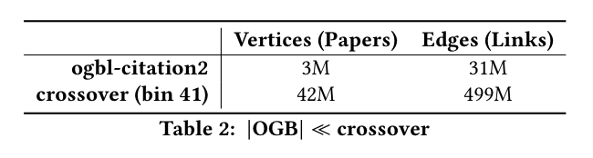
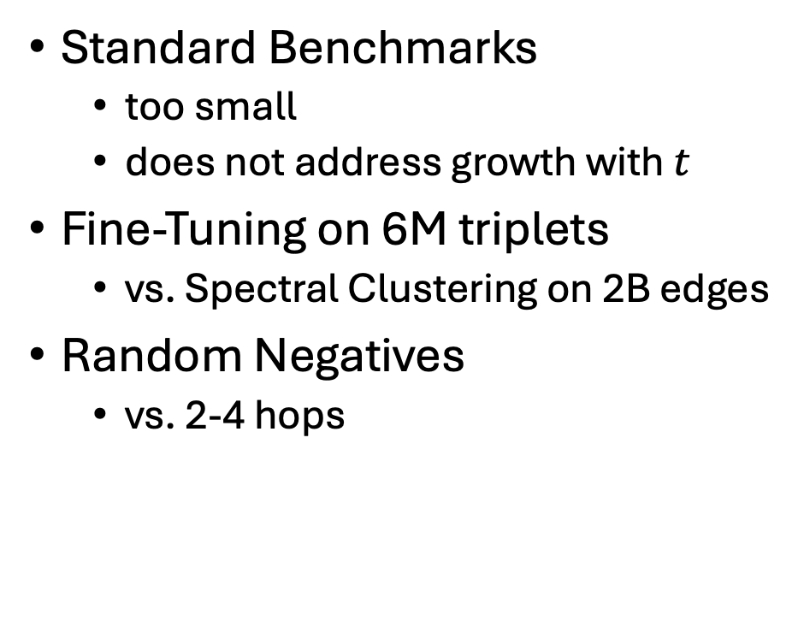
Related Work
Standard Benchmarks
too small
does not address growth with $t$
Fine-Tuning on 6M triplets
vs. Spectral Clustering on 2B edges
Random Negatives
vs. 2-4 hops

Slide 21
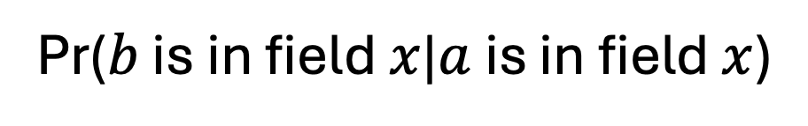
2-4 Hops are far from Random
Pr($b$ is in field $x$|$a$ is in field $x$)
Huge Space: 200M Papers
Papers tend to cite other papers in same field
But not with random neg
Priors on field of study:
Medicine: 21%
Biology: 4.6%
CS: 7.2%
Hops | Medicine | Biology | CS
1 | 68% | 38% | 53%
2 | 65% | 30% | 54%
3 | 62% | 22% | 53%
4 | 58% | 17% | 54%

Slide 22
Agenda
Data from Semantic Scholar
Binning by Time
TimeCite Benchmark
Prediction Task:
Does paper $a$ cite paper $b$?
Causal Splits:
Train on bins 0 to $t$
Test on bin $t+h$
Methods:
Node-based:
Specter: BERT encoding of titles & abstracts
Edge-based:
ProNE: spectral clustering of citation graph
Results
Related Work
Conclusions

Slide 23
Conclusions (Spoiler Alert)
Task: Predict whether
paper a cites paper b
Take-away Messages:
Task becomes
easier with $t$ (size of training set)
and harder with $h$ (forecasting horizon)
Metcalfe’s Law (Network Effects)
Because nodes, paths and edges scale with $n, {2^{n}and n}^{2}$
Performance depends on $\left|G\right|$
$$t$$
Train on bins 0 to $t$; Test on bin $t+h$

