Slide 1
Hard

Slide 2
Hard: Outline
Academia vs industry
Build an LLM; crawl the Web, build a production inverted index etc.
Research opportunities; pros/cons; pointers to related work
Pre-Training

Slide 3
Indexing and crawling
Small number of web-indexes available
English (Google and Bing), Chinese (Baidu), Russian (Yandex)
Inverted indexing techniques are well understood
Large scale is a different story
MapReduce architectures
Updating and serving
Ongoing crawling and data wrangling
Social networks
The Like economy

Slide 4
Relevance
Many factors affect whether a document satisfies a particular user’s information need
Topicality, novelty, freshness, authority, formatting, prior knowledge, expertise
Topical relevance: the document is on the same topic as the query
User relevance: everything else
Topical relevance
Focusing on topical relevance does not mean we’re ignoring everything else
It only means we’re focusing on one criteria by which users judge relevance
Domain specific features

Slide 5
Large scale experimentation
Principles for designing, running and analyzing experiments
Imagine an e-commerce website where the user:
Visit the homepage -> browse/search for items -> add item to cart -> start purchase process -> complete purchase
Product team wants to add coupon feature to UX
We need to evaluate the impact of the change
Hypothesis: adding new feature will increase revenue
Two user interfaces:
Control (no changes)
Treatment (with coupon feature)

Slide 6
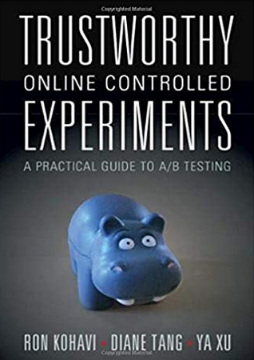
Designing experiments (A/B testing)
Randomization unit
Population
How large does our experiment need to be
How long do we run the experiment
Does the experiment scale well? (1%, 2%, 5%, 10%, … )
https://experimentguide.com/

Slide 7
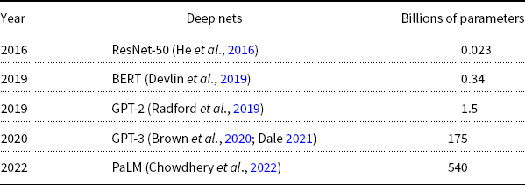
Pre-Training Large Language Models (LLMs)
GPT-3
PaLM
GPT-2
BERT
ResNet
Most users should not invest in pretraining
because growth (& costs) are out of control

