Slide 1
Evaluating Evaluations: A Perspective on Benchmarks

Slide 2
Validity and Reliability Krippendorff (2018) Content analysis: An introduction to its methodology
Reliability is about data, and validity is about truth:
Reliability:
The attribute of Data on which researchers can rely in answering their Research questions – Krippendorff, p. 411
Validity:
The quality of a claim to be as stated, true, or correct. – Krippendorff, p. 413
Validity assumes a hypothesis/claim.
Hard to test validity without a clearly stated hypothesis
There are more papers on reliability than validity in our field(s).
18k matches for “inter-annotator agreement” in ACL Anthology
https://aclanthology.org/search/?q=inter-annotator+agreement

Slide 3
Reliability of BLEU https://aclanthology.org/P02-1040/
The original paper asks 3 excellent questions about reliability
How reliable is the difference in BLEU metric?
What is the variance of BLEU score?
If we were to pick another random set of 500 sentences,
would we still judge S3 to be better than S2?

Slide 4
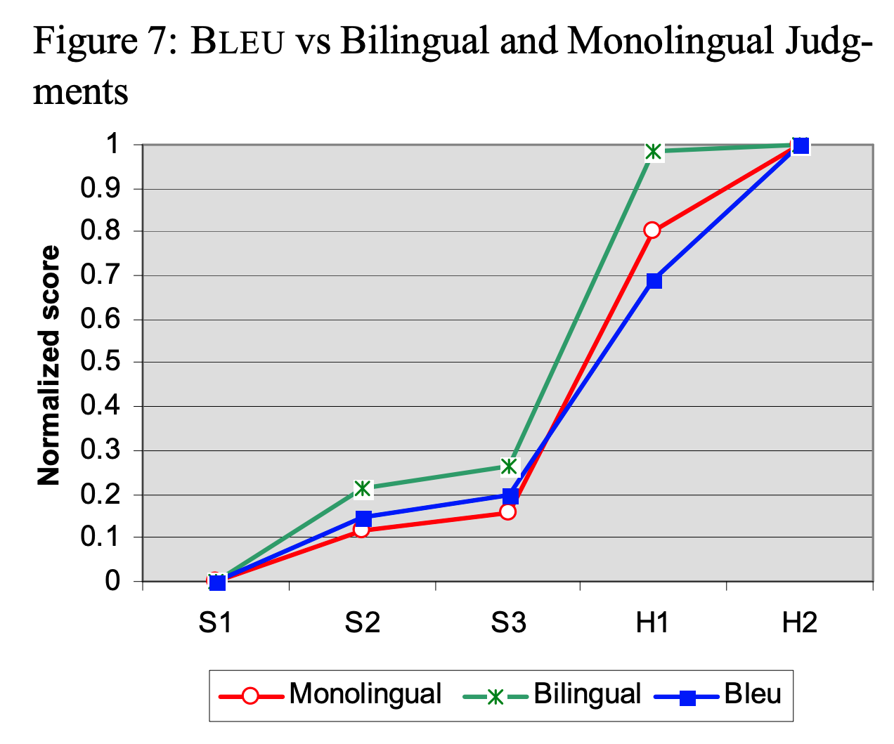
Reliability of BLEU
In their Figure 7,
they use BLEU to compare three machine translation systems (S1, S2 and S3) and
two human (non-professional) translators (H1 and H2).
They report that humans score better than machines.
They conclude:
“BLEU’s strength is that it correlates highly with human judgments
by averaging out individual sentence judgment errors over a test corpus
rather than attempting to divine the exact human judgment for every sentence:
quantity leads to quality.”
https://aclanthology.org/P02-1040/

Slide 5
Validity of BLEU
Less discussion of validity in original paper
Some papers raise serious questions about validity
of BLEU and other metrics
at least, for some use cases that go beyond the original BLEU paper
It is hard to talk about validity without a clearly stated use case
https://aclanthology.org/D17-1238/
This paper shows that state-of-the-art automatic evaluation metrics for NLG systems
do not sufficiently reflect human ratings,
which stresses the need for human evaluations.
https://aclanthology.org/J18-3002
Overall, the evidence supports using BLEU for diagnostic evaluation of MT systems
(which is what it was originally proposed for),
but does not support using BLEU outside of MT, for evaluation of individual texts, or for scientific hypothesis testing.

Slide 6
Use Cases
BLEU was originally proposed
to compare a small number of systems for DARPA competitions.
But soon after BLEU was introduced,
Och suggested using BLEU for a very different use case.
It had been standard practice to to use
different metrics for testing and training.
Och found that if one is going to use BLEU to evaluate systems,
then his system would do better in the evaluation if he also used BLEU for training.
Och’s suggestion did well in competitions,
but raises questions about reliability and validity

Slide 7
Consequence of Evaluation: Proposed Scale
Minor: e.g., SOTA-chasing, leaderboards
Moderate: e.g., Multitask learning
Generalizing results over workloads and tasks.
Major: e.g., Och training
Significant consequences for system performance
Mission Critical: e.g., SPEC
What should I buy? And what performance should I expect on my workloads?
Go/No-go decisions

Slide 8
Averaging: Arithmetic vs. Geometric
There are many benchmarks in our field:
e.g., GLUE, SciRepEval, MS MARCO and Big Bench
Many designed for SOTA-chasing,
but hopefully, results will generalize to more important use cases.
More likely to generalize to more important use cases
if they were designed to do so in the first place
SPEC was designed to report performance relative to baseline
How much better is the candidate CPU relative to VAX 11/780?
On the user’s (unspecified) workload?
Mashey argues that
geometric means generalize better
over workloads than arithmetic means.
Mashey suggests that results on our benchmarks would
generalize beyond less important SOTA-chasing use cases
if we replaced arithmetic means with geometric means in GLUE
(and many of our other benchmarks).

Slide 9
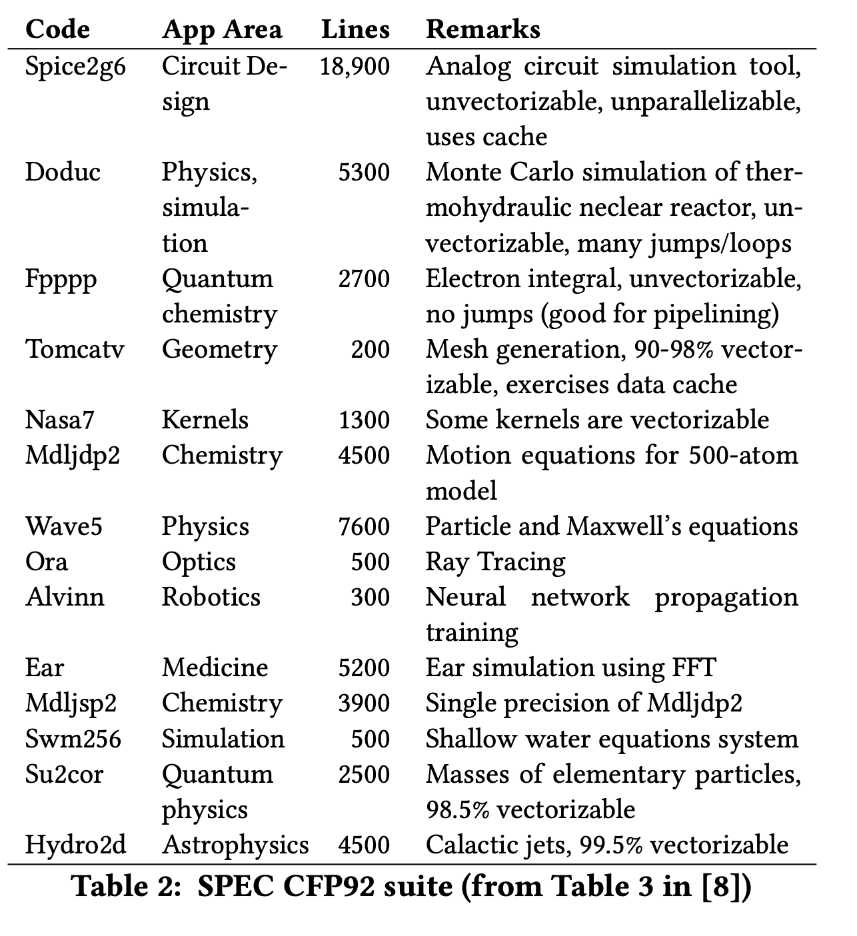
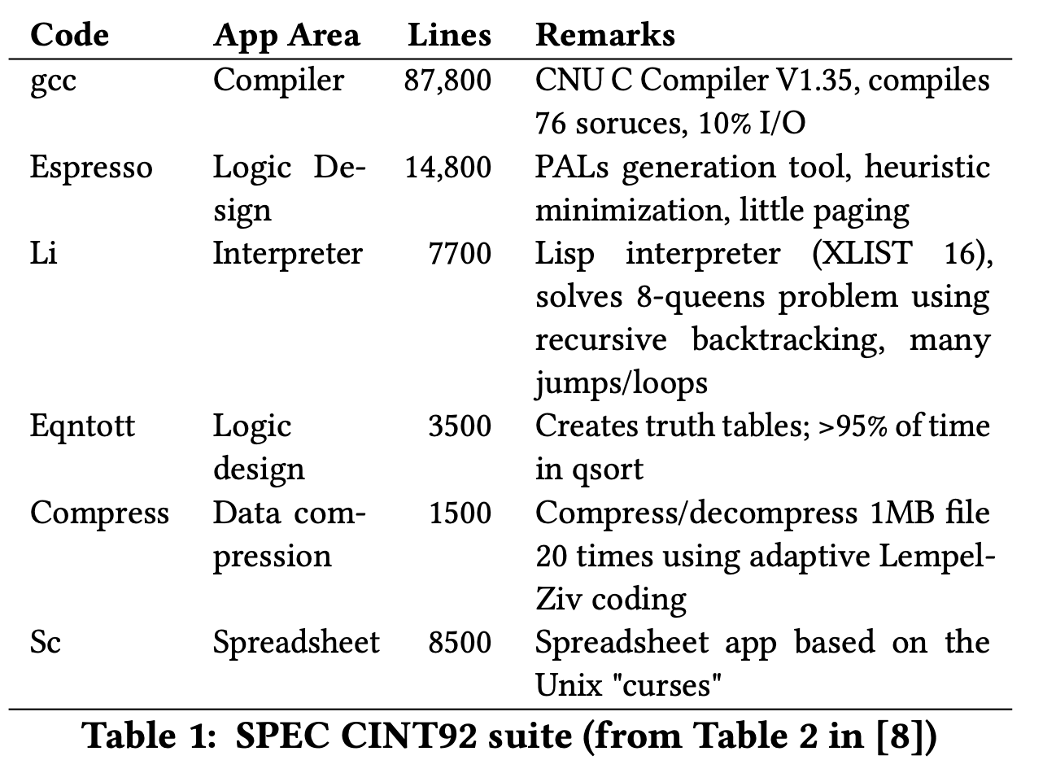
SPEC: A benchmark for evaluating CPUs

Slide 10
Challenges for Validity and Reliability
Unrepresentative Samples
Test/Train Splits: Interpolation vs. Extrapolation
Leakage
Labeling and Inter-annotator Agreement
Too many (irrelevant) tasks

Slide 11
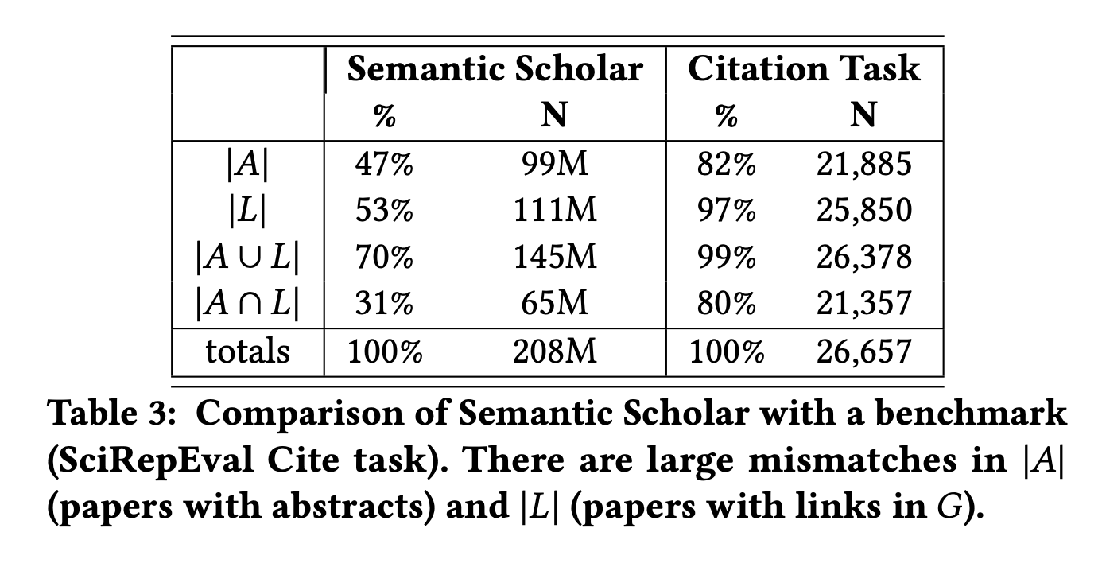
Unrepresentative Samples
Ideally, a benchmark should be
a representative sample
of a larger population of interest.
Balanced Corpora:
1960s: Brown Corpus
1990s: British National Corpus
Current view: catch as catch can
there is no data like more data – Mercer
Representative samples → More credible generalizations

Slide 12
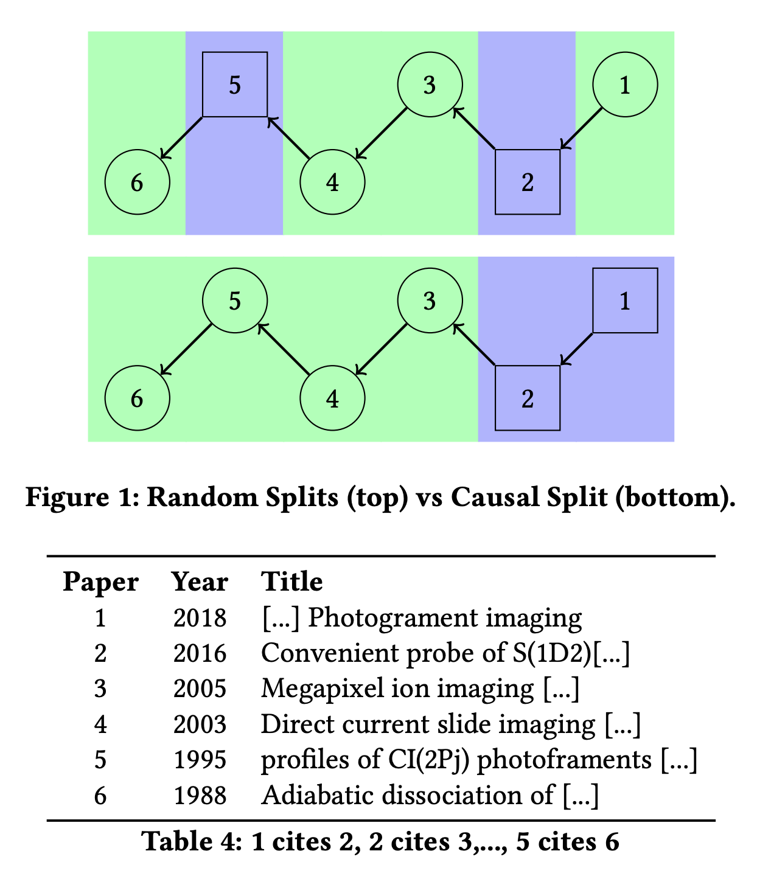
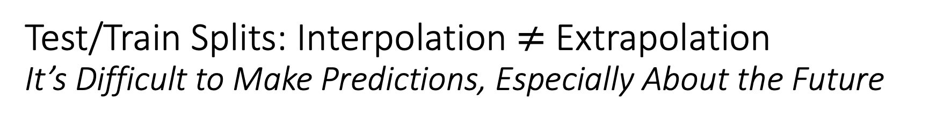
Test/Train Splits: Interpolation $≠$ Extrapolation It’s Difficult to Make Predictions, Especially About the Future
It is common for graphs to evolve over time.
For example, the academic literature is growing very quickly,
doubling every nine years
Benchmarks such as OGB focus on static snapshots from a few years ago,
missing opportunities to encourage the community to study growth and timeliness.
Random splits are common in graph learning benchmarks, e.g., WN18RR,
a popular Knowledge Graph Completion (KGC) task based on WordNet

Slide 13
Leakage
Leakage is common in many benchmarks
There is considerable discussion of leakage in SciDocs
(see 4.2 of https://aclanthology.org/2022.emnlp-main.802/)
WN18 → WN18RR (WordNet benchmarks)
If 𝑥 is-a 𝑦 (a car is a vehicle),
then there will be two links between x and y: hypernym and hyponym
Since WN18 randomly splits links into test and train,
one of these links is likely to be in test and the other in train
Unfortunately, WN18RR corrects some (but not all) of the leakage
See table 4 of https://aclanthology.org/2021.emnlp-main.501/
Despite this leakage, there are many papers on WN18RR
https://paperswithcode.com/dataset/wn18rr

Slide 14
Labeling and Inter-annotator Agreement
The documentation on SciRepEval makes it clear that some labels are “silver” (less reliable) [underlining added]:
... a new large-scale field of study (FoS) multi-label training set of more than 500K papers with silver FoS labels based on publication venue
We compared FoS labels in SciRepEval with FoS labels in MAG and found large differences.
More agreement in some fields (Computer Science)
Less agreement in History, Sociology and Art.
It is possible that the annotators
are more familiar with Computer Science
than History, Sociology and Art.

Slide 15
Too many (irrelevant) tasks
Example: SciRepEval
There are so tasks that
some will be more relevant to our use cases,
and others will be less relevant
The FoS task, for example, classifies documents into 23 fields of study.
The FoS task is probably not relevant to recommendation use cases

Slide 16
Principles
Characterize use case & audience
Validity:
Relevance of task to use case
Reliability:
Inter-rater agreement
Realistic workloads
Labeling and annotation
Documentation:
How was it done?
Availability of instructions
Maintenance
Include a feedback loop mechanism to maximize adoption
Workload Evolution
Lessons learned and addendum(s)
Lifecyle and deprecation
High standards
(for high-stakes use cases)
Use of established software engineering and data management techniques
(e.g., code review, versioning, configurations, dependencies, and testing).
How was the data sourced?
Provenance?
Can we data set be generated again easily?
Clean and well-documented data model

