Slide 1
Example: Recommendations and Compare/Contrast

Slide 2
Recommendation Use Cases
For readers:
What should I read?
For authors:
What should I cite?
For conference organizers:
Who should review what?
Finding experts:
Who knows? (Streeter & Lochbaum, 1998)

Slide 3
Semantic Scholar API
https://api.semanticscholar.org/recommendations/v1/papers/forpaper/21321bad706a9f9dbb502588b0bb393cf15fa052?from=all-cs&fields=title,externalIds,citationCount
Semantic Scholar: A collection of 200M papers
query: 21321bad706a9f9dbb502588b0bb393cf15fa052
A paper id on Semantic Scholar
200M papers → Specter embeddings
BERT-like vectors with 768 hidden dimensions
Mostly encodes titles and abstracts (with some fine-tuning on citation graph)
from=all-cs: limits search to computer science
about 10% of their collection of 200M papers
uses FAISS to find approximate nearest neighbors for query

Slide 4
Need to explain these topics before getting into this example
BERT
Specter
Approximate Nearest Neighbors
FAISS

Slide 5

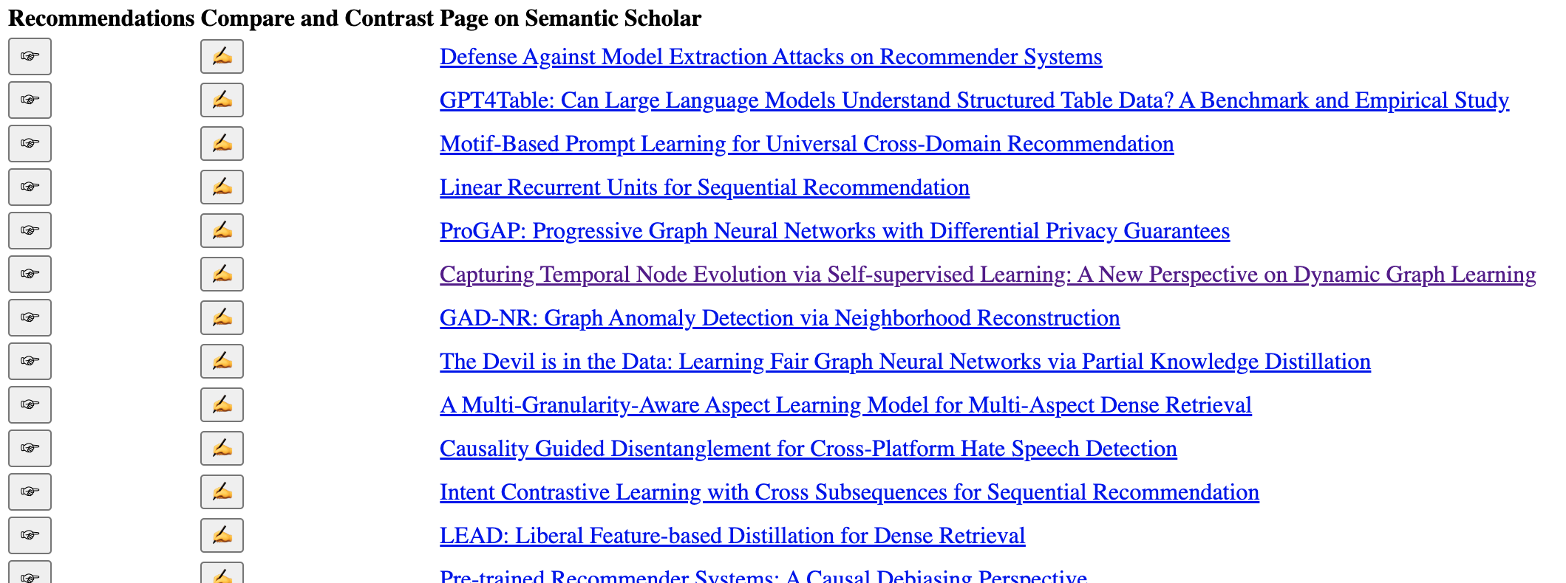
WSDM-2024 Papers on arXiv

Slide 6

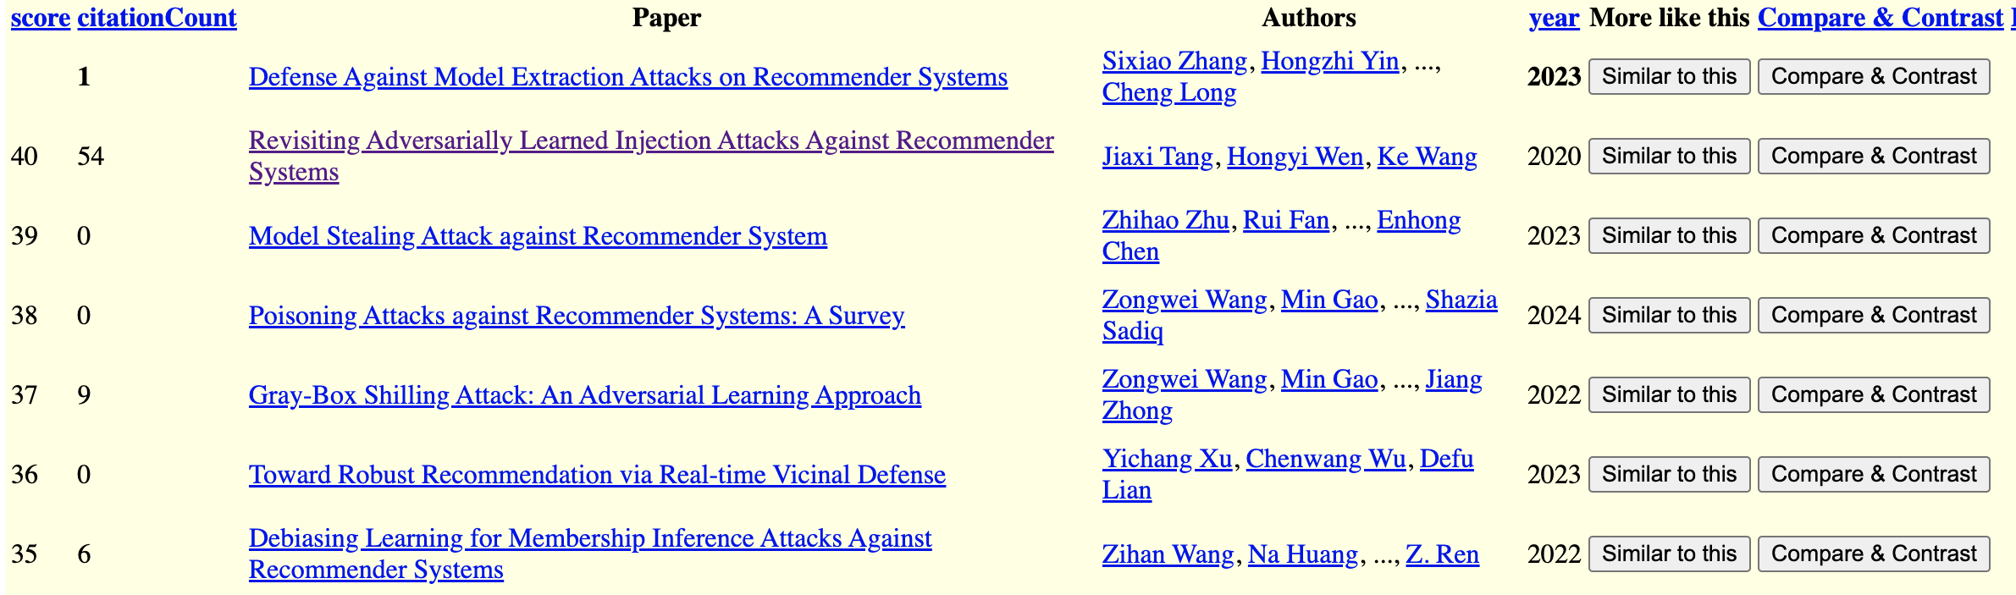
Recommendations for a Paper in WSDM-2024

Slide 7

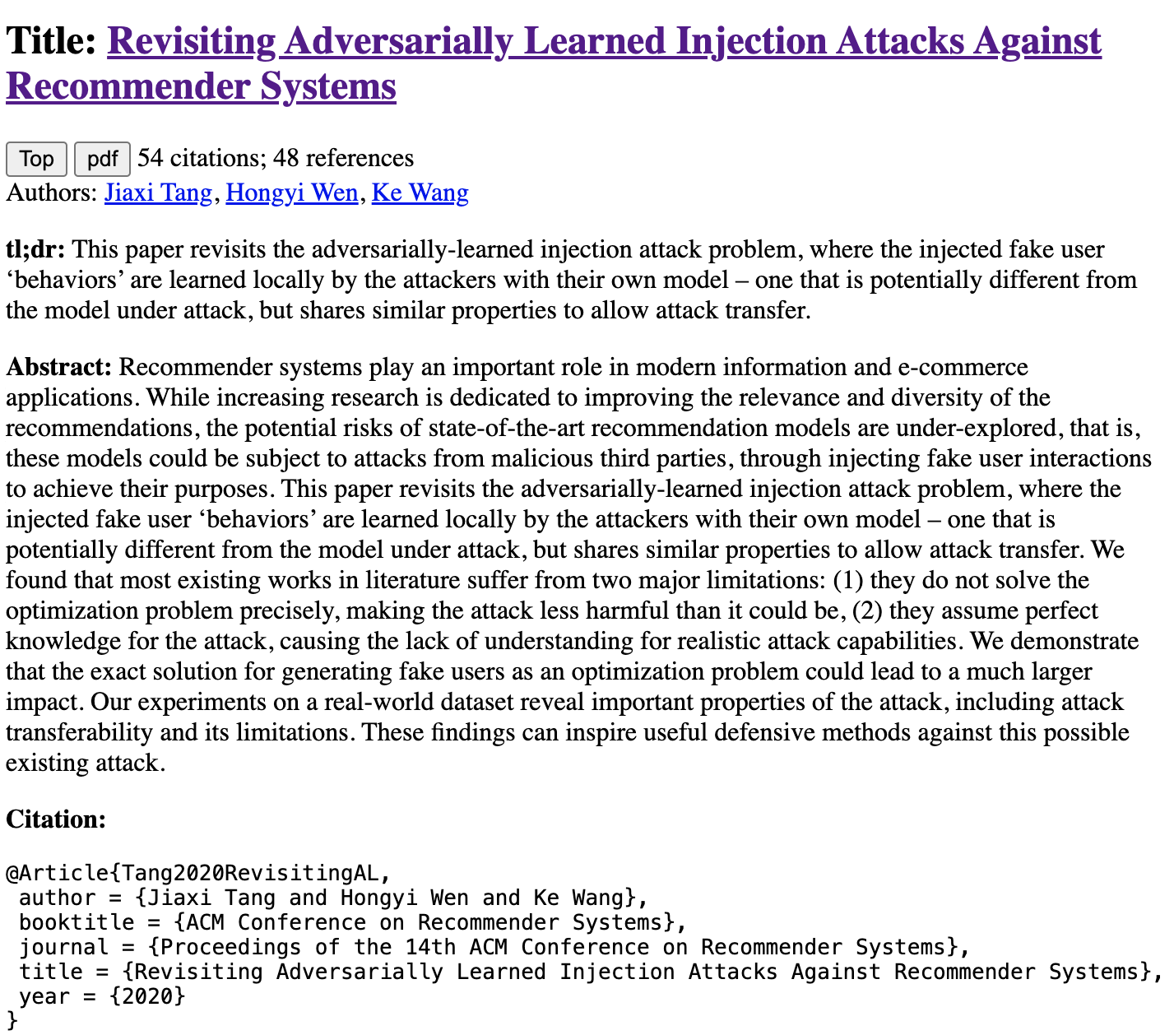
Compare and Contrast
Input: query + candidate
Use prompts (chatbots)
Summary of candidate
Similarities of query & candidate
Differences of query & candidate

Slide 8
Output from Chatbot
Similarities
Differences
As an Assistant, I can tell you that both "Revisiting Adversarially Learned Injection Attacks Against Recommender Systems" and "Defense Against Model Extraction Attacks on Recommender Systems" focus on security aspects of recommender systems. The first paper explores injection attacks where the attacker manipulates the recommendation model by injecting malicious data, while the second paper deals with defending against model extraction attacks aimed at extracting sensitive information from the recommender system. Both papers highlight the importance of addressing security vulnerabilities in recommender systems to protect user data and maintain the integrity of the recommendation models.
"Revisiting Adversarially Learned Injection Attacks Against Recommender Systems" focuses on exploring adversarially learned injection attacks against recommender systems, where the attacker has knowledge about the dataset used to train the target recommendation model. On the other hand, "Defense Against Model Extraction Attacks on Recommender Systems" focuses on strategies to defend against model extraction attacks, where attackers try to extract the architecture or parameters of a recommender system. The former paper deals with adversarial attacks, while the latter focuses on defense mechanisms against a different type of attack.

Slide 9
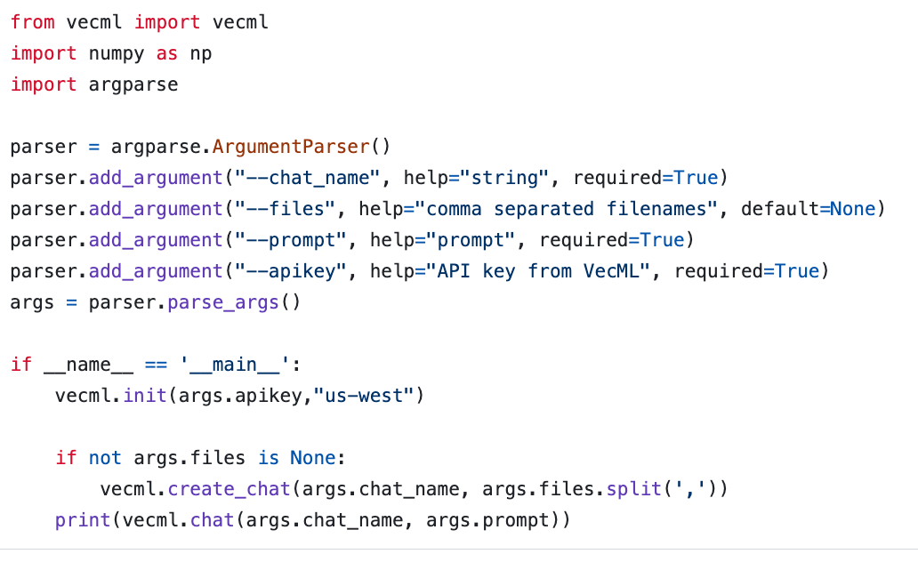
Chatbots are Super-Easy www.vecml.com

