Slide 1
Conclusions

Slide 2
Tutorial Agenda
Introduction
Hard
Easy
Medium
Ugly
Conclusions

Slide 3
Topics for Q&A / Discussion
The positive outlook
The cautious outlook
The negative outlook

Slide 4
The positive outlook
Lots of services and new components ready to be used
LLMs, web search, NLP components, data, etc.
Possible to solve different types of puzzles
Easy to build working prototypes
Fast development cycle
Good understanding of what is possible

Slide 5
The cautious outlook
No silver bullet
Difficult to change user behavior
Adoption
Data & labels are king
Provenance
Human vs AI content generation matters

Slide 6
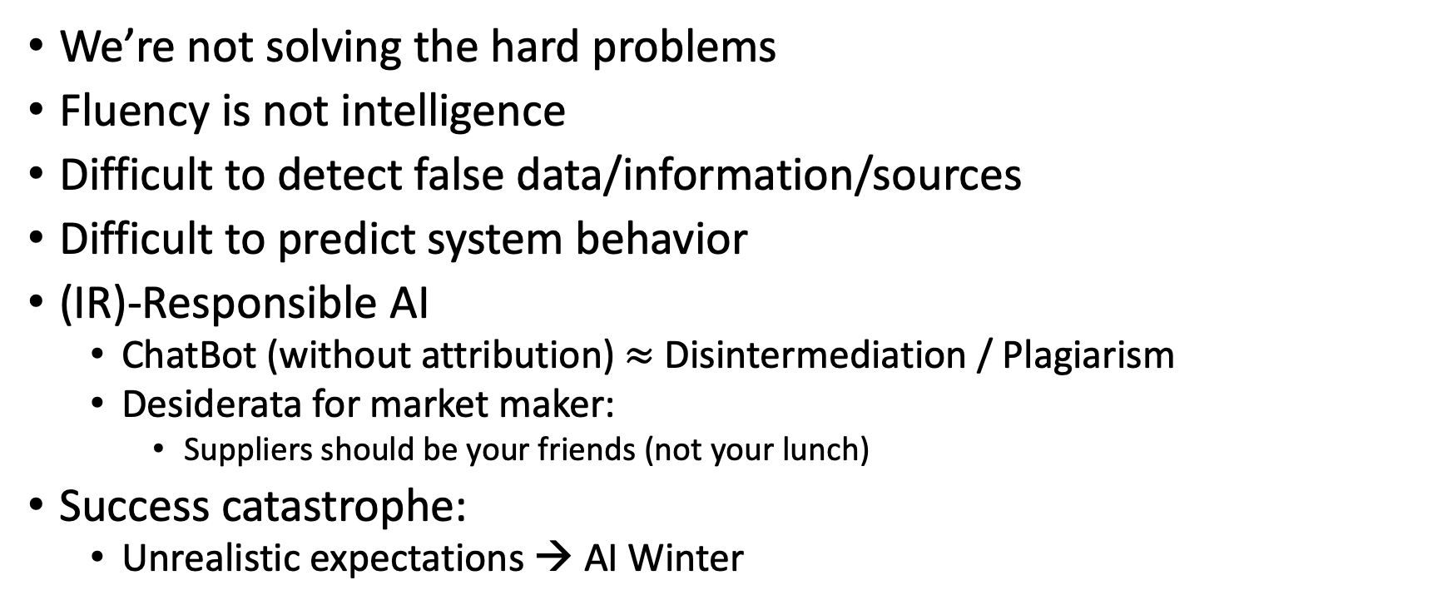
The negative outlook
We’re not solving the hard problems
Fluency is not intelligence
Difficult to detect false data/information/sources
Difficult to predict system behavior
(IR)-Responsible AI
ChatBot (without attribution) $≈$ Disintermediation / Plagiarism
Desiderata for market maker:
Suppliers should be your friends (not your lunch)
Success catastrophe:
Unrealistic expectations → AI Winter

