Slide 1
Medium
Query processing
Aggregated search
Knowledge graphs

Slide 2
Query processing
The front door of the search engine
In a nutshell
Query intent correctly identified and re-written in internal representation
Use re-written query to retrieve and match relevant results
Use all info to generate SERP
Lots of annotations and classifiers are used in this step
NLP components (POS, NER, stemming, keyphrases, geotagging, etc.)
Performance and matching (not covered in this tutorial)

Slide 3
Query intent
Broder’s taxonomy
Web search evolves
New users and behaviors
Emerging new types of search intents

Slide 4
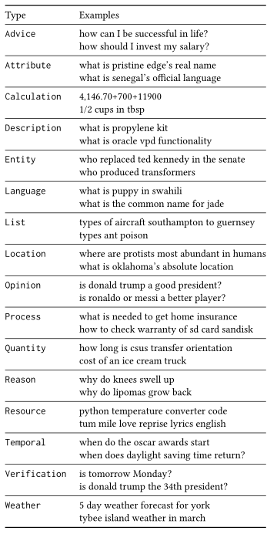
Question intent
Question taxonomy compared to queries
Multi-faceted question taxonomy
Detailed methodology
Agreement analysis and tie-breaking
B. Cambazoglu "An Intent Taxonomy for Questions Asked in Web Search", CHIIR 2021

Slide 5
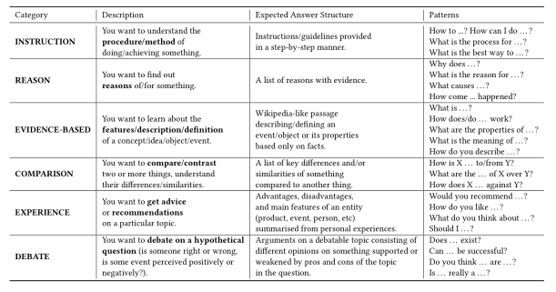
NFQ intent taxonomy
Very little understanding of Non-Factoid questions
Lots of research on factoid QA (SQuAD, MS MARCO) not on NFQ
Detailed taxonomy creation methodology
Data set and model available https://github.com/Lurunchik/NF-CATS
V. Bolotova et al. “A Non-Factoid Question-Answering Taxonomy” SIGIR 2022

Slide 6
Problems
Taxonomies and categorization mechanisms
Better understanding of user intent
Domain specific cases
Subjective queries and questions
Near-duplicate questions

Slide 7
Aggregated search
Integrated search across different sources
Common presentation
Content is retrieved from verticals for a given query
What is a vertical?
A specialized search service that focuses on a specific type of information need
Examples: maps, news, images, etc.
Aggregated search system decides what information to display and where

Slide 8
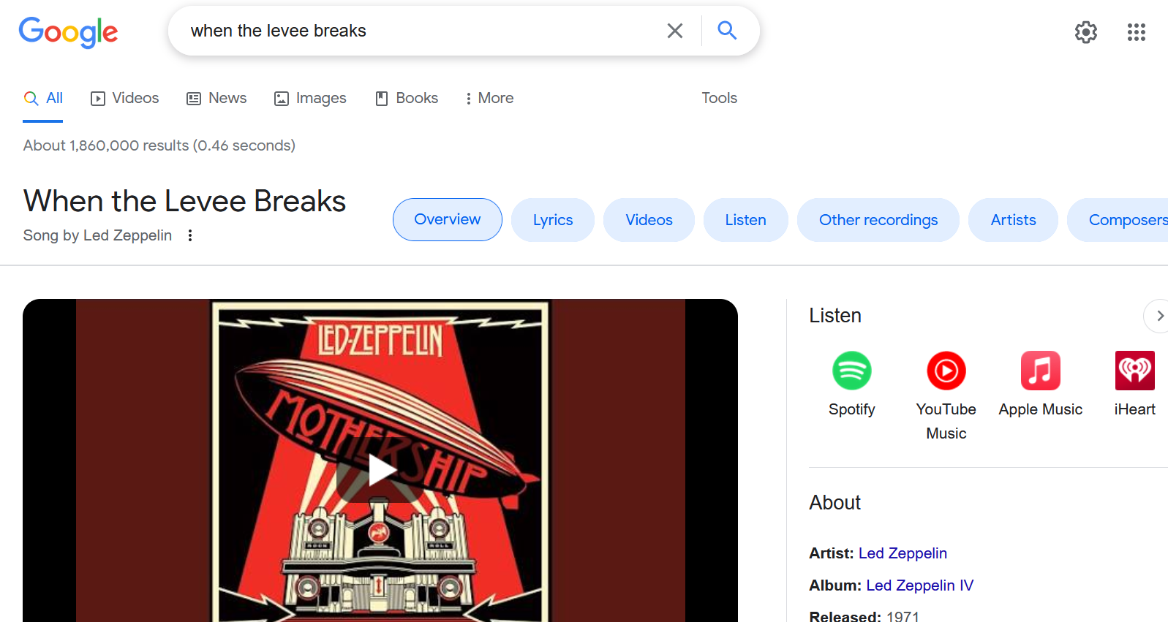
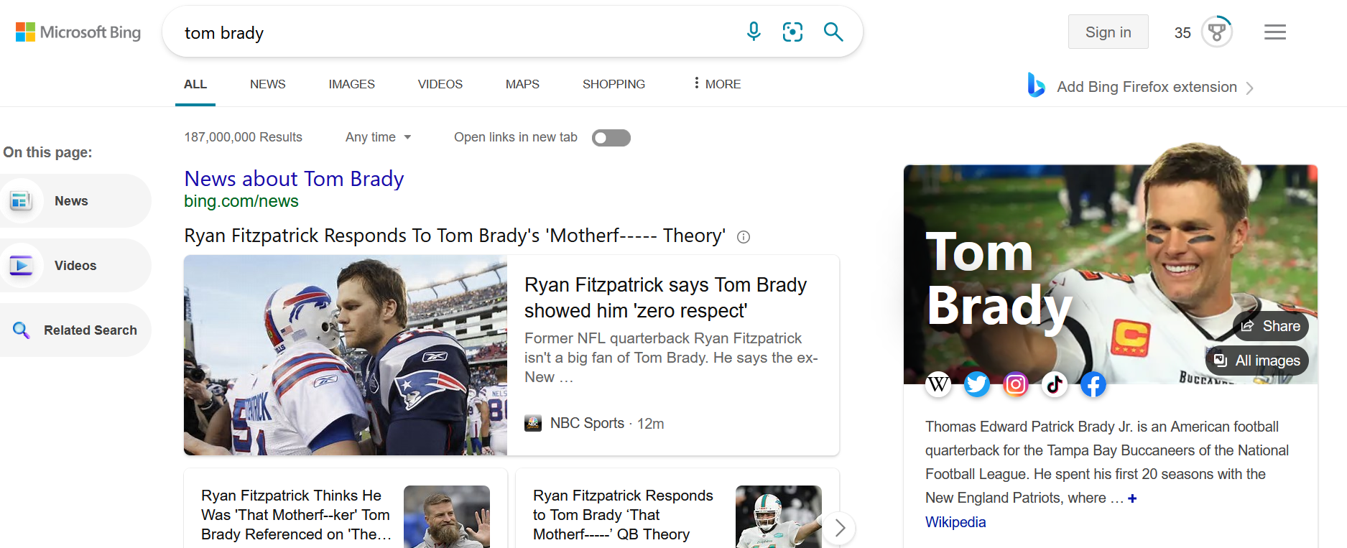
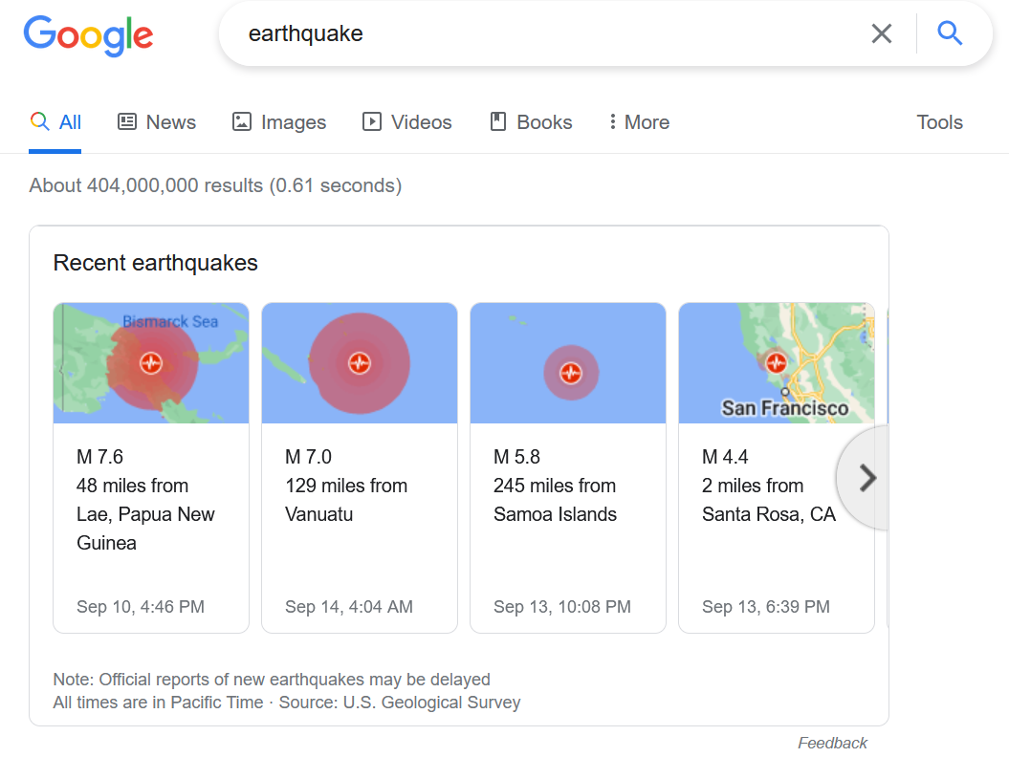
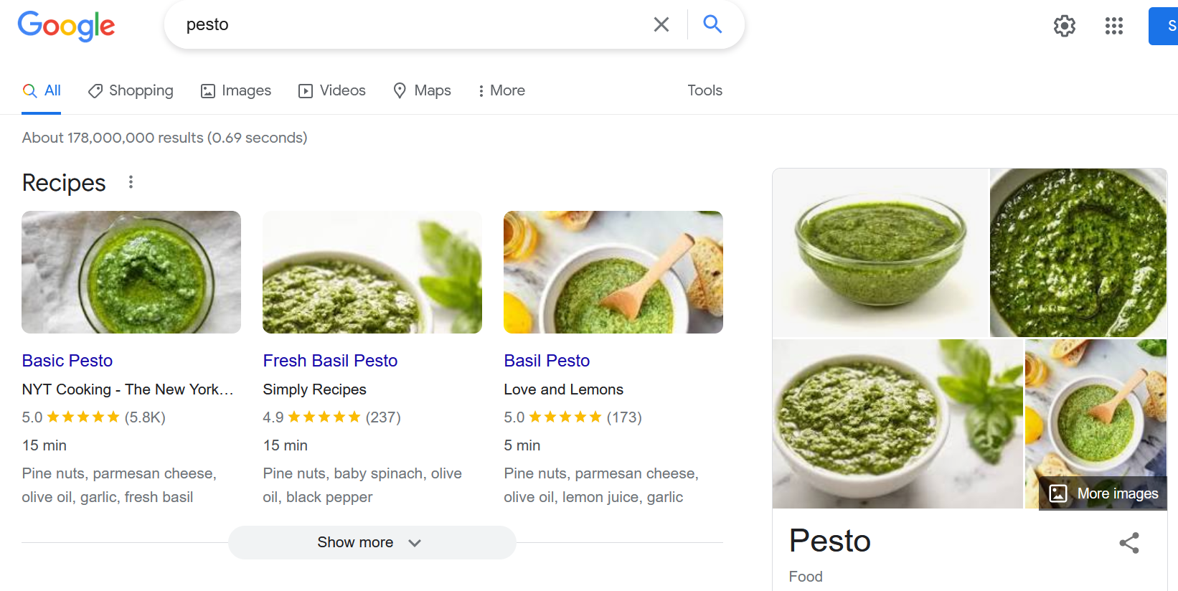

Slide 9
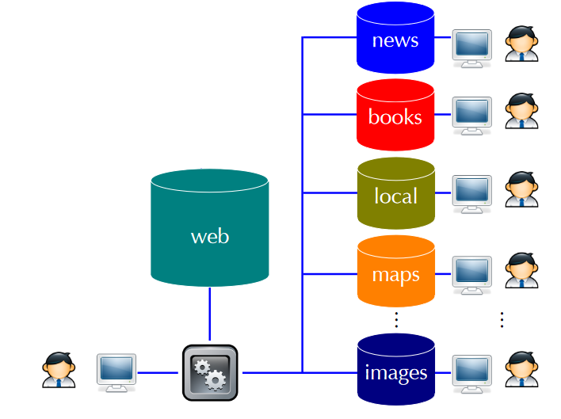
Aggregated search task
Combine results from multiple verticals into a single representation
Goal is to satisfy user with aggregated results
Better than to search on each vertical separately
Motivation:
Single point of entry
User may not know that a particular vertical exists
Results from different verticals at once
J. Arguello, Aggregated Search. Found. Trends Inf. Retr. 10(5), 2017

Slide 10
Sources of evidence
Predict which vertical is relevant for a given query
Predict where to present the information
Given a particular context, predict which vertical to present and where on the page
Context = core content, information need, user profile

Slide 11
Types of features
Query features
Properties of the input query
Independent of the vertical
Example: query contains “news”
Vertical features
Properties of the vertical
Independent of the query
Example: number of queries issued to the vertical
Query-vertical features
Properties of the vertical and query
Example: number of results from vertical to a query

Slide 12
Pre-retrieval features
Query keywords: presence of certain keywords (e.g., news, shopping)
Query characteristics: NER
Query class: navigational, transactional, informational
Query category: affinity to pre-defined topical categories
Co-occurrence with vertical triggers: query terms and trigger terms
Vertical corpus: similarity between query and sampled vertical results
Vertical query log: similarity between query and vertical query traffic
Query-vertical CTR
Vertical CTR

Slide 13
Post-retrieval features
Top vertical similarity: pairwise similarity between top vertical results
Recency
Vertical scores
Clarity: divergence of top results from a background language model
Metadata (e.g., reviews, location, publication date, etc.)

Slide 14
Post-presentation features
CTR
Average dwell time
Other behavioral signals like mouse movement, scrolling, etc.

Slide 15
Vertical selection
Decide which verticals to present in response to a query
Classification task
Single evidence
Compute a measure for each candidate vertical and predict
Comparable across verticals
Multiple evidence
Use ML to combine multiple sources
Two main problems when combining evidence
Certain features may not be available for some verticals
Learn a vertical-specific relationship between certain features and the relevance of a particular vertical
Adaptivity

Slide 16
Vertical presentation
Where to present relative to web results
Whole page layout constraints
Block or answer is sequence of results that are presented together
Pointwise: predict the relevance of each block to the query
Present at specific slots within web results
Simple and intuitive
Pairwise: predict the relevance between each candidate pairs
Voting
LTR
Requires common feature representation

Slide 17
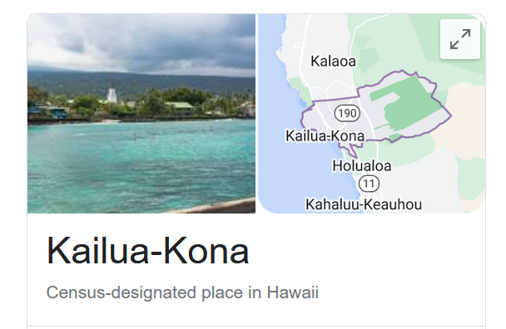
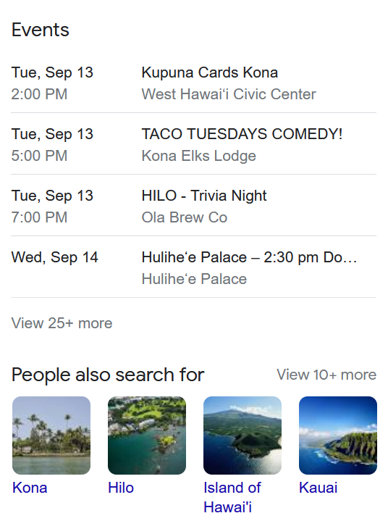
Composite retrieval
Aggregated search anchored around entities
Alternative to a list of results
Bundles
Results from verticals are grouped into bundles
Goal is to help with exploratory search tasks
Criteria (relevance, cohesion, diversity)
Techniques for composite
Knowledge graph assumption
KG contains entities and relationships
Query and traverse the KG to extract relevant elements
Query to categories: bundle around the best category
Result categories: bundling based on categories shared by the results

Slide 18
Problems
Research
Quantify utility of new and existing verticals/data sources
Algorithms and ML techniques to generate automatically aggregations
Relevance models
Optimizations for different configurations
Slotting
Engineering
Data flow architecture
Extract and publish the aggregations/bundles
Refresh content/keywords
What’s the best CX?
Layout
Relevance cues

Slide 19
Knowledge graphs
Knowledge graph (KG) describes objects of interest and connections
Organizing data as nodes and edges
Examples
Microsoft Satori, Google Knowledge Graph, Amazon Product Graph
Knowledge bases (KBs): Yago, Freebase
Knowledge graph and knowledge base terms are used interchangeably
Similar ideas have been around for quite some time
Ontologies and common sense knowledge
Cyc

Slide 20
What is it?
How to identify nodes and derives edges
So far, most research on KGs/KBs use Wikipedia as source
Benefits: easy to read, easy to parse, Wikipedians
Drawbacks: coverage, outdated content, bias
Why we care?
Machine readable facts about a domain
Data can be used for different use cases
More specifically
KG is a repository of entities, types and relationships
KG defines entities, types, attributes, relations, provenance
KG is data
KG evolves and needs maintenance

Slide 21
KG vs DB
What’s the difference?
DB
Store data for a specific application purpose
Semantics understood by those who built it and use it
Tables, columns, attributes
KG
All we know about a slice of the world
Semantics understood and agreed by all stakeholders
Application independent
Things, not strings

Slide 22
KGs in action
Semantic search
Going beyond 10-blue links
Understanding queries and documents
Document retrieval
Expansion
Language modeling
Entity retrieval
Recommendations
Question-answering
Data cleaning

Slide 23
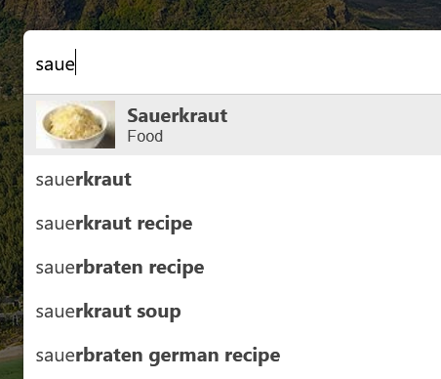
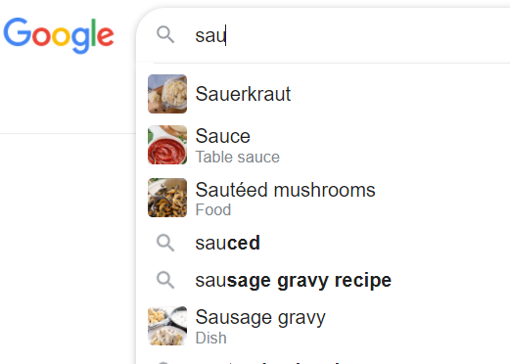
Example - Autocomplete

Slide 24
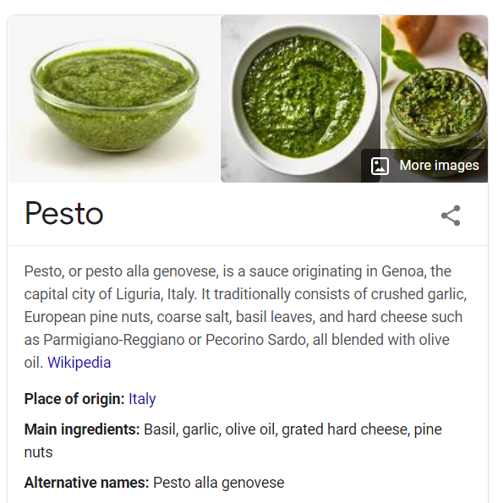
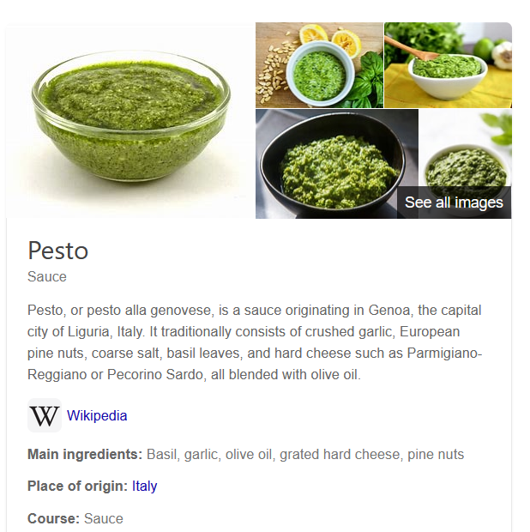
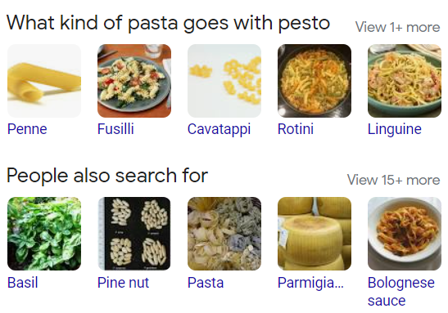
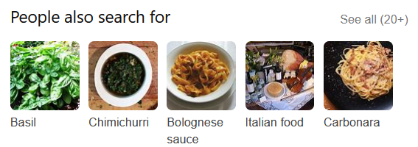
Example - Entity cards

Slide 25
Main concepts
Entity
Object or concept in the real world that can be identified
Uniquely characterized by its name(s), type(s), attributes, and relationships to other entities
Named-entity
Specific entity for which one or many designators or proper names can be used to refer to it
Examples: Red Cross (Organization), California (Location), February (Date)
Unique identifier
An identifier for an entity is a string of chars that uniquely denotes this entity
one-to-one correspondence between each entity identifier (ID) and the object it represents

Slide 26
Main concepts - II
Types
Entities may be categorized into multiple entity types
Types can also be thought of as containers that group together entities with similar properties
Ontology
The process of describing the kinds, properties of and relationships on things in the world
Use the tools of logic to formalize this description
Taxonomies
Taxonomy is a directed acyclic graph, where the nodes are classes and there is an edge from class X to class Y

Slide 27
Main concepts - III
Names
Multiple entities may share the same name
These alternative names are called surface forms or aliases
Attributes
Different types of entities are typically characterized by different sets of attributes
Relationships
Relationships describe how two entities are associated to each other

Slide 28
Relationships and attributes
SPO
Subject-Predicate-Object
Example
<Tom Brady, place of birth, San Mateo>
<Tom Brady, member of sports team, Tampa Bay>
<Tom Brady, occupation, American football player>
<fettuccine, subclass of, pasta>
<fusilli, subclass of, pasta>
<linguine, subclass of, pasta>
<paella, country of origin, Spain>
<paella, has ingredient, chicken>
<paella, has ingredient, rice>

Slide 29
Data models
Direct edge-labeled graphs
RDF is an example
Graph dataset
Set of named graphs. Each named graph is a pair (graph id, graph)
Property graphs
Allows a set of (property, value) pairs and a label to be associated with nodes/edges
Common in graph databases

Slide 30
Data access
Querying
SPARQL
SQL
Raw data
Materialization
Publish high quality data
Search & Browse UI

Slide 31
How do we build one
Manually
Experts, crowdsourcing
Automation
Generated from input sources
Information extraction
Representation
Entity extraction
Unstructured text
Structured KG
Relation and attribute extraction

Slide 32
Many choices
Semantic Web-like
RDF, OWL, SPARQL
Key-values
Text files, JSON
RDBMS
Tables, columns, SQL
Hybrid
Your favorite combination

Slide 33
Input sources
Data
Wikipedia, catalogs, web pages, query logs, etc.
Importance of top-tier sources
Authoritative content, high coverage, clean representation
Domain specific
Pre-existing categorization
Potentially useful
Alignment

Slide 34
Entity discovery
NER detects mentions of entities and assigns types
Part of your typical NLP toolkit (e.g., NLTK, Stanza, GATE)
Popular types: People, places, organizations, date, etc.
Dictionaries
Abbreviations (Apple, Apple Inc.)
Acronyms (MS, Microsoft)
Stage name (Lady Gaga, Stefani Joanne Angelina Germanotta)
Pattern-based methods
Hearst patterns; co-occurrence
“such as”, “X like Y”, “X and other Y”, “X including Y”

Slide 35
Entity discovery - II
ML
CRF
LSTM models
Embeddings
Word embeddings are computed from co-occurrences and neighborhoods of words in large corpora
Words are highly related if they are used in similar context
Taxonomies from catalogs, networks and user behavior
Wikipedia categories
Tagging systems
Query logs and clicks

Slide 36
Entity linking
Recognizing entity mentions in text and linking them to the corresponding entries in a KG
Assume a KG with existing entities
What’s the difference between NER and EL?
NER recognizes entities and assigns an entity type
EL recognizes entities and assigns an entity id
Importance of having an identifier management system

Slide 37

Entity linking - example
Tom Brady (player)
Tom Brady (director)
Super Bowl 2021
Super Bowl 2020
…
Tampa Bay (Location)
Tampa Bay (Buccaneers - NFL)
Tampa Bay (Lightning - NHL)
Tampa Bay (Ray - MLB)
Tampa (Florida)
Tampa (Kansas)
Tampa Bay Buccaneers (NFL team)

Slide 38
Entity linking – components
Mention detection
Identification of text snippets that can potentially be linked to entities
Using dictionary of entity names and variations
Candidate selection
Ranked list of candidate entities is generated for each mention
Disambiguation
The best entity (or none) is selected for each mention using context (if available)
Ranking problem
Entity annotations

Slide 39
Entity matching
Compute equivalence class
Also known as duplicate detection or record linkage
Name similarity
String similarity
Context similarity
Importance of proximity
Mention-entity popularity
Popularity of an entity
NEMO (Named Entities Made Obvious)
The best evidence for entity disambiguation is provided by the set of co-occurring entities

Slide 40
Attributes and relationships
Pattern-based
Regex
Rule-base extraction
Extraction from semi-structured content
DOM trees
Web tables
Information extraction
Extract (entity-type, alpha, entity-type)
Infoboxes are great if you have them

Slide 41
KG Curation
Quality
Precision, recall
Crowdsourcing
Human in the loop
KG life cycle
Provenance metadata (source, timestamp, extraction method)
Versioning
Twitter CEO (Jack -> Parag -> Elon)
Maintenance

Slide 42
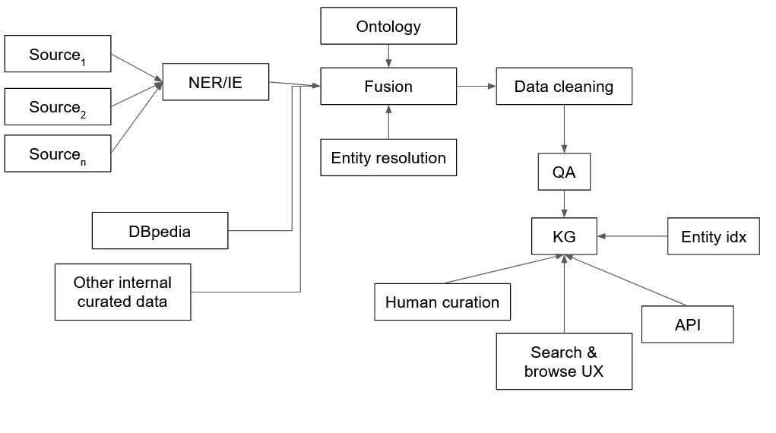
Architecture for KG construction

Slide 43
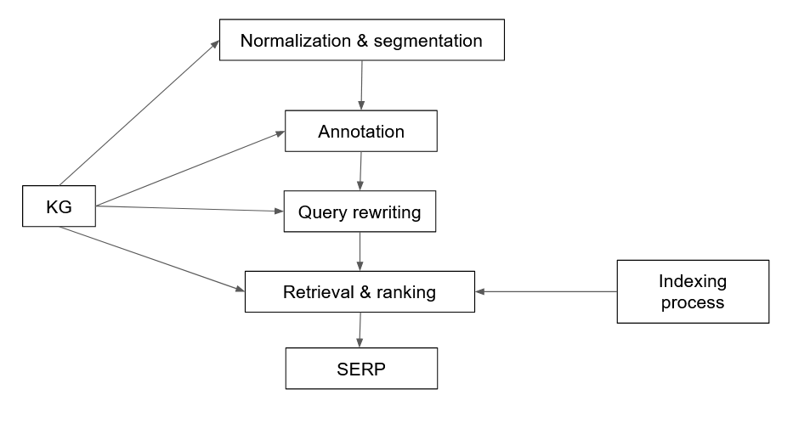
Where is the KG?

Slide 44
Representation
Unique problem
Entities in KG have no textual representation, apart from their names
We can run SPARQL queries but how do we add the IR part?
Predicate folding
Build a textual representation for each entity by considering all triples
Grouping predicates together into a small set of predefined categories
From SPOs triples to a structured document

Slide 45
Predicate folding - example
<spaghetti carbonara, instance_of, recipe>
<spaghetti carbonara, has_ingredient, spaghetti>
<spaghetti carbonara, has_ingredient, pancetta>
<spaghetti carbonara, has_ingredient, eggs>
<spaghetti carbonara, has_ingredient, parmesan>
<spaghetti carbonara, recipe_cuisine, italian cuisine>
<spaghetti carbonara, serving_size, 4>
<spaghetti carbonara, calories, 510>
<spaghetti carbonara, cook_time, 25min>
Name | spaghetti carbonara
Ingredients | Spaghetti, pancetta, eggs, parmesan
Attributes | italian cuisine, serves 4, calories 510, cook time 25min
Related entities | spaghetti aglio e olio, fettuccine alfredo

Slide 46
Entity retrieval
Field search retrieval
Linear combination of matching functions
Can use LTR to learn weights

Slide 47
Document retrieval
Preprocessing
Documents are preprocessed with EL + additional information obtained from KG
Query annotation
Query processed with EL
Expansion
KG feedback: query is issued against an index of a KG in order to retrieve related entities
Corpus-based feedback

Slide 48
Semantic search
Understanding information needs
Query classification
Assign a query to one or multiple pre-defined categories
Query intent classification (Broder)
Query annotation
Generate semantic markup for a query
Query segmentation: group terms into phrases
Query tagging (POS, NER)

Slide 49
EL in queries
Problems
Queries are very short
Limited context, or none at all
Online process under time constraints
Components
Mention detection
Candidate ranking
Interpretations: query may have more than 1 interpretation

Slide 50
Using entities for search
Query assistance
Auto-complete
Specific subset of queries that can be decomposed into entity and refiner components
Query recommendations
Entity cards
Summaries and facts
Entity recommendation
Entity based
Query based
Explanations

Slide 51
Domain specific KGs: healthcare domain
Scientific medical knowledge
Existing taxonomies and data sources
Examples
SNOMED (Systematized Nomenclature of Medicine)
RxNorm (medications available on the US market)
MeSH (Medical Subject Headings)

Slide 52
Challenges
Very sensitive data
EMR (Electronic Medical Records)
Clinical relevance
Vocabulary mismatch
Patient describing a symptom
MDs describing a diagnosis
Data labeling and curation

Slide 53
How to bootstrap?
No single approach to build a KG
Research and engineering problems
Iterative development cycle
Content
Infrastructure
Applications

Slide 54
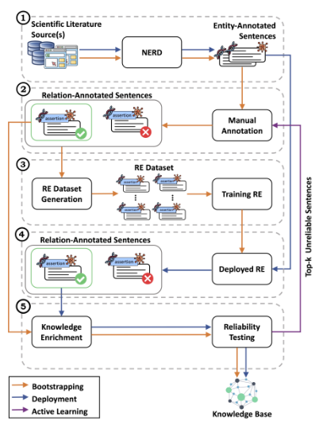
CORE (Collaborative Oriented Relation Extraction)
KG generation system
Combination of automated ML-based methods and domain experts
Modular architecture that can be easily modified
Reliability tests
Active learning process make the system suited to iterative
Versioning
S. Marchesin et al. "Building a Large Gene Expression-Cancer Knowledge Base with Limited Human Annotations" Database, 2023

Slide 55
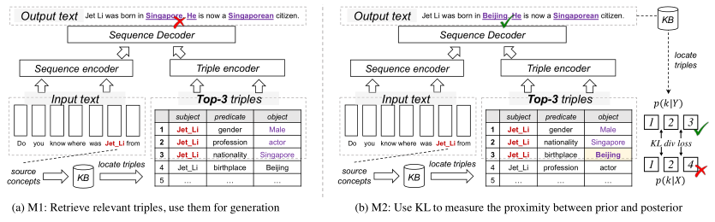
Knowledge-enhanced generation with KGs
Design Supervised Tasks around KG
Discover the dependencies of elements within a sequence
Retrieve relevant triples, then using them for generation
Using KL to measure the proximity between prior and posterior distribution
Selecting KG or facts in a KG
W. Yu et al. "A Survey of Knowledge-Enhanced Text Generation" ACM Computing Surveys 2022

Slide 56
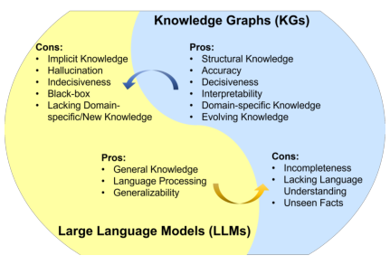
Combining KGs & LLMs
LLMs lack of factual knowledge
LLMs memorize and knowledge in a training set
No interpretability
KGs are difficult to construct and maintain
KGs are domain specific
S. Pan et al. "Unifying Large Language Models and Knowledge Graphs: A Roadmap" arxiv.org/abs/2306.08302

Slide 57
KG-enhanced LLMs
KG-enhanced LLM pre-training
Training objective
LLM inputs
Fusion models
KG-enhanced LLM inference
Dynamic fusion
Retrieval augmented
KG-enhanced LLM interpretability
Probing and analysis

Slide 58
LLM-augmented KGs
Embedding
Text encoders
Joint text and KG embeddings
Completion
Construction
Entity discovery
Relation extraction
Coreference
Distilling KGs from LLMs
KG-to-text generation
LLM-augmented KG question answering

Slide 59
Problems
Data quality for KGs
Use of LLMs for KG construction
Redundancy and completeness
Maintenance
LLM answer validation with KGs

