Slide 1
Medium
Query processing
Knowledge graphs

Slide 2
Query processing
The front door of the search engine
In a nutshell
Query intent correctly identified and re-written in internal representation
Use re-written query to retrieve and match relevant results
Use all info to generate SERP
Lots of annotations and classifiers are used in this step
NLP components (POS, NER, stemming, keyphrases, geotagging, etc.)
Performance and matching (not covered in this tutorial)

Slide 3
Query intent
Broder’s taxonomy
Web search evolves
New users and behaviors
Emerging new types of search intents

Slide 4
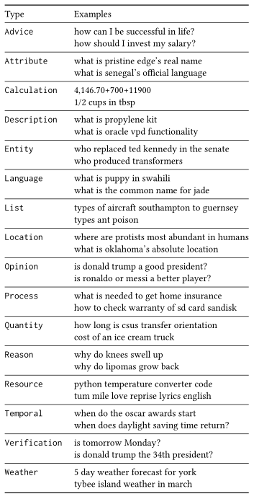
Question intent
Question taxonomy compared to queries
Multi-faceted question taxonomy
Detailed methodology
Agreement analysis and tie-breaking
B. Cambazoglu "An Intent Taxonomy for Questions Asked in Web Search", CHIIR 2021

Slide 5
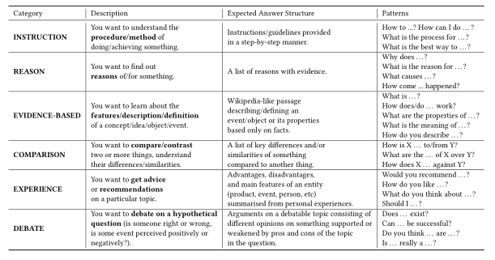
NFQ intent taxonomy
Very little understanding of Non-Factoid questions
Lots of research on factoid QA (SQuAD, MS MARCO) not on NFQ
Detailed taxonomy creation methodology
Data set and model available https://github.com/Lurunchik/NF-CATS
V. Bolotova et al. “A Non-Factoid Question-Answering Taxonomy” SIGIR 2022

Slide 6
Problems
Taxonomies and categorization mechanisms
Better understanding of user intent
Domain specific cases
Subjective queries and questions
Near-duplicate questions

Slide 7
Knowledge graphs
Knowledge graph (KG) describes objects of interest and connections
Organizing data as nodes and edges
Examples
Microsoft Satori, Google Knowledge Graph, Amazon Product Graph
Knowledge bases (KBs): Yago, Freebase
Knowledge graph and knowledge base terms are used interchangeably
Similar ideas have been around for quite some time
Ontologies and common sense knowledge
Cyc

Slide 8
What is it?
How to identify nodes and derives edges
So far, most research on KGs/KBs use Wikipedia as source
Benefits: easy to read, easy to parse, Wikipedians
Drawbacks: coverage, outdated content, bias
Why we care?
Machine readable facts about a domain
Data can be used for different use cases
More specifically
KG is a repository of entities, types and relationships
KG defines entities, types, attributes, relations, provenance
KG is data
KG evolves and needs maintenance

Slide 9
KGs in action
Semantic search
Going beyond 10-blue links
Understanding queries and documents
Document retrieval
Expansion
Language modeling
Entity retrieval
Recommendations
Question-answering
Data cleaning

Slide 10
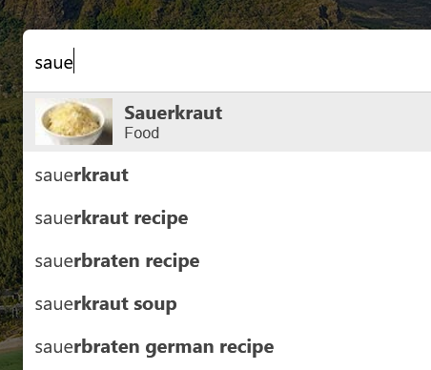
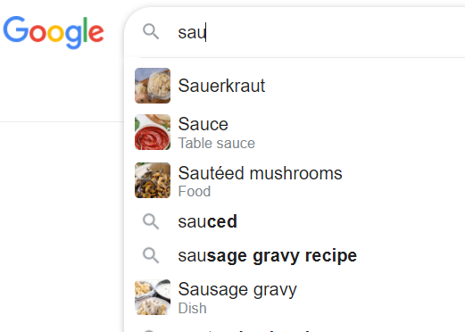
Example - Autocomplete

Slide 11
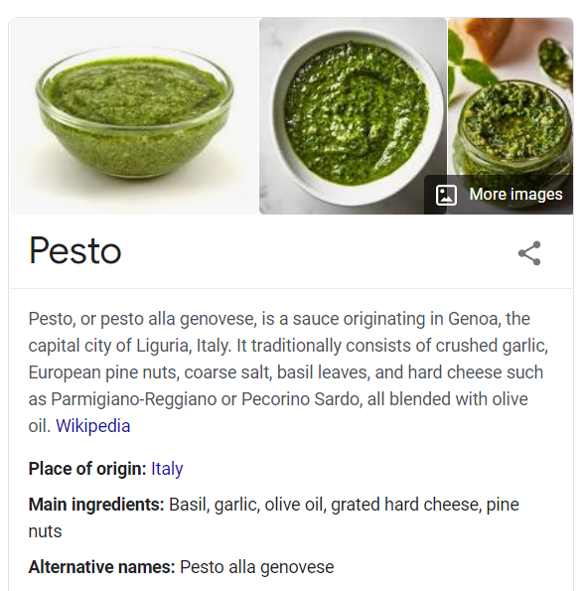
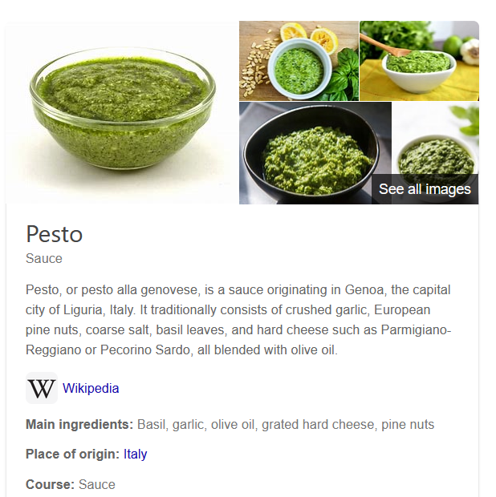
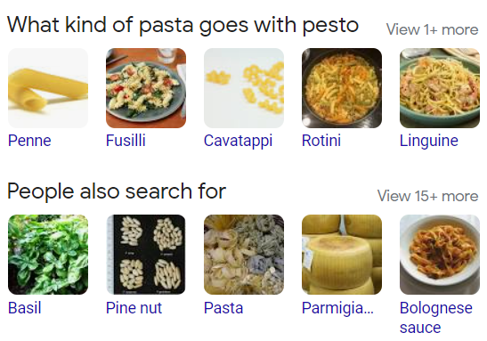
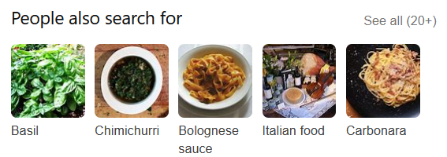
Example - Entity cards

Slide 12
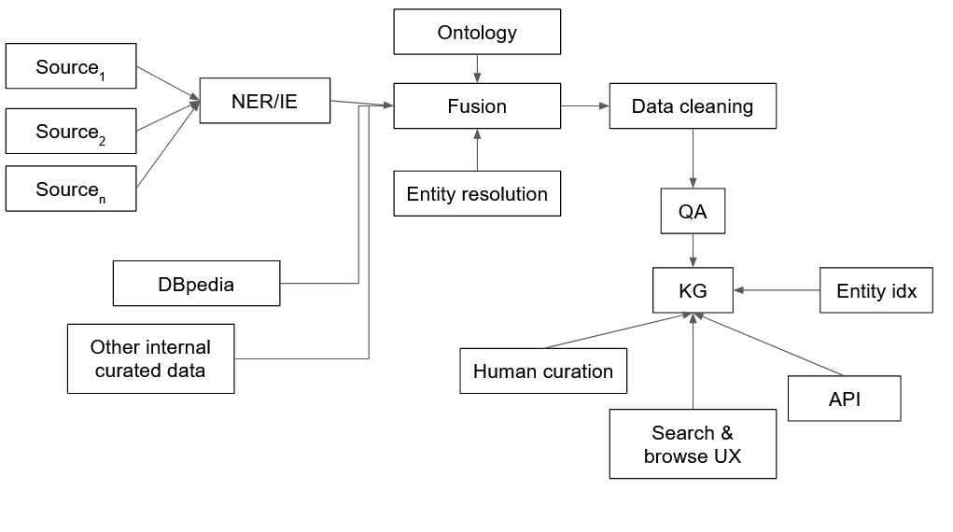
Architecture for KG construction

Slide 13
Semantic search
Understanding information needs
Query classification
Assign a query to one or multiple pre-defined categories
Query intent classification (Broder)
Query annotation
Generate semantic markup for a query
Query segmentation: group terms into phrases
Query tagging (POS, NER)

Slide 14
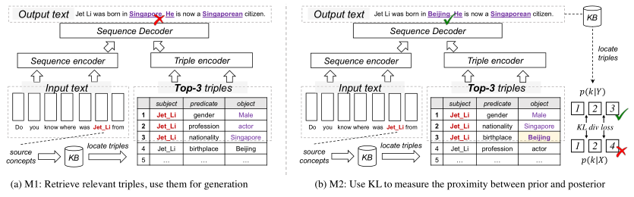
Knowledge-enhanced generation with KGs
Design Supervised Tasks around KG
Discover the dependencies of elements within a sequence
Retrieve relevant triples, then using them for generation
Using KL to measure the proximity between prior and posterior distribution
Selecting KG or facts in a KG
W. Yu et al. "A Survey of Knowledge-Enhanced Text Generation" ACM Computing Surveys 2022

Slide 15
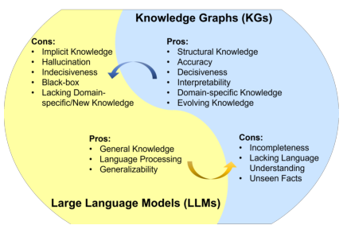
Combining KGs & LLMs
LLMs lack of factual knowledge
LLMs memorize and knowledge in a training set
No interpretability
KGs are difficult to construct and maintain
KGs are domain specific
S. Pan et al. "Unifying Large Language Models and Knowledge Graphs: A Roadmap" arxiv.org/abs/2306.08302

Slide 16
KG-enhanced LLMs
KG-enhanced LLM pre-training
Training objective
LLM inputs
Fusion models
KG-enhanced LLM inference
Dynamic fusion
Retrieval augmented
KG-enhanced LLM interpretability
Probing and analysis

Slide 17
LLM-augmented KGs
Embedding
Text encoders
Joint text and KG embeddings
Completion
Construction
Entity discovery
Relation extraction
Coreference
Distilling KGs from LLMs
KG-to-text generation
LLM-augmented KG question answering

Slide 18
Problems
Data quality for KGs
Use of LLMs for KG construction
Redundancy and completeness
Maintenance
LLM answer validation with KGs

