Slide 1
Labeling

Slide 2
The bad news first
Labeling is hard
Facebook
Points-Of-Interests (Foursquare, etc.)
Labeling is going to get more difficult
Enterprise
Personalization
Healthcare
New data sets
Some context
We assume supervised or semi-supervised learning
Large scale
Continuous

Slide 3

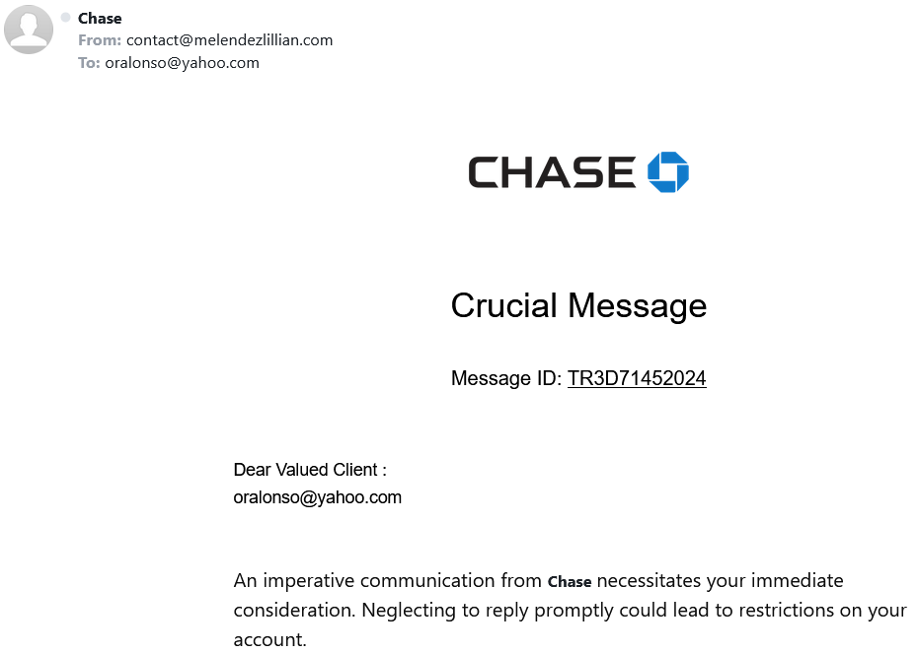
What is a label?
Spam email?
Label: yes, no

Slide 4
Why we care?
Provenance
Reproducibility & debugging
Explainability & interpretability
How a training set was created
Bias and fairness
Data management
ML/AI models live & die by the quality of input data
Metadata about labels
Maintenance
Lora Aroyo et al. "Data excellence for AI: why should you care?" Interactions 29(2): 66-69 (2022)

Slide 5
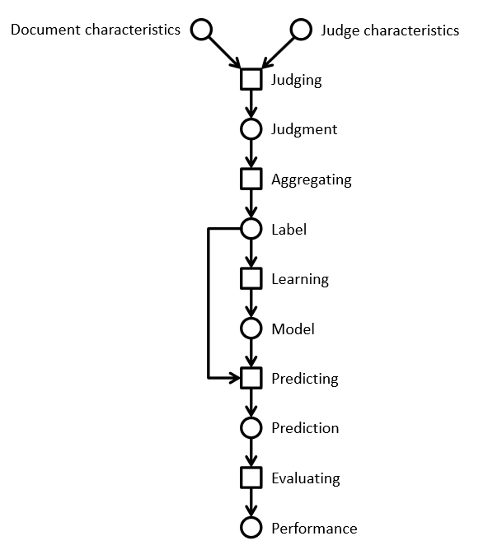
Lifecycle of a label
Information retrieval example
Using a crowd to label a data set
Using ML to process the complete data set

Slide 6
Relevance labels
Indicate whether a search result is valuable to a searcher
Key in evaluation and optimization IR systems
Editors or experts
TREC-style
Crowdsourcing
LLMs

Slide 7
Careful with that axe data, Eugene
In the era of big data and machine learning
labels -> features -> predictive model -> optimization
Labeling perceived as boring
Tendency to rush labeling
Quality is key
Garbage in, garbage out
Own the entire stack
Labeling, modeling, infrastructure, deployment

Slide 8
The state of the field
Human-labeled data is more important than ever
Requirements
Throughput -> ASAP; I need the labels for yesterday
Cost -> cheap; if possible free
Quality -> top
Performed as a one-off by 3rd party (crowd or editors)
Human Intelligence Task (HIT)
Micro-tasks
Needs development work to get good results
Very limited functionality in current platforms
Mechanical Turk, SageMaker (Amazon)
Figure Eight (Appen)
Toloka (Yandex)
Start-ups
LLMs

Slide 9
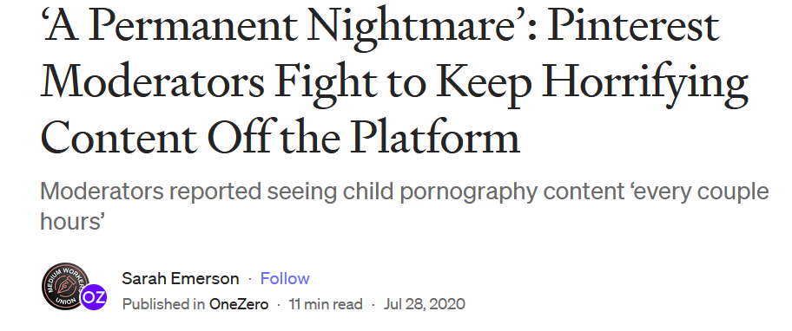
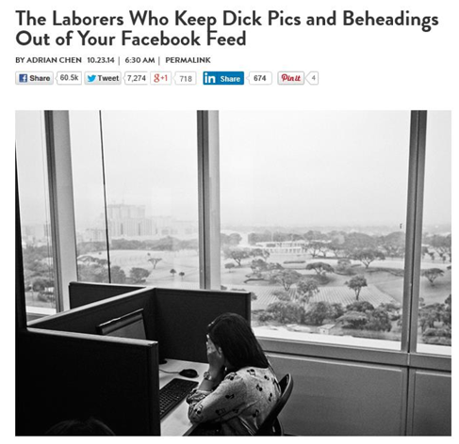
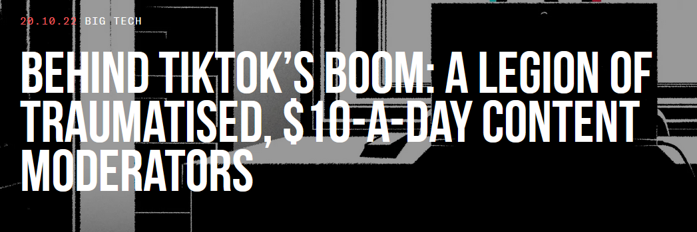
The need for humans
Many examples where humans are involved
Adult content and moderation
Baby sitting algorithms
https://onezero.medium.com/a-permanent-nightmare-pinterest-moderators-fight-to-keep-horrifying-content-off-the-platform-4d8e7ec822fe
https://www.wired.com/2014/10/content-moderation/
https://www.thebureauinvestigates.com/stories/2022-10-20/behind-tiktoks-boom-a-legion-of-traumatised-10-a-day-content-moderators

Slide 10
Problems
Monolithic HITs
The structure of a HIT mirrors the structure of the task the developer is working on
Similar to Conway’s law in software engineering
Task complexity
Lengthy instructions
RTFM doesn’t work
We don’t think of HC/crowdsourcing as programming
How to improve
Use established programming practices
Careful, we are dealing with humans and not machines

Slide 11
A spectrum of labeling tasks
Nature of task | Aggregation approach | Evaluation technique
Objective question has a correct answer (objective) | Reliable judge assigns appropriate label for an item | Evaluate workers by comparing individual results with gold set
Judgment question has a best answer (partially objective) | Inter-rater agreement determines label for an item | Evaluate workers by comparing individual results with consensus
Subjective question has consistent answer (subjective) | Repeatable polling determines probability of a label for an item | Evaluate workers by computing the consistency of results between groups

Slide 12
Prepare the environment
Homework before you label
Assess the lay of the land
Identify your use cases
Understand your product’s data
Design your HITs
Determine your guidelines
Communicate your task
Maintain high quality
Ongoing vs. one-offs HITs
Labels for the machine != labels for humans

Slide 13
HIT design principles
Self-contained, short, and simple
Document presentation
Text alignment & legibility; reading level; multi-cultural and multilingual
Cognitive biases
Implications on the final output: anchor effect, mere exposure, picture superiority
Task complexity
High cognitive load; low usability, specific expertise

Slide 14
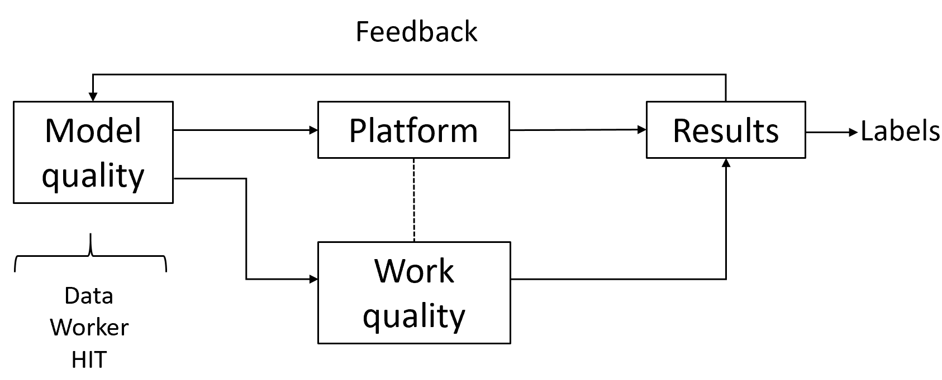
Quality control in general
Extremely important part of the task
Approach as “overall” quality; not just for workers
Bi-directional channel
You may think the worker is doing a bad job.
The same worker may think you are a lousy requester.
Quality framework
Module quality
Work quality
Measuring agreement

Slide 15
Algorithms used in practice
Voting
Majority vote, Borda, tiers
Strong baseline
Honey pots and programmatic gold
Expectation-Maximization
Get another label
Adaptivity
Quality-cost tradeoff
How many workers?
When to stop?
Stopping rules
Automatic honey pots creation

Slide 16
Behavioral features
Focus on the way workers work instead of what they produce
Task fingerprinting
High correlation with work quality
Wernicke
Information Extraction scenario
Weighted majority voting
Behavioral features outperform performance-based methods
J. Rzeszotarski and A. Kittur. “Instrumenting the Crowd: Using Implicit Behavioral Measures to Predict Task Performance”. UIST 2011.
S. Han, P. Dai, P. Paritosh, D. Huynh. “Crowdsourcing Human Annotation on Web Page Structure: Infrastructure Design and Behavior-Based Quality Control”. ACM TIST 2016

Slide 17
Active learning
Accuracy
Limited budget for annotating a small % of the unlabeled data
Speed
Model more accurate more quickly
Diversity
Uncertainty sampling
Least confidence, margin of confidence, ratio of confidence
Diversity sampling
Clustering to partition the data, real-world diversity
R. Munro. “Human-in-the-Loop Machine Learning”, Manning Publications 2021.

Slide 18
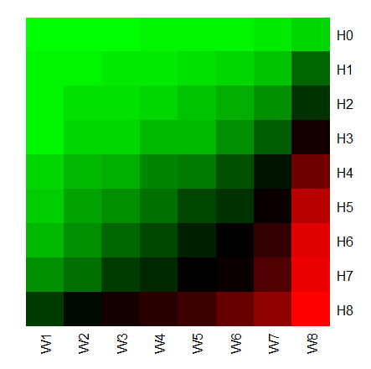
Error rates for different worker/HIT groups
Easy HITs
UHRS
2,700 HITs from 20 workloads
For difficult HITs
Good workers are doing well
Bad workers are doing poorly
For easy HITs
Good workers are doing well
Bad workers are doing well
Difficult HITs
Let error(Wi, Hj) be the average error rate of the
workers in the worker group Wi working on HITs Hj
Good workers
Bad workers
I. Abraham et al. “How Many Workers to Ask? Adaptive Exploration for Collecting High Quality Labels”. SIGIR 2016

Slide 19
Snorkel approach
Formalizing programmatic labeling
Models are commodities
pip install <what-you-want>
Training data is the interface for software 2.0
Labeling functions as black boxes that predict a label
Learn from agreements/disagreements between labeling functions

Slide 20
LLMs
Human labels are expensive
Expert > Crowd-based worker > LLM
Automatic label is not a new idea
How about using LLMs to label documents?
Potential advantages
Cost and performance
Allocate humans where are needed the most
Potential issues
Reliability
Quality control
P. Thomas et al. "Large language models can accurately predict searcher preferences" arxiv.org/abs/2309.10621
G. Faggioli et al. "Perspectives on Large Language Models for Relevance Judgment" ICTIR 2023

Slide 21
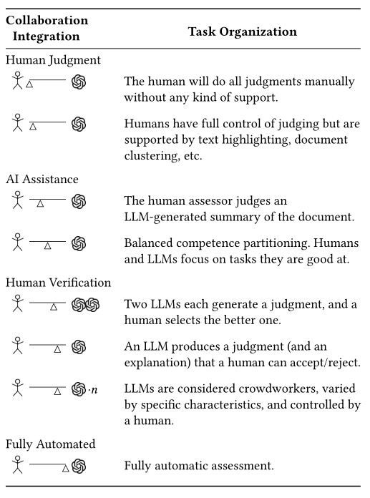
Spectrum of human-machine collaboration
LLMs judgement quality
LLMs cost
Multiple LLMs as judges
Truthfulness
Bias
Explanations/justifications

Slide 22
Prompting
In-context learning
New capabilities can be unlocked in LLMs
LLM is prompted with a few in-context demonstrations
Learns to perform a certain task
Task performance is very sensitive to prompts

Slide 23
Setup
Similar to crowdsourcing work
Take TREC judgement guidelines
HIT in Mturk
Prompt for GPT or similar LLM
Compute agreement using Cohen’s kappa
Two main approaches
Prompt “as is”
Prompt engineering

Slide 24
Prompt structure
Relevance evaluation task
Task instructions
You are a search quality rater evaluating relevance of web pages
Query-document pair to be labelled
Query {query}
Document {document}
Relevant?
Re-state the task
Output format

Slide 25
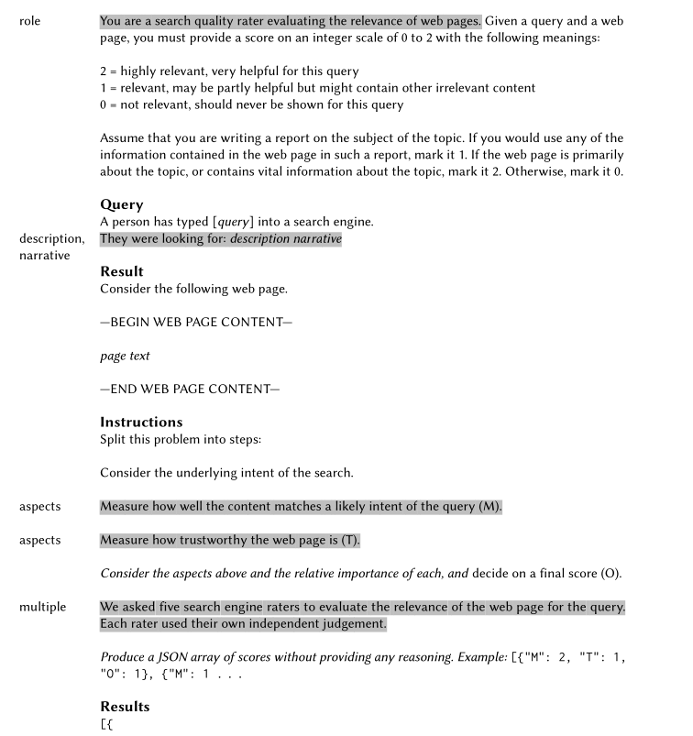
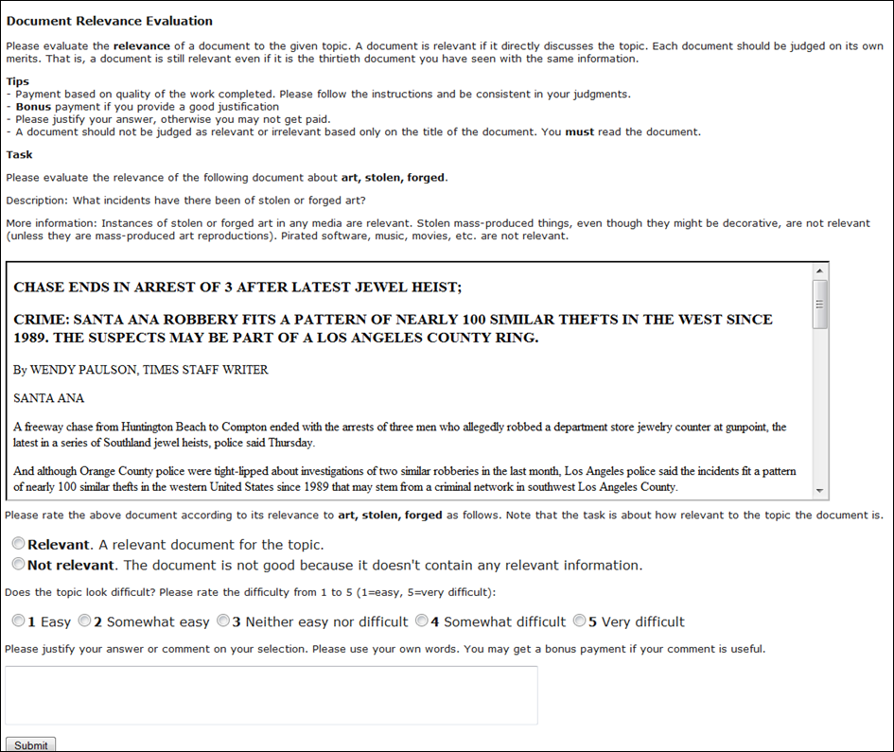
Prompts compared to HITs

Slide 26
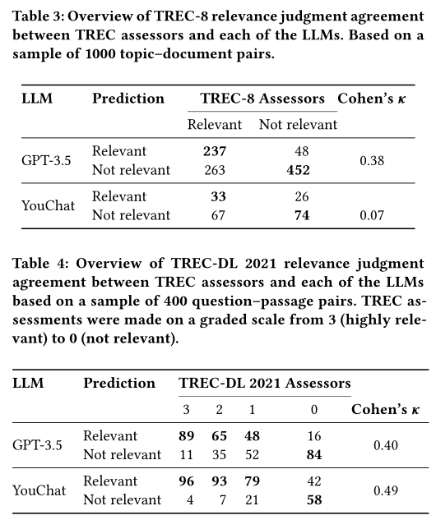
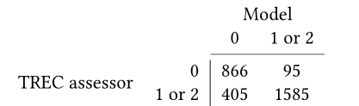
Preliminary results
With no prompt engineering
With prompt features
R (role), D (description), A (aspects), M (multiple judges)
Performance varies per feature
Cohen’s k (0.20 to 0.64)

Slide 27
Discussion
In favor
LLMs are able to produce an explanation
This could be used to assist humans in relevance judgements
Against
LLMs are not users
IR is about relevance to an information need
No proof that evaluation by LLM has any relationship to reality
Things to consider
Reliability over time
Cost in prompt engineering
Caveat
LLMs are systems
Query intent and answer construction

Slide 28
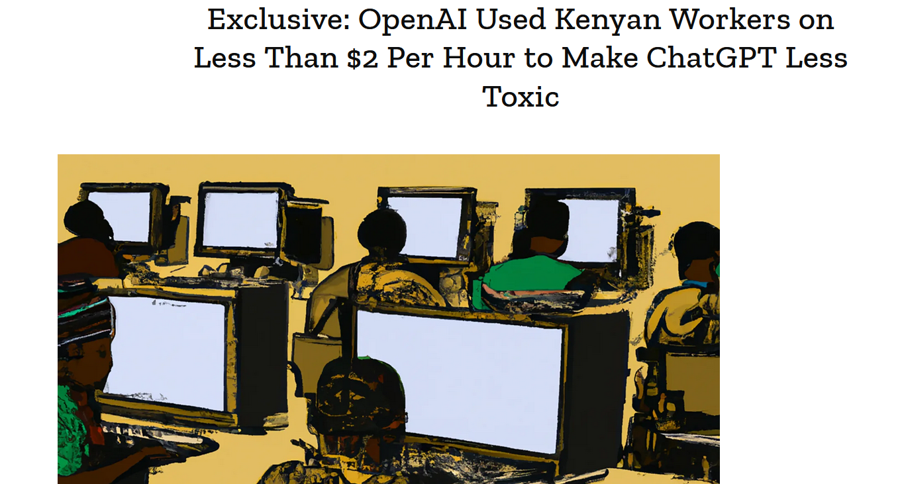
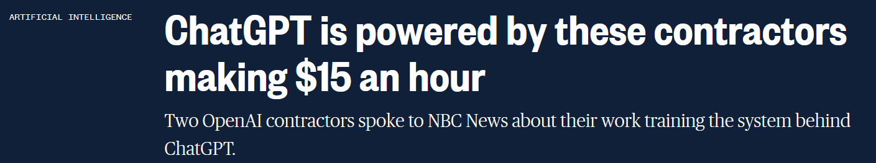
LLMs and human computation
For a LLM like ChatGPT, p(w_{i}|w₁,…,w_{i-1}) is defined by a transformer
LLM-based system do require editorial work
Not different from any major property on the Internet
https://time.com/6247678/openai-chatgpt-kenya-workers/
https://www.nbcnews.com/tech/innovation/openai-chatgpt-ai-jobs-contractors-talk-shadow-workforce-powers-rcna81892

Slide 29
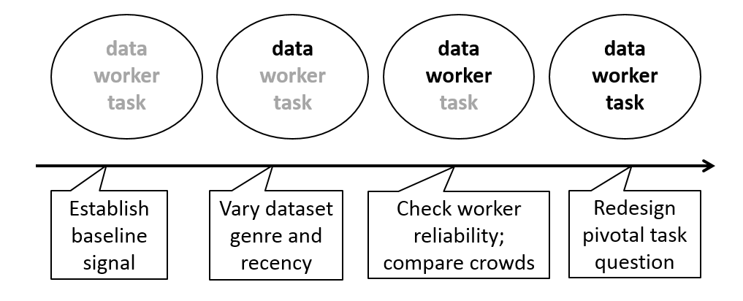
The main process is unchanged
Regardless if labeling is done by machines or humans
Three main components
Task design
HIT or prompt engineering
Data
Crowd
Human-based crowd or LLM-based crowd
Quality control
Debugging
 | Machine computation | Human computation
Design | Throw away | Reluctant to throw away
Testing | Systematic | Ad-hoc
Debugging | Programmer’s fault | Worker’s fault
J. Attenberg, P. Ipeirotis, F. Provost. “Beat the Machine: Challenging Humans to Find a Predictive Model’s ‘Unknown Unknowns’”. ACM JDIQ 2015

