Slide 1
Homework 1

Slide 2
Homework 2: Feynman
In 1979, Richard Feynman delivered four famous lectures on quantum electrodynamics at Auckland University.
Based on the four lectures, the book QED:
The Strange Theory of Light and Matter,
which presents a readable account of the theory of quantum electrodynamics for general audience, was published in 1985.
This video was the first of the four lectures.
Citation counts of QED:
The Strange Theory of Light and Matter
3296 citations from Google Scholar (2006 Edition)
800 citations from Semantic Scholar (1985 Edition)

Slide 3
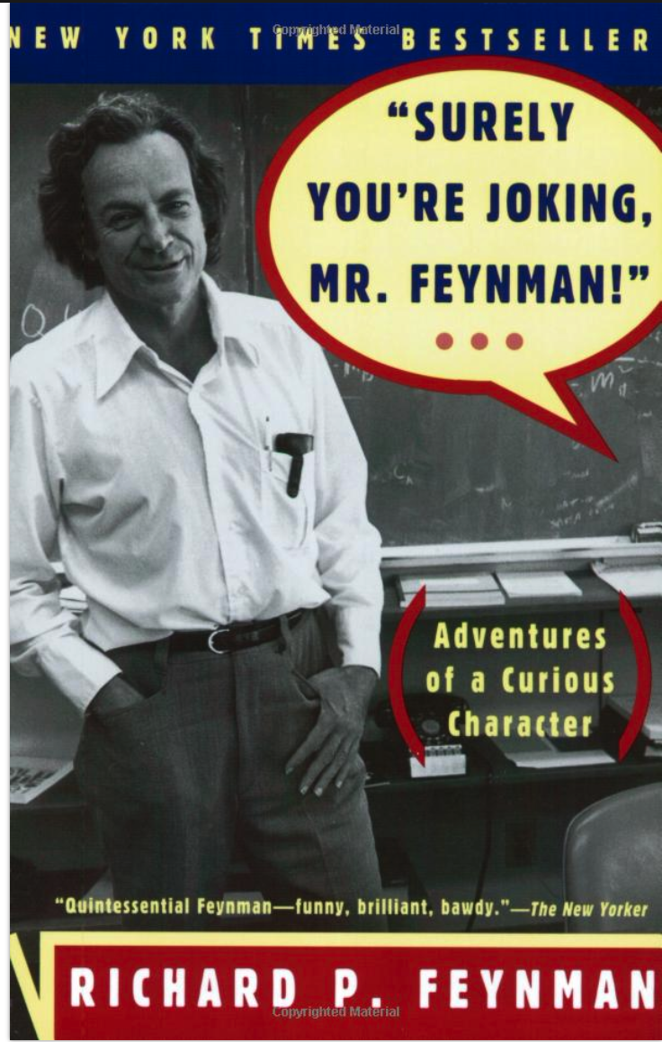
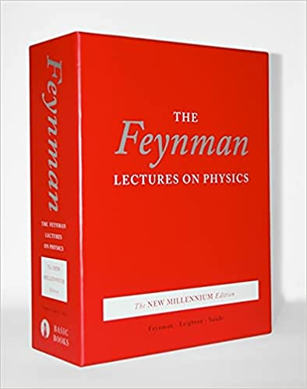
for general audience

Slide 4
Feynman
Although Richard Feynman was an extremely successful physicist worthy of a Nobel Prize,
one of his greatest accomplishments is the development of diagrams simple enough for the average person to comprehend quantum mechanics,
but without loss of information.
Combined with his humor and minimal use of highly technical terms, his presentation becomes more convincing and plausible.
Suddenly, quantum theory is not some mysterious and elusive idea anymore.

Slide 5
Hamming
“Those who cannot remember the past are condemned to repeat it”
history doesn’t repeat itself, but…
accepting that some problems are unsolvable
Learning to Learn
Importance of meta issues
Strategic Vision
Predictions: Physics vs. CS
Context: Hamming & Feynman
Healthy disrespect for authority

Slide 6
Citations: Our instructions are underspecified
Feynman
Hamming
Google Scholar: 3296
Semantic Scholar: 800
The Strange Theory of Light and Matter
3296 citations from Google Scholar (2006 Edition)
800 citations from Semantic Scholar (1985 Edition)
Google Scholar: 102
Semantic Scholar: 50

Slide 7
Hero Worship: Fads come and fads go
While there are great minds such as
Yoshua Bengio, Geoffrey Hinton, and Yann LeCun,
who have been deemed the “Godfathers of Artificial Intelligence”,
they are not the only ones who have significantly contributed to progress in this discipline.

Slide 8
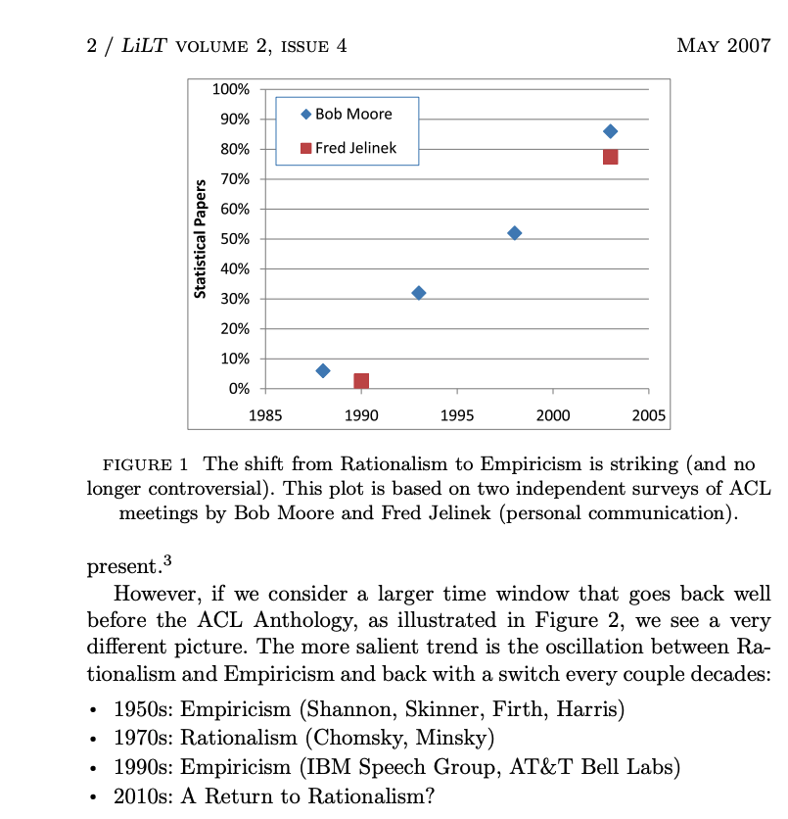
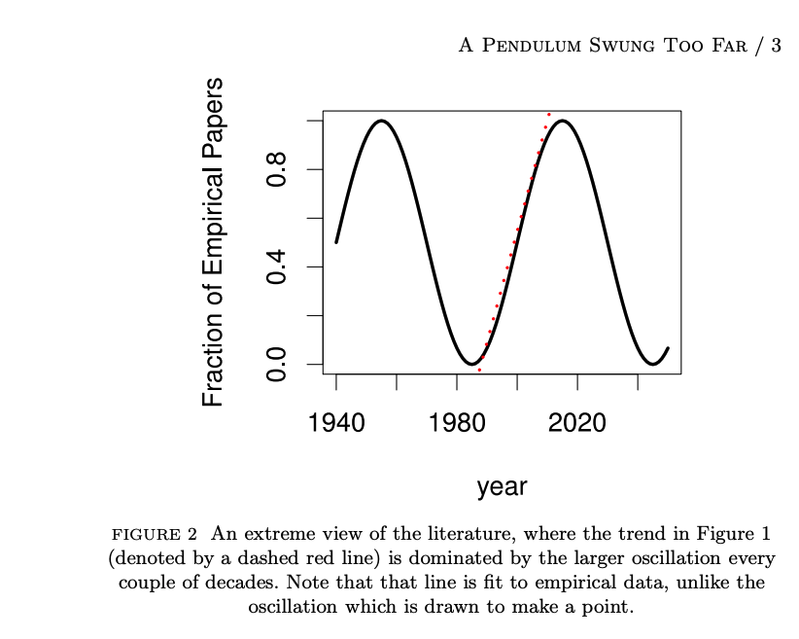
Pendulum Swung Too Far http://languagelog.ldc.upenn.edu/myl/ldc/swung-too-far.pdf

Slide 9
Meta-Issues
wave-particle duality
bureaucracy: pro & cons
implications for Navy
relevance to audience

Slide 10
Proposals

Slide 11
Two Questions
Do-able (painful)
Worth Doing (painless)
Evidence that you can deliver
on-time & on-budget
with available resources
Circumscribe problem
WordNet vs. Cyc
Identify Steps (Bottlenecks)
Goals, Metrics/Evaluation, Milestones
Timeline:
MVP (minimum viable product)
Midpoint evaluation
Final report
For-profit:
Business Case
Non-profit:
If successful, how will your project make the world a better place?

Slide 12
NSF Proposals
Summary
Need
Current Status
Approach
Intellectual Merit
Broader Impacts
NSF has a mandate to do more than just science
Education, Diversity, etc.

Slide 13
https://beta.nsf.gov/science-matters/nsf-101-five-tips-your-broader-impacts-statement
How does your research impact society?
Scientists and engineers funded by the U.S. National Science Foundation are
accountable to taxpayers for conducting research,
and collectively moving their research beyond the lab to impact the public good,
thereby benefitting the economy, society and discovery itself.
This is what NSF defines as "Broader Impacts."

Slide 14
https://beta.nsf.gov/science-matters/nsf-101-five-tips-your-broader-impacts-statement
Full participation of women, persons with disabilities and underrepresented minorities in STEM.
Improved STEM education and educator development at any level.
Increased public scientific literacy and public engagement with science and technology.
Improved well-being of individuals in society.
Development of a diverse, globally competitive STEM workforce.
Increased partnerships between academia, industry and others.
Improved national security.
Increased economic competitiveness of the U.S.
Enhanced infrastructure for research and education.

Slide 15
Project Suggestions

Slide 16
Enterprise Search
Omar’s pitch on the 1st class
People in industry (usually) don’t talk about stuff they are really working on
But there is more talk than you might expect
https://www.amazon.com/Regional-Advantage-Culture-Competition-Silicon/dp/0674753402
Enterprise Search: Some history of failures
https://en.wikipedia.org/wiki/Google_Search_Appliance
Enterprise search is harder than web search because of network effects
https://en.wikipedia.org/wiki/Metcalfe%27s_law
When benefits scale with edges (links between pages)
and costs scale with nodes (web pages)
then rich get richer (easier to find good stuff in larger graphs than smaller graphs)
(There are more links to good stuff in larger graphs)

Slide 17
Conference Automation
Routing of submissions to reviewers
https://blog.allenai.org/conference-peer-review-with-the-semantic-scholar-api-24ab9fce2324
Current status:
Many venues use routing tools:
https://openreview.net/
https://easychair.org/
https://www.softconf.com/
https://cmt3.research.microsoft.com/
Not clear these tools are safe and effective (better than manual routing)
Tools are too hard for program committees (see blog above)

Slide 18
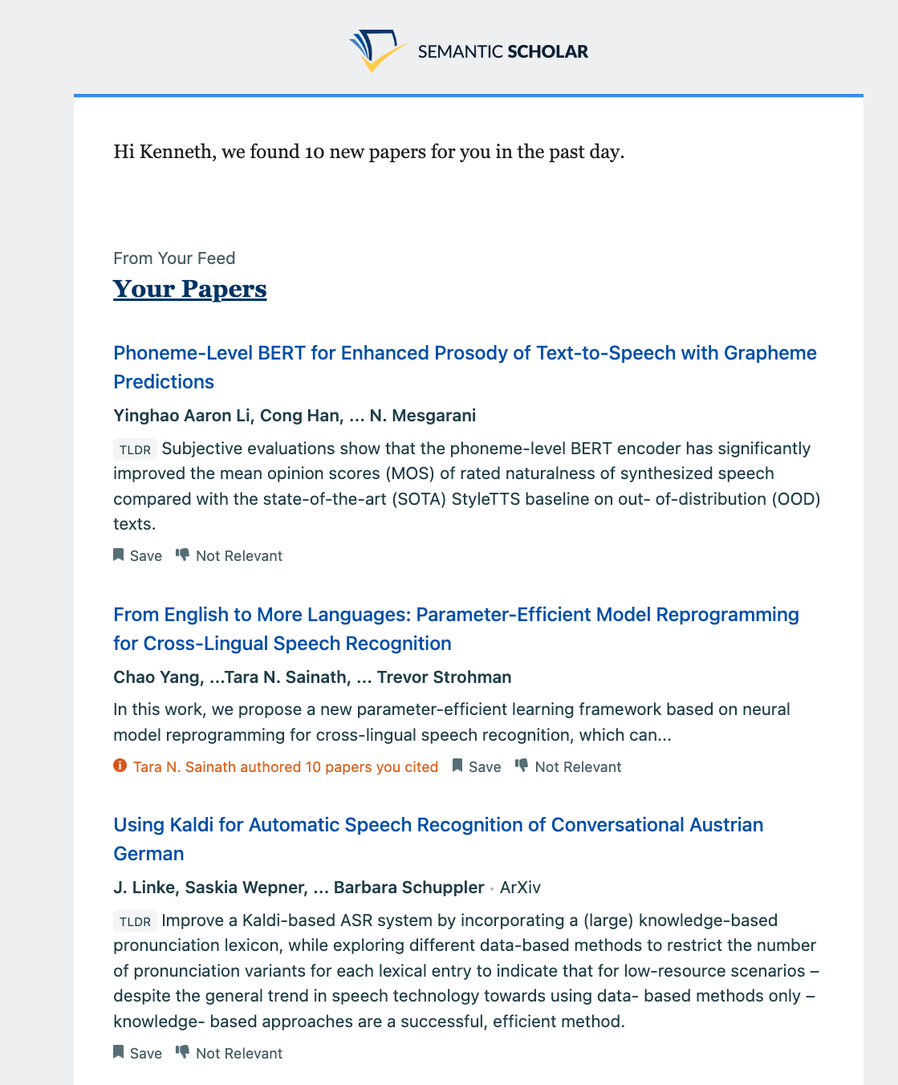
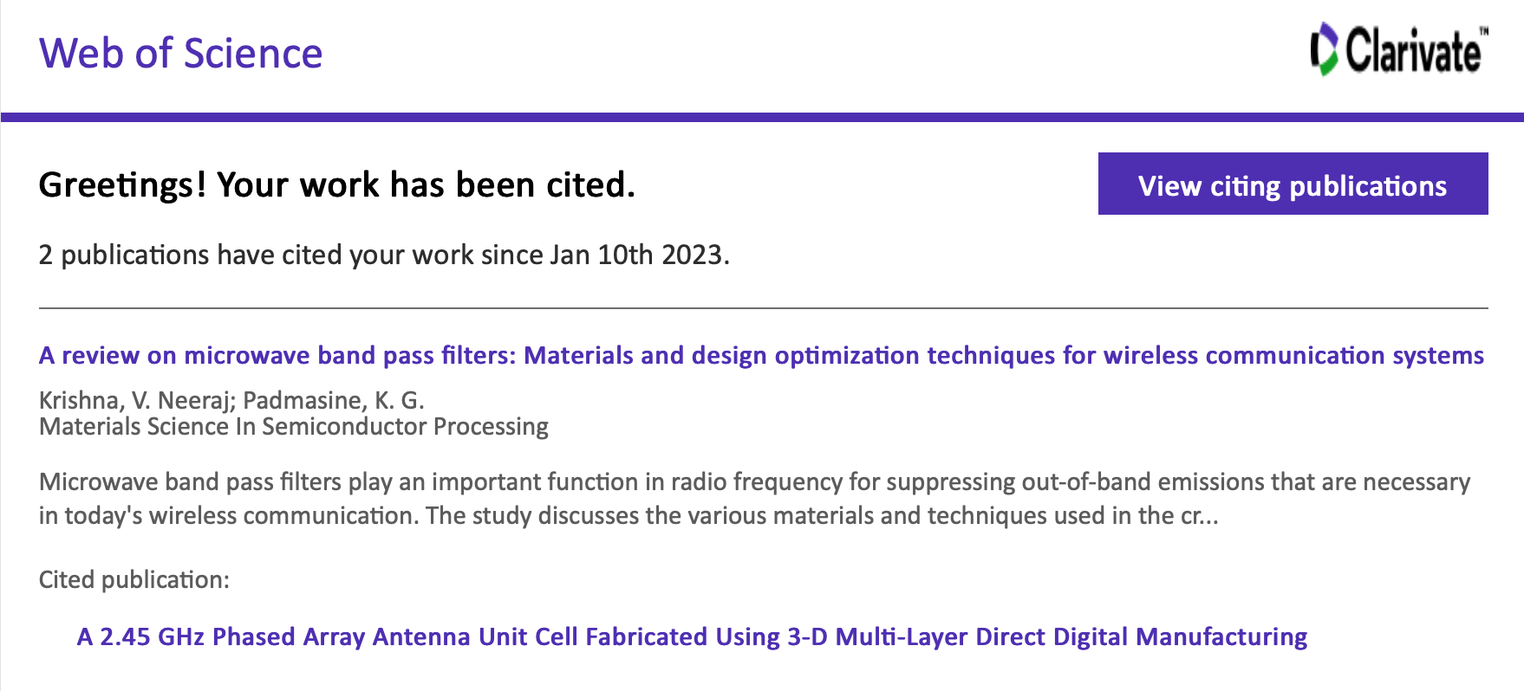
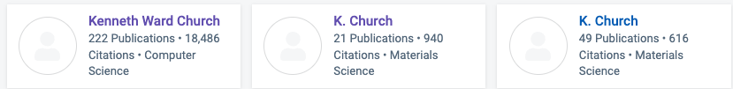
Recommender Systems
I regularly receive spam suggestions
Rarely credible
At best, recommendations are
recent,
buzz-word compliant
but not credible
Credible (Seminal) >> Recent
Not useful/credible
(18k over 50 years >> 2/week)
Semantic Scholar

Slide 19
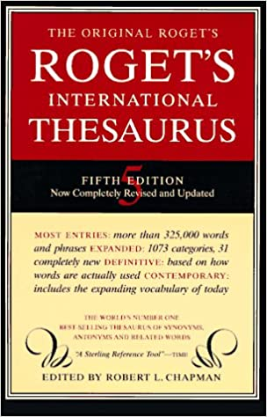
Thesaurus → Deep Nets (ChatGPT)
Good writers use resources
Dictionaries, Thesauruses, etc.
Active vocab << Passive vocab
Hard to find the right word,
But easier when prompted
(Especially in 2nd language)
So too, there may be a role for deep nets
https://www.npr.org/2023/01/24/1151160196/how-to-stop-worrying-and-love-or-at-least-live-with-chatgpt
Deep nets are better on fluency than truth
https://www.cambridge.org/core/journals/natural-language-engineering/article/gpt3-whats-it-good-for/0E05CFE68A7AC8BF794C8ECBE28AA990
“Unreliable doesn’t mean useless”

Slide 20
Nanny Cameras for Young and Old
In China, massive migration from rural areas to cities
Cities are not designed for families
Workers move to cities, and leave children with their parents in rural areas
Children miss their parents (might see them just once a year at New Year)
Workers can do 30 minutes of homework per day before calling home
Can we summarize a day of video down to 30 minutes?
In much of the world, seniors are living alone, far from their children
Children would like to know that their parents are ok
If parents fall, or need help, could nanny cam take appropriate action
No need for wake-up words
My father couldn’t remember ``Alexa’’
If he fell, he wouldn’t think to ask for help (because that wasn’t a thing in his day)

Slide 21
Where is my phone? My kid? My father?
Where did I leave my keys?
Where are my eyeglasses?
You shouldn’t need your eyeglasses to find your eyeglasses…
Where is that book I was reading a few years ago?

Slide 22
Where did my day go?
Can you help me be more productive?
Time and motion study of my life
https://en.wikipedia.org/wiki/MyLifeBits

Slide 23
Workflow
Example scenario: Access to medical expertise
Better hospitals in urban areas than rural areas in China (and everywhere)
Medical expertise tends to be concentrated near top medical schools
Biopsies from rural areas are digitized and sent to experts
No need for expertise to be physically near patients
Traditionally, Amazon Mechanical Turk is used for low-skill tasks
Is there a Human-in-the-Loop opportunity for high-skill task?
If so, can we log workflows to collect data for machine learning?
Can we create exchanges like Ad exchange, Futures exchange (FTX)
https://en.wikipedia.org/wiki/Ad_exchange

Slide 24
BOTUS https://www.npr.org/transcripts/522897876
Today on the show PLANET MONEY builds a robot,
a bot to trade stocks with real money.
The official Twitter handle, yeah. BOTUS, bot of the United States.
Task
Input: Trump Tweets
Output: Trades
Technologies
Crawl tweets
Filter for Trump tweets
Sentiment analysis
Tweet → Buy / Sell
Named Entity Recognition (NER)
Tweet → Stock
Spoiler Alert:
They lost $$

Slide 25
HuggingFace Tutorials
Sentiment Analysis
https://huggingface.co/blog/sentiment-analysis-python
Named Entity Recognition (NER)
https://huggingface.co/dslim/bert-base-NER
https://huggingface.co/course/chapter7/2
General Fine-Tuning (GFT)
https://github.com/kwchurch/gft

Slide 26
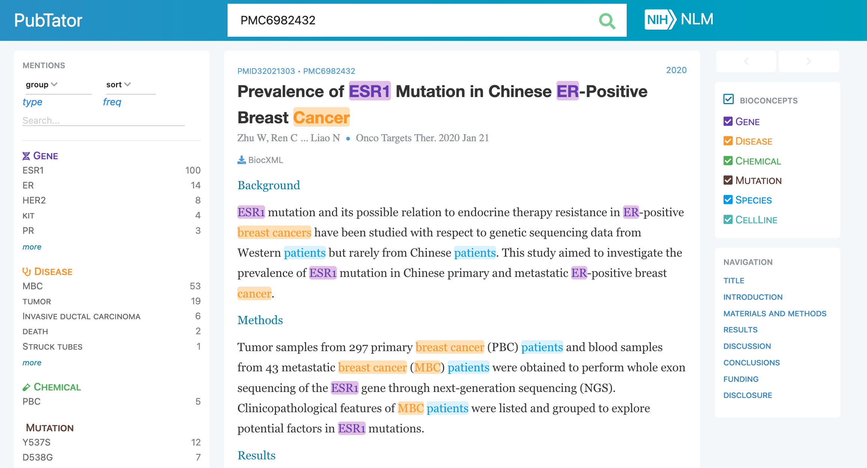
PubTator https://www.ncbi.nlm.nih.gov/research/pubtator/?view=docsum&query=PMC6982432

Slide 27
Medical Resources
PubTator: Abstracts (papers) with annotations (entities)
https://www.ncbi.nlm.nih.gov/research/pubtator/?view=docsum&query=PMC6982432
Pubmed: Abstracts (papers) with annotations (MeSH)
https://www.ncbi.nlm.nih.gov/mesh/
MeSH: Medical Subject Headings (Ontology / Knowledge Graph)
https://www.ncbi.nlm.nih.gov/mesh/

Slide 28
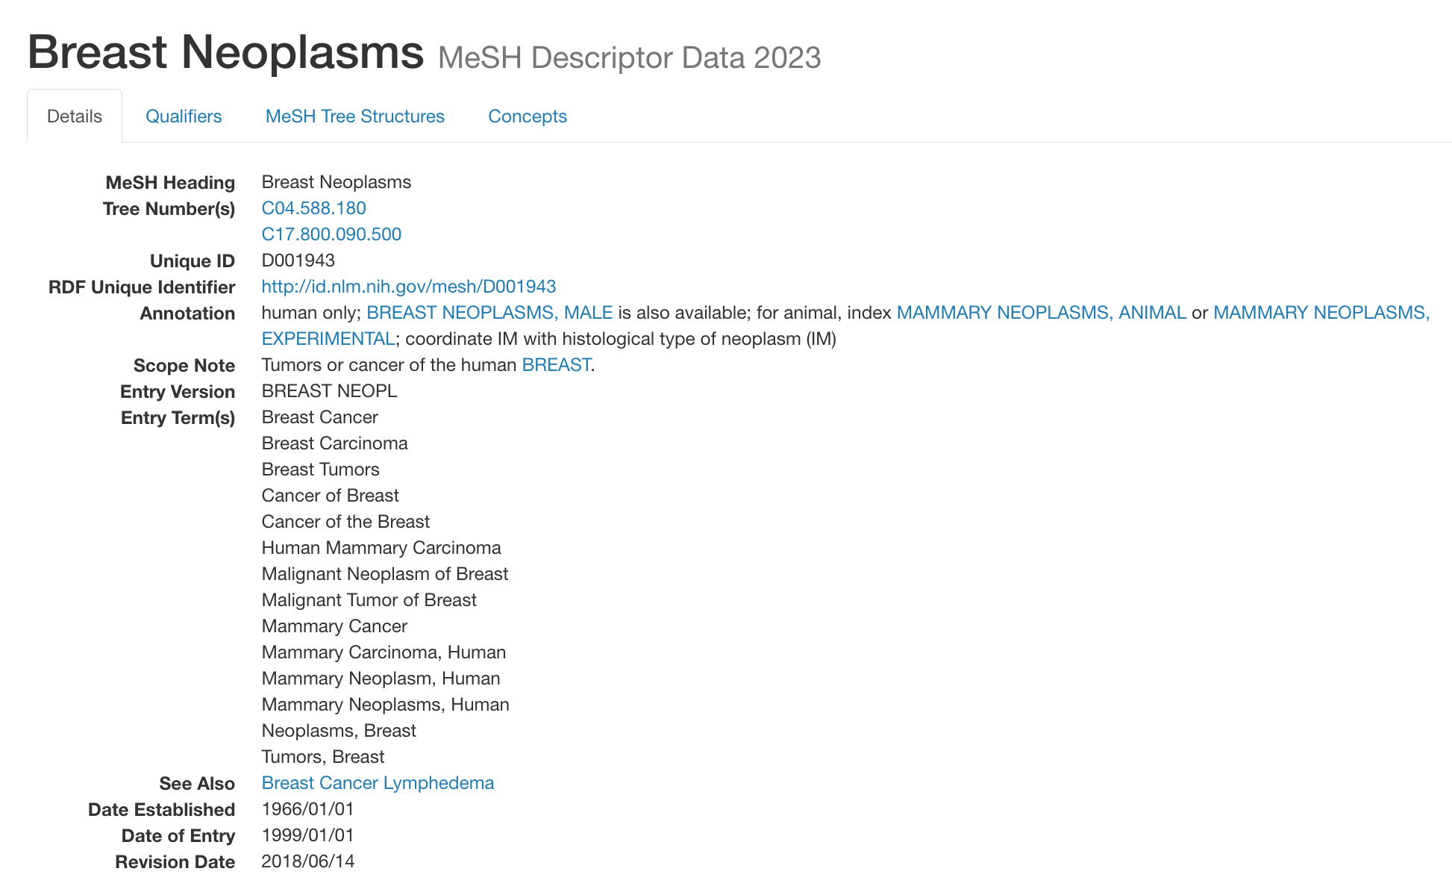
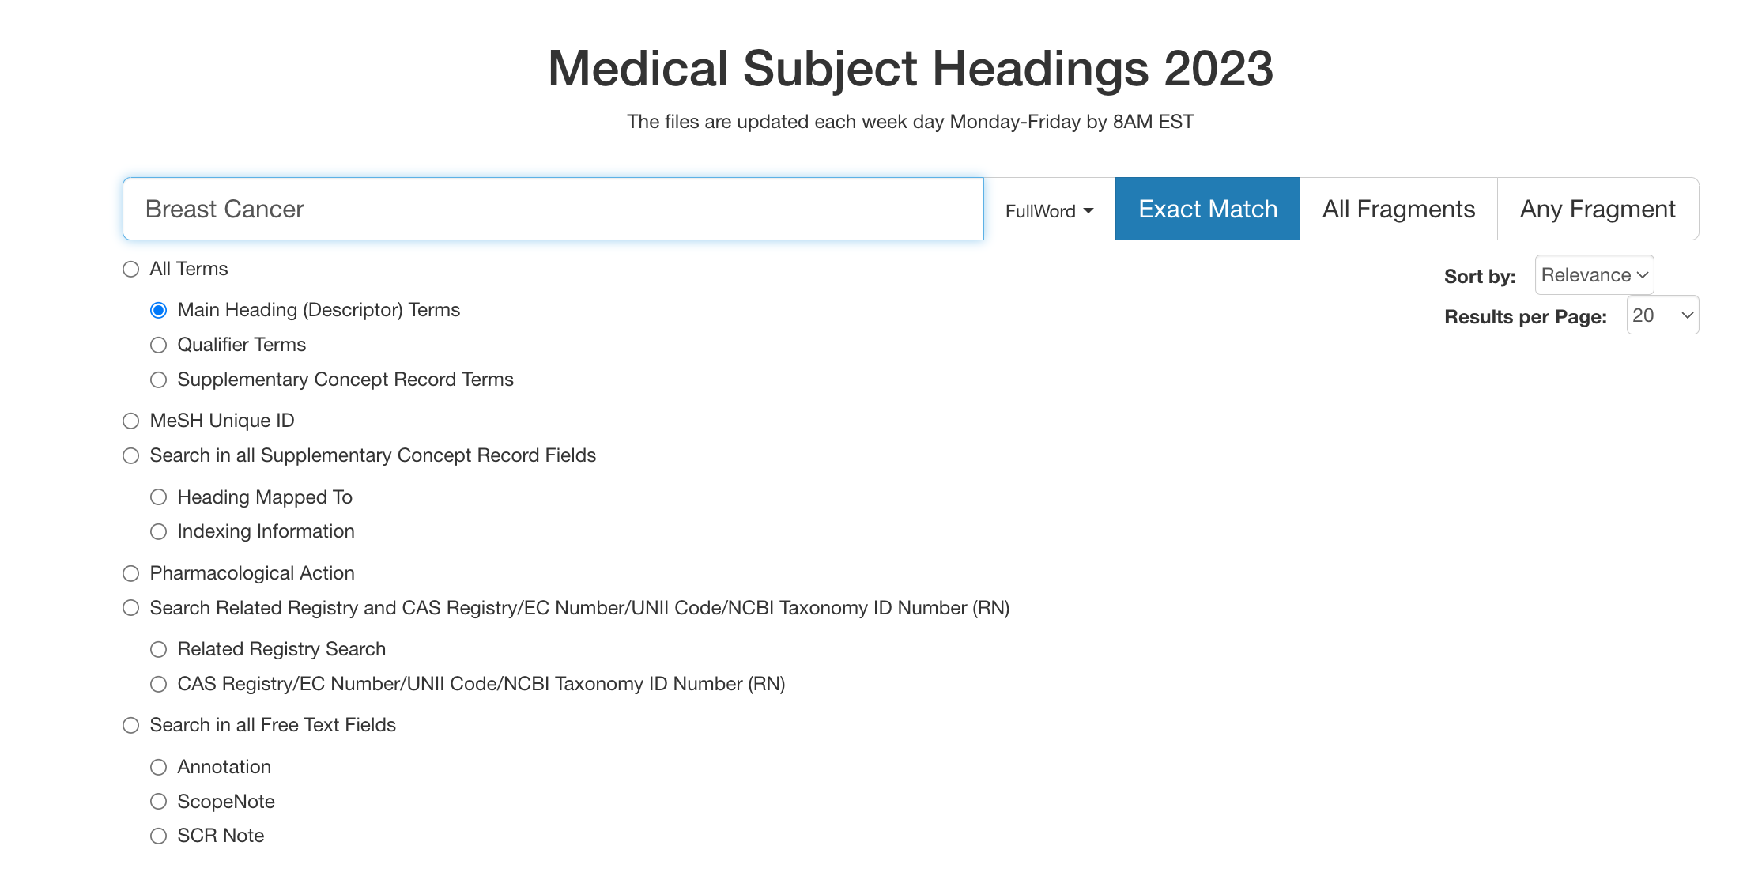
MeSH
https://meshb.nlm.nih.gov/search
https://meshb.nlm.nih.gov/record/ui?ui=D001943

Slide 29
Many start-up companies in this space
Use cases
Personalized medicine:
Many rare diseases
Literature is large (and growing quickly)
Doctors can’t keep up
Opportunity to help doctors find papers relevant to patient
Bloomberg-terminal for drug companies
Electronic Health Records
Map records to codes (for insurance purposes)
Maximize bills (for doctors)
Minimize bills (for insurance companies)

Slide 30
Wikipedia search
Can we improve Wikipedia search?
What would be an alternative to 10-blue links for Wikipedia?
https://en.wikipedia.org/wiki/Wikipedia:Database_download

Slide 31
Q&A systems
Question-answering system exist from the early days.
Quora, StackOverflow, etc.
ChatGPT is a new incarnation
What to do when there are potentially alternative answers?
How to organize non-factoid answers

Slide 32
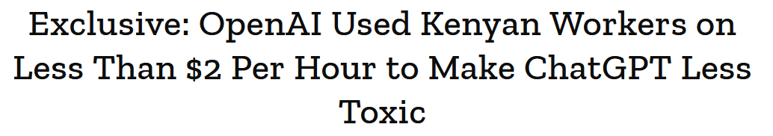
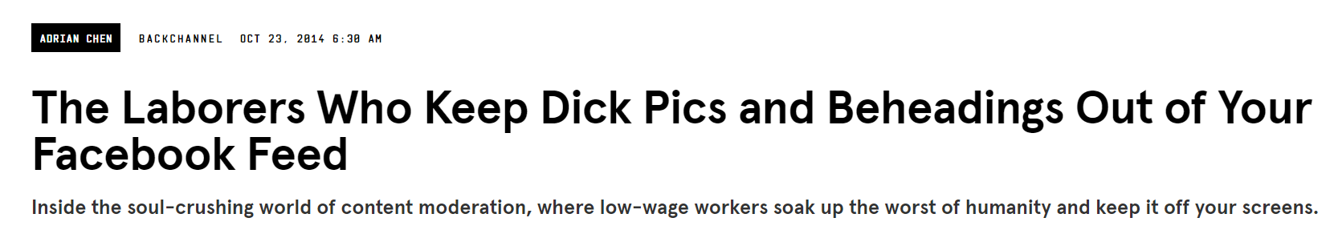
Labeling
Ground truth is a key component of ML projects
Current tools like Mechanical Turk are somewhat primitive
Are there new alternatives for content moderation tasks?
Further reading
https://www.wired.com/2014/10/content-moderation/
https://time.com/6247678/openai-chatgpt-kenya-workers/

Slide 33

Reddit
Lots of interesting content on Reddit
Not well organized and not easy to find
Perception that Google’s search is not as good as it used to be
How would you organize Reddit data for better access?
https://dkb.io/post/google-search-is-dying
https://paperswithcode.com/dataset/reddit

