Slide 1
CS6120
Jiaji Huang
https://jiaji-huang.github.io

Slide 2
About myself
PhD in electrical engineering from Duke University
Thesis: statistical signal processing and machine learning
Worked at Baidu Research on NLP and Speech
Now at AWS, on Large Language Models

Slide 3
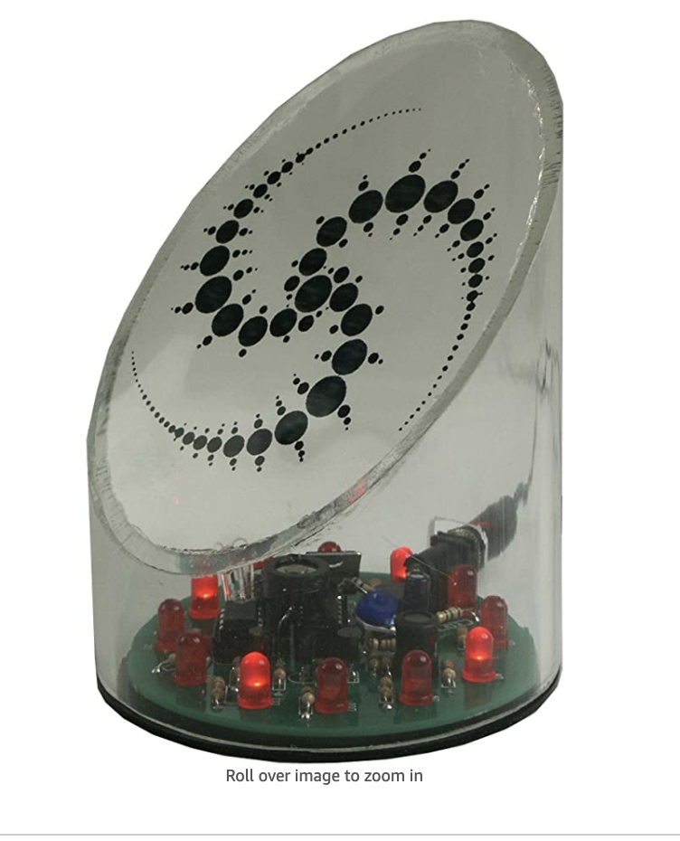
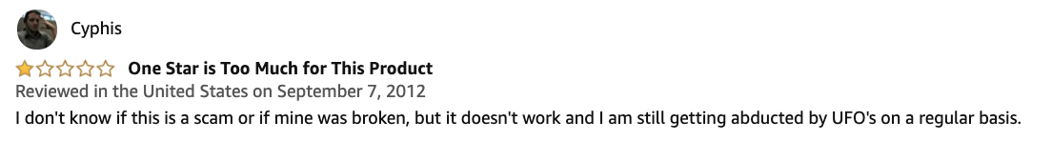

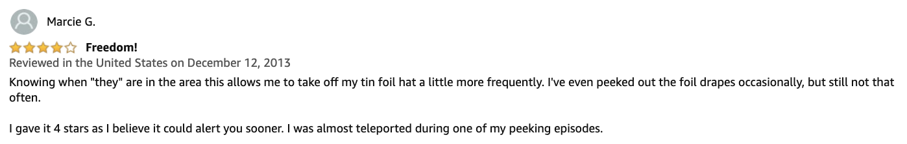
Motivating Task: Positive or Negative Reivew?

Slide 4

A Machine Learning Approach
Feature extraction
0.5
-1.2
2.5
👍
1.8
2.2
-2.0
⋮
⋮
classifier
⋮
👎
documents
Representations

Slide 5
Roadmap
Document representation
Bag of words
tf-idf
Word representation
Word2vec and PMI
Applications
Classifier
Naïve Bayesian classifier
Softmax classifier

Slide 6
Roadmap
Document representation
Bag of words
tf-idf
Word representation
Word2vec and PMI
Applications
Classifier
Naïve Bayesian classifier
Softmax classifier

Slide 7
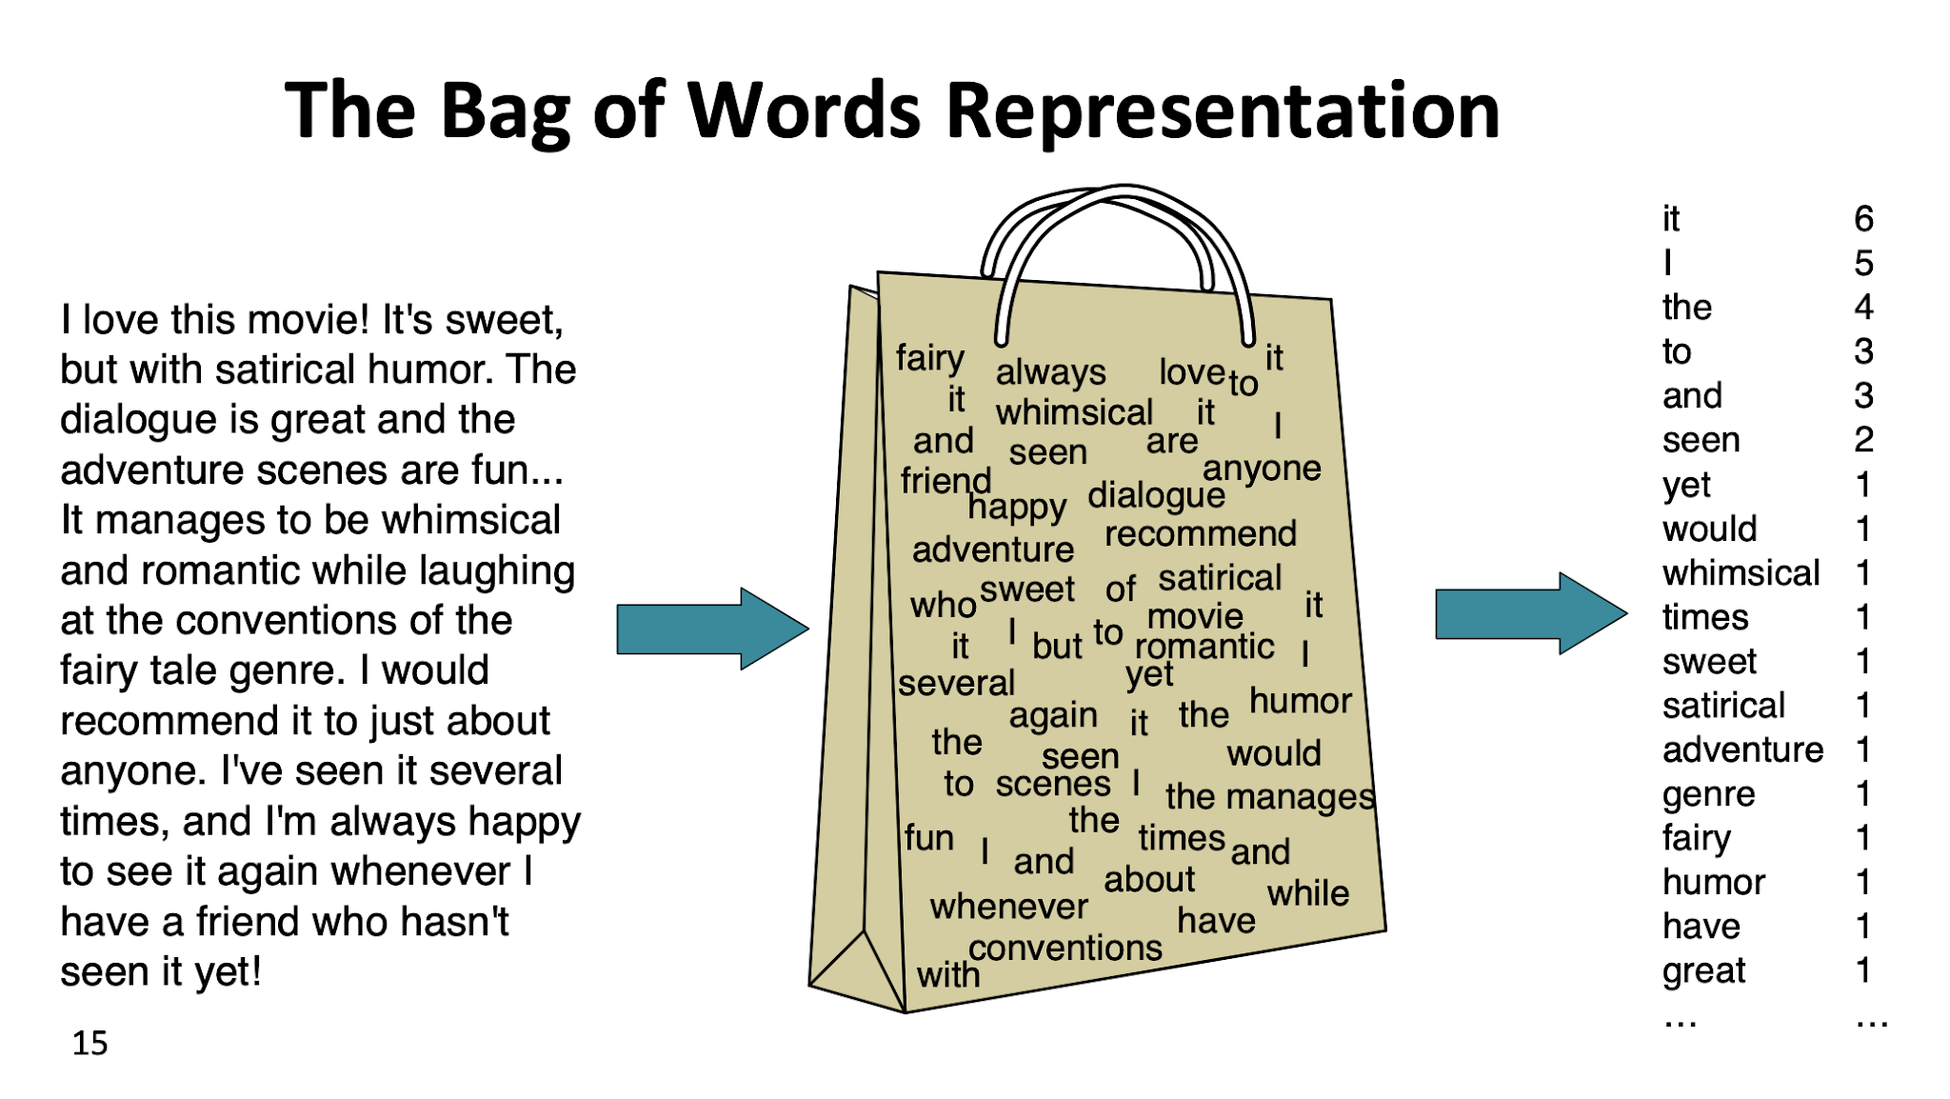
https://web.stanford.edu/~jurafsky/slp3/slides/7_NB.pdf

Slide 8
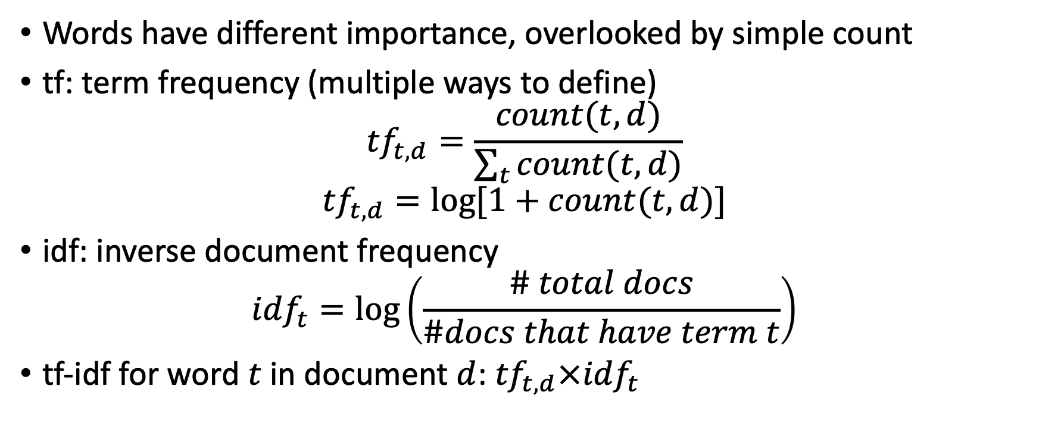
tf-idf
Words have different importance, overlooked by simple count
tf: term frequency (multiple ways to define)
$${tf}_{t,d}=\frac{count(t,d)}{\sum_{t}{count(t,d)}}$$
$${tf}_{t,d}=\log{[1+count(t,d)]}$$
idf: inverse document frequency
$${idf}_{t}=\log\left(\frac{\# total docs}{\#docs that have term t}\right)$$
tf-idf for word $t$ in document $d$: ${tf}_{t,d}×{idf}_{t}$

Slide 9
Example

Slide 10
Brain storming
Ways to improve bag of words representation?
Word order information: counts of tuple of n words (n-gram)
For “new” word: sub-word counts
More efficient: dimension reduction, PCA etc…
…

Slide 11
Roadmap
Document representation
Bag of words
tf-idf
Word representation
Word2vec and PMI
Applications
Classifier
Naïve Bayesian classifier
Softmax classifier

Slide 12
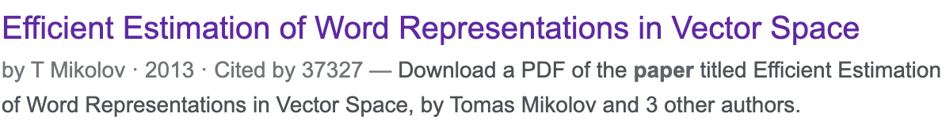
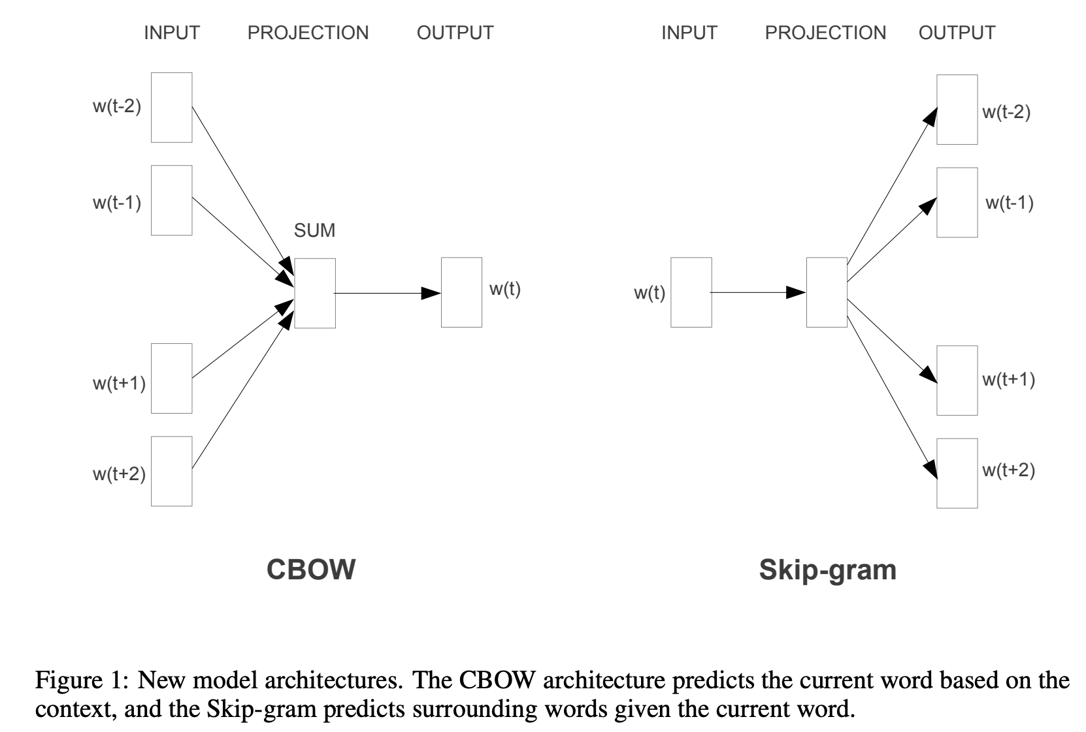
word2vec

Slide 13
How it works
Word2vec software
Show a demo …

Slide 14
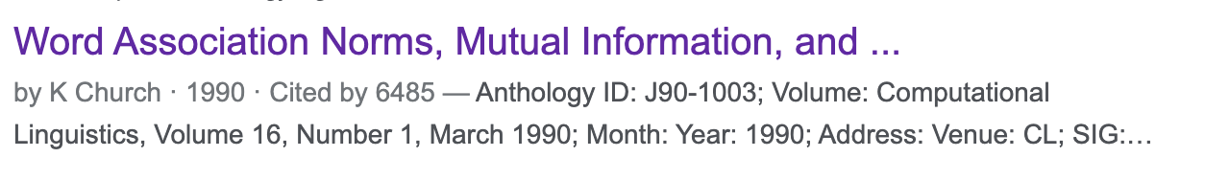
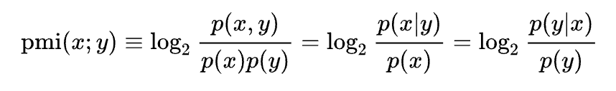
PMI
The PMI (point wise mutual information) between two words x, y
Practically: How associated are two words?

Slide 15
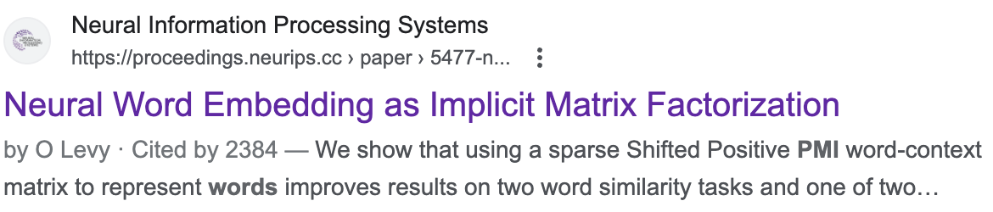
Connections
Do some math on whiteboard …

Slide 16
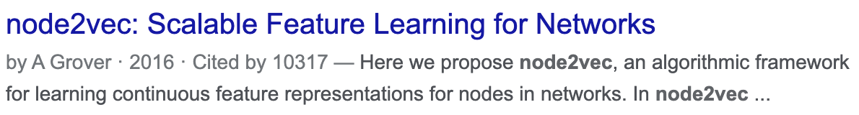
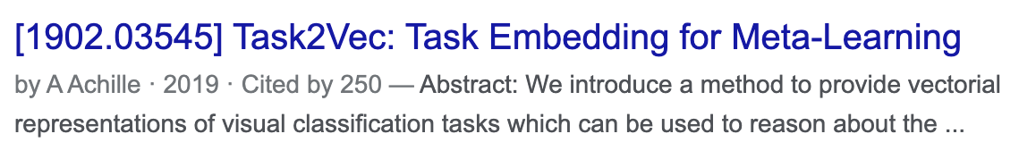

Generalize: *2vec
Create pairwise associations between entities, call it matrix $M$
Then factorize $M$!

Slide 17
Application: Word Analogy

Slide 18
Application: Bilingual Lexicon Induction (BLI)

Slide 19
More cools things about BLI …
Unsupervised Machine Translation

Slide 20
Connection with BERT

Slide 21
Roadmap
Document representation
Bag of words
tf-idf
Word representation
Word2vec and PMI
Applications
Classifier
Naïve Bayesian classifier
Softmax classifier

Slide 22
Naïve Bayesian Classifier
Switching to slides last year …

Slide 23
Softmax classifer

Slide 24
Brain storming …
Strength and weakness of Naïve Bayesian v.s. softmax

