Slide 1
Abstracts
1/23/2024

Slide 2
Say everything three times
Talks
Abstracts
Say what you will say (promise)
Say it (connect the dots)
Say what you said (delivery)
Lead Sentence
Body
Conclusion

Slide 3
Part of Speech Tagging (1988) https://aclanthology.org/A88-1019.pdf
Lead
A program that tags each word in an input sentence with the most likely part of speech has been written.
Body
The program uses a linear-time dynamic programming algorithm to find an assignment of parts of speech to words that optimizes the product of (a) lexical probabilities (probability of observing part of speech i given word i) and (b) contextual probabilities (probability of observing part of speech i given n following parts of speech).
Conclusion
Program performance is encouraging; a 400-word sample is presented and is judged to be 99.5% correct

Slide 4
BERT: Pre-training of Deep Bidirectional Transformers for Language Understanding https://aclanthology.org/N19-1423.pdf
Lead
We introduce a new language representation model called BERT,
which stands for Bidirectional Encoder Representations from Transformers.
Body
Unlike recent language representation models (Peters et al., 2018a; Radford et al., 2018), BERT is designed to pretrain deep bidirectional representations from unlabeled text by jointly conditioning on both left and right context in all layers. As a result, the pre-trained BERT model can be finetuned with just one additional output layer to create state-of-the-art models for a wide range of tasks, such as question answering and language inference, without substantial taskspecific architecture modifications. BERT is conceptually simple and empirically powerful.
Conclusion
It obtains new state-of-the-art results on eleven natural language processing tasks,
including pushing the GLUE score to 80.5% (7.7% point absolute improvement),
MultiNLI accuracy to 86.7% (4.6% absolute improvement),
SQuAD v1.1 question answering Test F1 to 93.2 (1.5 point absolute improvement) and
SQuAD v2.0 Test F1 to 83.1 (5.1 point absolute improvement).

Slide 5
Techniques for Automatically Correcting Words in Text https://dl.acm.org/doi/pdf/10.1145/146370.146380
Lead
Research aimed at correcting words in text has focused on three progressively more difficult problems:
(1) nonword error detection;
(2) isolated-word error correction; and
(3) context-dependent word correction.
Body
In response to the first problem, efficient pattern-matching and n-gram analysis techniques have been developed for detecting strings that do not appear in a given word list.
In response to the second problem, a variety of general and application-specific spelling correction techniques have been developed. Some of them were based on detailed studies of spelling error patterns.
In response to the third problem, a few experiments using natural-language-processing tools or statistical-language models have been carried out.
Conclusion
This article surveys documented findings on spelling error patterns,
provides descriptions of various nonword detection and isolated-word error correction techniques,
reviews the state of the art of context-dependent word correction techniques, and
discusses research issues related to all three areas of automatic error correction in text.

Slide 6
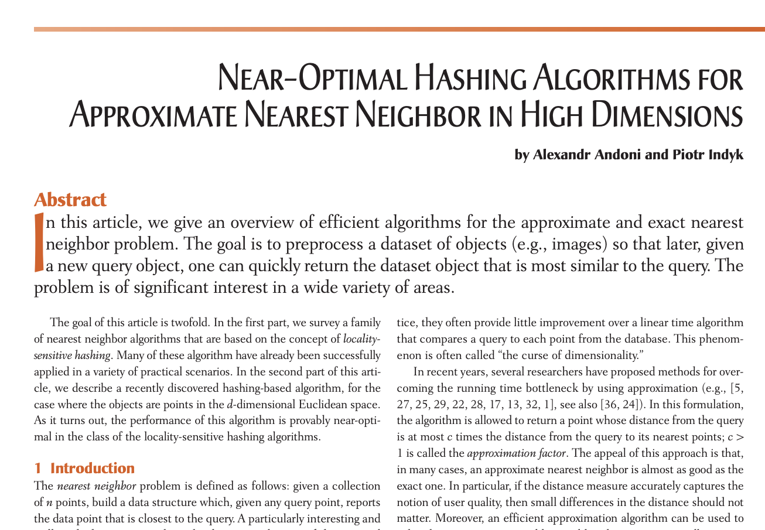

https://people.csail.mit.edu/indyk/p117-andoni.pdf

Slide 7
Not-so-great leads
Such and such is an important problem
Restate the title:
This survey will survey such-and-such paper
Introduce some irrelevant background material
(failing to advance the main point)
Assumption: there should be one (and only one) main point

