Slide 1
Feb 9
Kenneth Church

Slide 2
Links on Reviewing
Example of open review
https://openreview.net/forum?id=fsacLLU35V&noteId=0YZBFu5GSG
Reviewing the reviewers:
https://aclanthology.org/J05-4006/
https://www.cambridge.org/core/journals/natural-language-engineering/article/emerging-trends-reviewing-the-reviewers-again/10CDC1D71E1AEB21456CFBDA187CBCB6
https://www.cambridge.org/core/journals/natural-language-engineering/article/emerging-trends-sotachasing/5E9F9F796159040973053C52C443C1D6
https://blog.neurips.cc/2021/12/08/the-neurips-2021-consistency-experiment/

Slide 3

Page Rank
Fun Facts
Ellen Spertus [Spe97]
https://ellenspertus.com/
Rejected by SIGIR
Highly cited
PageRank 17,540 citations
But not the first
[Kle98] 11,406 citations
Why so many citations?
Google was successful
Widely believed (incorrectly) that PageRank was the secret sauce

Slide 4
Scale
It is often said that web crawls are the largest …
Actually,
for a healthy ecosystem,
the market maker [Google] wants lots of engagement
from all parties, including
readers, writers, advertisers, etc.
with more readers than writers
Consequently,
query logs >> web crawls
How big is big?
1998: PageRank (section 2.2)
150M nodes (pages)
1.7B edges (links)
2022: Semantic Scholar
200M nodes (papers)
2B edges (citations)
Easy to download

Slide 5
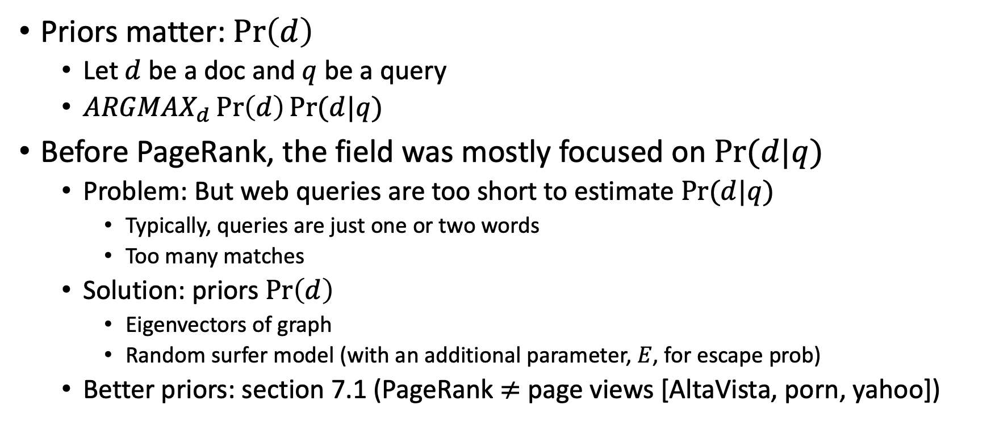
PageRank (aka, Static Rank [Microsoft Terminology])
Priors matter: $\operatorname{Pr}\left(d\right)$
Let $d$ be a doc and $q$ be a query
${ARGMAX}_{d}\operatorname{Pr}\left(d\right)Pr⁡(d|q)$
Before PageRank, the field was mostly focused on $Pr⁡(d|q)$
Problem: But web queries are too short to estimate $Pr⁡(d|q)$
Typically, queries are just one or two words
Too many matches
Solution: priors $\operatorname{Pr}\left(d\right)$
Eigenvectors of graph
Random surfer model (with an additional parameter, $E$, for escape prob)
Better priors: section 7.1 (PageRank $≠$ page views [AltaVista, porn, yahoo])

Slide 6
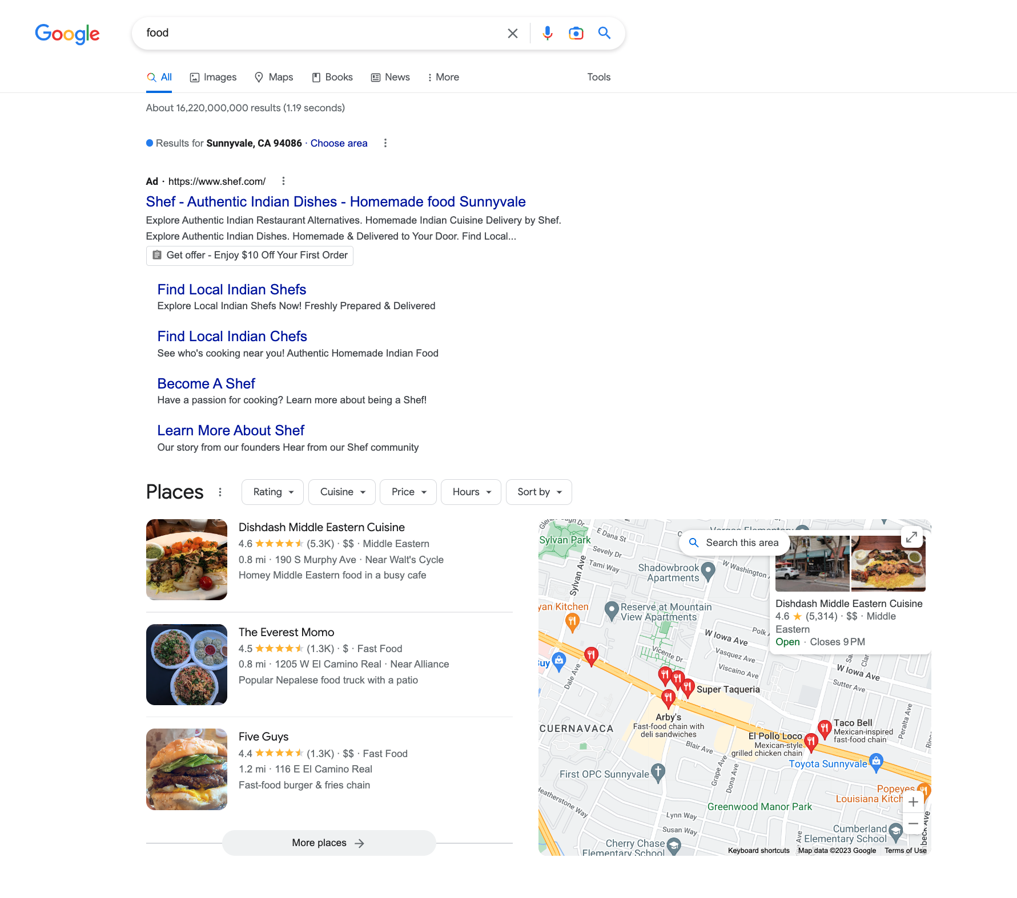
Too many matches Query: food → 16,220,000,000 matches

Slide 7
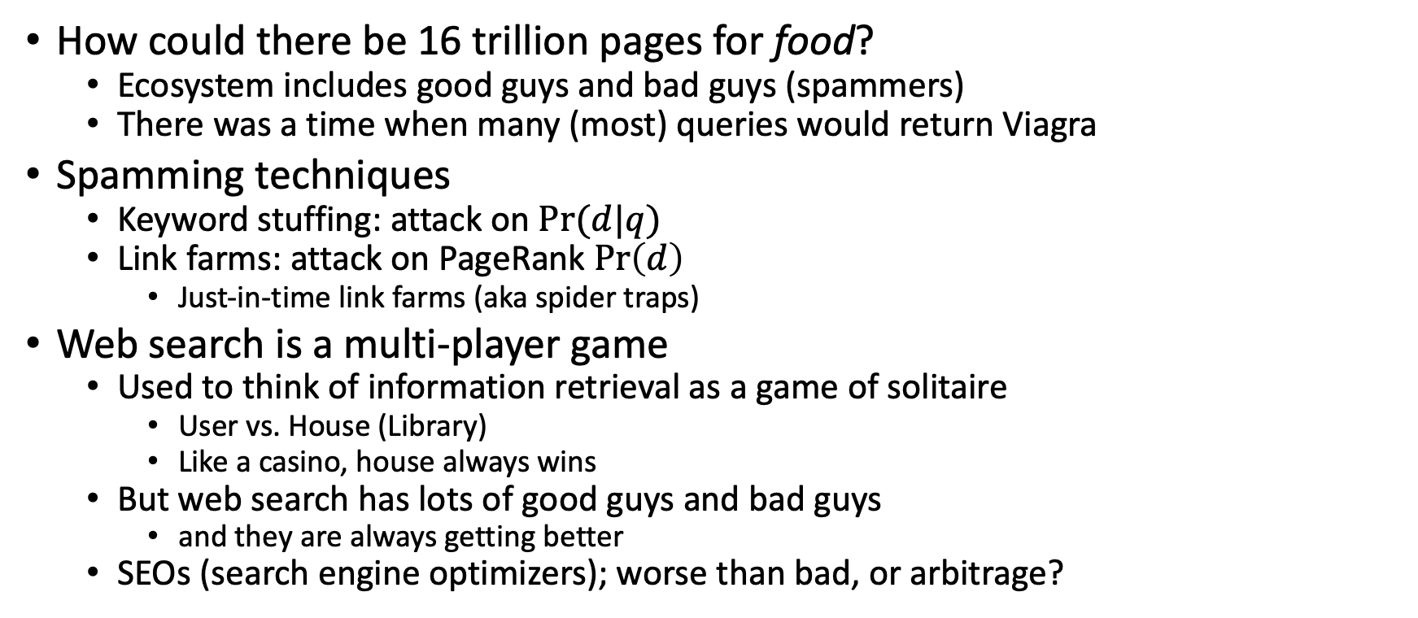
Adversaries: Web Spam
How could there be 16 trillion pages for food?
Ecosystem includes good guys and bad guys (spammers)
There was a time when many (most) queries would return Viagra
Spamming techniques
Keyword stuffing: attack on $Pr⁡(d|q)$
Link farms: attack on PageRank $\operatorname{Pr}\left(d\right)$
Just-in-time link farms (aka spider traps)
Web search is a multi-player game
Used to think of information retrieval as a game of solitaire
User vs. House (Library)
Like a casino, house always wins
But web search has lots of good guys and bad guys
and they are always getting better
SEOs (search engine optimizers); worse than bad, or arbitrage?

Slide 8
Criticism should be constructive
3. List at least three points of improvement. ● Some of the diagrams or tables could be more clear ● Share the code repository (reproducibility) ● Could expand the relevant work more.
SIGIR rejection focused on lack of evaluation
Prioritize opportunities for improvement
Actually, this paper is very clear
But even so, clarity should be the last complaint, not the first
(unless clarity is a show-stopper)
Github didn’t exist in 1998
PageRank was revolutionary at the time
Many papers cite PageRank now, but there wasn’t much to cite then

Slide 9
PageRank (Eigenvectors) are ``somewhat conventional’’ now
At the time, Salton’s Vector Space model was
all about matching pages of words
with no discussion of links between docs
and little thinking about graphs and/or Eigenvectors

Slide 10
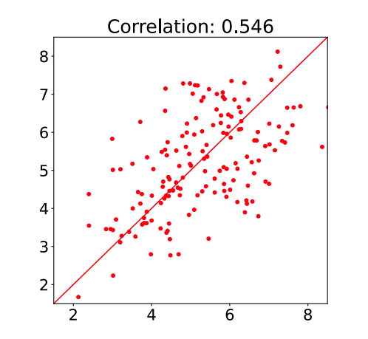
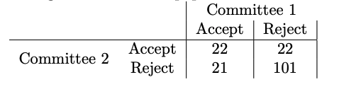
Blog had a pointer to https://arxiv.org/abs/2109.09774 Inconsistency in Conference Peer Review: Revisiting the 2014 NeurIPS Experiment
Table 1: Table showing the results from the two committees as a confusion matrix. Four papers were rejected or withdrawn without review resulting in a final of 166 papers.
Figure 2: Correlation between mean calibrated reviewer scores per paper across the two independent committees. Standard error on the correlation for n = 166 papers and Gaussian assumptions is sr = 0.065.

Slide 11
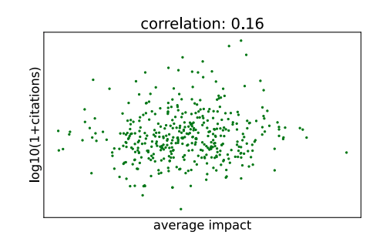
Is reviewing a leading indicator of citations?
Figure 5: Scatter plot of the citation impact
(defined as log10(1+ citations))
against the average impact score for accepted NeurIPS 2014 papers.
As in Figure 4, data is corrupted for plotting by differentially private noise.
The scatter plot is to show the general shape of the points,
validating our use of Pearson’s correlation coefficient, ρ.
Correlation is 0.16 ± 0.049 giving a statistically significant result.

Slide 12
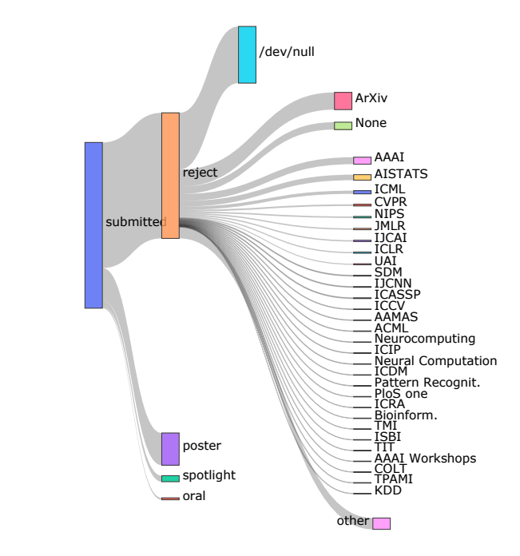
7 Fate of Rejected Papers

Slide 13
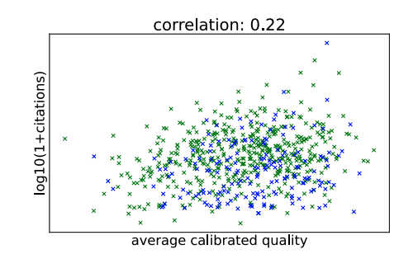
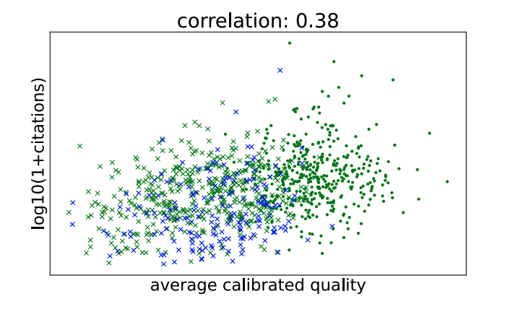
Citations of papers rejected from NIPS-2014
weak correlation between reviews (quality) and citations
Appendix G we plot rejected papers and accepted papers together (Figure 24).
Among the rejected papers are papers which received hundreds and thousands of citations.
The most highly cited rejected paper has more citations than all but two of the accepted papers.
Green: Published Elsewhere
Cross: Rejected

Slide 14
Conclusions:
Revisited the 2014 NeurIPS Experiment
~25% of decisions were inconsistent between the two committees.
Reaction to the experiment in the community focused on
a statistic we call the accept precision.
percentage of presented papers that would have been the same through an independently rerun version of the same reviewing process.
Our analysis has shown this statistic to be unreliable,
where a headline figure of 50% has been presented,
the Bayesian analysis in Appendix E.1 suggests that the actual figure is somewhere between 38% and 62%.

Slide 15
More conclusions
Consistency does not mean correctness
We therefore explored the extent to which
the reviewer quality scores are predictive of eventual paper impact (citations)
Finally, we followed up the fate of papers that were rejected from the conference.
Many rejected papers are published soon after the NeurIPS conference in other high quality venues.
We found that there was weak correlation between rejected papers’ citation impact and their quality scores,
suggesting that reviewers are better at judging which papers are weak, in terms of citation impact, than they are at judging which papers are strong.

