Slide 1
Challenges for the Future
Lexical Semantics
Comparisons at word level
Compare and Contrast
Comparisons at document level
Contrasts in addition to comparisons
More Modalities
Words, Documents → Pictures, Audio, Video, etc.
Filter Bubbles
Comparable Corpora can help us get beyond Anglocentric Biases

Slide 2
Compare and Contrast Task
Input two papers
maybe in the same language
(and maybe not)
Output snippets
summaries of each paper
as well as
similarities and
differences
Chatbots are ok
at summarization
though not as good as tldr
Chatbots are not ok
on similarities and
differences

Slide 3
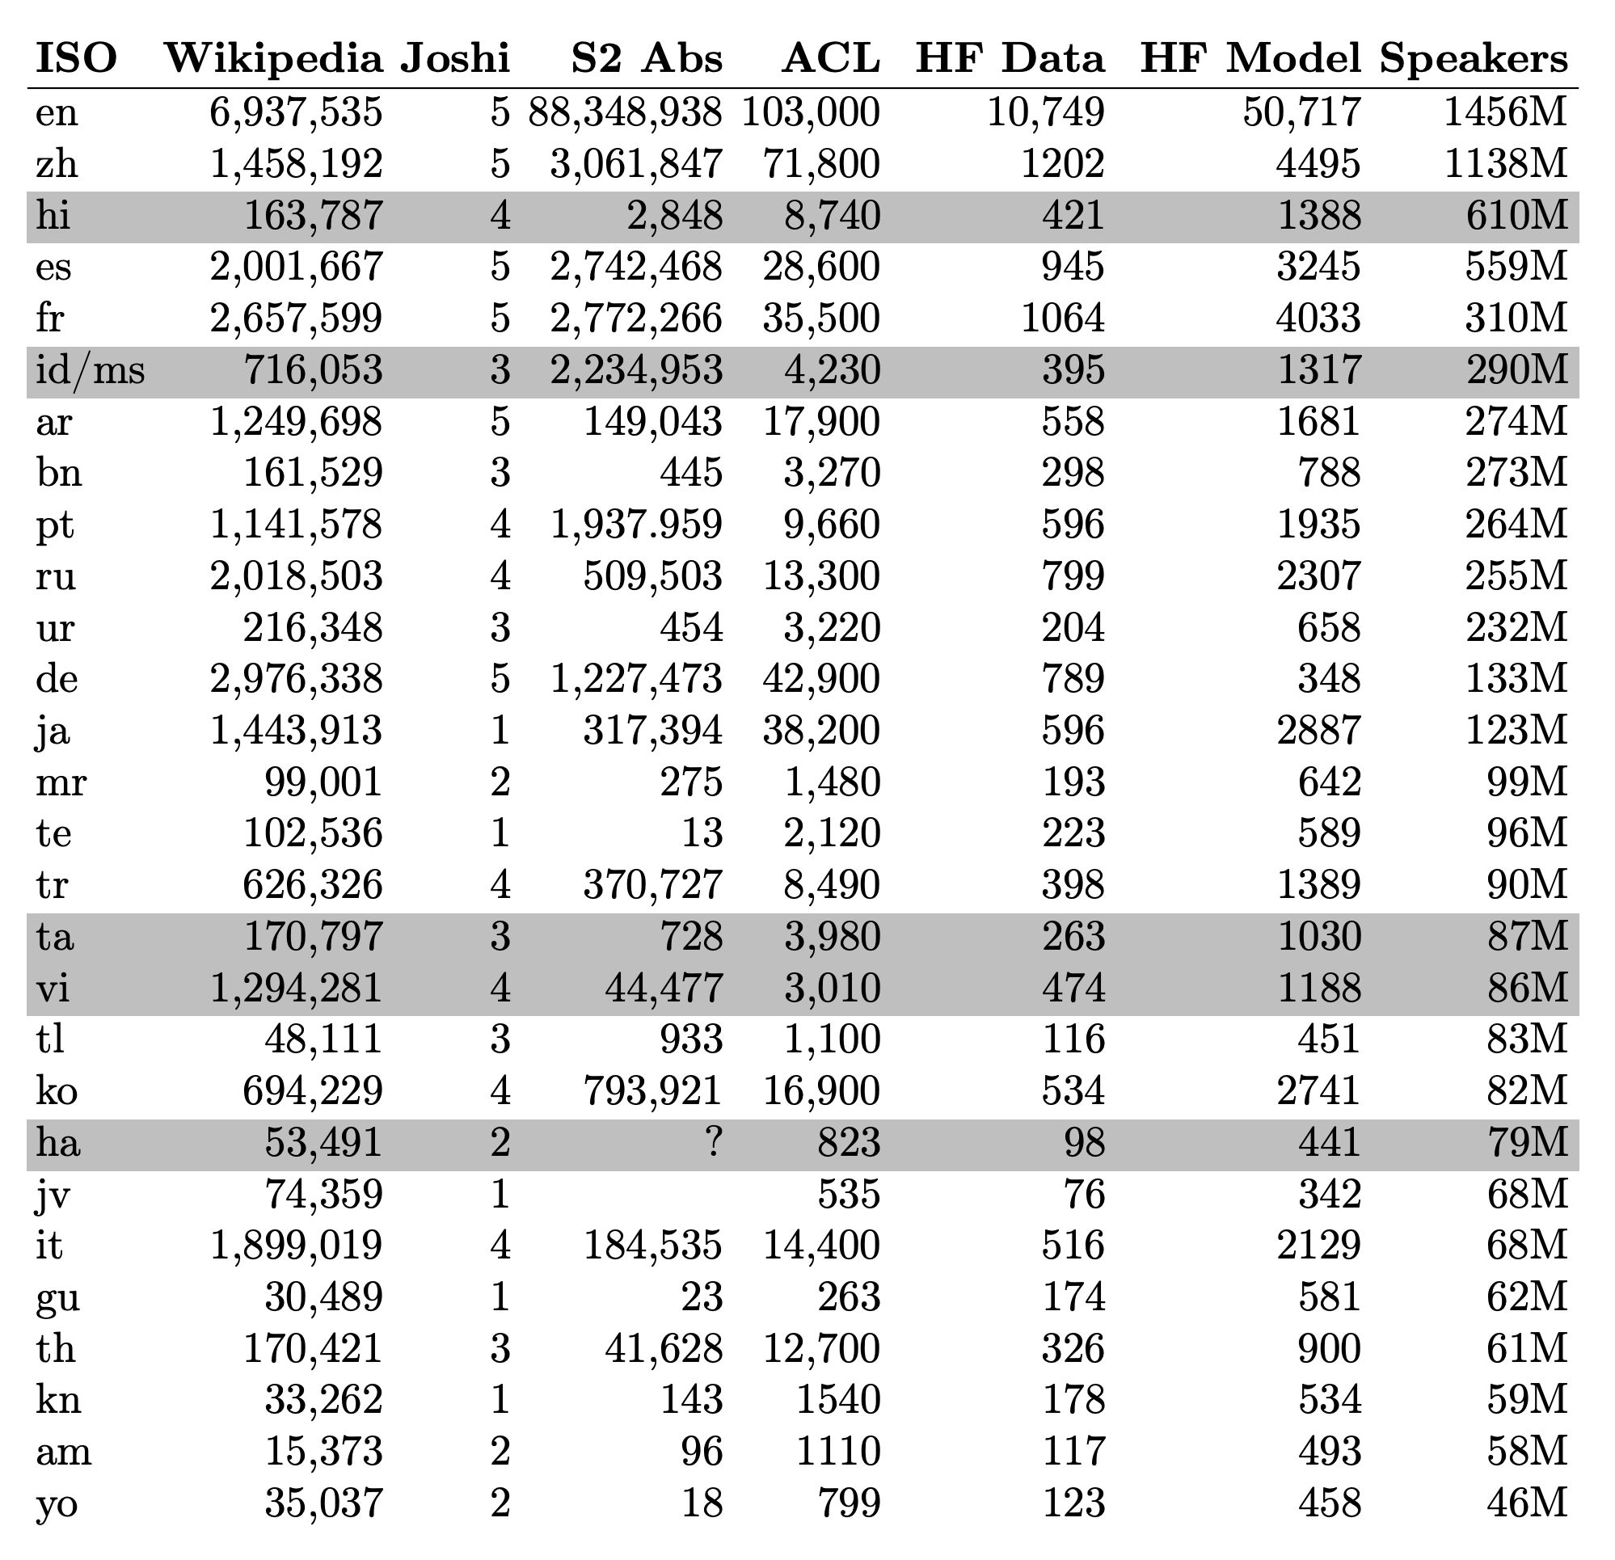
Transfer Learning: Bootstrap LLMs to more languages
Good News
There are lots of papers in Semantic Scholar (S2)
in many languages
mostly translation-free
Challenge
Find comparable papers in high-resource languages

Slide 4
Tasks:
Find Comparable Papers
Compare and Contrast
Input: paper id
Output: Similar papers
Similar to recommendations
Input: two paper ids
Outputs:
Similarities
Differences
(and summaries of both papers)
Variations
Monolingual
Multilingual

Slide 5
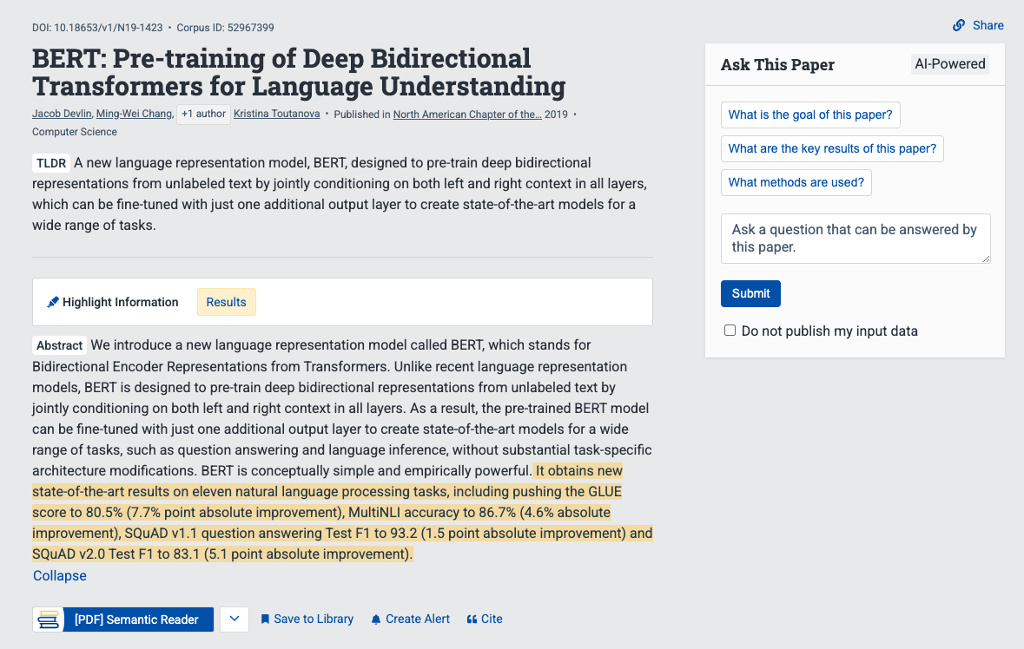
Snippet from Semantic Scholar
tldr
chat

Slide 6
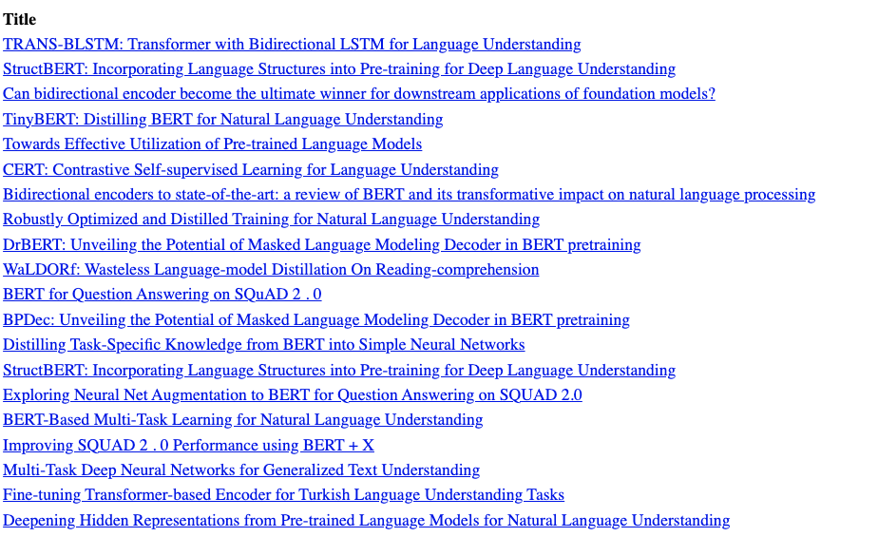
Recommendations: Query: BERT paper

Slide 7
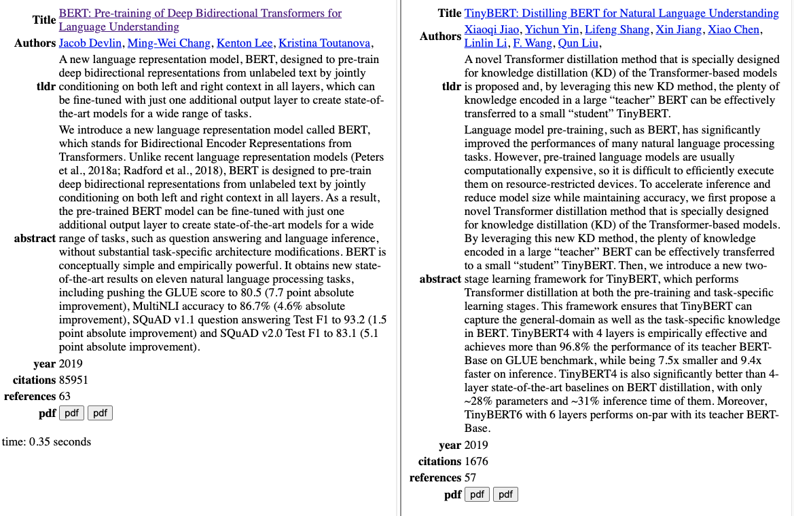
Summaries of Two Papers

Slide 8
What do I really want to ask this paper?
How does this paper compare with that paper?
What do they have in common?
How do they differ?
Similarities
Both BERT and TinyBERT use similar methods (transformers)
to encode text as vectors
Differences
TinyBERT is smaller, faster, cheaper
and almost as good

Slide 9
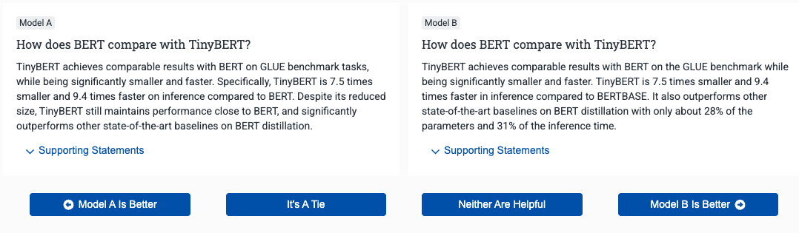
How does BERT compare with TinyBERT?
Source: S2
Similarities
Both BERT and TinyBERT use similar methods (transformers) to encode text as vectors
Differences
TinyBERT is smaller, faster, cheaper and almost as good
Target

Slide 10
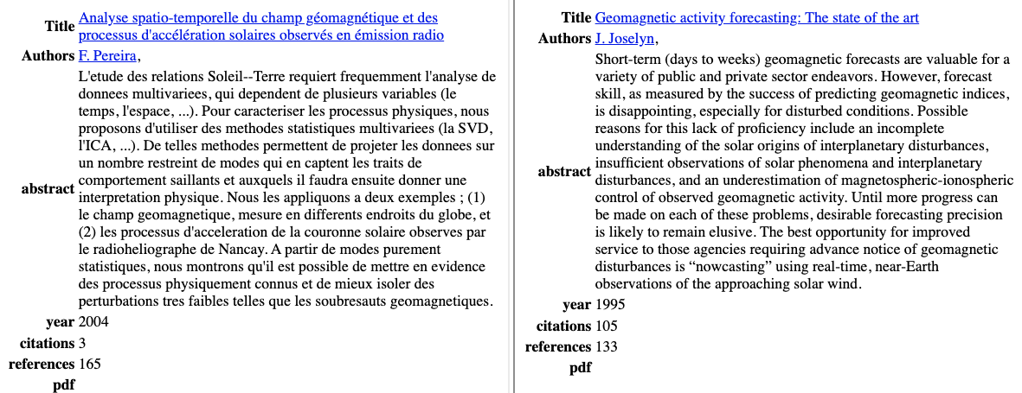
Multilingual Version: Please compare and contrast these two papers

Slide 11
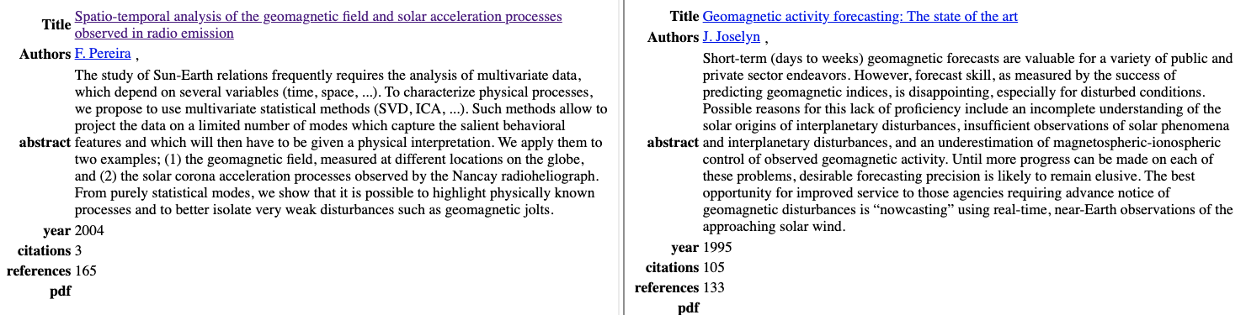
Multilingual Version (translation of previous slide) Please compare and contrast these two papers

Slide 12
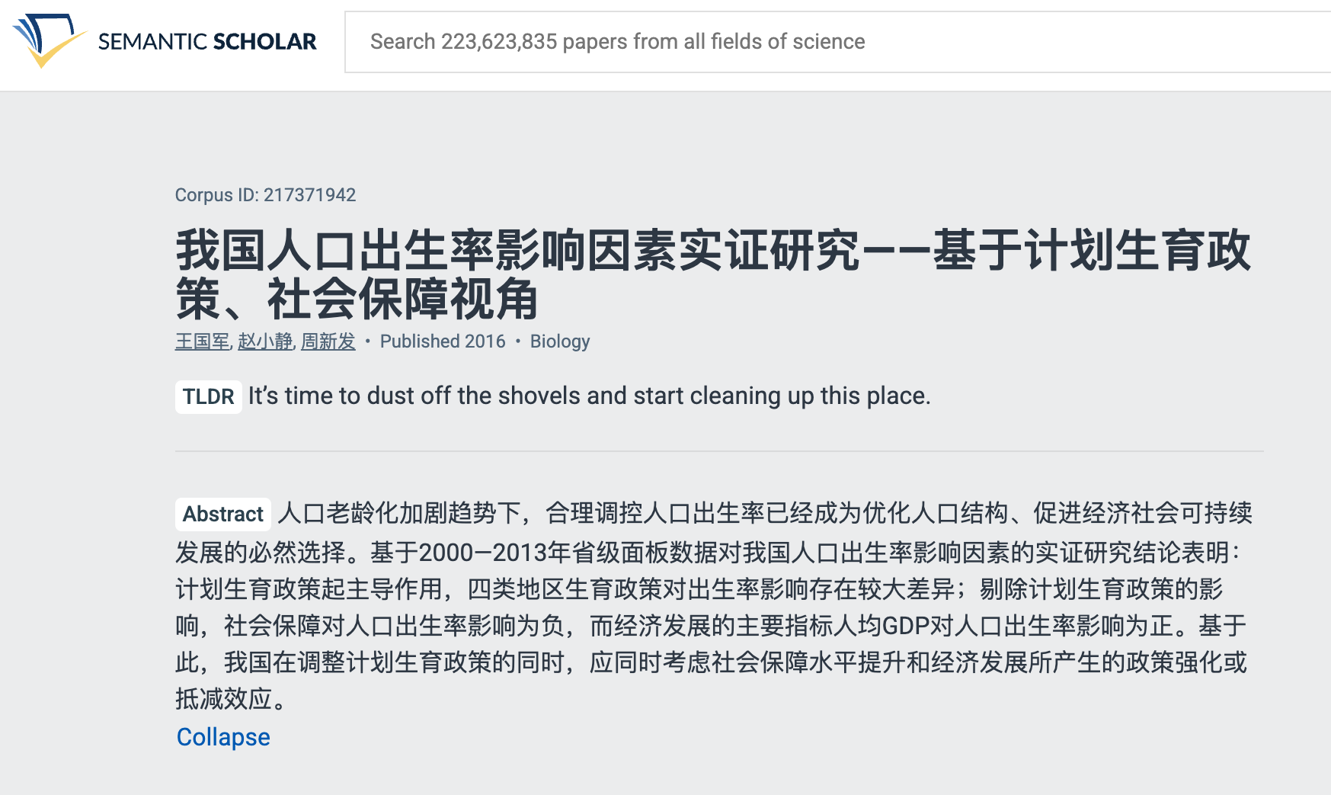
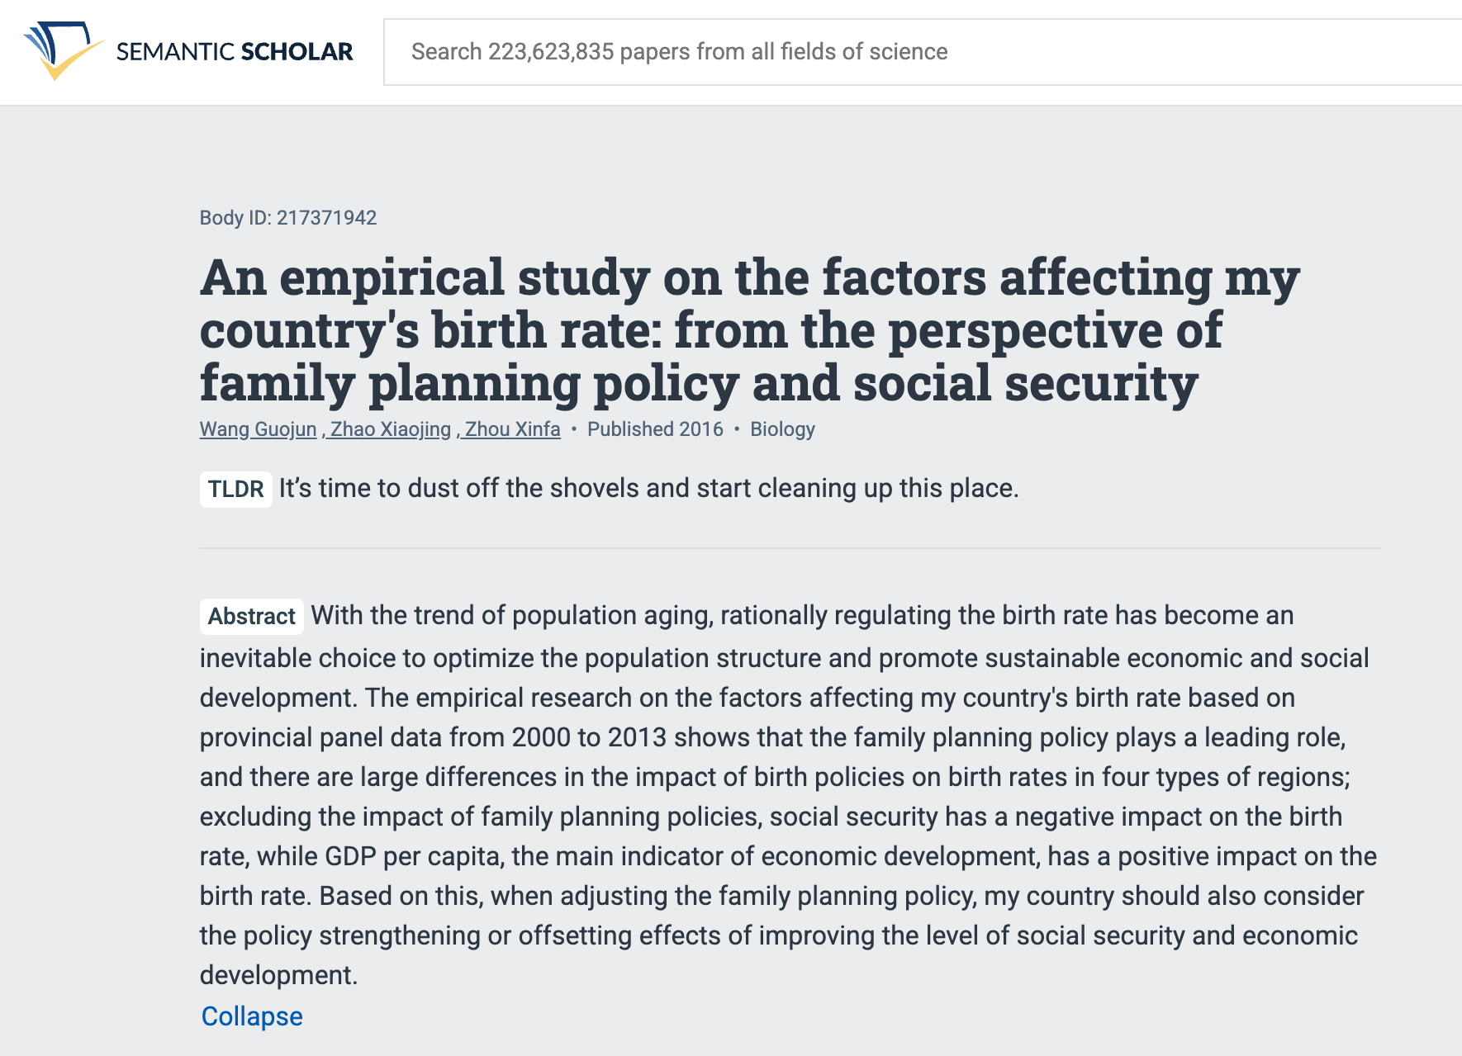
tldr: Better in English than Chinese

Slide 13

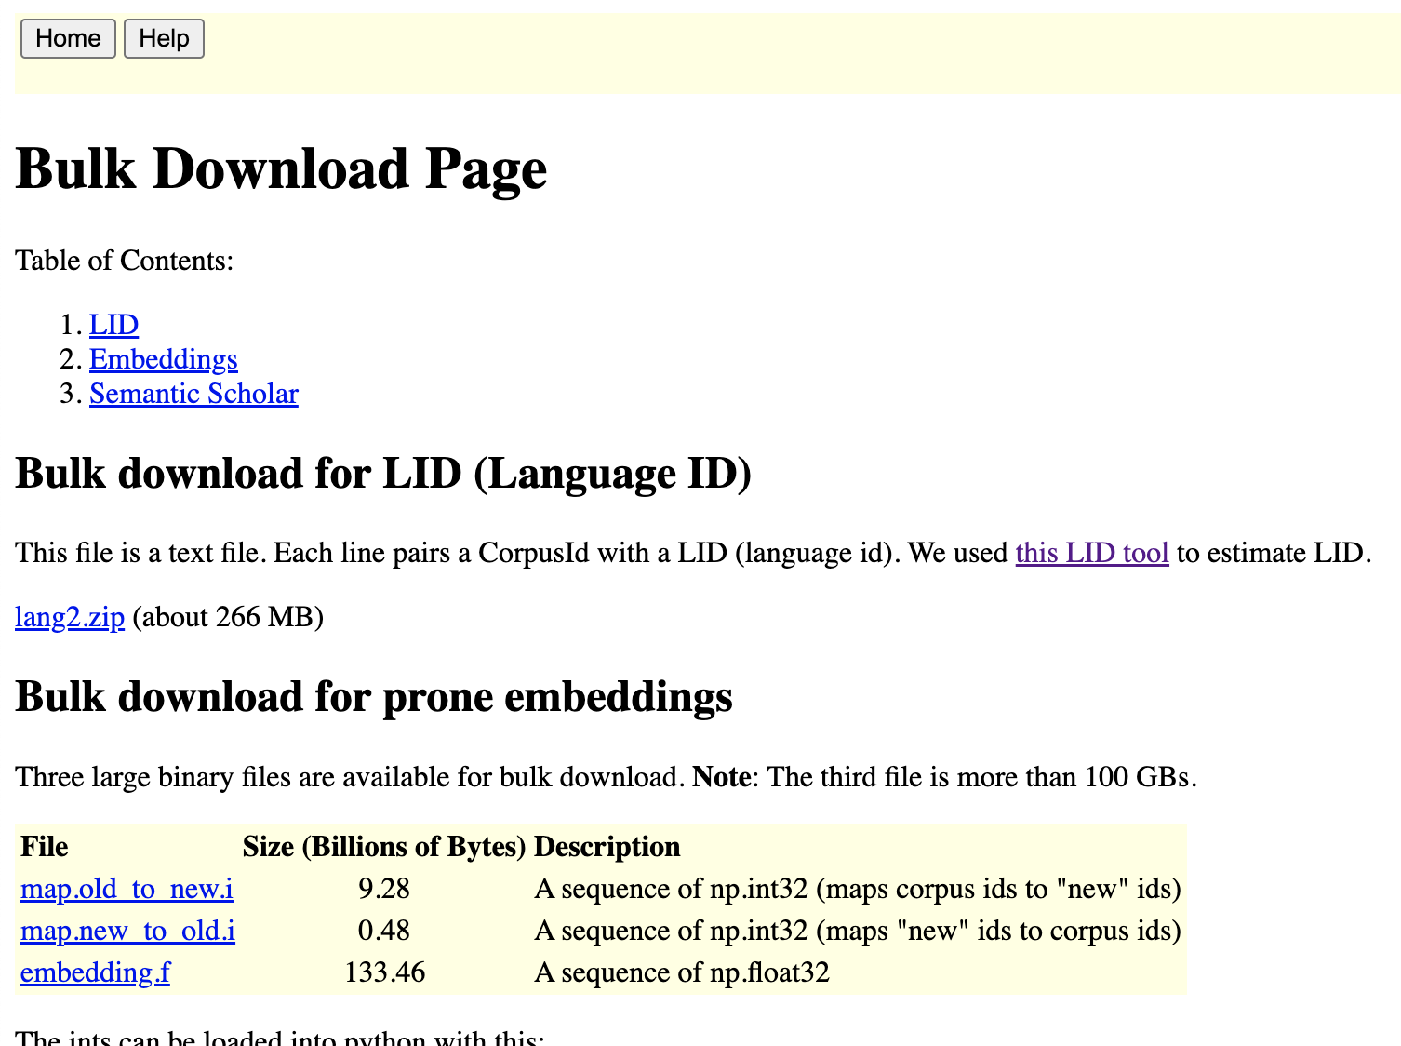
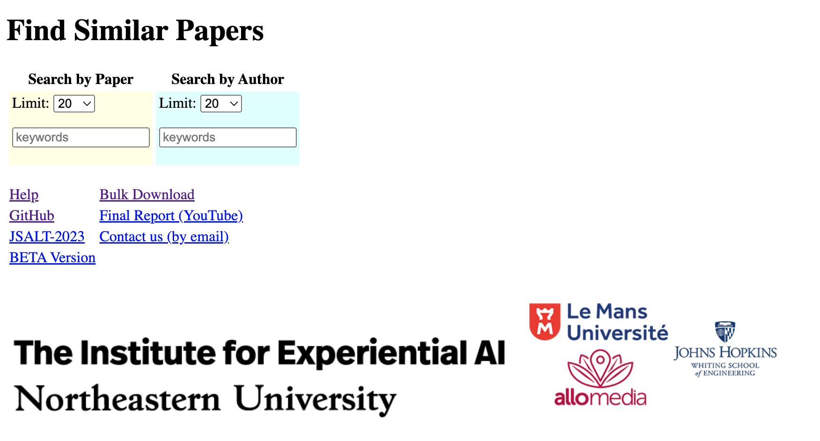
Shameless Plug: http://recommendpapers.xyz

