Slide 1


https://recommendpapers.xyz
Kenneth Church

Slide 2
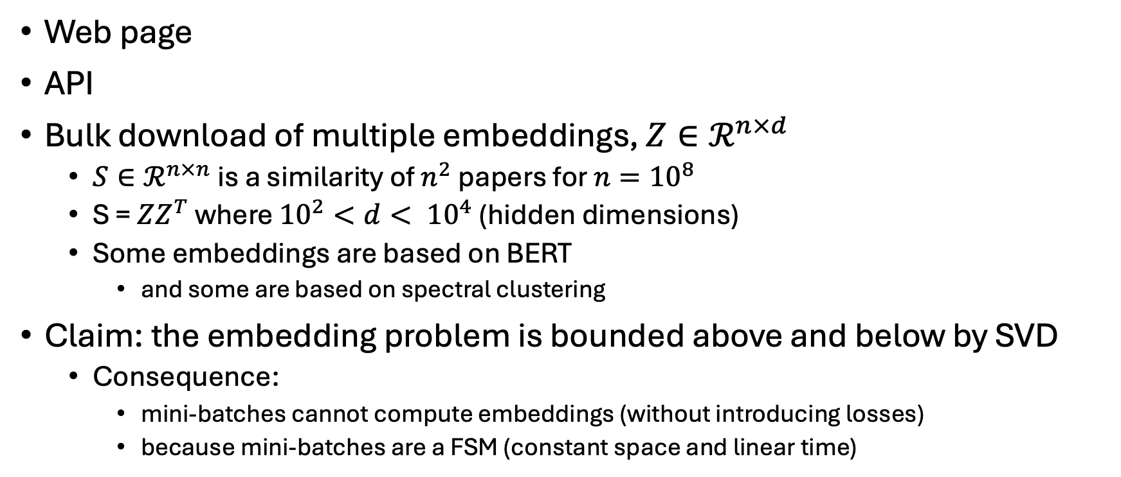
Resources for Academic Search
Web page
API
Bulk download of multiple embeddings, $Z∈ℛ^{n×d}$
$S∈ℛ^{n×n}$ is a similarity of $n^{2}$papers for $n={10}^{8}$
S = $ZZ^{T}$ where ${10}^{2}<d< {10}^{4}$ (hidden dimensions)
Some embeddings are based on BERT
and some are based on spectral clustering
Claim: the embedding problem is bounded above and below by SVD
Consequence:
mini-batches cannot compute embeddings (without introducing losses)
because mini-batches are a FSM (constant space and linear time)
Kenneth Church

