Slide 1
Feb 17
Kenneth Church

Slide 2
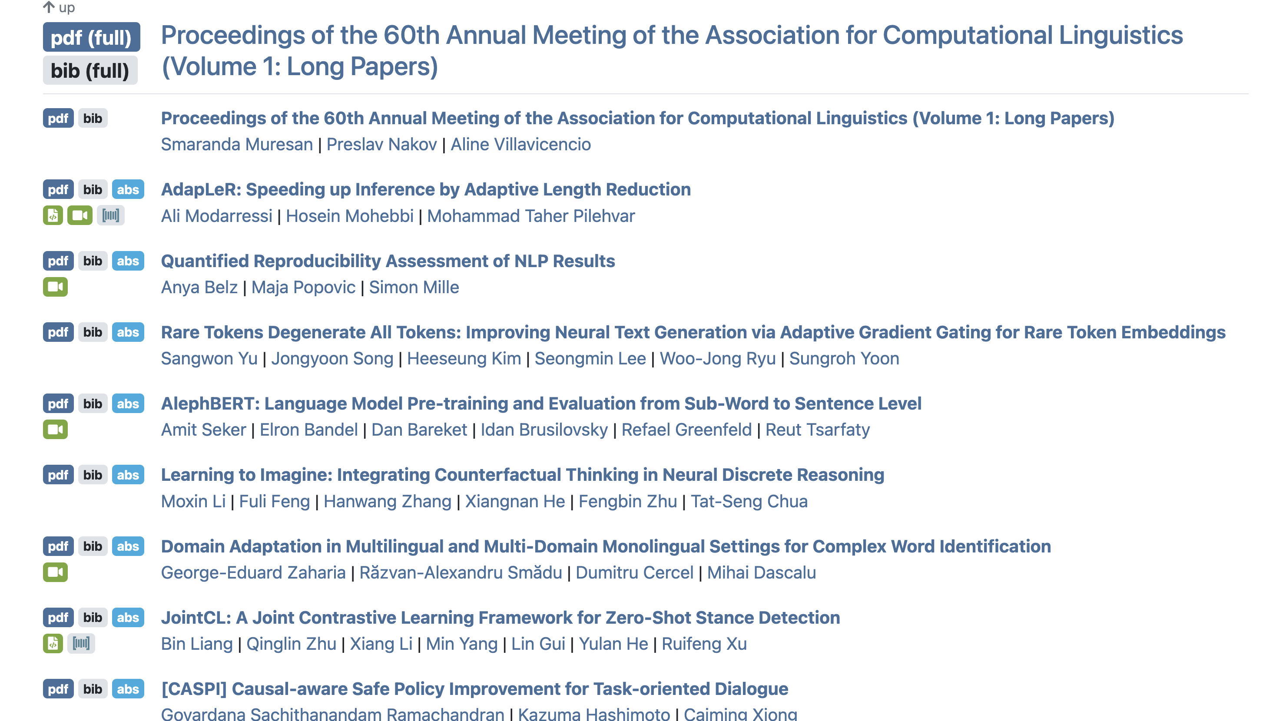
https://aclanthology.org/events/acl-2022/#2022acl-long

Slide 3
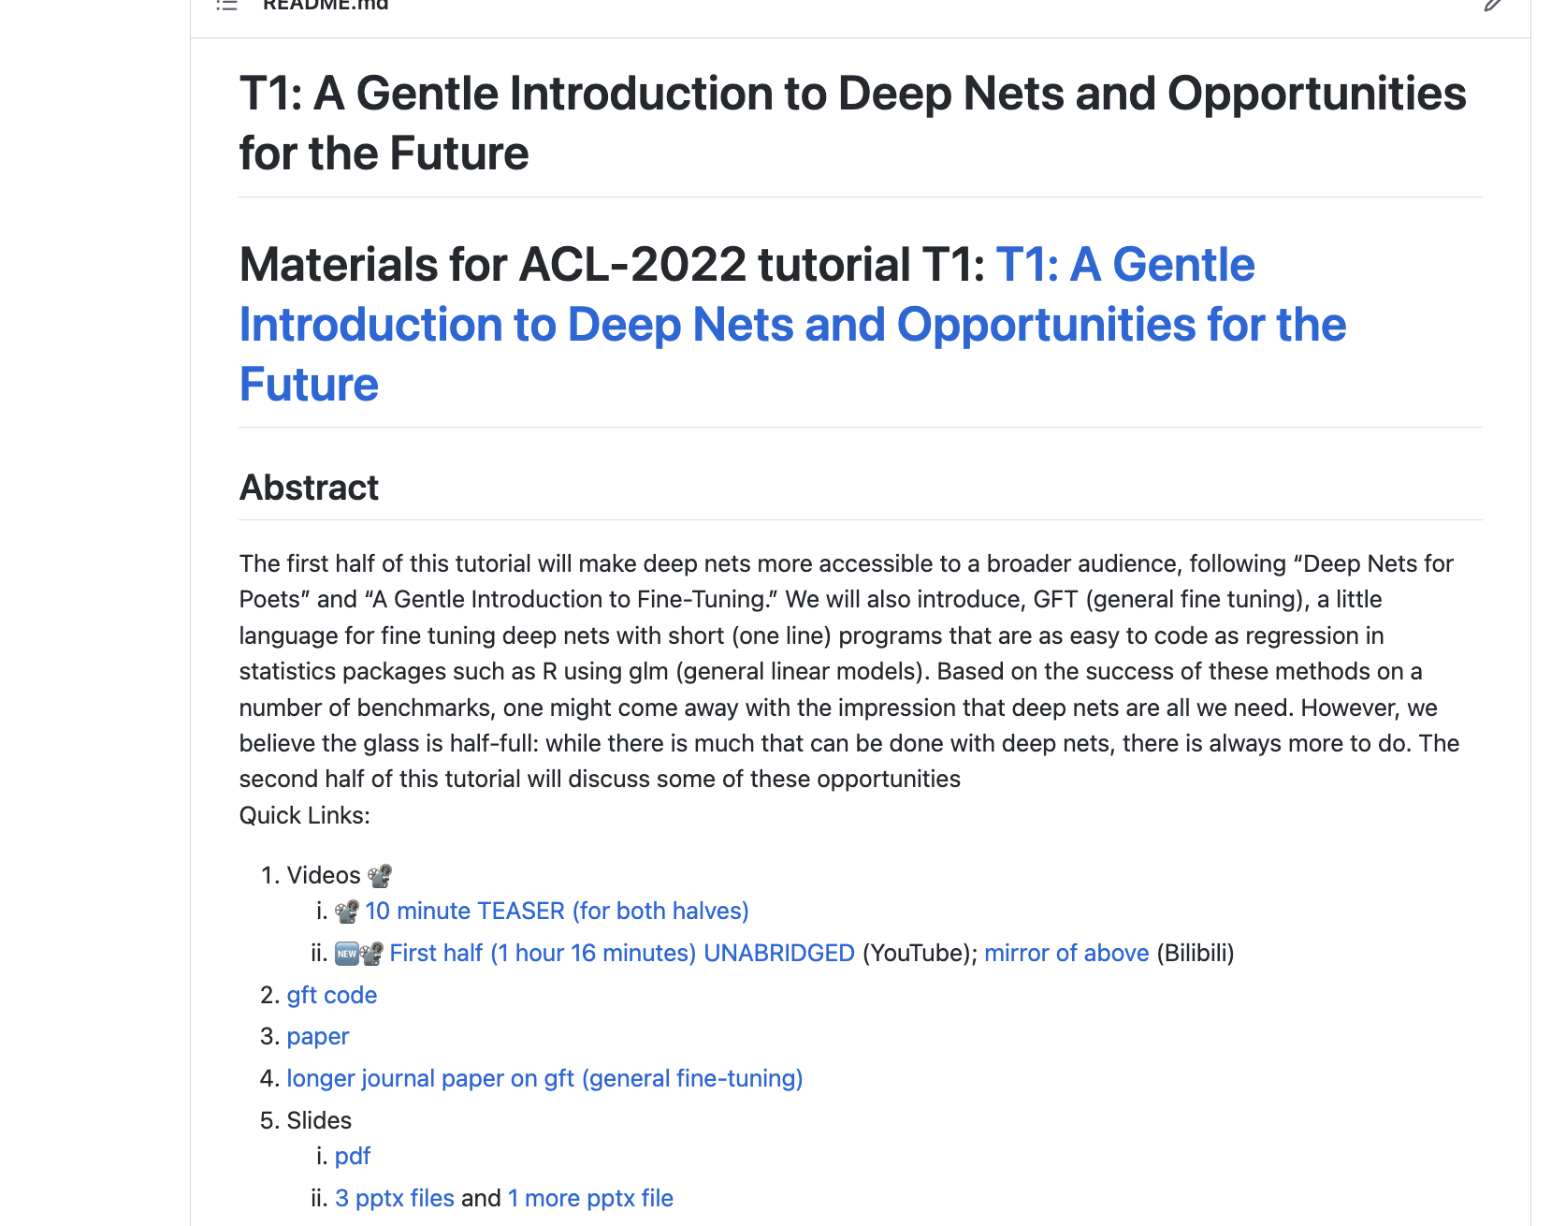
https://github.com/kwchurch/ACL2022_deepnets_tutorial

Slide 4
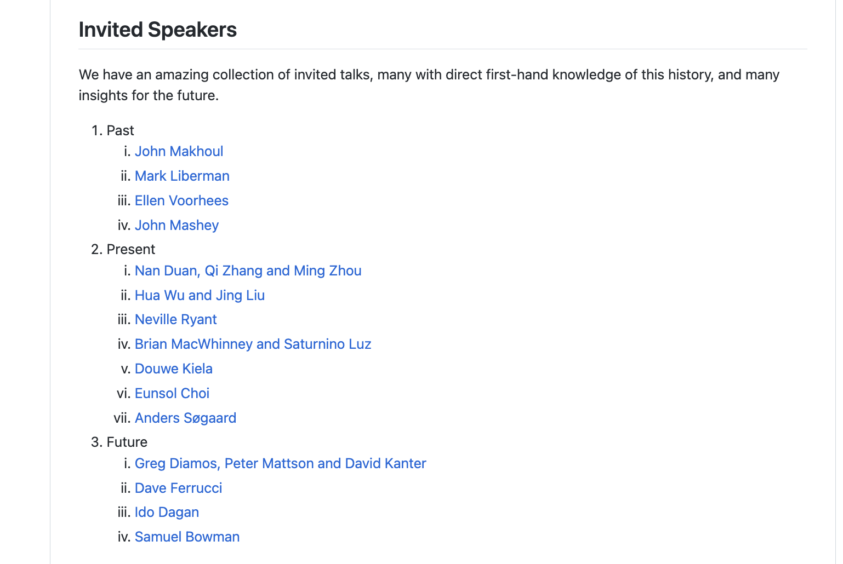
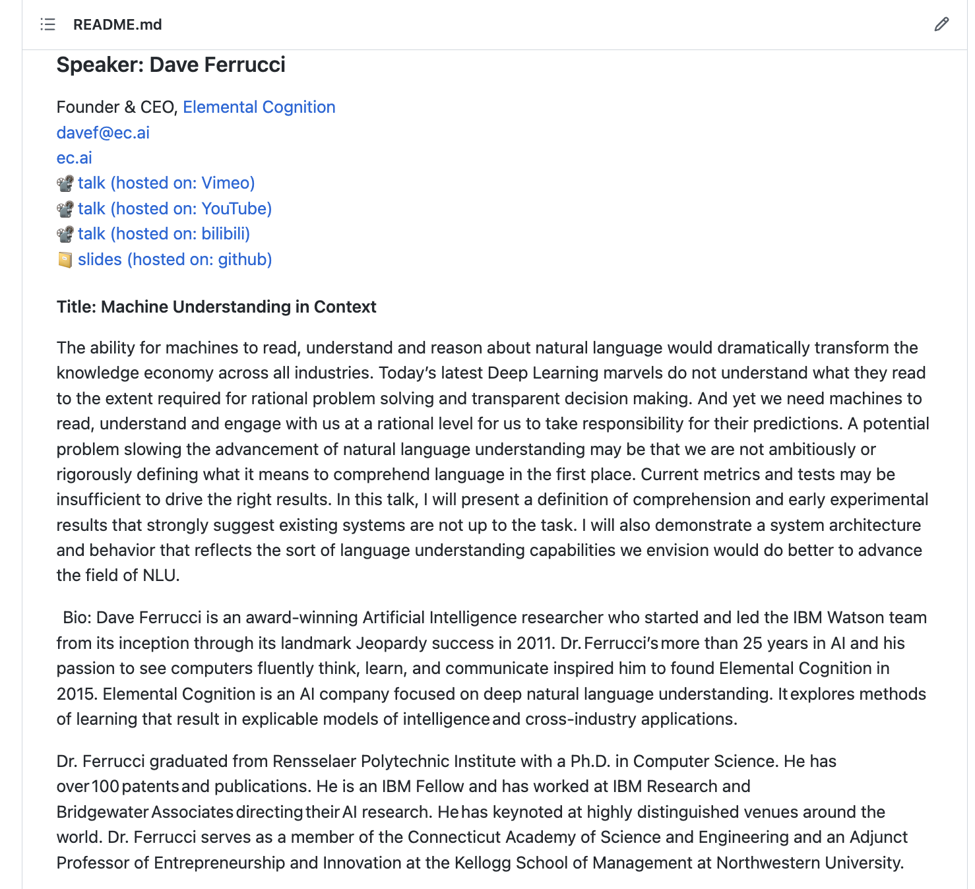
https://github.com/kwchurch/Benchmarking_past_present_future

Slide 5
Keynotes
Alchemy
https://www.youtube.com/watch?v=x7psGHgatGM
Metcalfe’s Law
https://www.youtube.com/watch?v=f6CJA421aUo
https://youtu.be/Fj7r3vYAjGY
https://github.com/kwchurch/Benchmarking_past_present_future/
Watson
https://www.youtube.com/watch?v=P18EdAKuC1U
Jurafsky
https://www.superlectures.com/interspeech2016/ketchup-interdisciplinarity-and-the-spread-of-innovation-in-speech-and-language-processing

Slide 6
Commencement Speeches & More…
Commencement Speeches
Other Speeches
Kai-Fu Lee
https://web.archive.org/web/20170801054115/https://www.engineering.columbia.edu/kai-fu-lee-speech
Steve Jobs
https://youtu.be/UF8uR6Z6KLc
Steve Jobs
Superbowl ads
Practice (friendly audience)
https://www.youtube.com/watch?v=zlQvMp5rB6g
Higher stakes
https://www.youtube.com/watch?v=1tQ5XwvjPmA
Kai-Fu Lee (then)
https://drive.google.com/file/d/0B5QfqZms4UpjNDVYSzdhNm5pSkk/view?resourcekey=0-pkeTvF9mbuWUMrWsLeSFqA
https://youtu.be/_6Fm3q7R8iQ
Rabbit (now)
https://www.youtube.com/watch?v=daVcXde3QJE
https://www.youtube.com/watch?v=Rqh6fhcAqpw
Why Xerox failed
https://www.youtube.com/watch?v=NlBjNmXvqIM
Snark
https://youtu.be/ZWaX1g_2SSQ
Steve Jobs and Bill Gates
https://youtu.be/ntZ14BAFMyo
Woz
https://www.youtube.com/watch?v=iW1BulWR9dI

Slide 7
Memorials: Who is the audience? What is the Point?
Jobs (Woz)
https://www.youtube.com/watch?v=dK_XEGrzHUo
Minsky (Hillis)
https://youtu.be/PnLdPo1Lz-8
Buckley (Chomsky)
https://www.youtube.com/watch?v=57mi_RpaZr4
Coffin Confessor
https://www.thisamericanlife.org/766/well-someone-had-to-do-something/act-three-11
https://youtu.be/ty-U5DvaVtk

