Slide 1
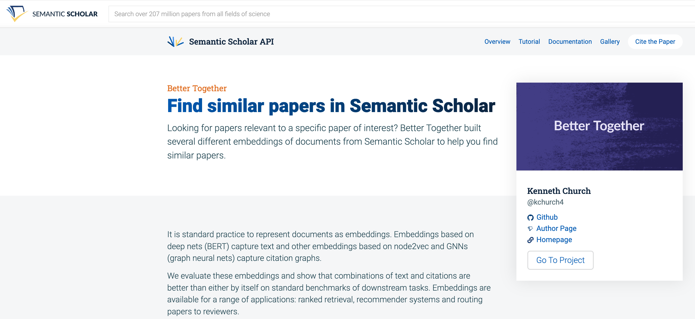
https://www.semanticscholar.org/product/api/gallery
click here

Slide 2
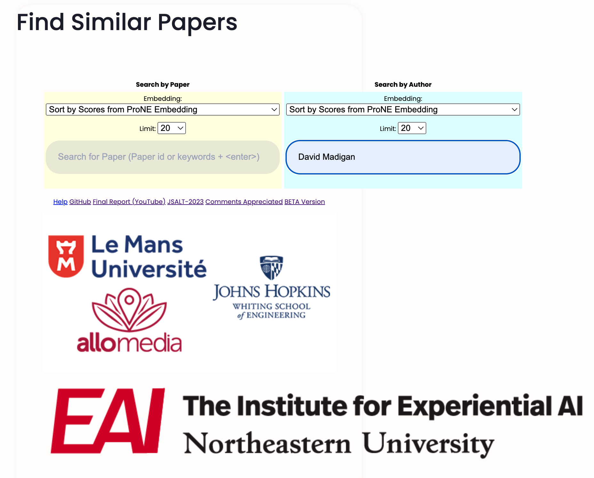
<return>

Slide 3
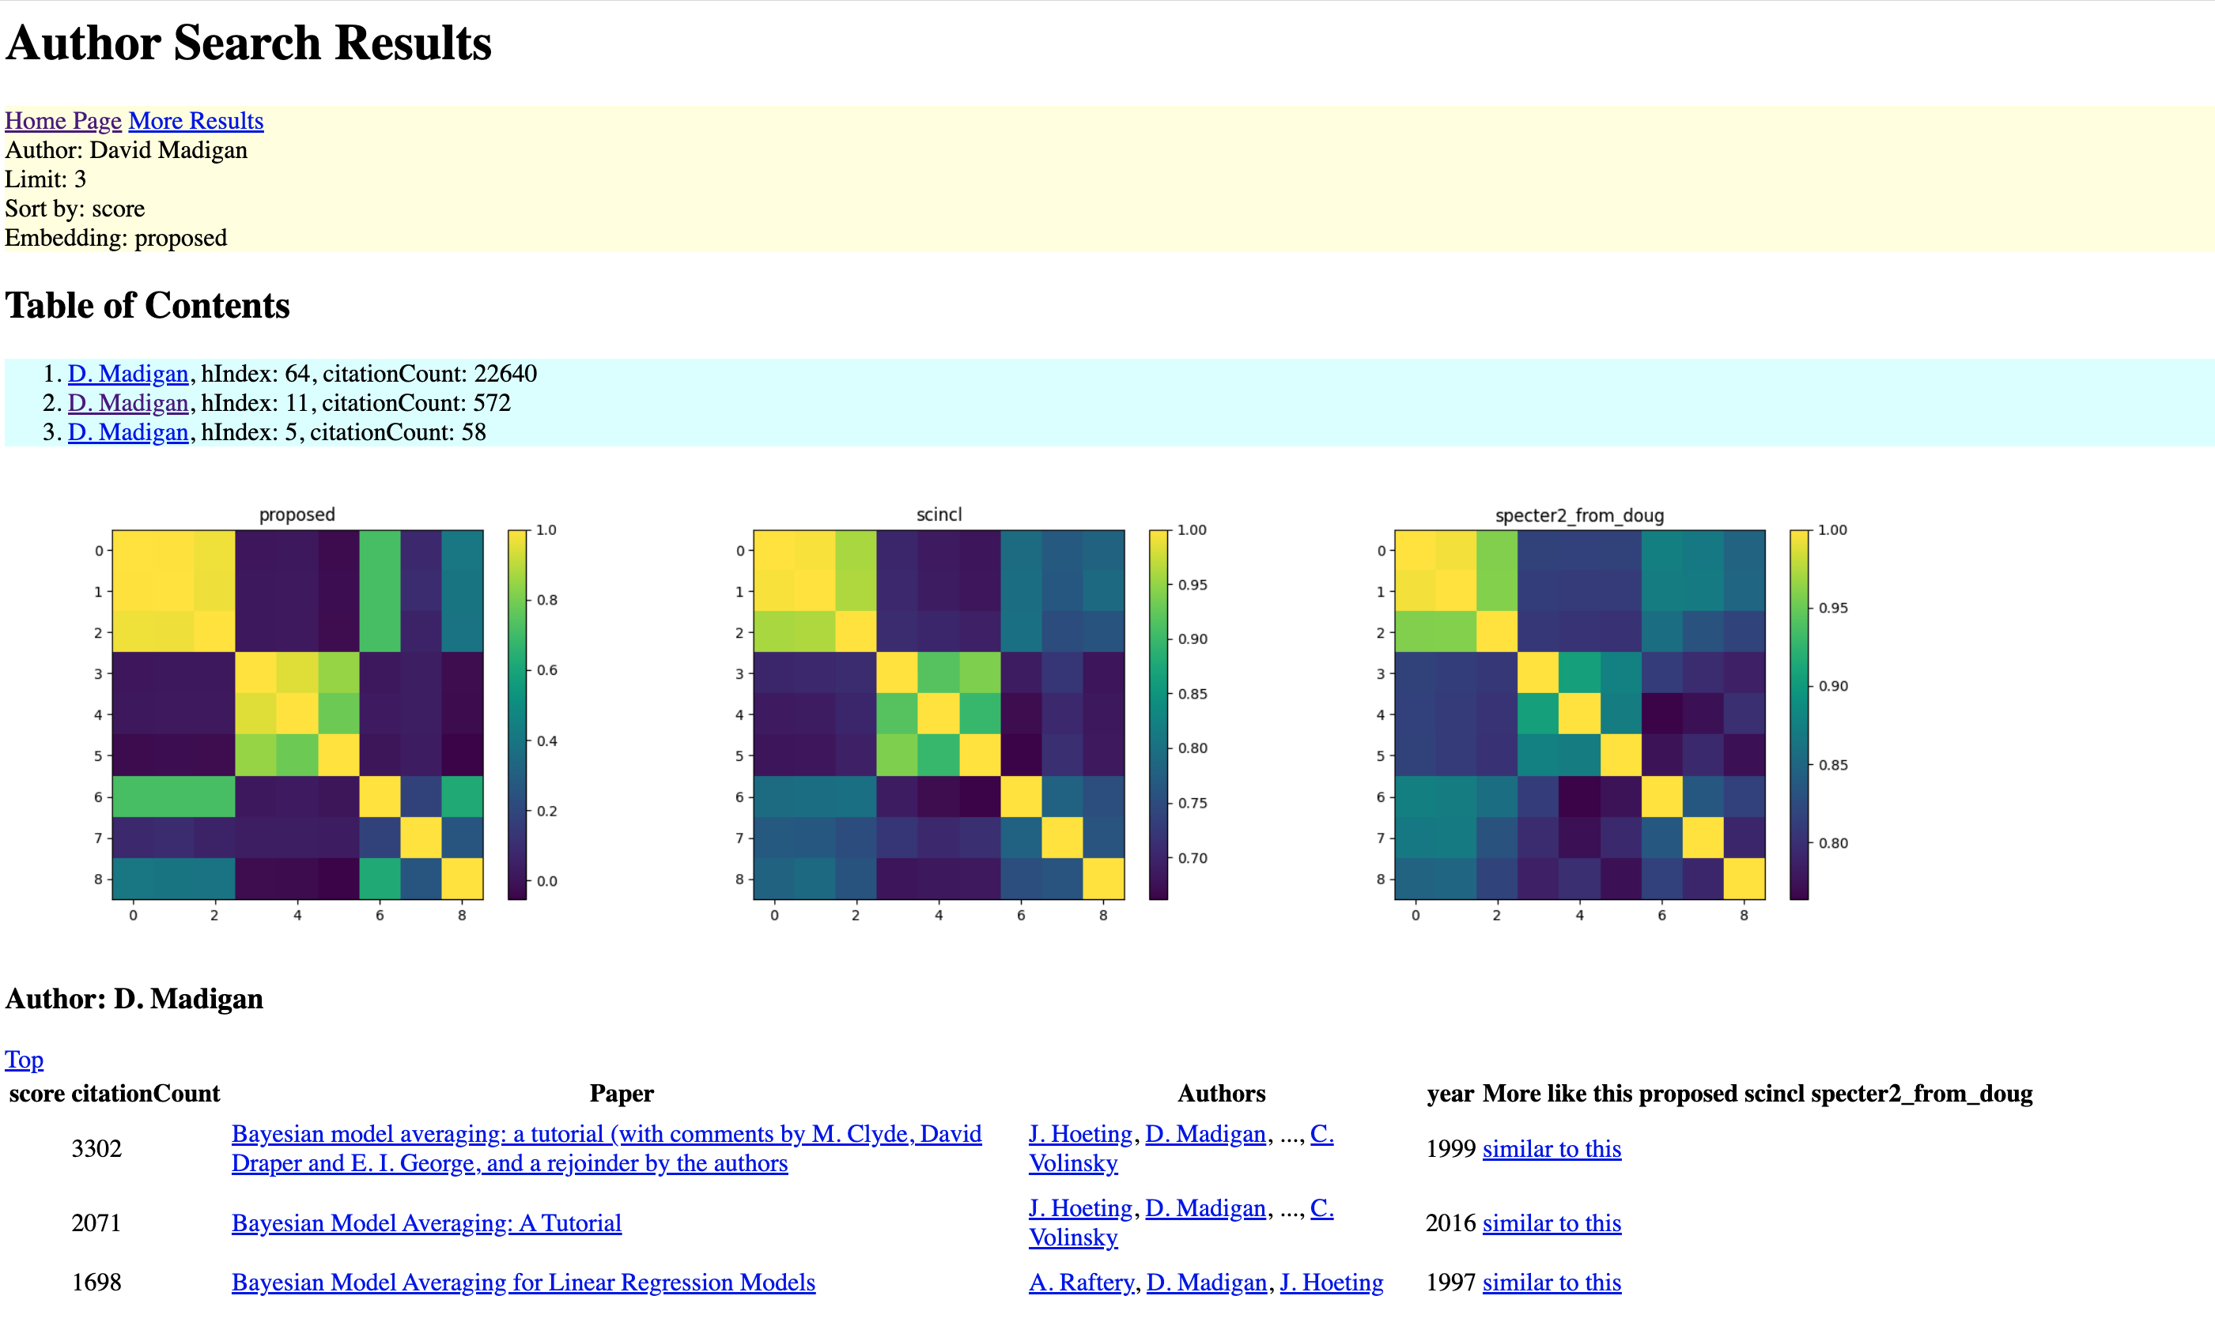
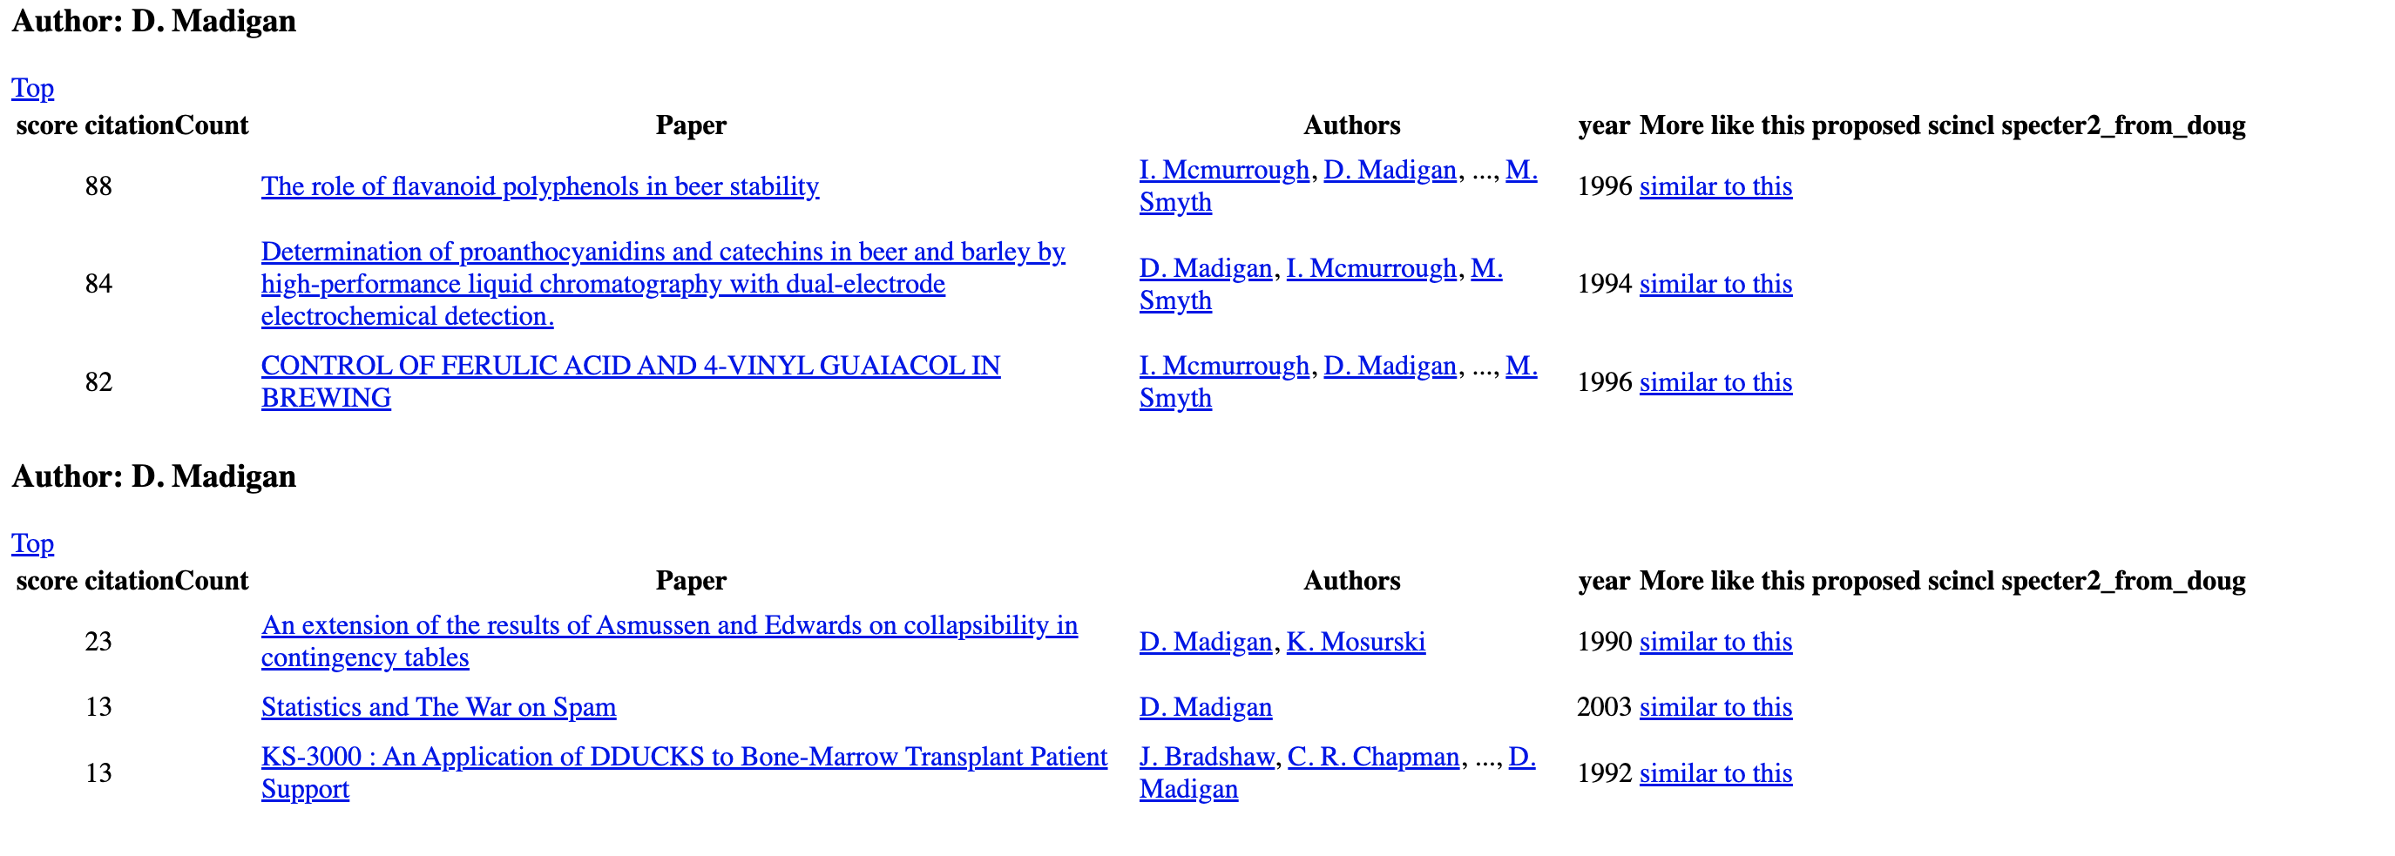
https://www.semanticscholar.org/api-gallery/better-together

Slide 4
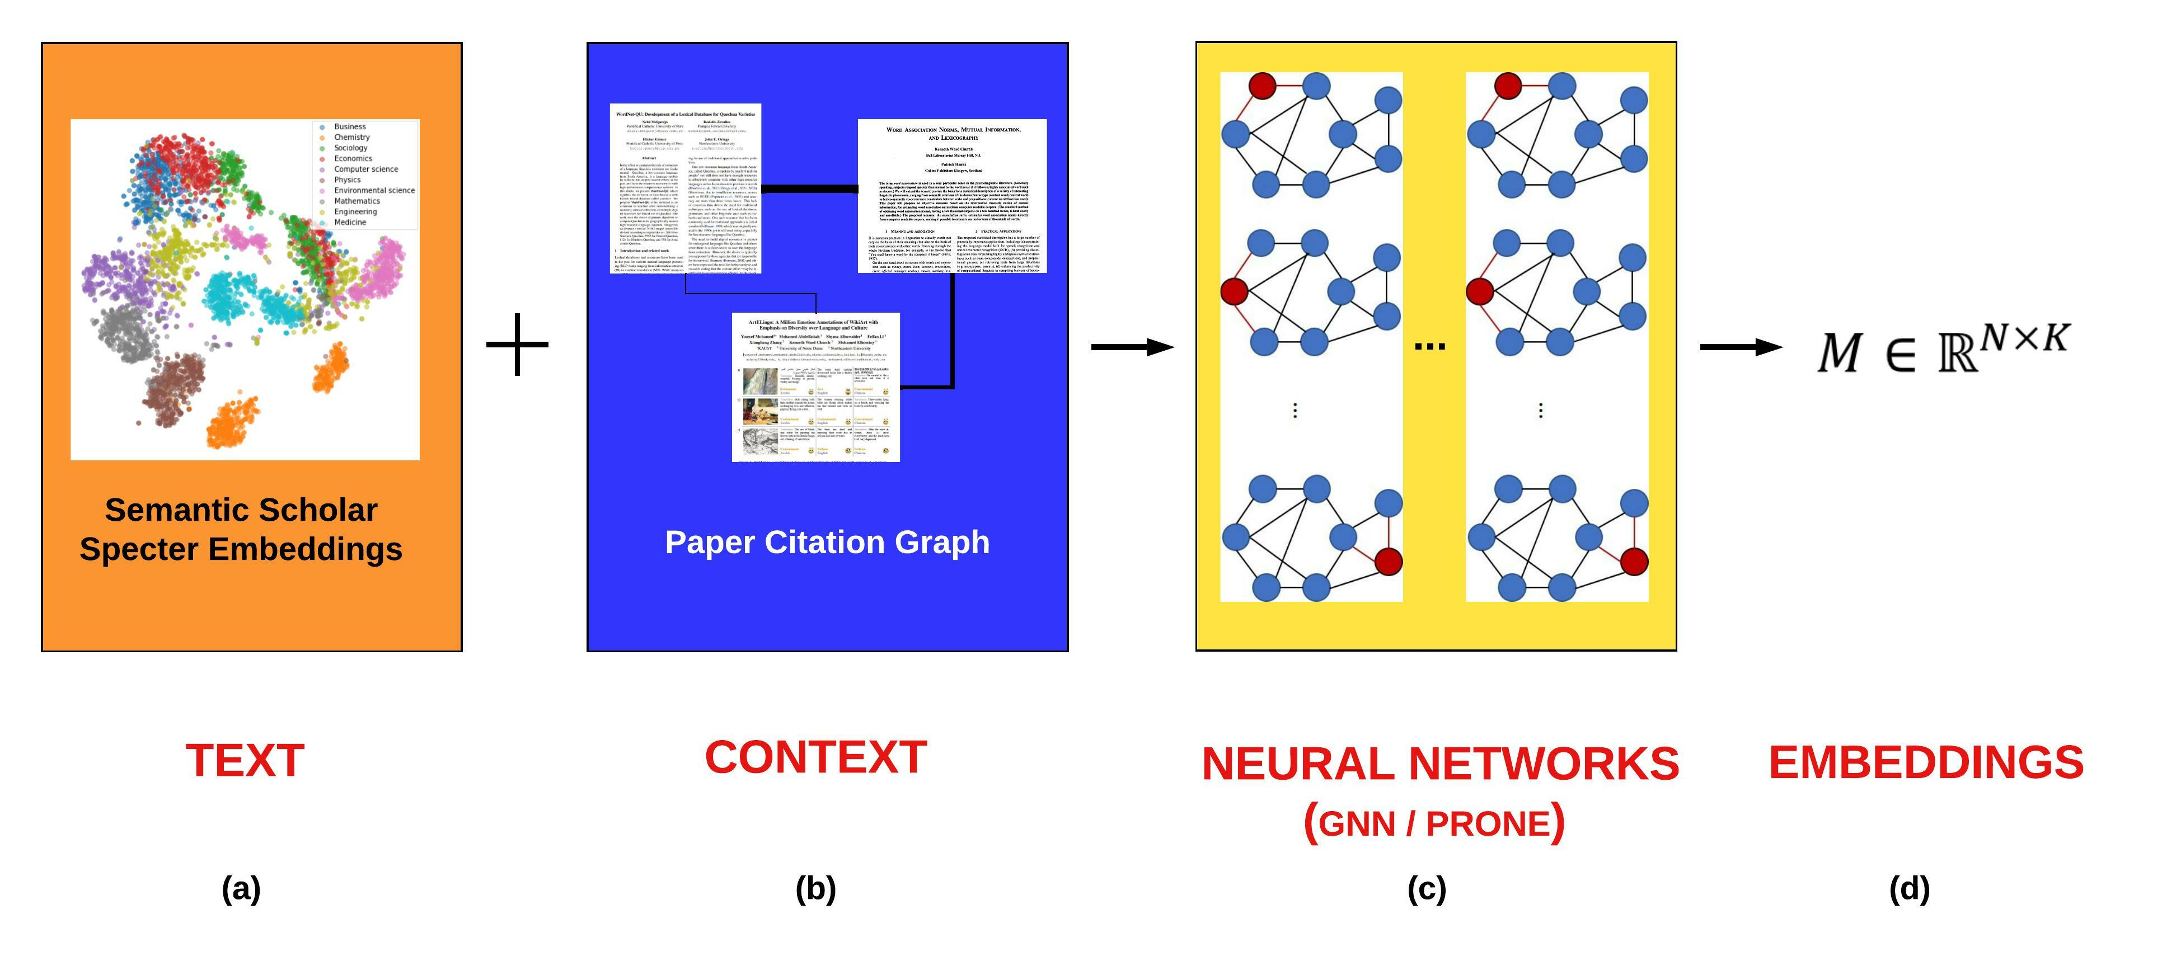
Better Together: JSALT-2023 (France) Text (Titles & Abstracts); Context (Citations)
Audience Perspective
Author Perspective
BERT
Spectral Clustering

Slide 5
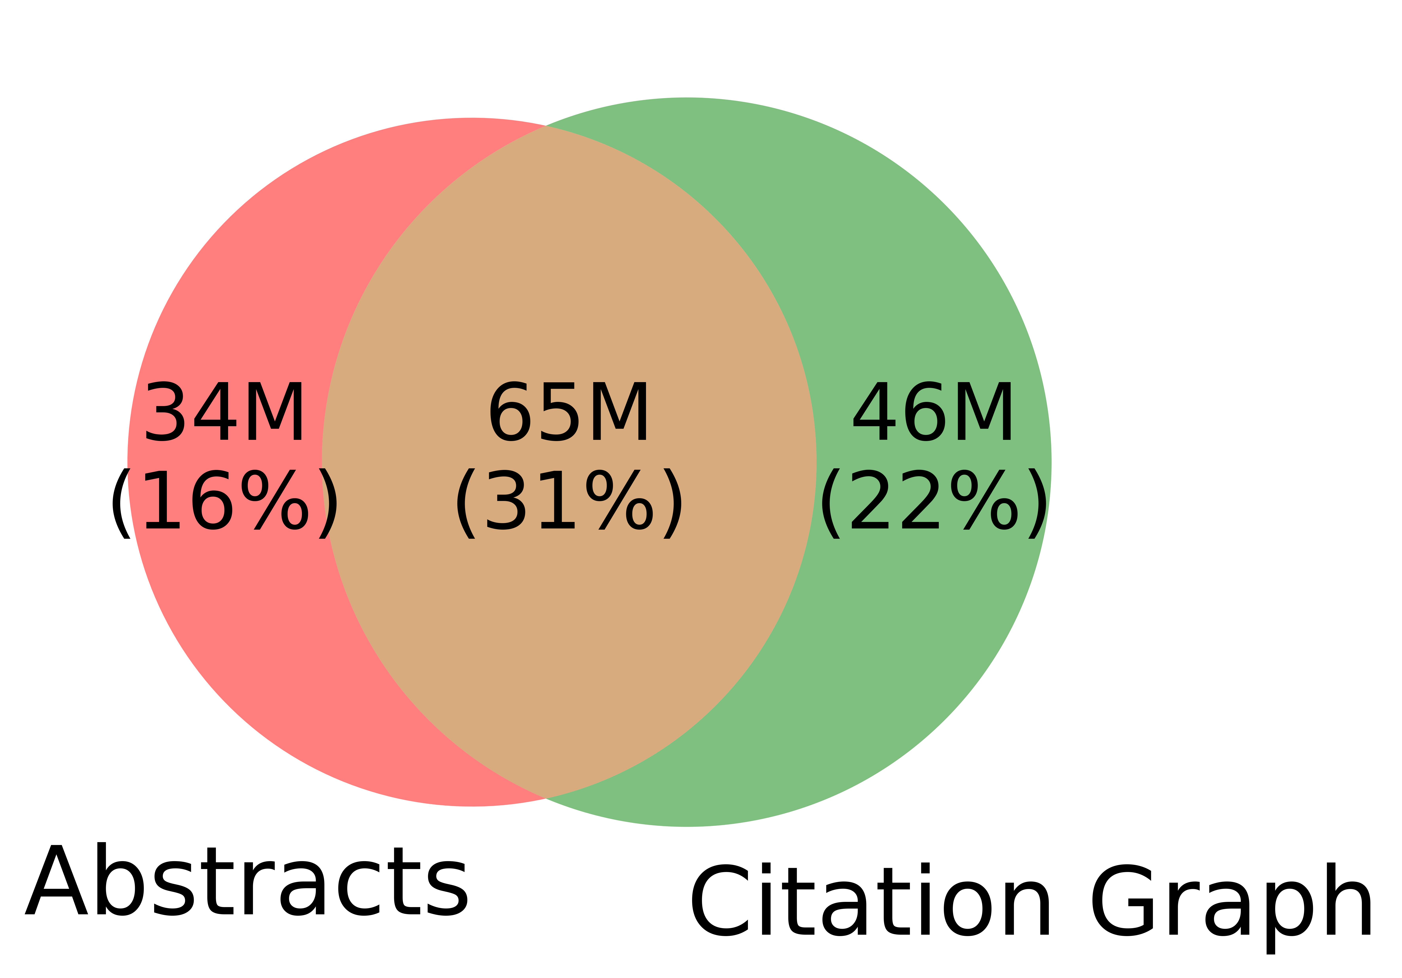
Better-Together Conjectures
Multiple representations are helpful (for dirty data)
for missing values (and bad values)
If abstracts are missing, use links
If links are missing, use abstracts
and for graphs of different sizes
When graphs are small:
Text >> Links
when graphs are large:
Links >> Text (Metcalfe’s Law)

Slide 6
https://www.semanticscholar.org/api-gallery/better-together

