Slide 1
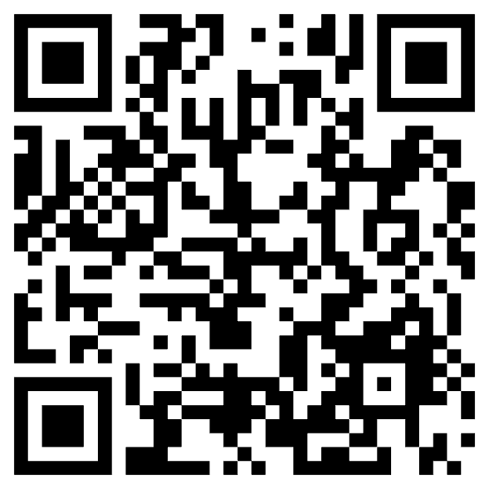
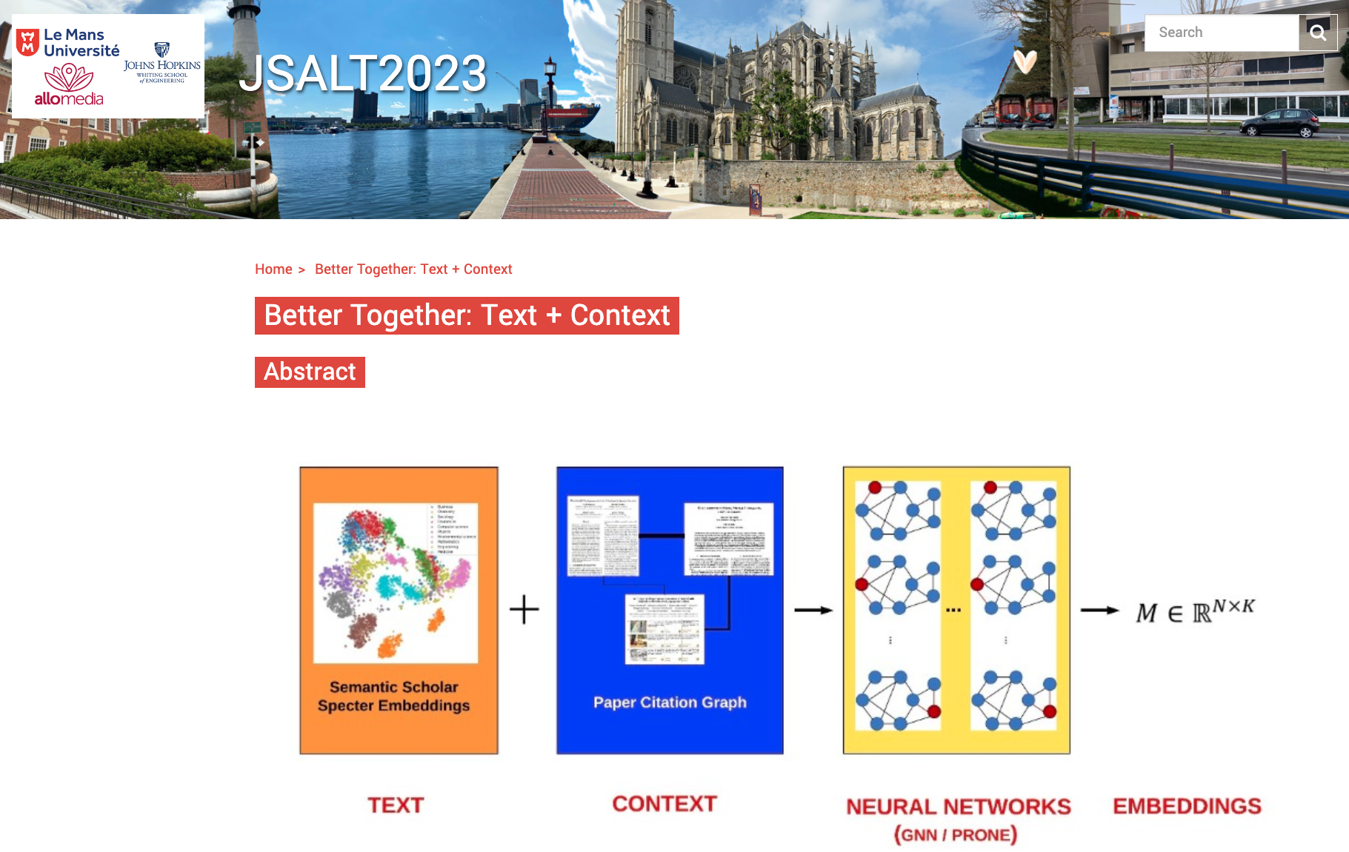
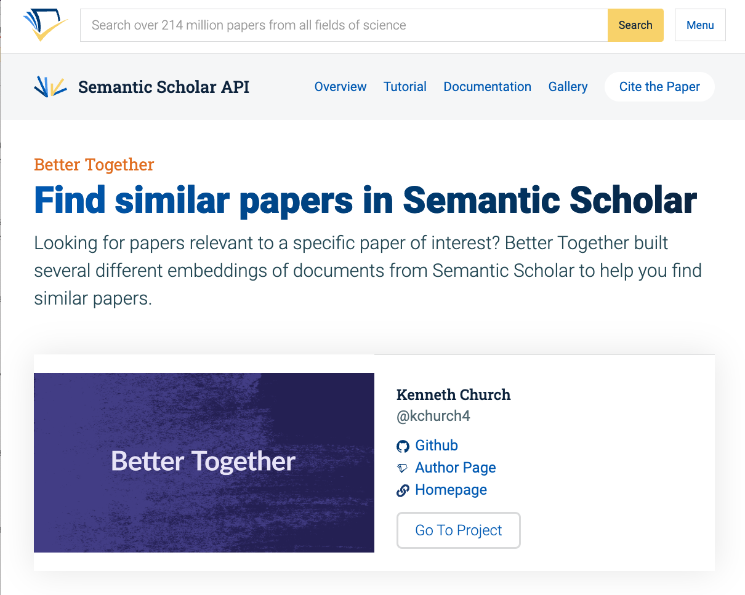
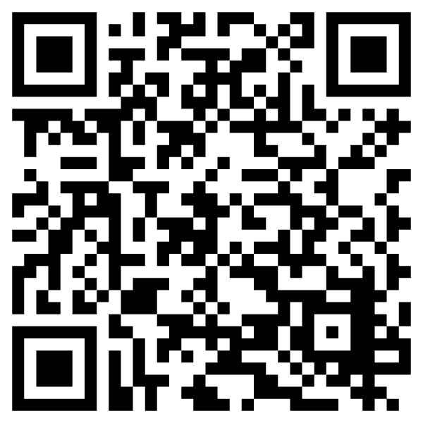
Better Together: Text + Context Use Case: Academic Search
https://github.com/kwchurch/Better_Together_Resources
https://www.clsp.jhu.edu/2023-jelinek-summer-workshop/
Semantic Scholar Gallery

