Slide 1
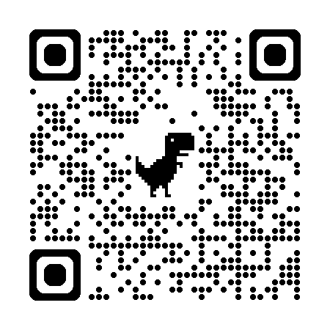
Intermission 1

Slide 2
Agenda
Bigger Picture: A personal perspective not found in textbooks
Corpora
Lexical Semantics
Word Associations
Information Theory
PMI → Word2Vec → Bots

Slide 3
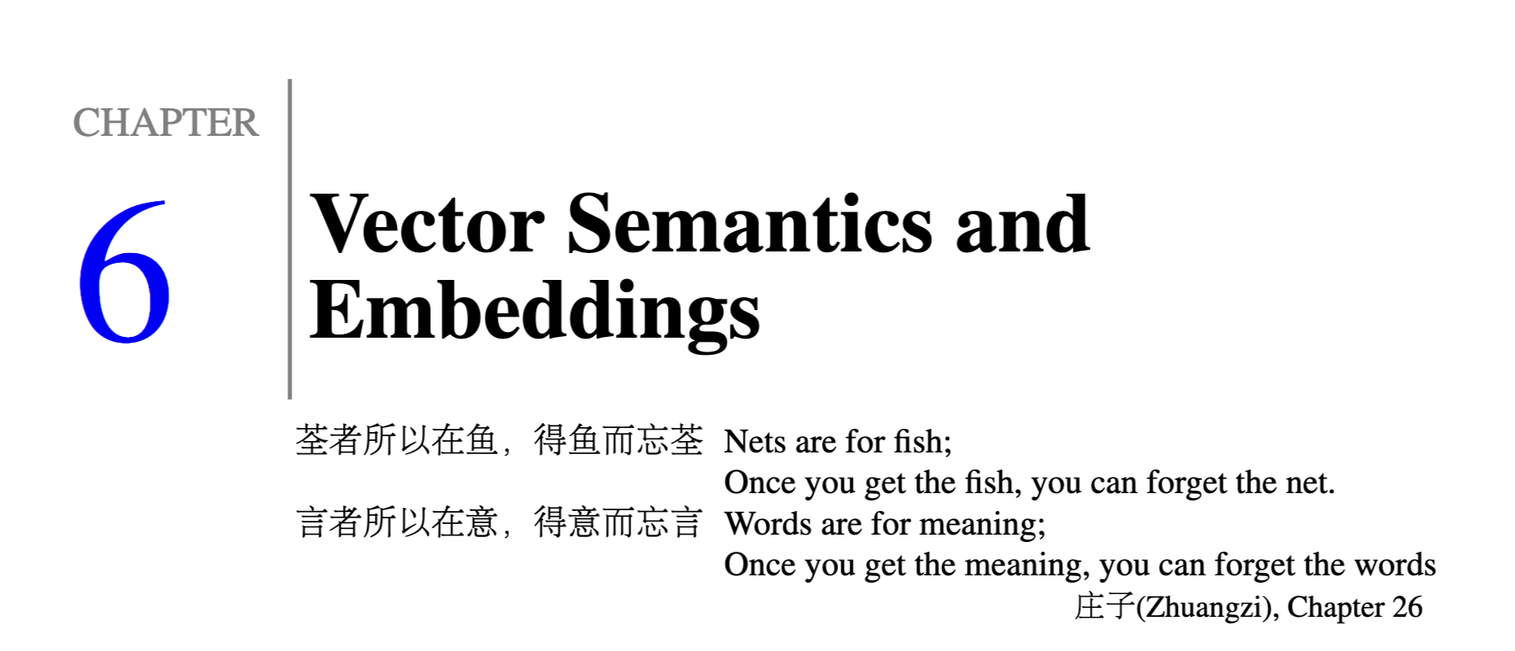
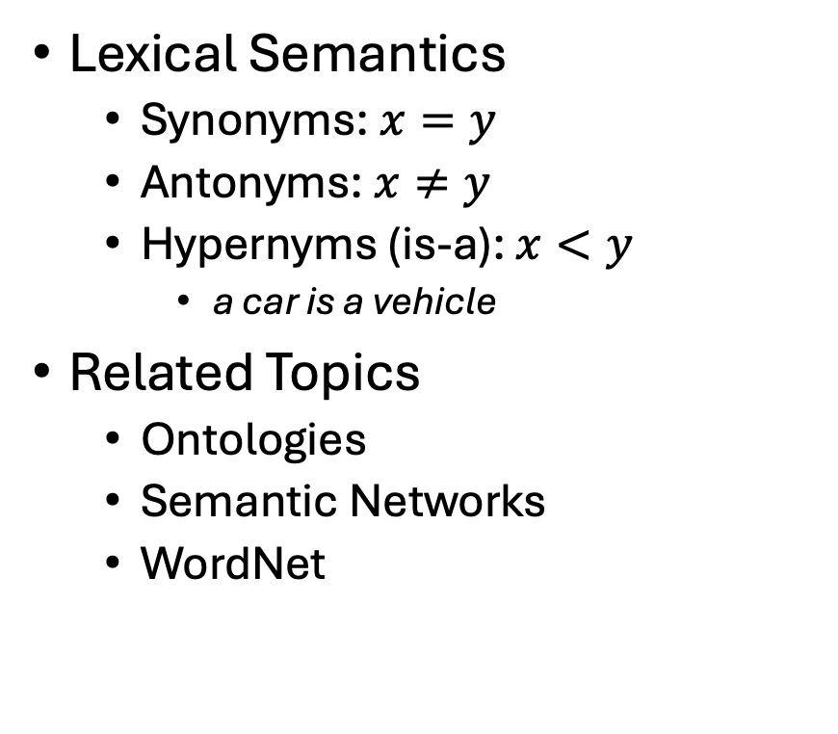
Lexical Semantics → Embeddings
Lexical Semantics
Synonyms: $x=y$
Antonyms: $x≠y$
Hypernyms (is-a): $x<y$
a car is a vehicle
Related Topics
Ontologies
Semantic Networks
WordNet
Vectors/Embeddings:
More modern view of meaning
Behind much of the recent excitement in AI
Large Language Models (LLM)
Bots: ChatGPT, DeepSeek
Equivalence Relation
Partial Order

Slide 4
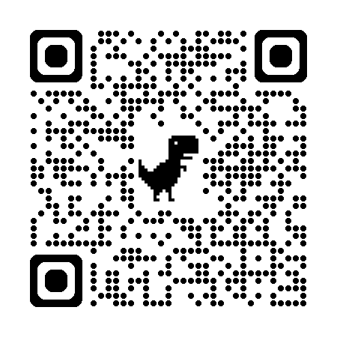
So far
Jurafsky’s Slide 17
Word-Sense Disambiguation (WSD)
Concepts or word senses
Have a complex many-to-many association with words (homonymy, multiple senses)
Have relations with each other
Synonymy
Antonymy
Similarity
Relatedness
Connotation
Collocations
Collocations
Collocations
Collocations
Collocations
Large PMI
https://web.stanford.edu/~jurafsky/slp3/slides/vectorsemantics2024.pdf

Slide 5
Collocations: Examples >> Definitions (George Miller: Chomsky’s Mentor & WordNet)
Exercise: Use “erode” in a sentence:
My family erodes a lot.
to eat into or away; destroy by slow consumption or disintegration
Battery acid had eroded the engine.
Inflation erodes the value of our money.
Miller’s Conclusion:
Dictionary examples are more helpful than definitions
Effective examples:
Make heavy use of collocations
Definition
Examples
6/27/2014
Fillmore Workshop
5

Slide 6
Corpus-Based Lexicography
Examples should be “natural”
Based on corpus evidence
Avoid temptation to make up examples
Representative (sorted by frequency)
Classify concordances by sense (collocates)
Sort senses by frequency

Slide 7
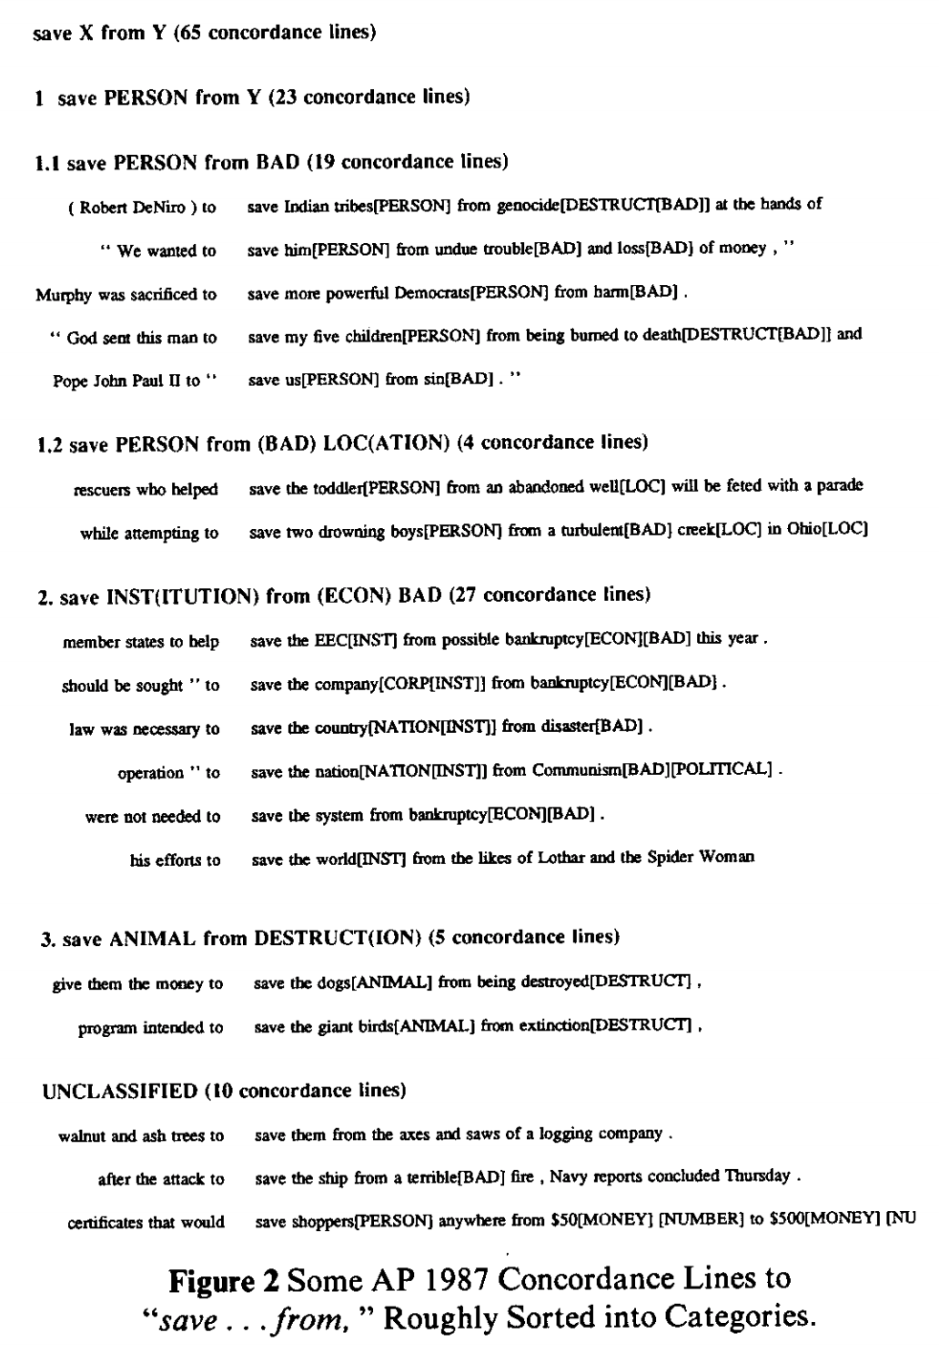
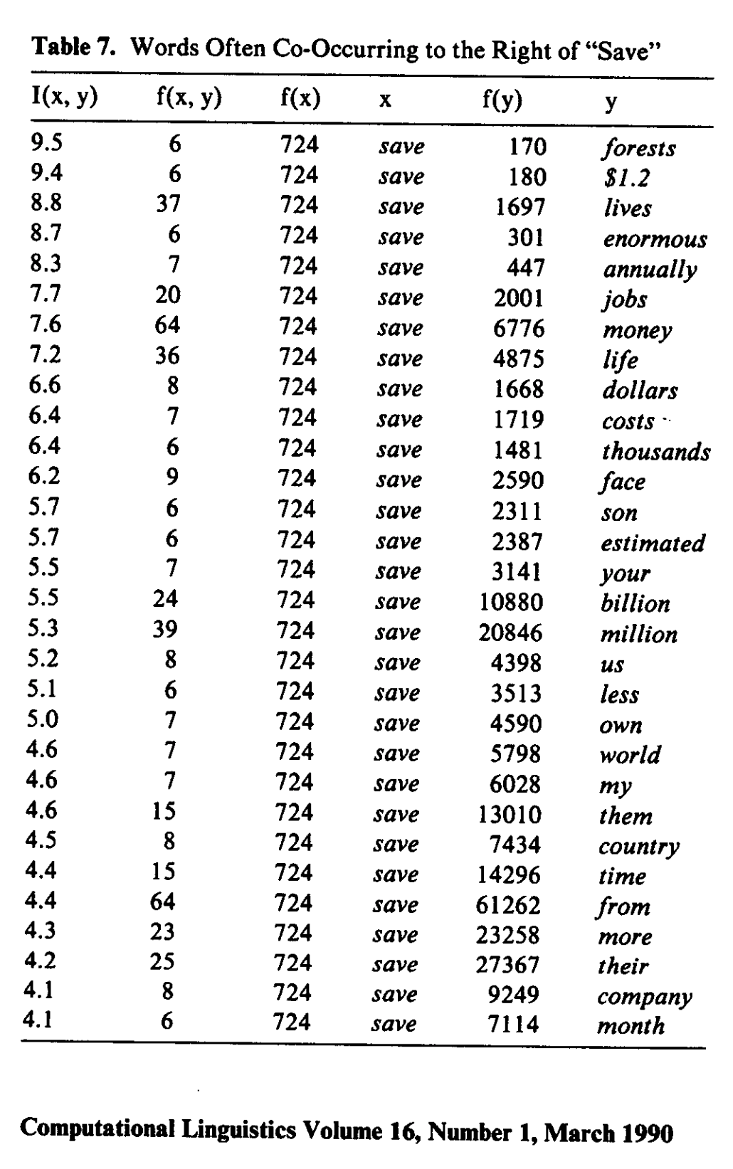
Save <good> from <bad>

Slide 8
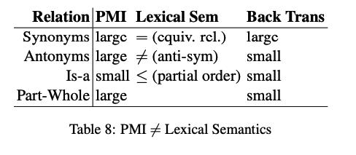

PMI $≠$ Lexical Semantics $≠$ Back Translation
PMI estimates collocations
Probability that two words
appear near one another,
normalized by chance
good / OK / bad
Back Translation
Random walk over translations
Good → Bien → OK
But not, good → … → bad
Large PMI
Collocations:
Truth, Justice & American Way
Red, White and Blue
Synonyms: true / correct
Antonyms: true / false
Part-Whole: window /house

Slide 9
Agenda
Bigger Picture: A personal perspective not found in textbooks
Corpora
Lexical Semantics
Word Associations
Information Theory
PMI → Word2Vec → Bots

Slide 10
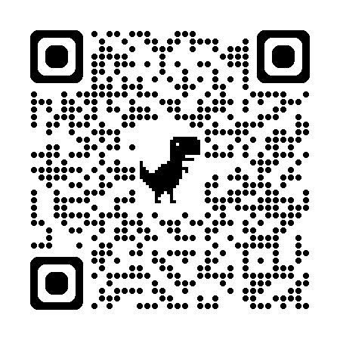
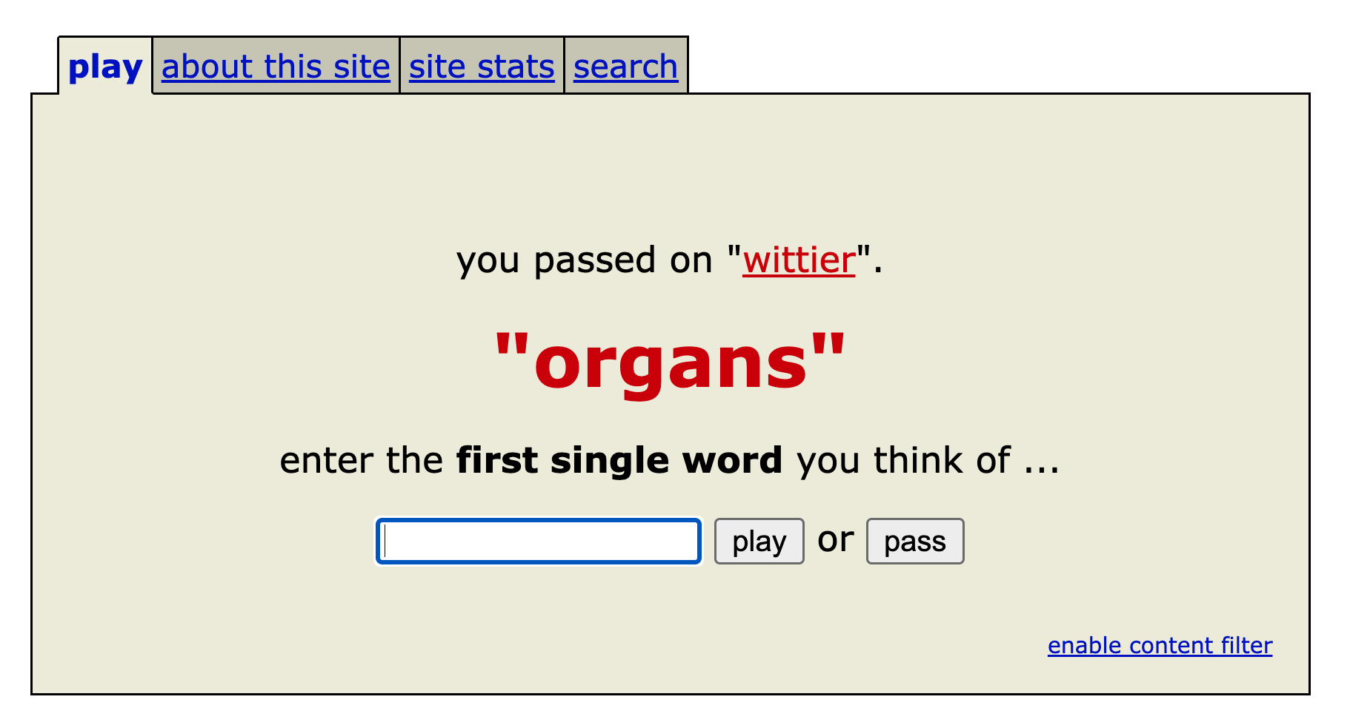
Word Associations https://wordassociation.org/

Slide 11
https://en.wikipedia.org/wiki/Gestalt_psychology
“atomism,” also known as “elementalism,’’
the view that all knowledge, even complex abstract ideas, is built from simple, elementary constituents
“sensationalism,”
the view that the simplest constituents—the atoms of thought—are elementary sense impressions
“associationism,”
the view that more complex ideas arise
from the association of simpler ideas.
PMI: Word Associations

Slide 12
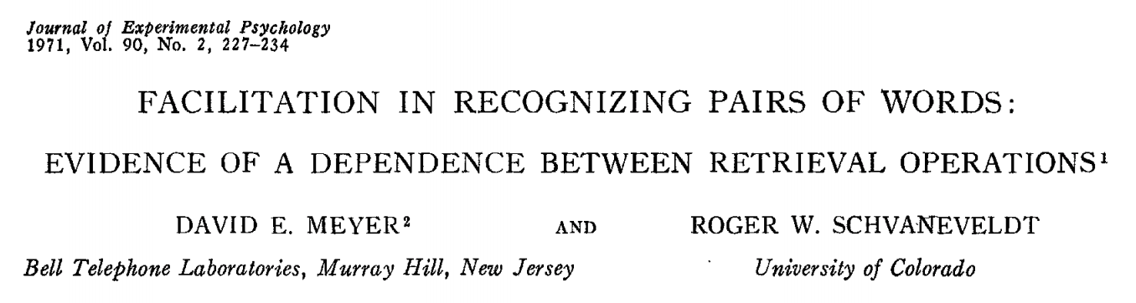
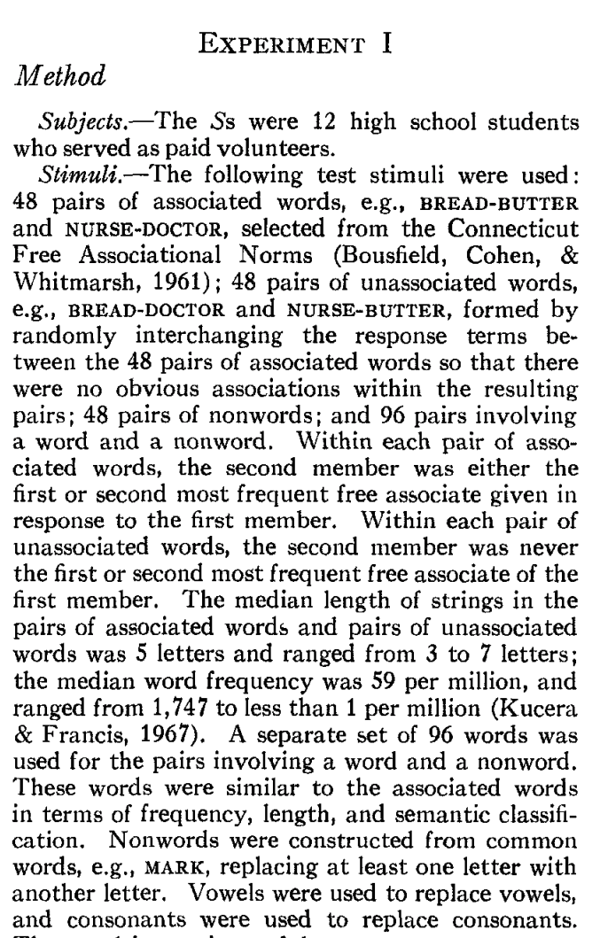
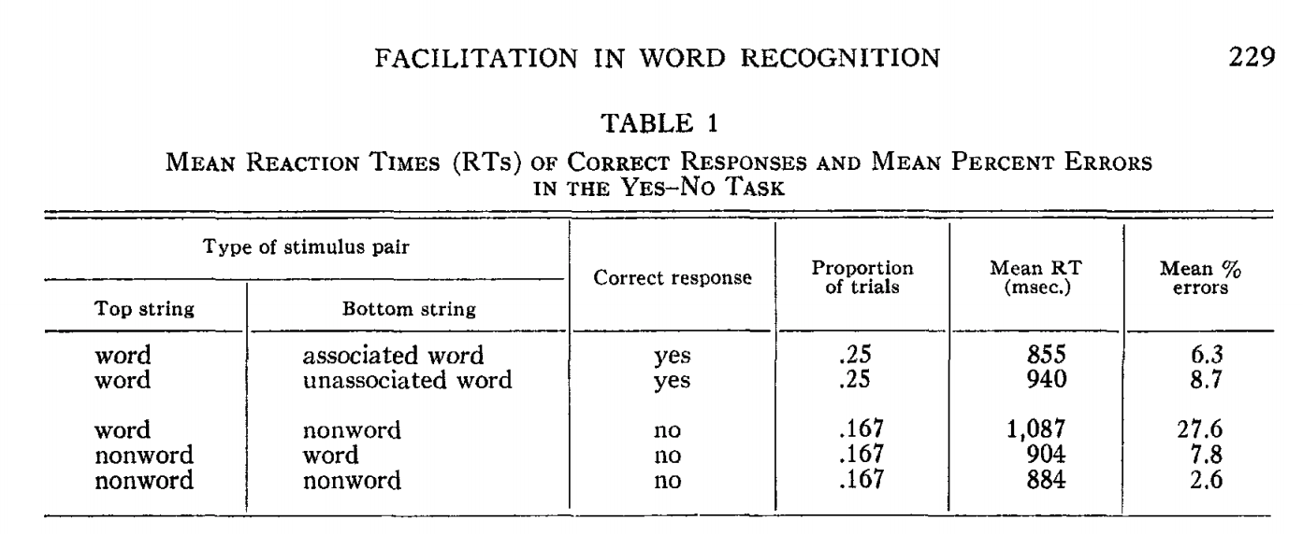
Priming & Word Associations Task: Subject is given two strings and responds “yes” if both are words

Slide 13
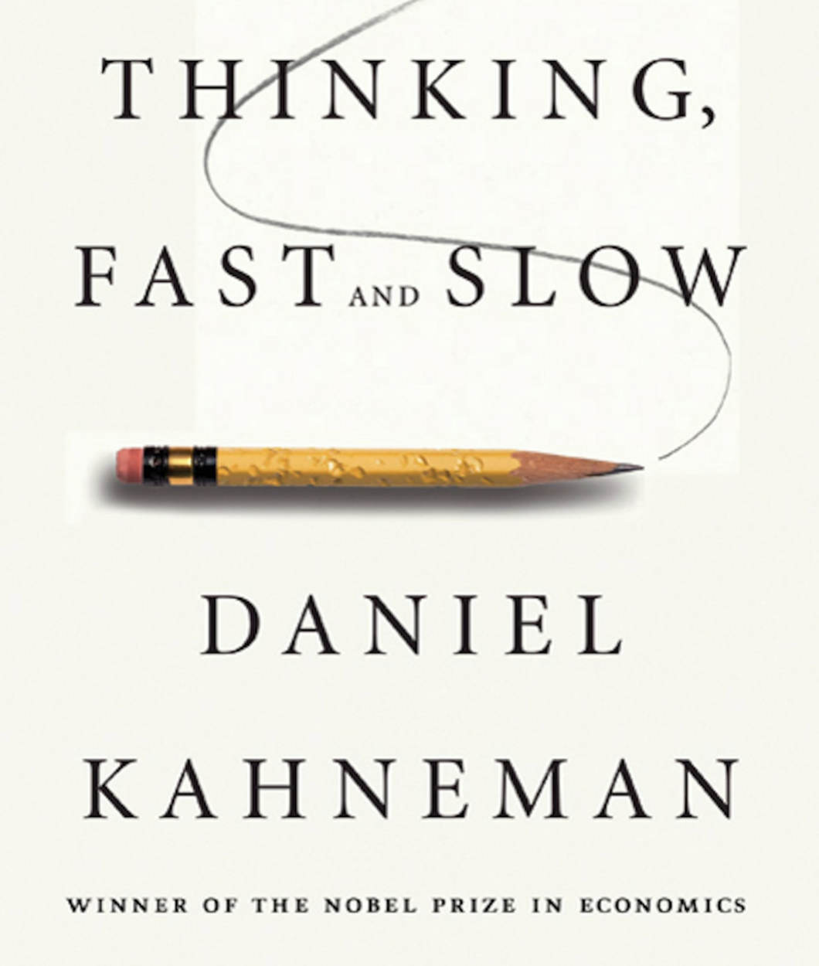
Size of Priming Effect (Split Second): 855 msec v. 940 msec (from previous slide)
System 1 vs System 2
Fast (Unconscious)
Slow
Rules of Thumb
500 msec:
Push a button after tone
1000 msec: Lexical retrieval
Push one button for words and another button for non-words
Longer: System 2
Explain your work

Slide 14
Thinking Fast and Slow Quoted from pp. 20-21
System 1 operates automatically and quickly,
with little or no effort and
no sense of voluntary control.
System 2 allocates attention to the effortful mental activities that demand it, including complex computations.
The operations of System 2 are often associated with the subjective experience of agency, choice, and concentration.

Slide 15
Consequences for Artificial Intelligence (AI)
Recent excitement in AI
Large Language Models (LLMs)
Deep Networks
ChatBots (ChatGPT)
RAG
Thus far, AI is more effective
for System 1 tasks
than System 2 tasks
What about bots for programming?
That sounds like a System 2 task
But bots program by table lookup
More like lexical retrieval
than problem solving
Interpretability: Open problem
Bots find it hard to explain their work
Just as people find it hard to explain
what happens during lexical retrieval

Slide 16
Agenda
Bigger Picture: A personal perspective not found in textbooks
Corpora
Lexical Semantics
Word Associations
Information Theory
PMI → Word2Vec → Bots

Slide 17
Intermission 2

