Slide 1


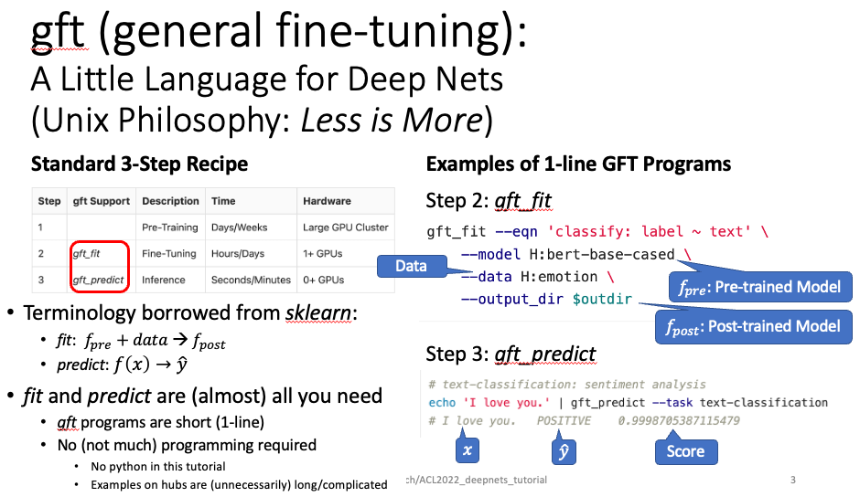
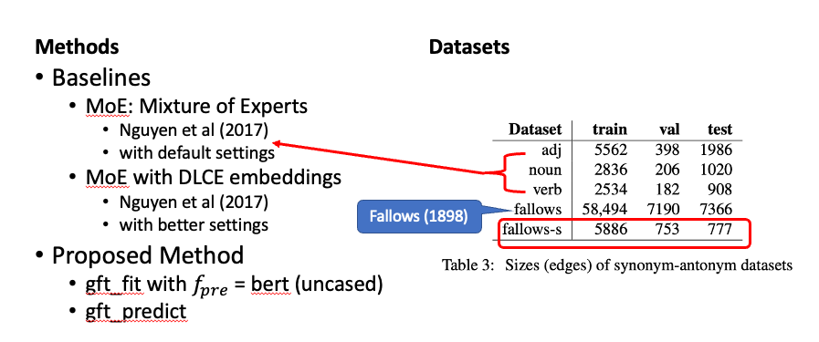
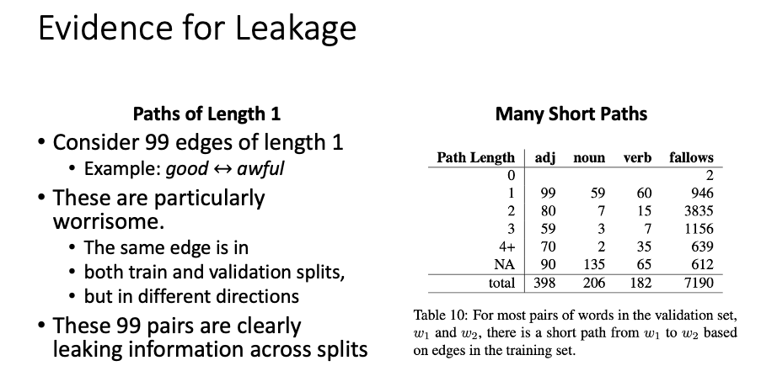
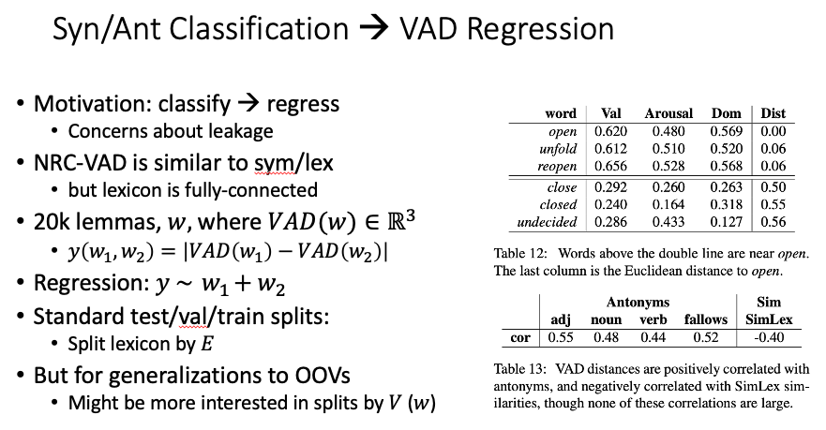
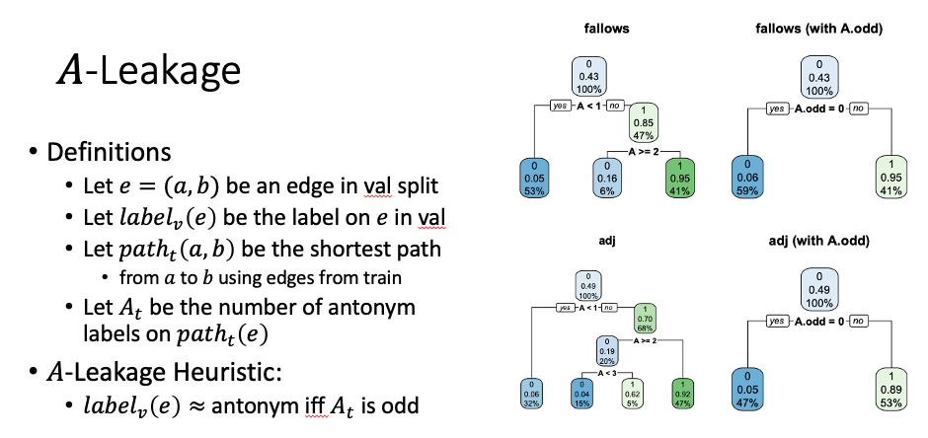
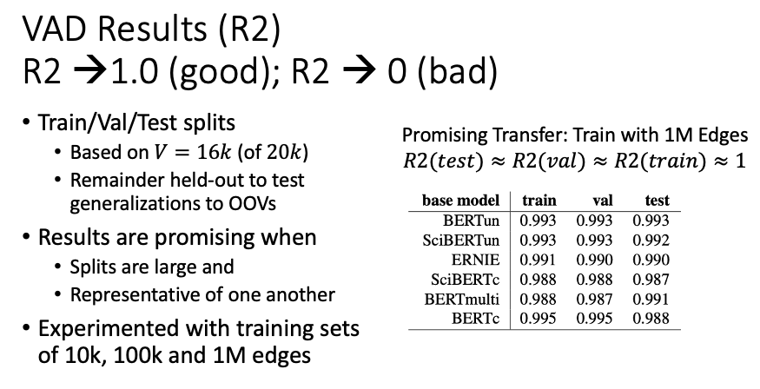

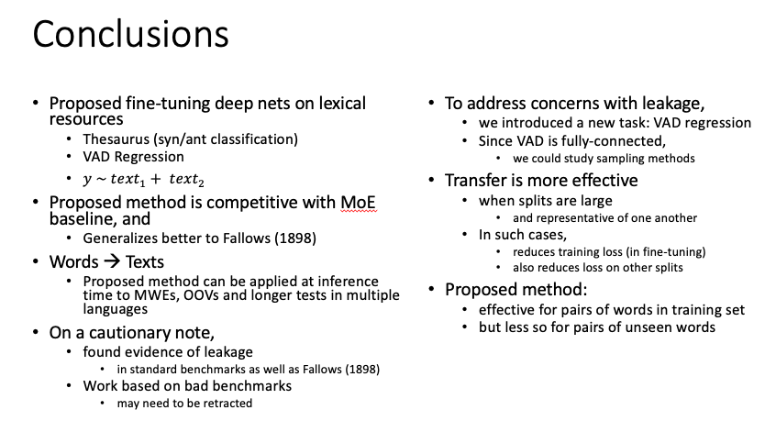
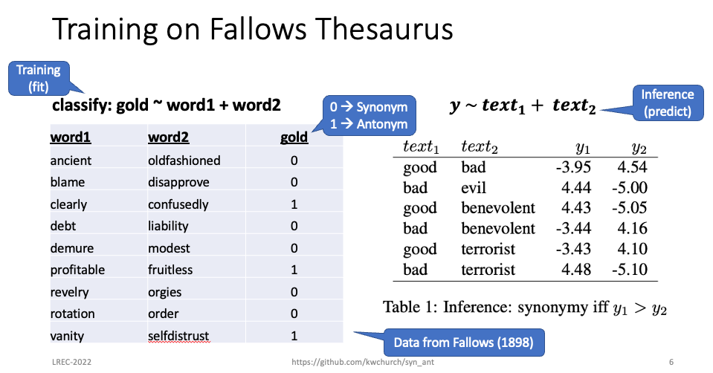
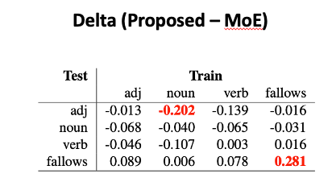
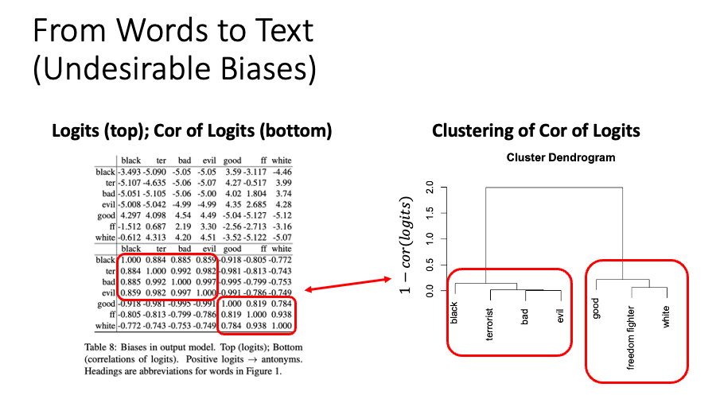
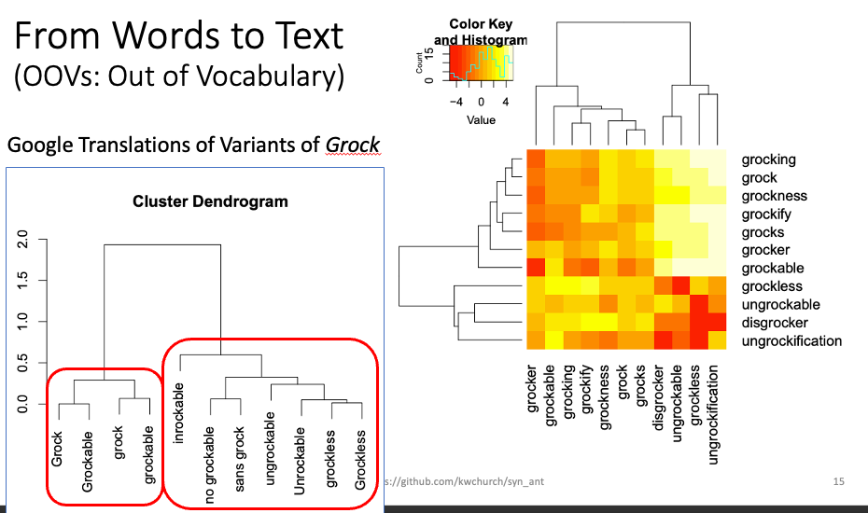
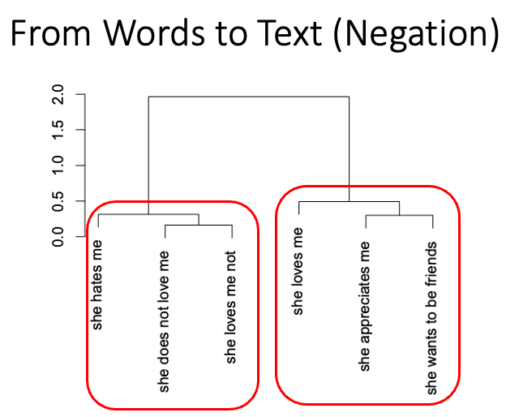
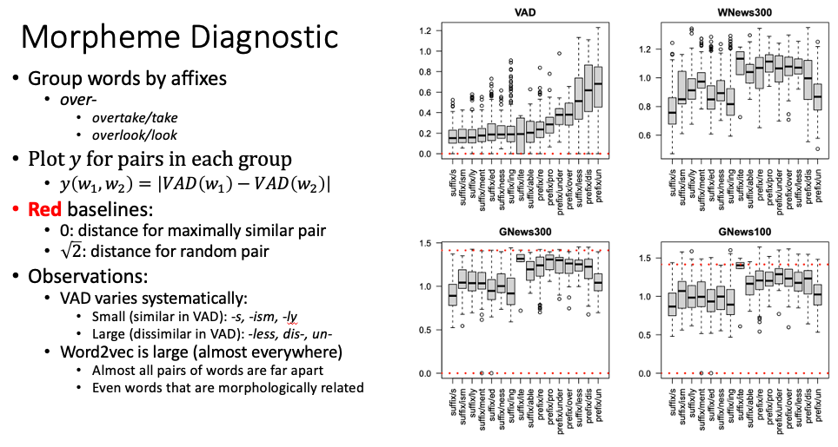
Training on Lexical Resources
Kenneth Church, Xingyu Cai, Yuchen Bian
Baidu, USA
Agenda
Syn/Ant Binary Classification
From Words to Texts
MWEs: Multiword Expressions
OOVs: Out of Vocabulary words
Multi-Lingual
Negation
Leakage with Standard Benchmarks
VAD Regression
VAD = Valance, Arousal, Dominance
Notes:
For assistance with this research poster template visit: https://www.posterpresentations.com/helpdesk.html

