Slide 1


Slide 2
Proof Of Concept - Scope
Technology Stack
Frontend – HTML, CSS, JS, Blade
Backend – PHP Laravel, Eloquent ORM
Database – PostgreSQL(pgAdmin4)
Herd Development Environment
Functional Requirements
RF01 - Online Complaint Registration
RF14 - Multi-tenant data isolation
RF04- Assign Ticket to Support Person
RF05 - Support Person Ticket Update
RF06 – Consumer status tracking
RF18 - Role-based action restriction
Non-Functional Requirements
NFR20 – Form Validation Feedback
NFR08 - The system shall allow system admins to add and remove user accounts.
NFR22 – Support efficient ticket triage providing list views …
NFR21 – Present role-appropriate screens and functions relevant to role
Users
Consumer
Agent
Support Person
Manager
System Admin

Slide 3
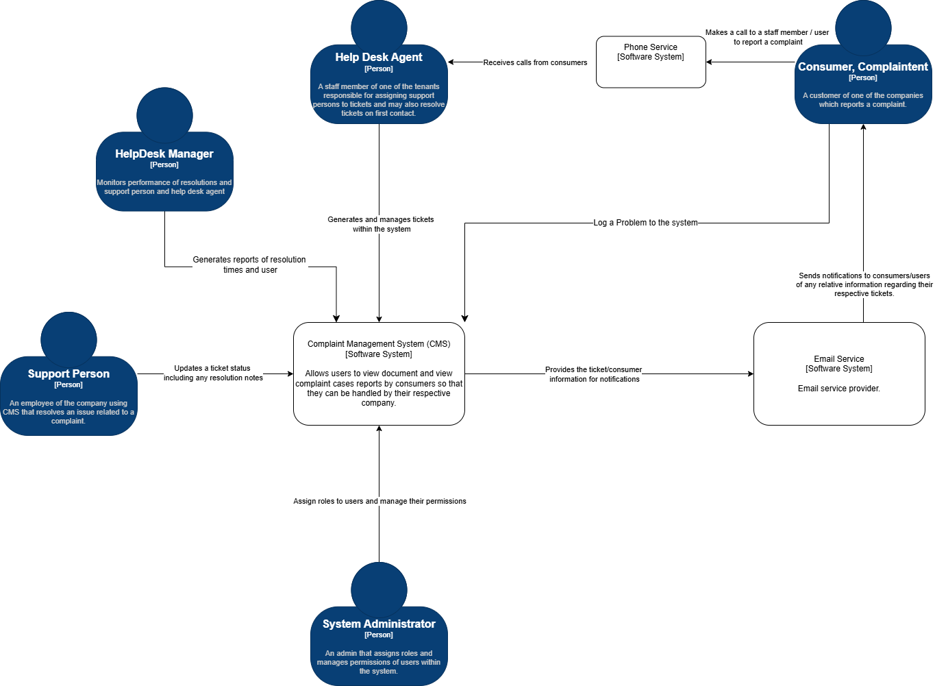
C4 Level 1 - Context
System Boundary – Shows all user roles and external systems
User Interaction –
Highlights roles within the system.

Slide 4
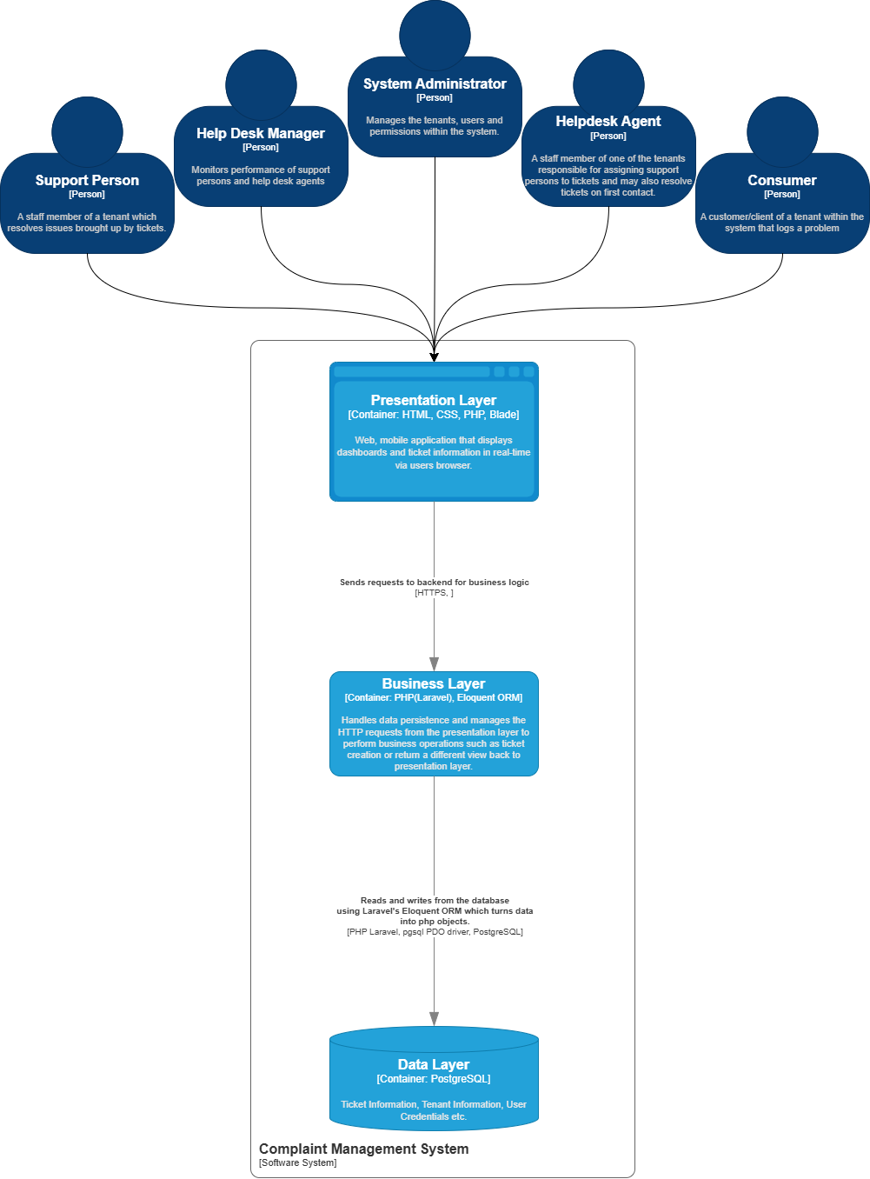
C4 Level 2 – Container
Purpose – High level look at what the main application system is composed of.
Shows where in users interact with system.
Scope – Complaint Management System

Slide 5
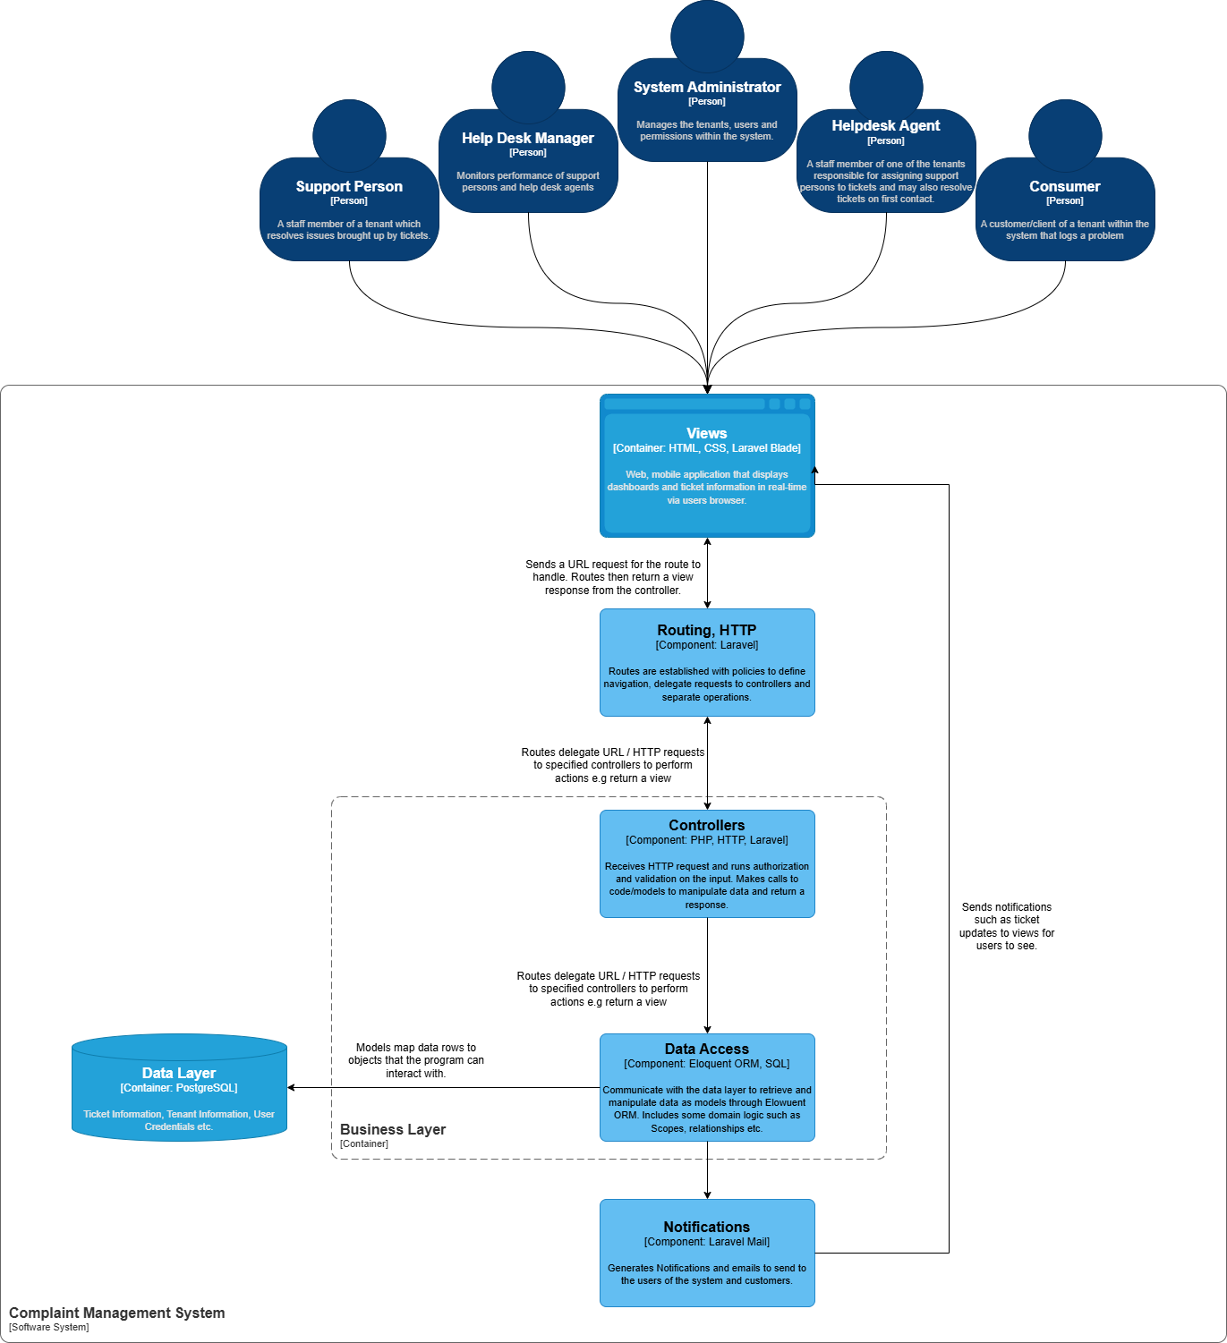
C4 Level 3 - Component
Purpose – Zooms in on container to describe components that reside within.
Scope – Backend Component.
Design – MVC design pattern.
Laravel framework.

Slide 6
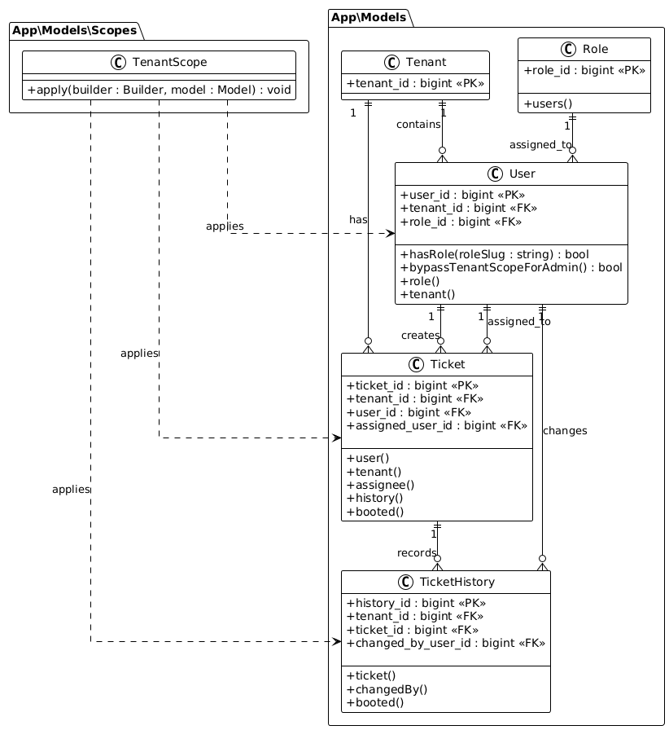
C4 Level 4 - Structural
Scope – Data Access Component
Represents the Eloquent Models
Includes – FK , PK , methods , Relationships
TenantScope applies to all models with record data.:
Makes all permissions TenantScoped for all roles except admin. (“bypassTenantScopeAdmin()”)

Slide 7
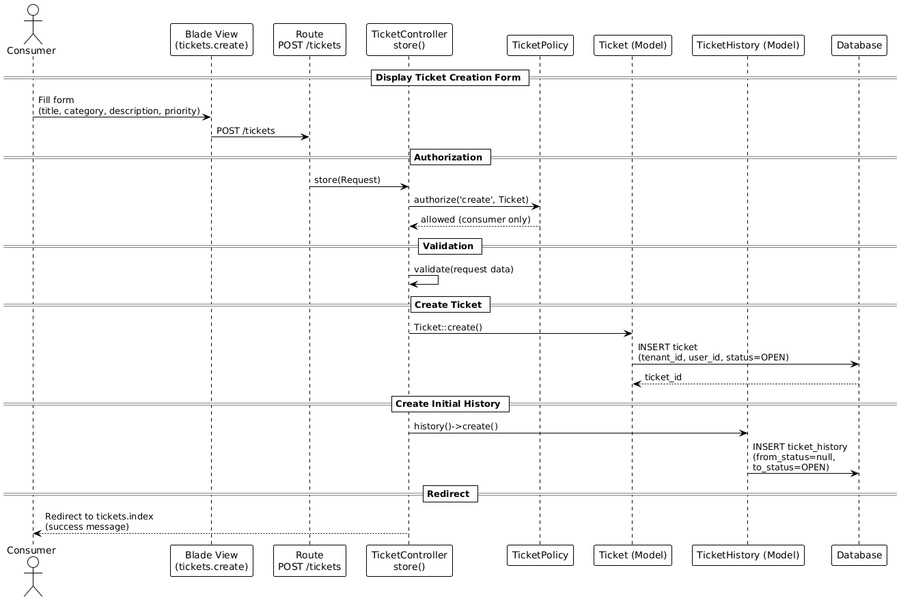
C4 Level 4 - Behavioural
Scope – RF01 Online Complaint Registration
Represents end-to-end flow.
Includes authorization, validation, routing.

Slide 8
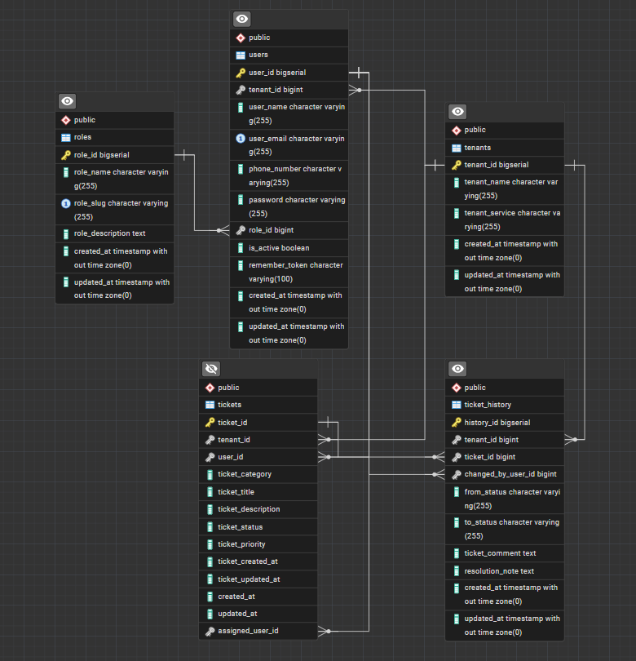
Data Design - ERD
Purpose - Represents the relationship between Tables.
Includes the PK, FK, Relationship Types (Crows Foot Notation)

Slide 9
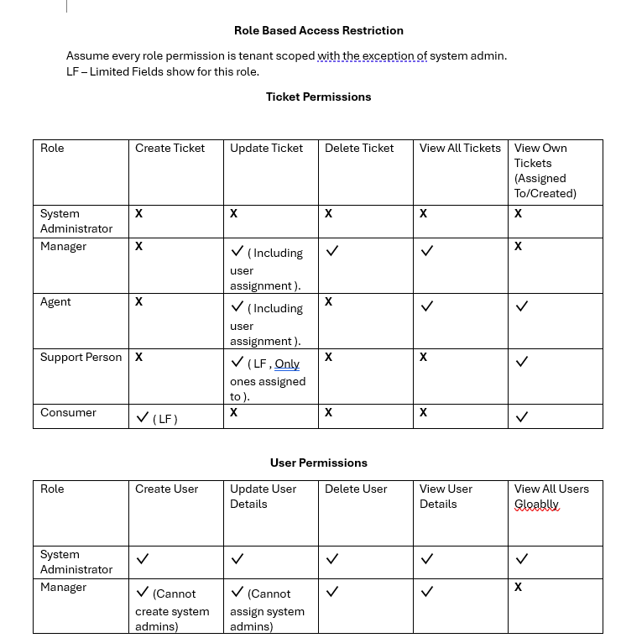
Proof Of Concept: Implements this full Role Based Access Restriction.
Note: Other roles not included in user permissions as none of them can do any function.

