Slide 1
Simple Expense Tracker
Capgemini Assessment
Built by Kyle Day

Slide 2




High-Level Design
read/write
display/form
expense_data.csv
app.py
Frontend Dashboard
File-based storage using expense_data.csv (no DB required)
Streamlit UI with three pages:
  View Expenses
  Add Expense
  Expense Trends
Pandas for data processing (grouping, totals, trend aggregation)
Altair for analytics visualization
Modular engine-like functions inside app (load_expenses, add_expense, etc.)

Slide 3
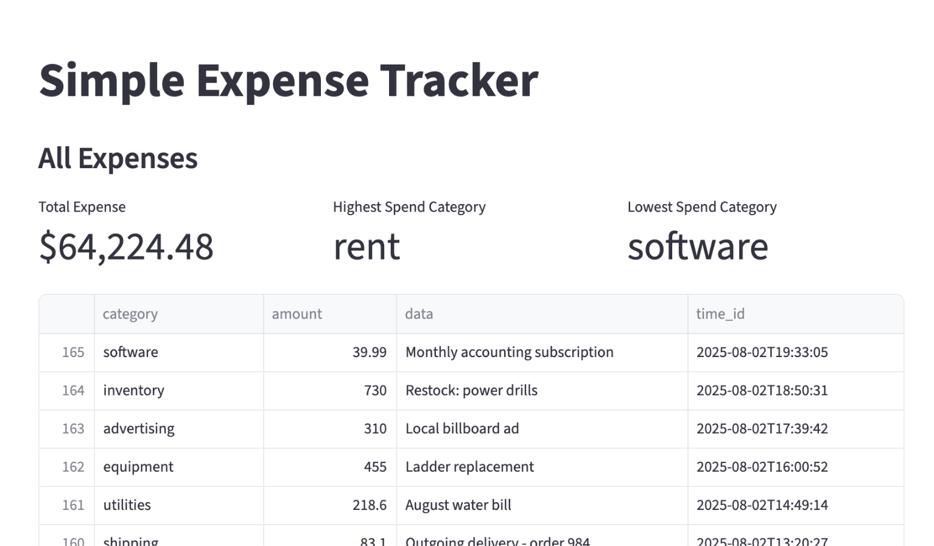
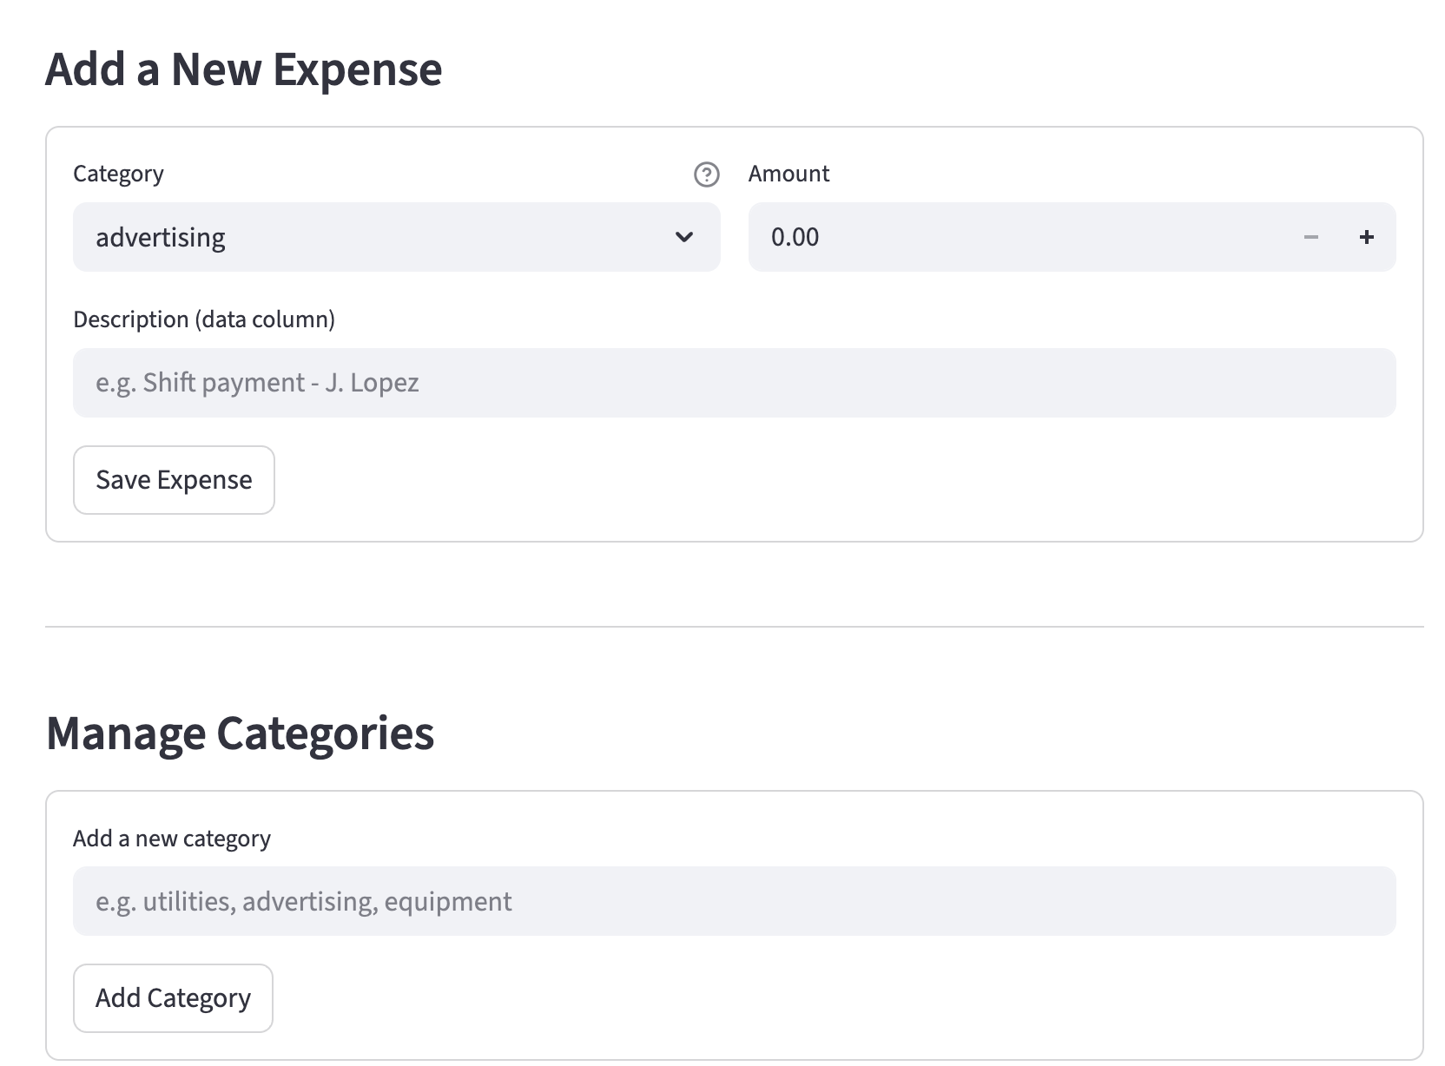
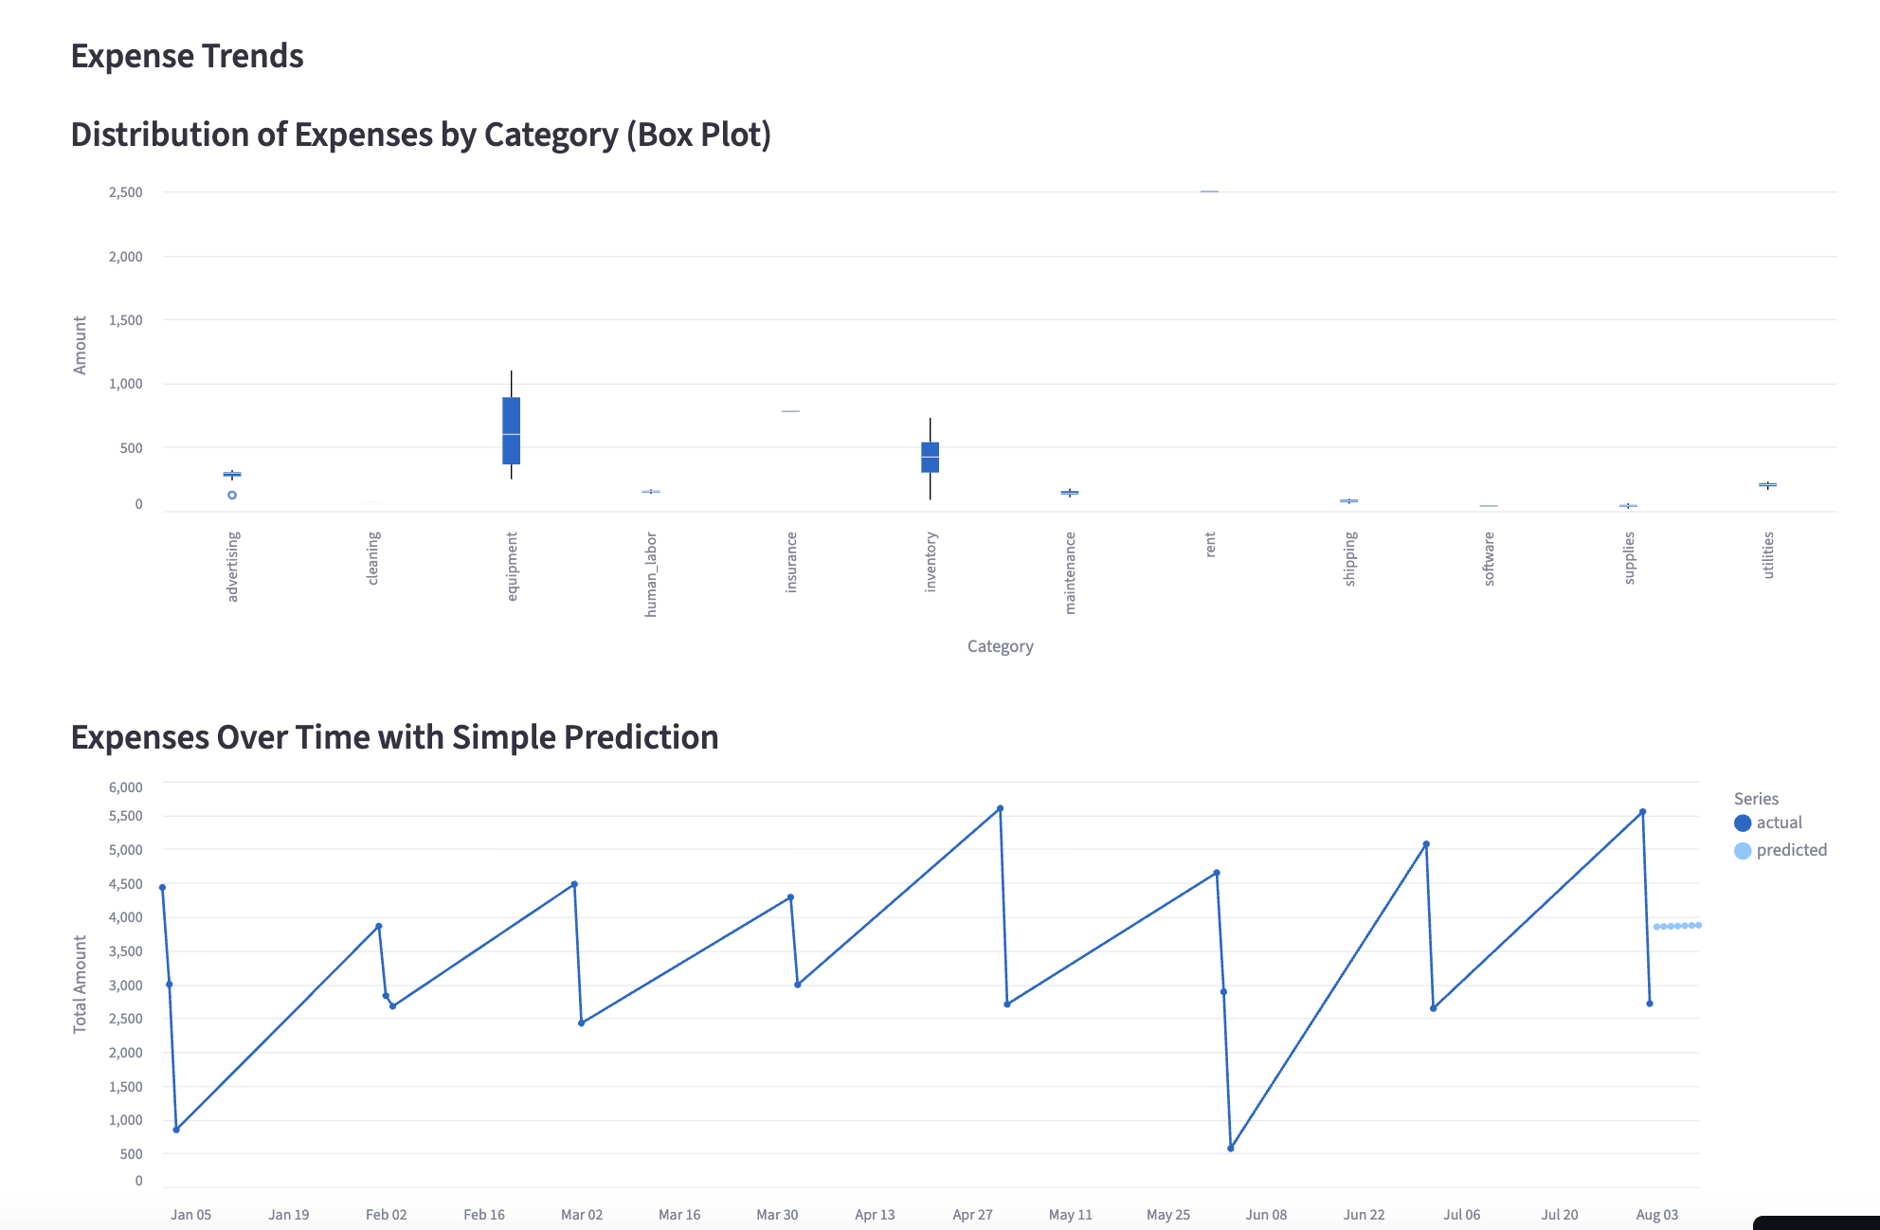
Core Functionality
Add new expenses
Add new categories dynamically
Compute total expense
Total expense by category
Highest and lowest spend categories
Visual analytics:
  Category box plot
  Daily spend trend
  Simple 7-day spend prediction

Slide 4
Project Structure & Key Files
app.py – Main Streamlit UI + logic
expense_data.csv – Seed data (file-based storage)
requirements.txt – Dependencies
README.md – Documentation

Slide 5
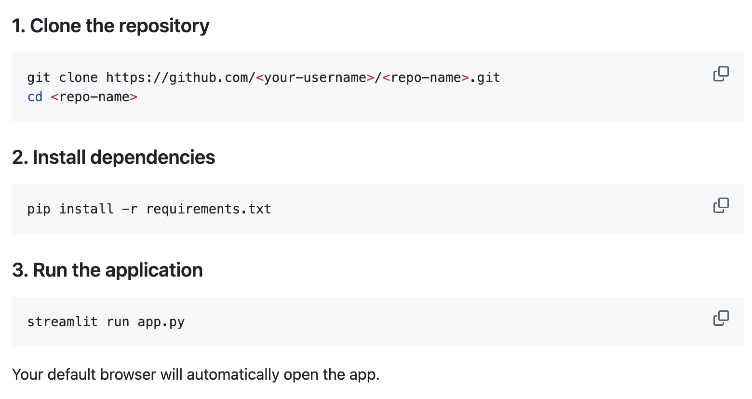
How to Run Locally
Hosted version:
kd-capgemini-app.streamlit.app
*Persists data during runtime
*CSV updates live as expenses are added

Slide 6
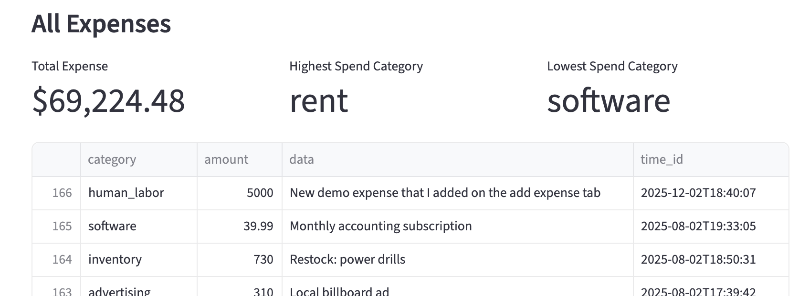
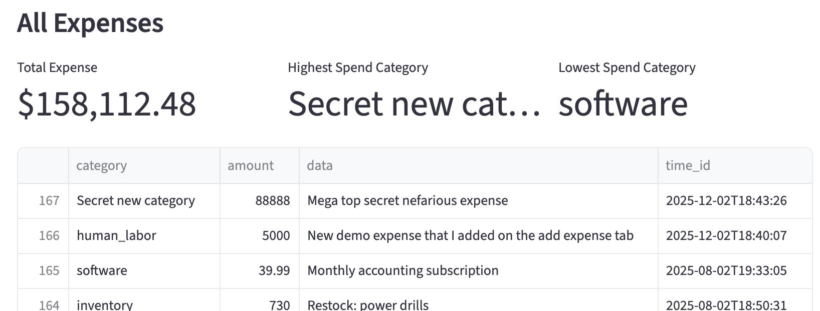
Testing & Verification
Add a new expense → verify:
  Appears in table
  Totals update
  Category totals update
Add a new category → appears in dropdown
View trend page after updates:
  Box plot renders
  Trend line updates
  Prediction line appears

Slide 7
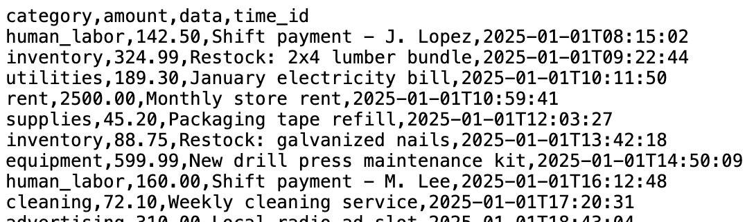
Seed Data
expense_data.csv includes ~160 rows of realistic hardware store expenses
Categories include: labor, rent, inventory, materials, equipment, etc.
Allows full demonstration of:
  Category totals
  Trends over time
  Prediction quality

Slide 8


Future Enhancements
Real database backend (PostgreSQL / SQLite)
User authentication
Export to CSV/Excel
Multi-user expense separation
database
Local report download
app.py
Frontend Dashboard

Slide 9
Thank you!
I’m excited to hear about the next steps of the recruitment process.
https://github.com/kwday888/CapgeminiTestApp/tree/main
https://www.linkedin.com/in/kyle-day-356233229/
day127@purdue.edu
847-463-0829

