Slide 1
Network flows

Slide 2
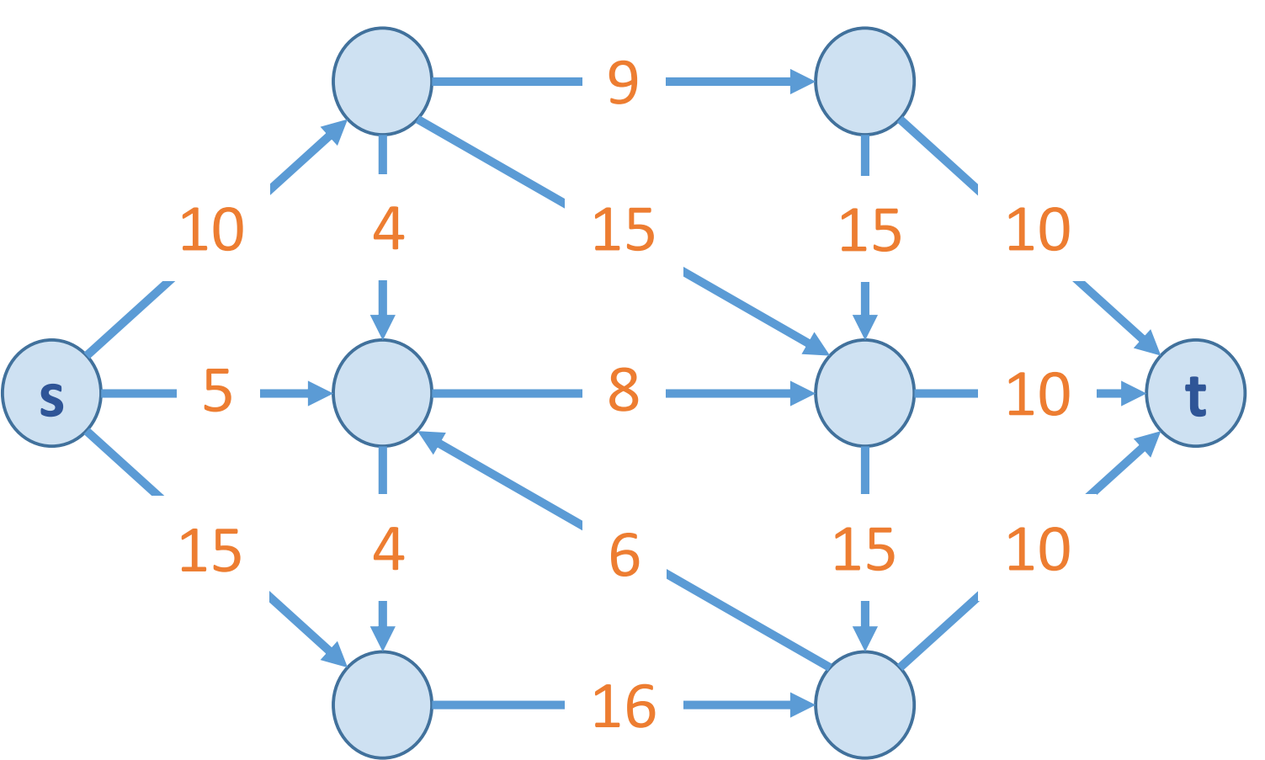
Flow network
A Graph G=(V,E) with source s and sink t
no parallel edges
no edge enters s
no edge leaves t
Each edge e has a non-negative
capacity c(e)

Slide 3
Today’s goal
Solve minimum cut problem
Solve maximum flow problem
Prove that they are equivalent

Slide 4
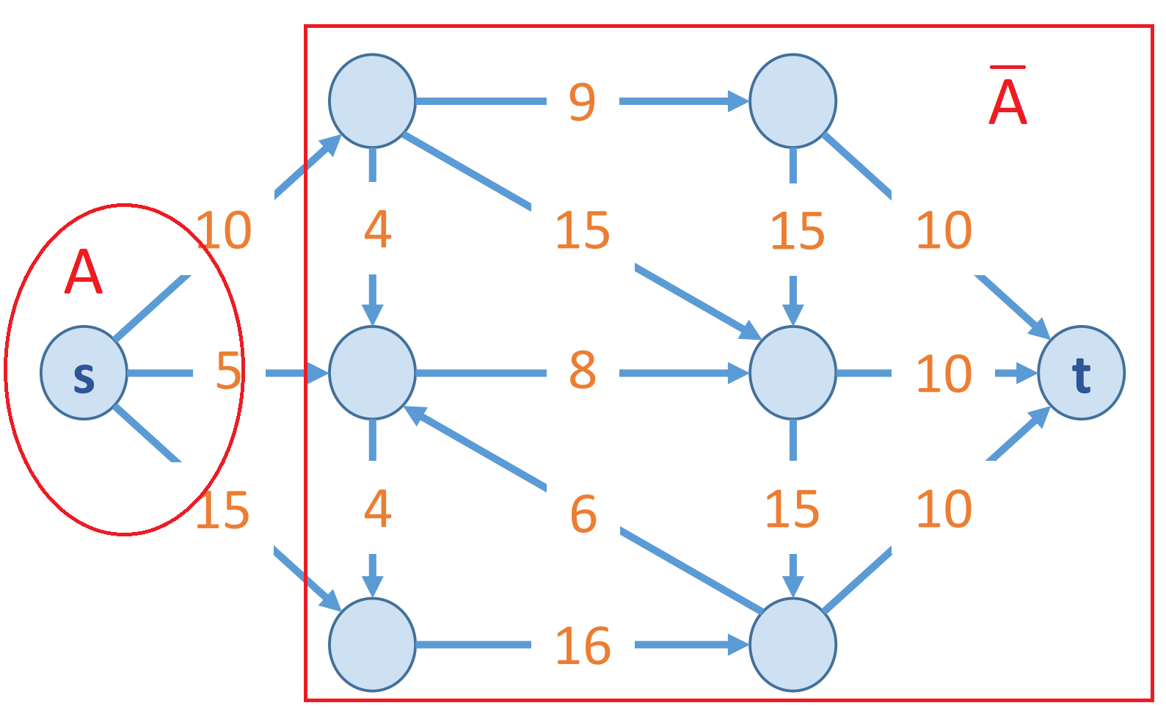
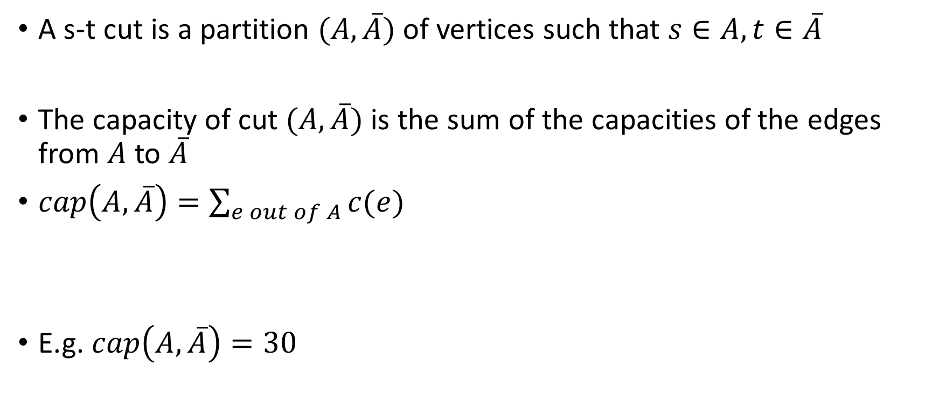
Minimum cut problem
A s-t cut is a partition $(A, \overline{A})$ of vertices such that $s∈A, t∈\overline{A}$
The capacity of cut $(A, \overline{A})$ is the sum of the capacities of the edges from $A$ to $\overline{A}$
$cap\left(A, \overline{A}\right)=\sum_{e out of A}{c(e)}$
E.g. $cap\left(A, \overline{A}\right)=30$

Slide 5
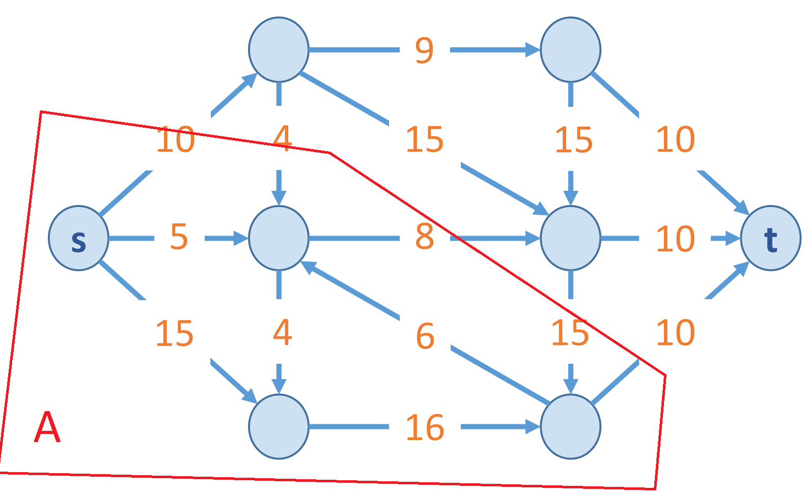

Minimum cut problem : find a cut with minimum capacity
$cap\left(A, \overline{A}\right)=28$

Slide 6
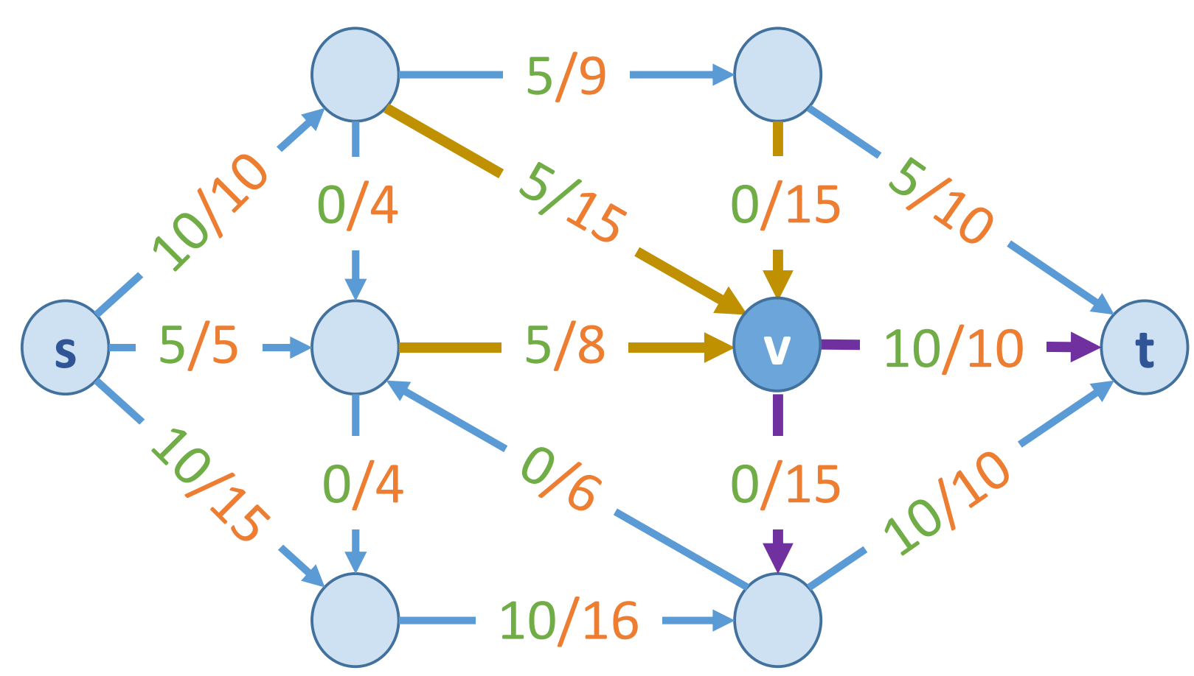

Maximum flow problem
A s-t flow is a function $f:E→ℝ^{+}$ that satisfies
$0≤f\left(e\right)≤c(e)$ (capacity)
$\sum_{e into v}{f(e)}=\sum_{e out of v}{f(e)}$ for $v≠s,t$ (conservation)

Slide 7

The value of a flow $f$ is
$v\left(f\right)=\sum_{e out of s}{v(e)}$
E.g. $v\left(f\right)=25$

Slide 8
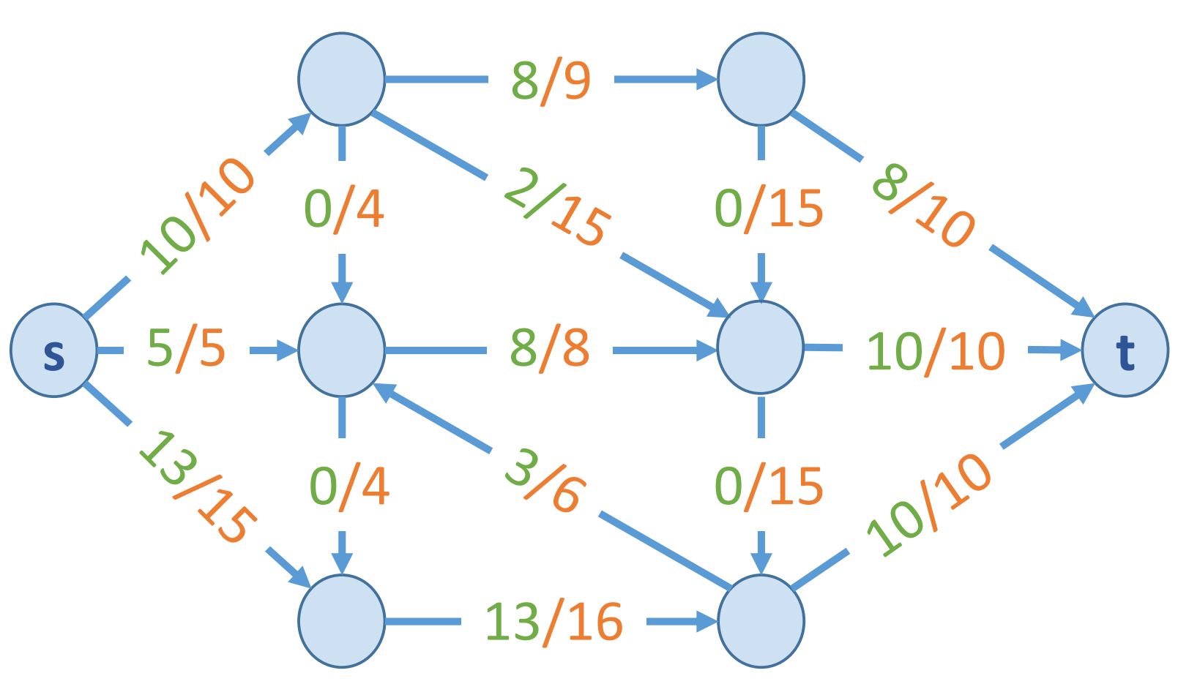

Maximum flow problem: find a flow of maximum value
$v\left(f\right)=28$

Slide 9
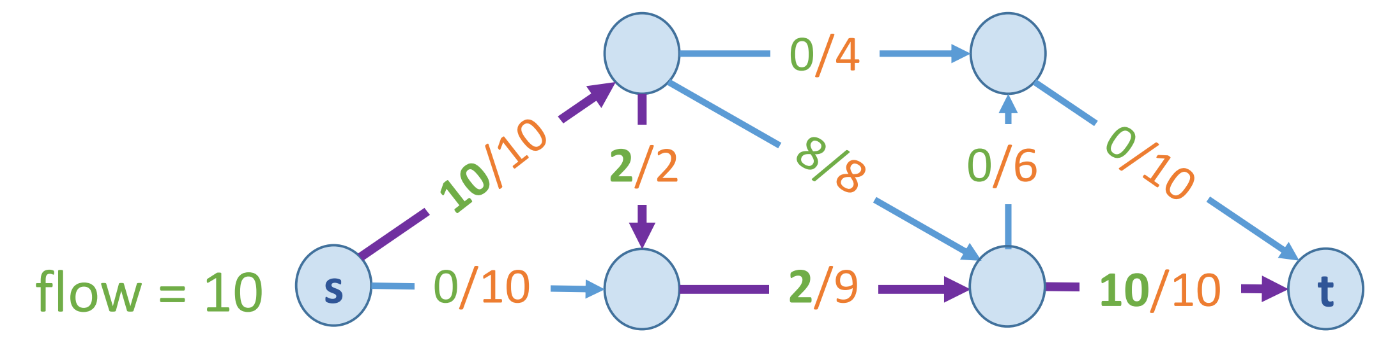
Greedy algorithm
Start with f=0
Find a path p = s->t where f(e)<c(e)
Augment the flow along p
Repeat until we get stuck

Slide 10
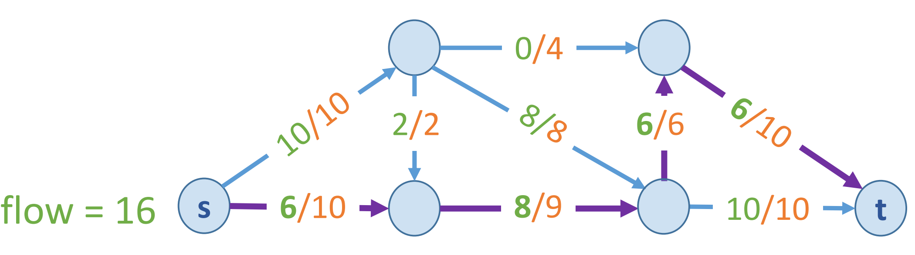

Slide 11
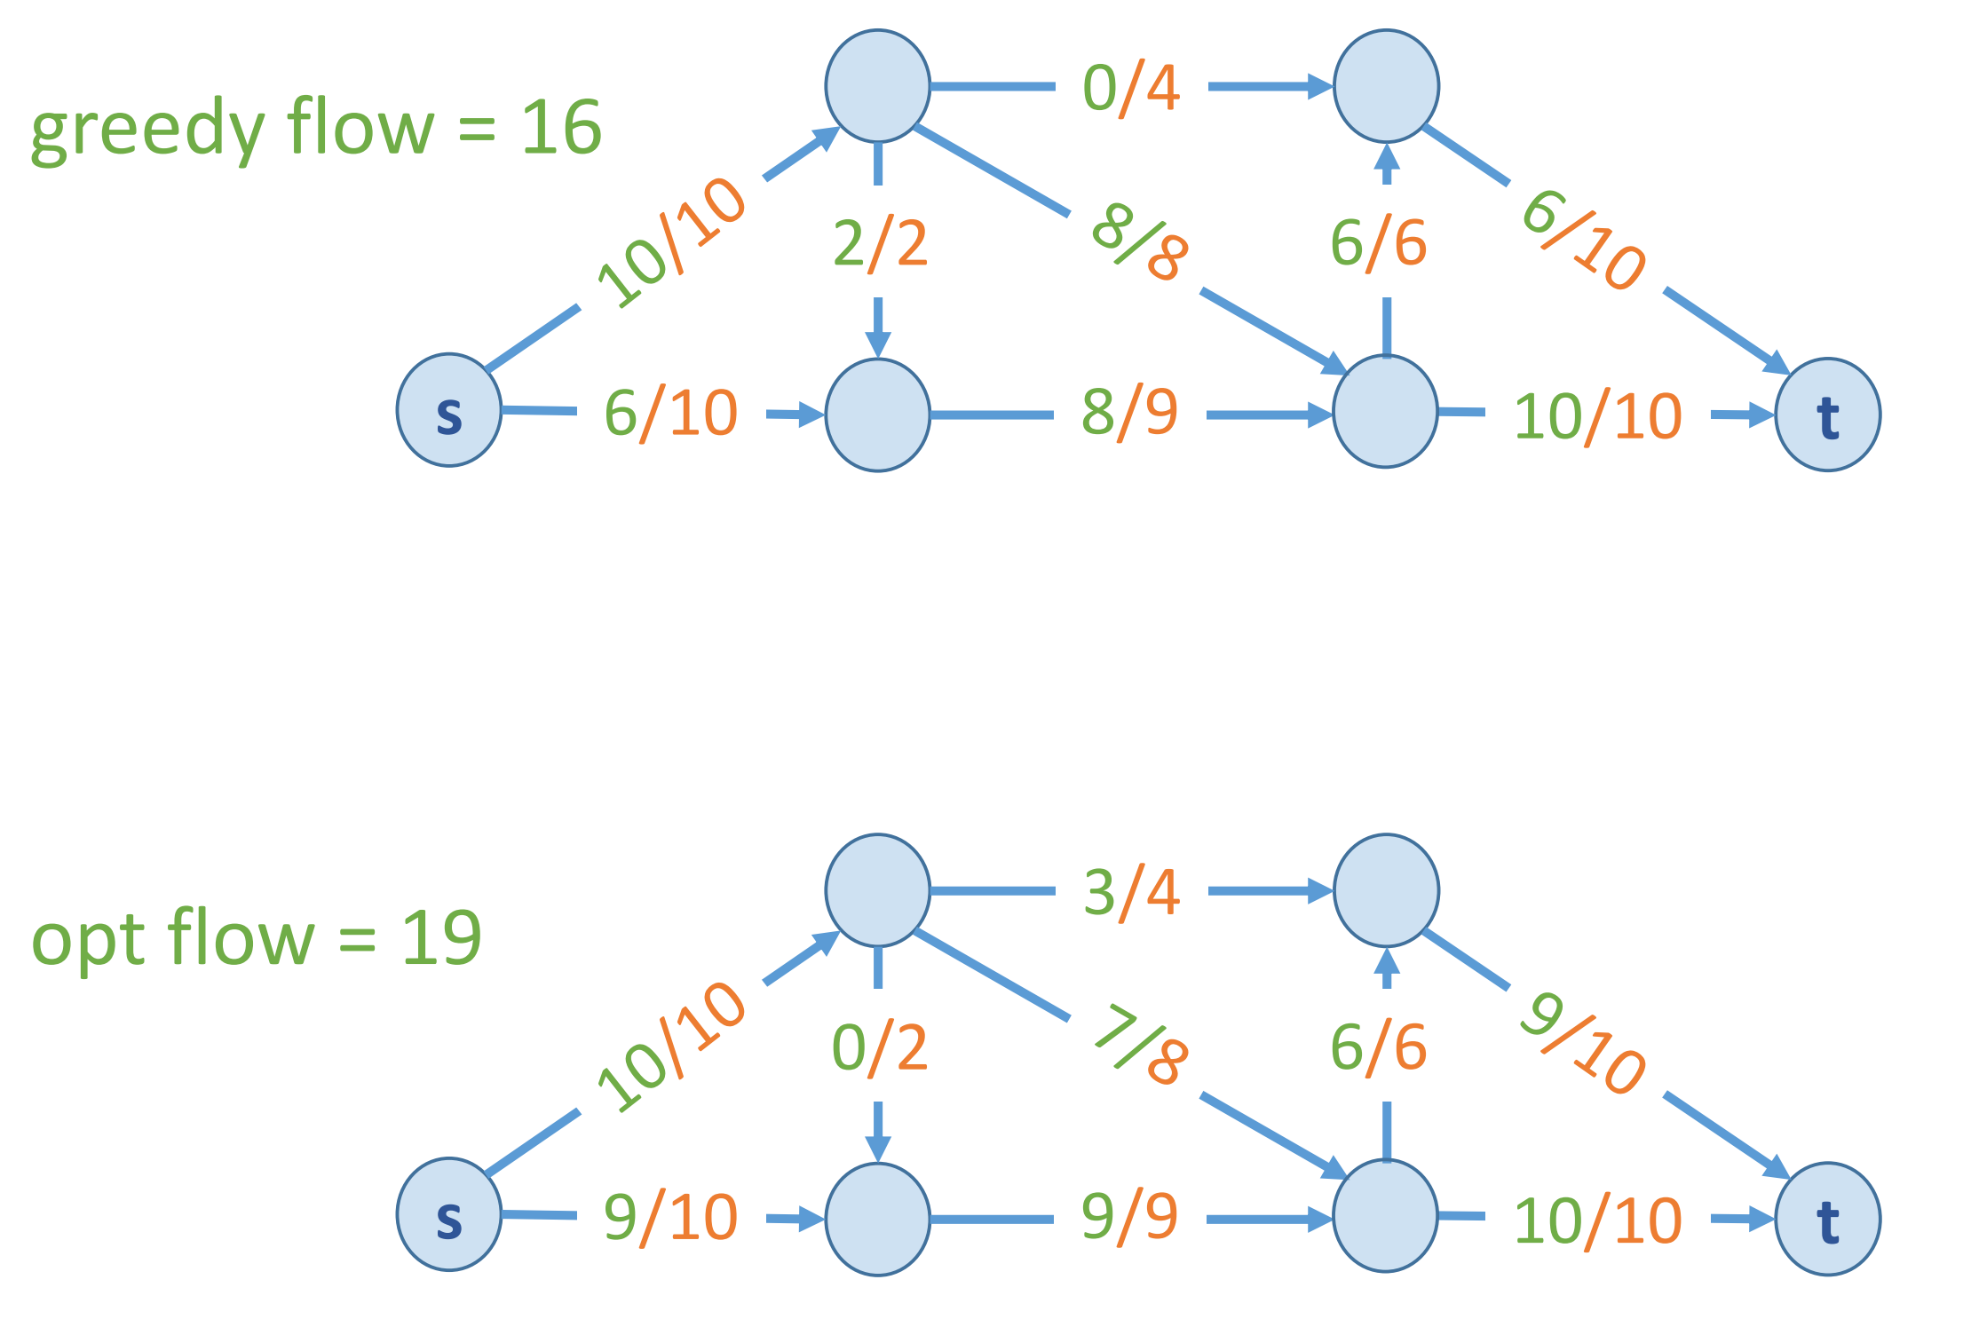

Slide 12
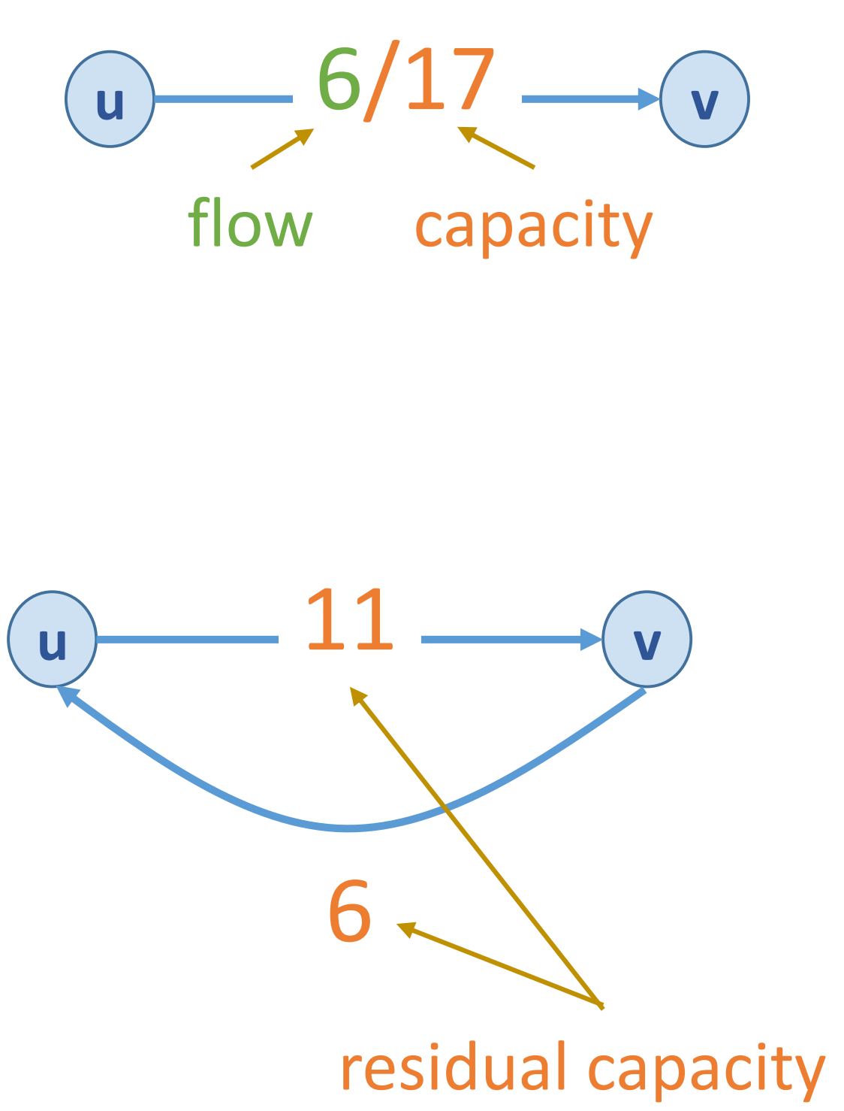

Residual graph
Residual graph $G_{f}$ w.r.t. f:
$e=\left(u,v\right)$ and $e^{R}=\left(v,u\right)$
to “undo” the flow (find another path)
residual capacity $c_{f}\left(e\right)=$
$c(e) – f\left(e\right)$ if $e∈E$
$f\left(e\right)$ if $e^{R}∈E$

Slide 13
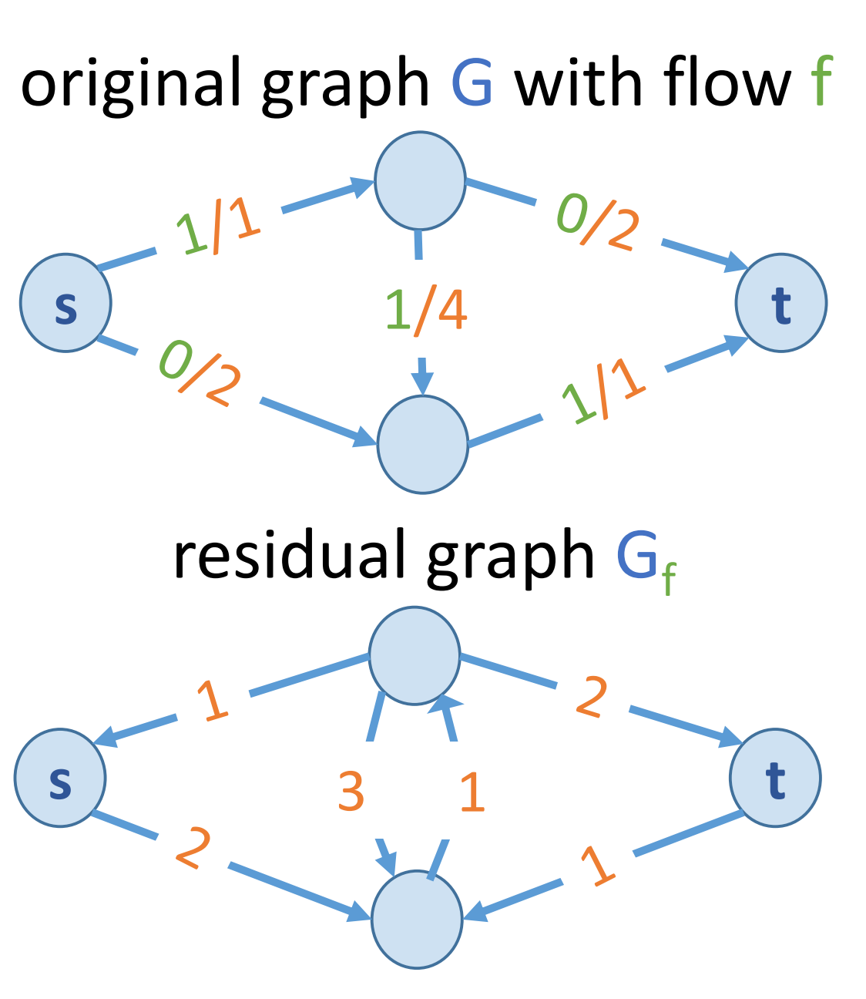
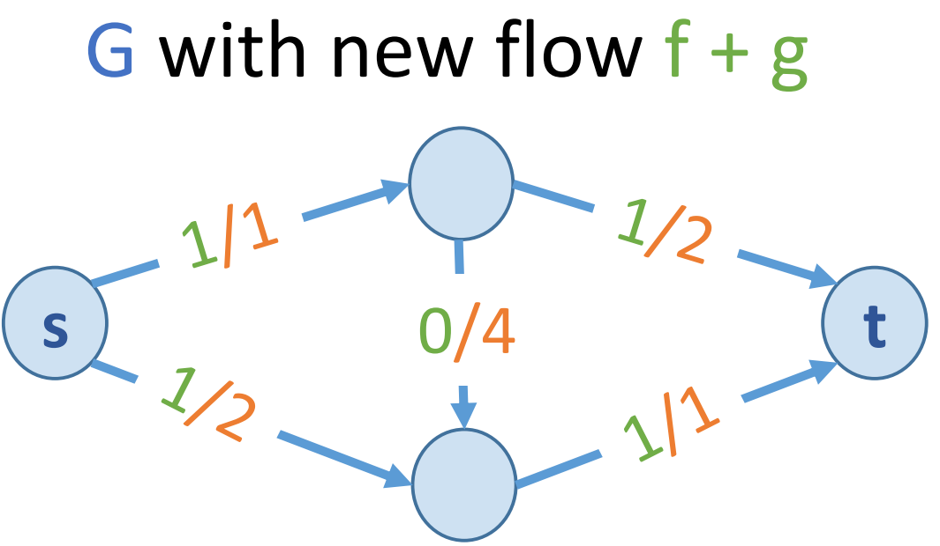
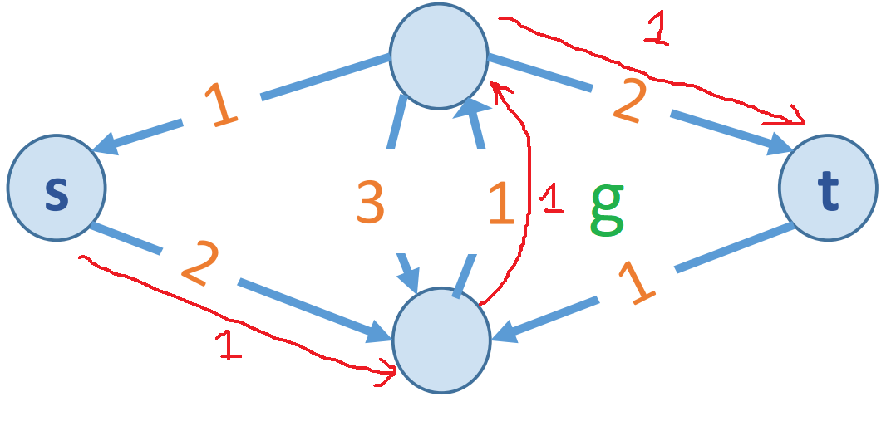

Residual graph $G_{f}=(V, E_{f})$ where
$E_{f}= \{e: f(e) < c(e)\} U \{e^{R}: f(e) > 0\}$
Key property: g is a flow in $G_{f}$
iff f + g is a flow in G

Slide 14
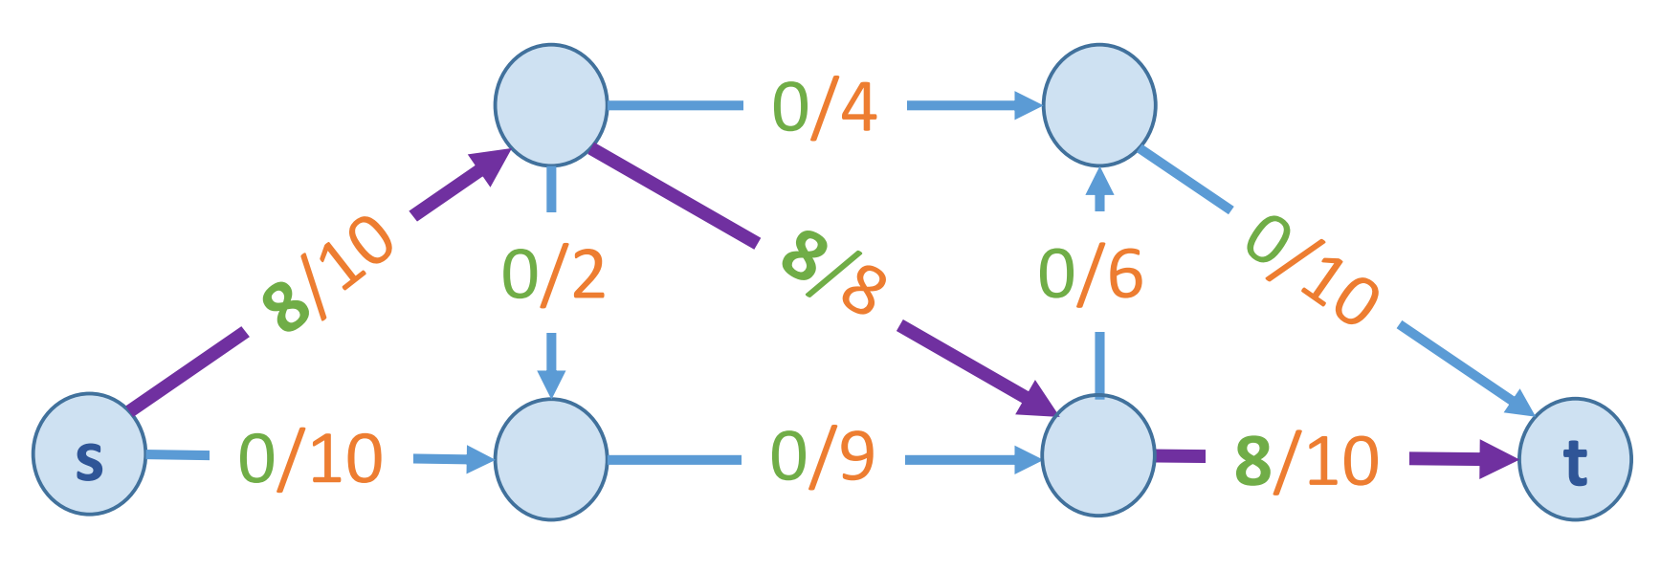
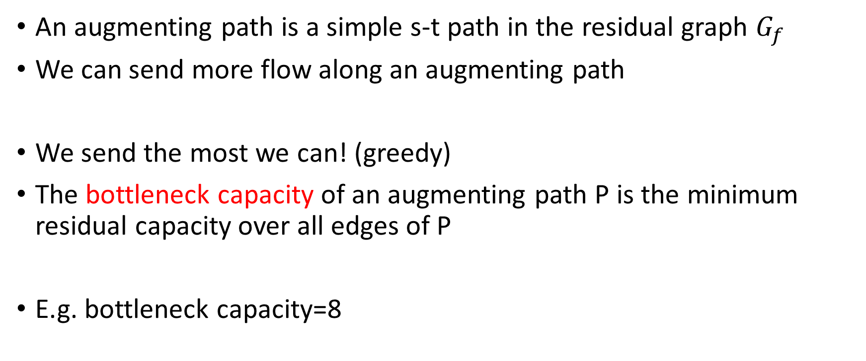
Augmenting path
An augmenting path is a simple s-t path in the residual graph $G_{f}$
We can send more flow along an augmenting path
We send the most we can! (greedy)
The bottleneck capacity of an augmenting path P is the minimum residual capacity over all edges of P
E.g. bottleneck capacity=8

Slide 15
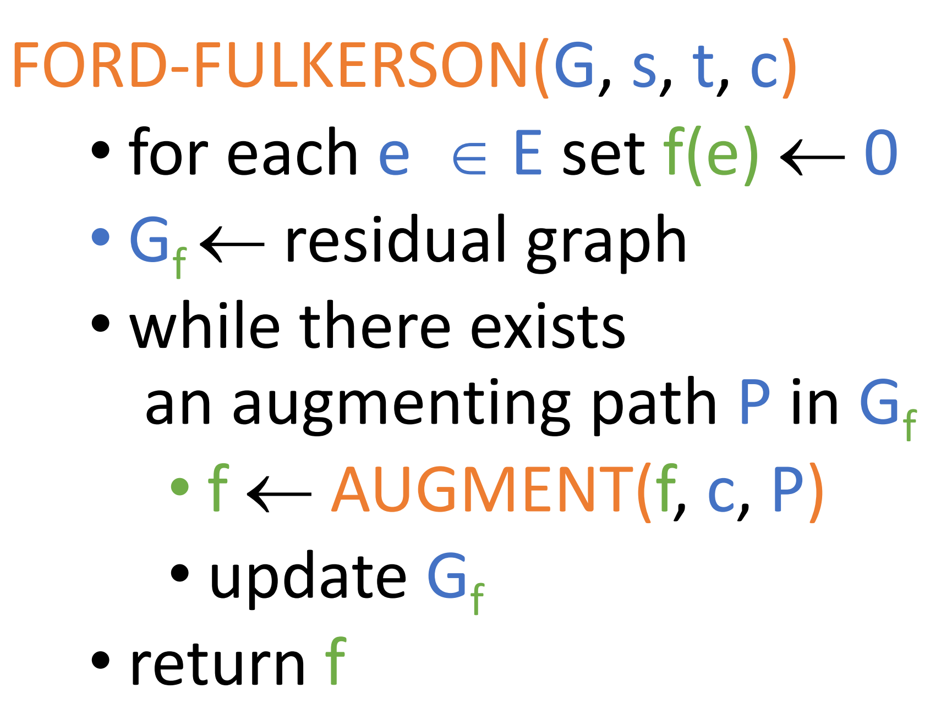
Ford-Fulkerson algorithm

Slide 16
Demo

Slide 17
C++ implementation

Slide 18
Does this always finishes?
The program finishes when there is no augmenting paths…
How do the capacities evolve?
Assume the edge weights are integers
How about rational number, irrational number capacities?

Slide 19
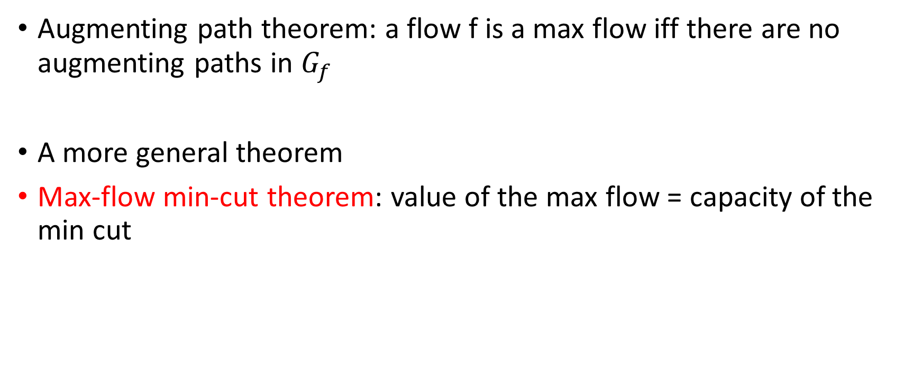
Correctness?
Augmenting path theorem: a flow f is a max flow iff there are no augmenting paths in $G_{f}$
A more general theorem
Max-flow min-cut theorem: value of the max flow = capacity of the min cut

Slide 20
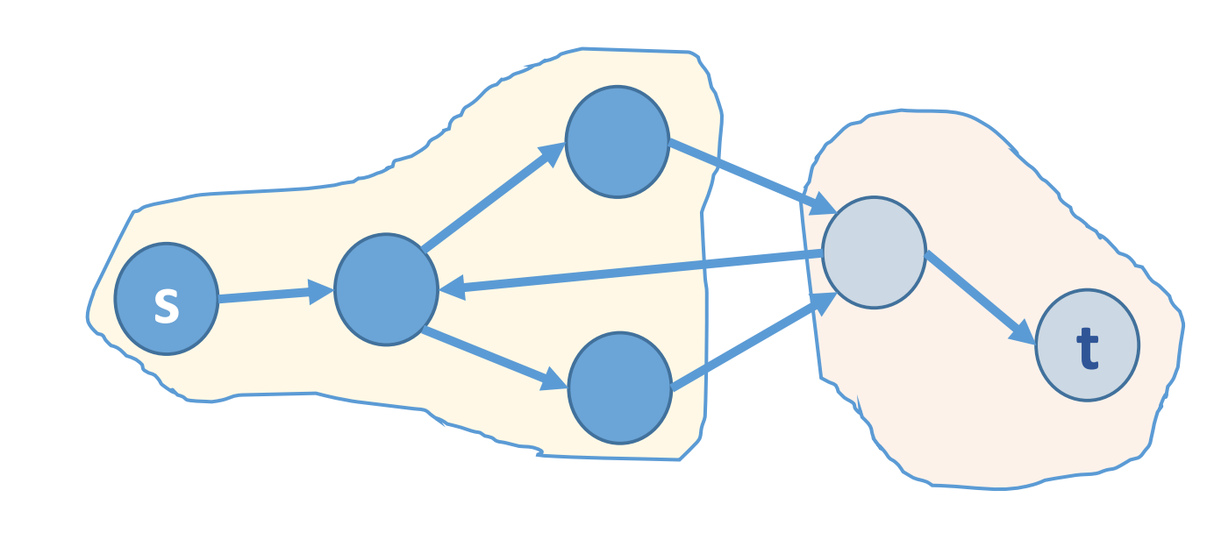
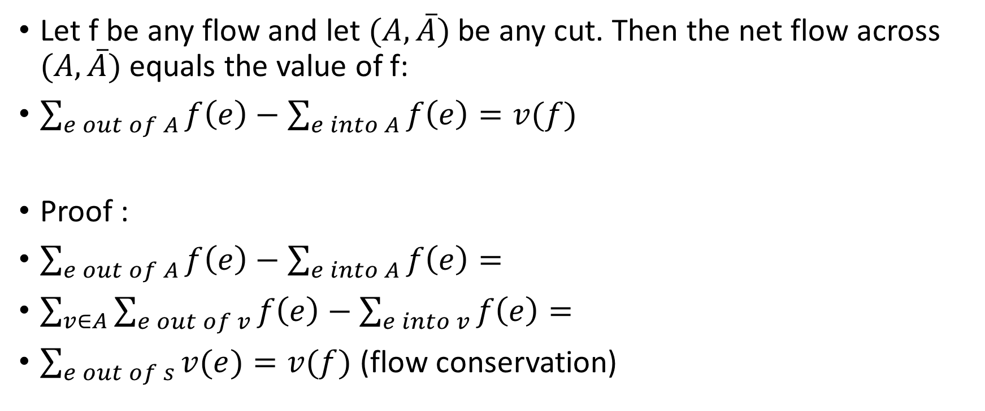
Flow value lemma
Let f be any flow and let $(A, \overline{A})$be any cut. Then the net flow across $(A, \overline{A})$equals the value of f:
$\sum_{e out of A}{f\left(e\right)}−\sum_{e into A}{f\left(e\right)}=v(f)$
Proof :
$\sum_{e out of A}{f\left(e\right)}−\sum_{e into A}{f\left(e\right)}=$
$\sum_{v∈A}{\sum_{e out of v}{f\left(e\right)}−\sum_{e into v}{f\left(e\right)}}=$
$\sum_{e out of s}{v(e)}=v(f)$ (flow conservation)

Slide 21

Corollary (weak duality)
Let f be any flow and let $(A, \overline{A})$be any cut. Then $v(f) ≤cap(A, \overline{A})$
Proof :$v\left(f\right)=\sum_{e out of A}{f\left(e\right)}−\sum_{e into A}{f\left(e\right)}$
$≤\sum_{e out of A}{f\left(e\right)}≤\sum_{e out of A}{c\left(e\right)}=cap(A, \overline{A})$

Slide 22
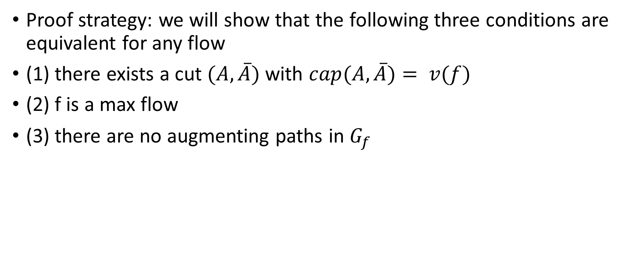
Max-flow min-cut theorem
Proof strategy: we will show that the following three conditions are equivalent for any flow
(1) there exists a cut $(A, \overline{A})$with $cap(A, \overline{A})= v(f)$
(2) f is a max flow
(3) there are no augmenting paths in $G_{f}$

Slide 23
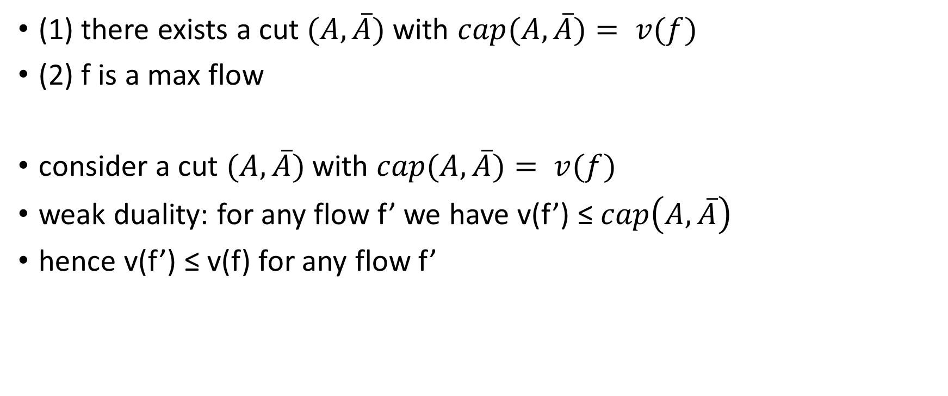
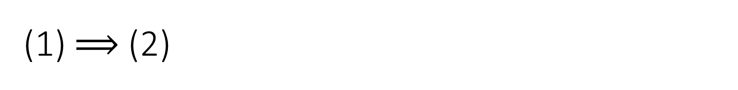
(1) $⟹$ (2)
(1) there exists a cut $(A, \overline{A})$with $cap(A, \overline{A})= v(f)$
(2) f is a max flow
consider a cut $(A, \overline{A})$with $cap(A, \overline{A})= v(f)$
weak duality: for any flow f’ we have v(f’) ≤ $cap\left(A, \overline{A}\right)$
hence v(f’) ≤ v(f) for any flow f’

Slide 24
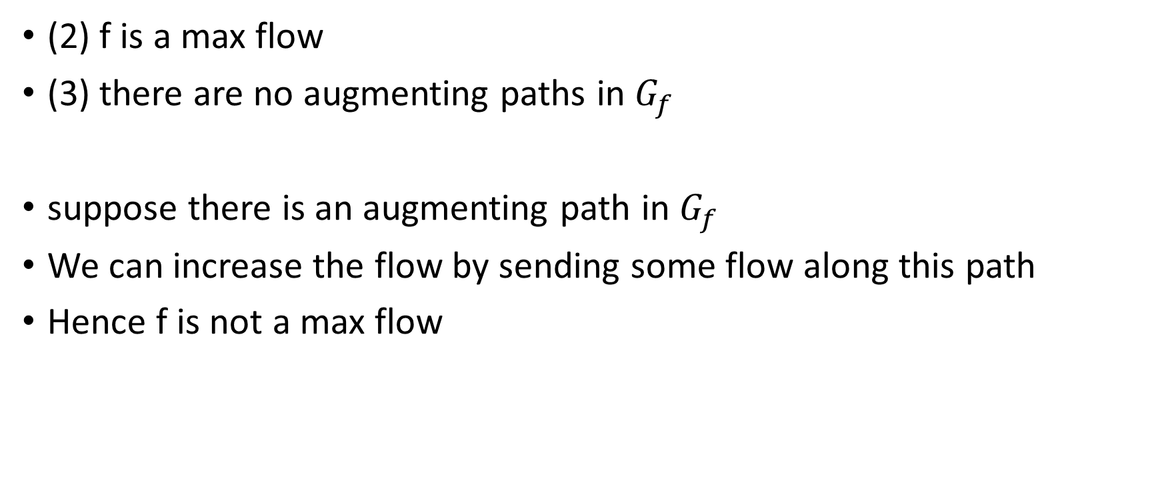
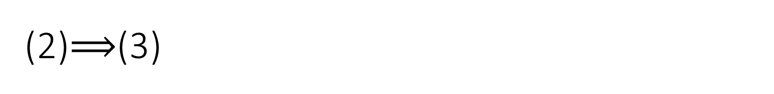
(2)$⟹$(3)
(2) f is a max flow
(3) there are no augmenting paths in $G_{f}$
suppose there is an augmenting path in $G_{f}$
We can increase the flow by sending some flow along this path
Hence f is not a max flow

Slide 25
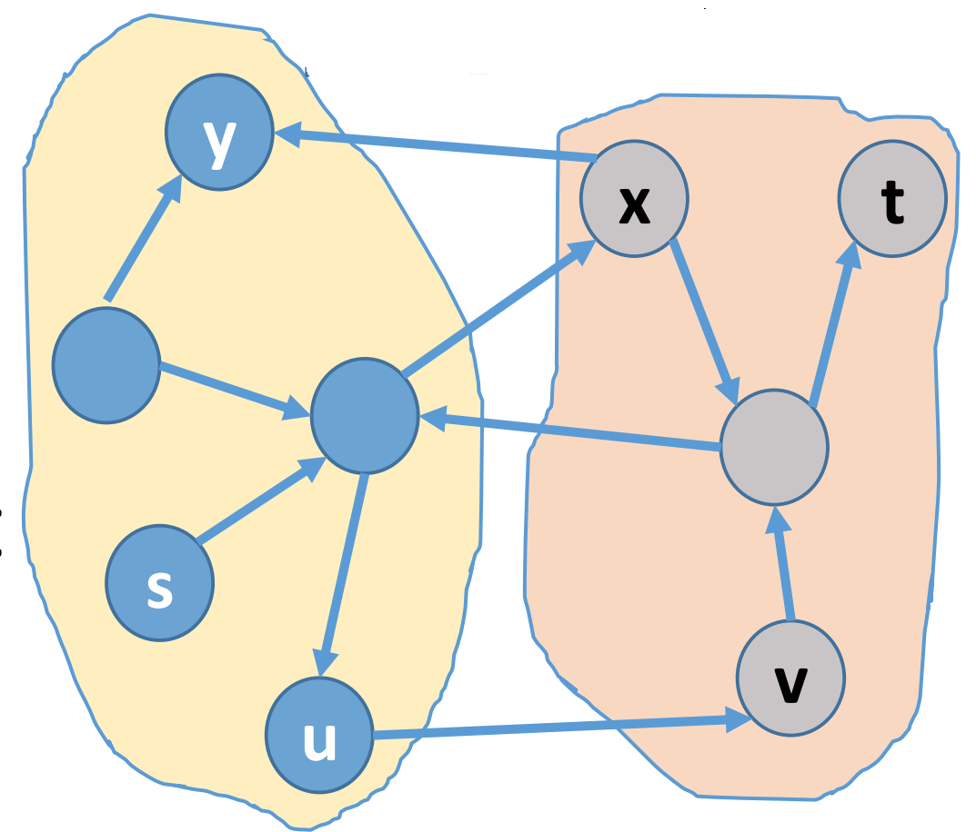
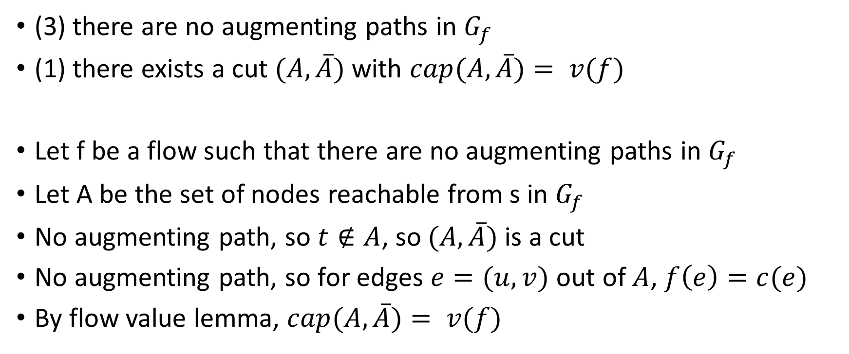
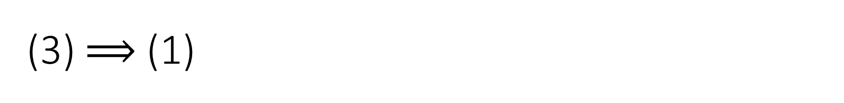
(3) $⟹$ (1)
(3) there are no augmenting paths in $G_{f}$
(1) there exists a cut $(A, \overline{A})$with $cap(A, \overline{A})= v(f)$
Let f be a flow such that there are no augmenting paths in $G_{f}$
Let A be the set of nodes reachable from s in $G_{f}$
No augmenting path, so $t∉A$, so $(A, \overline{A})$is a cut
No augmenting path, so for edges $e=(u,v)$ out of $A$, $f\left(e\right)=c(e)$
By flow value lemma, $cap(A, \overline{A})= v(f)$

Slide 26
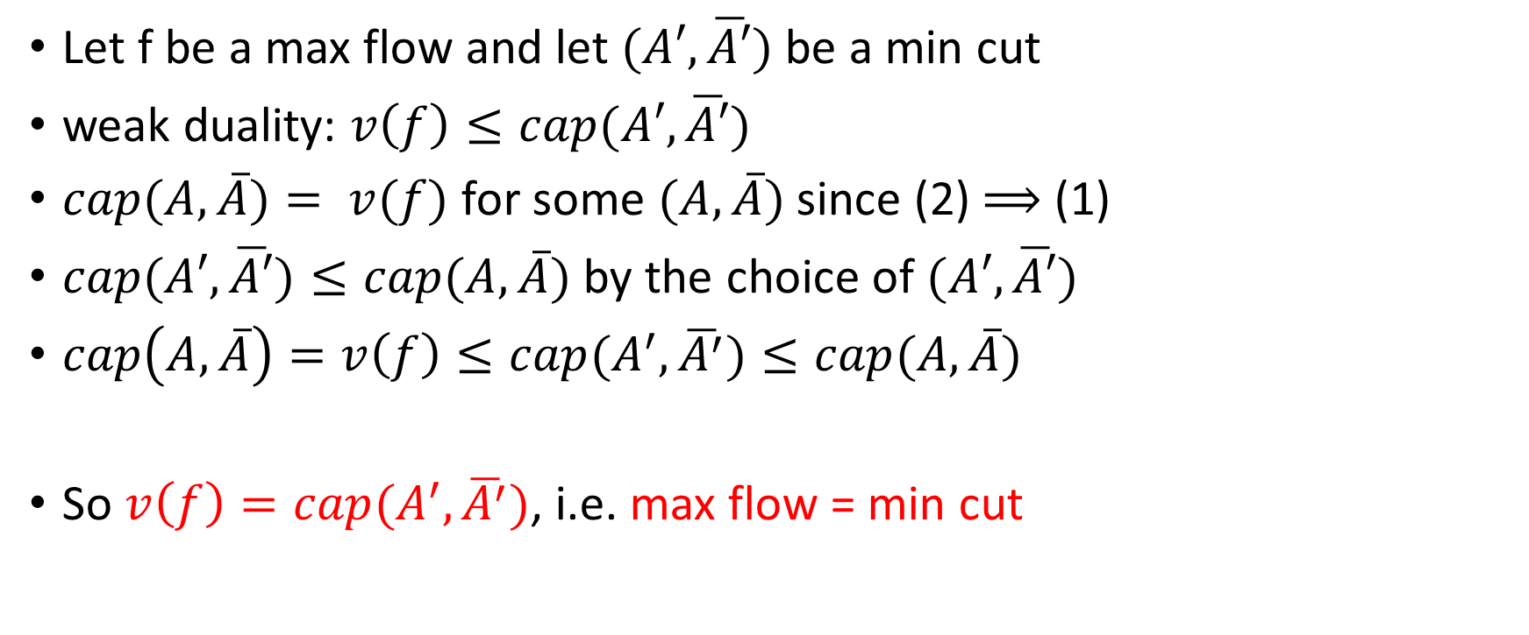
Max-flow min-cut theorem
Let f be a max flow and let $(A′, \overline{A′})$be a min cut
weak duality: $v\left(f\right)≤cap(A′, \overline{A′})$
$cap(A, \overline{A})= v(f)$ for some $(A, \overline{A})$ since (2) $⟹$ (1)
$cap(A′, \overline{A′})≤cap(A, \overline{A})$ by the choice of $(A′, \overline{A′})$
$cap\left(A, \overline{A}\right)=v\left(f\right)≤cap(A^{′}, \overline{A^{′}})≤cap(A, \overline{A})$
So $v\left(f\right)=cap(A^{′}, \overline{A^{′}})$, i.e. max flow = min cut

Slide 27
Complexity
When the capacities are integers, O(Ef) where f is the max flow
If the capacities are irrational values, this algorithm might not converge!

Slide 28
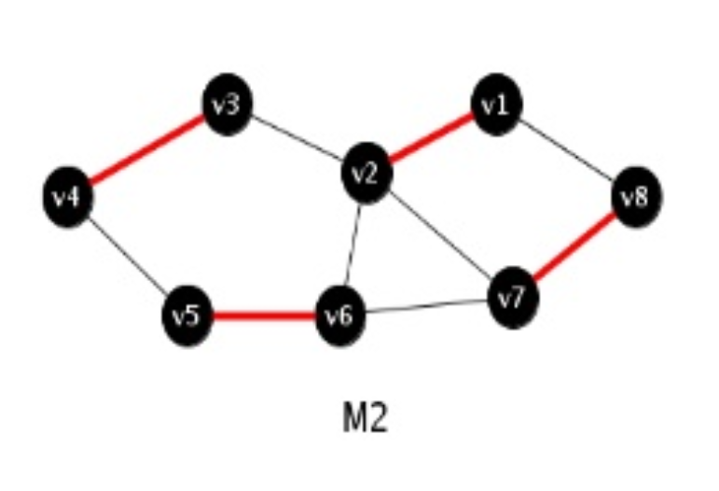
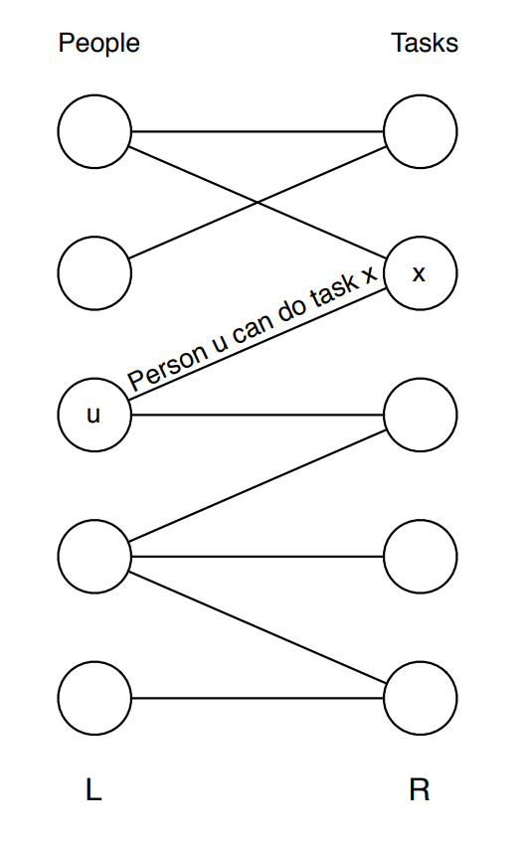
Application : Maximum Bipartite Matching
A matching for a graph is a set of edges
whose vertices do not overlap.
Bipartite matching : when there are
two disjoint set of nodes

Slide 29
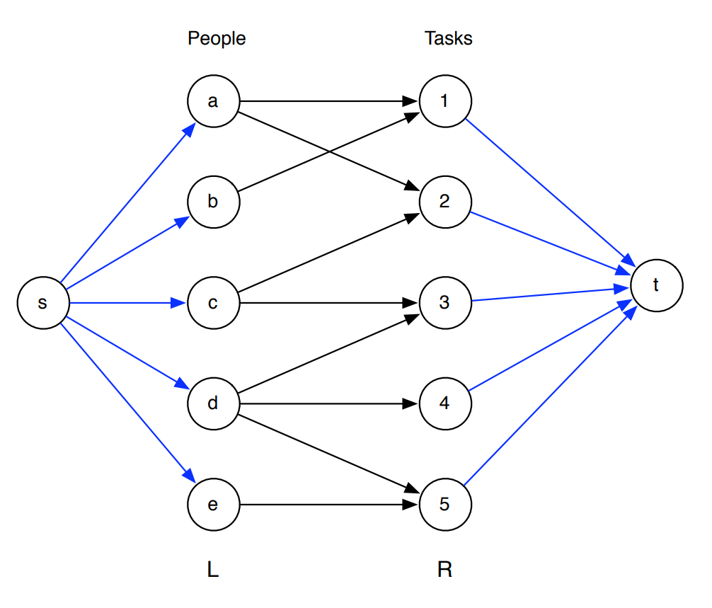
Maximum Bipartite matching
How to find the maximum number of matchings?
Consider the following graph and
Find the max flow!
How to assign the capacities?

