Slide 1
Advanced

Slide 2
Binary indexed tree
Fenwick tree/Segment tree
Efficient data structure for computing cumulative sums

Slide 3
Problem
We have N boxes, a[1..N]
Possible queries are:
Add v balls to a[i]
Sum balls from a[l] to a[r]
Naïve solution : <O(1), O(N)>

Slide 4
Sum table
If there’s no operation of kind “add v balls to …”
Can you think of an efficient way to get the sum of balls from a[l] to a[r]?

Slide 5
Sum table
We store the cumulative sum in another array c,
Where c[i] = sum a[1..i]
Then the sum a[l..r] = c[r]-c[l-1]
Complexity O(1)! (initialization costs O(N))

Slide 6
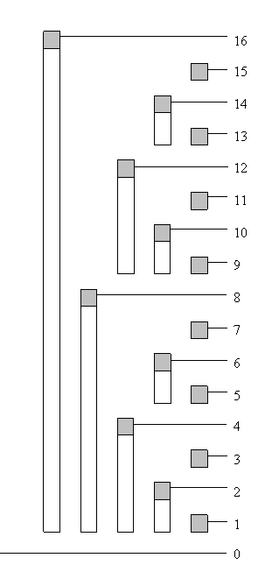
Binary indexed tree
Idea : store the cumulative sums in a tree (actually
a table)
The index is represented in binary
Explicit rule: let r be the last digit of i that is 1 (in
binary), denote j = i with the rth bit flipped to 0
then tree[i] stores the sum from a[j+1] to a[i]

Slide 7
Example
i = 13 = 1101, j = 1100 = 12, so tree[13] = a[13]
i = 6 = 110, j = 100 = 4, so tree[6] = a[5]+a[6]
i = 4 = 100, j = 000 = 0, so tree[4] = a[1]+…+a[4]

Slide 8
The 1st query : add v balls to a[i]
We need to modify the values in tree, which ones?
Example : 5 = 101
We need to modify
5 = 101
6 = 110
8 = 1000
16 = 10000

Slide 9

The 1st query : add v balls to a[i]
Explicit rule:
We represent i in binary, and r be the last digit
of i that is 1
We need to do the following:
While i<=N:
Add v to tree[i]
$i ←i+2^{r}$

Slide 10
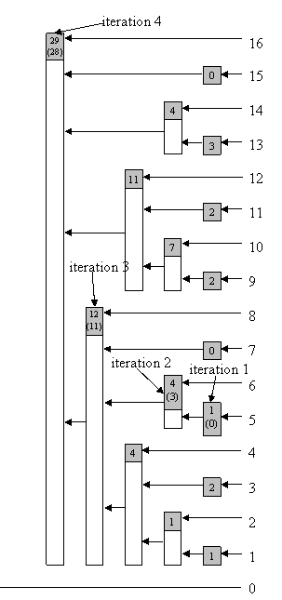
The 1st query : add v balls to a[i]
Example : 5 = 101
5 = 101
6 = 110
8 = 1000
16 = 10000
32 = 100000 (terminates here since 32>N)

Slide 11
How to do this efficiently?
The question we frequently encountered…
Compute r, the last digit of i that is 1.
Let n be a number whose binary representation is a1b, where a represents the bits before the last non-zero digit and b=0...0 represents the 0-bits after the last non-zero digit

Slide 12
n = a1b
-n = ?
We denote x the binary number by flipping all bits in x.
By 2’s complement rule, -n = a1b+1 = a0b+1.
Since b=0..0, b=1..1, so a0b+1 = a0(1…1)+1 = a10..0 = a1b.
Finally, -n = a1b

Slide 13

If we use the bitwise AND operator (&), we get :
a1b & a1b ——————– = (0..0)1(0..0)
Which is $2^{r}$.

Slide 14
Intermediate step : get the prefix sum a[1..n]
Example : a[1]+…+a[13]
Can you see how to do it?

Slide 15
Intermediate step : get the prefix sum a[1..n]
Example : a[1]+…+a[13]
We need to sum tree[13]+tree[12]+tree[8]
13 = 1101
12 = 1100
8 = 1000
Can you guess the rule?

Slide 16

Intermediate step : get the prefix sum a[1..n]
Yes, just keep eliminating the last non-zero bit!
13 = 1101
12 = 1100
8 = 1000
0 = 0000 (terminates here once it reaches 0)

Slide 17
2nd query : Sum balls from a[l] to a[r]
Just do a[1..r] – a[1..l-1] using the intermediate step!

Slide 18
C++ implementation

Slide 19
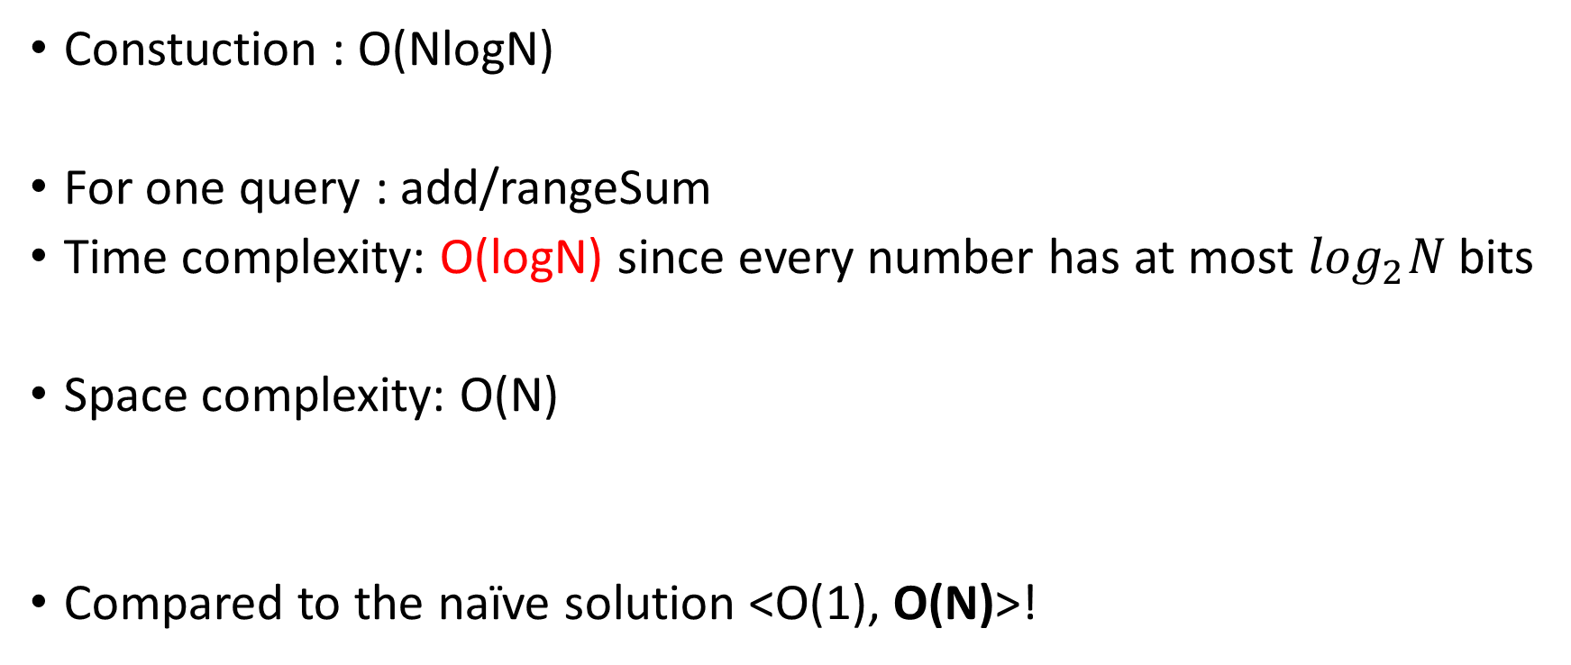
Complexity
Constuction : O(NlogN)
For one query : add/rangeSum
Time complexity: O(logN) since every number has at most $\log_{2}N$ bits
Space complexity: O(N)
Compared to the naïve solution <O(1), O(N)>!

Slide 20
Exercise
How to get a single element a[i]?
We can easily see that a[i] = a[1..i] – a[1..i-1].
But look at i = 11, we can instantly get a[11] = tree[11]
without any subtraction!
Is there a faster way?
Hint : for example, how to get a[12]?

Slide 21
Extension
We can easily extend the 1d BIT to 2d, 3d… actually whichever dimension.
void add(int x , int y , int val){
int y1;
while (x <= max_x){
y1 = y;
while (y1 <= max_y){
tree[x][y1] += val;
y1 += (y1 & -y1);
}
x += (x & -x);
}
}

Slide 22
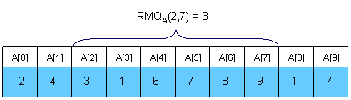
Application : range minimum query (RMQ)
Range Minimum Query (RMQ)
Given an array a[0..N-1], find the position of the element with the minimum value between two given indices.

Slide 23
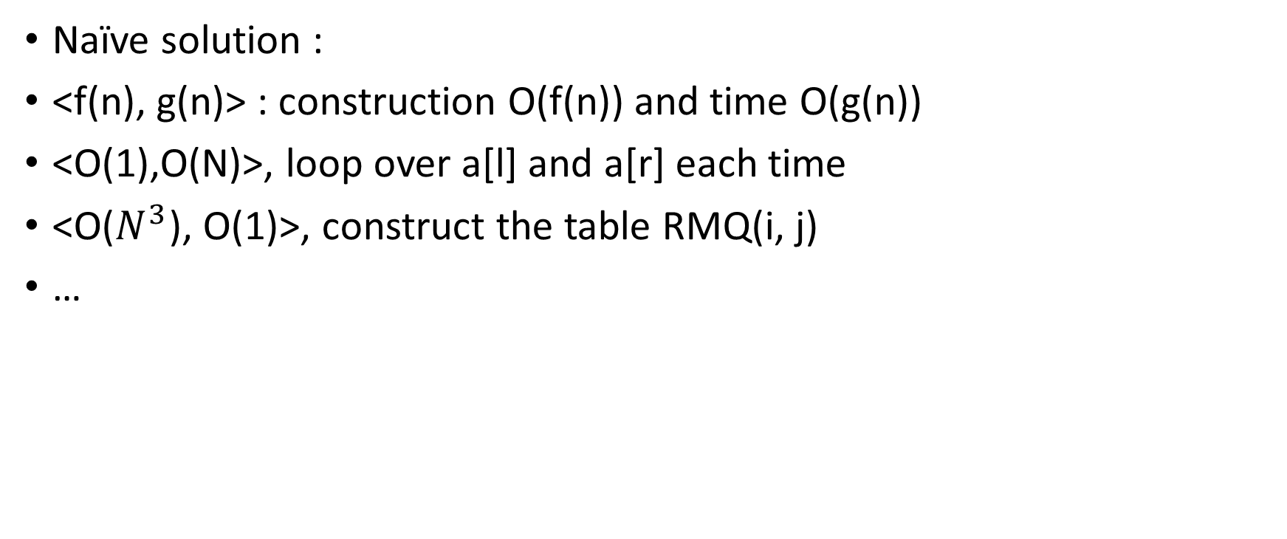
Naïve solution :
<f(n), g(n)> : construction O(f(n)) and time O(g(n))
<O(1),O(N)>, loop over a[l] and a[r] each time
<O($N^{3}$), O(1)>, construct the table RMQ(i, j)
…

Slide 24
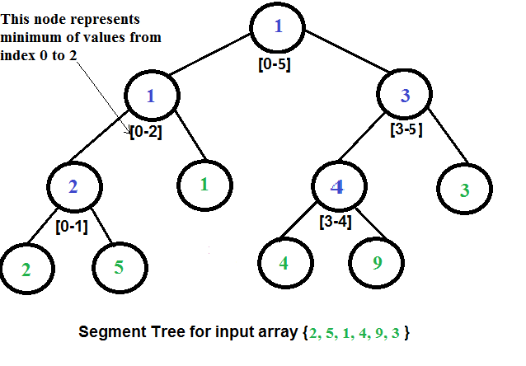
Using BIT
Split the array into 2 parts,
and recursively construct the tree

Slide 25
Some detail
How many nodes in the BIT?

Slide 26
C++ implementation

Slide 27
Complexity
Construction : O(NlogN)
Time complexity : O(logN) for one query, since the height is O(logN)
Space complexity : O(N) for the BIT
Finally, <O(N), O(logN)>!

Slide 28
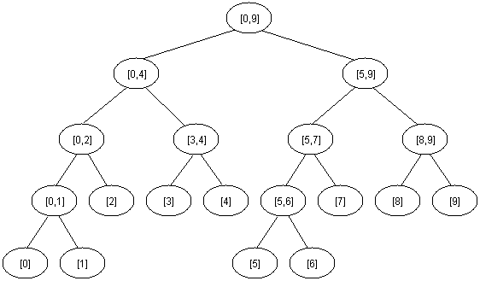
Exercise
What if we want to modify the array? For example, we reassign a[5] to a new value, then how should we update the tree?
Hint : top->down or bottom->up?
Implement this.
What’s the complexity?

Slide 29
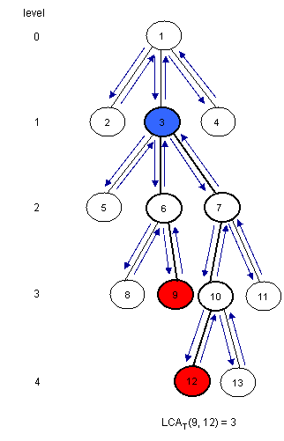
Application of RMQ : LCA
We can make a reduce the problem LCA to RMQ
We need three arrays to represent the problem:
E : stores the Euler tour (across the same edge
twice) of the tree
L : stores the level of the nodes
H : stores the first occurrence of a node in E

Slide 30
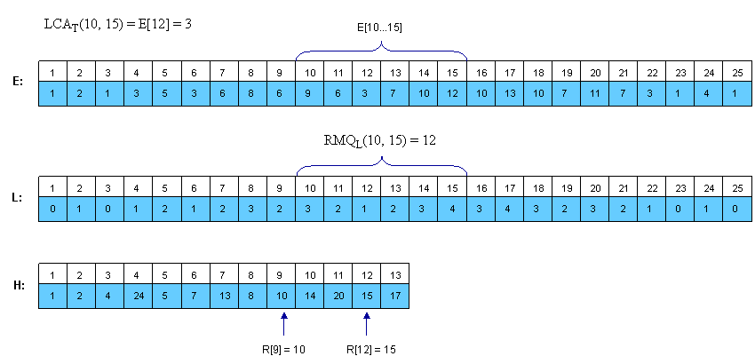
Example

Slide 31
C++ implementation

Slide 32
Backtracking
Backtracking is a method to find all possible solutions to a certain problem, by constructing incrementally and testing them all.
If we know at some point that the solution is already false, we go back one step and test another configuration

Slide 33
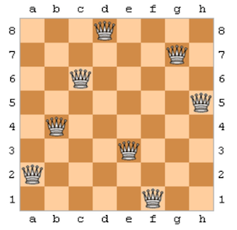
Eight queen problem
Eight queen problem is a classic example of backtracking:
We place a queen on each row, starting
from the top, if it doesn’t conflict with other
queens, proceed to the next row.
Otherwise, take off the last queen we put,
move it to one column to the right and test
again. If it’s already at the rightmost column,
take off the queen on the above row.

Slide 34
GIF animation
https://en.wikipedia.org/wiki/Eight_queens_puzzle

Slide 35
C++ implementation
Here, we are only interested in the number of solutions, not the configuration

Slide 36
Homework
https://github.com/kwea123/cpp_data_algo/blob/master/AdvancedHW

