Slide 1
Network flows

Slide 2
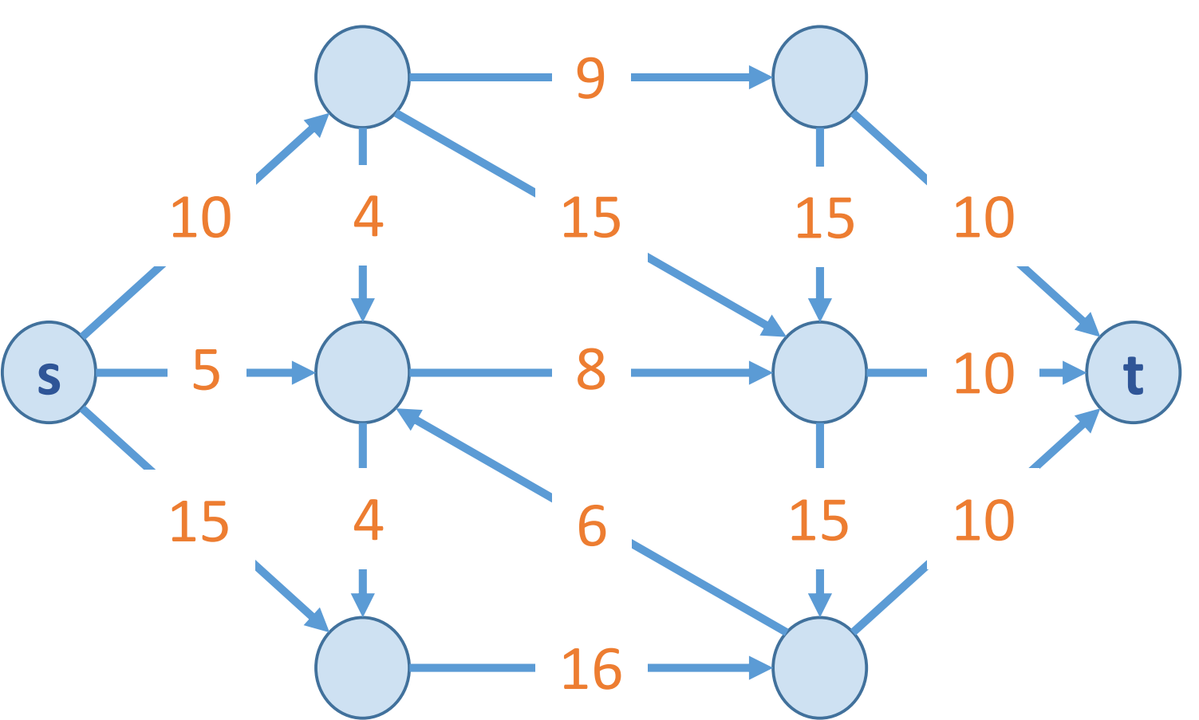
Flow network
A Graph G=(V,E) with source s and sink t
no parallel edges
no edge enters s
no edge leaves t
Each edge e has a non-negative
capacity c(e)

Slide 3
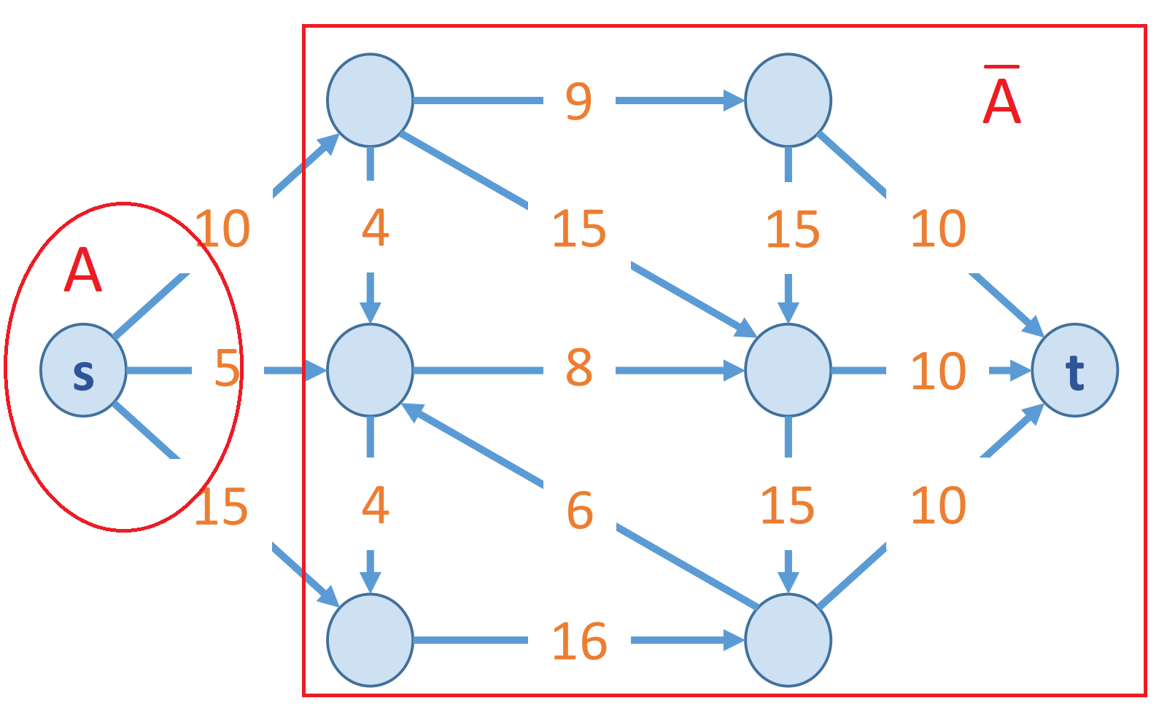
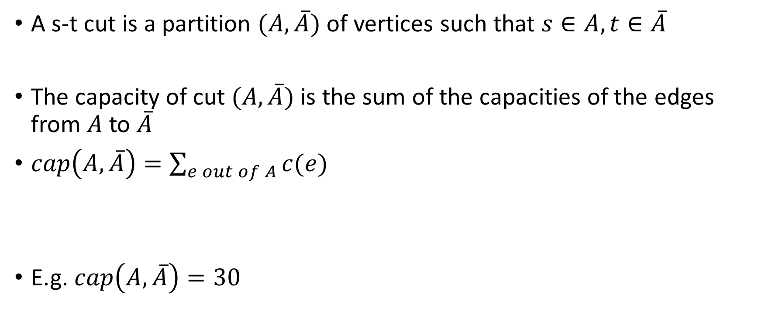
Minimum cut problem
A s-t cut is a partition $(A, \overline{A})$ of vertices such that $s∈A, t∈\overline{A}$
The capacity of cut $(A, \overline{A})$ is the sum of the capacities of the edges from $A$ to $\overline{A}$
$cap\left(A, \overline{A}\right)=\sum_{e out of A}{c(e)}$
E.g. $cap\left(A, \overline{A}\right)=30$

Slide 4
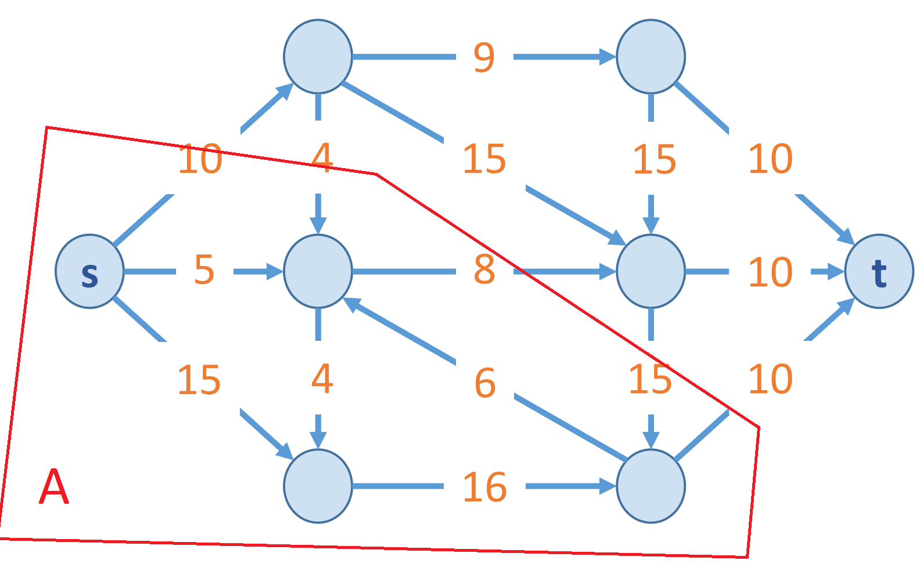

Minimum cut problem : find a cut with minimum capacity
$cap\left(A, \overline{A}\right)=28$

Slide 5
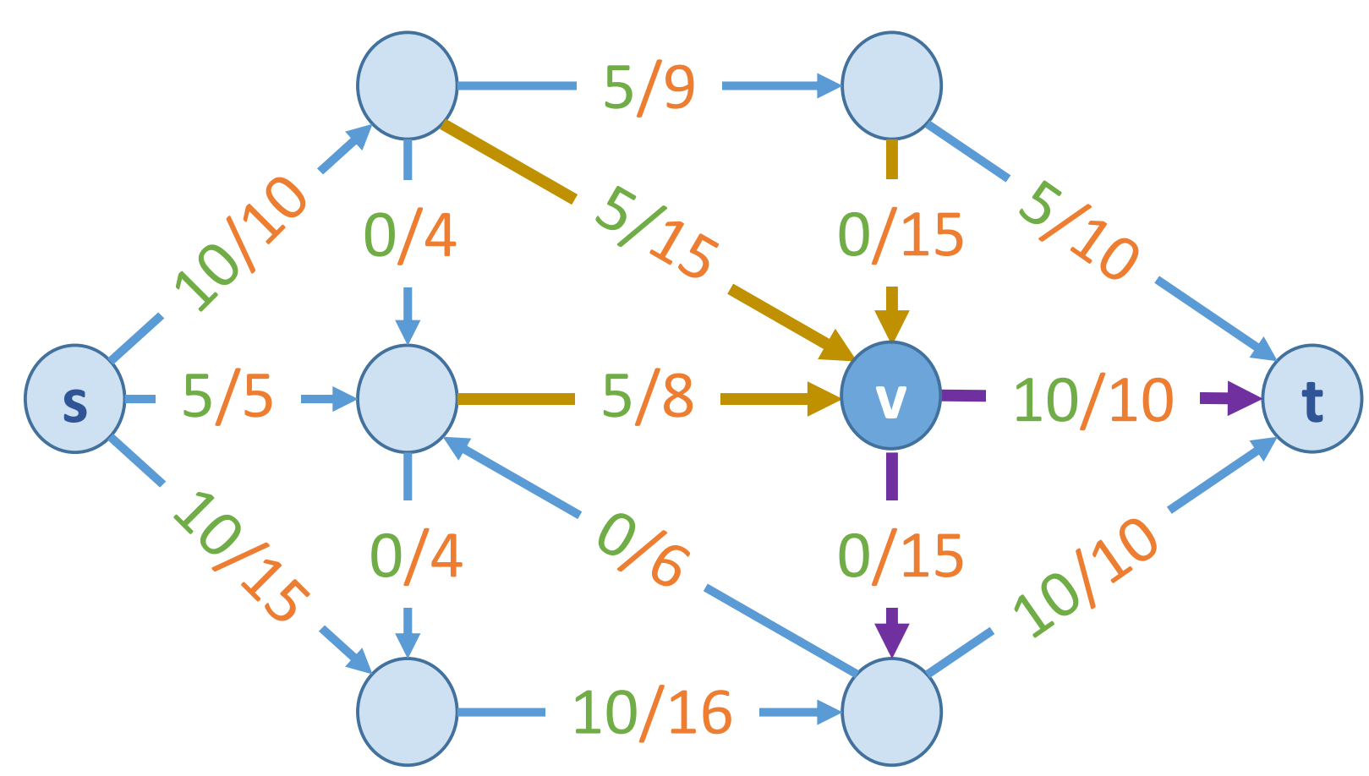

Maximum flow problem
A s-t flow is a function $f:E→ℝ^{+}$ that satisfies
$0≤f\left(e\right)≤c(e)$ (capacity)
$\sum_{e into v}{f(e)}=\sum_{e out of v}{f(e)}$ for $v≠s,t$ (conservation)

Slide 6

The value of a flow $f$ is
$v\left(f\right)=\sum_{e out of s}{v(e)}$
E.g. $v\left(f\right)=25$

Slide 7
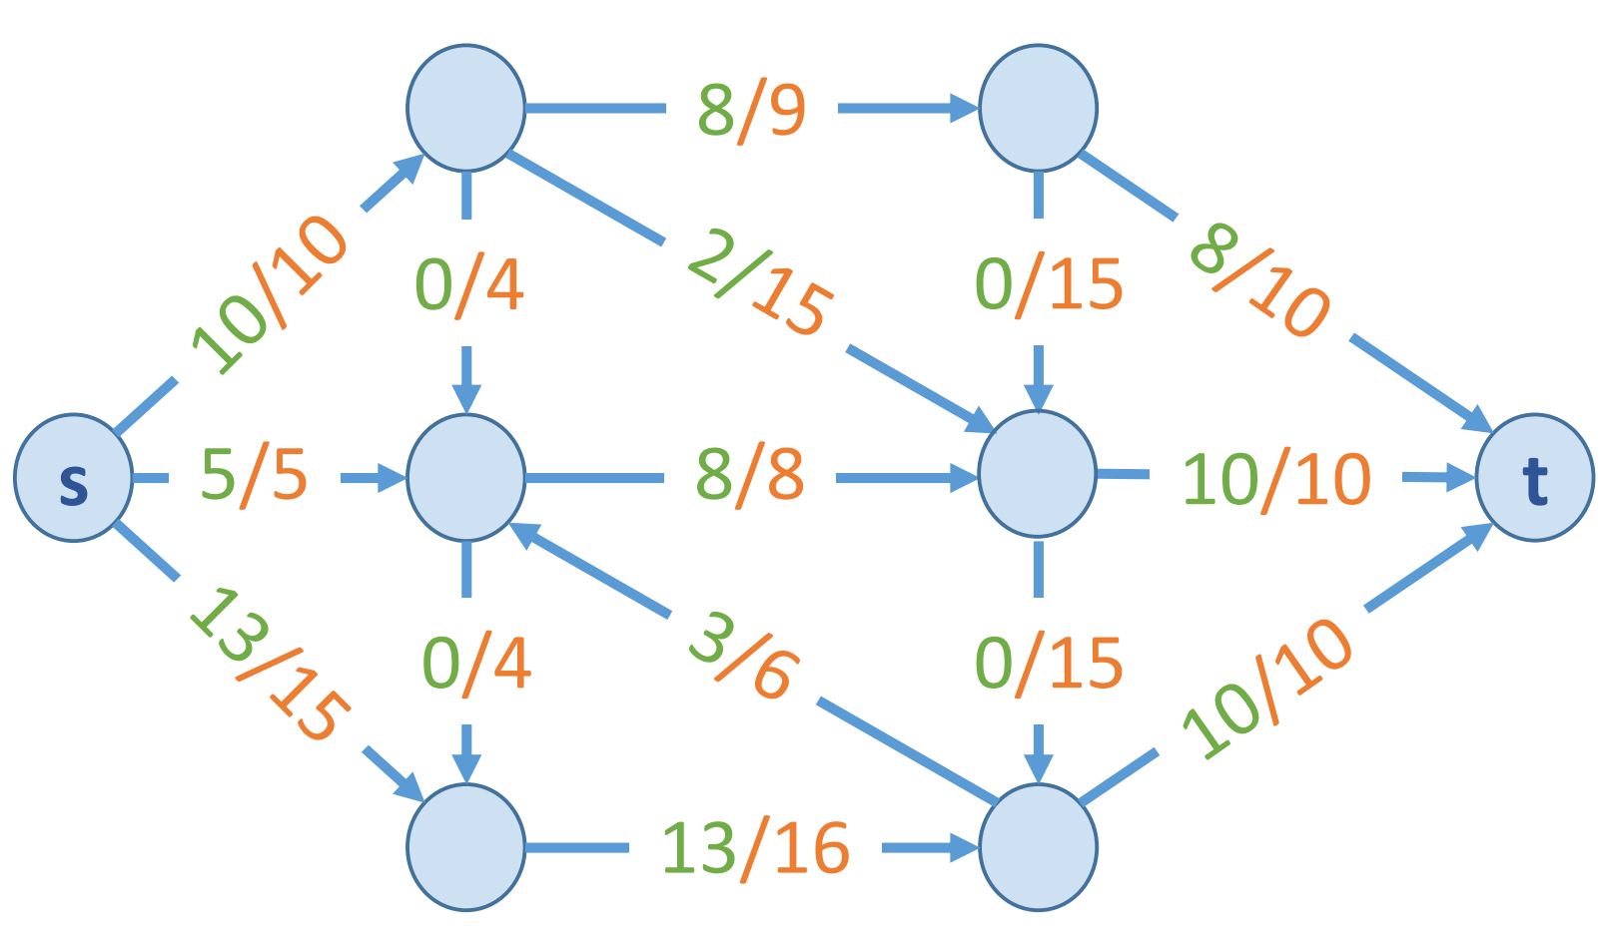

Maximum flow problem: find a flow of maximum value
$v\left(f\right)=28$

Slide 8
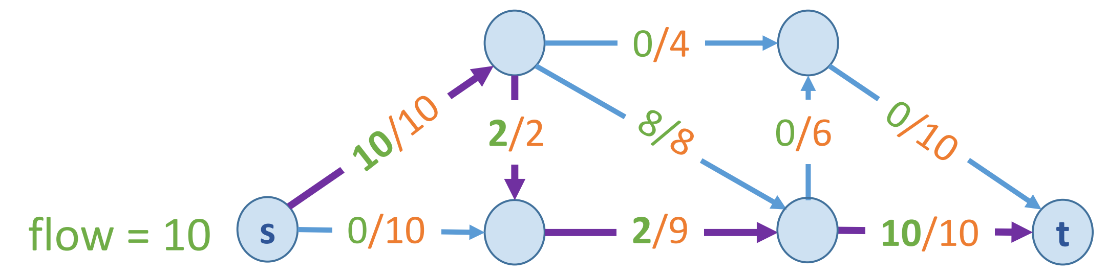
Greedy algorithm
Start with f=0
Find a path p = s->t where f(e)<c(e)
Augment the flow along p
Repeat until we get stuck

Slide 9
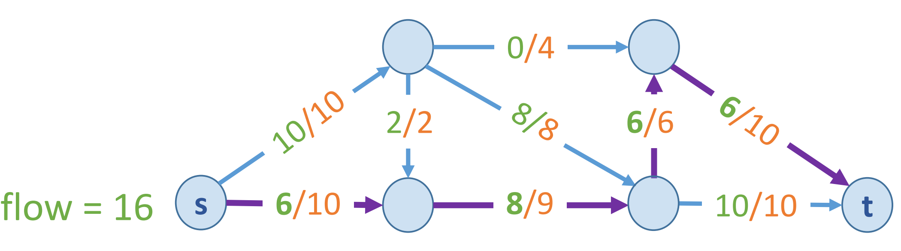

Slide 10
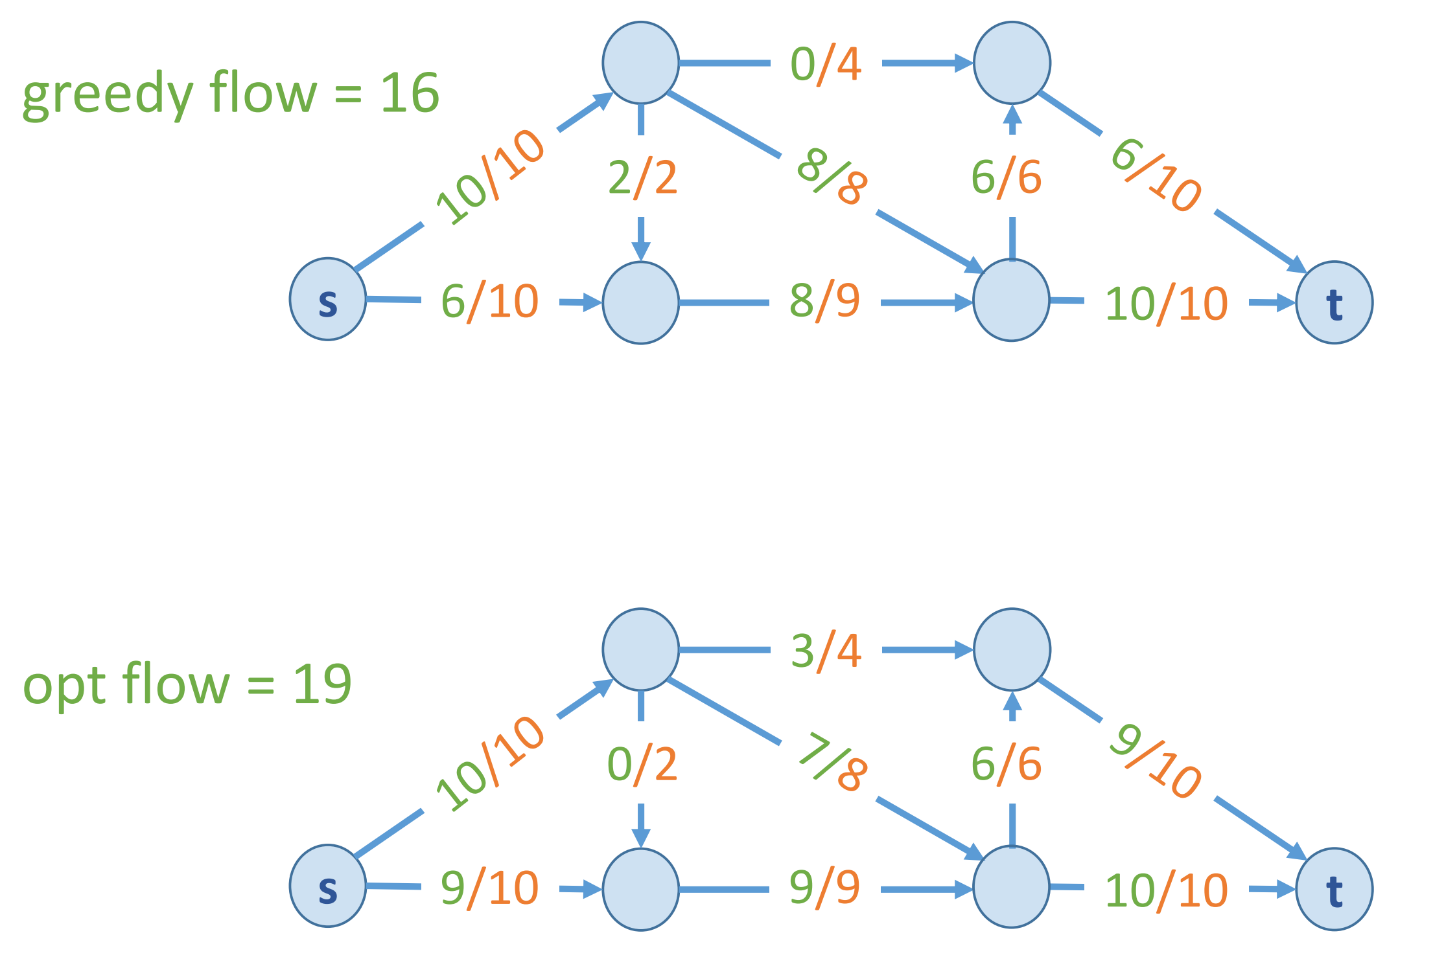

Slide 11
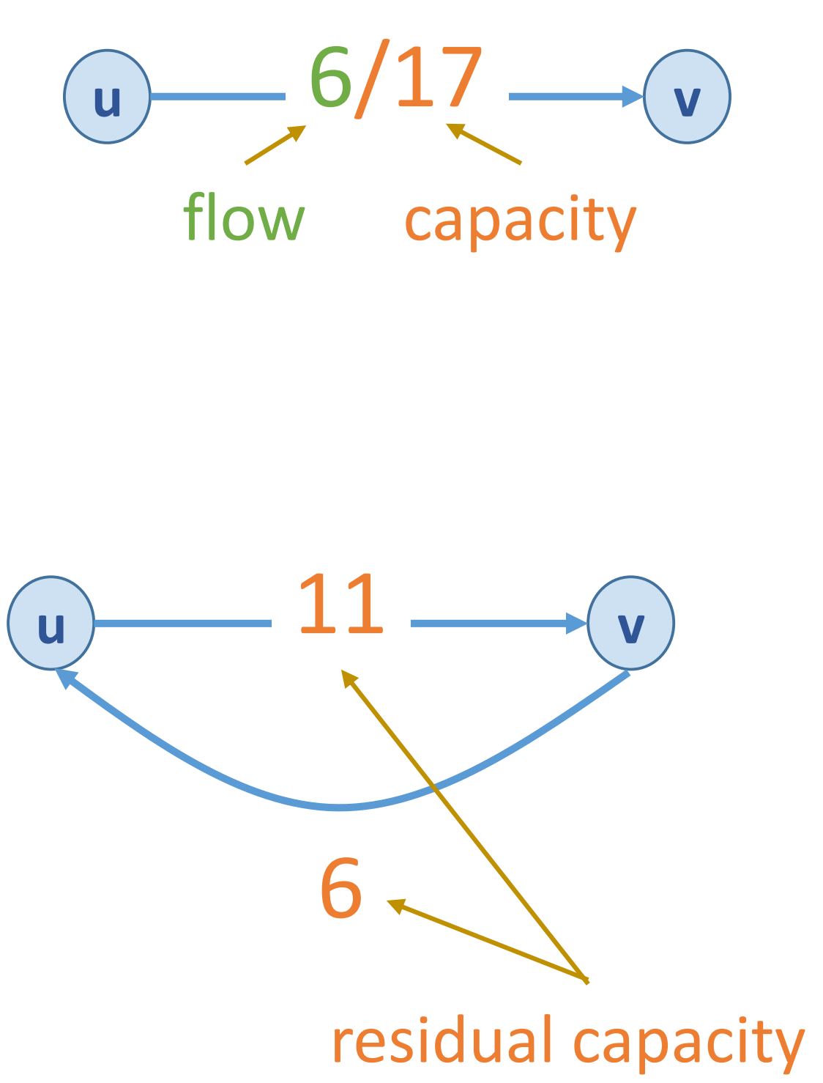

Residual graph
Residual graph $G_{f}$ w.r.t. f:
$e=\left(u,v\right)$ and $e^{R}=\left(v,u\right)$
to “undo” the flow (find another path)
residual capacity $c_{f}\left(e\right)=$
$c(e) – f\left(e\right)$ if $e∈E$
$f\left(e\right)$ if $e^{R}∈E$

Slide 12
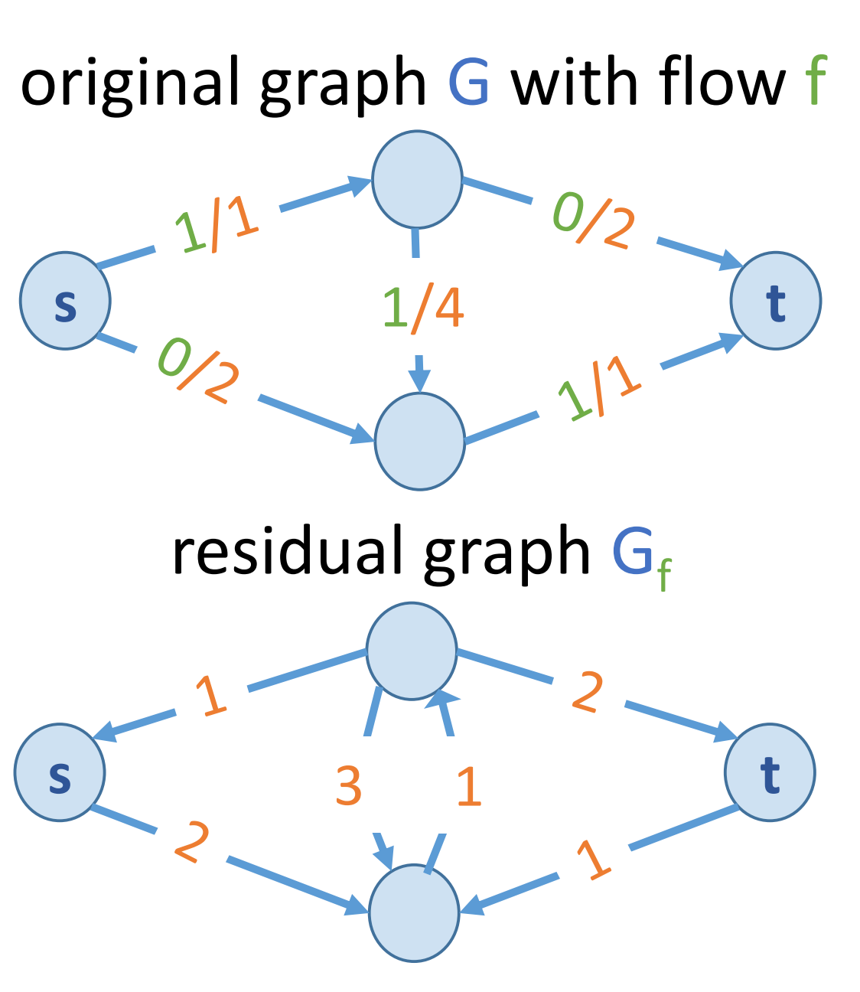
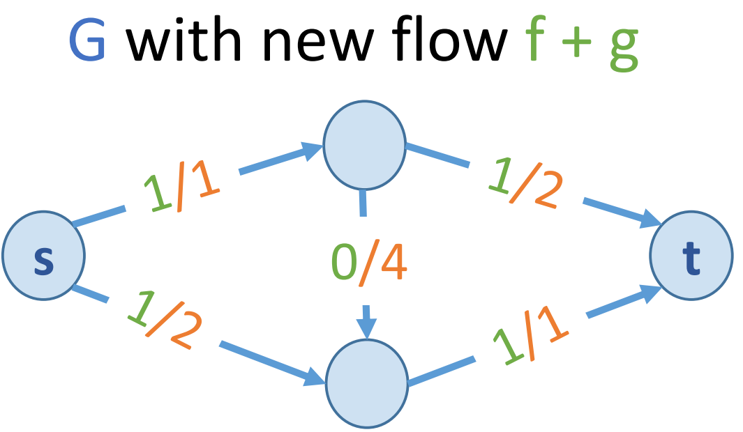
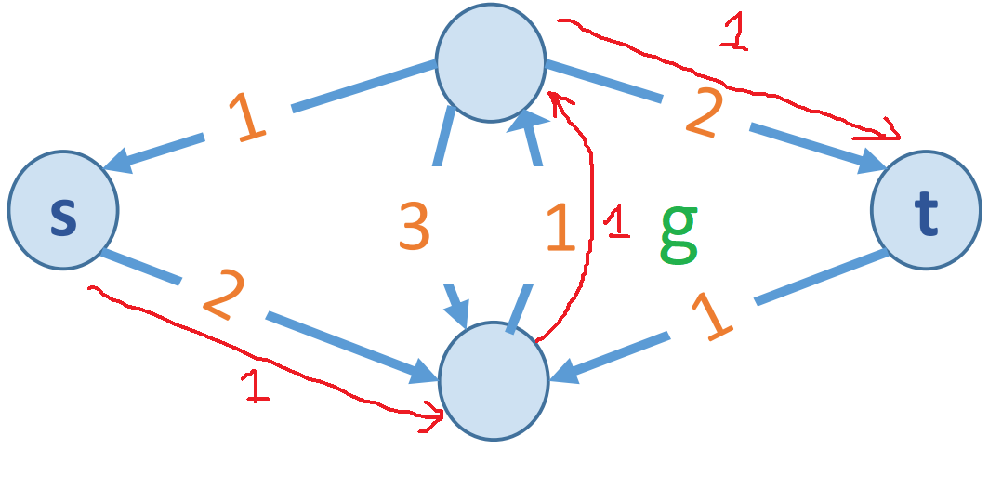

Residual graph $G_{f}=(V, E_{f})$ where
$E_{f}= \{e: f(e) < c(e)\} U \{e^{R}: f(e) > 0\}$
Key property: g is a flow in $G_{f}$
iff f + g is a flow in G

Slide 13
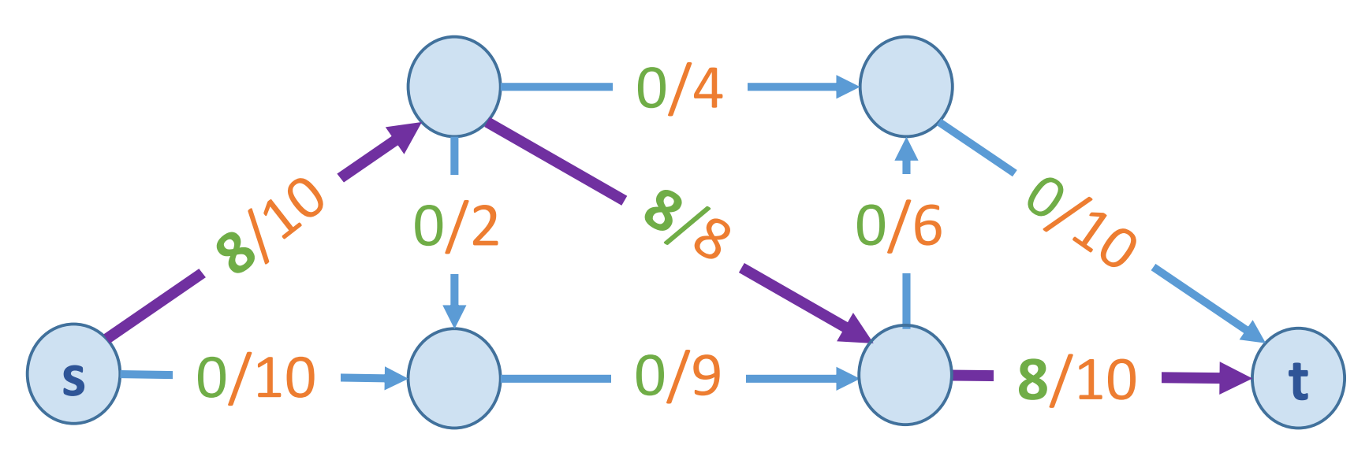
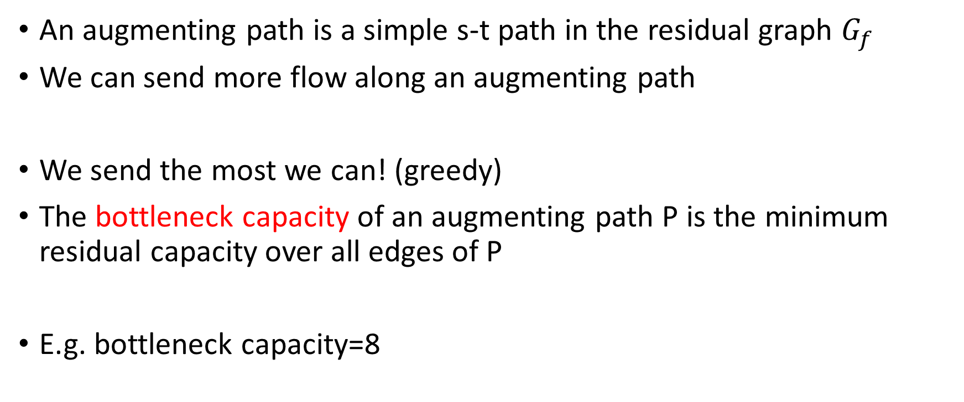
Augmenting path
An augmenting path is a simple s-t path in the residual graph $G_{f}$
We can send more flow along an augmenting path
We send the most we can! (greedy)
The bottleneck capacity of an augmenting path P is the minimum residual capacity over all edges of P
E.g. bottleneck capacity=8

Slide 14
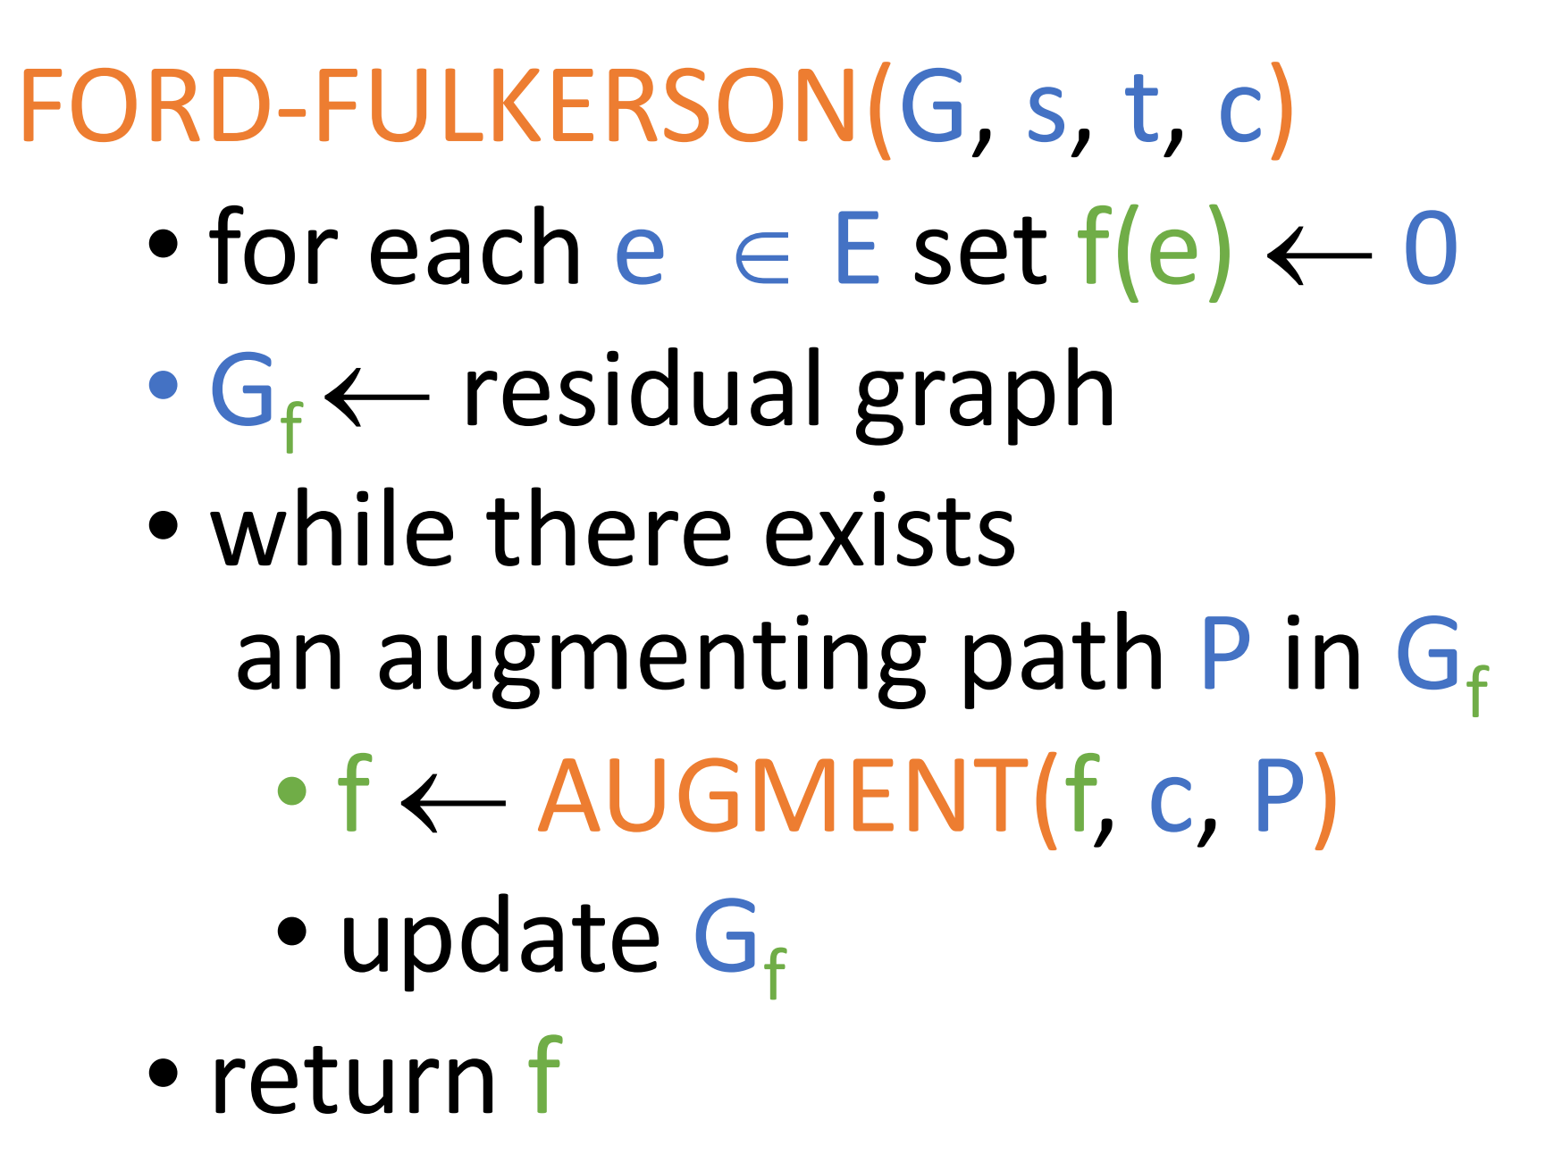
Ford-Fulkerson algorithm

Slide 15
Demo

Slide 16
C++ implementation

Slide 17
Does this always finishes?
The program finishes when there is no augmenting paths…
How do the capacities evolve?
Assume the edge weights are integers

Slide 18
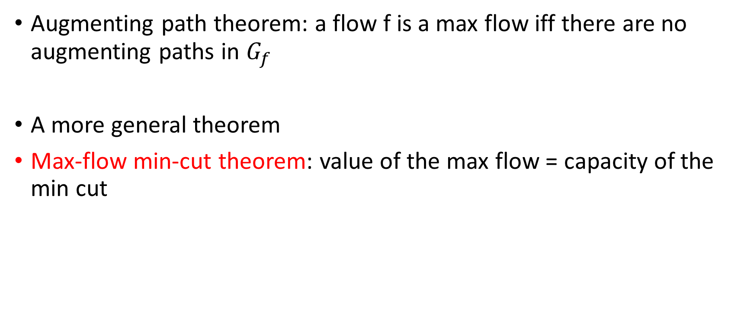
Correctness?
Augmenting path theorem: a flow f is a max flow iff there are no augmenting paths in $G_{f}$
A more general theorem
Max-flow min-cut theorem: value of the max flow = capacity of the min cut

Slide 19
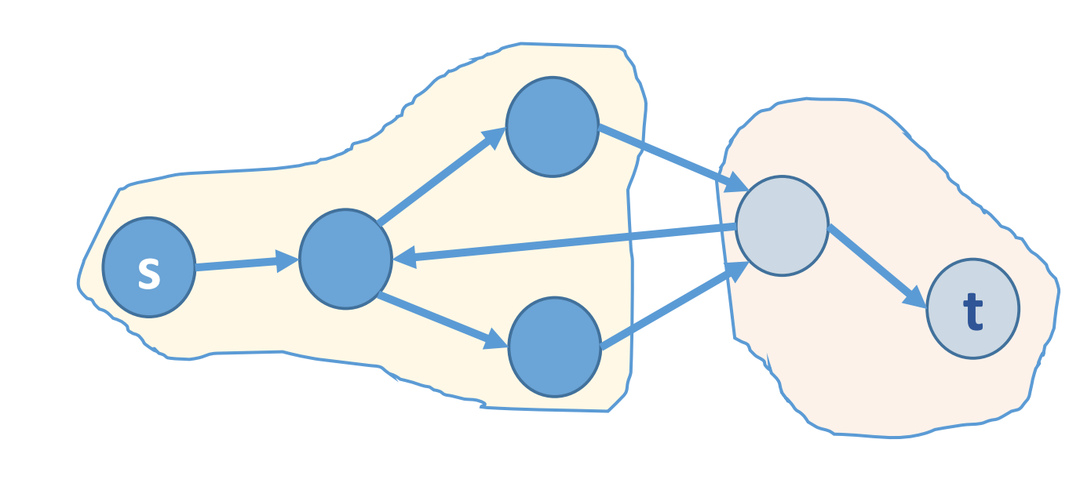
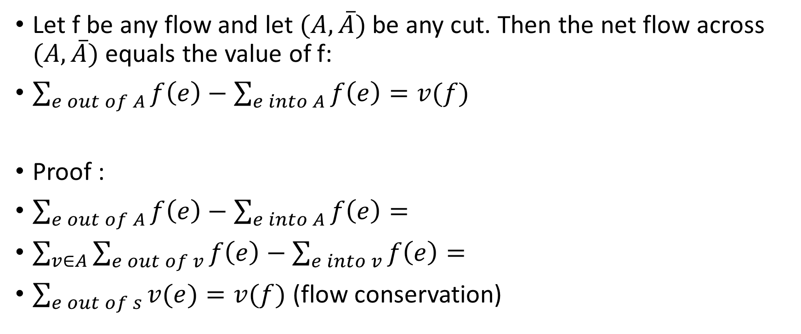
Flow value lemma
Let f be any flow and let $(A, \overline{A})$be any cut. Then the net flow across $(A, \overline{A})$equals the value of f:
$\sum_{e out of A}{f\left(e\right)}−\sum_{e into A}{f\left(e\right)}=v(f)$
Proof :
$\sum_{e out of A}{f\left(e\right)}−\sum_{e into A}{f\left(e\right)}=$
$\sum_{v∈A}{\sum_{e out of v}{f\left(e\right)}−\sum_{e into v}{f\left(e\right)}}=$
$\sum_{e out of s}{v(e)}=v(f)$ (flow conservation)

Slide 20

Corollary (weak duality)
Let f be any flow and let $(A, \overline{A})$be any cut. Then $v(f) ≤cap(A, \overline{A})$
Proof :$v\left(f\right)=\sum_{e out of A}{f\left(e\right)}−\sum_{e into A}{f\left(e\right)}$
$≤\sum_{e out of A}{f\left(e\right)}≤\sum_{e out of A}{c\left(e\right)}=cap(A, \overline{A})$

Slide 21
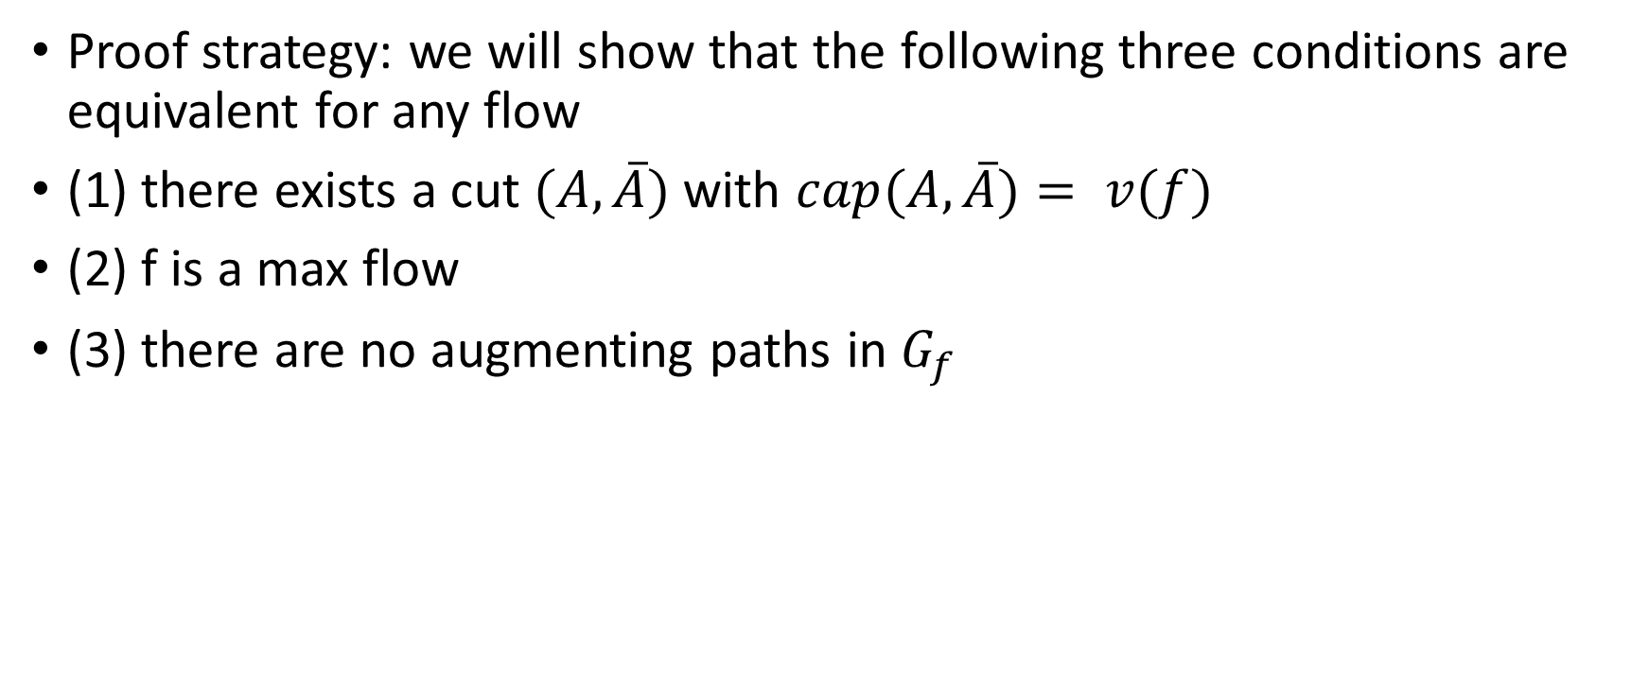
Max-flow min-cut theorem
Proof strategy: we will show that the following three conditions are equivalent for any flow
(1) there exists a cut $(A, \overline{A})$with $cap(A, \overline{A})= v(f)$
(2) f is a max flow
(3) there are no augmenting paths in $G_{f}$

Slide 22
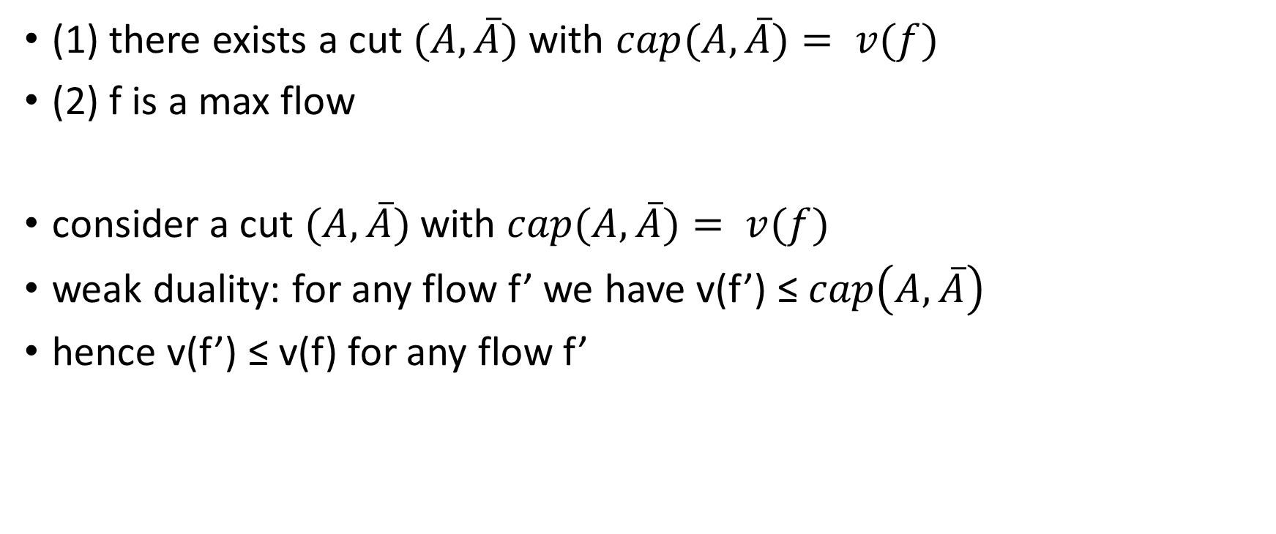
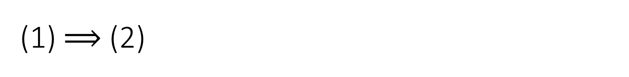
(1) $⟹$ (2)
(1) there exists a cut $(A, \overline{A})$with $cap(A, \overline{A})= v(f)$
(2) f is a max flow
consider a cut $(A, \overline{A})$with $cap(A, \overline{A})= v(f)$
weak duality: for any flow f’ we have v(f’) ≤ $cap\left(A, \overline{A}\right)$
hence v(f’) ≤ v(f) for any flow f’

Slide 23
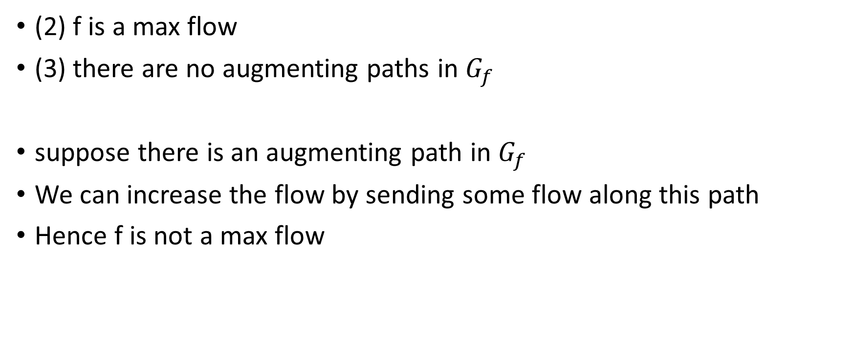
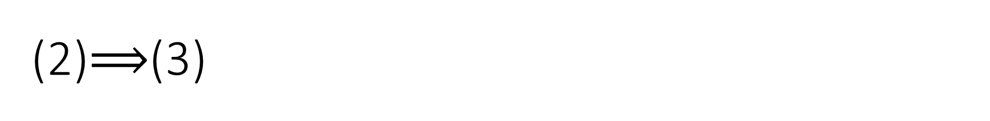
(2)$⟹$(3)
(2) f is a max flow
(3) there are no augmenting paths in $G_{f}$
suppose there is an augmenting path in $G_{f}$
We can increase the flow by sending some flow along this path
Hence f is not a max flow

Slide 24
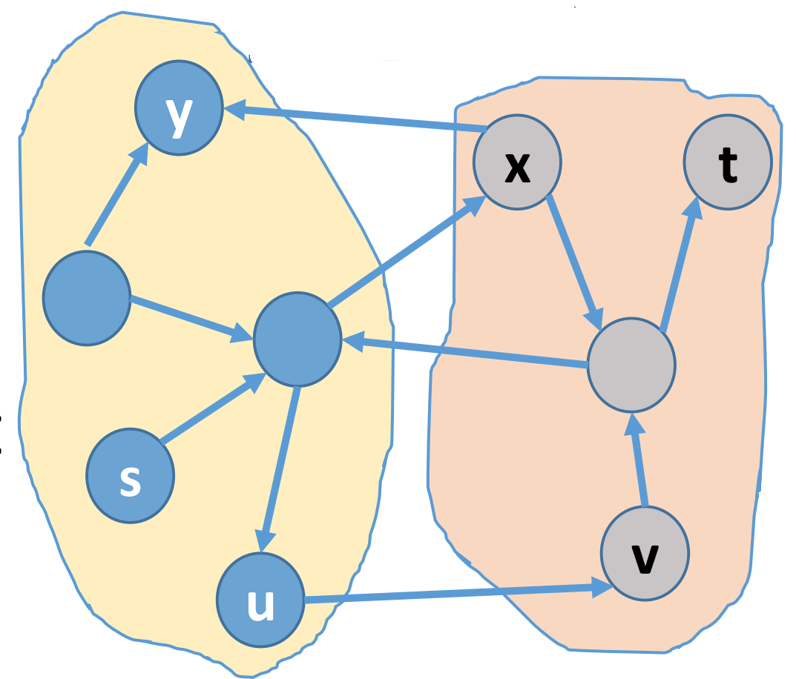
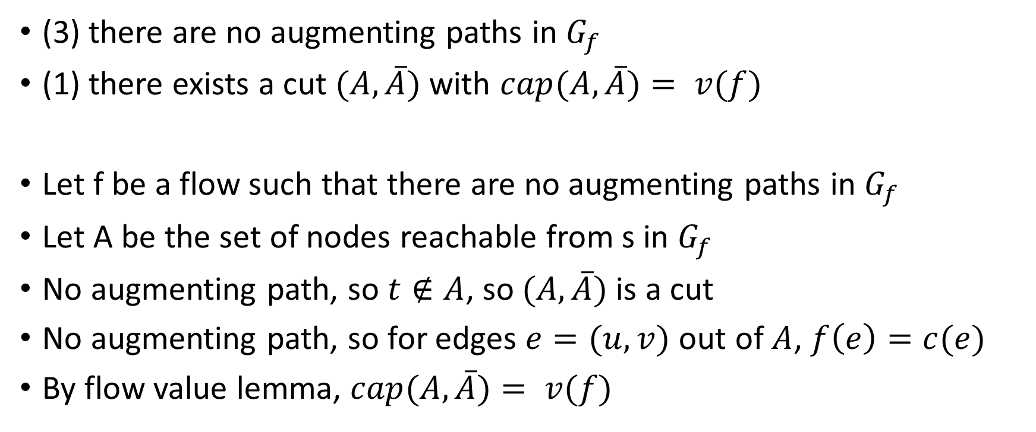
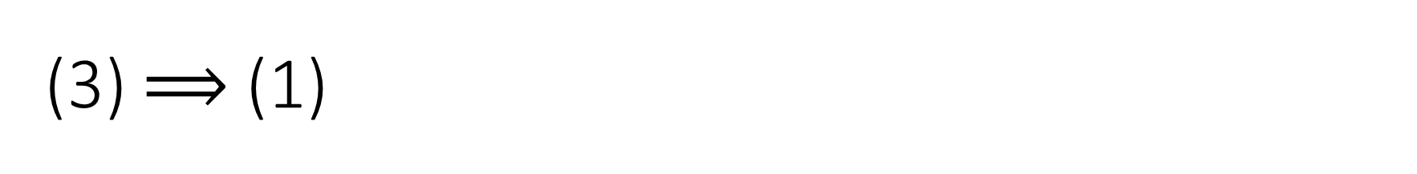
(3) $⟹$ (1)
(3) there are no augmenting paths in $G_{f}$
(1) there exists a cut $(A, \overline{A})$with $cap(A, \overline{A})= v(f)$
Let f be a flow such that there are no augmenting paths in $G_{f}$
Let A be the set of nodes reachable from s in $G_{f}$
No augmenting path, so $t∉A$, so $(A, \overline{A})$is a cut
No augmenting path, so for edges $e=(u,v)$ out of $A$, $f\left(e\right)=c(e)$
By flow value lemma, $cap(A, \overline{A})= v(f)$

Slide 25
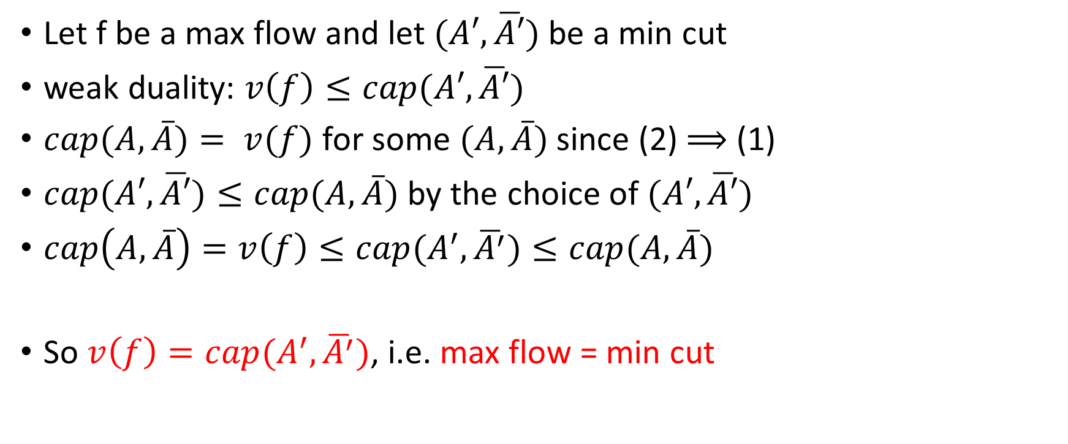
Max-flow min-cut theorem
Let f be a max flow and let $(A′, \overline{A′})$be a min cut
weak duality: $v\left(f\right)≤cap(A′, \overline{A′})$
$cap(A, \overline{A})= v(f)$ for some $(A, \overline{A})$ since (2) $⟹$ (1)
$cap(A′, \overline{A′})≤cap(A, \overline{A})$ by the choice of $(A′, \overline{A′})$
$cap\left(A, \overline{A}\right)=v\left(f\right)≤cap(A^{′}, \overline{A^{′}})≤cap(A, \overline{A})$
So $v\left(f\right)=cap(A^{′}, \overline{A^{′}})$, i.e. max flow = min cut

Slide 26
Complexity
When the capacities are integers, O(Ef) where f is the max flow
If the capacities are irrational values, this algorithm might not converge!

