Slide 1
Array

Slide 2

Array
Data structure that stores a sequence of values, having fixed length
int a[7] = {3, 7, 42, 1, 4, 8, 12}

Slide 3
For loop
If we want to loop over the elements in the array:
1. We need to get the size of the array
int length = sizeof(a)/sizeof(*a)
2. Use for loop

Slide 4
Basic exercise
Given an array a[], compute the sum of its elements

Slide 5

Exercise
Evaluate a polynomial $P\left(X\right)= \sum_{i=0}^{d}{a_{i}X^{i}}$
The array a[] (of length d+1) stores the coefficients
double evalPoly(double a[], int d, double x)

Slide 6
Exercise
Write a method void shuffle(int a[], int length) which does Knuth shuffle:
For i from 1 to size-1:
Let j an random integer from 0 to i-1
Exchange a[i] and a[j]

Slide 7
Finding values in an array
Naïve way : for loop in linear time

Slide 8
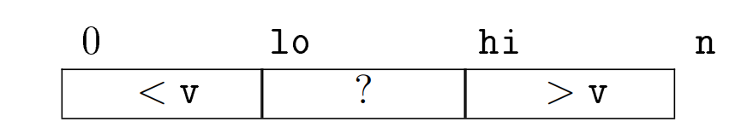
dichotomous search in a sorted array
Binary search
Suppose we’re looking for the value 9 in {1,3,5,6,9,12,14}
The invariant : the values on the left are less than the values on the right

Slide 9
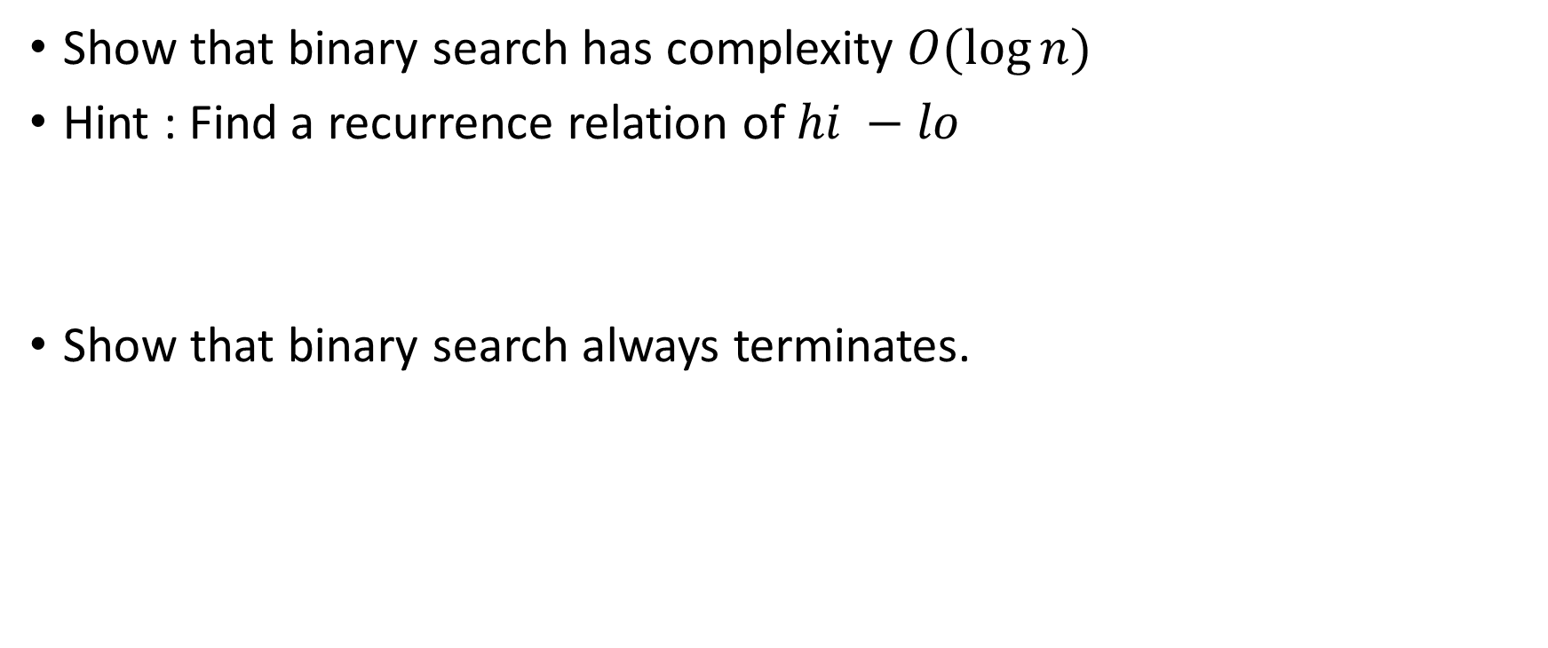
Exercise
Show that binary search has complexity $O(\log{n})$
Hint : Find a recurrence relation of $hi −lo$
Show that binary search always terminates.

Slide 10
Resizable array
Problem with normal arrays : sizes are fixed!
What if we want to keep adding elements?
Naïve solution : create a very large array!

Slide 11
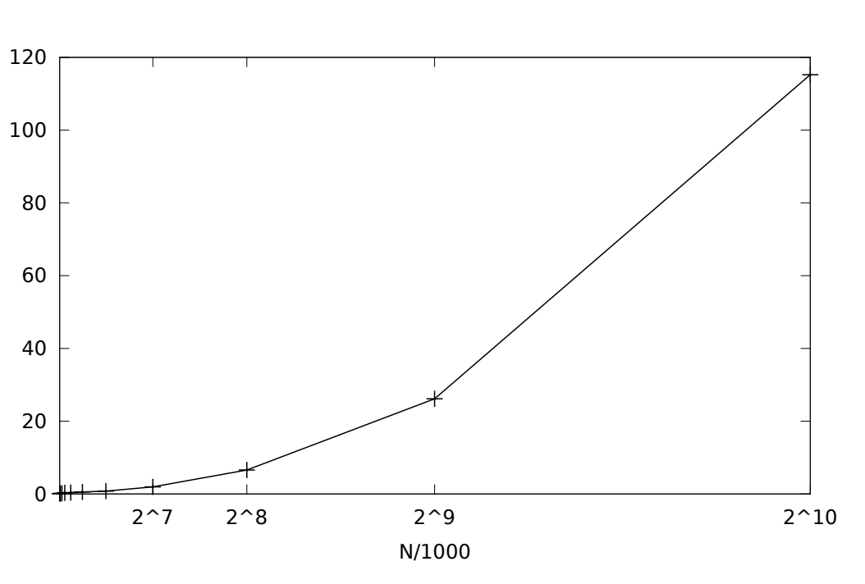
1st solution
Increase the size of the array by 1 (or a larger, but constant value) when there is no place
Complexity?

Slide 12
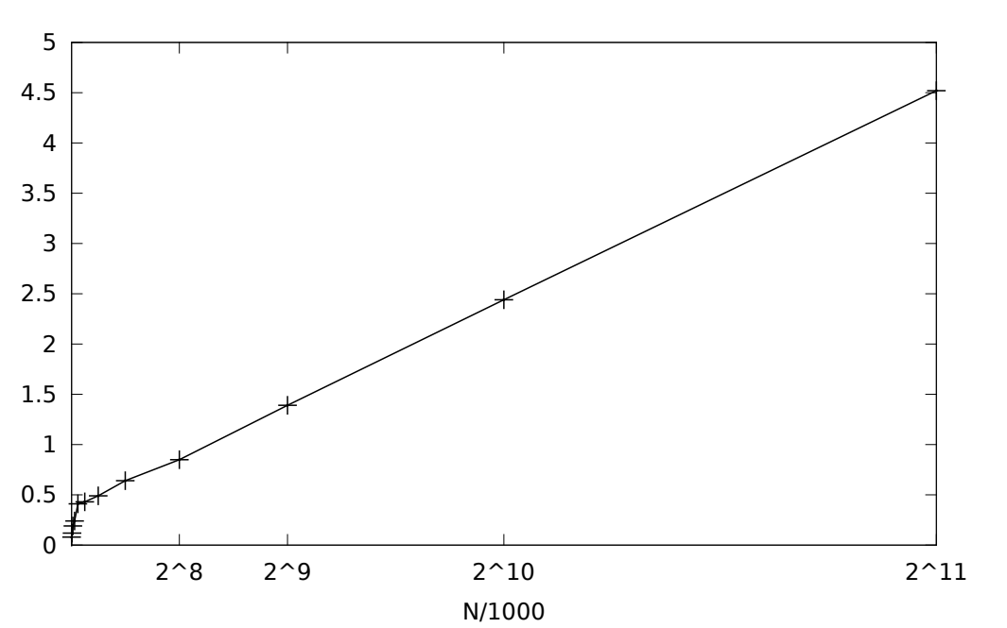

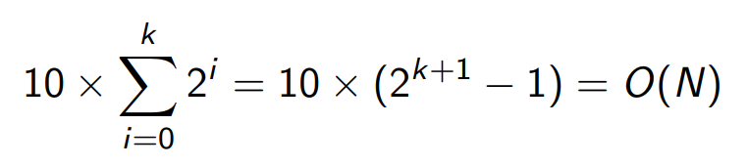
2nd solution (improved)
Instead of just increasing a constant value, we double the size.
Complexity?

Slide 13
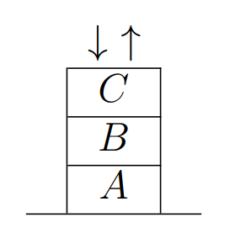
Stack
Stack is a one-way data structure (LIFO, FILO)
No size limit (can be implemented using a resizable array)

Slide 14
Exercise
Write a method that exchanges the top elements of two stacks
void swap_stack(stack<int>& s1, stack<int>& s2)

Slide 15
Comparison
 | Array | Resizable array | Stack
Size | Fixed | Dynamic | Dynamic
Access the ith element | O(1) | O(1) | Impossible

Slide 16
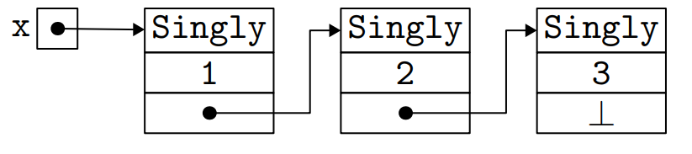
Linked List
Linked list: each element (node) contains its data value and a pointer to the next element (node)

Slide 17
Implementation in c++

Slide 18
Exercise
Write a method int get(int i) which returns the ith element of the linked list (first element has index 0)

Slide 19
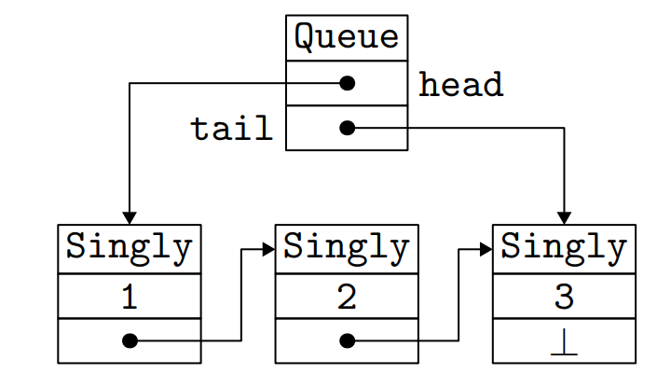
Queue
A Queue can be considered as a linked list with two pointers : one to the head and the other to the tail
FIFO structure

Slide 20
Comparison
 | Linked List | Array
Size | Dynamic | Fixed
Access the ith element | O(N) | O(1)
Insert or delete an element at the ith place | O(1) | O(N) (how?)

Slide 21
Doubly linked list
Linked lists that are linked in both directions
Efficient when both way element insertions are required

Slide 22
C++ libraries
<stack> = stack
<list> = (doubly) linked list
<queue> = queue
<deque> = double-ended queue
<vector> = resizable array

Slide 23
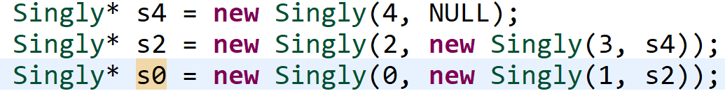
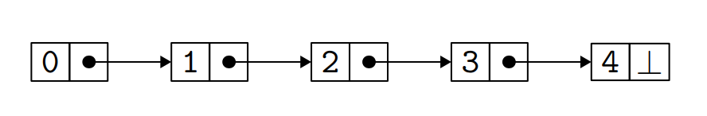

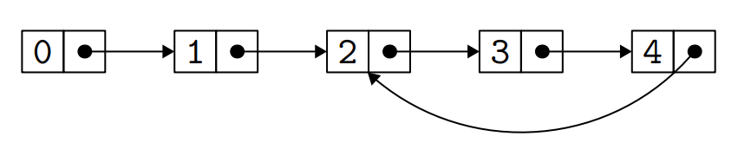
Cyclic lists
Does the previous algorithms still work?
E.g. size??

Slide 24
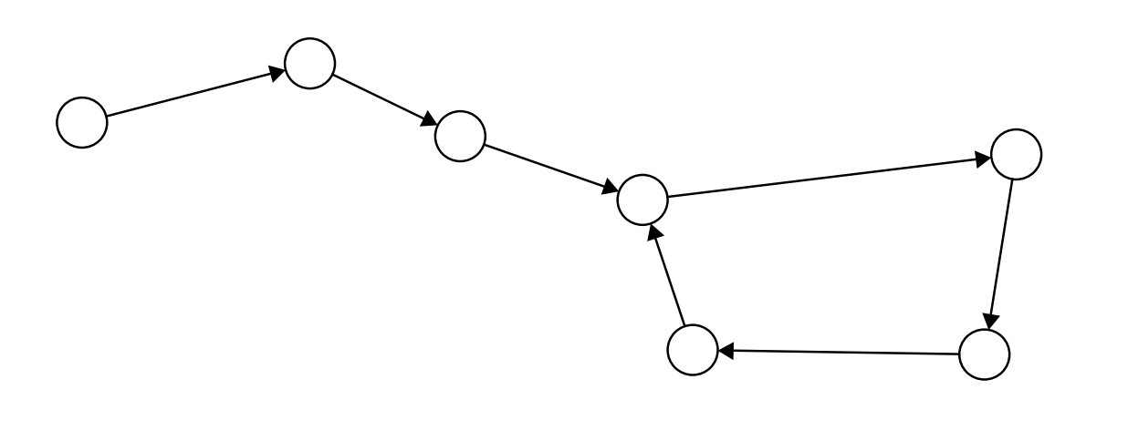
Floyd’s cycle detection algorithm
Floyd's Tortoise and Hare
Hare moves two times faster than the tortoise

Slide 25
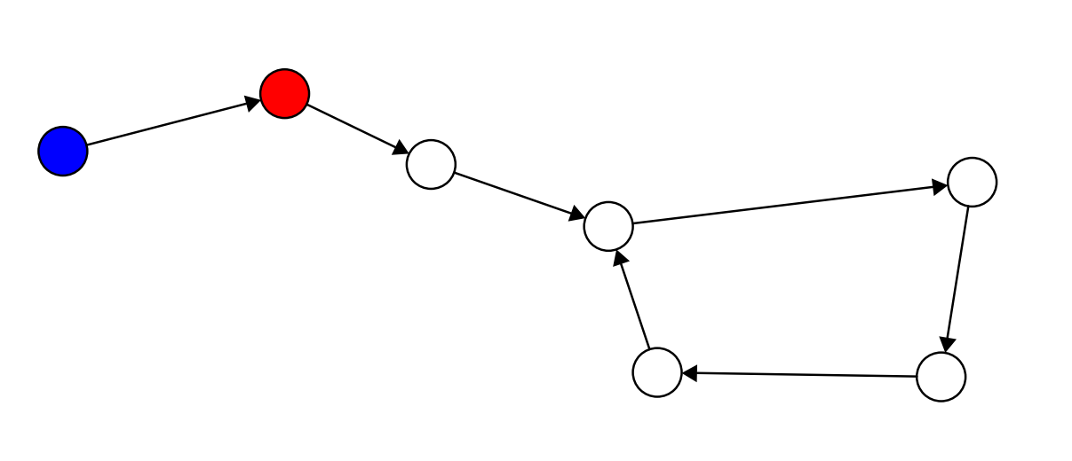
Hare and tortoise

Slide 26
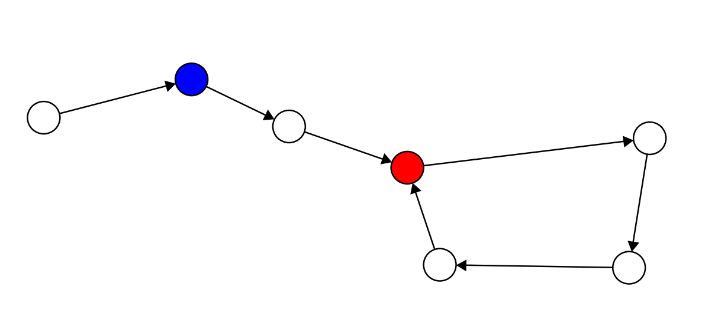

Slide 27
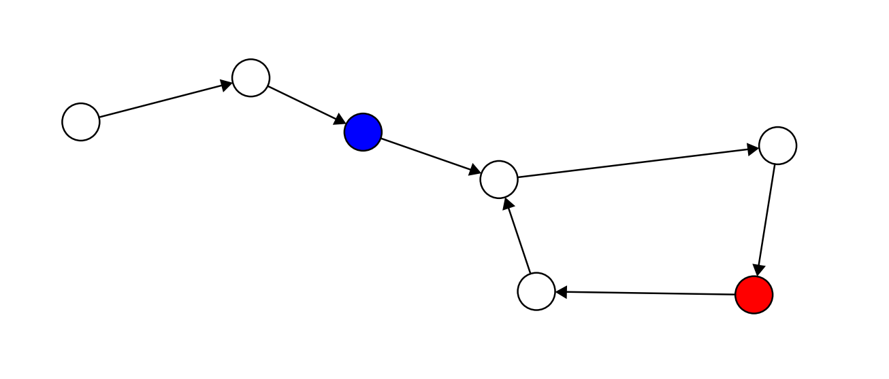

Slide 28
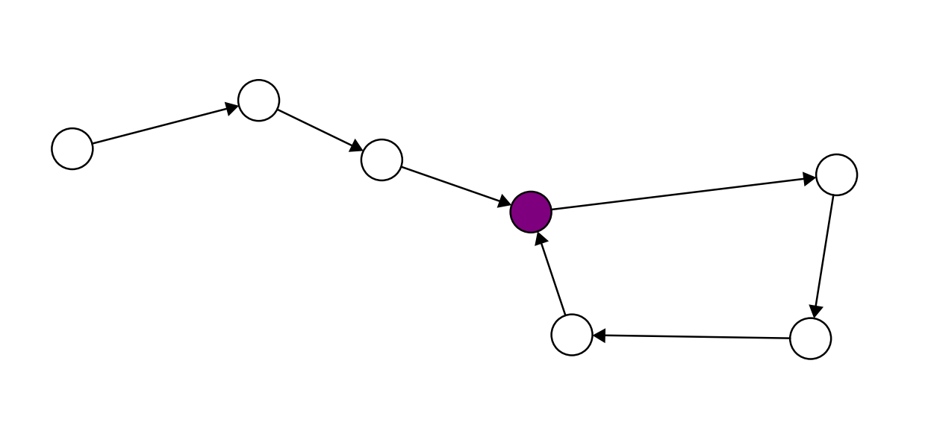

Slide 29
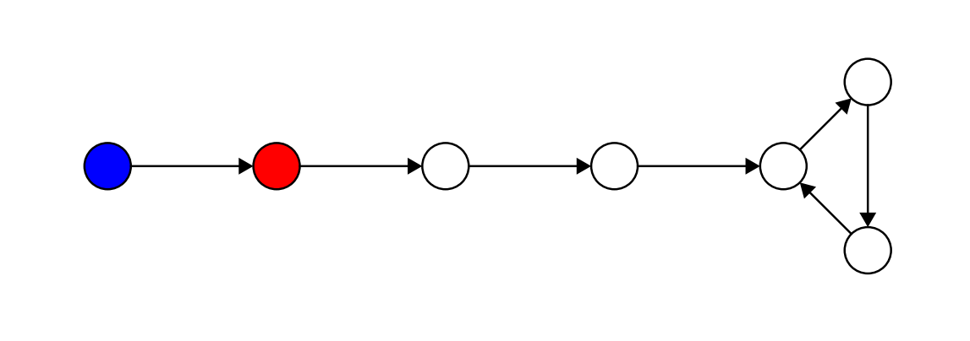
Another example

Slide 30
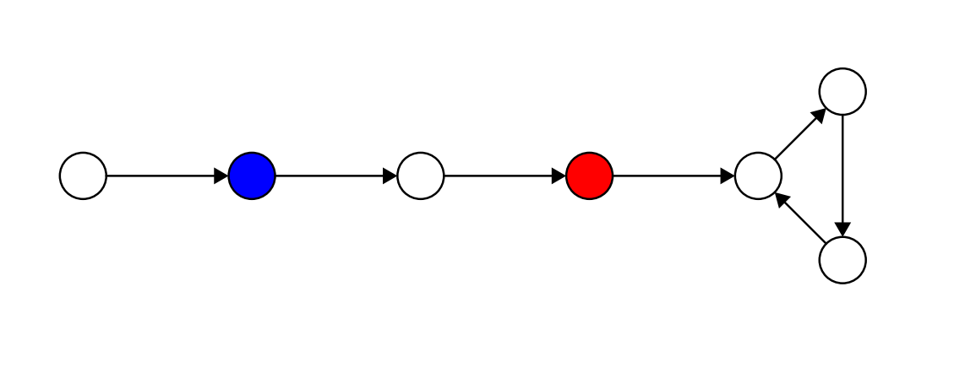

Slide 31
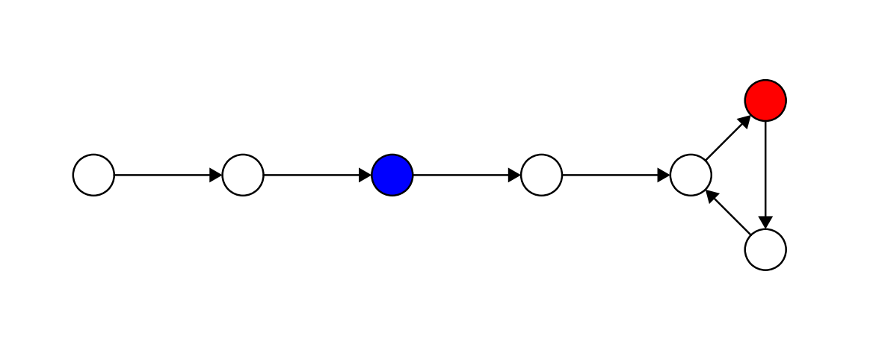

Slide 32
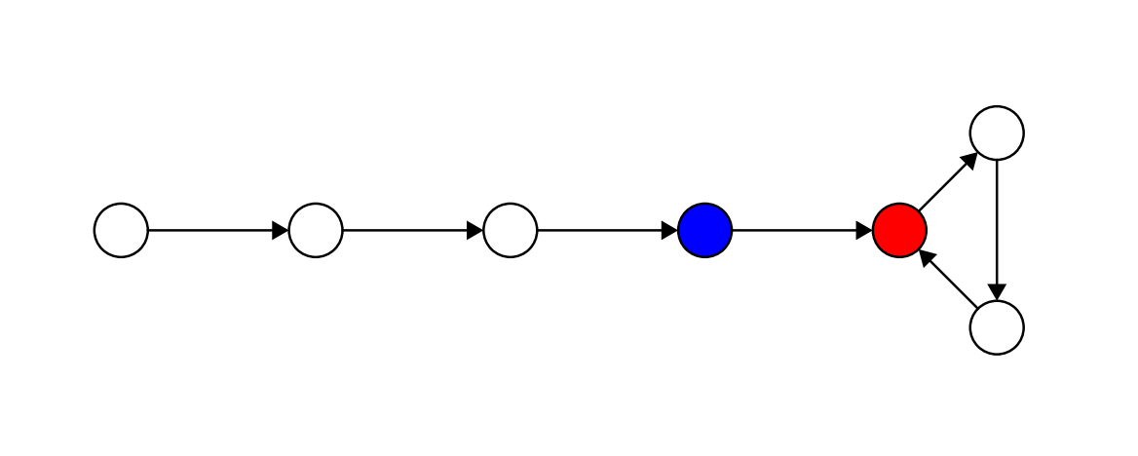

Slide 33
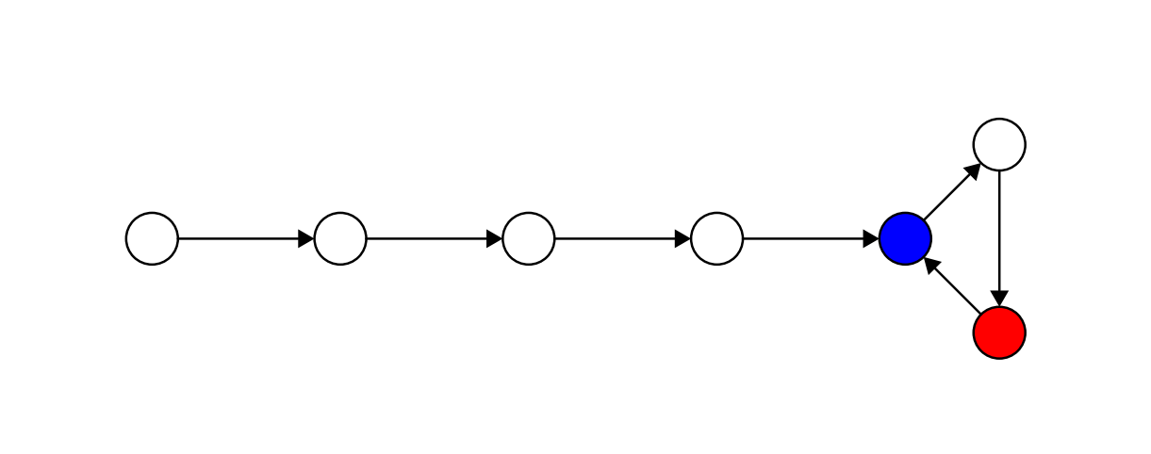

Slide 34
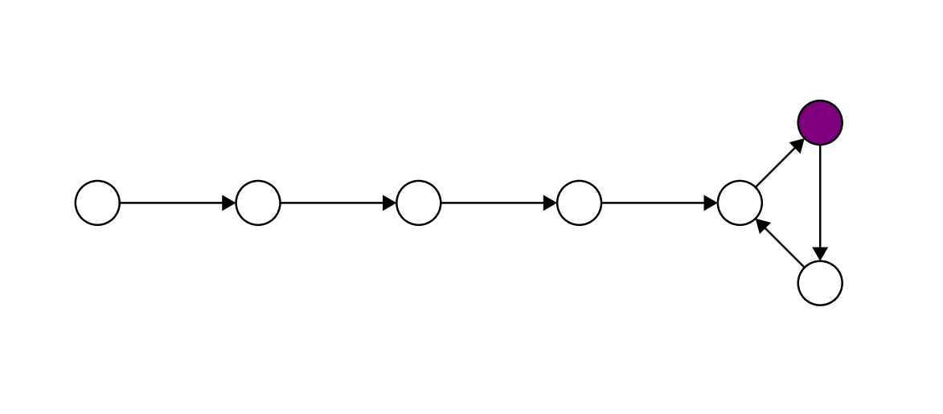

Slide 35
Code
Does this always terminates?

Slide 36

Complexity
Time complexity : $O(N)$ (why?)
Space complexity : $O(1)$ (because there are only 2 variables)

Slide 37
Exercise
If we want to constantly add elements, and get access to the ith element, which data structure is the best?

Slide 38
Homework
For class Singly :
Write a method void insert(Singly* s, int i) which inserts a Singly* s to the ith place
Write a method void remove(int i) which removes the ith node of the linked list

Slide 39
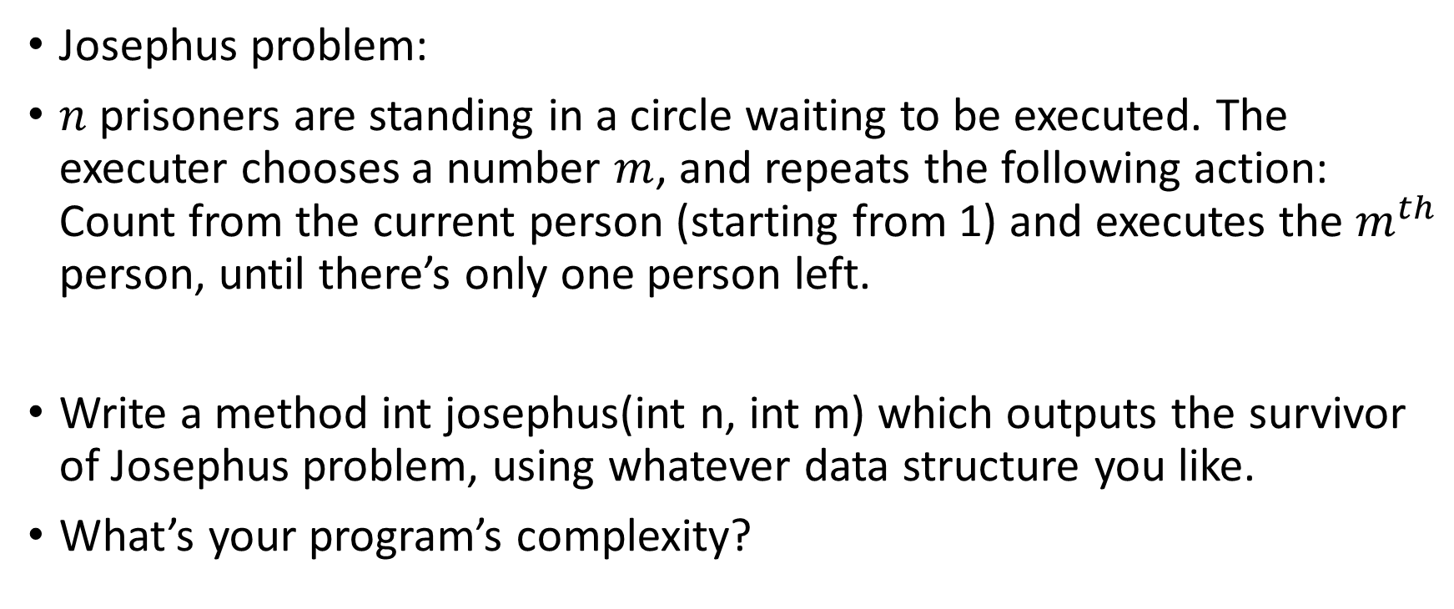
Homework
Josephus problem:
$n$ prisoners are standing in a circle waiting to be executed. The executer chooses a number $m$, and repeats the following action: Count from the current person (starting from 1) and executes the $m^{th}$ person, until there’s only one person left.
Write a method int josephus(int n, int m) which outputs the survivor of Josephus problem, using whatever data structure you like.
What’s your program’s complexity?

