Slide 1
Tree

Slide 2
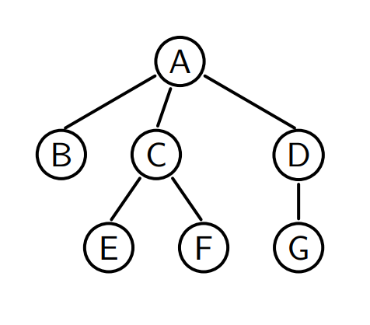
Tree
A tree is defined recursively, it contains:
Root
(Internal) Nodes
Leaves
A tree must not contain a cycle!
Attribute : height

Slide 3
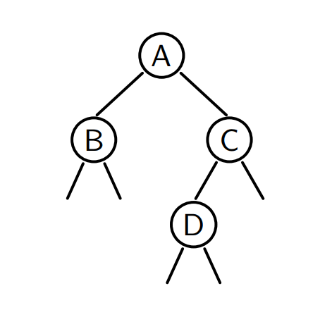
Binary tree
A binary tree is either empty or a node having two children, both of which are binary trees.
We call the children “right-child” and “left-child”

Slide 4
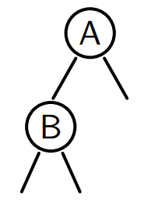
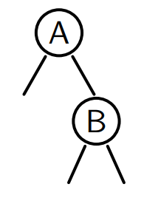
Attention
and are different!

Slide 5

Property
A binary tree of height $h$ has at most $2^{h}−1$ children
Proof by induction

Slide 6
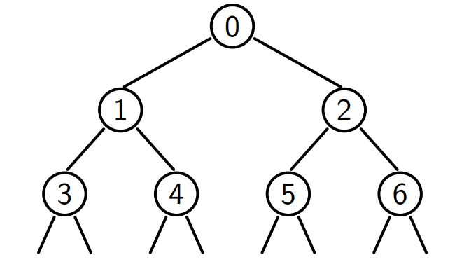
Upper bound
Reached for a perfect tree

Slide 7
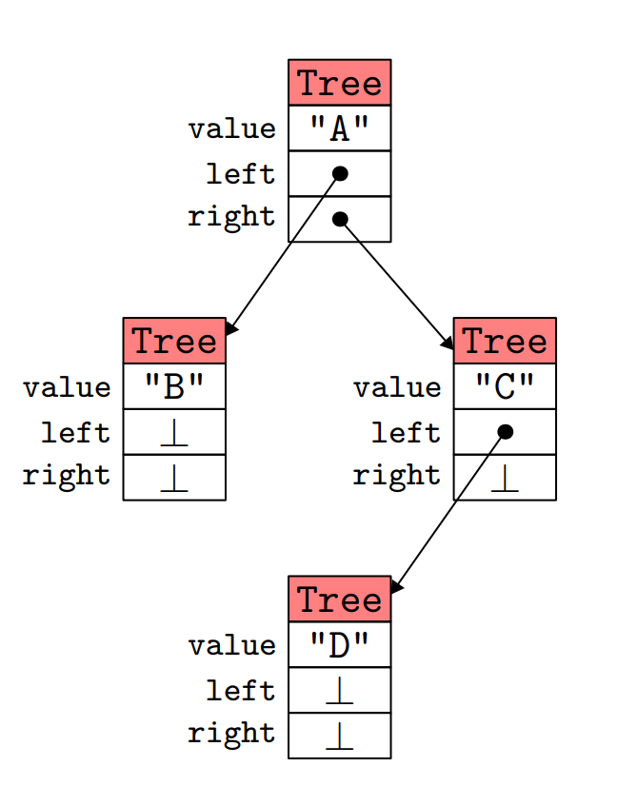
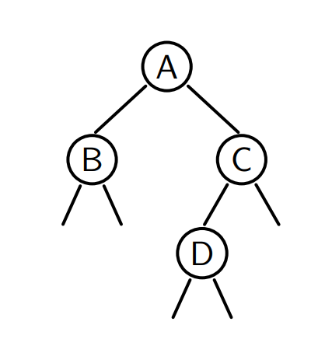
Implementation

Slide 8
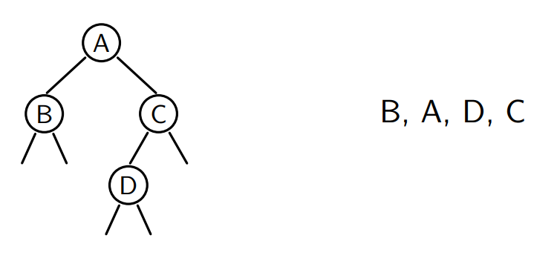
Inorder traversal
Traverse the left child, the node, and the right child
What if we want the result as a list?

Slide 9
It’s too naïve, because splice(it, l) costs O(l.size())
What’s the total complexity?

Slide 10
We use a method that accumulates the list in the argument:
void inorder(Tree* t, list<string>& res)
We just pass an empty list at the beginning, and its complexity is linear!

Slide 11
Different traversals
Actually, inorder traversal is one way of Depth-First Traversal (DFS), with order: left->root->right
Preorder traversal: root->left->right
Postorder traversal: left->right->root
Level order traversal: Breath-First Traversal (BFS)

Slide 12
Exercise
轉學考題目
Find two different trees with 3 nodes that share the same preorder traversal and postorder traversal.
This shows that preorder+postorder doesn’t define a tree uniquely.
But other combinations do (inorder is necessary). Show it.
Hint: the first node in preorder is its root

Slide 13
Implementation of BFS
We need to use a queue to store the current node
And successively add its left child and then right child

Slide 14
Exercise
Write a method that computes the size (the total number of nodes) of a tree.
Write a method that computes the height of a tree.

Slide 15
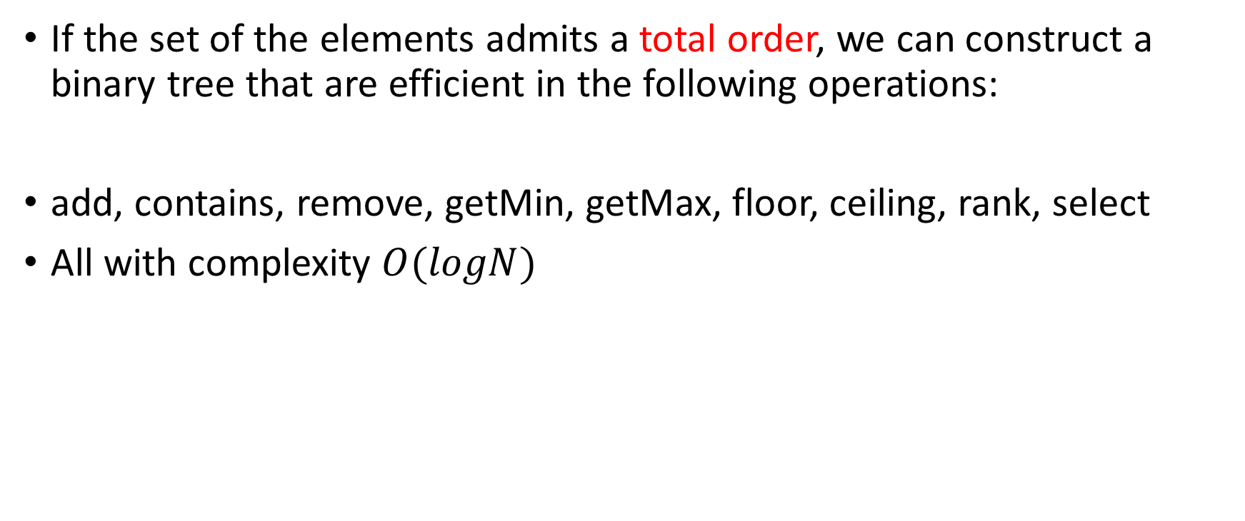
Binary Search Tree (BST)
If the set of the elements admits a total order, we can construct a binary tree that are efficient in the following operations:
add, contains, remove, getMin, getMax, floor, ceiling, rank, select
All with complexity $O(logN)$

Slide 16
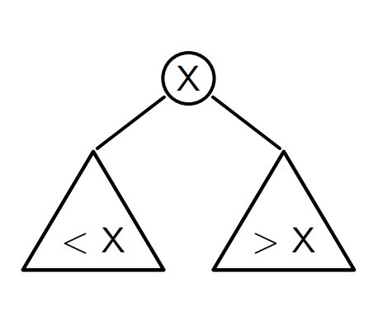
Definition
A BST is a tree where
All values in the left child are <X
All values in the right child are >X

Slide 17
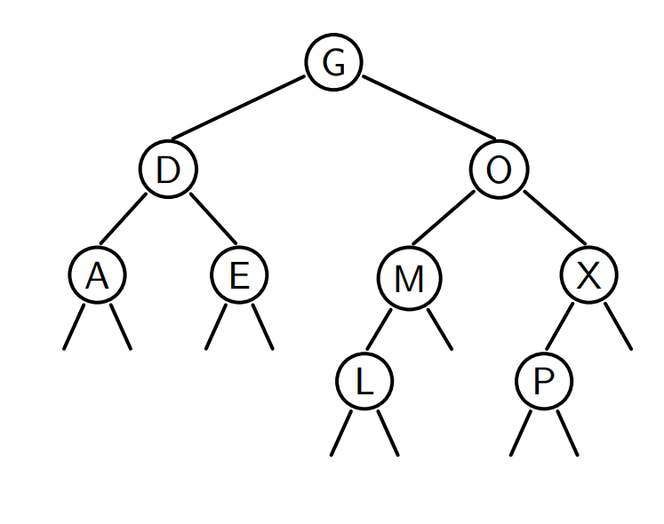

Slide 18
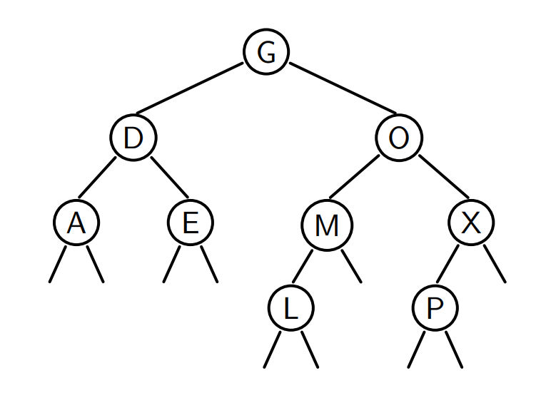
Why is it efficient?
Because we only need to look at one child!
Example: we search for M

Slide 19
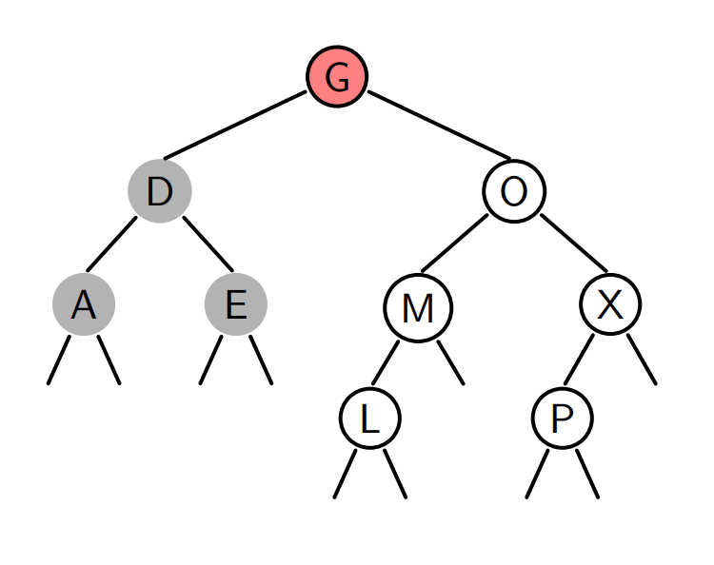
M>G
So we go right

Slide 20
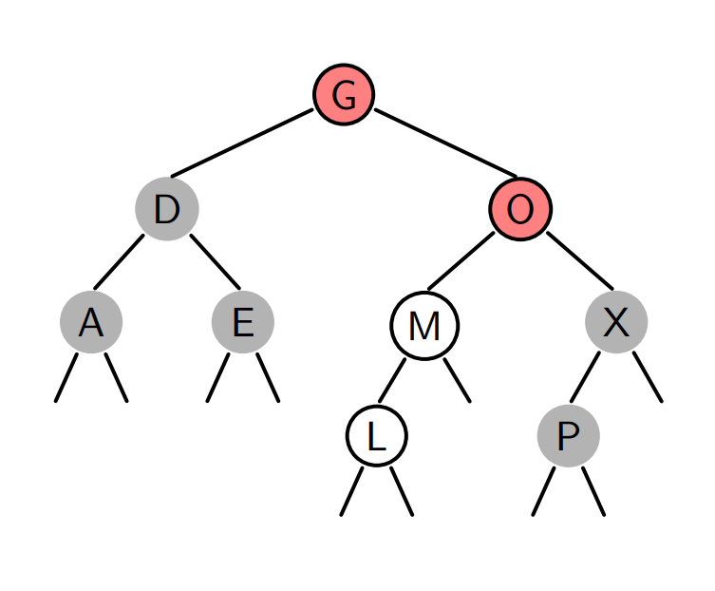
M<O
So we go left
M=M
Success!

Slide 21
If we look for N

Slide 22
N>G
So we go right

Slide 23
N<O
So we go left

Slide 24
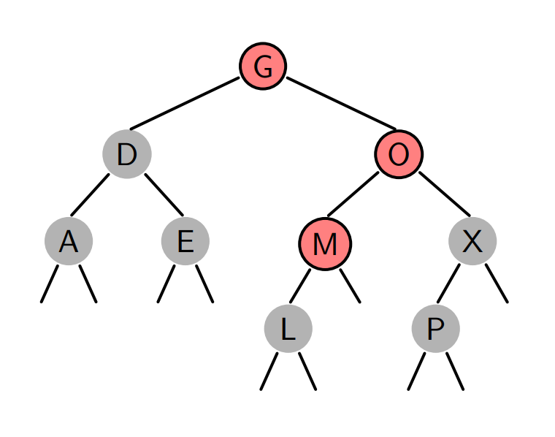
N>M
So we go right
No right child
Failed -> No such element

Slide 25
getMin
Where is the minimum value?

Slide 26
contains
We compare the value to the root:
If it is ==, then we’ve found it
If it is >, then go right
If it is <, then go left
If we encounter NULL, it means the value doesn’t exist

Slide 27
Exercise
Rewrite the contains function recursively.

Slide 28
Insertion
We find the right place to insert the element

Slide 29
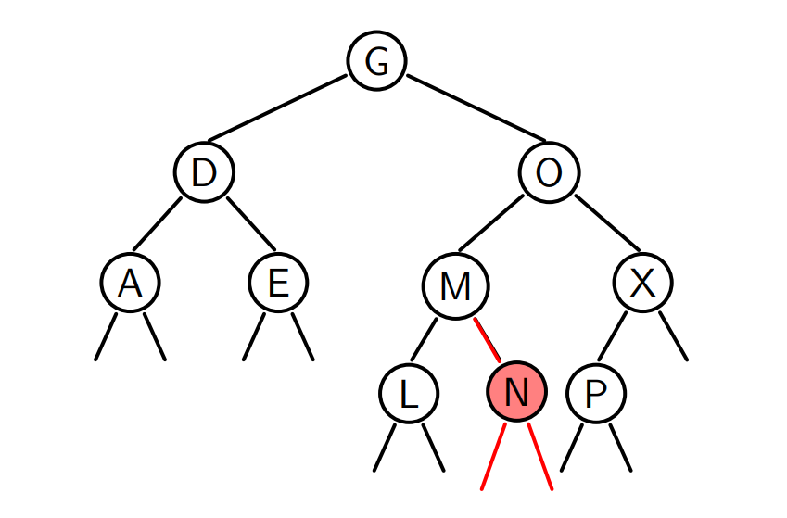
Example: add N

Slide 30
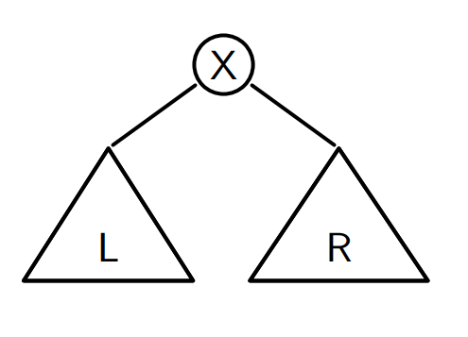
Delete an element
Almost the same as inserting an element…
What happens if we want to delete the root?
------→ ???

Slide 31
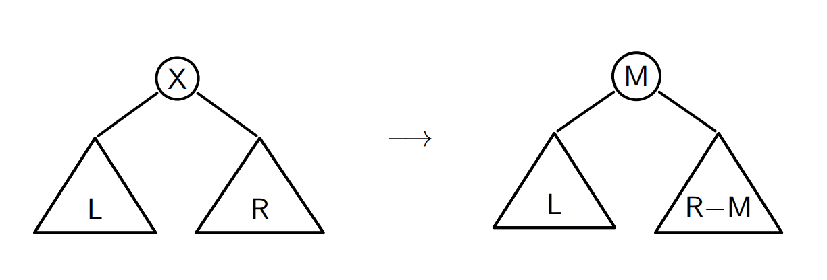
We replace the root by min(R)
Or by max(L), depending on the implementation

Slide 32
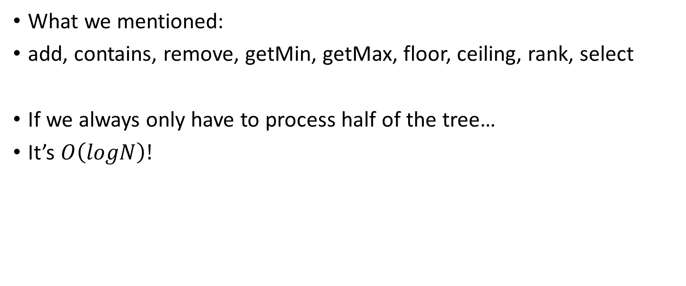
Complexity
What we mentioned:
add, contains, remove, getMin, getMax, floor, ceiling, rank, select
If we always only have to process half of the tree…
It’s $O\left(logN\right)!$

Slide 33
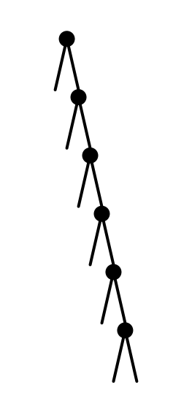
But we can be unlucky…
What’s the complexity in this case?

Slide 34
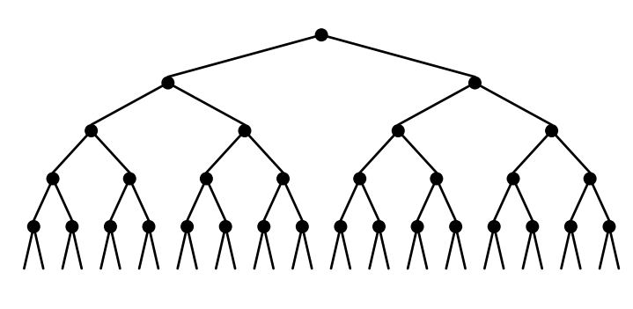

Look at the good side first
If the tree is perfect
add, contains,… in $O(logN)$
Construction in$O(NlogN)$

Slide 35
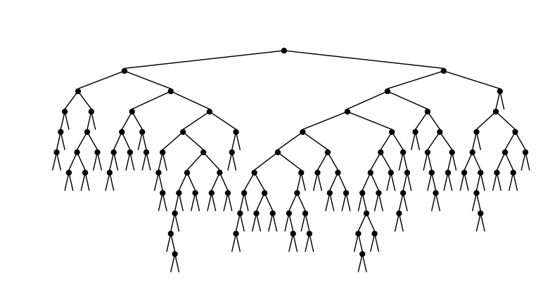
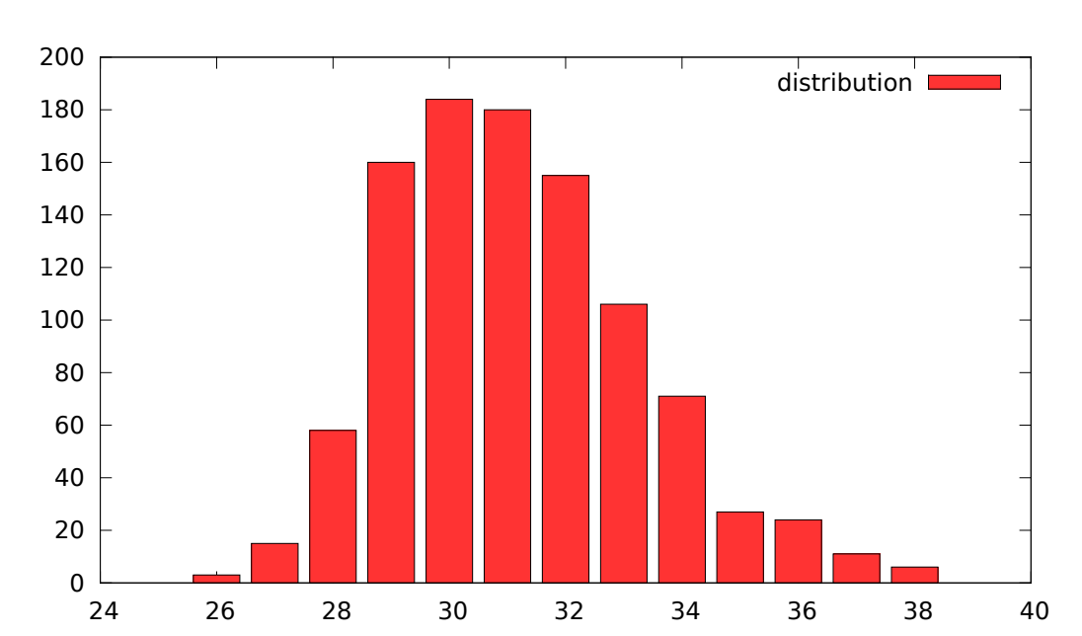
In reality…
For N = 10000, repeated 1000 times

Slide 36
We still want to avoid the worst case
We need to balance the tree

Slide 37
Balanced BST
We want to guarantee that the height of the tree is logarithmic of the number of nodes

Slide 38
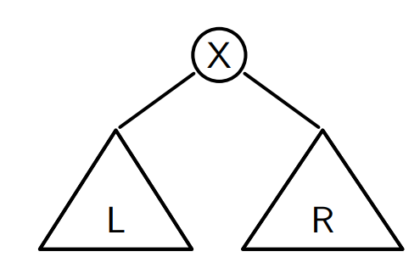

One solution: Adelson-Velsky and Landis (AVL)
Definition of an AVL tree: $\left|h\left(L\right)−h\left(R\right)\right|≤1$

Slide 39
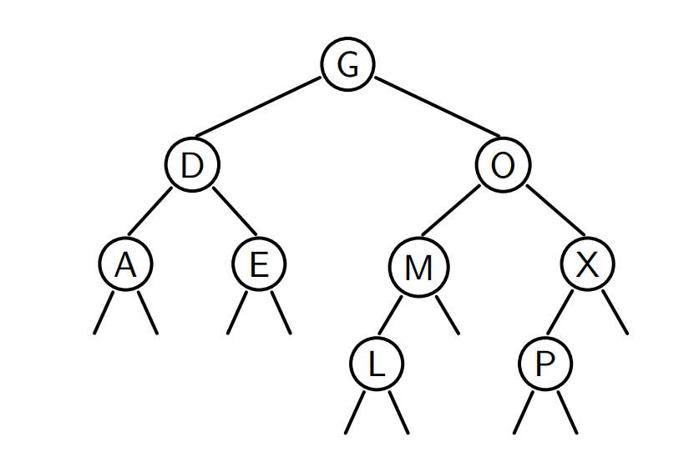
Example

Slide 40
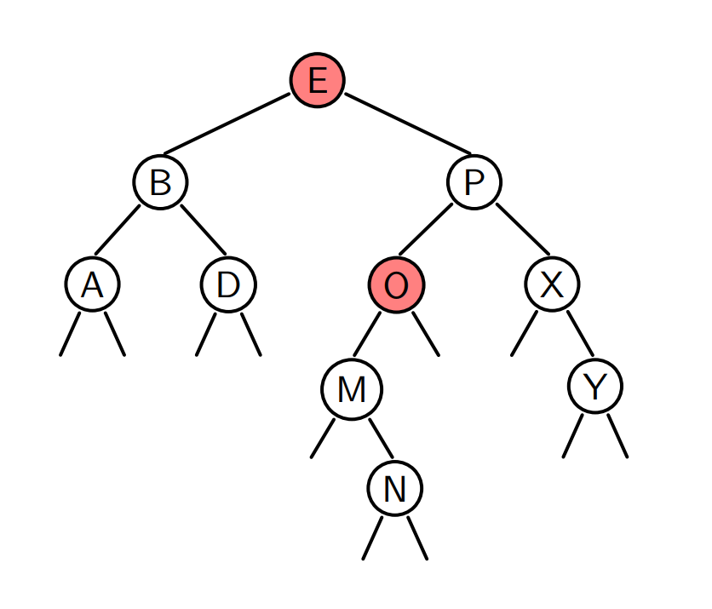
Counter example

Slide 41

Math question
What is the maximal height of an AVL tree having N nodes?
Dual question:
What is the minimal number of nodes $N_{h}$ in an AVL tree of height $h$?

Slide 42

$N_{h}=$The minimal number of nodes in an AVL tree of height $h$
$N_{1}=1$
$N_{2}=2$
$N_{h}=1+N_{h−1}+N_{h−2}$

Slide 43

By adding 1 to $N_{h}$, we recognize the Fibonacci sequence
$N_{1}+1=2$
$N_{2}+1=3$
$N_{h}+1=\left(N_{h−1}+1\right)+{(N}_{h−2}+1)$
$N_{h}+1=F_{h+2}$

Slide 44
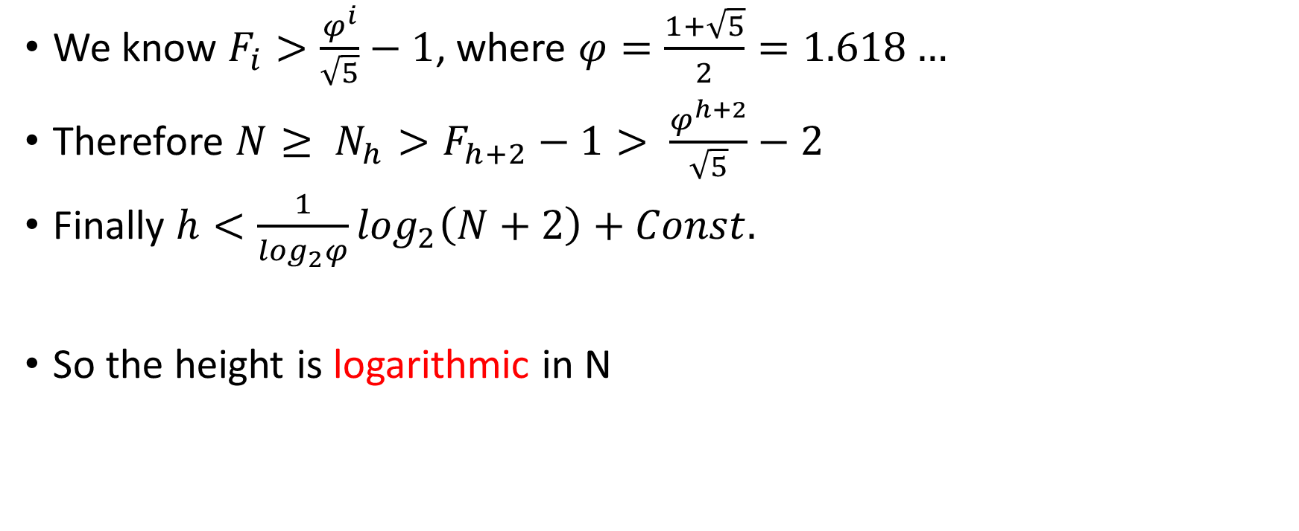
We know $F_{i}>\frac{φ^{i}}{\sqrt{5}}−1$, where $φ=\frac{1+\sqrt{5}}{2}=1.618…$
Therefore $N≥ N_{h}>F_{h+2}−1> \frac{φ^{h+2}}{\sqrt{5}}−2$
Finally $h<\frac{1}{\log_{2}φ}\log_{2}\left(N+2\right)+Const.$
So the height is logarithmic in N

Slide 45
C++ implementation
Which methods are not changed?
Which methods are changed?

Slide 46
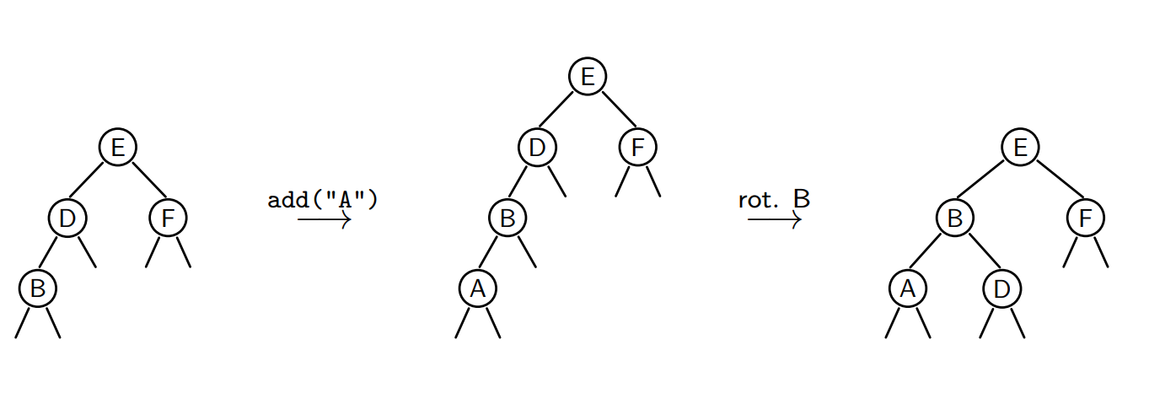
Add

Slide 47
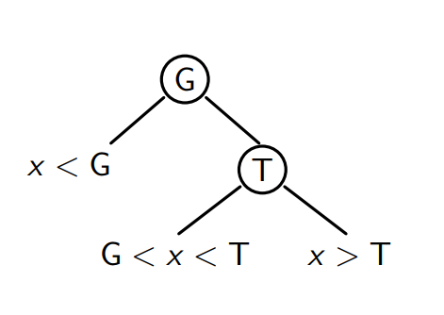
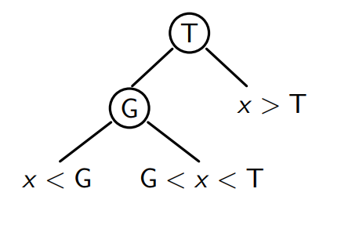
Rotation
A rotation to the right conserves the property of an AVL
Same for a rotation to the left

Slide 48
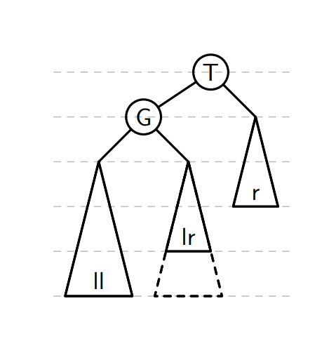
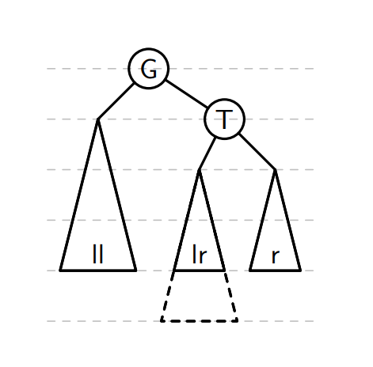
The rotation to the right allows to rebalance the tree when the imbalance comes from the left child of the left child

Slide 49
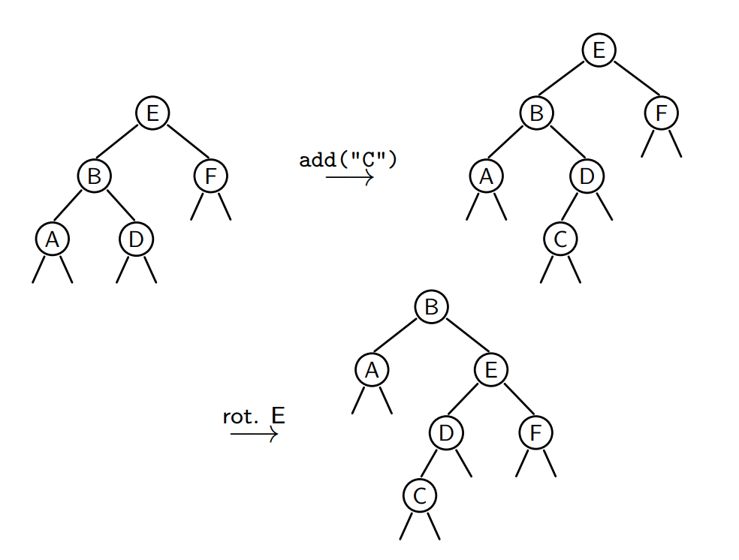
One rotation is not always enough

Slide 50
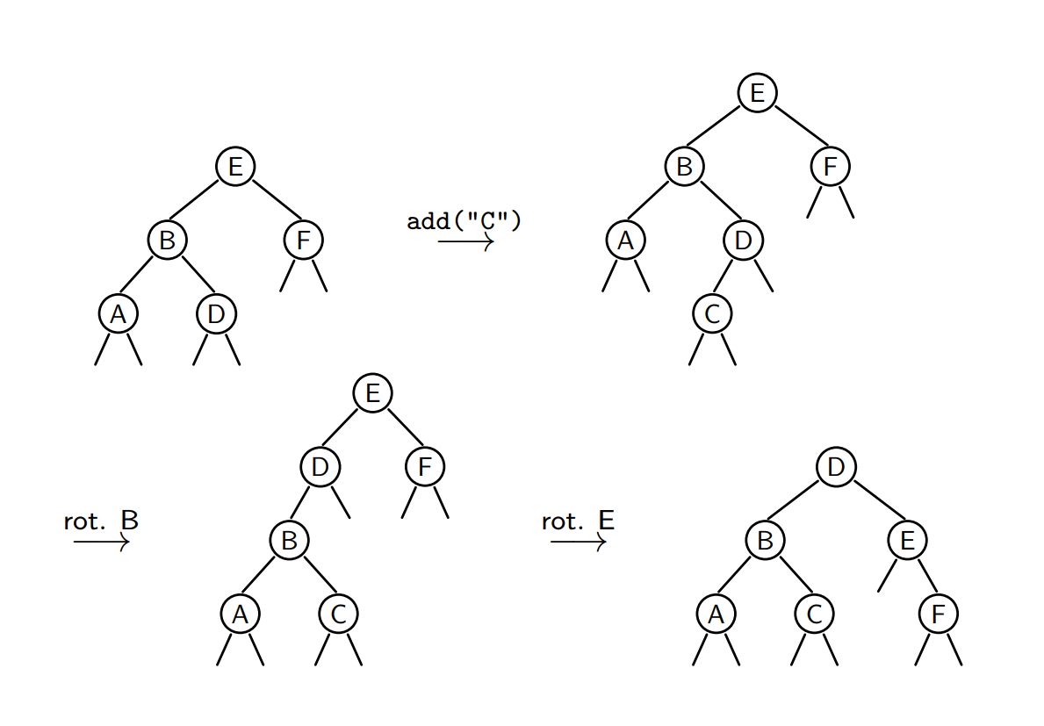

Slide 51
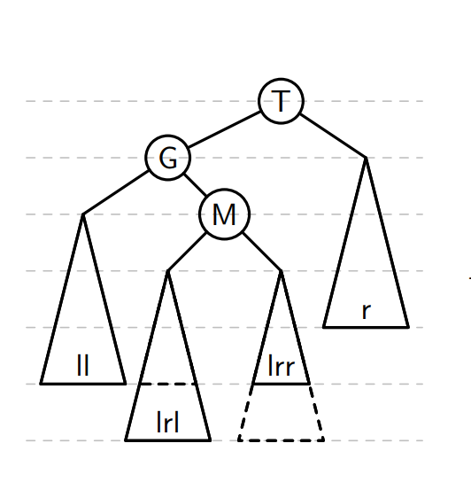
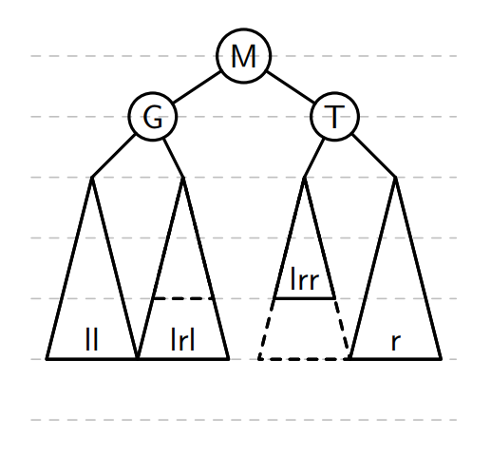
Double rotation
The left-right rotation allows to rebalance the tree when the imbalance comes from the right child of the left child

Slide 52
rotateLeft
rotateRight
balance

Slide 53
Which methods need to be balanced?
add
removeMin
remove

Slide 54
C++ libraries
<set>
<map>

Slide 55
Exercise
Create a struct/class AVLSet that uses the struct AVL, which acts as a set structure, in particular, it must contain the following methods:
isEmpty()
contains(string x)
add(string x)
remove(string x)
Write another method size() that returns the size of the set.

Slide 56
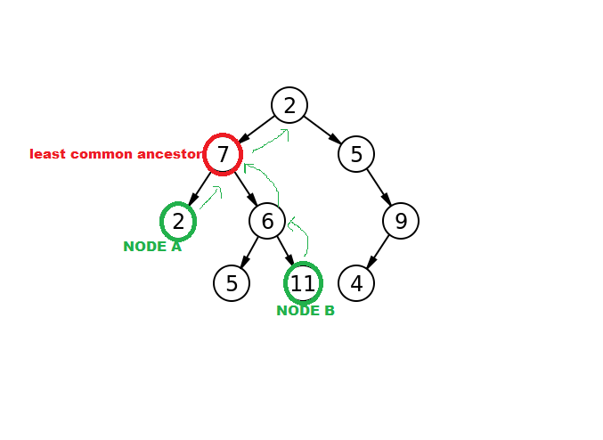
Homework
Make use of the struct BST, find the lowest common ancestor (LCA) of two nodes
LCA:
What is the complexity?
How to find the LCA for nodes in a
(binary) Tree (not sorted)?

