Slide 1
Priority Queue

Slide 2
Today’s problem
What are the 100 most long titles in wiki?
More generally, what are the M biggest values in N values?

Slide 3
Solution 1: array
Read all : O(N) in space
Find the M biggest : O(M*N) in time

Slide 4
Solution 2: array, then sort
Read all : O(N) in space
Sort the array, and retrieve the first M values: O(NlogN) in time
We’ll talk about sorting next time

Slide 5
Problem
There are too many titles! (N very large)
Which will raise an OutOfMemoryException

Slide 6
Solution 3
We only store the M largest value, in a sorted array : O(M) in space
When we read a new value:
If it is smaller than the smallest value, discard it
Otherwise, insert it to the good place
O(N*M) in time

Slide 7
Solution 4
We only store the M largest value, in a BBST : O(M) in space
When we read a new value:
If it is smaller than the smallest value, discard it
Otherwise, insert it to the good place
O(N*logM) in time

Slide 8
We identify three necessary operations for this data structure:
Add an element
Find the smallest element
Delete the smallest element

Slide 9
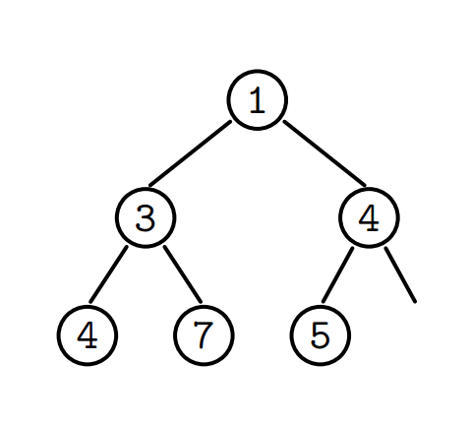
Heap
A (min) heap is a binary tree where:
For every node C, its parent node P is <= C

Slide 10
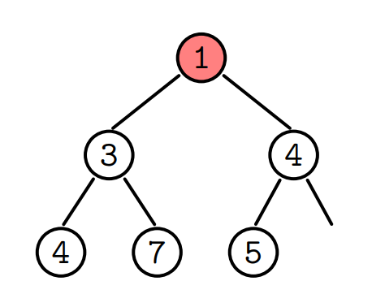
Property
The smallest value is situated at the root

Slide 11
Add an element
We add from the bottom
And raise the nodes if necessary
Ex. Add 6

Slide 12
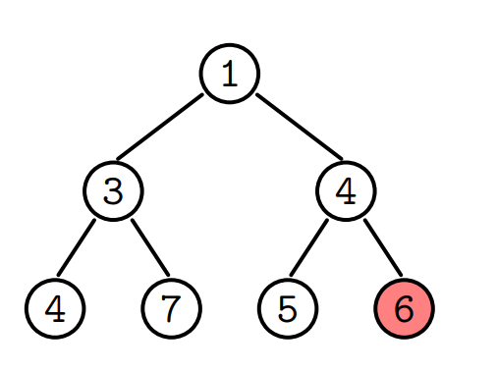

Slide 13
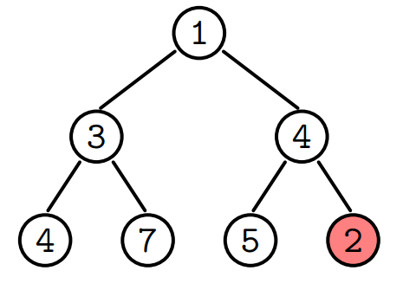
Ex: add 2

Slide 14
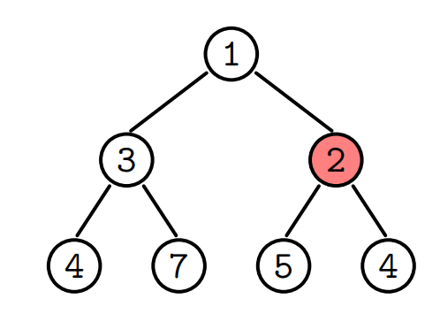

Slide 15
Ex: Add 0

Slide 16
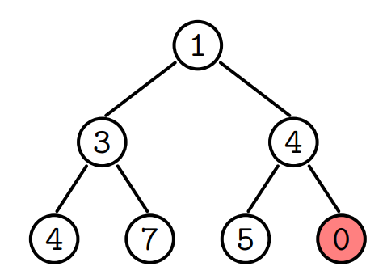

Slide 17
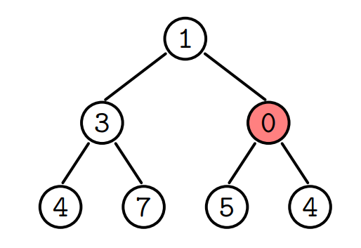

Slide 18
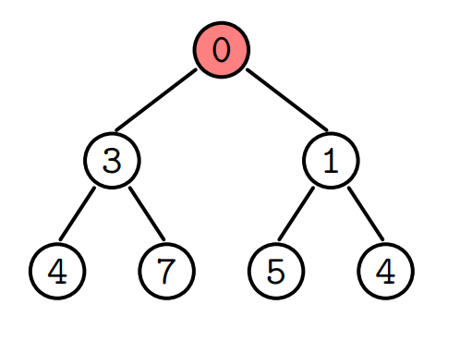

Slide 19
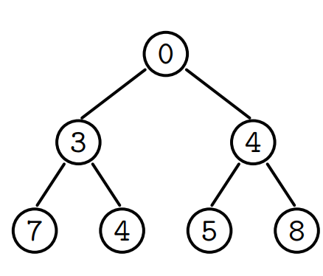
Delete the smallest value
We replace the root by the element on the bottom right
And lower it as is necessary

Slide 20
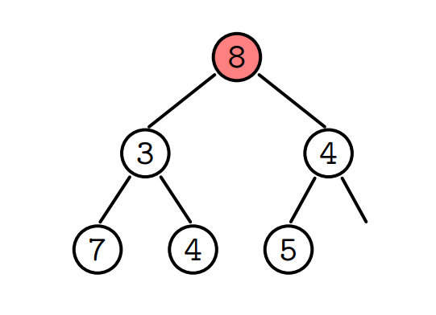

Slide 21
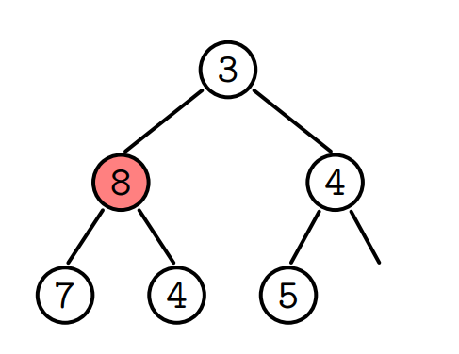

Slide 22
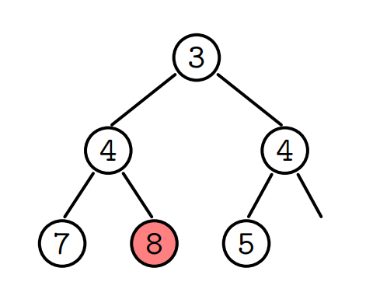

Slide 23
For simplicity, we maintain the tree such that it is almost perfect (all levels filled, except perhaps the leaves)
We can then store this “tree” in an array

Slide 24
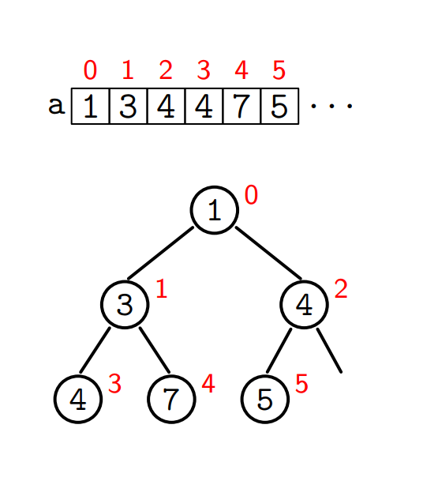
Root = 0
Left(i) = 2i+1
Right(i) = 2i+2
Parent(i) = (i-1)/2 (integer division)

Slide 25
C++ implementation

Slide 26
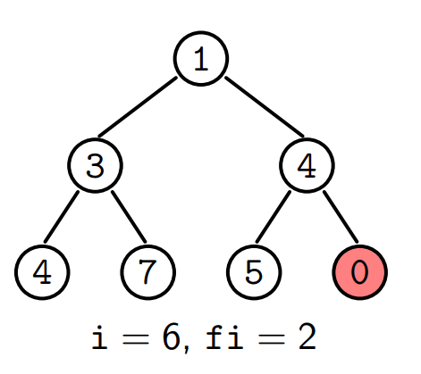
Illustration of add

Slide 27
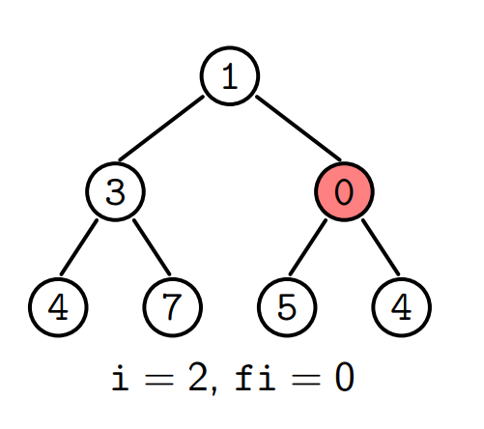

Slide 28
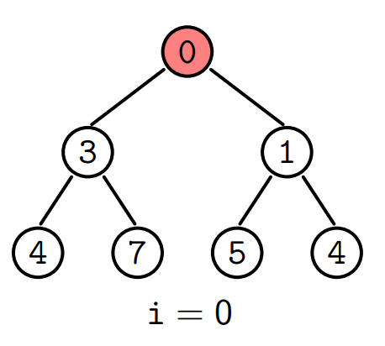

Slide 29
Complexity
The cost is at most the height of the tree, which is O(logN)

Slide 30
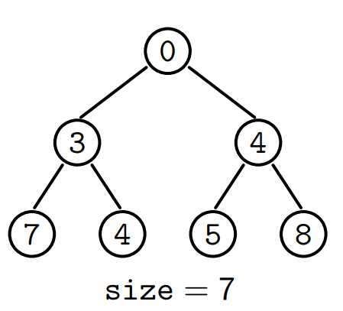
Illustration of removeMin

Slide 31
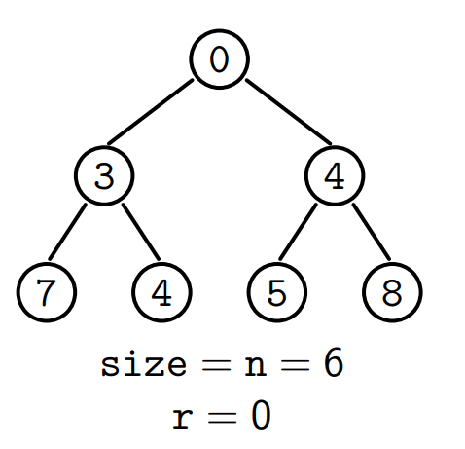

Slide 32
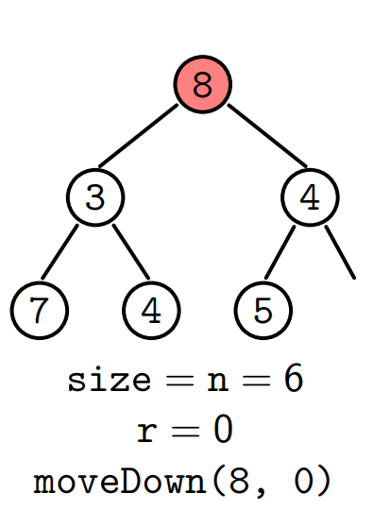

Slide 33
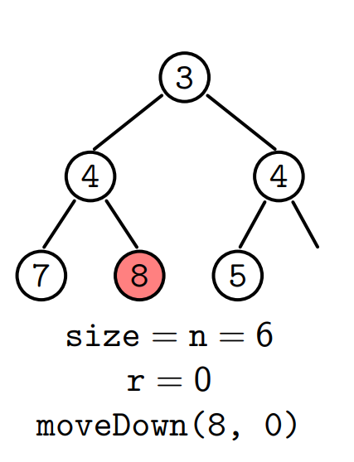

Slide 34
Complexity
The cost is at most the height of the tree, which is O(logN)

Slide 35
In general, we don’t limit the size of the queue, so use <vector> (resizable array) instead of array.

Slide 36
C++ library
priority_queue (#include <queue>!!)
Attention: the default order is decreasing (the largest element at the top)

Slide 37
Solution to the problem
There are 13644994 titles
Two_Old_Iudges_Ouercomen_with_Carnal_Consupi鰱cence,_Tempt_Cha鰱te_Su鰱anna:_Who_Con鰱tantly_Re鰱i鰱ting,_Is_by_Them_Fal鰱ly_Accu鰱ed,_&_Condemned_of_Adultrie._Daniel_Conuinceth_Them_of_Fal鰱e_Te鰱timonie,_and_They_Are_Punished_with_Death.
Two_old_iudges_ouercomen_with_carnal_consupi鰱cence,_tempt_cha鰱te_Su鰱anna:_who_con鰱tantly_re鰱i鰱ting,_is_by_them_fal鰱ly_accu鰱ed,_&_condemned_of_adultrie._Daniel_conuinceth_them_of_fal鰱e_te鰱timonie,_and_they_are_punished_with_death.
You_Spoof_Discovery:_The_ultimate_viewer-submitted_low-cost_high-quality_extremely_entertaining_Discovery_parody_special_hosted_by_Mike_Rowe_of_Dirty_Jobs,_who_also_narrates_the_series_American_Chopper,_American_Hot_Rod_and_Deadliest_Catch
Everybody_has_a_secret...Duke_wants_Olivia_who_likes_Sebastian_who_is_really_Viola_whose_brother_is_dating_Monique_so_she_hates_Olivia_who's_with_Duke_to_make_Sebastian_jealous_who_is_really_Viola_who's_crushing_on_Duke_who_thinks_she's_a_guy...
To_authorize_the_President_to_extend_the_term_of_the_Agreement_for_Cooperation_between_the_Government_of_the_United_States_of_America_and_the_Government_of_the_Republic_of_Korea_Concerning_Civil_Uses_of_Nuclear_Energy_(H.R._2449;_113th_Congress)
Jugemu-jugemu_Gok?osurikire_Kaijarisuigyo-no_Suigy?atsu_Ungy?atsu_F贖raimatsu_K贖nerutokoroni-sumutokoro_Yaburak?ino-burak?i_Paipopaipo-paiponosh贖ringan_Sh贖ringanno-g贖rindai_G贖rindaino-ponpokop蘋no-ponpokon?o_Ch?y贖meino-ch?uke
Jugemu-jugemu_Gok?osurikire_Kaijarisuigyo-no_Suigy?atsu_Unraimatsu_F贖raimatsu_K贖nerutokoroni-sumutokoro_Yaburak?ino-burak?i_Paipopaipo-paiponosh贖ringan_Sh贖ringanno-g贖rindai_:G贖rindaino-ponpokop蘋no-ponpokon?o_Ch?y贖meino-ch?uke
Phosphoenolpyruvate:(D-GlcA-beta-(1-4)-2-O-Ac-D-GlcA-beta-(1-4)-D-Glc-beta-(1-4)-(3-O-CH3-CH2CH(OH)C(O)-D-Gal-beta-(1-4)-D-Glc-beta-(1-4)-D-Glc-beta-(1-4)-D-Glc-beta-(1-6))-2(or3)-O-Ac-D-Glc-alpha-(1-6))n_4,6-O-(1-carboxyethan-1,1-diyl)transferase
Alternating_UDP-alpha-N-acetyl-D-glucosamine:beta-D-glucuronosyl-(1-3)-(nascent_hyaluronan)_4-N-acetyl-beta-D-glucosaminyltransferase_and_UDP-alpha-D-glucuronate:N-acetyl-beta-D-glucosaminyl-(1-4)-(nascent_hyaluronan)_3-beta-D-glucuronosyltransferase
Protocol_Amending_the_Agreements,_Conventions_and_Protocols_on_Narcotic_Drugs_concluded_at_The_Hague_on_23_January_1912,_at_Geneva_on_11_February_1925_and_19_February_1925,_and_13_July_1931,_at_Bangkok_on_27_November_1931_and_at_Geneva_on_26_June_1936

Slide 38
Another application
We can use a priority queue to sort
We’re talking about heapsort
We construct the heap by adding elements one by one (in any order)
And get the sorted array by removing the minimum value successively

Slide 39
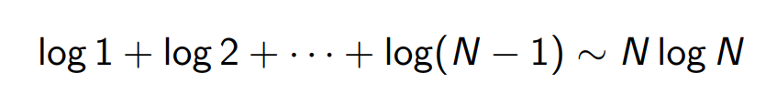
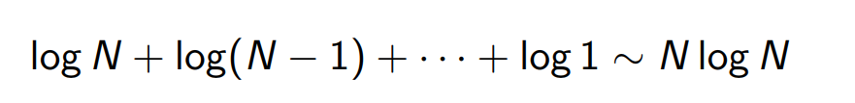
Complexity
In construction
In destruction

Slide 40

How to compute this
Use integrals to bound.
$\int{lnx}dx=xlnx−x+C$

Slide 41
The sorting complexity is O(NlogN)
We will see that this complexity is optimal next time

Slide 42
Important application
Dijkstra’s algorithm. (will talk about later)
K nearest neighbors (machine learning)
Huffman coding

Slide 43
Huffman coding
A way to compress data in 0 and 1’s
An example:
mississippi → 100011110111101011010

Slide 44
We choose
i → 0
s → 11
m → 100
p → 101
It’s a prefix code : no sequence is a prefix of another

Slide 45
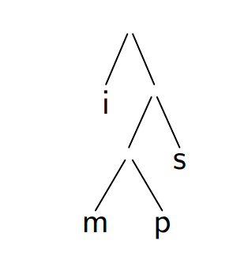
We can represent the encoding using a prefix binary tree:
Where 0 = left, 1 = right

Slide 46
Huffman’s algorithm
1. Initially, each character is a leaf with its frequency
2. As long as there are two disjoint nodes
Choose two nodes with the least frequencies
Merge them, and add the frequencies

Slide 47
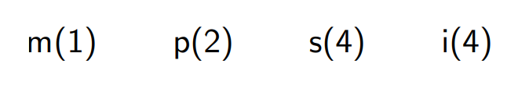

Slide 48
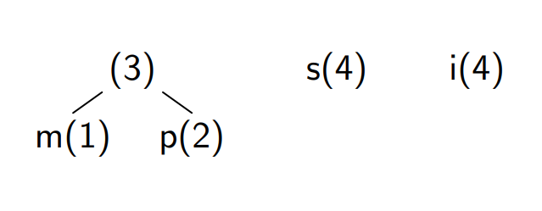

Slide 49
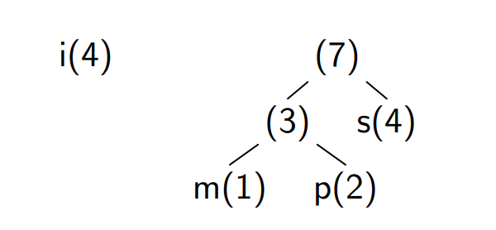

Slide 50
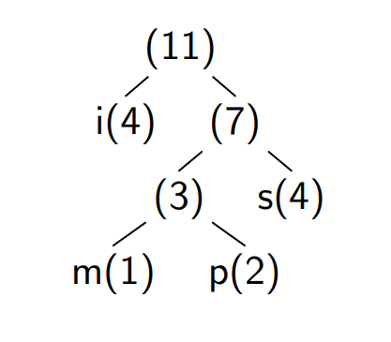

Slide 51

If each character $c_{i}$ appears with frequency $f_{i}$
Huffman tree minimizes $\sum{f_{i}d_{i}}$, where $d_{i}$ is the depth of $c_{i}$
This sum is also the length of the encoded sequence.

Slide 52
Homework
Read a proof of the optimality of Huffman’s algorithm
http://www.utdallas.edu/~sizheng/CS4349.d/l-notes.d/L9.pdf

Slide 53
C++ implementation
while(q.size()>1){
HuffmanTree left = q.top();
q.pop();
HuffmanTree right = q.top();
q.pop();
q.push(HuffmanTree(&left, &right));
}

Slide 54
Exercise/homework
Write method encode(string s) that will construct the HuffmanTree from s, and output the encoded string (0 and 1’s) of s.
Write a method decode(string s) that will do the inverse.
Hint: use an auxiliary method traverse(map) that will traverse the tree and add the mapping <char, string> to map.

