Slide 1
Dynamic programming

Slide 2
Definition
Break down the problem into small subproblems
Solve the subproblems (usually by memoization)
Combine the sub-results to get the final result
Approaches :
1. Top-down : start with the original big problem, break it down, then recursively solves small problems and store the results
2. Bottom-up : start with base cases, and construct the results step by step until the final answer is found

Slide 3
Example top-down and bottom-up
In previous lectures
Bottom-up : Fibonacci numbers, we construct F1, then F2, … , until F80.
Top-down : matrix max sum problem, we start with C=1…1 then goes downwards, calculate and save the result when we reach the last row

Slide 4
Memoization
Store previously computed results, so that we don’t need to compute them again.
Useful when some computations occur frequently
Implementation : using Array or Map

Slide 5

Previous homework (in case not done yet)
Simple one…
Print $C_{a}^{b}$ for 0<=a<=b<=20
Using DP

Slide 6
Longest common subsequence(LCS)
A subsequence is a sequence obtained by deleting elements of the original sequence, while maintaining the order.
E.g. s=“abcdefg”, sub=“abeg”
a=[0, 1, 3, 4, 9], sub=[0, 9]
LCS : Given two sequences, find the longest common subsequence of the two:
E.g. s1=2,5,7,9,3,1,2 s2=3,5,3,2,8
LCS(s1,s2) = 5,3,2

Slide 7
DP
Question : how to break down to small problem?
Usually, it is done by looking at one step before
For strings, one step before… the string obtained by deleting the last letter

Slide 8
If s1 = s’1+e1, s2 = s’2+e2, where e1 (resp. e2) is the last letter of s1 (resp. s2)
If e1==e2, then adding e1 to the LCS makes it longer, so we include e1.
LCS(s1, s2) = LCS(s’1, s’2) + e1
Otherwise, we don’t know whether e1 (and e2) should be included or not, but at least we know they cannot be included at the same time
So we need to find LCS(s’1, s2) (case e1 is not included) and LCS(s1, s’2) (case e2 is not included), and take the max of the two.

Slide 9
Did we cut the problem smaller?
Yes!
We have the following:
If e1==e2, LCS(s1, s2) = LCS(s’1, s’2) + e1
Else LCS(s1, s2) = max(LCS(s’1, s2), LCS(s1, s’2))
The new strings in the method is now shorter than before!

Slide 10
Question : when to stop cutting the problem? (This is the same question you must consider when writing a recursive method, e.g. factorial)
We stop when the string is empty, i.e. either s1 or s2 is “”

Slide 11
C++ implementation
Let’s find the length of the LCS first

Slide 12
C++ implementation
Now we want to retrieve this subsequence
For this, we need to store “where previous LCS comes from”
There are three cases if we inspect the algorithm:
1. if e1==e2, then the previous LCS comes from s’1 and s’2
2. if e1!=e2 and LCS(s’1, s2) < LCS(s1, s’2), prev comes from s1 and s’2
3. if e1!=e2 and LCS(s’1, s2) > LCS(s1, s’2), prev comes from s’1 and s2

Slide 13
Complexity
Space Complexity : O(n1*n2)
Time complexity : O(n1*n2)

Slide 14
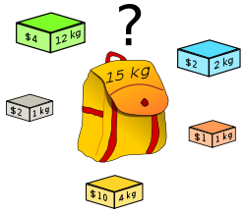
Knapsack problem
Given a set of items, each has a weight and a value, and a knapsack with a certain capacity, determine the maximum value that can be put into the knapsack.

Slide 15
Any idea?
Naïve solution : Brute force… O(2^N)

Slide 16
DP
Question : how to break down to small problem?
Also look at one step before…
Capacity of one kg less?
No, because it doesn’t give us information about whether to put another object or not (the object could have weight > 1kg)
Instead, we consider the problem with one object fewer

Slide 17
If we order the objects 1,…,N (any order is fine)
Consider the object N and assume the capacity of the knapsack is W
There are two situations:
1. We put N (provided w[N]<W)
Then the value becomes v[N]+dp[N-1][W-w[N]]
i.e. the result of the subproblem where we only have N-1 objects and the capacity is W-w[N]
2. We don’t put N
Then the value becomes dp[N-1][W]
I.e. the result of the subproblem where we only have N-1 objects and the capacity is W

Slide 18
Question : when to stop cutting the problem?
When there is no object to put, or the knapsack’s capacity is zero

Slide 19
C++ implementation

Slide 20
Complexity
Space complexity : O(NW) (can you improve it?)
Time complexity : O(NW)

Slide 21
Exercise
Write a method print_KS() that will output the content of the final knapsack (output which objects are put in)

Slide 22
Many other applications
Edit distance
Max increasing subsequence
Staircase walk
…

Slide 23
General approach
Cut the original problem into small problems
Find a relation between the result of the small problem(s) and the big one
Build base cases
Construct the solutions step by step

Slide 24
Exercise (Google Kickstart Round F 2017)
Wheatley is at the best party in the world: it has infinitely many cakes! Each cake is a square with an integer side length (in cm). The party has infinitely many cakes of every possible integer side length. The cakes all have the same depth, so we will only consider their areas.
Wheatley is determined to eat one or more cakes that have a total combined area of exactly N cm². But, since he is health-conscious, he wants to eat as few cakes as possible. Can you help him calculate the minimum number of cakes he can eat?
Constraint : N<=10000

Slide 25
You just made some simulations of…
Lagrange's four-square theorem
Every natural number can be represented as the sum of four integer squares.

Slide 26
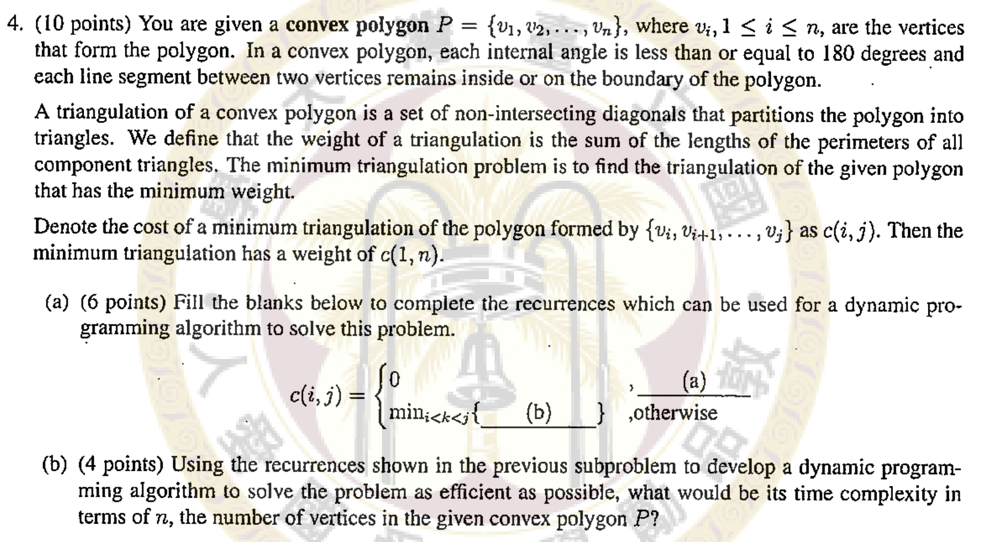
NTU 2013

