Slide 1
Graph

Slide 2
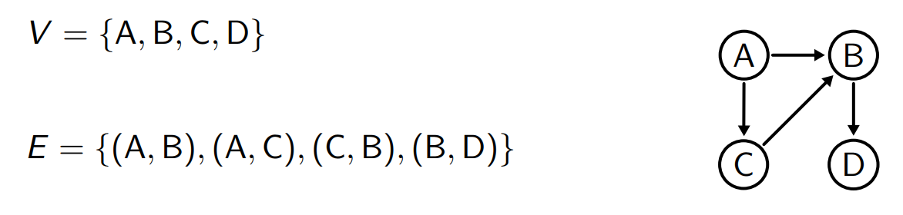

Definition
A oriented graph consists of a set of vertices V and a set of edges E$⊆$VxV

Slide 3
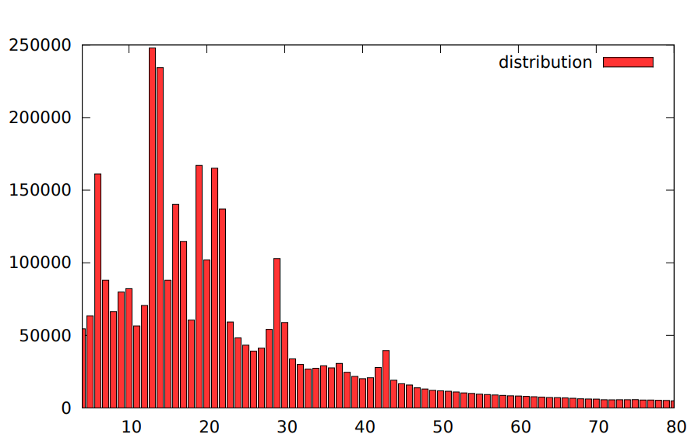
Example of wiki links
|V| = 6 million
|E| = 142 million

Slide 4
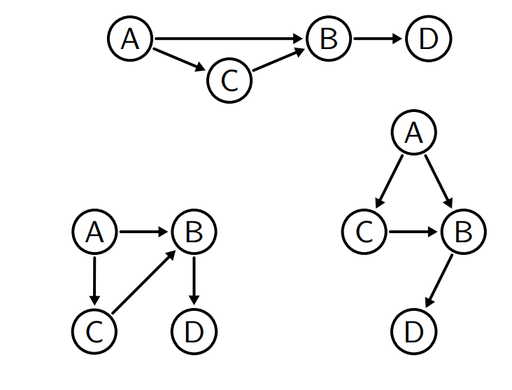
Attention
These graphs share the same topology

Slide 5
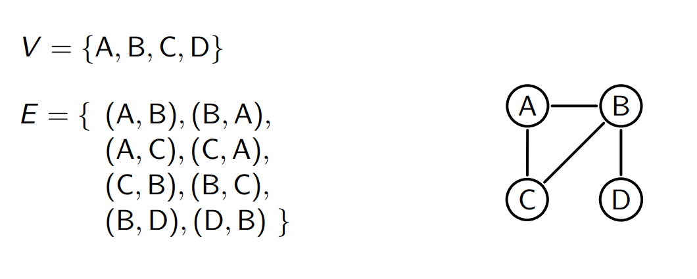
If E is symmetric, we refer to a non-oriented graph

Slide 6
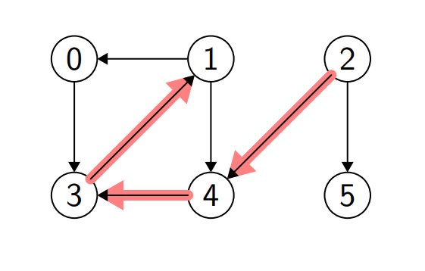
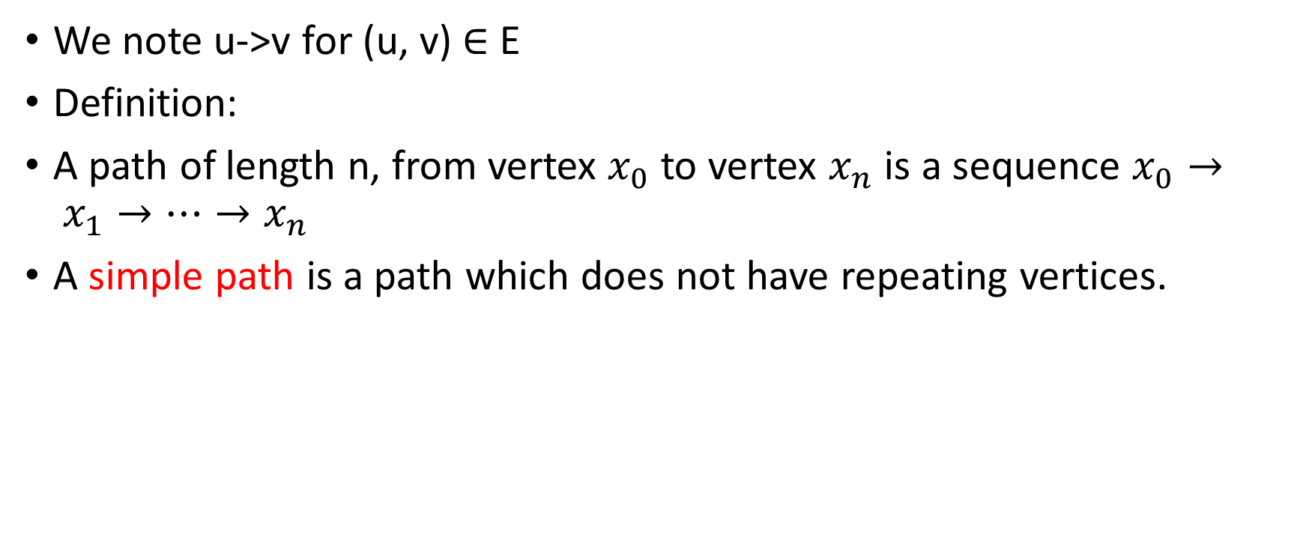
Path
We note u->v for (u, v) $∈$ E
Definition:
A path of length n, from vertex $x_{0}$ to vertex $x_{n}$ is a sequence $x_{0}→ x_{1}→…→x_{n}$
A simple path is a path which does not have repeating vertices.

Slide 7
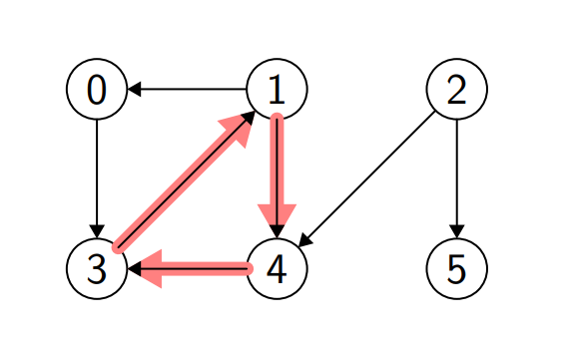
Definition
A cycle is a path from u to u of length >= 2

Slide 8
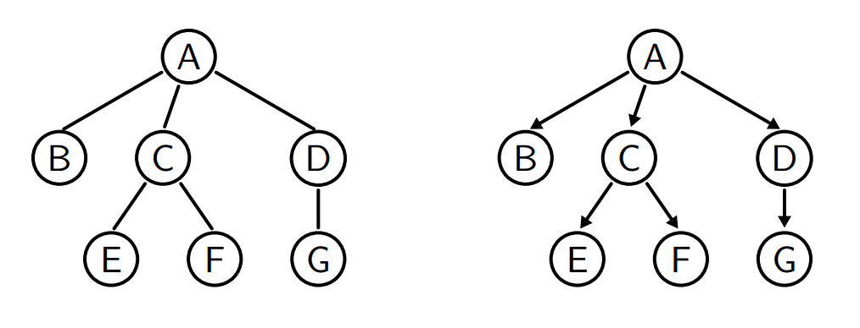
A tree is a special case of graph.
In particular, trees don’t have cycles.

Slide 9
Representation of a graph

Slide 10
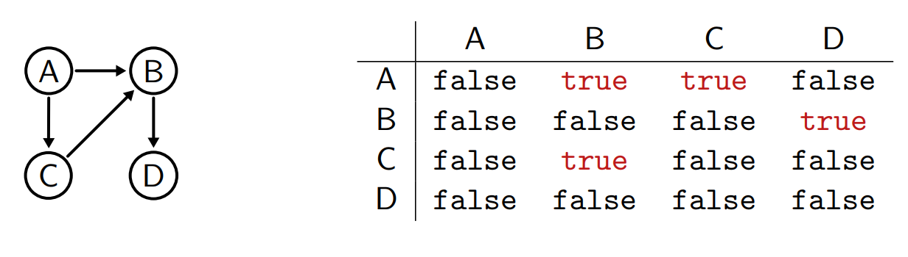

Solution 1: adjacency matrix
$M_{ij}=1 iff (i,j)∈E$

Slide 11
C++ implementation

Slide 12

Complexity
Space complexity : $O(V^{2})$
Eg. V = 1024 -> 1 Mbytes
Time complexity:
Edge add/remove/exist: O(1)
Neighbors/all vertices : O(V)

Slide 13
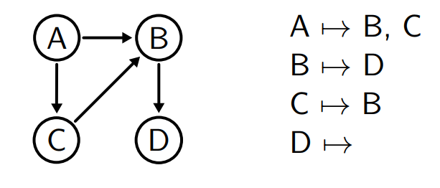
Solution 2: adjacency list
Associate the list of neighbors to each node

Slide 14
C++ implementation

Slide 15
Exercise
Write a method nVertices() which returns the number of vertices
Write a method nEdges(int i) which returns the number of neighbors for vertex I

Slide 16
Complexity
Space complexity : O(V+E)
Time complexity :
Add : O(1)
exist/remove : O(d(u)), d is the number of neighbors (degree)
Neighbors: O(d(u))
All vertices : O(V)

Slide 17
Solution 3: Adjacency set
Use sets instead of lists to store neighbors

Slide 18
Adjacency set
Optimal representation
Space complexity : O(V+E)
Add/remove/exist : O(1)
Neighbors : O(d(u))
All vertices : O(V)

Slide 19
Comparison
Adjacency matrix:
Advantageous when the graph is dense (much more compact when V is small)
Requires V = {0,1,…}
Adjacency list/set:
Advantageous when the graph is sparse
V can be any value (string, object,…)

Slide 20
Today’s problems
What are the reachable vertices from u?
Is there a path from u to v?
What’s the shortest path from u to v?
Is there a cycle starting from u?
We can answer these questions by traversal

Slide 21
Depth-first search (DFS)
Uses the principle of backtracking:
If there’s an edge, follow it
Otherwise, we go back to the previous vertex

Slide 22
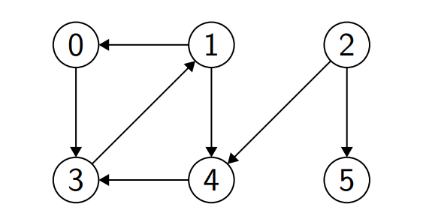
difficulty
There might be cycles
To avoid going round in circles, we need to mark vertices already seen.

Slide 23
C++ implementation

Slide 24
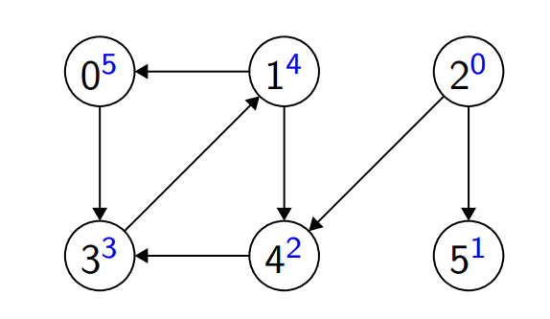
example
Starting from vertex 2

Slide 25
Complexity
Each edge (v, w) is considered at most once (the first time dfs is called on v)
So the complexity is O(E), optimal.

Slide 26
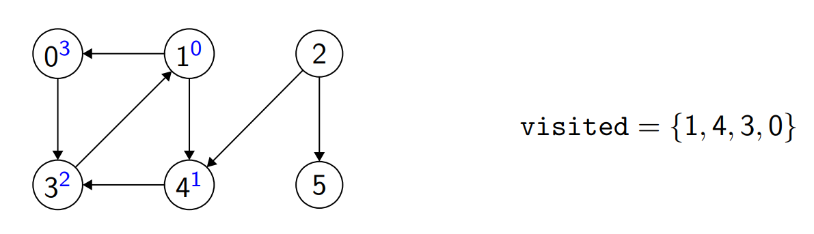
Starting from vertex 1…
Therefore no path from 1 to 2, either from 1 to 5.

Slide 27
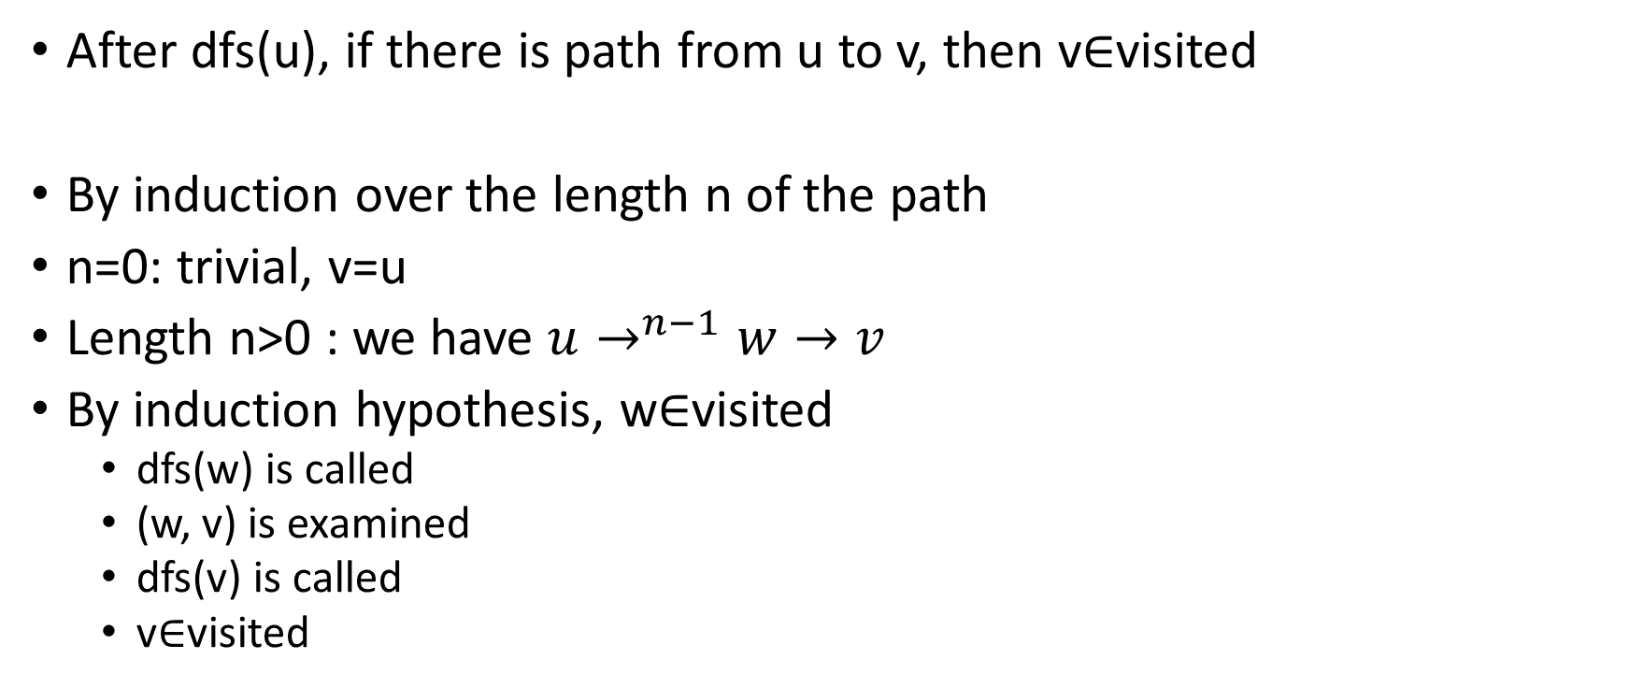
Property
After dfs(u), if there is path from u to v, then v$∈$visited
By induction over the length n of the path
n=0: trivial, v=u
Length n>0 : we have $u→^{n−1}w→v$
By induction hypothesis, w$∈$visited
dfs(w) is called
(w, v) is examined
dfs(v) is called
v$∈$visited

Slide 28
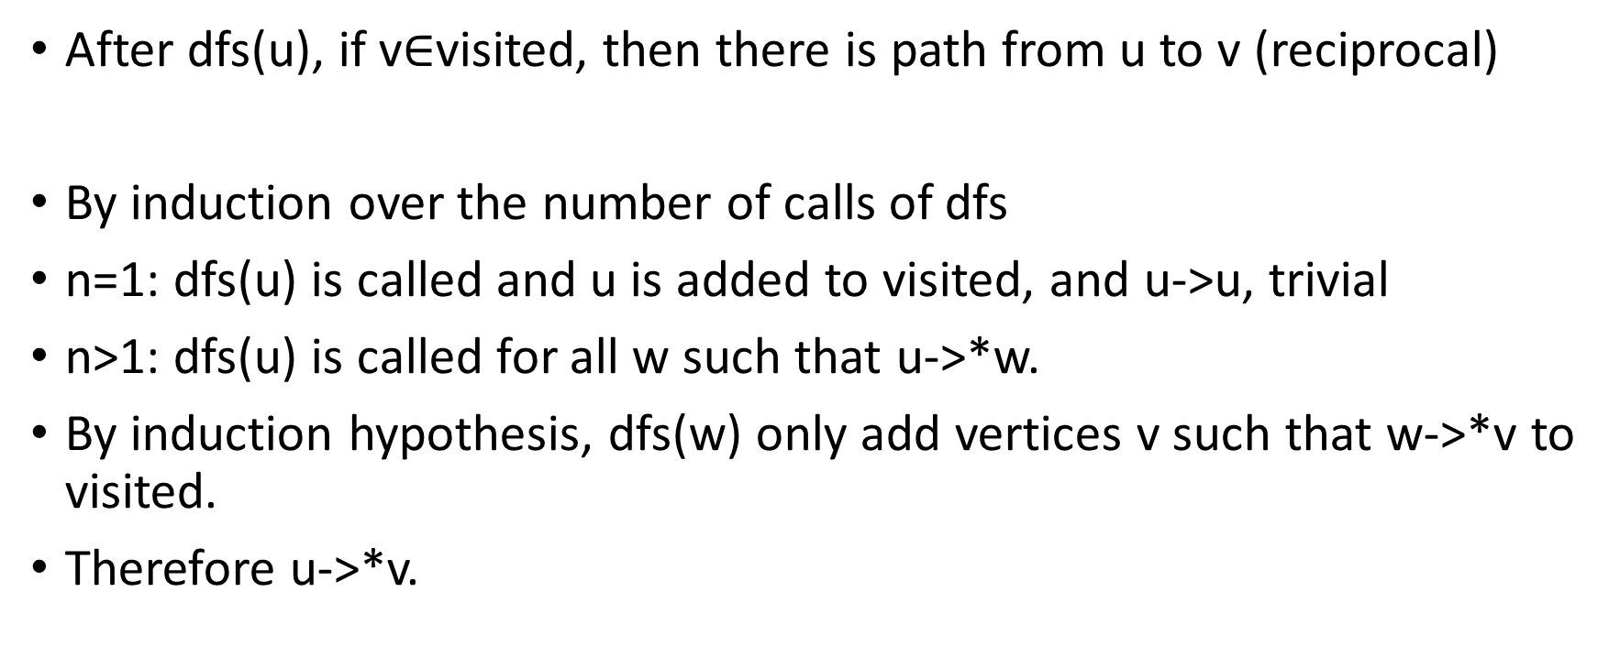
Property
After dfs(u), if v$∈$visited, then there is path from u to v (reciprocal)
By induction over the number of calls of dfs
n=1: dfs(u) is called and u is added to visited, and u->u, trivial
n>1: dfs(u) is called for all w such that u->*w.
By induction hypothesis, dfs(w) only add vertices v such that w->*v to visited.
Therefore u->*v.

Slide 29
Exercise
Write a method existPath(int i, int j) which returns true if there’s a path from i to j

Slide 30
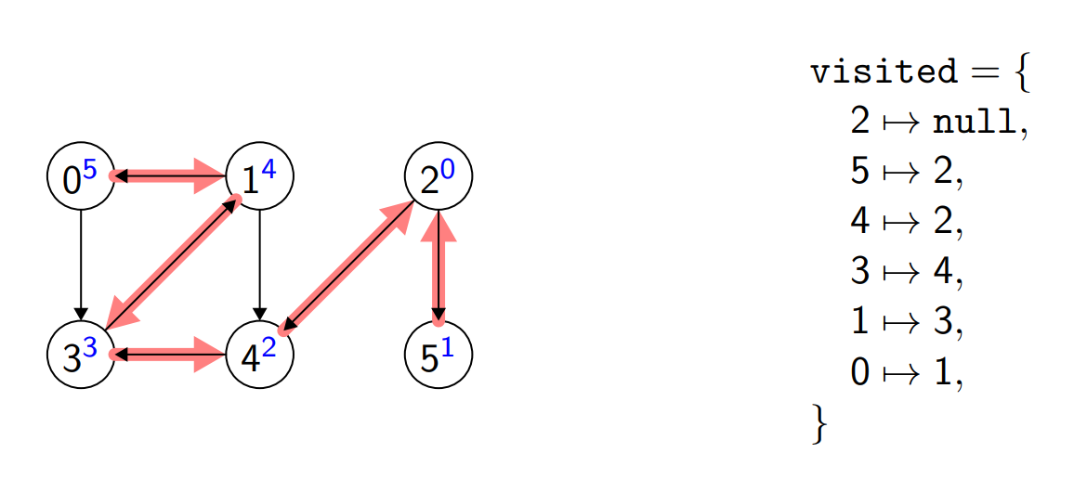
What if we want a explicit path?
We modify visited to be a map<int, int> which stores the provenance of each vertex, more precisely, pairs (v, u) representing that vertex v is reached from vertex u (in one step)
A such tree is called spanning tree

Slide 31
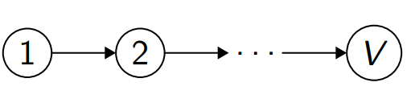
Space complexity
The space complexity is at most O(N),
For a graph
Recursive calls might cause stack overflow error!

Slide 32
Solution :
Use a stack to store the vertices that we’re going to traverse

Slide 33
C++ implementation

Slide 34
Now, we can answer the questions
What are the reachable vertices from u?
Is there a path from u to v?

Slide 35
Homework
For the question
Is there a cycle starting from u?
We need to modify dfs. Instead of two states (visited or not) for each vertices, we need in fact three states (visited, visiting, or not visited)
Because when we discover an already-visited vertex, we’re not sure if we’ve found a cycle, since this vertex can be reached by another parallel path.

Slide 36
Hint : use a map<int, int> to store the information of a vertex, e.g. (v,0) means the vertex v is not yet visited, (v,1) means visiting and (v,2) means visited, etc.
In the case where the graph is a linked list, what’s the complexity compared to “hare and tortoise algorithm”?

Slide 37
Last question
What’s the shortest path from u to v?
(in terms of number of edges)

Slide 38
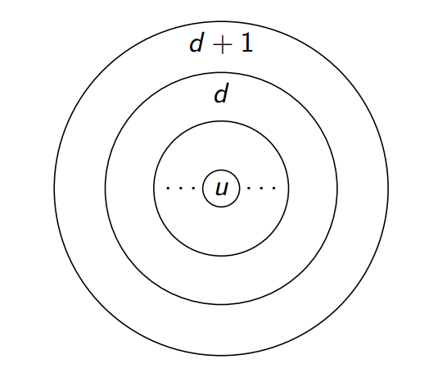
Breadth-first search (BFS)
Principle: traverse the graph in concentric circles
Traverse the vertices
Of distance 1
Of distance 2
Etc…

Slide 39
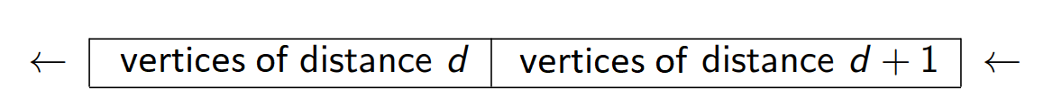
Idea: use a queue

Slide 40
C++ implementation

Slide 41
Complexity
Each vertex is put at most 1 time in the queue
Each edge is considered at most 1 time
O(V+E)

Slide 42
Compute the distance
Instead of a set, we can use map<int, int> that stores the distance of the vertices

Slide 43
Exercise
Write a method bfs that will also return (or store) a map<int, int> of distances to all reachable vertices

Slide 44
Homework
https://github.com/kwea123/cpp_data_algo/tree/master/GraphHW

