Slide 1
Hash table

Slide 2
Today’s problem
We want to produce a random text! (but not totally random…)
Method:
Choose a large text
Consider every triple (A,B,C):
Start with A, B
Generate a word C, where (A,B,C) is a triple appearing in the text
Continue with B, C

Slide 3
I chose “The adventure of the six Napoleons” by Conan Doyle
It was no very unusual thing for Mr. Lestrade, of Scotland Yard, to look in upon us of an evening, and his visits were welcome to Sherlock Holmes, for they enabled him to keep in touch with all that was going on at the police head-quarters….

Slide 4
It was no very unusual thing for Mr. Lestrade
(it, was) -> no
(was, no) -> very
(no, very) -> unusual
(very, unusual) -> thing
……

Slide 5
32 occurrence of pair (it, was), followed by
3 times “the”
2 times “not”
2 times “on”
……

Slide 6
it was broken into fragments i am gathering all the threads into my hands and the farther i go with

Slide 7
What data structure to use?
We need a dictionary
Which associates a set of words C to a pair (A,B)

Slide 8
Generally speaking, dictionaries (maps) are data structures that:
Associate values V to keys K
They have the following methods:
void add(K key, V value)
V get(K key)
And also remove, size, empty, etc…

Slide 9
Do we need a new data structure?
How about using an array?
How about using a tree?

Slide 10
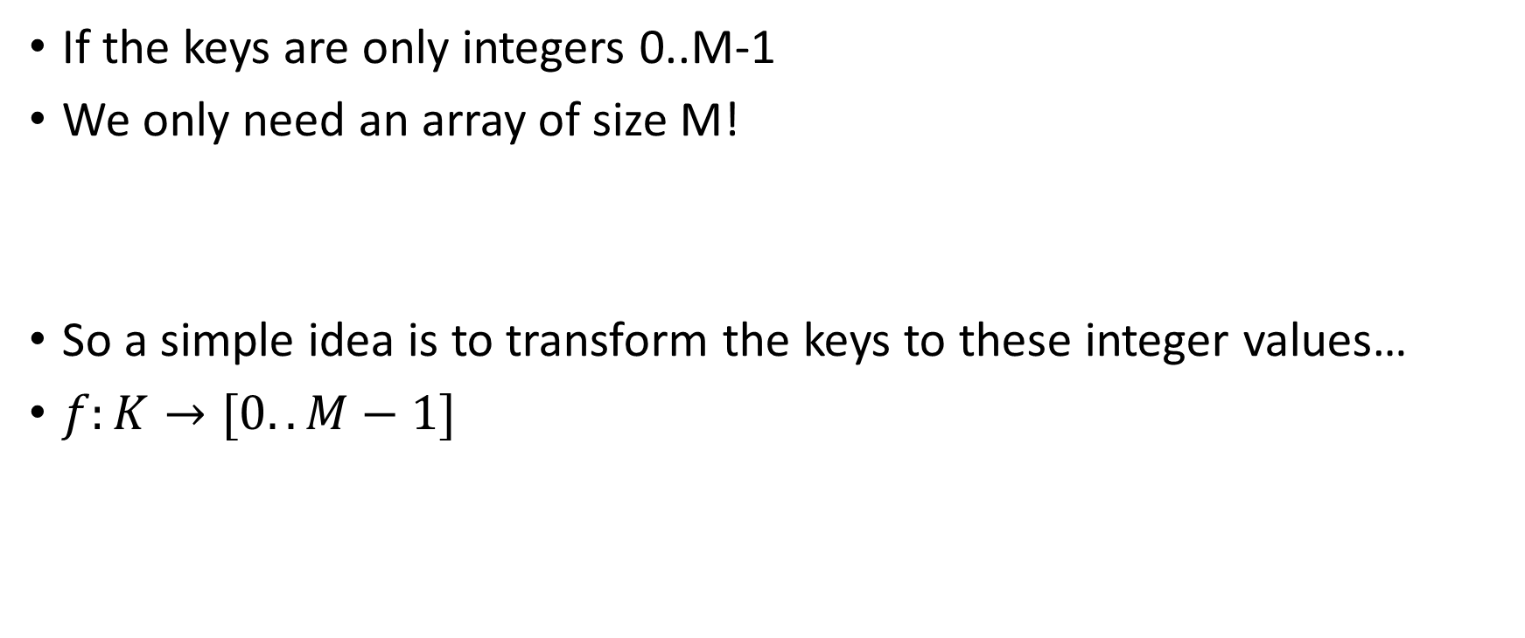
A simple idea
If the keys are only integers 0..M-1
We only need an array of size M!
So a simple idea is to transform the keys to these integer values…
$f:K→[0..M−1]$

Slide 11
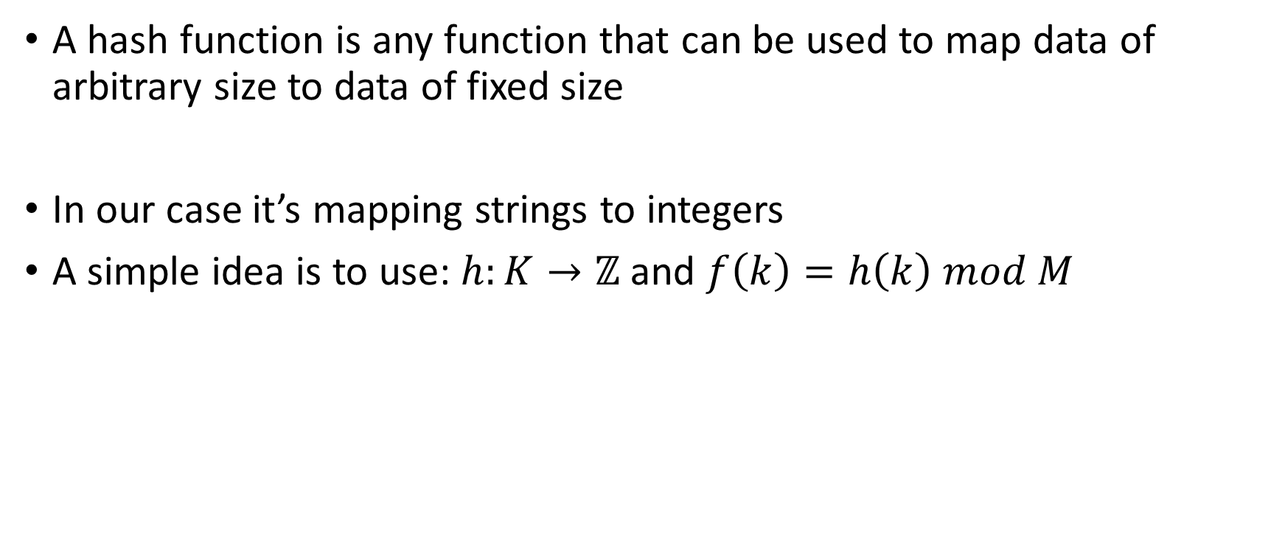
Hash function
A hash function is any function that can be used to map data of arbitrary size to data of fixed size
In our case it’s mapping strings to integers
A simple idea is to use: $h:K→ℤ$ and $f\left(k\right)=h\left(k\right) mod M$

Slide 12
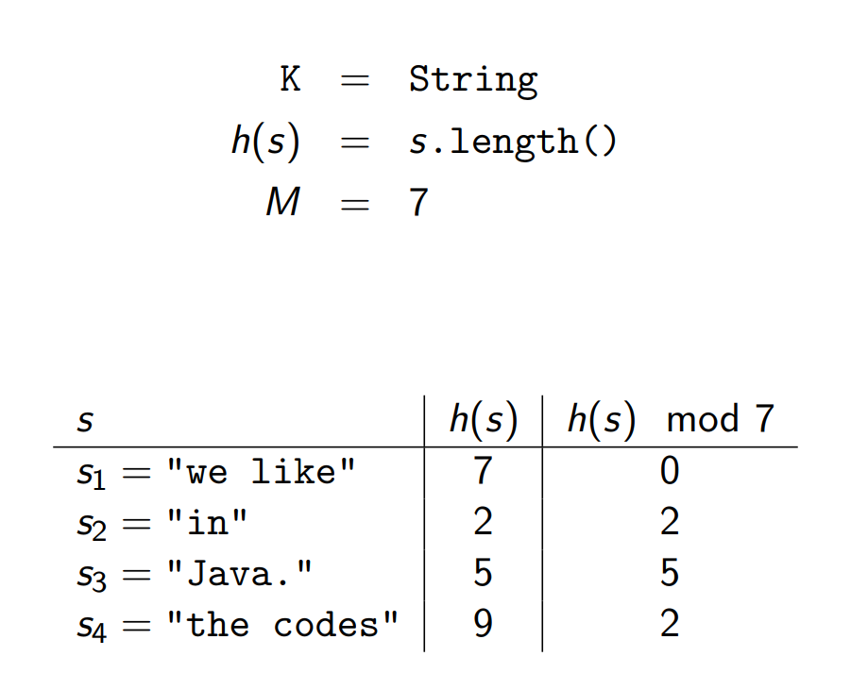

Slide 13
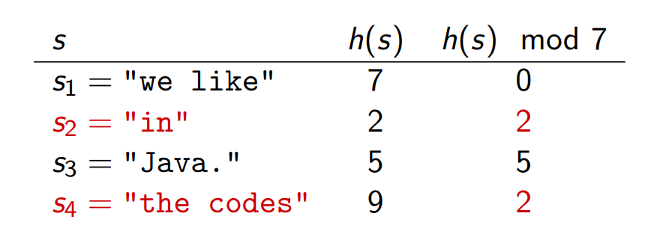
collision
When the hash function has the same output for different inputs

Slide 14
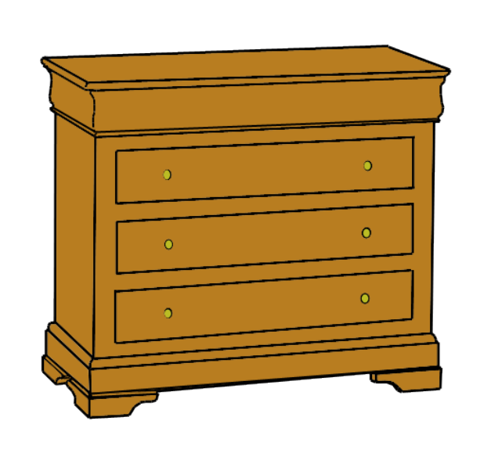
Image
Put the clothes in the first drawer
Put the socks in the second drawer
Put the pants in the third drawer

Slide 15
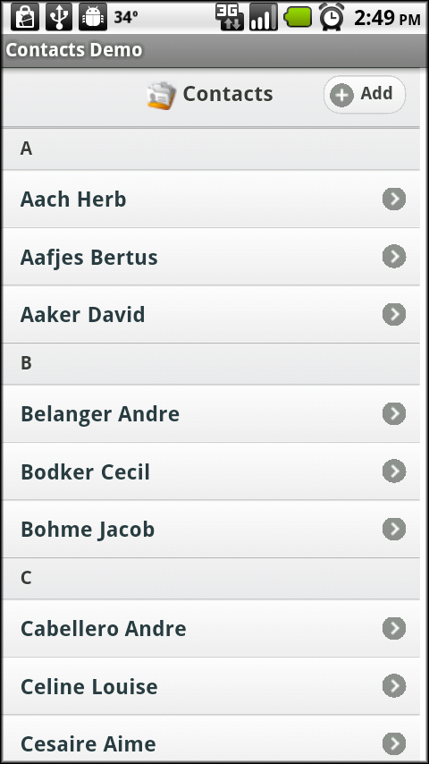

Slide 16

C++ implementation
We choose as hash function
Can we choose other numbers than 31?

Slide 17
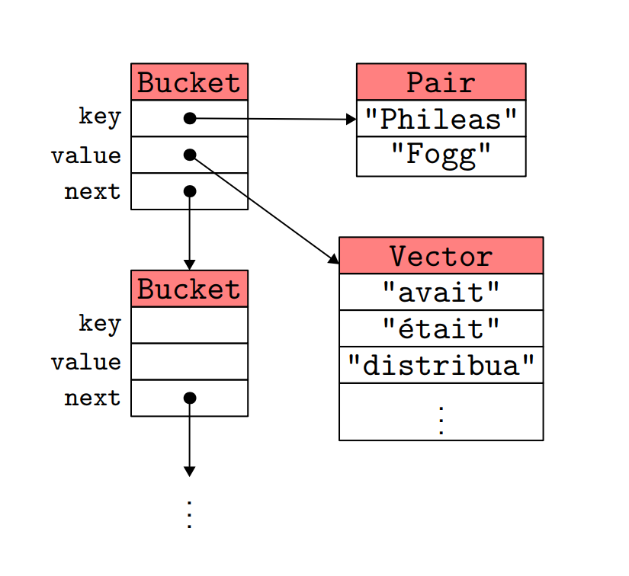
illustration

Slide 18
Results
i am a methodical man you don't seriously believe that? holmes smiled don't i?
he was doing here and i concluded that they had noticed a man who made himself useful in the light

Slide 19
C++ libraries
<map>: the keys are stored in a BBST (sorted)
<unordered_map>: equivalent to the hash table we talked about here

Slide 20
Experiment of a larger text
For “Around the World in Eighty Days”:
N = 89224 words
We want to measure the influence of M = the number of buckets

Slide 21
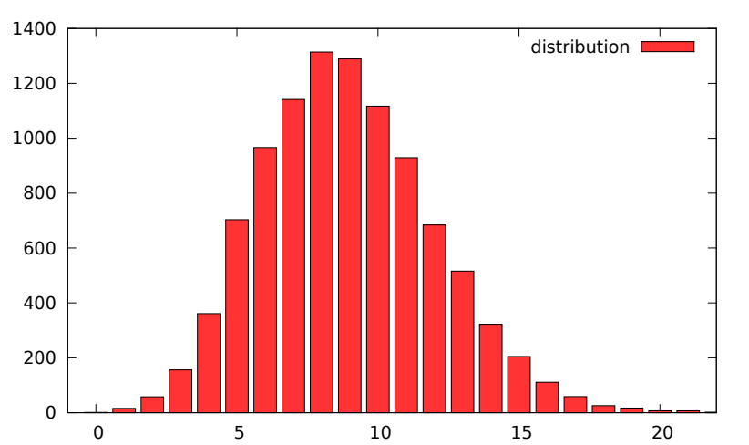
M = 10007
N/M = 8.9

Slide 22
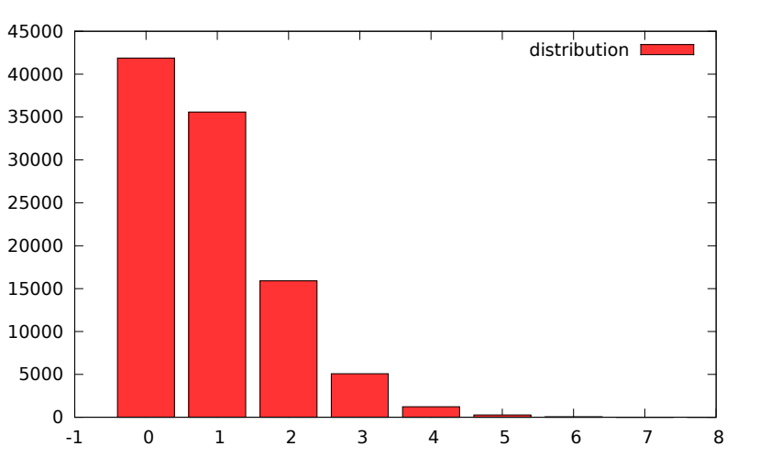
M = 100003
N/M = 0.89

Slide 23
We choose the number of buckets M to be of the same order of N.
To avoid collisions (why)?
This assumes that we already know N. What if we don’t know?

Slide 24
We use a resizable array!
Strategy: (same as before) when the array is full, double the size.

Slide 25
Complexity
For adding an element:
When there is no need to resize the array, O(1)
When we need to resize the array, O(N)
What’s the overall complexity? O(1) ! (why?)
For contains: O(1) (calculation of the hash function)
Efficient when we want to add and look for an element

Slide 26
Comparison
 | add | contains | get(i)
array | O(1) amortized | O(N) | O(1)
Sorted array | O(N) | O(logN) | O(1)
list | O(1) | O(N) | O(i)
Balanced BST | O(logN) | O(logN) | --
Hash table | O(1) amortized | O(1) | --

Slide 27

Application: memoization
We can avoid doing the same computation multiple times
Consider the Fibonacci sequence:
$F_{0}=0$
$F_{1}=1$
$F_{n}=F_{n−1}+F_{n−2}$ for n>=2

Slide 28
Naïve solution
int fibo(int n){
if(n<=1) return n;
return fibo(n-1)+fibo(n-2);
What’s the problem?

Slide 29
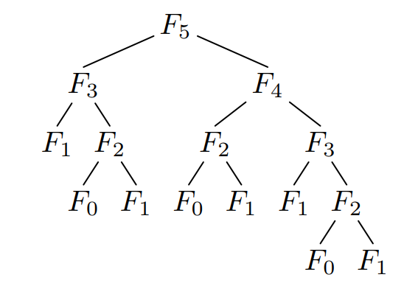
We compute the same things too many times!!

Slide 30

Homework
What’s the complexity of this naïve solution?
Hint: the required number of additions can be expressed using $F_{n}$

Slide 31
Idea: store the values already computed in a map
map<int, long long (int)> m;

Slide 32

We can calculate $F_{80}=\text{23416728348467685}$ instantly

Slide 33
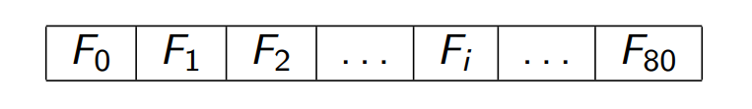
In this case, since the keys are integers, we can simply use an array, and we fill in the array in increasing order
We are talking about dynamic programming

Slide 34
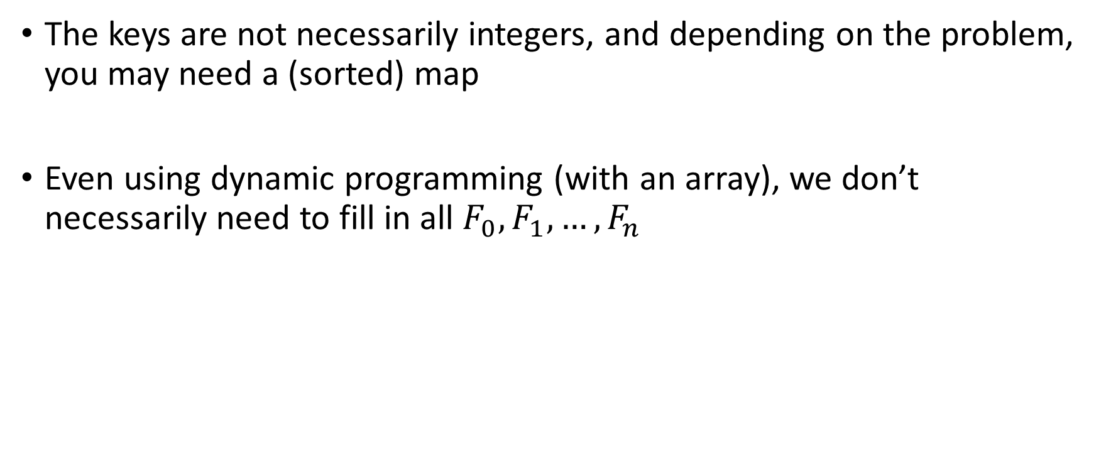
In general
The keys are not necessarily integers, and depending on the problem, you may need a (sorted) map
Even using dynamic programming (with an array), we don’t necessarily need to fill in all $F_{0},F_{1},…,F_{n}$

Slide 35
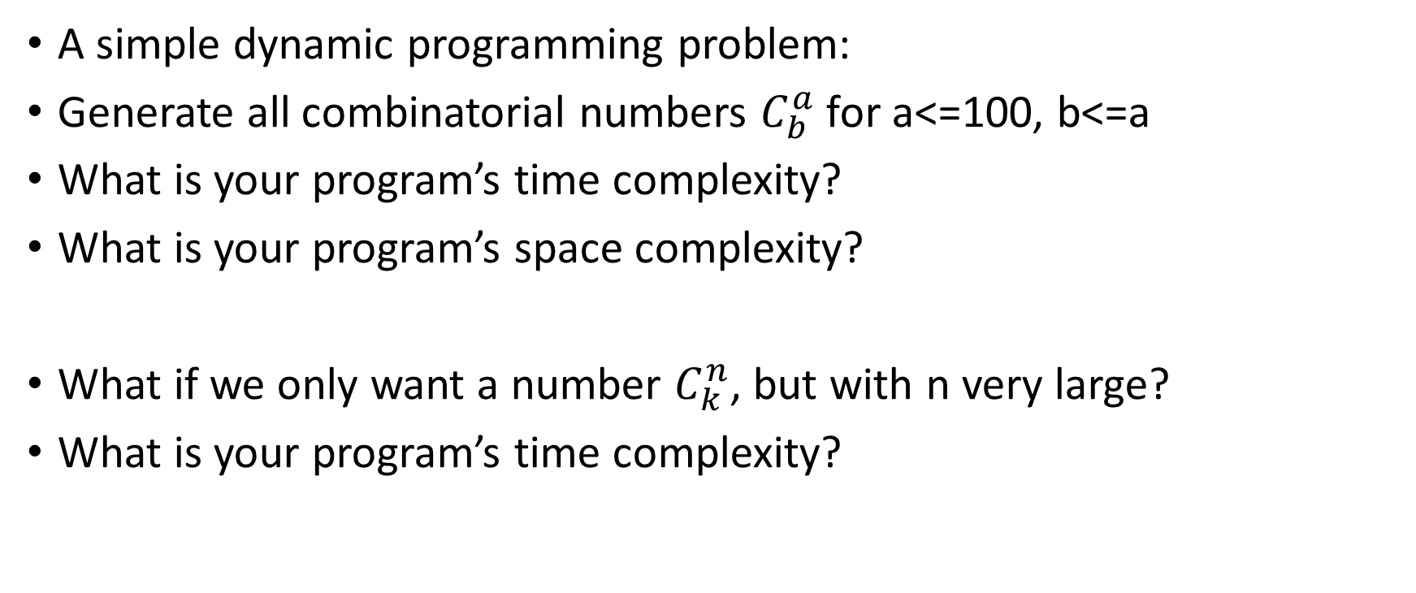
Homework
A simple dynamic programming problem:
Generate all combinatorial numbers $C_{b}^{a}$ for a<=100, b<=a
What is your program’s time complexity?
What is your program’s space complexity?
What if we only want a number $C_{k}^{n}$, but with n very large?
What is your program’s time complexity?

Slide 36
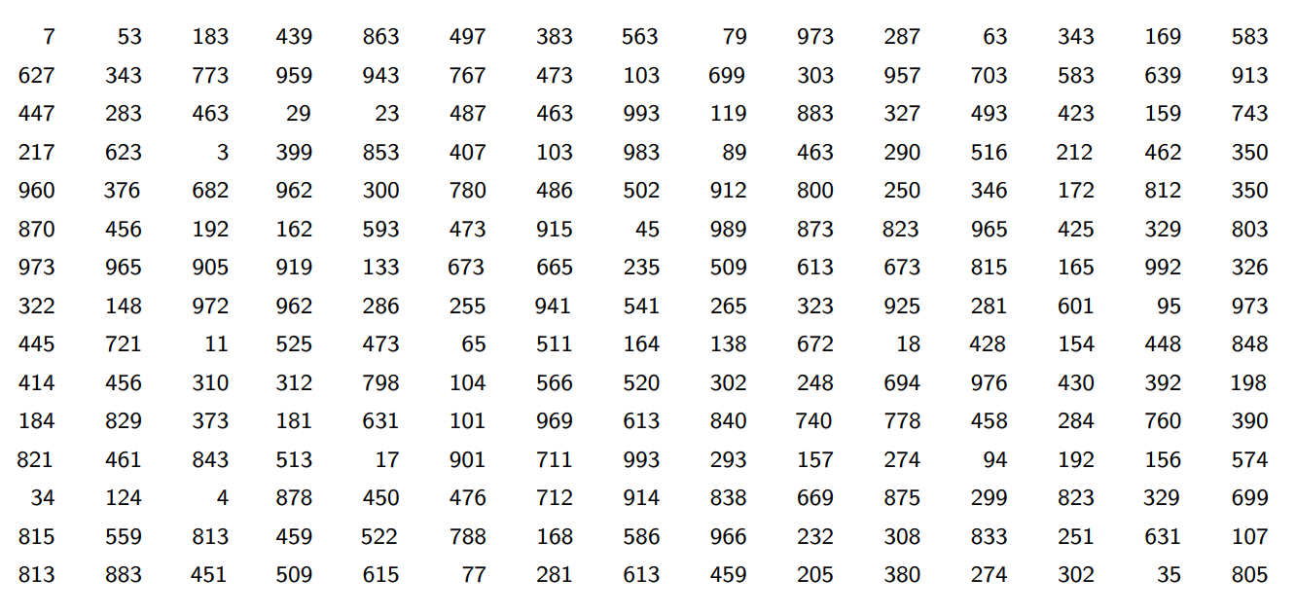
Homework
One more complex example:

Slide 37
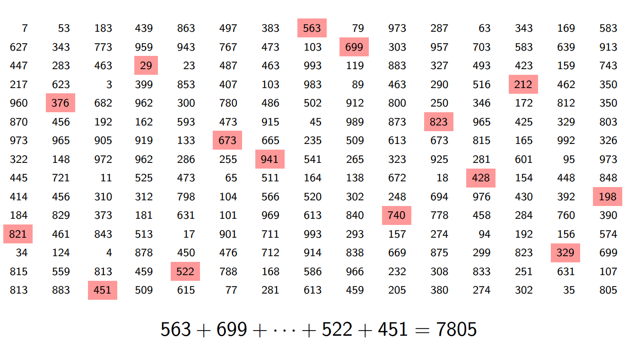
We want to choose 15 numbers, with different rows and columns, such that the sum is maximal

Slide 38
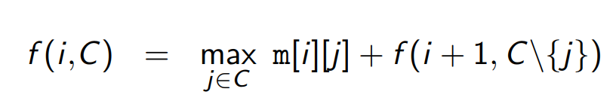

General idea
For rows >=i
For a set of columns C of cardinal N-i
The solution is then

Slide 39
Naïve solution
Recurrence on n:
int f(int i, set<int> c){
if(i==0) return 0;
int s = 0;
for(int j=0;j<n;j++)
if(c.count(j)){
c.erase(j);
s = max(s, m[i][j] + f(i+1, c));
}
return s;
}

Slide 40

What is the complexity?
However, we have only
15 values for I
$2^{15}$ values for C
In total $15∗2^{15}=491520$ combinations only! (<<<15!)

Slide 41
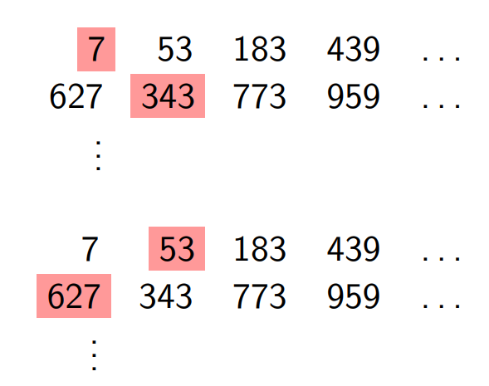
In fact, we encounter the same problem as before:
In these two cases, we continue with f(2, {2,..N-1}), but we made the computation two times!

Slide 42
Homework
Use dynamic programming, solve the above problem.
Hint: Create a map<int, set<int>> that stores the result of the max value that can be obtained from the set<int> argument…
For a more compact set representation, you can use bitmask (will talk about this in the last lecture)
What is your program’s complexity?

Slide 43
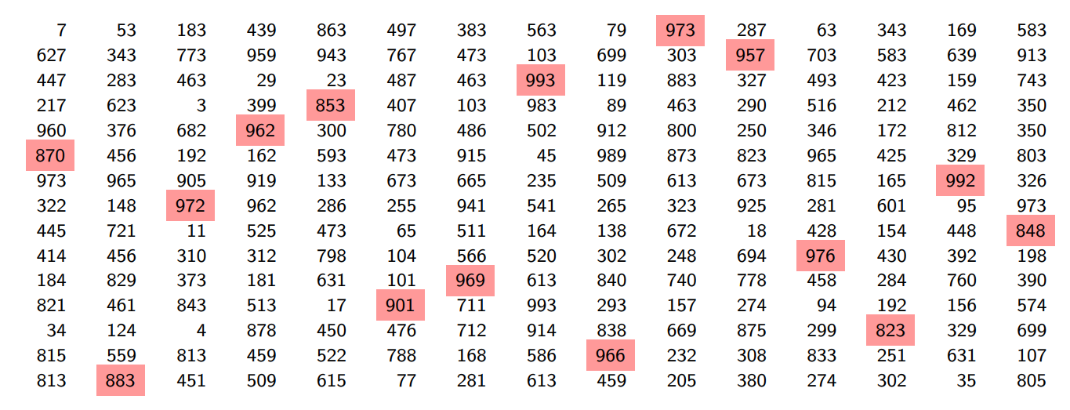
Answer
13938

