Slide 1
Disjoint set

Slide 2
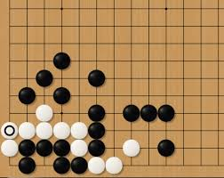
Today’s problem
Go!
How to compute how many groups are there?

Slide 3
Which data structure?
Naïve solution : A graph or an array
Recursively traverse its neighbors
Complexity?

Slide 4
Disjoint set
Nearly constant time (if implemented optimally) to
Add new sets
Merge exisiting sets
Determine if two elements are in the same set

Slide 5
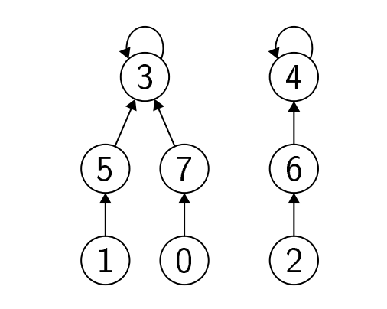
Each node has its “root”
Two elements in the same set : same root
When merging sets, set the root of one group to be the root of the other

Slide 6
C++ implementation
Using forest
There are also list/table implementations

Slide 7
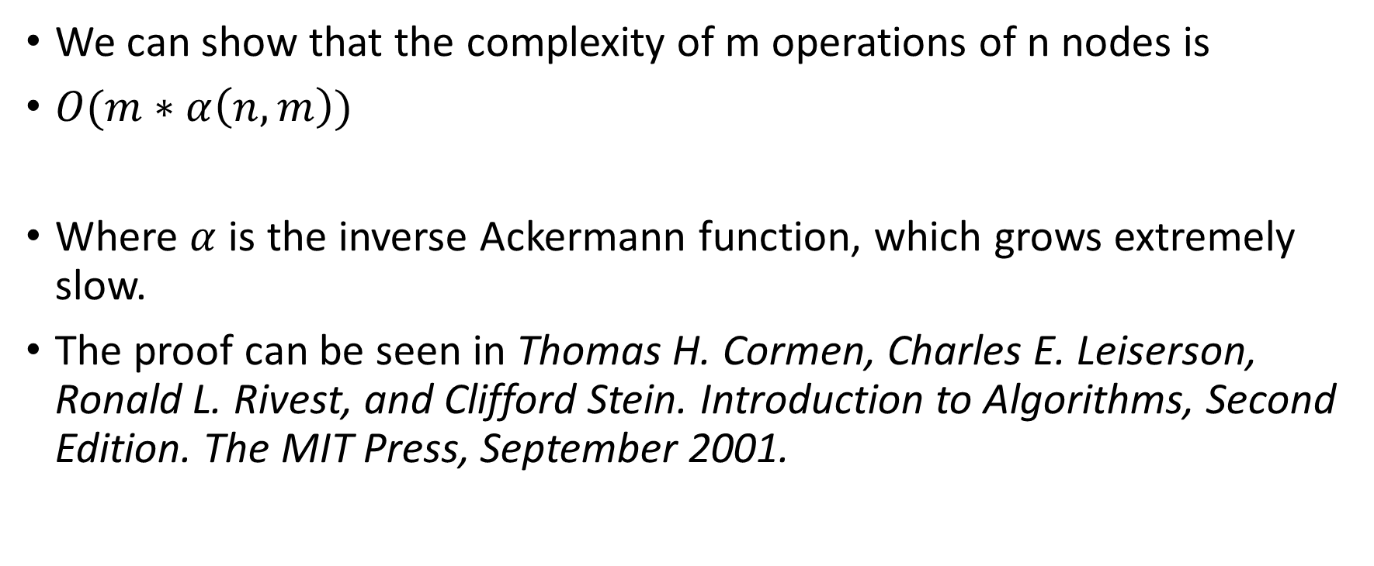
Complexity
We can show that the complexity of m operations of n nodes is
$O(m∗α\left(n,m\right))$
Where $α$ is the inverse Ackermann function, which grows extremely slow.
The proof can be seen in Thomas H. Cormen, Charles E. Leiserson, Ronald L. Rivest, and Clifford Stein. Introduction to Algorithms, Second Edition. The MIT Press, September 2001.

Slide 8
Exercise
Write a method set<Node*> classes(set<Node*> s) which returns the set of representatives
Derive a method nClasses(set<Node*> s) which returns the total number of classes
What’s your program’s complexity?
Can we improve this by modifying “uni”?

Slide 9
Today’s problem
Use disjoint set…
black groups : 9
white groups : 3

Slide 10
Challenge
How to count the liberties?
Many special cases to handle…

Slide 11
Application : Minimum spanning tree
A spanning tree for a graph is a tree (no cycles) whose edges cover all vertices

Slide 12
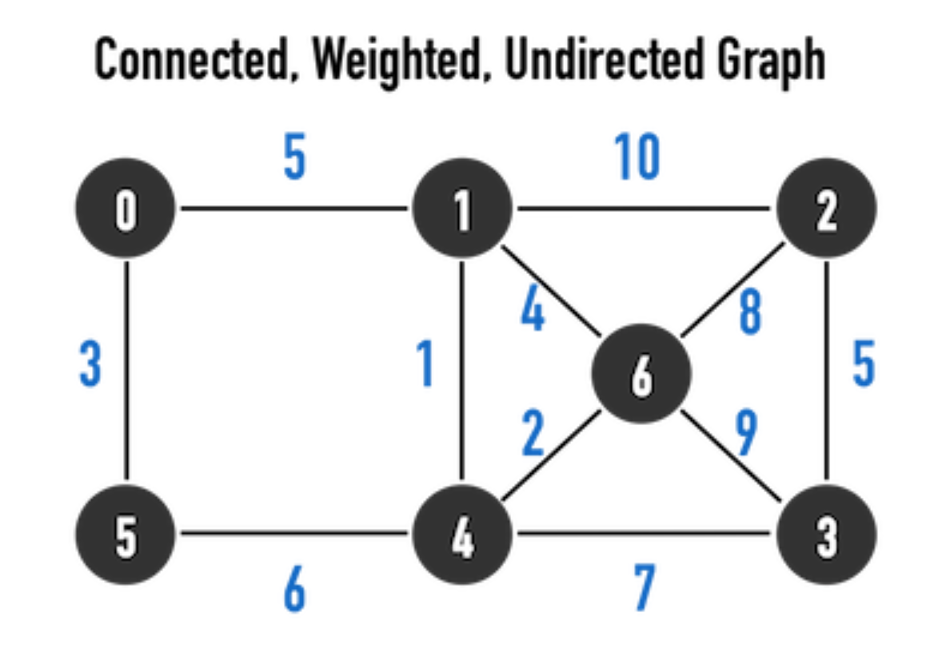
Example : for undirected graph

Slide 13
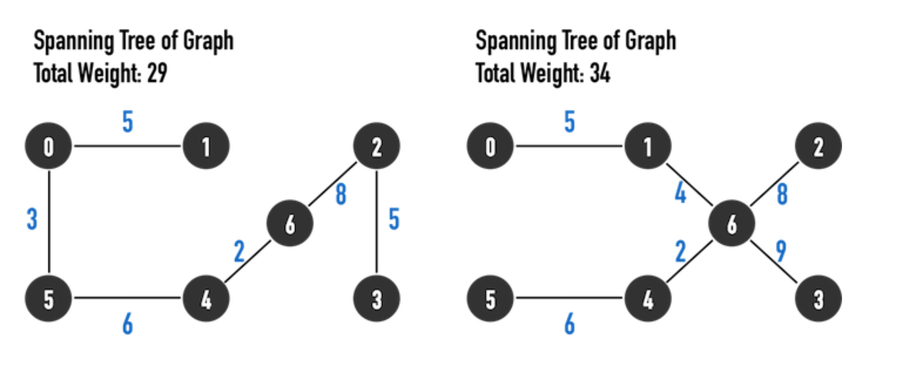

Slide 14
We can show that there exists a spanning tree for any connected undirected graph.
If the graph is not connected, then there will be multiple spanning trees.

Slide 15
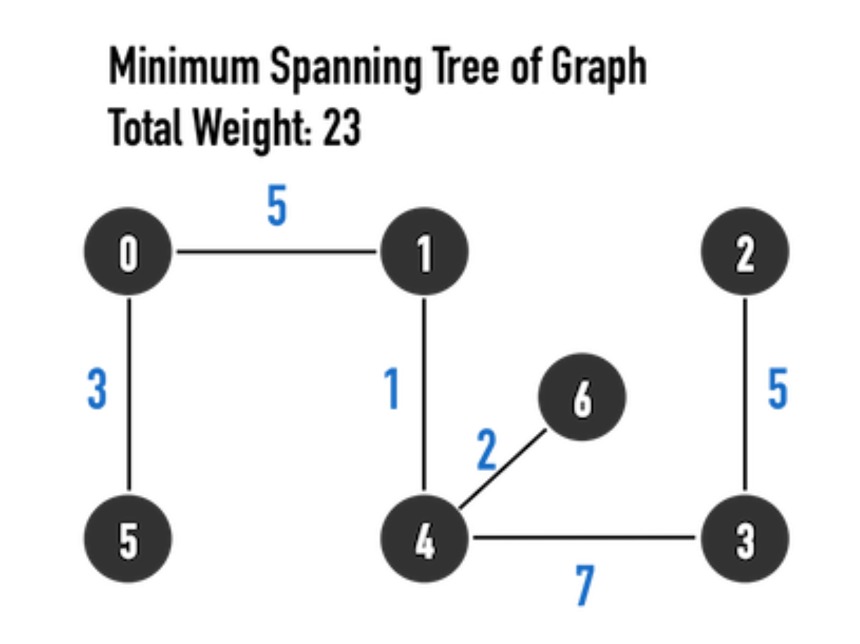
Minimum spanning tree (MST)
A spanning tree with minimal weight
There can be multiple as well.

Slide 16
Kruskal’s algorithm
Consider two disjoint trees in the graph, if we want to merge them, then it is better connecting them with the edge with minimal weight.
Greedy algorithm
At the beginning every node is a single tree, then we merge them with the minimal edge progressively.

Slide 17
C++ implementation
Using disjoint sets

Slide 18
Result
1 4
4 6
0 5
0 1
2 3
3 4
Minimum weight : 23

Slide 19
Correctness
http://people.qc.cuny.edu/faculty/christopher.hanusa/courses/634sp12/Documents/KruskalProof.pdf

Slide 20

Complexity
Sort the edges : O(ElogE)
Merge the trees : O(1*V)
Total: O(ElogE) since $\frac{V}{2}≤E$ (connected) and $E≤V^{2}$ (true for all graphs)

Slide 21
Homework
https://github.com/kwea123/cpp_data_algo/tree/master/DisjointHW

