Slide 1
Graph

Slide 2
Shortest path problem
In terms of distance
Every edge (u, v) has now a cost d>0

Slide 3
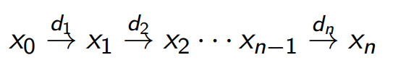
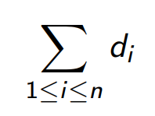

The length of the path
Is the sum
We note the existence of a path from u to v of length d

Slide 4
In addition to a normal Graph<T>, our graph must implement the method edgeWeight(T u, T v) which returns the weight of edge (u,v).

Slide 5
C++ implementation

Slide 6
The objective is to fill in a dictionary map<V, int> distances;
Which stores the length of the shortest path to a certain source
By calling shortestPath(V source)…

Slide 7
Dijkstra’s algorithm
The principle is like BFS, we discover the shortest path in increasing order of lengths.

Slide 8
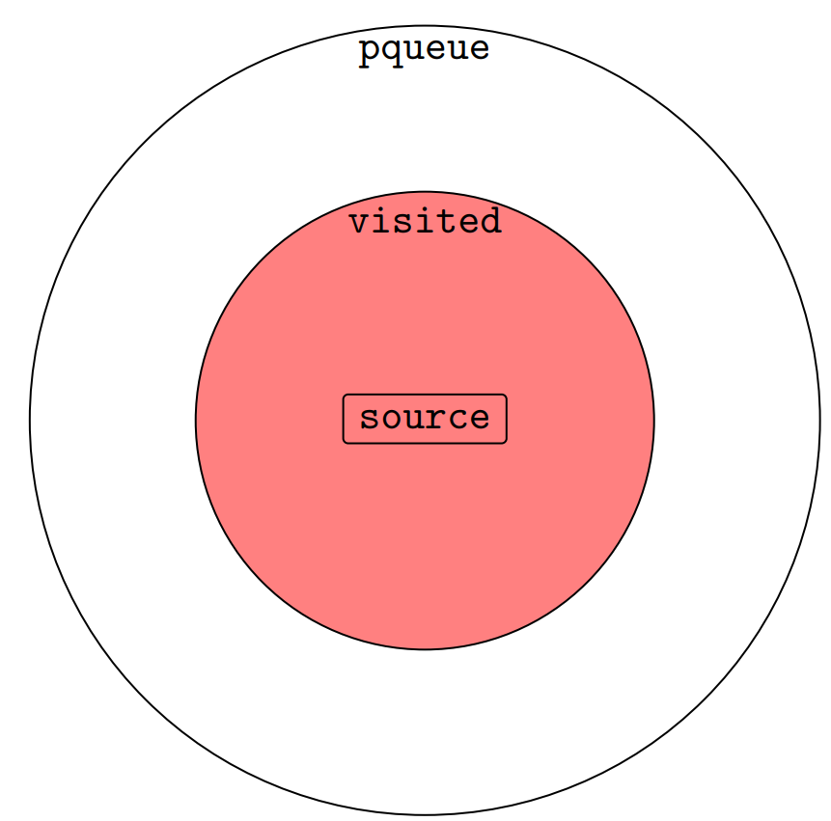
A set “visited” contains the
vertices for which we’ve already
foud the shortest path
Another priority queue “pqueue”
storing vertices that we’ve already
reached (but not sure if by the
shortest path)

Slide 9
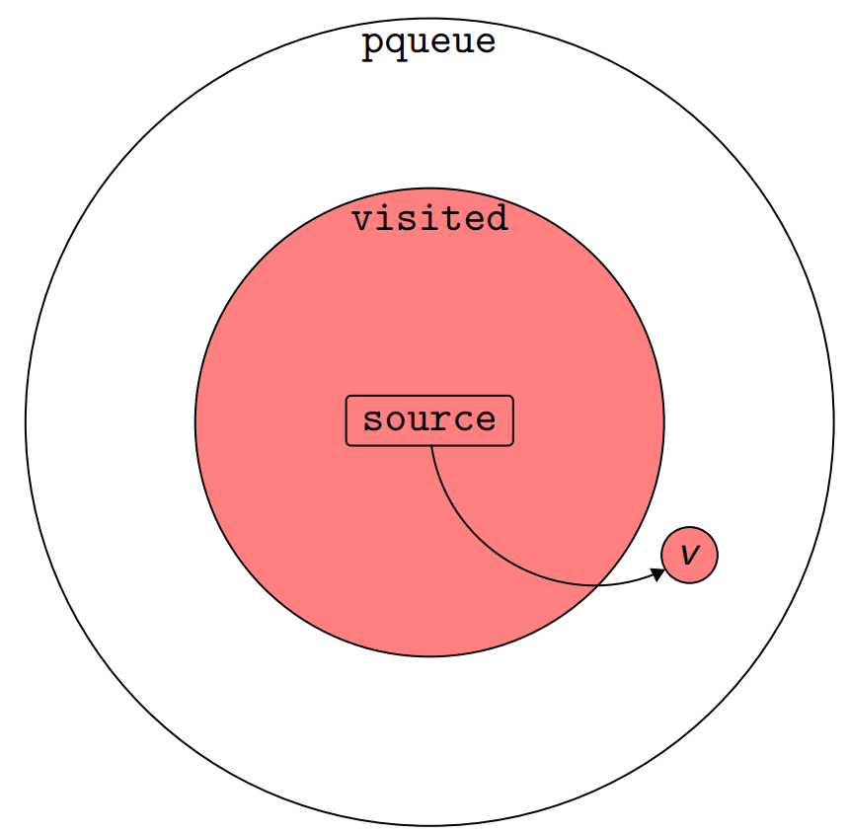
We select the vertex v in pqueue
of the shortest distance to the source
(the elements in pqueue are ordered
by increasing distance from the source)

Slide 10
We then consider all edges (v, w)
There are several cases

Slide 11
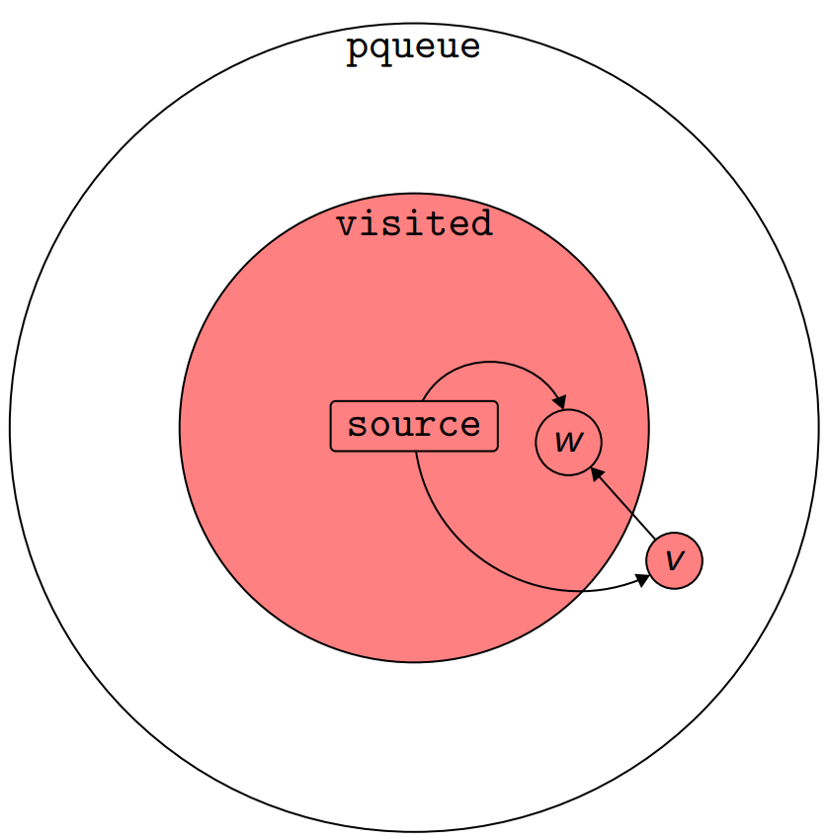
Case 1
w is already in visited
The path source->v->w is not shorter
Because (v, w) >=0
This case is ignored

Slide 12
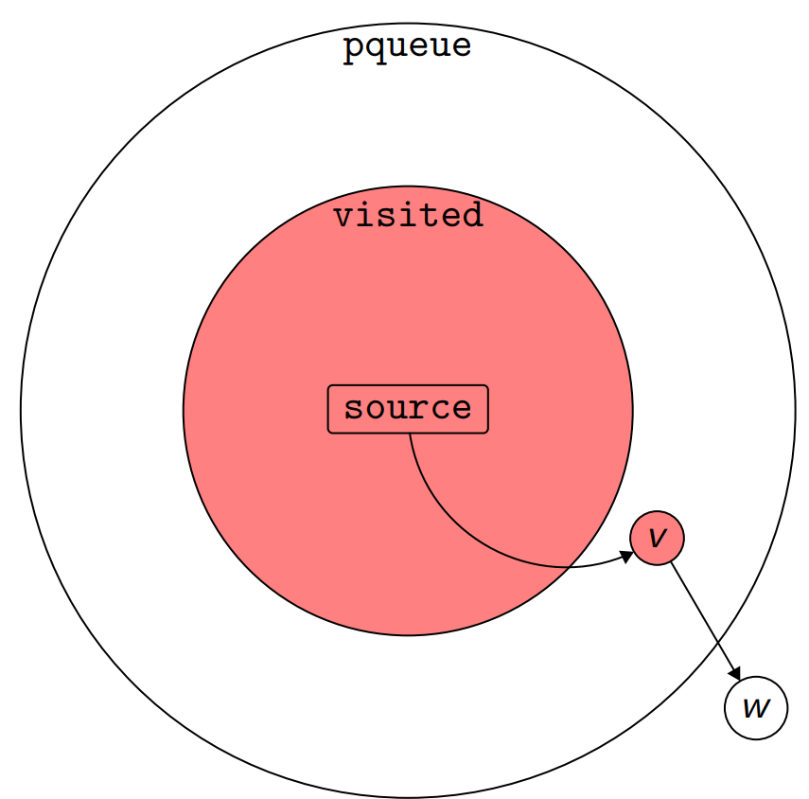
Case 2
w is not in pqueue
This means it’s the first time we reach w
So add w to pqueue

Slide 13
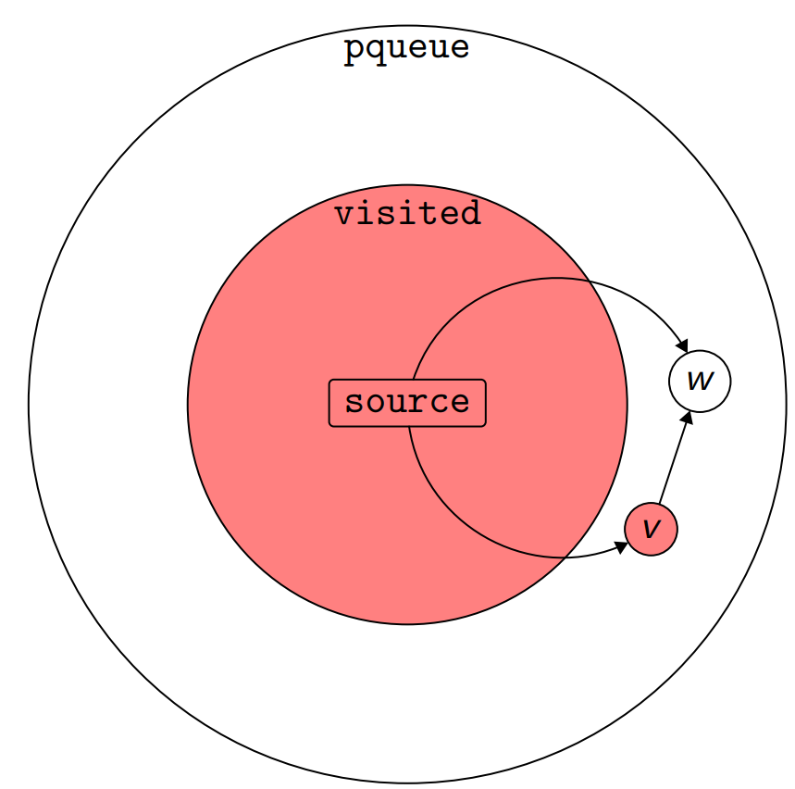
Case 3, 4
w is in pqueue
If the distance source->*w <=
source->*v + v->w
Don’t do anything
If it’s shorter
Update distance[w] = source->v + v->w

Slide 14
C++ implementation

Slide 15
Exercise
Write a method that will output the shortest path
Cf Path extraction in Graph.cpp

Slide 16
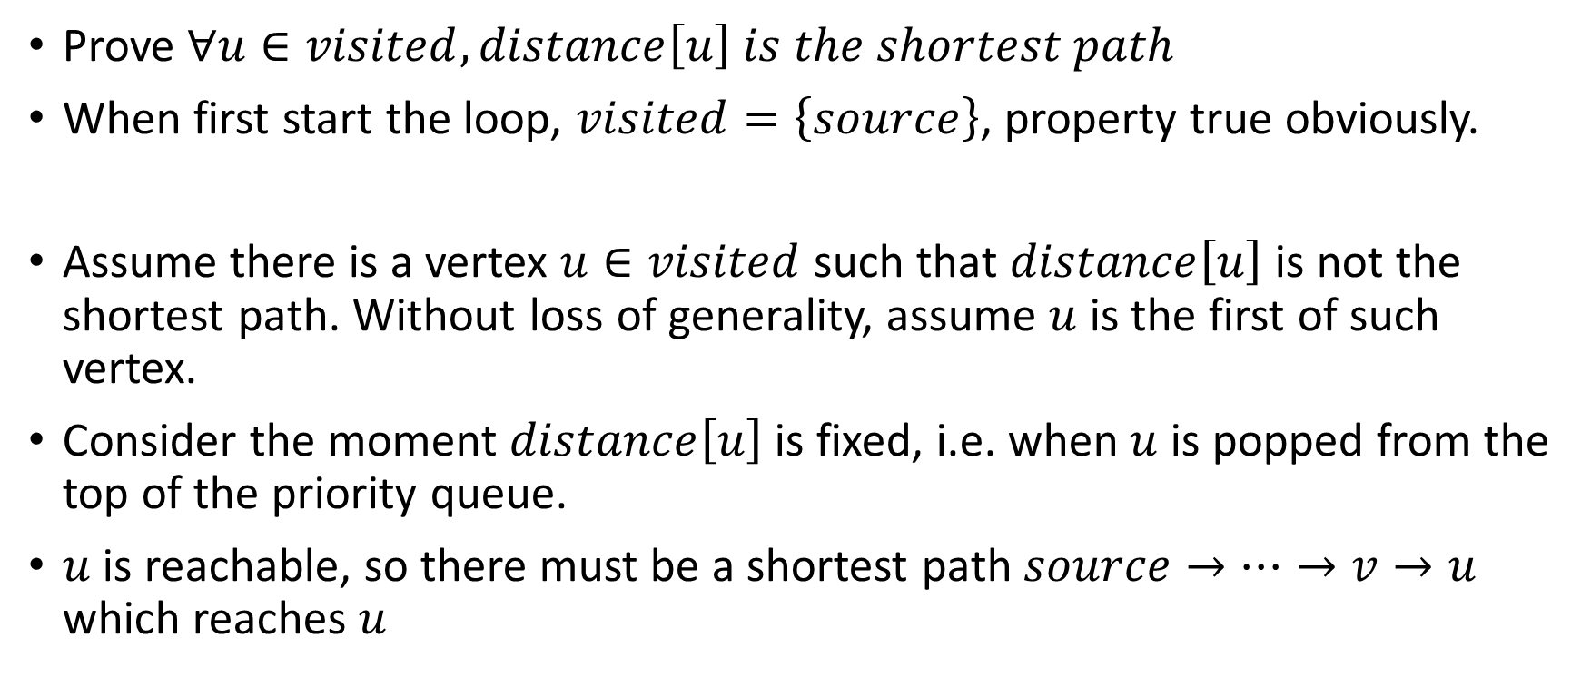
Correctness (invariant of the loop)
Prove $∀u∈visited, distance\left[u\right] is the shortest path$
When first start the loop, $visited=\left\{source\right\}$, property true obviously.
Assume there is a vertex $u∈visited$ such that $distance\left[u\right]$is not the shortest path. Without loss of generality, assume $u$ is the first of such vertex.
Consider the moment $distance\left[u\right]$is fixed, i.e. when $u$ is popped from the top of the priority queue.
$u$ is reachable, so there must be a shortest path $source→…→v→u$ which reaches $u$

Slide 17
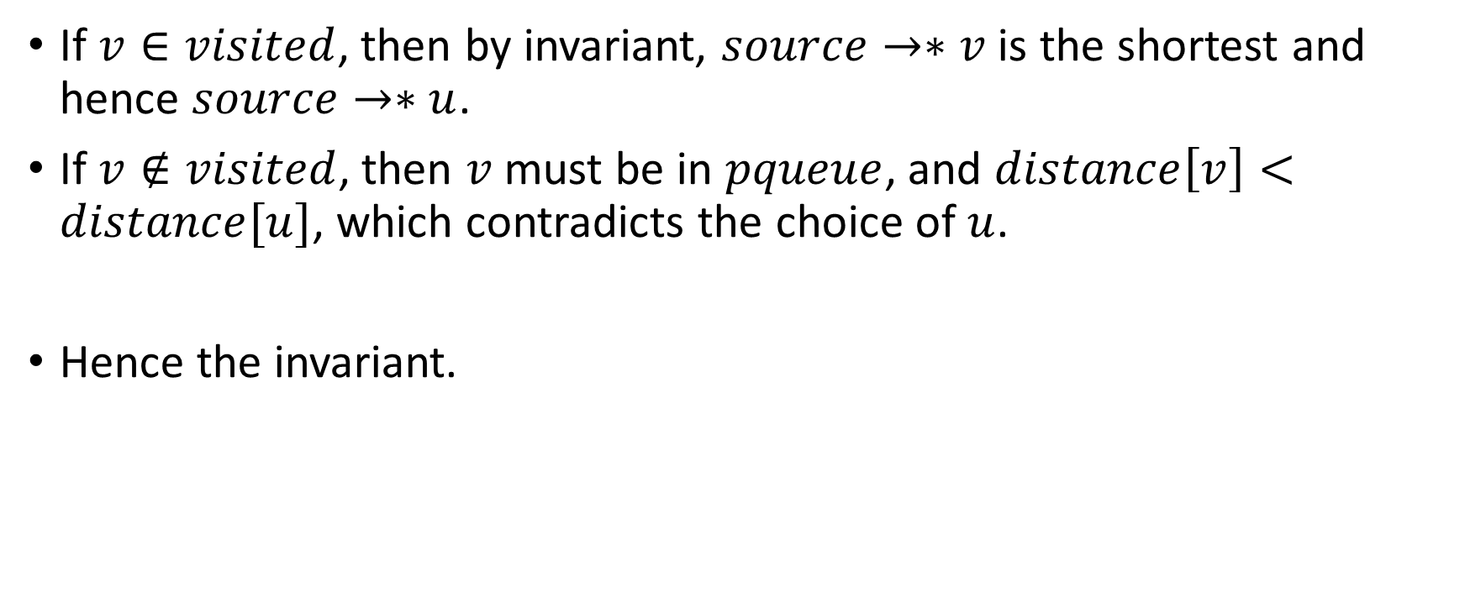
If $v∈visited$, then by invariant, $source→∗v$ is the shortest and hence $source→∗u$.
If $v∉visited$, then $v$ must be in $pqueue$, and $distance\left[v\right]<distance[u]$, which contradicts the choice of $u$.
Hence the invariant.

Slide 18
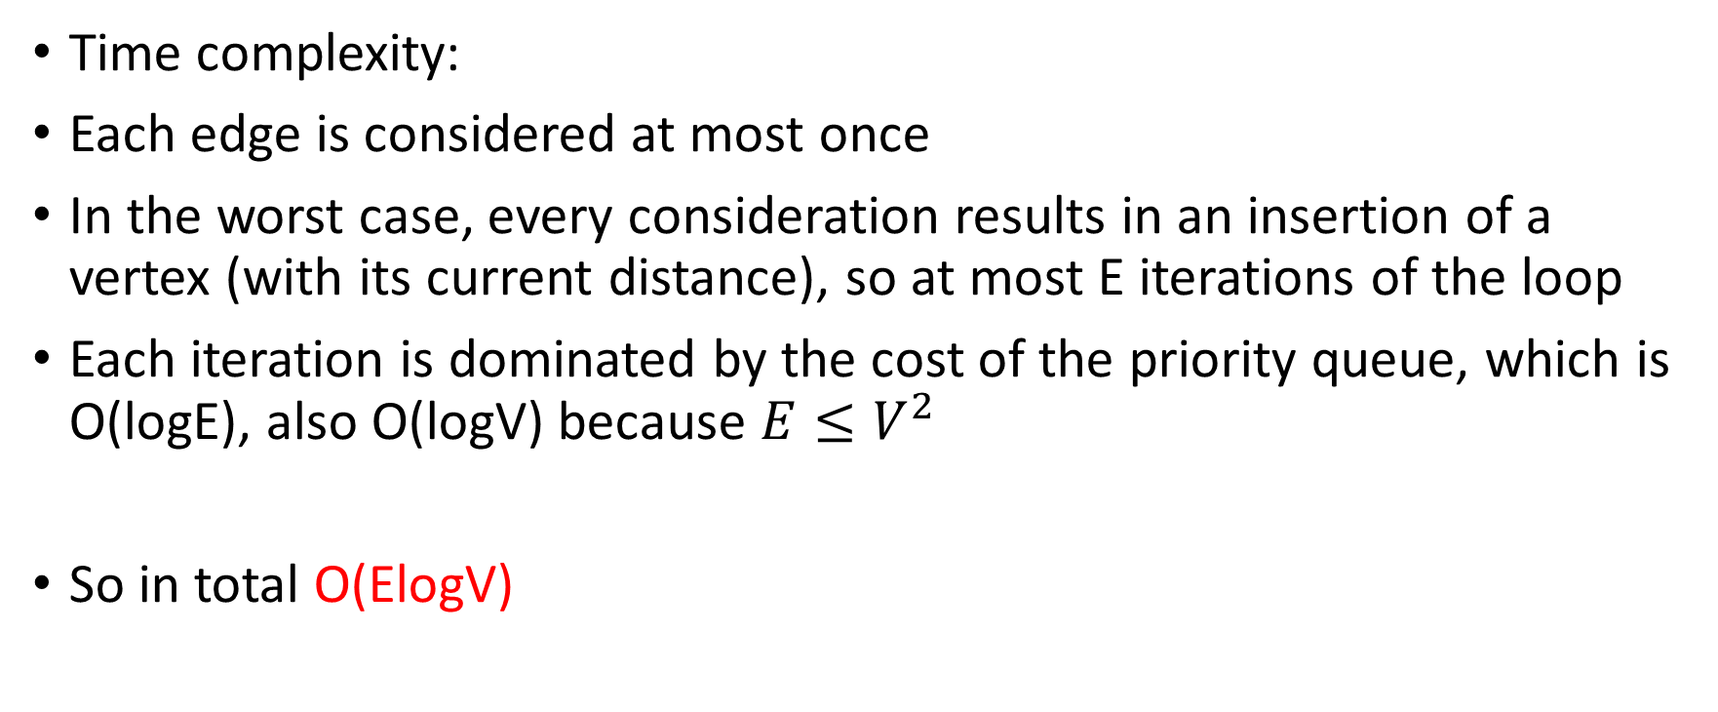
Complexity
Time complexity:
Each edge is considered at most once
In the worst case, every consideration results in an insertion of a vertex (with its current distance), so at most E iterations of the loop
Each iteration is dominated by the cost of the priority queue, which is O(logE), also O(logV) because $E≤V^{2}$
So in total O(ElogV)

Slide 19
Space complexity : O(E) since
In the worst case, every consideration results in an insertion of a vertex (with its current distance), so at most E iterations of the loop

Slide 20
Is it optimal?
There exists other priority queue implementations where the modification of priorities can be done in O(1)
https://en.wikipedia.org/wiki/Fibonacci_heap
V insertions/deletions in pqueue -> O(VlogV)
E modifications -> O(E)
So O(E+VlogV) in total. But in practice Dijksta’s algorithm is good enough

Slide 21
Homework
https://github.com/kwea123/cpp_data_algo/tree/master/Graph2_HW

