Slide 1
Tree

Slide 2
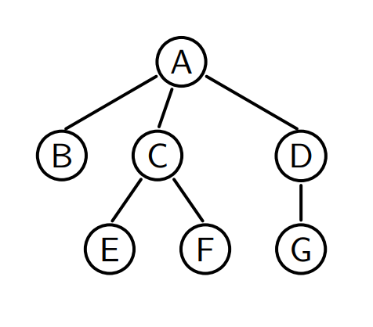
Tree
A tree is defined recursively, it contains:
Root
(Internal) Nodes
Leaves
A tree must not contain a cycle!
Attribute : height

Slide 3
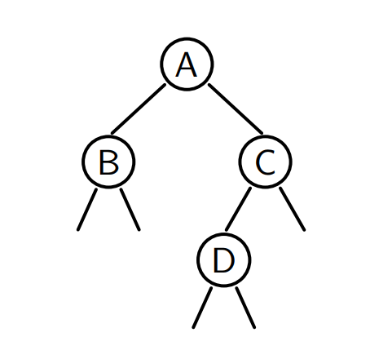
Binary tree
A binary tree is either empty or a node having two children, both of which are binary trees.
We call the children “right-child” and “left-child”

Slide 4
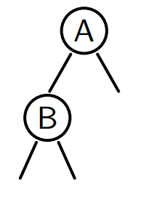
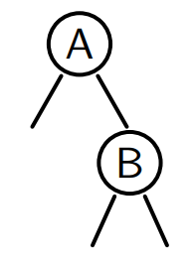
Attention
and are different!

Slide 5

Property
A binary tree of height $h$ has at most $2^{h}−1$ children
Proof by induction

Slide 6
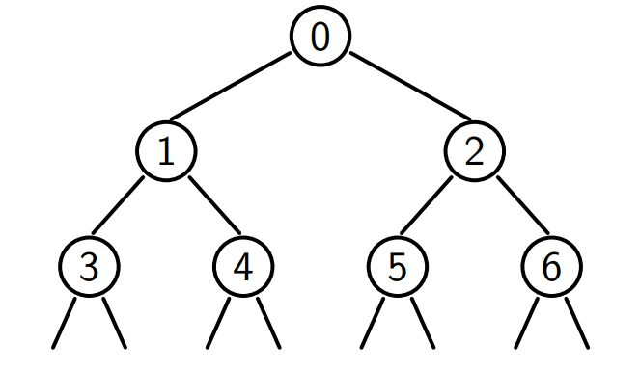
Upper bound
Reached for a perfect tree

Slide 7
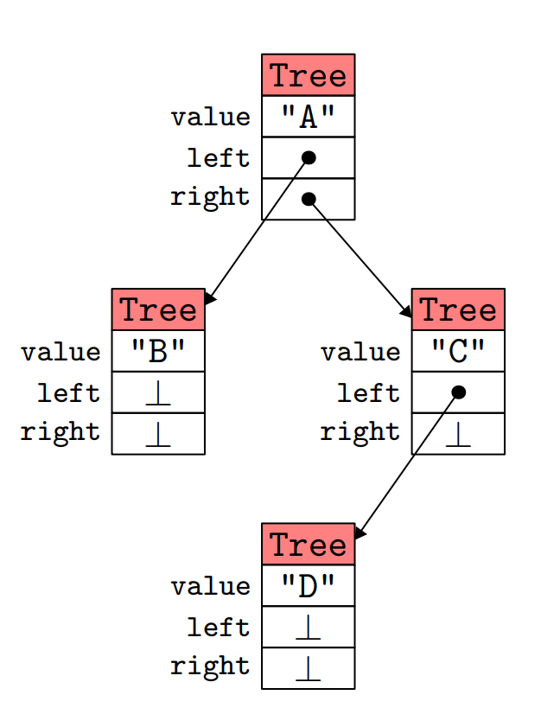
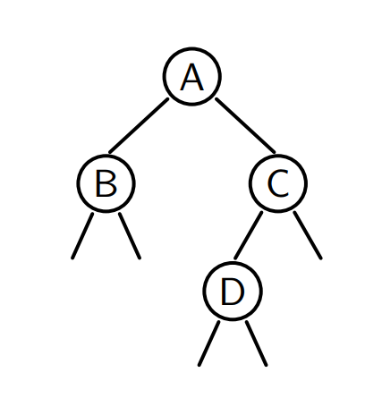
Implementation

Slide 8
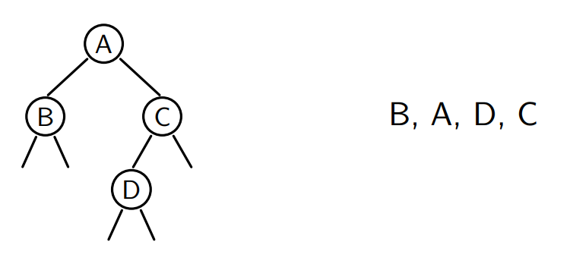
Inorder traversal
Traverse the left child, the node, and the right child
What if we want the result as a list?

Slide 9
It’s too naïve, because splice(it, l) costs O(l.size())
What’s the total complexity?

Slide 10
We use a method that accumulates the list in the argument:
void inorder(Tree* t, list<string>* res)
We just pass an empty list at the beginning, and its complexity is linear!

Slide 11
Different traversals
Actually, inorder traversal is one way of Depth-First Traversal (DFS), with order: left->root->right
Preorder traversal: root->left->right
Postorder traversal: left->right->root
Level order traversal: Breath-First Traversal (BFS)

Slide 12
Implementation of BFS
We need to use a queue to store the current node
And successively add its left child and then right child

Slide 13
Exercise
Write a method that computes the size (the total number of nodes) of a tree.
Write a method that computes the height of a tree.

Slide 14
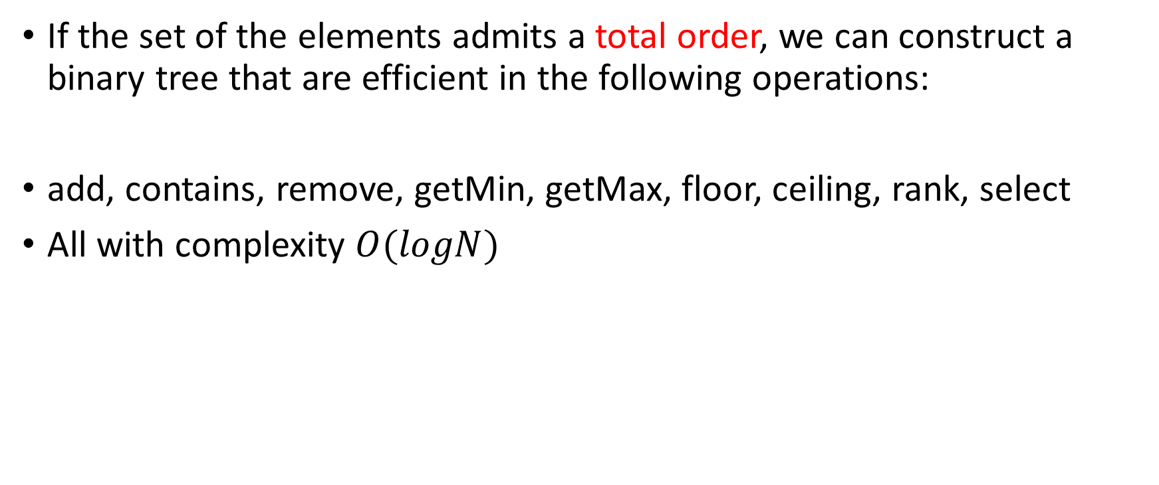
Binary Search Tree (BST)
If the set of the elements admits a total order, we can construct a binary tree that are efficient in the following operations:
add, contains, remove, getMin, getMax, floor, ceiling, rank, select
All with complexity $O(logN)$

Slide 15
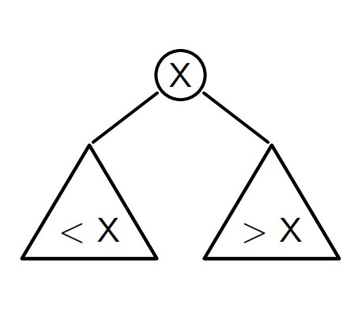
Definition
A BST is a tree where
All values in the left child are <X
All values in the right child are >X

Slide 16
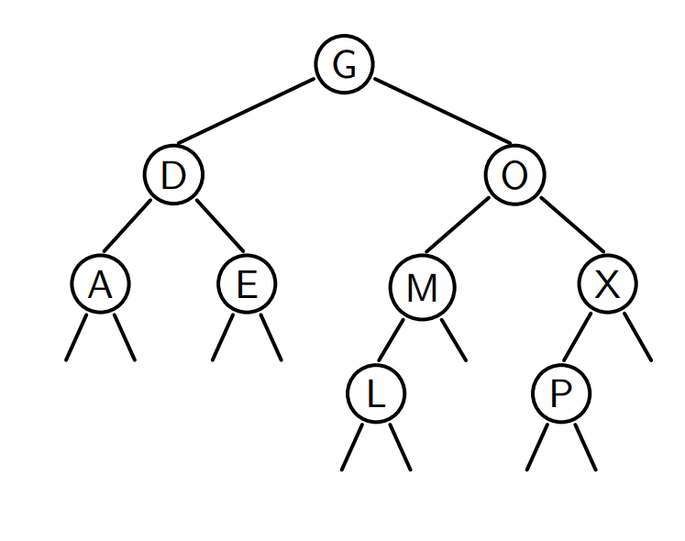

Slide 17
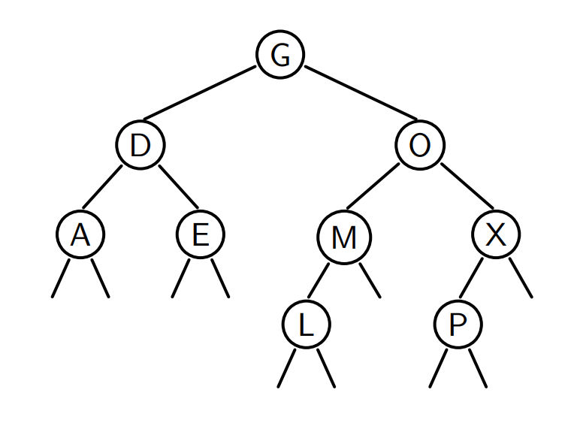
Why is it efficient?
Because we only need to look at one child!
Example: we search for M

Slide 18
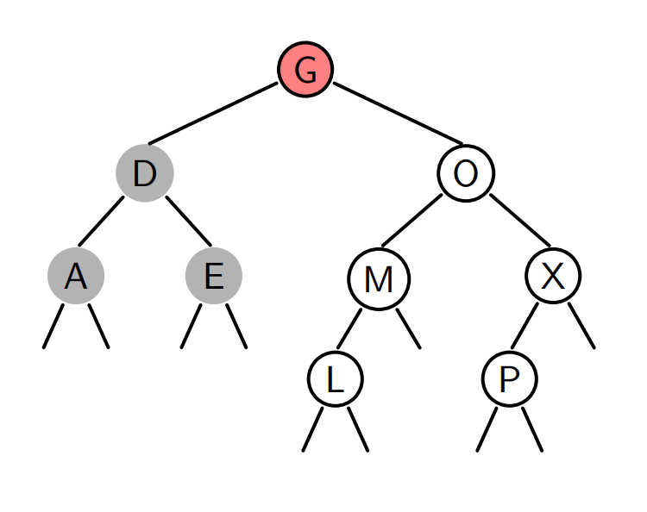
M>G
So we go right

Slide 19
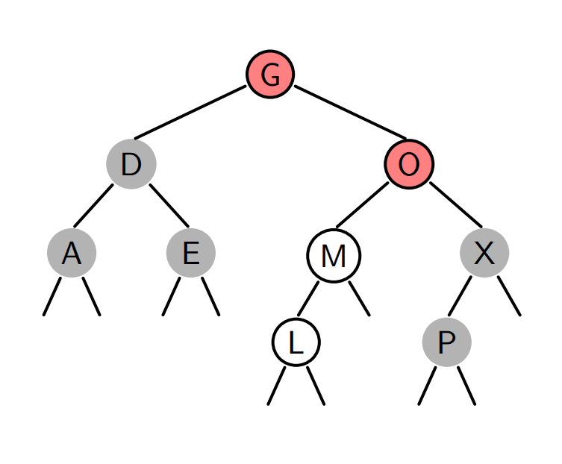
M<O
So we go left
M=M
Success!

Slide 20
If we look for N

Slide 21
N>G
So we go right

Slide 22
N<O
So we go left

Slide 23
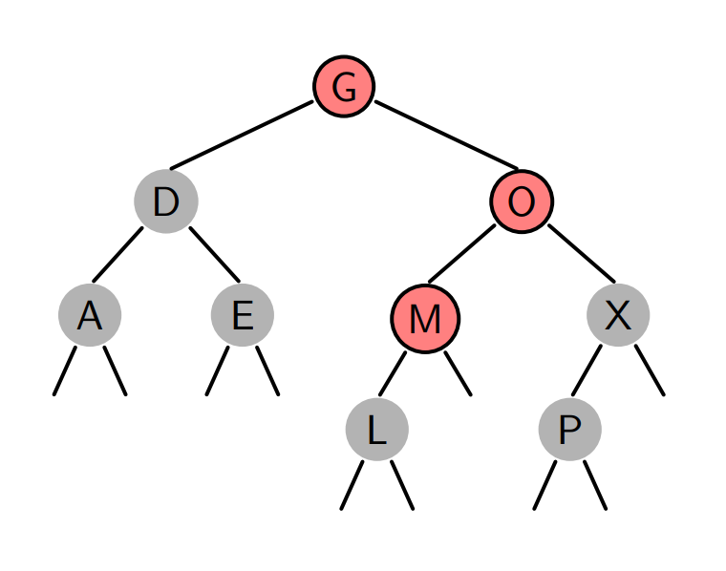
N>M
So we go right
No right child
Failed -> No such element

Slide 24
getMin
Where is the minimum value?

Slide 25
contains
We compare the value to the root:
If it is ==, then we’ve found it
If it is >, then go right
If it is <, then go left
If we encounter NULL, it means the value doesn’t exist

Slide 26
Exercise
Rewrite the contains function recursively.

Slide 27
Insertion
We find the right place to insert the element

Slide 28
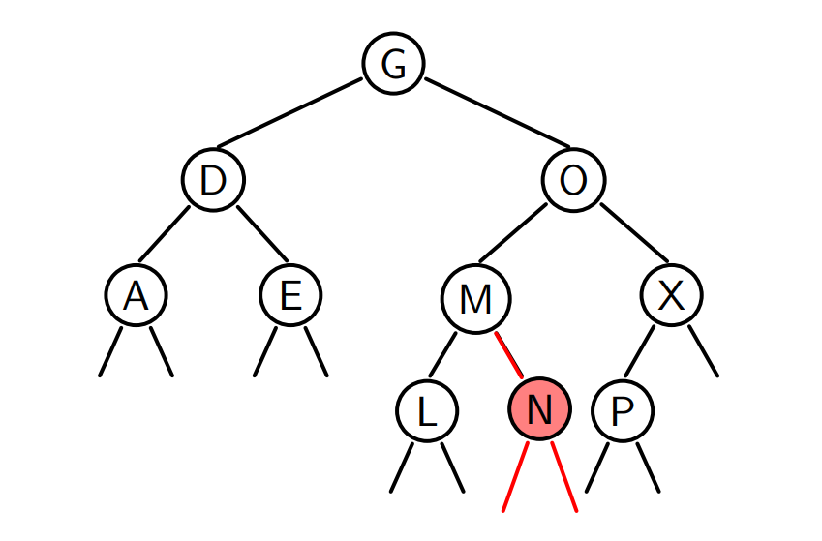
Example: add N

Slide 29
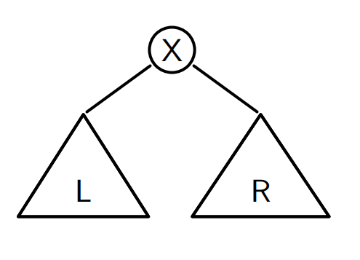
Delete an element
Almost the same as inserting an element…
What happens if we want to delete the root?
------→ ???

Slide 30
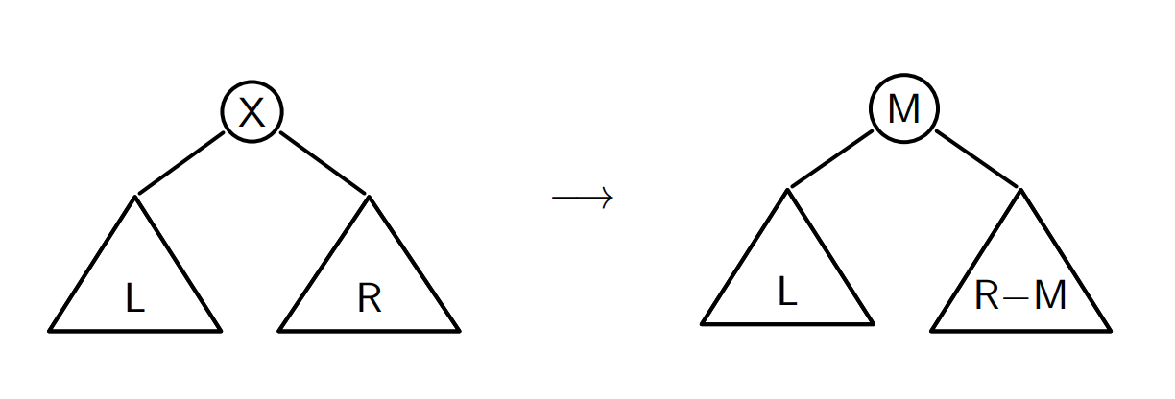
We replace the root by min(R)

Slide 31
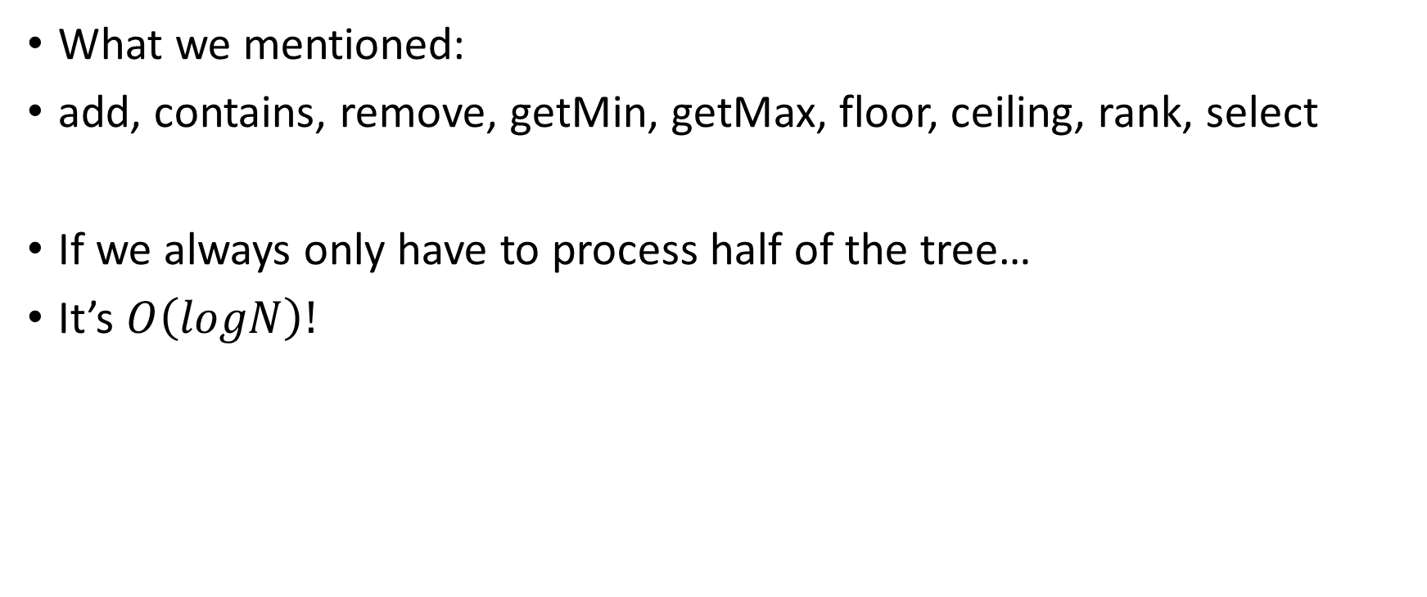
Complexity
What we mentioned:
add, contains, remove, getMin, getMax, floor, ceiling, rank, select
If we always only have to process half of the tree…
It’s $O\left(logN\right)!$

Slide 32
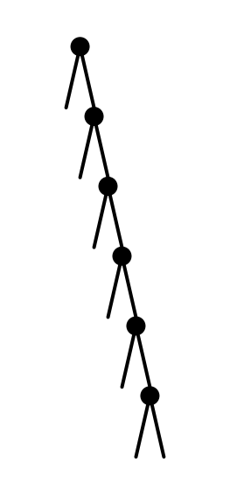
But we can be unlucky…
What’s the complexity in this case?

Slide 33
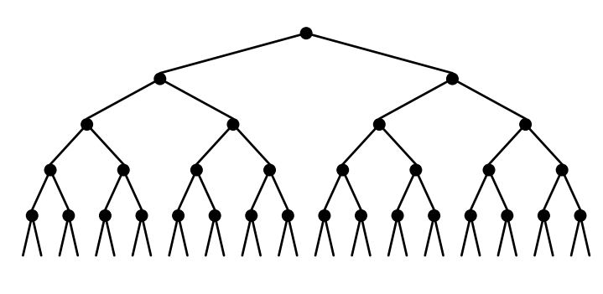

Look at the good side first
If the tree is perfect
add, contains,… in $O(logN)$
Construction in$O(NlogN)$

Slide 34
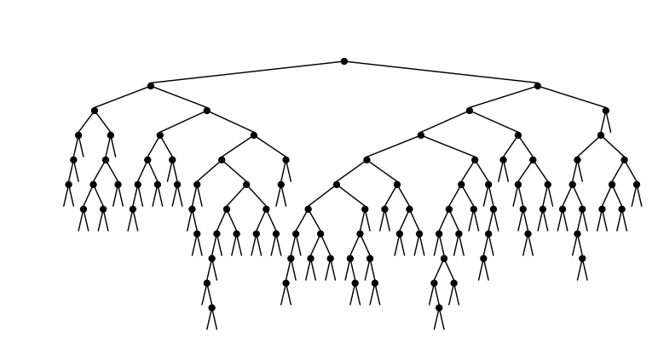
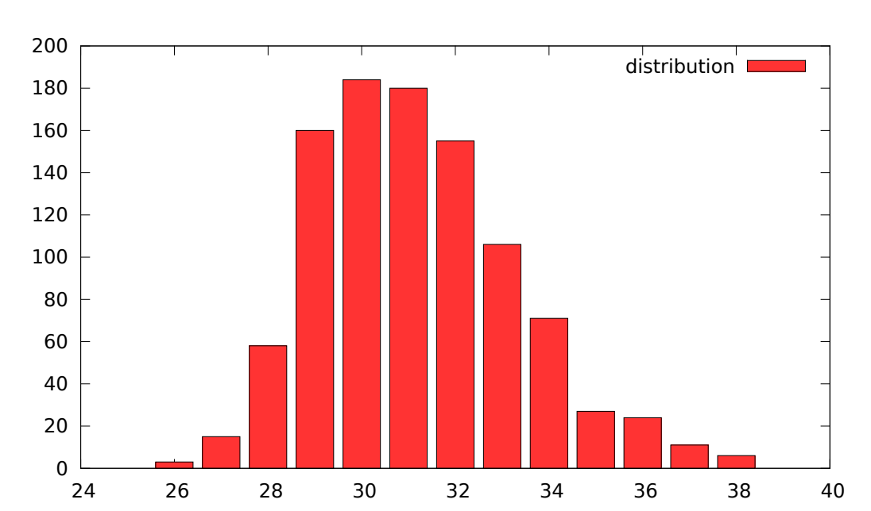
In reality…
For N = 10000, repeated 1000 times

Slide 35
We still want to avoid the worst case
We need to balance the tree

Slide 36
Balanced BST
We want to guarantee that the height of the tree is logarithmic of the number of nodes

Slide 37
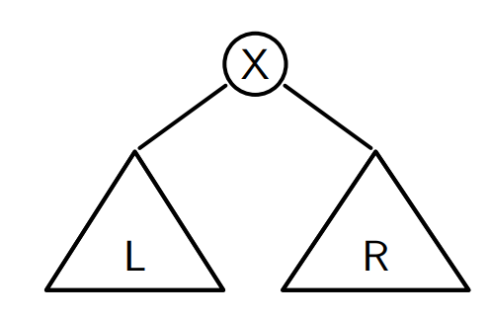

One solution: Adelson-Velsky and Landis (AVL)
Definition of an AVL tree: $\left|h\left(L\right)−h\left(R\right)\right|≤1$

Slide 38
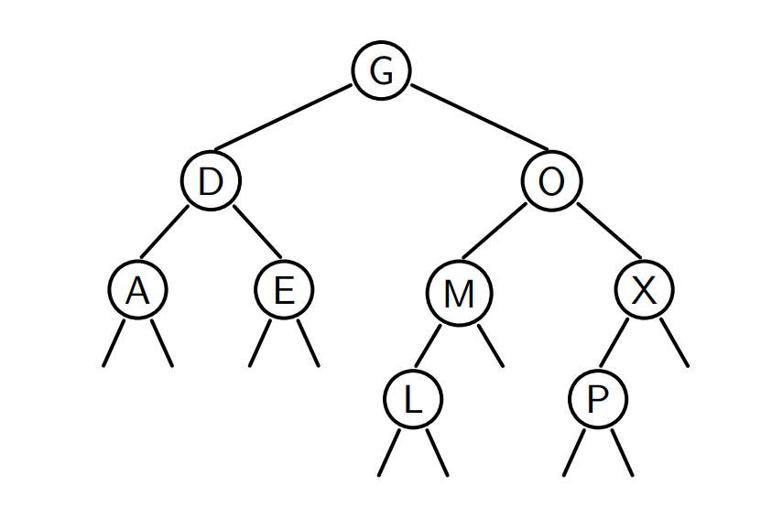
Example

Slide 39
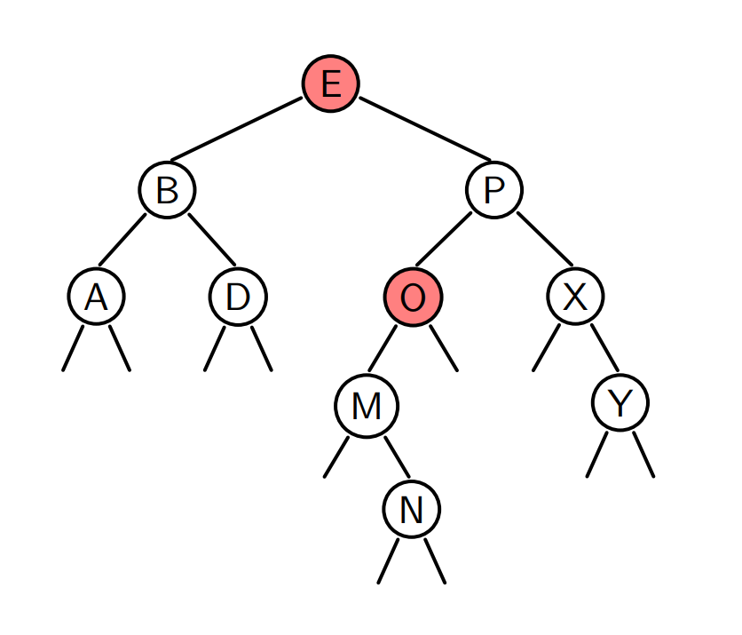
Counter example

Slide 40

Math question
What is the maximal height of an AVL tree having N nodes?
Dual question:
What is the minimal number of nodes $N_{h}$ in an AVL tree of height $h$?

Slide 41

$N_{h}=$The minimal number of nodes in an AVL tree of height $h$
$N_{1}=1$
$N_{2}=2$
$N_{h}=1+N_{h−1}+N_{h−2}$

Slide 42

By adding 1 to $N_{h}$, we recognize the Fibonacci sequence
$N_{1}+1=2$
$N_{2}+1=3$
$N_{h}+1=\left(N_{h−1}+1\right)+{(N}_{h−2}+1)$
$N_{h}+1=F_{h+2}$

Slide 43
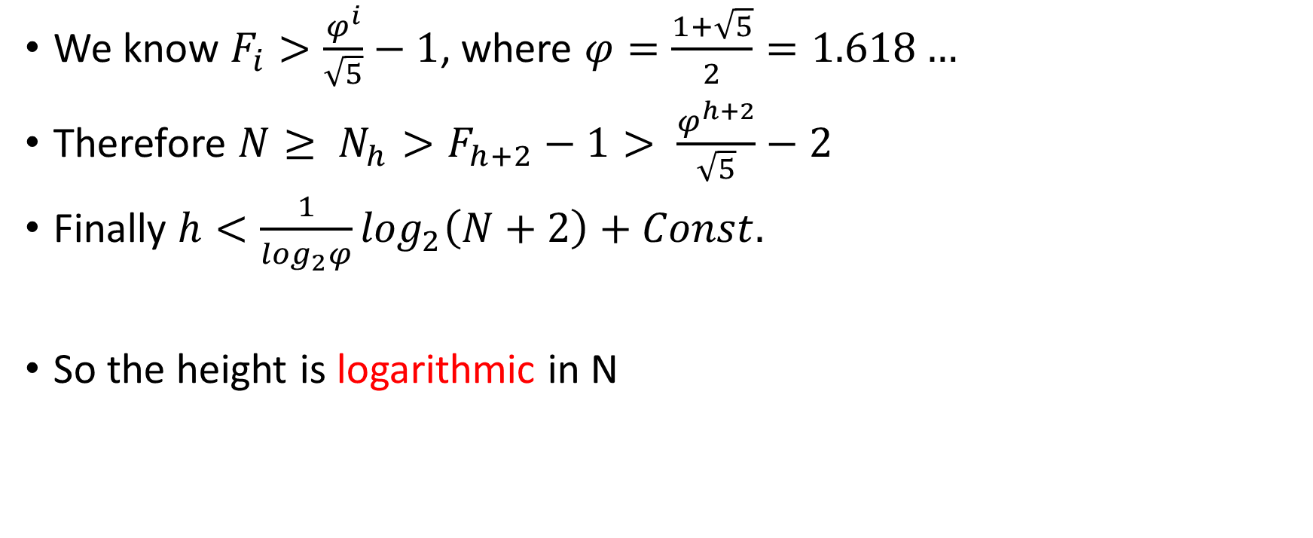
We know $F_{i}>\frac{φ^{i}}{\sqrt{5}}−1$, where $φ=\frac{1+\sqrt{5}}{2}=1.618…$
Therefore $N≥ N_{h}>F_{h+2}−1> \frac{φ^{h+2}}{\sqrt{5}}−2$
Finally $h<\frac{1}{\log_{2}φ}\log_{2}\left(N+2\right)+Const.$
So the height is logarithmic in N

Slide 44
C++ implementation
Which methods are not changed?
Which methods are changed?

Slide 45
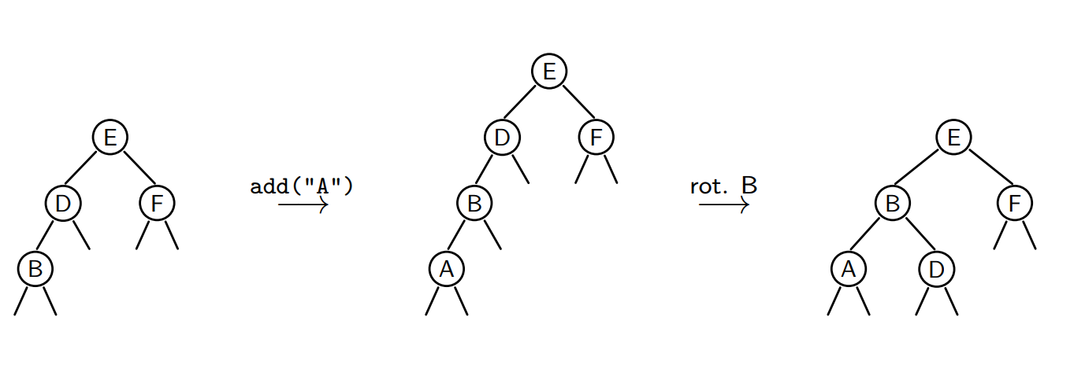
Add

Slide 46
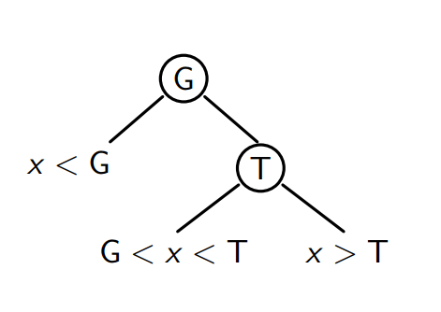
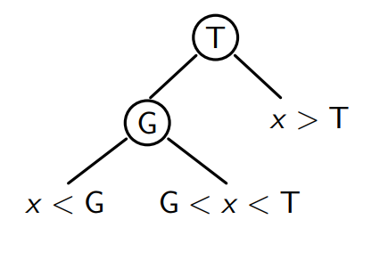
Rotation
A rotation to the right conserves the property of an AVL
Same for a rotation to the left

Slide 47
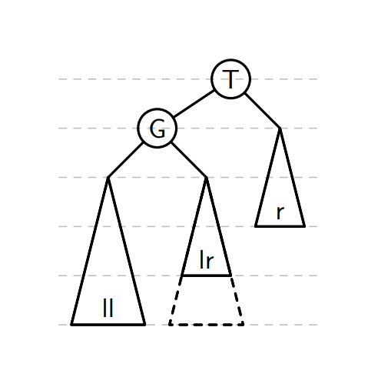
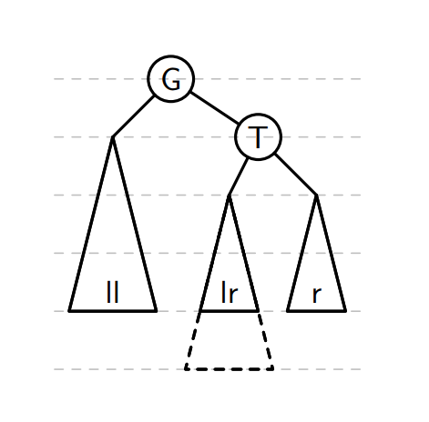
The rotation to the right allows to rebalance the tree when the imbalance comes from the left child of the left child

Slide 48
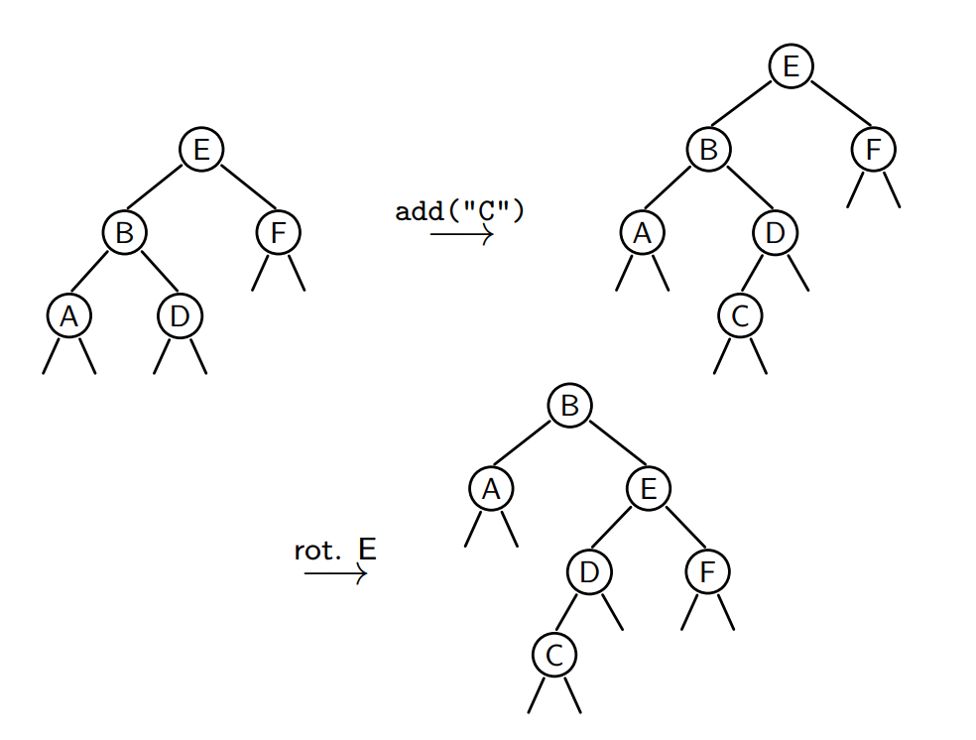
One rotation is not always enough

Slide 49
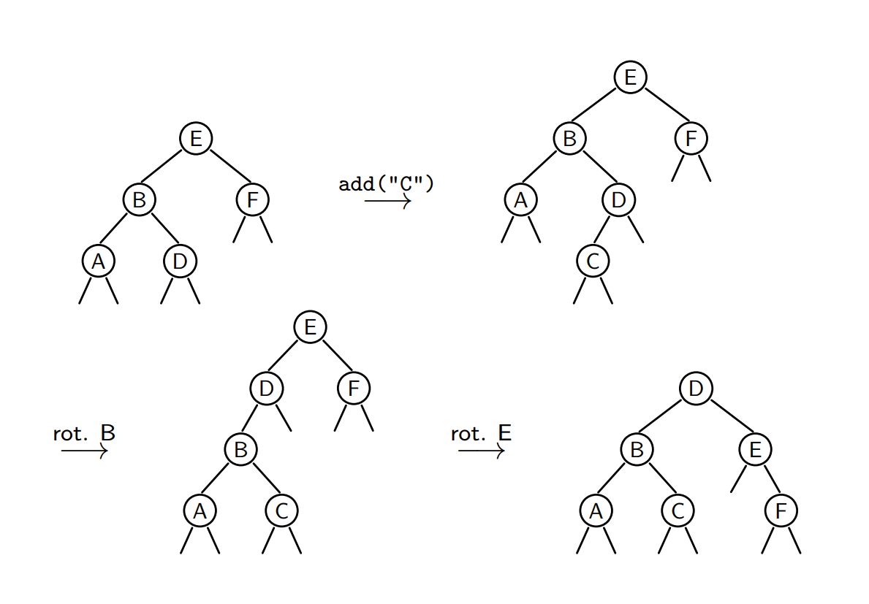

Slide 50
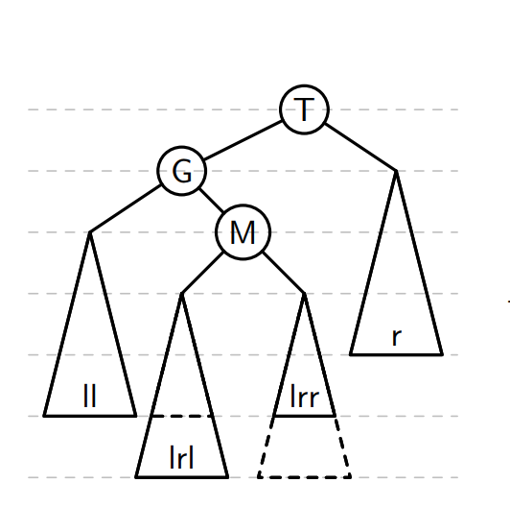
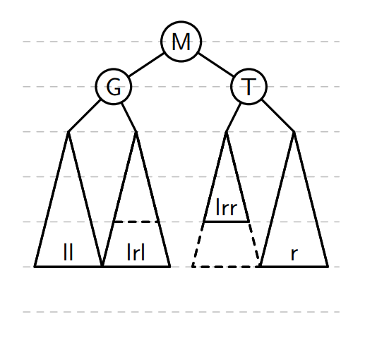
Double rotation
The left-right rotation allows to rebalance the tree when the imbalance comes from the right child of the left child

Slide 51
rotateLeft
rotateRight
balance

Slide 52
Which methods need to be balanced?
add
removeMin
remove

Slide 53
C++ libraries
<set>
<map>

Slide 54
Exercise
Create a struct/class AVLSet that uses the struct AVL, which acts as a set structure, in particular, it must contain the following methods:
isEmpty()
contains(string x)
add(string x)
remove(string x)
Write another method size() that returns the size of the set.

Slide 55
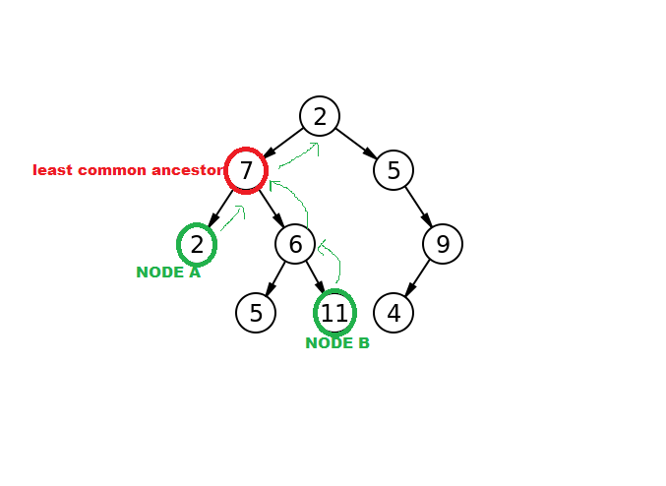
Homework
Make use of the struct BST, find the lowest common ancestor (LCA) of two nodes
LCA:
What is the complexity?
How to find the LCA for nodes in a
(binary) Tree (not sorted)?

