Slide 1
Sorting

Slide 2
Today’s problem
Sorting!!!!

Slide 3
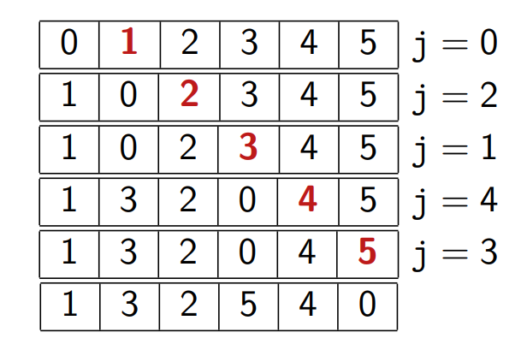

How to shuffle an array randomly?
Knuth shuffle:
Exchange each element i with element j$∈[0..i]$

Slide 4
Exercise
Implement Knuth shuffle in c++

Slide 5
Homework
Proof the correctness of Knuth shuffle. i.e. all possible permutations appear with same probability.

Slide 6
Knuth shuffle
Easy to implement
Time complexity : O(N)

Slide 7
Sorting
What is the optimal solution for sorting?
Hypotheses:
We only do comparisons between elements
We don’t assume any distribution of the elements

Slide 8
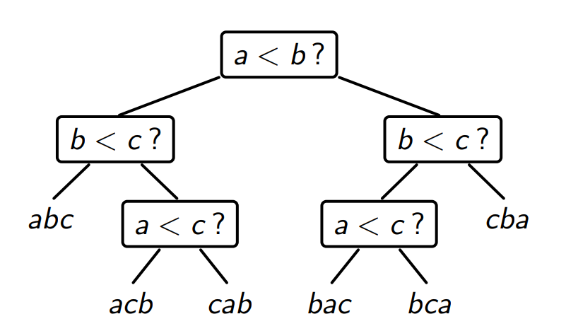
Example : we can sort a,b,c with the following decision tree

Slide 9
Here, we do 2 or 3 comparisons depending on the values
So at most 3 comparisons

Slide 10
Likewise, an algorithm sorting N values can be considered as a big decision tree, where each node represents a comparison, and each leaf represents a permutation
How many permutations for N numbers?
What’s the least height for a such tree?

Slide 11
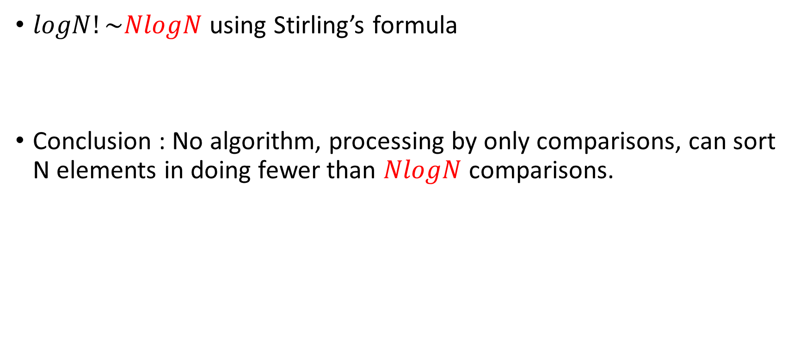
$logN!\sim NlogN$ using Stirling’s formula
Conclusion : No algorithm, processing by only comparisons, can sort N elements in doing fewer than $NlogN$ comparisons.

Slide 12
Heapsort, executed with a heap, is an example.

Slide 13
Special cases
When we have additional information on the distribution of the elements.
Homework:
Dutch national flag problem: the elements are only from the set {red, white, blue}, and we want to sort the array in the order red->white->blue
The complexity should be in O(N)

Slide 14
Homework
More generally, suppose the elements are from set {0, 1,…, k-1} of size k, sort the array such that the order is 0->1->…->k-1.
The complexity should be O(max(k,N))

Slide 15

Insertion sort
We successively insert elements to the sorted part of the array:

Slide 16
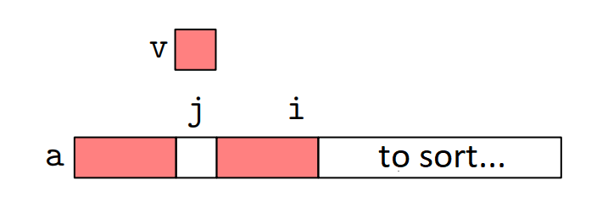
C++ implementation

Slide 17
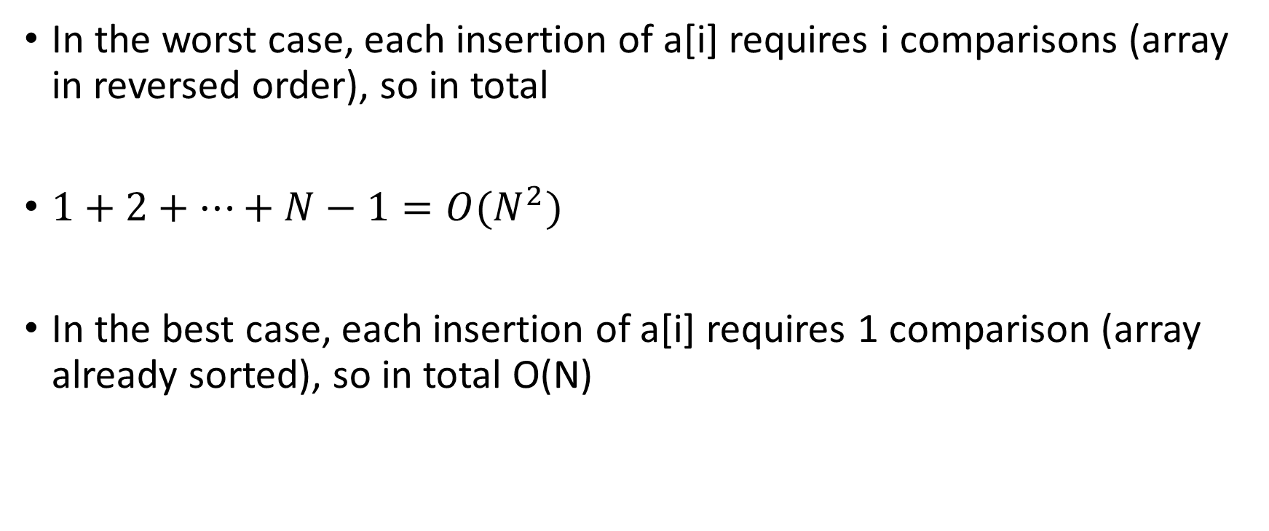
Complexity
In the worst case, each insertion of a[i] requires i comparisons (array in reversed order), so in total
$1+2+…+N−1=O(N^{2})$
In the best case, each insertion of a[i] requires 1 comparison (array already sorted), so in total O(N)

Slide 18
Merge sort
Divide and conquer:
1. cut the array into two subarrays
2. sort them recursively
3. merge the results

Slide 19

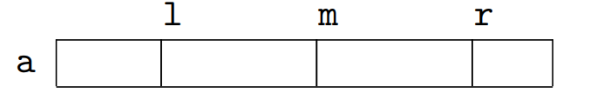
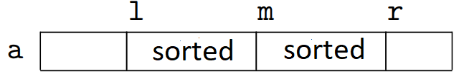
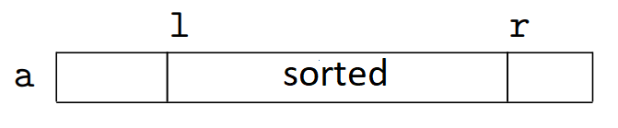
We need to generalize to a[l..r[
1. cut the array into two equal parts
2. Sort recursively a[l..m[ and a[m..r[
3. merge the results

Slide 20
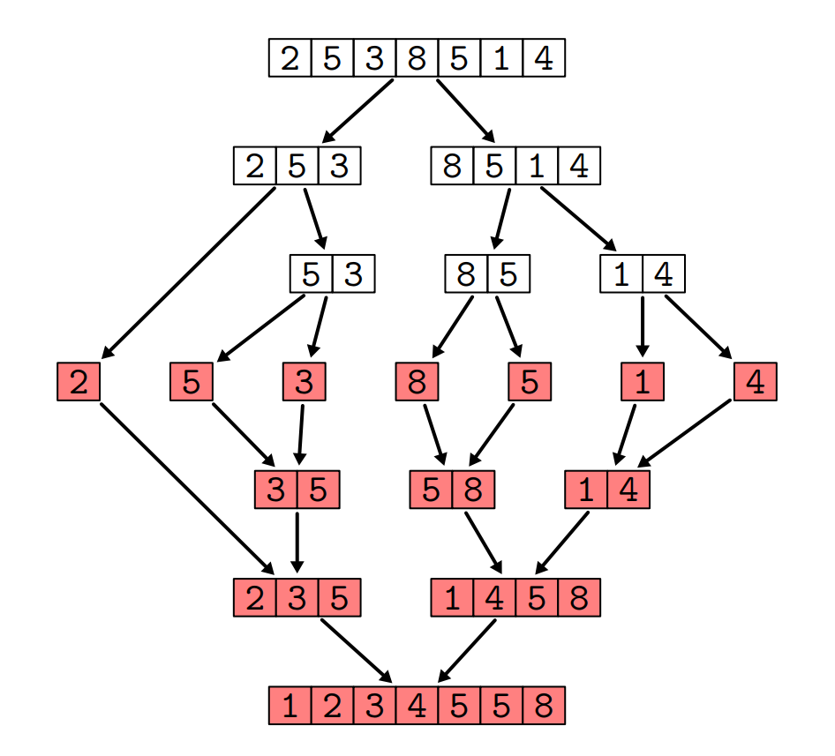
example

Slide 21
C++ implementation

Slide 22
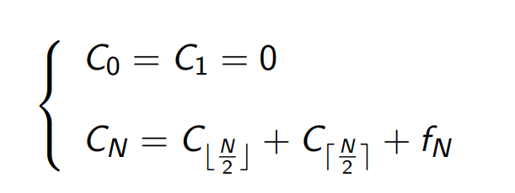

Complexity
Let $C_{N}$ be the number of comparisons to sort N elements
$f_{N}$ the cost to merge two arrays of total length N

Slide 23
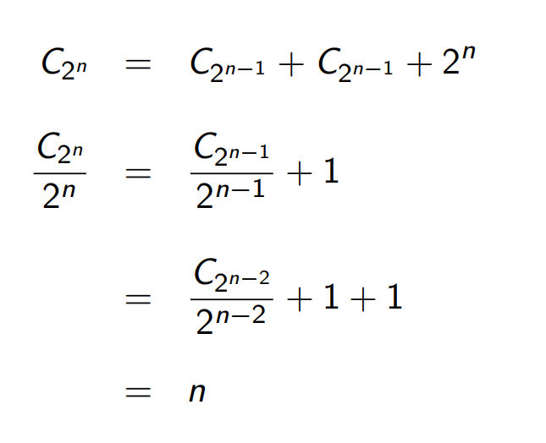

Let $N= 2^{n}$ (more specifically, we need to bound $2^{k}≤N<2^{k+1}$)
In the worst case $f_{N}=N$
So

Slide 24
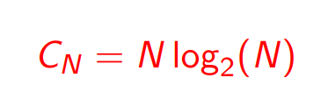
Therefore

Slide 25
Exercise : merge sort for lists
Write a method void split() that takes three arguments, l1, l2, l3, and split half of the elements of l1 to l2, and the other half to l3.
Write a method merge() that takes two sorted list, and return the merged list.
Write a method mergeSort() that takes a list, a return a sorted list, by recursively calling merge().

Slide 26
Quick sort
We saw that in mergeSort, we need to allocate another array of the same size.
We can avoid this by using quick sort.

Slide 27
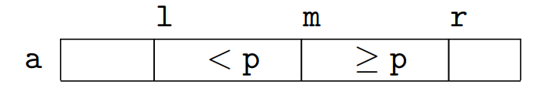
Choose a pivot p
Sort recursively

Slide 28
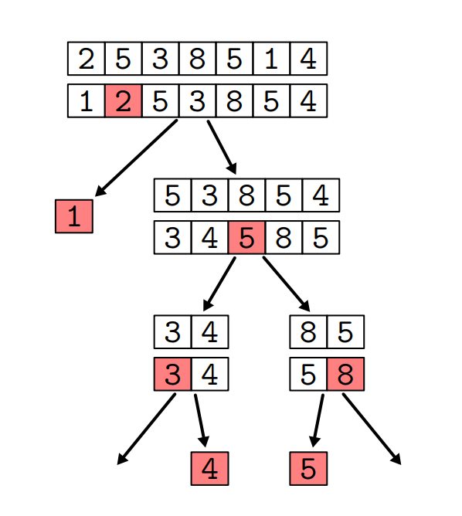
Example

Slide 29
C++ implementation

Slide 30
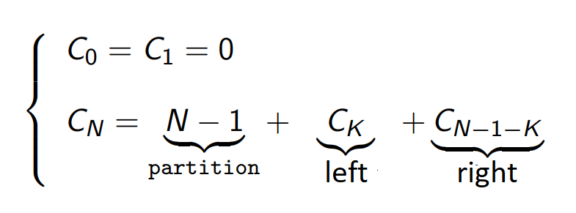
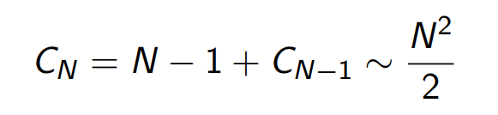

Complexity
Let $C_{N}$ be the number of comparisons to sort N elements
If the array is already sorted, K=0 (because we chose the leftmost element to be the pivot)

Slide 31
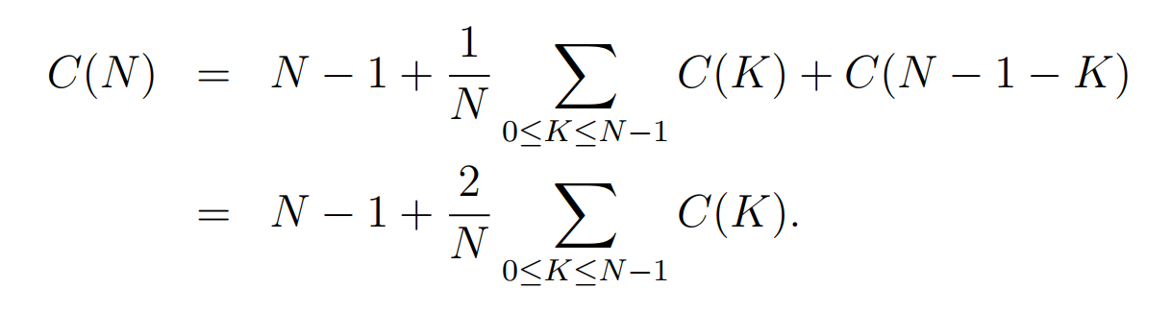
What’s the optimal case?
We can also show that in average, quick sort is optimal!
Homework : Show the optimality of the average case
Hint : start with

Slide 32
To avoid the worst case
We can randomly pick a pivot
Or we can shuffle the array before sorting

Slide 33
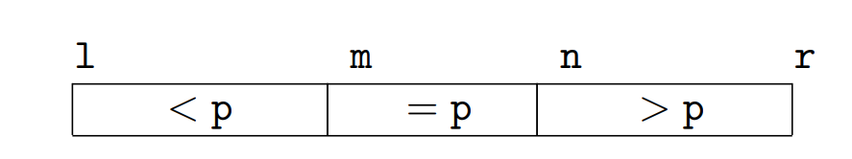
Is it enough?
It’s not enough when the array has multiple same values…
Every element is equal = pivot is leftmost or rightmost
We need to perform a 3-way partition:
And sort a[l..m[, a[n..r[

Slide 34
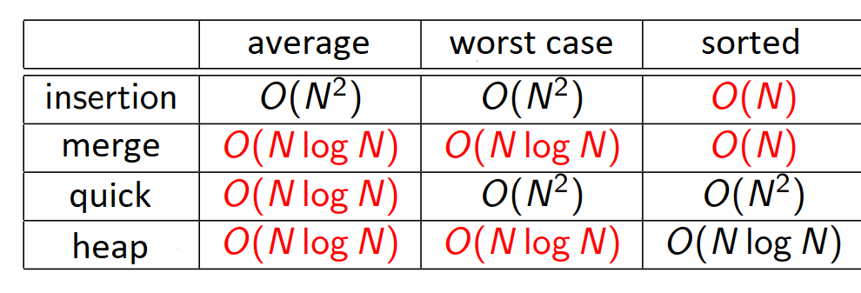
Comparison

Slide 35
C++ library
#include <algorithm>
sort(a, a+n)
l.sort()
sort(v.begin(), v.end())

Slide 36
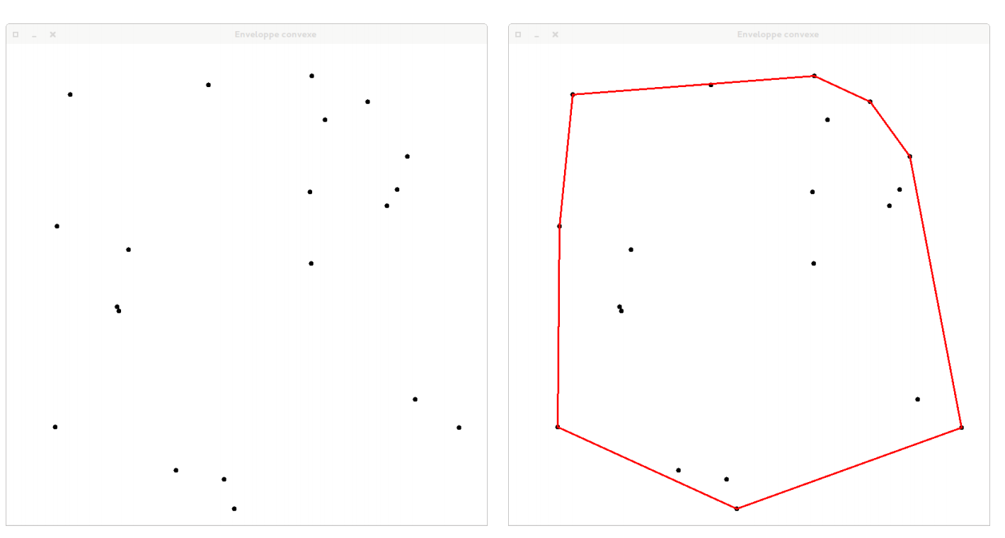
Application : finding convex hull

Slide 37
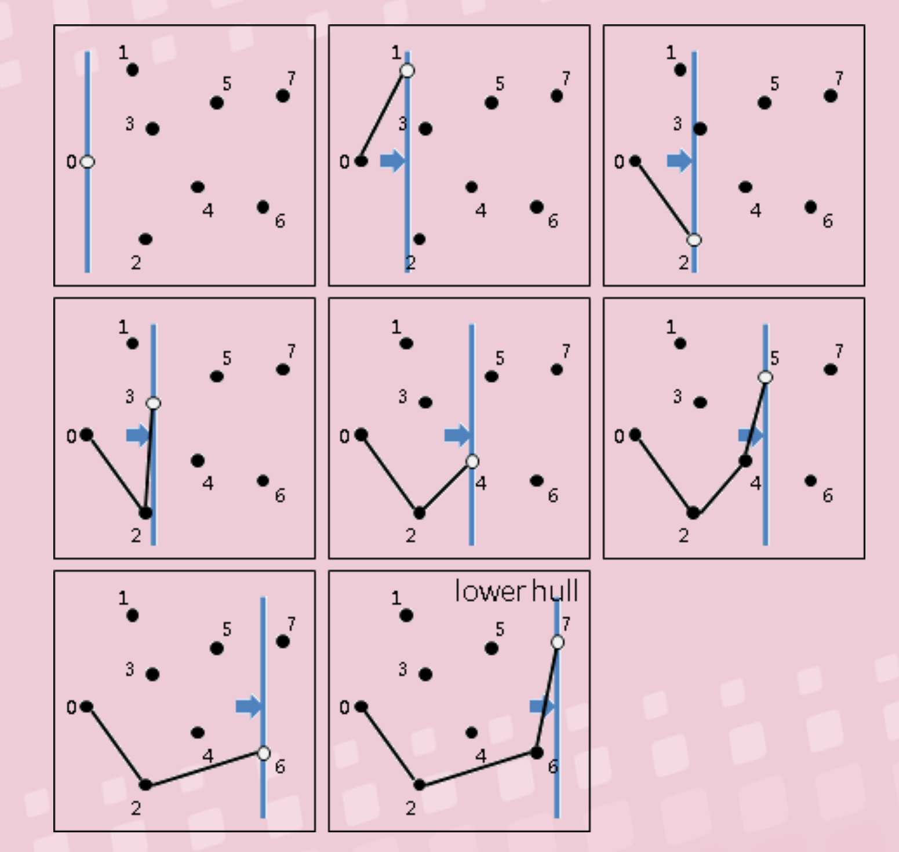
Andrew's Monotone Chain
Sort the points according to x coordinate O(NlogN)
Find the lower hull O(N)
Find the upper hull O(N)

Slide 38
Homework
Implement Andrew's Monotone Chain in c++.

Slide 39
Advanced reading
http://www.csie.ntnu.edu.tw/~u91029/ConvexHull.html#4

