Slide 1
Disjoint set

Slide 2
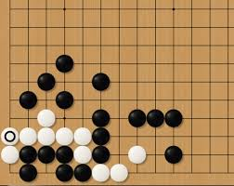
Today’s problem
Go!
How to compute how many liberties a group has?

Slide 3
Which data structure?
Naïve solution : A graph or an array
Recursively traverse its neighbors
Complexity?

Slide 4
Disjoint set

