Slide 1


FUNDAMENTALS OF DEVELOPMENT
Instructor: Beck Johnson Week 1

Slide 2

Introductions
Who are you? Who am I?
What do you do/study/etc?
What is your experience with web development?
Do you have related skills like Photoshop, wireframing, email marketing, etc?
What are you hoping to get out of this class?

Slide 3

CLASS SCHEDULE
Five sessions over six weeks
Wednesdays from June 20 to July 25, at 6:30-9:30 pm
No class week of July 4th
10 minute break somewhere in the middle
No grades, no tests
Questions and feedback highly encouraged!

Slide 4

course OVERVIEW
Basics of HTML and CSS
Website structure, navigation, and file organization
Hosting, FTP, Github
Overview of Javascript and jQuery
The role of the developer in the product lifecycle

Slide 5

today
Overview of a website
Code editors
Basic HTML
Overview of CSS – font styling, colors, alignment
What does a developer DO anyway?

Slide 6
ODDS & ENDS
kweeket.github.io/dev-101
Slides, sample files, “homework", and interesting links will be posted here

Slide 7

Overview OF A WEBSITE

Slide 8



CONTENT, DESIGN, & CODE
Content
Most important part of any website
HTML
Design
Critical to the best user experience
CSS
Code
Brings content and design to life
Javascript

Slide 9

CONTENT
What am I presenting?
TEXT
Articles
Links
Lists
MEDIA
Images
Videos
Audio
Content is entered using HTML

Slide 10
DESIGN
What is the experience?
USER EXPERIENCE
GRAPHIC DESIGN
Layout
Navigation
User flows
Colors
Fonts
Backgrounds
Design is done with CSS

Slide 11

CODE EDITING TOOLS

Slide 12






CODE EDITORS
VS Code
Brackets
Atom
Sublime Text
Coda

Slide 13
PRACTICE, STUDY, PRACTICE
CODE EDITORS
HTML is just text
You can right-click and select "View Source" on any webpage to see how the developer made it

Slide 14

WEB BROWSERS
You can experiment directly in the browser before making permanent changes
You can modify HTML or CSS
Any changes disappear when you refresh the page – copy to a local file if you want to keep them!

Slide 15

DEVELOPER TOOLS
Chrome/Firefox
Right-click anywhere on the page > Inspect
OR hit the F12 key
Safari
Open Preferences > Advanced > Show Develop menu
Right-click > Inspect Element
Internet Explorer
F12 key

Slide 16
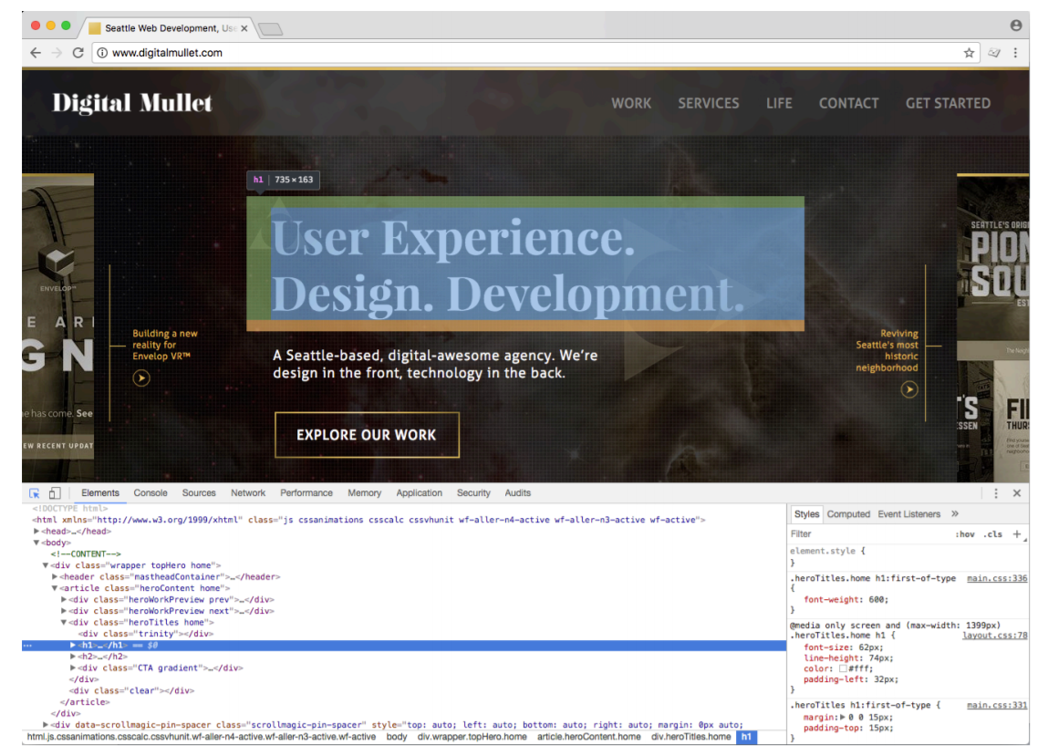
DEVELOPER TOOLS

Slide 17
Let’s try it

Slide 18
<html>
HTML DOCUMENTS

Slide 19
HTML Elements
HTML elements are contained in <> brackets
Most HTML tags have an opening tag and a closing tag
<tag>Content goes in here</tag>
Some types of tags are “self-closing”
<tag />

Slide 20

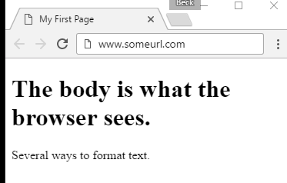
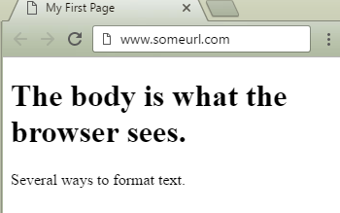
HTML DOCUMENT
<!doctype html>
<html>
<head>
<meta charset="UTF-8">
<title>My First Page</title>
</head>
<body>
<h1>The body is what the browser sees.</h1>
<p>Several ways to format text.</p>
</body>
</html>

Slide 21
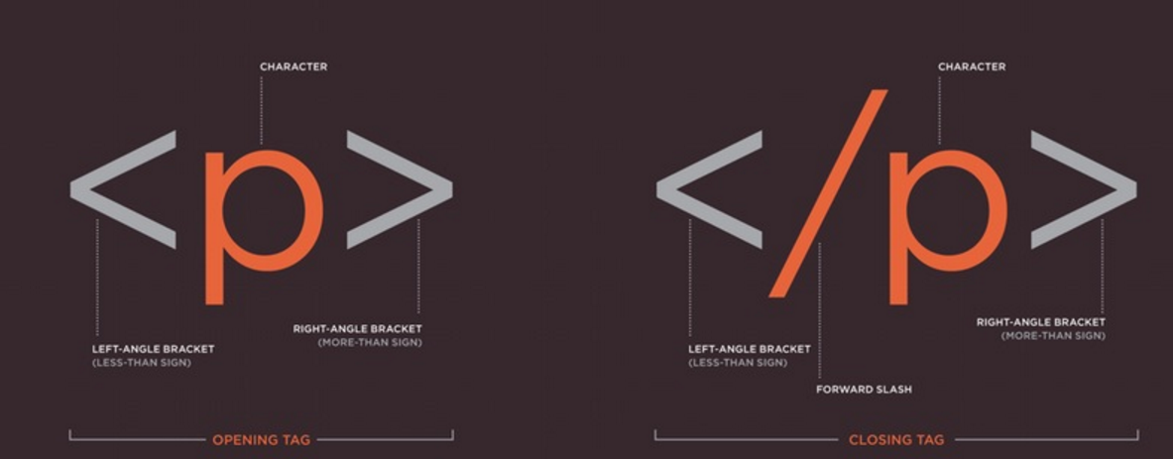

HTML Elements
20

Slide 22
HTML RULES
Tags are written in lowercase
<a> not <A>
Tags must be closed
<p>Text in here.</p>
<div>Content in here.</div>
<br/> Self-closing line break

Slide 23
DOCTYPE
<!doctype html>
The very first thing in any HTML document
Tells the browser what version of HTML the document is written in (this one is HTML5)

Slide 24
DOCTYPE
These old doctypes are not commonly in use anymore:
<!doctype html PUBLIC "=//W3C//DTD XHTML 1.0 Strict//EN" "http://www.w3.org/TR/xhtml1/DTD/xhtml-strict.dtd">
<!doctype html PUBLIC "=//W3C//DTD HTML 4.01 Transitional//EN" "http://www.w3.org/TR/xhtml1/DTD/transitional.dtd">

Slide 25
HTML DECLARATIOn
<html>
The top line after <doctype>
declaration.
Tells the browser “This is where everything starts!”
<html><!-- everything else --></html>

Slide 26
<!--HTML COMMENTS-->
<!-- Comments are great -->
Are not visible to the user in their browser
Great for leaving notes for yourself or other developers
Can be seen in “view source”

Slide 27
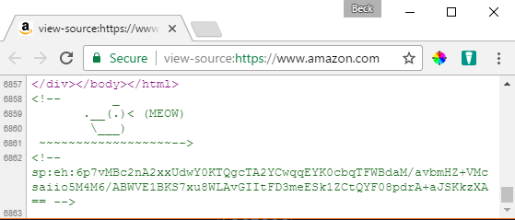
<!--HTML COMMENTS-->
Sometimes they don’t really have a point…

Slide 28
HEAD ELEMENT
<head></head>
Required for a valid HTML document
Holds information about the document that is (mostly) not visible to the user
Can contain CSS and Javascript
<head>
<!-- metadata and resources -->
</head>

Slide 29
META TAGS
<meta charset="UTF-8"/>
Used to specify "meta" information to the browser like page description, author, search engine keywords, and character encoding
UTF-8 represents Unicode, a system to handle text consistently in a variety of languages.
<head>
<meta name="author" content="Your Name" />
<meta name="description" content="A thrilling page"/>
</head>

Slide 30
TITLE TAG
<title>My First Page</title>
Displays in the browser tab
Required inside <head>

Slide 31
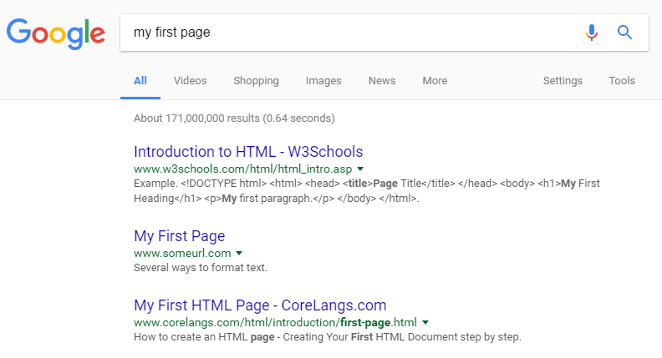
TITLE TAG
<title>My First Page</title>
Name of the page when page is bookmarked
The title for the page in search results on Google (or Bing)

Slide 32
BODY ELEMENT
<body></body>
The part of the HTML document that’s visible to the user
Contains all content of the document, such as tags, links, images, tables, etc.
<body>
<!-- all my sweet content -->
</body>

Slide 33
MAJOR BODY ELEMENTS
Headings for dividing up your page and content
Paragraphs of text
Bulleted, ordered, unordered lists
Images
Links to other pages, websites, or resources.

Slide 34
HEADINGS
<h1>My Page Header</h1>
Headings range from most important to least important
<h1> to <h6>
Search engines use <h1> to determine important information about the page

Slide 35
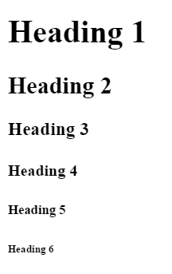
HEADINGS
<h1>Heading 1</h1>
<h2>Heading 2</h2>
<h3>Heading 3</h3>
<h4>Heading 4</h4>
<h5>Heading 5</h5>
<h6>Heading 6</h6>

Slide 36
PARAGRAPHS
<p>Hi! I’m a paragraph!</p>
Browsers automatically add space around <p> elements (although this can be changed with CSS)

Slide 37
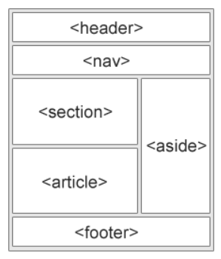
layout
<nav> indicates that everything inside is related to navigation
<section>, <article> and <main> are used to define content sections
<footer> wraps footer content (for example copyright)

Slide 38
formatting
<em> indicates emphasis
By default, this displays as <em>italic</em>
<strong> indicates importance
By default, this displays as <strong>bold</strong>

Slide 39
List Elements
<ul>
<li>Puppies</li>
<li>Kittens</li>
</ul>
Unordered lists <ul> appear in the browser by default with bullets
Puppies
Kittens

Slide 40
List Elements
<ol>
<li>Puppies</li>
<li>Kittens</li>
</ol>
Ordered lists <ol> appear in the browser by default with numbers
Puppies
Kittens

Slide 41
List Elements
<ul>
<li>Puppies</li>
<li>Kittens</li>
</ul>
Both unordered and ordered lists can only contain list items <li> directly

Slide 42
IMAGES
<img src="kitten.jpg" alt="Cute kitten" />
Images are “self-closing" (meaning they end with />)
Images have two required attributes:
src is where the file lives (local or external)
alt is a description of the image (used for screen readers, search engines, etc)

Slide 43

IMAGES
<img src="kitten.jpg" alt="Cute kitten"
height="200" title="Ollie" />
height and width resize images and ensure the page
doesn't jump
title is shown as a tooltip in some browsers when you hover your mouse over the image

Slide 44
Links with the anchor tag
<a href="http://google.com">Google</a>
The <a> element defines an "anchor" or link
Anything inside <a> is clickable – can be text, an image, or any other valid HTML

Slide 45
Some <A>ttributes
<a href="http://google.com" title="Search" target="_blank">Google</a>
href is the URL where the link should send the user
title appears as a tooltip when you mouse over the link. It's read aloud by screen readers
target="_blank" forces the link to open in a new tab

Slide 46
Url-scuse me?
URL stands for “Uniform Resource Locator”
Uniform
because it is a global standard
Resource Locator
because that’s what an URL does – it locates a resource that lives on the internet

Slide 47
Relative file Paths
Relative paths are URLs that go to a resource in relation to the page you’re on
Resources “local” to you should all be relative paths (your images, HTML documents, fonts, CSS, and JS files)
<a href="other-page.html">Link to another page on my website</a>
<img src="image.gif" /> (image is in same folder)
<img src="../images/image.gif" /> (image is in parent folder)

Slide 48
absolute FILE PATHS
Absolute paths are URLs that start with http
<a href="http://google.com">Ubiquitous search engine</a>
These documents are not hosted by you, so if someone renames or deletes the file, your link will be broken

Slide 49
PRACTICE TIME!

Slide 50
Assignment
Create a website that about something that interests you
At least two pages that are linked to each other
Include a link to an outside website.
Use some heading tags and at least one paragraph
Use at least one list
Show at least two images – one local and one remote
Add one HTML comment
Validate your website

Slide 51
The role of the developer

Slide 52
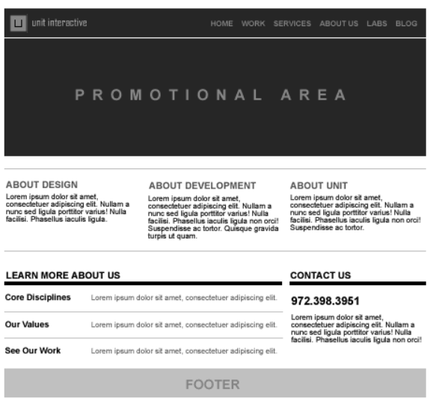
Lifecycle of a website
Step 1
User Interface Designers (UX) create wireframes based on research and conversations with the client
Wireframes show layout and content

Slide 53
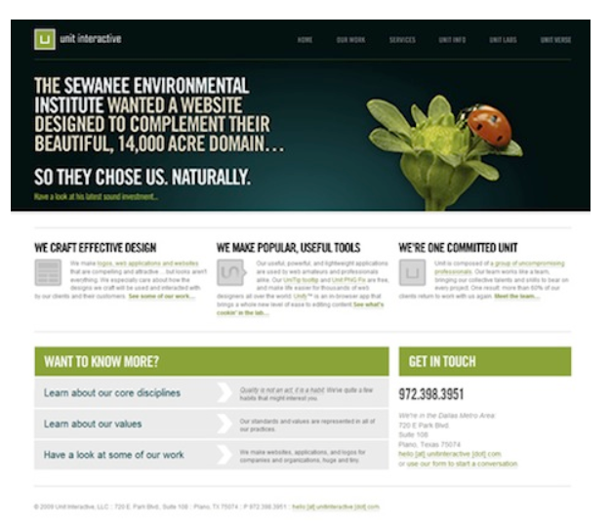
Lifecycle of a website
Step 2
Visual Designers turn wireframes into comprehensive layouts, or “comps”

Slide 54
Lifecycle of a website
Step 3
Developers turn comps into HTML and style with CSS
Add interactivity with Javascript

Slide 55
The role of the dev
What do devs do besides code?
Problem solve
Innovate with new technologies and frameworks
Bring designs to life with animation and motion
Optimize for fast loading

Slide 56


Slide 57
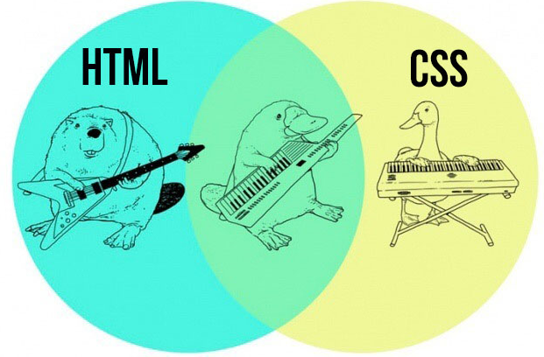
html + CSS = WEBPAGE

Slide 58
CASCADING STYLE SHEETS
CSS is a language for specifying how documents are presented to users
Allows us to override the browser’s default presentation styles with a custom version
Provides consistent and scalable ways to style single elements, single pages, or entire websites
Separates look and feel from content/markup (HTML)

Slide 59
CSS: FAIR WARNING
There is A LOT you can do with CSS
We won’t get anywhere close to covering everything!
We will cover CSS for text styles, colors, positioning, layout, and a couple of extras

Slide 60
WHY USE CSS?
Helps you avoid duplication by keeping styles in one place (one external stylesheet for many HTML pages)
Makes style maintenance easier - for example, update the font for the entire site in one line of code!
Separating presentation from content enforces style consistency

Slide 61
Css goes where?
CSS is a different type of language than HTML, and has its own syntax
CSS can go directly in your HTML file, inside a <style></style> element
You can also create a .css file that can be linked to your HTML page
Styles inside a .css file don’t need a <style></style> tag because the whole file is assumed to be in the CSS language

Slide 62
ANATOMY OF A CSS RULE
selector { property: value; }
selector is the thing you want to style
property is the attribute you want to style
value is how you want to style it
Values always end in semicolons (;)

Slide 63
ANATOMY OF A CSS RULE
So!
<style>
p { color: blue; }
</style>
"All paragraphs will have blue text "

Slide 64
EXAMPLE CSS RULE
p { color: blue; }
selector is p (all <p> tags in the HTML)
property is color
value is blue (many color names are supported, or use the hex code #0000ff)
Notes:
Look up hex code for blue

Slide 65
EXAMPLE CSS RULE
p {
color: blue;
font-size: 14px;
}
Multiple properties can be defined for a single selector, each separated by a semicolon (;)
Notes:
Look up hex code for blue

Slide 66
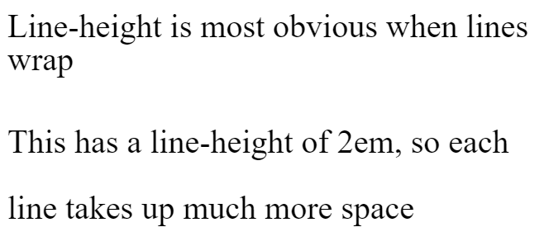
{ } Common font Properties
line-height: a number followed by a measurement of the height of a line of that element, in ems (em) or pixels (px)
similar to leading in typography
p { line-height: 1.4em; }
font-size: a number followed by a measurement of the height of that element’s text in ems (em) or pixels (px)
p { font-size: 14px; }
Notes:
Website live example

Slide 67
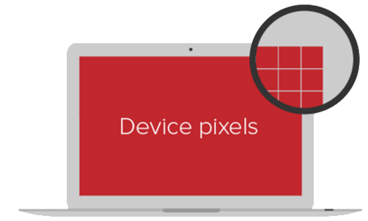
{ } Quick aside about units
The two standard units for sizing in CSS are px and em
px is an abstract unit that isn’t related to font height and isn’t a physical unit of measurement
Devices with more PPI (pixels per inch) may use several “device” pixels when displaying a 1px line
That means that px size varies by device, but should always look "about the same"

Slide 68
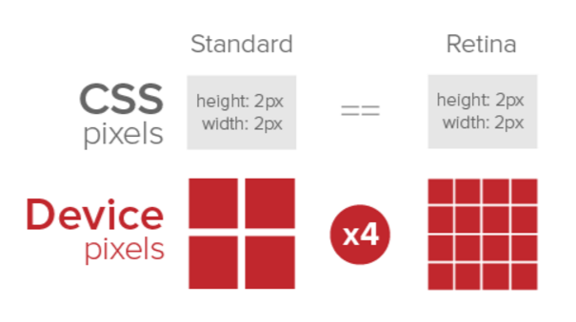
{ } Quick aside about units

Slide 69
{ } ah-em
em refers to the height of the letter 'm' of the font being used
This unit of measurement is a description of the relative size between this element and its parent
So h2 { font-size: 2em; } means the header is 2 times as big as the letter 'm' of the default font in your html document

Slide 70
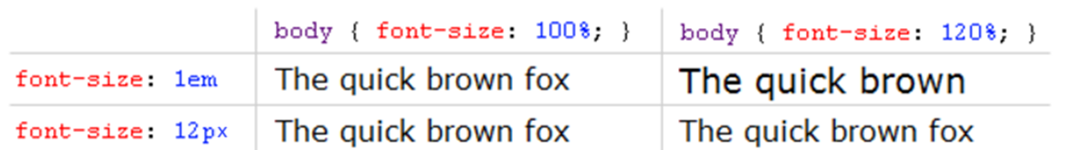
{ } That wasn’t quick
Because em is relative, that means that if the parent’s font size is increased, the children will get bigger too.

Slide 71
{ } Common font Properties
font-style: normal by default – can also be italic or oblique
font-weight: normal by default – can also be bold, or values of 100, 200, etc. (depending on the typeface)
font-family: the name of a typeface installed on the user's computer
p { font-family: Arial, Helvetica, sans-serif;
}
The W3 has a list of “web safe” fonts that most people will have installed locally

Slide 72

{ } font transform
text-transform: changes font casing. Can be uppercase (all caps), lowercase, or capitalize (first letter of all words capitalized)
letter-spacing: change font kerning by specifying the space between letters in ems (em) or pixels (px)
p { font-family: Arial;
text-transform: uppercase;
letter-spacing: 2.4px;
}

Slide 73
{ } Colors
color: changes the color of text
background-color: sets the background color of an element
Color value can be set using names, HEX, RGB, or RGBA
Name: white
Hex: #ffffff
• RGB: rgb(255, 255, 255)
• RGBA: rgba(255, 255, 255, 0.8)
Notes:
256?

Slide 74
{ } Color examples
p { color: black;
}
p { background-color: #000000;
}
p { background-color: rgb(0, 0, 0);
}
Notes:
256?

Slide 75
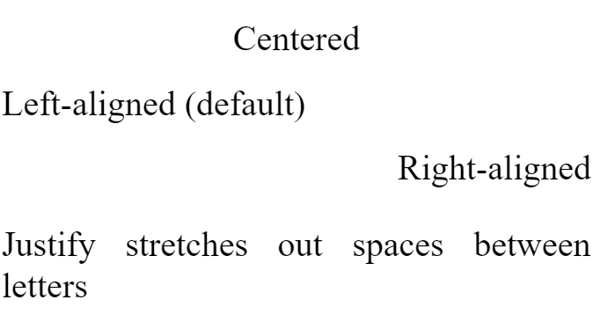
{ } Text-align
You can change the alignment of text using the
text-align property.
Values:
center
left
right
justify
h1 { text-align: center; }

Slide 76
{ } CSS COMMENTS
Just like HTML, CSS can have comments
Start with /*
End with */
<style>
/* I am a CSS comment! */
</style>

Slide 77
PRACTICE TIME!

Slide 78
Practice
Add a <style></style> section in the <head> on your page
Make some style changes using CSS
Consider changing font color, font family, font size, text alignment, and background color

Slide 79

“HOMEWORK”
Practice!
Next time you see a cool website, inspect how they did it
If you have questions during the week, feel free to email me at beckjohnson@gmail.com
Optional: read chapters 6-7 of HTML and CSS: Design and Build Websites

