Slide 1


HTML & CSS: FUNDAMENTALS OF DEVELOPMENT
Instructor: Beck Johnson
Week 3

Slide 2

SESSION OVERVIEW
Week Two review and questions
The CSS box model
Block vs inline elements
Coding from a design “comp”

Slide 3

REVIEW!

Slide 4
{ } REVIEW: EXAMPLE CSS RULE
p { color: blue; }
selector is p (all <p> tags in the HTML)
property is color
value is blue (many color names are supported, or use the hex code #0000ff)

Slide 5
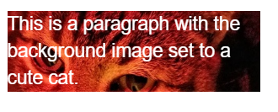
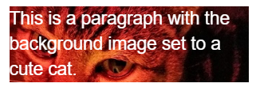
BACKGROUND IMAGES
{ } REVIEW: background images
Can set background of an element as an image (instead of a color) with the property background-image
The value is url("path"), where path is the relative or absolute path to where the image lives, like this:
p {
background-image: url("images/kitten.jpg");
color: white;
}

Slide 6
BACKGROUND IMAGES
{ } REVIEW: background images
background-position: allows you to move a background image around within its container
background-attachment: images usually scroll with the main view, but setting to fixed means the image stays in place when the user scrolls the page
background-repeat: defines if (and how) the background image will repeat
background-size: specifies how much of the container that the image covers

Slide 7


BACKGROUND IMAGES
{ } REVIEW: background images
You can set background-image to linear-gradient, which is a gradient that the browser draws for you:
section { background: linear-gradient(black, white); }
By default linear-gradient draws from top to bottom, but you can set the gradient to draw at an angle instead by starting with to
section {
background: linear-gradient(to right, red, #f06d06, yellow, green);
}

Slide 8
Height and width
{ } REVIEW: height and width
height and width can be set on (most) elements to change how much room they take up on the page.
We’ll discuss later why elements like <a> and <em> don’t change when you set their height or width
The value of this property must be a positive number.
Units are either px or em
Or you can specify a percentage
header { height: 6em; }

Slide 9
REVIEW: Linking to external stylesheet
<link href="css/styles.css" rel="stylesheet">
Tells the browser to find and load the styles.css file from the css directory
The rel attribute stands for "relation" - in this case, this link's relationship to the document is "stylesheet"
This tag goes inside the <head> element
Should be on every page that needs the styles

Slide 10
REVIEW: The “CASCADING” Part
The 3 rules for determining how styles get applied:
Styles are applied from far to near
Styles are applied from top to bottom
Children elements are more specific than parents

Slide 11




{} Styles “Location”
REVIEW: near to far
Styles that are “closer” to the elements they style take precedence
Browser default
External styles
(in a .css file)
Internal styles
(in the <head>)
Inline styles
(directly on an element)
Closer to element

Slide 12
REVIEW: Top to bottom
If the same property is styled multiple times for the same selector, the last one sticks.
p { color: #2f4251; }
p { color: #daa645; } /* this wins */

Slide 13
REVIEW: children are specific
If one style is more specific than another, it takes precedence
p { color: #daa645; } /* all paragraphs */
a { color: #e7c0c8; } /* links in general */
p a { color: #c4fe46; } /* links in paragraphs */

Slide 14
QUESTIONS?

Slide 15
{}
Css Pseudo classes

Slide 16
Pseudo selectors
A CSS pseudo-selector specifies a special state of the element we want to style
• It’s “pseudo” because the element doesn’t exist in markup – may change based on user interaction or position relative to other elements
We saw this already for hovering:
a:hover { font-size: 20px; }

Slide 17
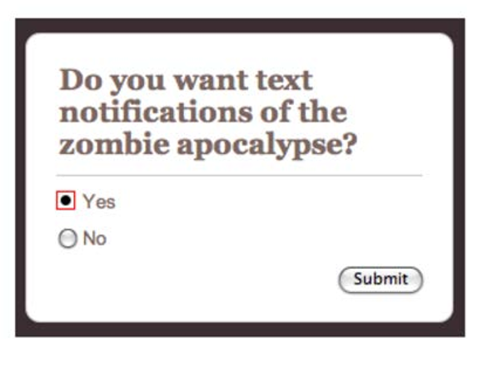
More Pseudo selectors
:focus styles an element that has the current keyboard focus, from either click or tab
:checked styles a selected radio button or checkbox

Slide 18
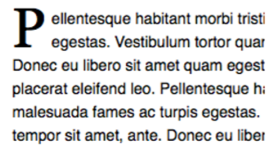
More Pseudo selectors
:first-letter styles the first letter of a block of text
:first-child and :last-child style the first and last elements of that type
p:first-letter {
font-size: 20px;
float: left;
}

Slide 19
Putting it together
a {
color: #0099CC;
border: 2px solid #0099CC;
border-radius: 6px;
padding: 16px 32px;
text-decoration: none;
text-transform: uppercase;
transition: all .4s;
}
a:hover {
color: #fff;
background-color: #008CBA;
}

Slide 20
THE CSS BOX MODEL

Slide 21
CSS BOX MODEL
Content: stuff in the box
Padding: bubble wrap and packing peanuts
Border: sides of the box
Margin: space between multiple boxes

Slide 22
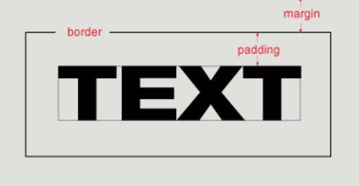
CSS BOX MODEL

Slide 23
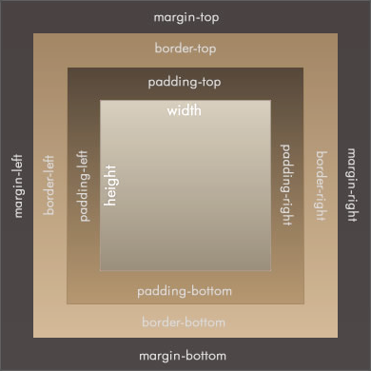
CSS BOX MODEL
Content
Padding
Border
Margin

Slide 24
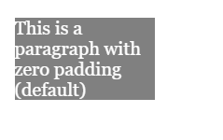
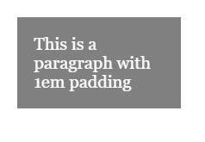
Padding
Padding is useful for moving content away from the edges of its container.
p {
padding: 1em;
}

Slide 25

MARGIN
Margin moves elements away from one another.
img {
margin: 6px;
}

Slide 26
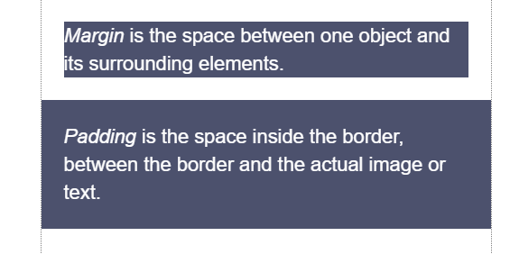
MARGIN vs. padding
Use margin to separate the element from the things that are around it.
Use padding to move the element away from the edges of the block.

Slide 27
BORDER STYLES
Between margin and padding, you can set a border
Values are separated with spaces, in this order:
Width (usually in pixels, but can be em)
Border style (solid, dotted, dashed, etc)
Color
p {
border: 2px dotted #ff0000;
}

Slide 28
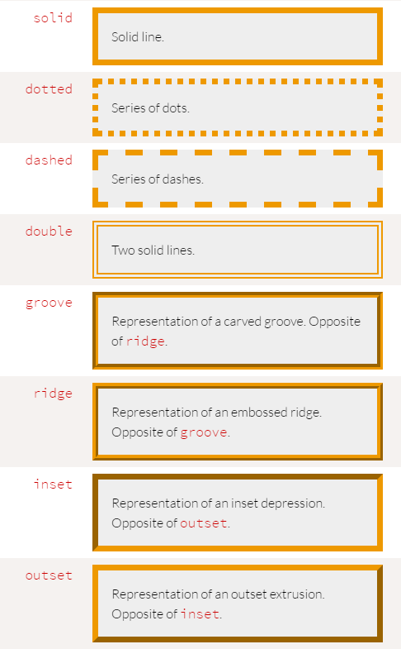
BORDER STYLES
Border styles:

Slide 29

BORDER STYLES
You can set a border on only one side of an element:
h1 { border-bottom: 3px solid black; }

Slide 30

BORDER STYLES
A common use of border is to visually separate list items in a navigation menu.
ul {
list-style : none;
}
li {
padding: 1em;
background-color: #283c51;
border-top: 1px solid #395673;
color: #adadad;
}
<ul>
<li>About us</li>
<li>Products</li>
<li>Services</li>
<li>Contact Us</li>
</ul>

Slide 31
List style
Note that we set
ul {
list-style: none;
}
to remove the bullets that appear
by default on an unordered list

Slide 32
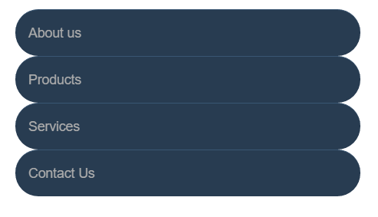
BORDER radius
To make an element appear curved, use the property border-radius
The value is a number (in px or em) or percentage
You can use border-radius even if you don’t explicitly set a border
li {
/* same styles... */
border-radius: 2em;
}

Slide 33

BORDER radius
border-radius can be used to create a circle.
Set border-radius to 50%
Set height and width to the same value
li {
border-radius: 50%;
background-color: black;
color: white;
text-align: center;
height: 3em;
width: 3em;
line-height: 3em;
margin: 5px;
}

Slide 34

BORDER radius
This technique can be used on images to crop them into a circle
Note: if the image itself doesn’t have a square ratio, it will look distorted
<img src="kitten.jpg" />
img {
border-radius: 50%;
height: 200px;
width: 200px;
}

Slide 35

PRACTICE TIME!

Slide 36
ASSIGNMENT
Add a list of links in your navigation menu
Make the navigation menu pretty by using padding, margin, border, background color, and other tricks we’ve learned.
ONLY style lists that are in the nav menu – not any lists that may appear on the rest of the page
Give your design some “breathing room” with padding and/or margin.

Slide 37
<>
Block vs. Inline Elements

Slide 38
<> Block ELEMENTS
<> Block ELEMENTS
Block elements
Expand naturally to fill their parent container
Takes up a “full line”
Can have margin and/or padding
Can have height and/or width
By default, will be placed below previous elements in the markup

Slide 39
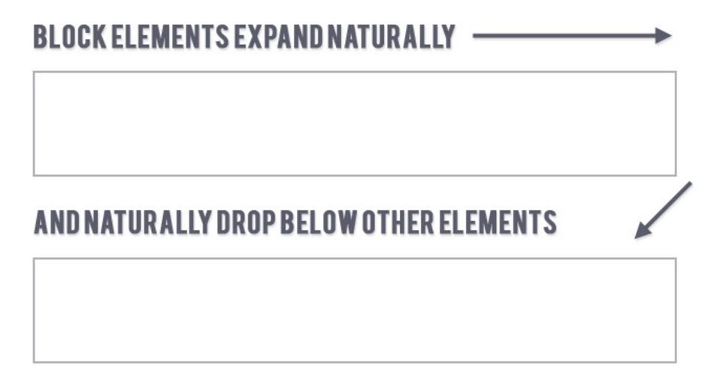
<> Block ELEMENTS
<> Block ELEMENTS

Slide 40
<> Block ELEMENTS
Examples of block elements:
Headings <h1>…<h6>
Paragraphs <p>
Lists <ul>, <ol>

Slide 41
<> INLINE ELEMENTS
inline elements
Flow along with text content
Only take up as much space as necessary
Ignore width and height properties
Margin and padding only pushes other elements away horizontally, not vertically
Top and bottom margin/padding is ignored

Slide 42
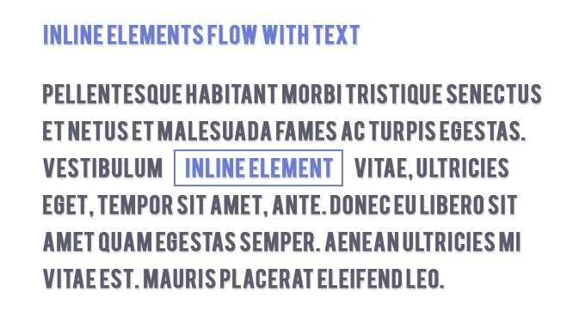
<> INLINE ELEMENTS

Slide 43
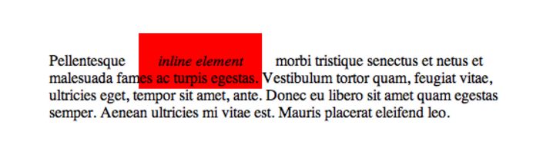
<> Block & INLINE ELEMENTS
Examples of inline elements:
Links <a>
Font emphasis <em>
Font bold <strong>

Slide 44
<> Inline block
inline-block element
Is a hybrid of inline and block
Takes up width and height like block-level elements
Flows with content
Can have margin and padding
Examples of inline-block elements:
Image <img />

Slide 45
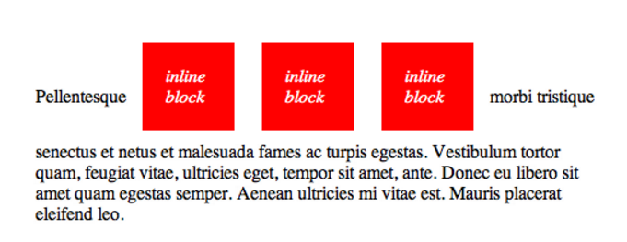
<> Inline block

Slide 46

<> Display
You can change whether or not any element is block, inline, or inline-block by using the CSS display property.
This means we can do some neat things!
li {
display: inline-block;
}

Slide 47
PRACTICE TIME!

Slide 48
ASSIGNMENT
Update your navigation to a horizontal menu using CSS.
Give the li elements a display property of either inline or inline-block. Which looks better? Why do you think that is?
Update your styles so that they look nice in the new orientation
Create an <a> link that looks like a button.
Style the button differently on hover and click

Slide 49
<html>
(MORE) HTML ELEMENTS

Slide 50
<SPAN> elements
<span></span>
A <span> is a generic inline element
No default style
Used to style inline content

Slide 51
<div> elements
<div></div>
A <div> is a generic block element
No default style
Heavily used as a wrapper for other elements, to create complex layouts

Slide 52
Why use div or span?
Both div and span really need something extra to be useful, since they have no presentation style by default.
Used mostly to create layout
Have no semantic meaning
You don’t need to “reset” them before making them fit your design (like ul or p)

Slide 53
ID & Class selectors

Slide 54
CLASSES AND IDs
CSS lets us target all paragraphs like this:
p {
font-size: 20px;
}
But what if we want to style only some paragraphs?

Slide 55
CLASSES AND IDs
You can add class and id attributes to any HTML element to identify it for styling.
You decide the class and id names – be descriptive!
<p class="important">Big text</p>
<p class="anyLettersOrNumb3rsOr_Or-">Still totally valid</p>

Slide 56
CLASSES AND IDs
Adding a class or id does nothing to an element by default.
Classes and ids don’t have any styling information by themselves
They require you to add CSS if you want styling to be applied

Slide 57
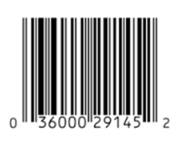

CLASSES AND IDs
Multiple elements can have the same class
A class is like a barcode – all of the same products have the same barcode
Only one element per page can use the same id
An id is like a serial number – it uniquely identifies one specific instance of a product

Slide 58
Class selectors in css
In CSS, target a class with a period
Will style all types of elements that have
that class:
.ghost { color: white; opacity: .1; }
<p class="ghost">Spooooky!</p>
<div class="ghost">This will be spooky toooo</div>

Slide 59
ID Attributes
An id can only be used once per page
Elements cannot have multiple id attributes
<div id="mainContent">
<!-- This better be the only main -->
</div>

Slide 60
ID selectors in css
<div id="lego"></div>
In CSS, target an id with a hash:
#lego {
display: block;
}

Slide 61
IDs for anchoring
If you put a hash followed by the element’s id in the URL, the browser will jump to that location on the same page:
<a href="#kittens">Proceed directly to kittens</a>
...
<div id="kittens">Meow<div>

Slide 62
ID Attributes
Q: What horrible thing will happen if you use an id twice on the same page?
A: Well…actually nothing.
But your page won’t validate
Jump links will go to whatever id appears first
And any Javascript that needs to locate that specific element will fail

Slide 63
how to choose - class or id?
If you think it’s likely or possible that you’ll want to apply the same style to multiple things, definitely use class
If your element is guaranteed to be the only one on the page, you can use id – or you can still use class
If your element needs to be linked to directly, use id

Slide 64
PRACTICE TIME!

Slide 65
ASSIGNMENT
Give an element on your page a descriptive class
Apply a special style using a CSS class selector
Style a child element of this element
Create another class and apply it to two different types of elements
Bonus points: apply to an element that already has a class. What happens if the styles conflict? How would you make sure the result is what you want?
Assign an id to an element on your page
Apply a unique style using an id selector
Create a link in your nav that jumps to that element

Slide 66
PRACTICE TIME!

Slide 67
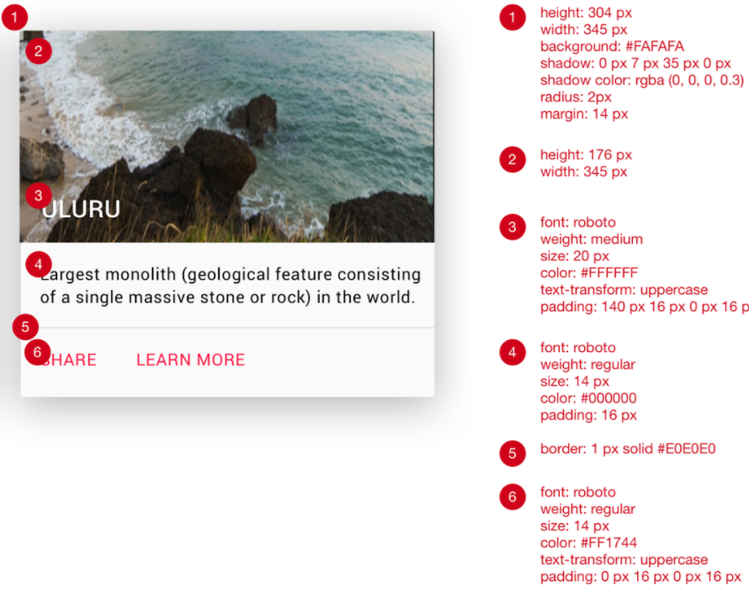
{ } match the comp
Using all the techniques you’ve learned, try to match this comp:

Slide 68
{ } match the comp: Tips
Use a <section> for the entire tile, and specify a width using CSS
Use a <header> to hold the title, and apply a background image to that element
Use this URL to generate a random nature photo:
https://placeimg.com/344/204/nature
Use a <nav> for the row that contains links, and specify a border-top using CSS
To get the drop-shadow effect, apply this CSS to the section:
box-shadow: 0 7px 35px 0 rgba(0, 0, 0, 0.3);

Slide 69

“HOMEWORK”
Practice!
Optional: read chapter 8 of HTML and CSS: Design and Build Websites
Try playing with this interactive demo of the CSS box model

