Slide 1


Introduction to HTML & CSS
Instructor: Beck Johnson
Week 5

Slide 2

SESSION OVERVIEW
Review float, flex, media queries
CSS positioning
Fun CSS tricks
Introduction to JavaScript
Evaluations

Slide 3

REVIEW!

Slide 4
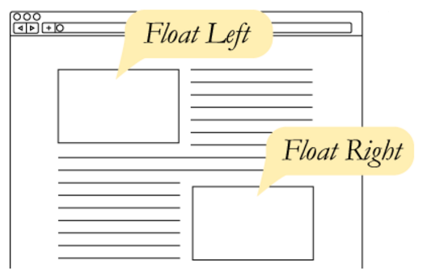
CSS Floats
The float property takes an element out of the normal flow and “floats” it to the left or right side of its container.
This allows other content
to flow around it
img { float: left; }

Slide 5
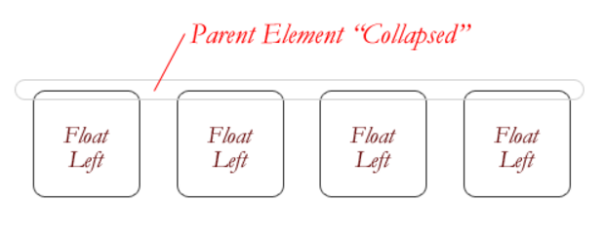
CSS Floats
The three values for float are:
left
right
none
If everything in a container is floated, then the container thinks it’s empty.

Slide 6
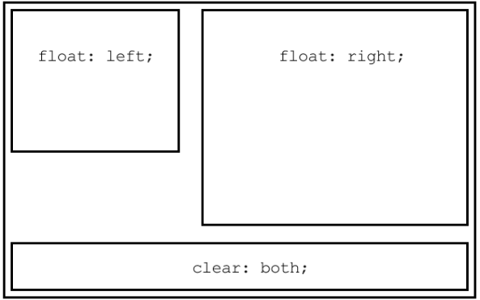
The CLEAR PROPERTY
The clear property is the sister property to float
It doesn’t do much until there are floated elements on the page
An element with clear applied to it will force itself below the floated element
Everything after that will be back in the normal flow
This “stretches” out the container and keeps it from collapsing

Slide 7
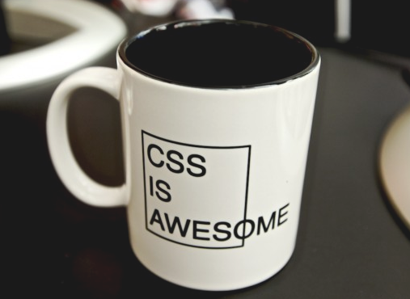
The overflow PROPERTY
overflow is a CSS property that governs how content looks when it breaks out of its container.
By default, elements have
overflow: visible,
which means all content
is fully visible.
overflow: auto
adds scrollbars when
the content is bigger than
its container.

Slide 8
Media queries
Media queries start with @media and have curly braces that contain all the CSS that applies for that case
@media (min-width: 768px) {
/* Only when bigger than tablet */
h1 { font-size: 20px; }
}

Slide 9
QUESTIONS?

Slide 10

CSS POSITIONING

Slide 11
web layout properties
display: dictates how elements behave within the box model
float: moves elements around within the page flow
position: takes elements entirely out of the page flow

Slide 12
CSS POSITIONing
The position property specifies how an element is positioned on the page. Possible values are:
static
fixed
absolute
relative
The default position is static, which just means that the element obeys whatever its box model rules tell it to do.

Slide 13
CSS POSITIONing
There are 4 directional properties that affect positioning:
left
right
top
bottom
The value is a number (positive or negative) followed by a unit.
They define how far an element is offset that direction.

Slide 14
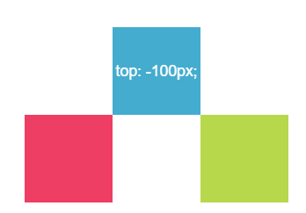
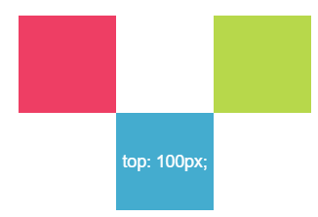
CSS POSITIONing
top defines how far an element is offset from its original top edge.
Positive top values push an element down
Negative top values push an element up

Slide 15
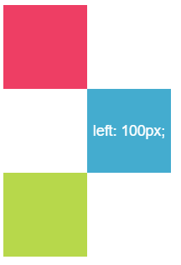
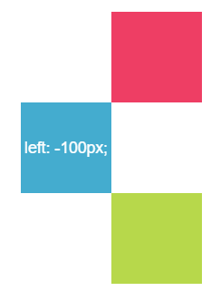
CSS POSITIONing
Similarly, left defines how far it’s offset from its original left edge.
Positive left values push an element right
Negative left values push an element left

Slide 16
POSITION: FIXED
position: fixed makes content “stick” to the browser window, regardless of where the user scrolls.
Commonly used to make headers, navigation menus, or sidebars that follow the page as it scrolls.
nav {
position: fixed;
left: 0;
top: 0;
}
Hard to describe, see a live demo

Slide 17

Fixed
This popup background uses position: fixed to grey-out the entire page, even if the user scrolls.

Slide 18
absolute
position: absolute is a powerful tool that allows you to place any page element exactly where you want it, down to the pixel
When an element has position: absolute, it is entirely removed from the normal flow of the page
That means its padding, margins, and borders no longer affect the elements around it

Slide 19
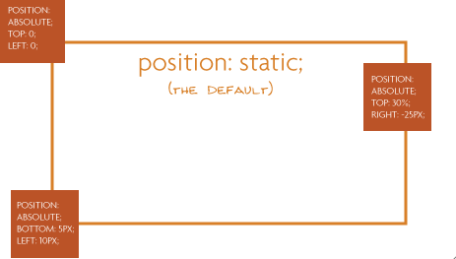
absolute
An element with position: absolute is absolutely positioned:
To its closest parent with positioning
Or if it has no parents with positioning (other than static), to the body of the page

Slide 20
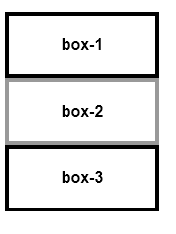
Default positioning
Remember that by default, block elements full up their entire row, and push any content to the next line, like this:

Slide 21
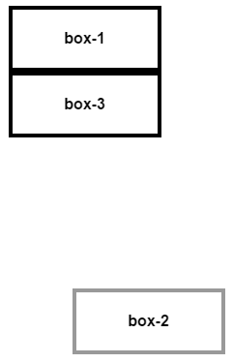
absolute
If we give box-2 absolute positioning:
#box-2 {
position: absolute;
right: 0px;
bottom: 0px;
}
box-2 is moved to the bottom right of the page
box-3 moves up to occupy the space
vacated by box-2

Slide 22

Absolute power
position: absolute is commonly used when creating page modals that pop up over other content

Slide 23
Get your z’s
When you start changing how elements are positioned, you may need to specify which ones should be “on top”, if they begin to overlap
Elements with no position declared will appear under elements that have absolute, fixed, or relative positioning
By default, the last item on the webpage will appear on top of earlier elements that have the same type of position

Slide 24
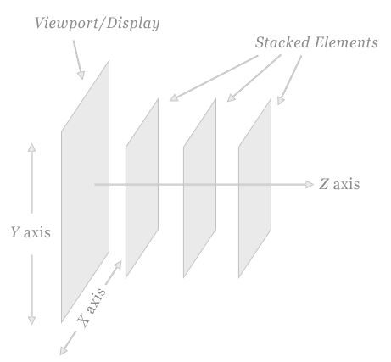
Get your z’s
The CSS property z-index can be applied to force an element with position on top of any other by giving it a higher number
By default all elements have z-index: 0
Can assign negative or positive values to z-index

Slide 25
relative
position: relative allows you to move an element using directional attributes (top, bottom, etc).
If you set position: relative but no directional attributes, the element won’t change at all
If you set top: 10px; then it will be shifted 10 pixels down from where it would normally be

Slide 26
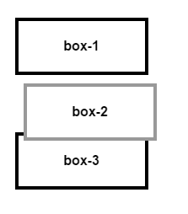
relative
box-2 has the following style, which moves it down and right:
The other boxes behave like box-2 was in its original position (unlike using negative margins).
#box-2 {
position: relative;
left: 10px;
top: 10px;
}

Slide 27
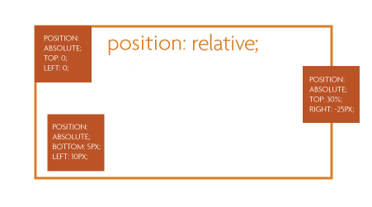
relative
More commonly, position: relative is used to position other absolutely-positioned elements inside the container

Slide 28
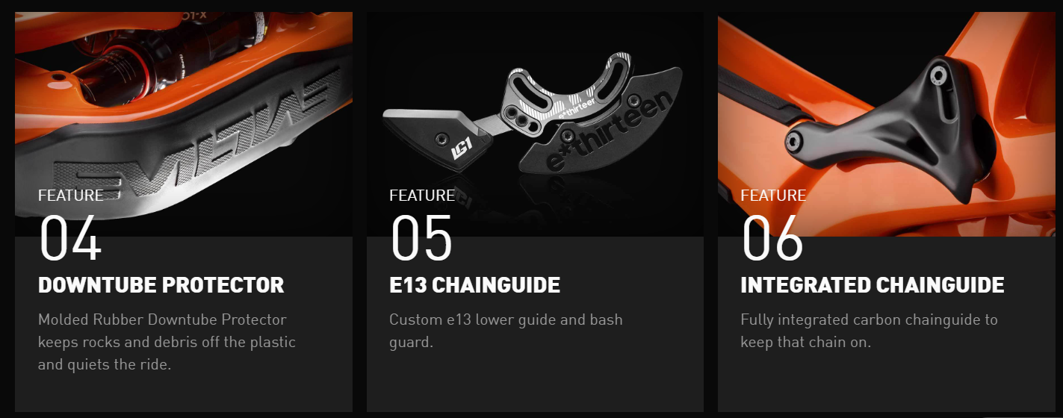
Absolute relativity
https://www.evil-bikes.com/products/following-mb

Slide 29
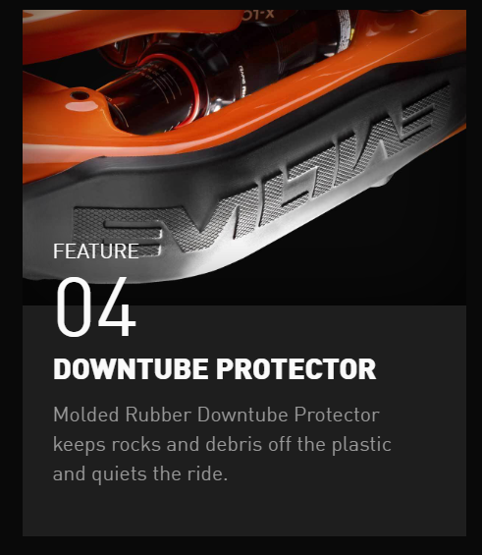
Absolute relativity
<div class="product_feature">
<div class="feature_img">
<img src="following-mb-down-tube-protector.jpg" />
</div>
<h3>
<span class="feature_header">Feature</span>
04
</div>
<div class="post_text">
<h5>Downtube Protector</h5>
<p>Molded Rubber Downtube Protector keeps rocks and debris off the plastic and quiets the ride. </p>
</div>
</div>

Slide 30

PRACTICE TIME!

Slide 31
ASSIGNMENT
Create a new page using this page as a template:
http://kweeket.github.io/dev-101/demos/modal.html
Write CSS so that the modal (the div with the class modal) appears over the boilerplate text
Apply box model properties to the content until it looks nice
Hint: Recall that you target a class in CSS like this:
.modal

Slide 32
Fun CSS tricks

Slide 33
Opacity
The opacity property changes an element’s transparency
By default, all elements have opacity: 1; meaning fully opaque
To make an element transparent, specify a decimal value between 0 and 1
h2 { opacity: .5; }
Keep in mind that opacity value will apply to all children, and they can never become more opaque than their parent!

Slide 34
filter
The filter property can be used to apply graphical effects similar to Photoshop filters on images, backgrounds, or borders.
Some options include blur, grayscale, brightness, saturate, and sepia.
Its value is one of the above options, followed by parenthesis indicating how much to apply the effect, like this:
img { filter: grayscale(1); }

Slide 35
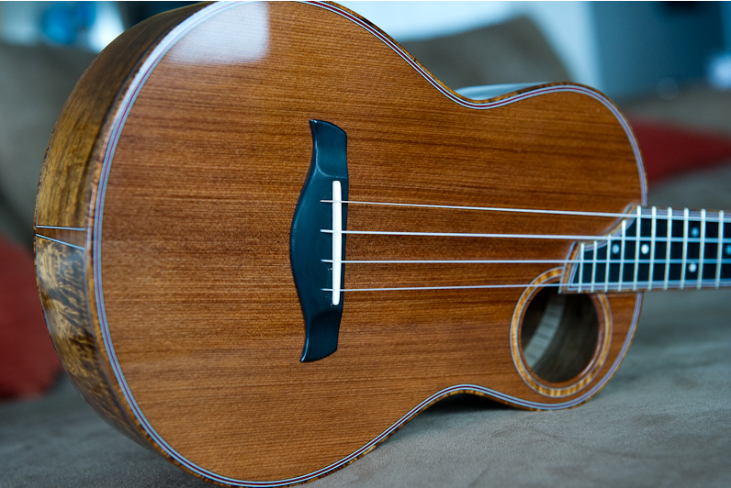
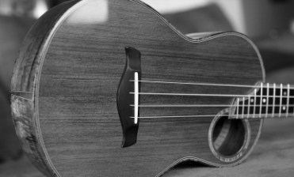
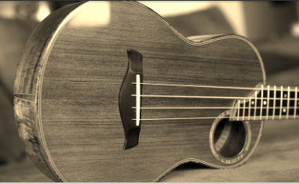
filter
filter
Original image
filter: grayscale(1);
Converts the image to gray. 1 is fully gray, 0 is original. Any value between 0 and 1 is allowed
filter: sepia(1);
Converts the image to sepia. 1 is fully sepia, 0 is original. Any value between 0 and 1 is allowed

Slide 36
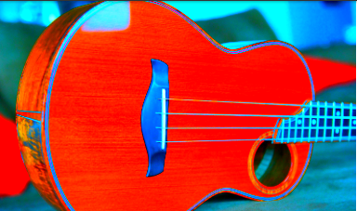
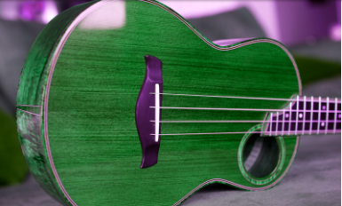
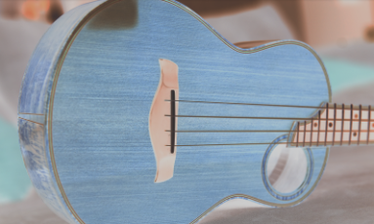
filter
filter
filter: saturate(8);
Larger values are more saturated. Anything under 1 will make the element less saturated than the original
filter: hue-rotate(90deg);
Must be an angle of rotation in degrees, that will affect how far around the color circle the input is adjusted
filter: invert(.8);
Must be a percentage. Flips RGB values by that amount

Slide 37
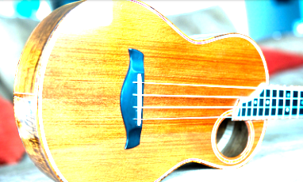
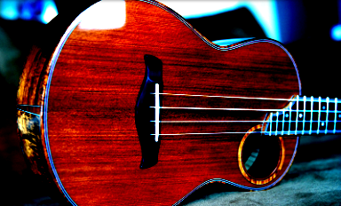
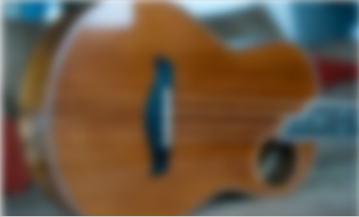
filter
filter
filter: brightness(3);
Larger values are brighter. Anything under 1 will make the element darker
filter: contrast(4);
Larger values apply greater contrast. Anything under 1 will apply less contrast than the original
filter: blur(5px);
Applies a Gaussian blur. The px value is how many pixels will blend into each other

Slide 38
Animate
To allow elements on your page to animate using CSS, use the transition property
By default, an element that transforms will change abruptly – for example, when you changed the text color of links using :hover
transition makes those changes occur smoothly over time, instead of suddenly

Slide 39
Animate
Animate
nav { transition: all 1s; }
This means, animate all CSS properties that happen to nav for 1 second
The first value: which CSS properties can be animated
The second value: how long the animation should take to finish
Separate the values with spaces

Slide 40
Animate
Animate
Until there is a CSS property that changes, transition won’t have any noticeable effect
Remember that you can give any element a different style when the user hovers on it
Use the CSS rule :hover
This will allow us to see the animation effect as the style changes from one value to another

Slide 41
Filter on hover
img {
filter: grayscale(0);
transition: all 1s;
}
img:hover {
filter: grayscale(1);
}
Note that a grayscale of 0 (ie, none) is applied to the “normal” image. This allows the transition to run both when the user hovers and when they move their mouse away

Slide 42
transformation
The transform property lets you manipulate an element by skewing, rotating, moving, or scaling
Like filter, the value is the type of transformation you want to apply, with the degree of transformation inside parentheses
.bigger {
transform: scale(20);
}

Slide 43
transformation
transform options include:
scale – changes the size of an element
skew – tilts the element
rotate – rotates the element a specified number of degrees
translate – moves an element

Slide 44
transformation
Potential uses for transform:
Flip an arrow when sorting or expanding a menu
.toggle {
transform: rotateZ(0deg);
transition: all .11s;
}
.toggle:hover {
transform: rotateZ(180deg);
}
For a live example, see the Starbucks footer at mobile

Slide 45
transformation
“Lift” a card when the user interacts with it
.card {
transform: scale(1);
transition: all .15s ease-in;
}
. card:hover {
transform: scale(1.01);
}
For a live example, see the Dignity Memorial website

Slide 46
Practice time!

Slide 47
Play with animation
Apply transition to at least one element on your page
Give that element a different style on hover so that you can see the animation occur
Apply filter or transform to at least one element on your page
Play with all the possibilities!
Reference https://robots.thoughtbot.com/transitions-and-transforms to see more options for transform

Slide 48

Overview of javascript

Slide 49

What is javascript?
JavaScript is a programming language that runs in your web browser
Can manipulate any element on the page
Can listen to user interaction, such as button clicks or scrolling the browser window

Slide 50
Where to put javascript?
JavaScript goes inside a new tag called <script>
Just like how anything inside a <style> tag is expected to be a different “language” than your HTML document (CSS), everything inside a <script> tag is expected to be in the Javascript language
Unlike malformed CSS, you’ll see red errors in the console if the browser can’t understand how to read things inside <script>

Slide 51
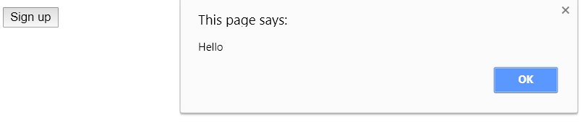
Javascript example
<button id="signup">Sign up</button>
<script>
var signupButton = document.getElementById("signup");
signupButton.addEventListener("click", function(){
alert("Hello");
});
</script>
See a live demo

Slide 52
What is jquery?
jQuery is a popular Javascript library that makes it easy to locate and manipulate elements
Uses CSS syntax to locate DOM elements
Handles browser inconsistencies (so that you don’t have to)
Simplifies many common tasks

Slide 53
Using jquery
To be able to use jQuery, you have to include a link to the Javascript file that contains the jQuery library
Like web fonts, the easiest way to get started is to link to a CDN:
<script src="https://code.jquery.com/jquery-1.12.4.js"></script>

Slide 54
Jquery example
<button id="signup">Sign up</button>
<script>
var signupButton = $("#signup");
signupButton.click(function(){
alert("Hello");
});
</script>

Slide 55
Better Jquery example
<a class="menu-toggle">Top level menu</a>
<ul class="menu">
<li>Menu item</li>
<li>Menu item</li>
<li>Menu item</li>
</ul>
<script>
$(".menu-toggle").click(function(){
$(".menu").slideUp();
$(this).next(".menu").slideDown();
});
</script>
See a live demo

Slide 56
Jquery provides easy animations
jQuery makes showing or hiding elements very easy, and provides a bunch of animation options as well
Show/hide
Fade in / fade out
Slide down / slide up
Each of these options can be given a duration (how long the animation lasts) and a speed (called “easing”, which can vary over time)
See some jQuery animation examples

Slide 57
“the end”

Slide 58
End times
I will be keeping all slides and demos up on the class site indefinitely
You can continue to ask me questions anytime at beckjohnson@gmail.com

Slide 59
That's ALL FOLKS!
Please provide feedback for this class!
http://svcseattle.com/evaluation

