Slide 1
(U) FLYTHRU Plans
Wally Westlake
Principal Mechanical Engineer

Slide 2
(U) FLYTHRU Plans
FLYTHRU Requirements:
What does it need to do?
Approach:
How?
Interface:
Database
API Calls
Testing:
With close agreement in the delayed source and transmission, rest of problem is geometry, answers should be very close

Slide 3
FLYTHRU Requirements*
Prompt
Calculate prompt environment (any available in RES)
Calculate at follower location relative to intercept of leading RB
Assume same trajectory with time offset, downrange offset, crossrange offset
Calculate prompt environments as a function of leading RB altitude at intercept
Specify minimum, maximum, and number of altitudes for calculation
Sustained (Delayed) Radiation
Calculate integrated delayed dose (integral and dose rate) for along RB trajectory for follower weapon as it “flies through the debris cloud” (FLYTHRU)
Environments
Total Ionizing Dose in silicon (n, g, 2g)
Number fluence
Others:
Energy Fluence
1 MeV equivalent fluence
Fission Heating?
* FLYTHRU System Requirements Document 8/2018

Slide 4
Approach: Prompt
Geometry
Calculate slant range and angle based on time offset, down/cross range offset
Options:
Assume velocity is constant from leading RB altitude to following RB altitude – Calculate distance up trajectory using constant velocity
Integrate distance using velocity as function of time from intercept altitude up to time offset
Environments
Use RES to calculate environment at point using slant range and angle
Same calculations apply when looping over intercept altitude
Time
Offset
Leading RB Intercept Alt
Crossrange
Offset
Downrange Offset

Slide 5
Approach: Sustained Radiation
Geometry
Sustained radiation comes from fission debris cloud (fireball at early times)
Expands in radius as function of time
Rises vertically as function of time
Spherical at early times, toroidal at late times
Integration
Find time of closest approach
Subdivide time from leading RB intercept to follower RB reaches desired HOB into time steps
Makes sure time steps include time of closest approach
Calculate dose rate at each time using:
Debris Cloud Geometry data
Emission rate from debris cloud
Transport from debris cloud to target
Time
Offset
Debris Cloud rising with time
Crossrange
Offset
Downrange Offset
Time of Closest Approach

Slide 6
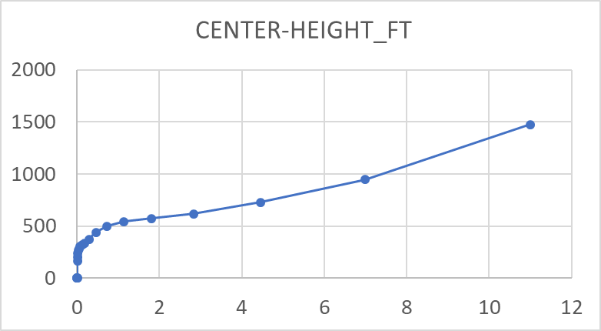
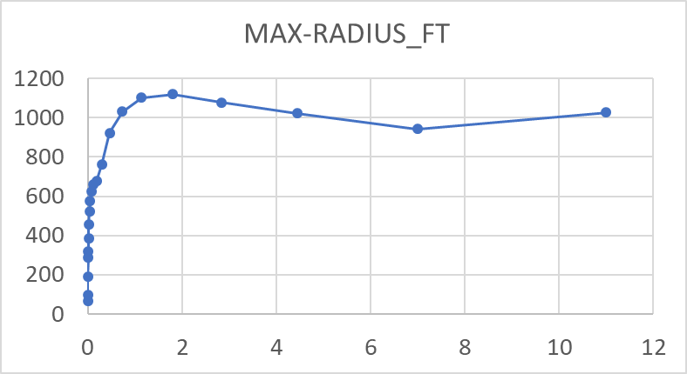
Debris Cloud Geometry Data
Proposed Debris cloud geometry (modified point source with evacuated fireball)
Spherical geometry of debris cloud from MAZe hydrocode runs
Height and radius versus time as a function of intercept (or builder) yield and height of burst
Interpolate size on yield, height of burst, time
Radiation source located on sphere of debris within fireball
Spherical evacuated fireball at lower density than ambient
Data stored in SQL database with environments
Yld = 0.1kT - 30 Mt, SHOB = 0-2000 ft/kT^1/3, t = 0-60 s
RhoR = RhoR in Fireball +
Ambient RhoR from surface
Slant range
Based on debris sphere
To target

Slide 7
Delayed Neutron/Gamma Emission Rate
Emission Rate
Fission debris emits neutrons and gammas at a time dependent rate that is proportional to the amount of fission during the detonation – This is the radiation source
Three (or more) sources of emission rate data
STYOUT has emission rate curve fit to experimental data
Nuget/eNWEDS used data from running CINDER calculations
Direct experimental data (Fisher-Engel)
STYOUT data does not include neutrons or spectra information
CINDER results from isotopes activated by fast neutron spectrum, ENDFbVII cross sections
Proposed
Use CINDER data, interpolate rate vs time

Slide 8
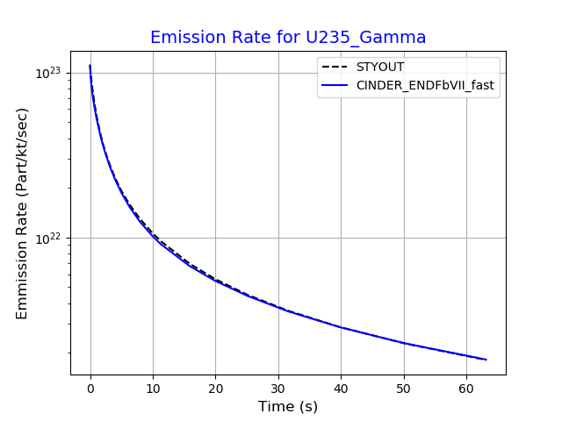
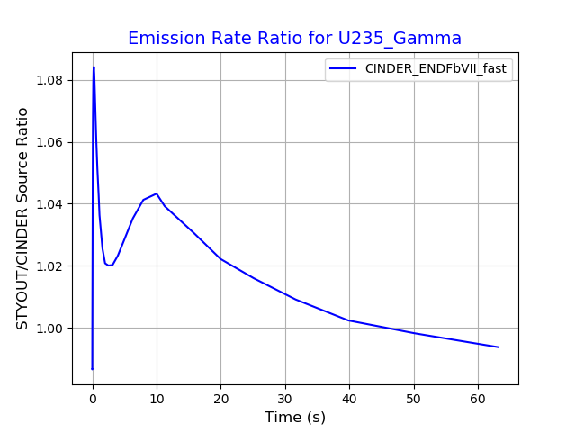
Delayed Source Rate – U235
Almost Exact Agreement for U235

Slide 9
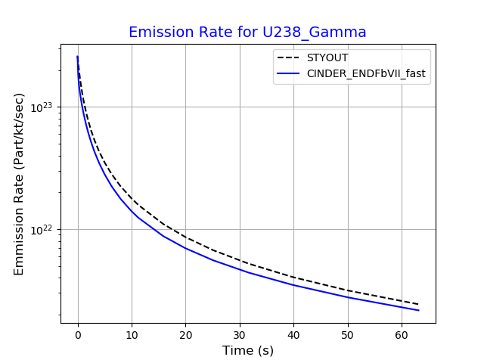
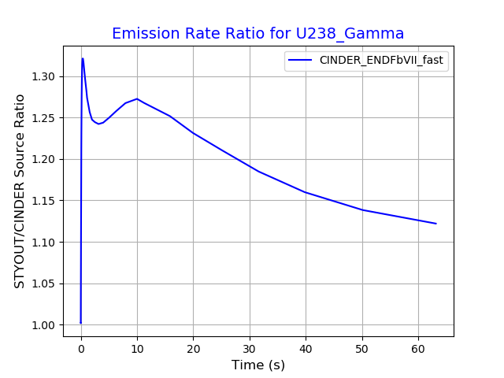
Delayed Source Rate – U238
Slightly higher for STYOUT – 15-30% higher

Slide 10
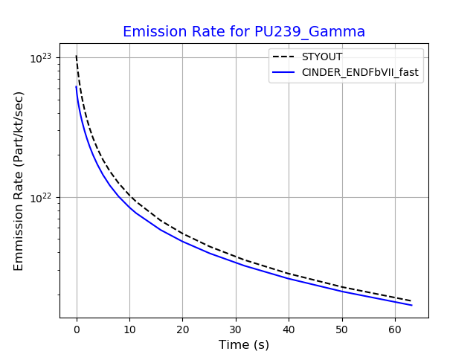
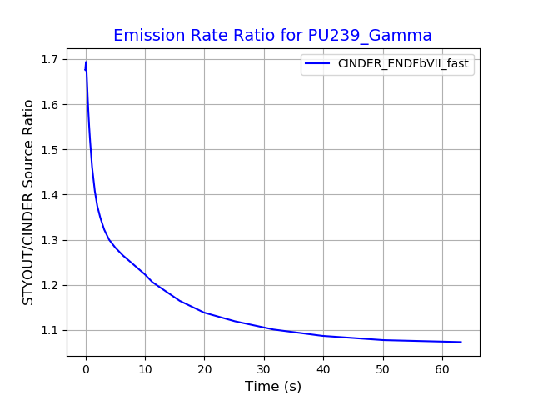
Delayed Source Rate – U239
STYOUT predictions up to 1.7x higher at early times

Slide 11
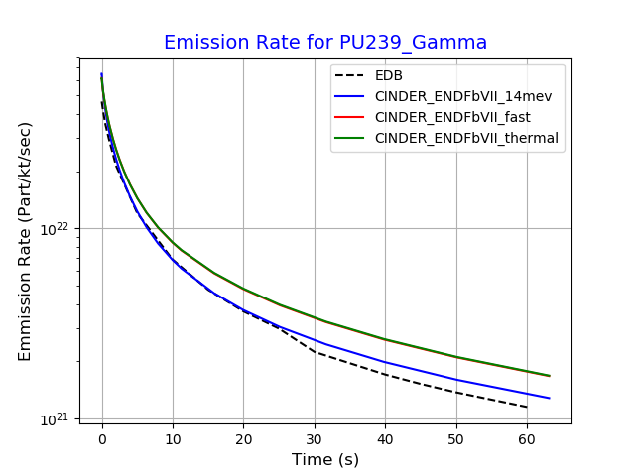
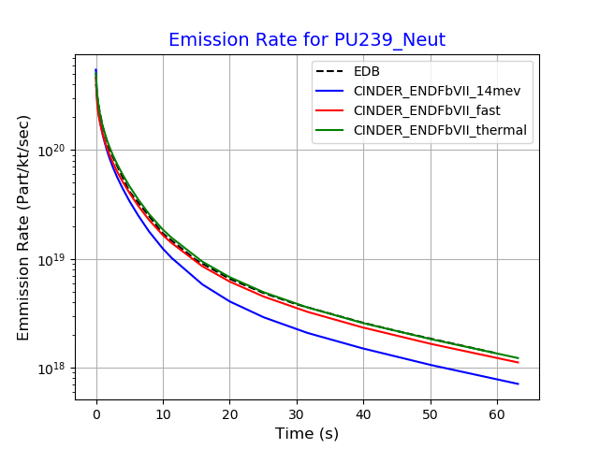
Experimental Data vs CINDER Data - Pu239
EDB is Fisher-Engle Data (original eNWEDS data)

Slide 12
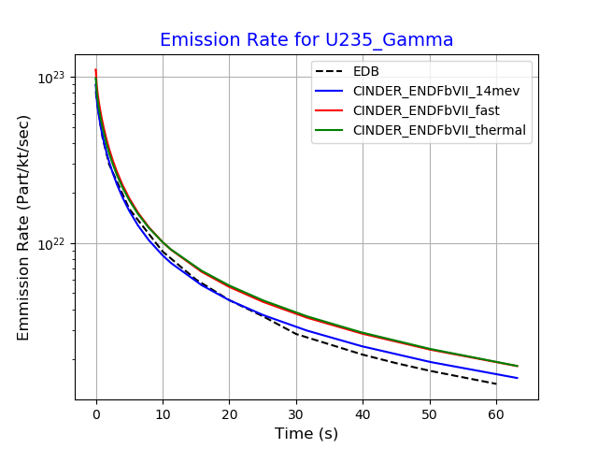
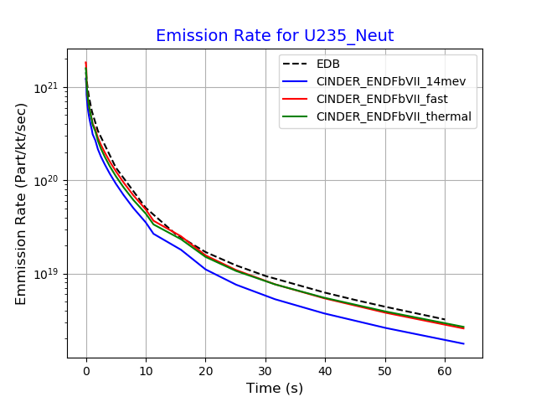
Experimental Data vs CINDER Data – U235
EDB is Fisher-Engle Data (original eNWEDS data)

Slide 13
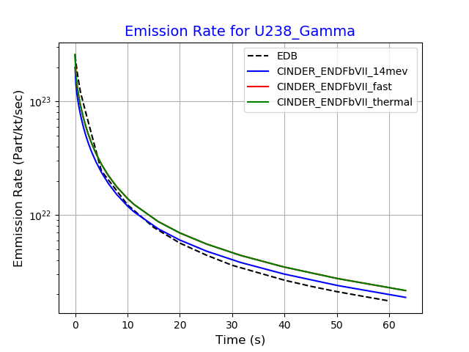
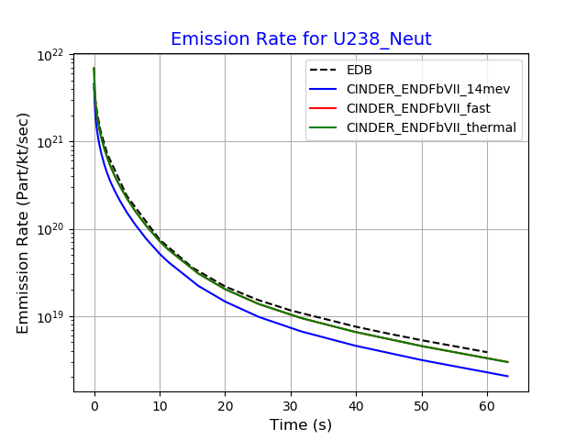
Experimental Data vs CINDER Data – U238
EDB is Fisher-Engle Data (original eNWEDS data)

Slide 14
Radiation Transport
Predict amount of radiation reaching target given divergence and atmospheric scattering, extinction, and moderation
STYOUT has single “build-up” factor curve as function of integral density (rhor)
Only applies to primary gammas
Unsure of origin
Legacy FLYTHRU used RANC methodology, presumably fits to DO calculations
eNWEDS uses transmission matrices calculated with MCNP/ADVANTG
Primary/Secondary Gamma and neutrons
Delayed source spectra folded with transmission matrices provides precalculated Dose/Fission Yield as a function of Slant range/RhoR and time after burst
Ionizing dose in Si, Fluence, and 1-MeV fluence precalculated and already loaded in Sqlite database
Could add other response types (fission heating) by folding with transmission matrix
eNWEDS data can be applied to any altitude with mass-integral scaling
Propose using eNWEDS transmission data for radiation transport
Precalculated dose/kt curves as function of time, isotope, and response function

Slide 15
(U) Comparison of STYOUT delayed radiation with eNWEDS
Delayed Build-up Factor from STYOUT:
Ratio of dose at source divided by 4πR²Dose as a function of density (ρR)
eNWEDS Build-up factor is based on delayed source spectra at early time = 1.e-6
No information about STYOUT spectrum, eNWEDS uses isotope and time-dependent spectrum
Even with these uncertainties, agreement is very close within 300 g/cm2

Slide 16
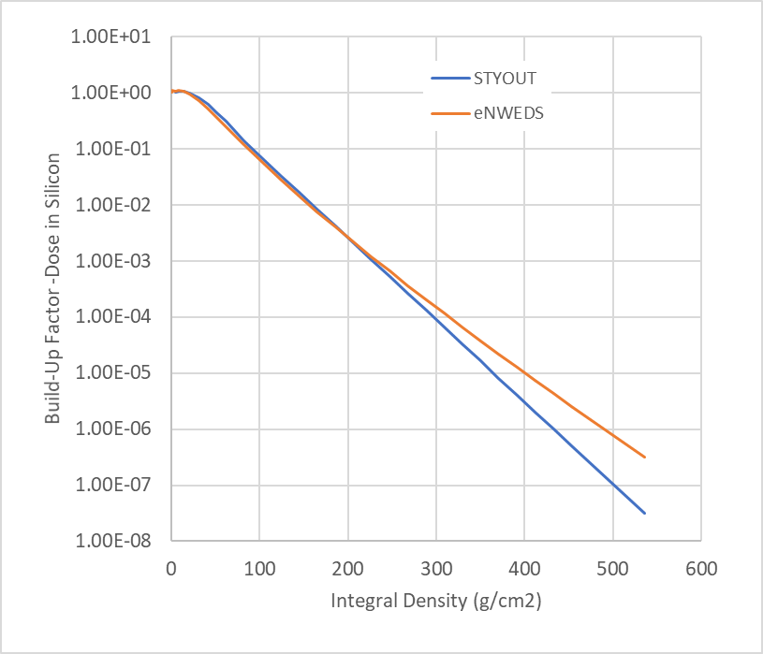
Compare Radiation Transport (build-up factors) for STYOUT
eNWEDS versus STYOUT build-up factors - Good agreement in main region of interest ( < 300 g/cm2) (10 kft slant range near ground)
Ratio of dose at source divided by 4πR²Dose as a function of density (ρR)
No information about STYOUT spectrum, eNWEDS uses isotope and time-dependent spectrum

Slide 17
Genfit_dose.dll Interface
To do a prompt dose calculation
constructDatabase(handle);
openDatabase(handle, filename, fname_len );
setDevice(handle, primDevice, primDeviceYield, secondDevice, secondDeviceYield);
addEnvironment(handle, dosekind, kindEnv, ishld, constraintvalue, neutronflag, gammaflag, secondarygammaflag, xrayflag);
setGeometry(handle, heightofburst, angle);
calculateDoseToRange(handle, slantrange, dose);
To do a delayed dose calculation on a trajectory
constructDatabase();
openDatabase();
setDevice();
addEnvironment();
setTrajectoryGeometry( handle, heightofburst, velocity, gamma, downrange, crossrange, timeoffset );
calculateDelayedDoseTraj(handle, dose);

Slide 18
Interface (cont)
To do a delayed dose calculation non-moving target
constructDatabase();
openDatabase();
setDevice();
addEnvironment();
calculateDelayedDose(handle, slantrange, dose);
Or calculateDelayedDoseX(handle, hot, xrange, dose);

Slide 19
Status of New FLYTHRU
Data
Debris cloud data loaded into RES database
Transmission data loaded into RES database
Code
Interface calls added to “Genfit_dose.dll”
Interpolation of debris cloud geometry complete
Dose calculation using mass integral scaling complete
Code complete for delayed dose integration along straight line trajectory
Code complete for delayed dose for non-moving target
Testing
Delayed dose for non-moving target running and comparing reasonably well with eNWEDS
Delayed dose verification with Nuget shows close agreement for similar modeling assumptions
Delayed dose along trajectory working, preliminary verification with Nuget
More detailed analysis needed

Slide 20
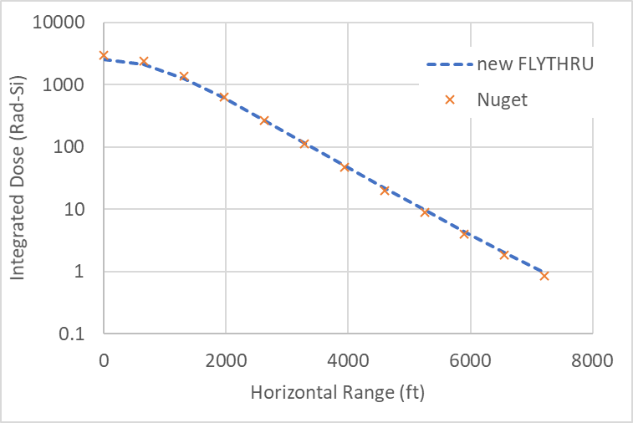
Verification with Nuget – Non-moving Target
20 kt builder at 4000 ft altitude
Non-Moving target at 2000 ft altitude, Dose integrated over 0-60 seconds
Horizontal range varied from 0 – 7200 ft
Many delayed options in Nuget: This Nuget run used LAMB debris cloud, KSC source definition, point source geometry with normal air transport, only one other option tried
Non-moving verification takes out complexity of fireball geometry and trajectory
Very good agreement for source rates, and transport calculations

Slide 21
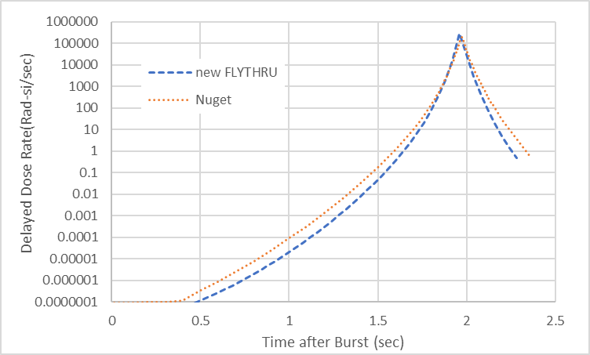
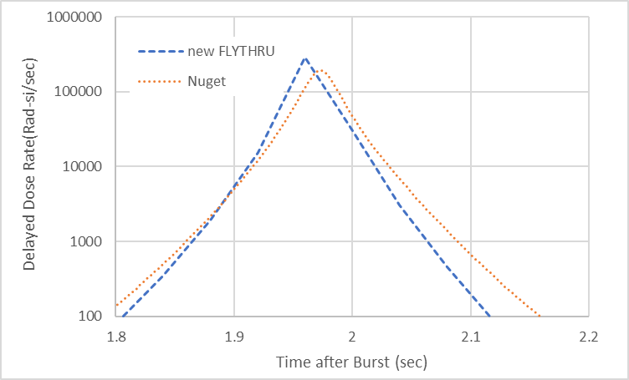
Verification with Nuget - Trajectory
20 kt builder at 4000 ft altitude
Nuget unclassified trajectory with VRE = 25500, GRE = 45
Time offset = 2 seconds, Downrange offset 500 ft, Crossrange offset = 0 ft
FLYTHRU prototype used constant velocity averaged over time from time of leading RB intercept to follower RB reaching HOB.
Probably need to add capability for time varying trajectory
Nuget – Integrated dose = 8196 Rad-Si, new FLYTHRU = 9709 Rad-Si
This was a rough first try, need to examine trajectory and debris cloud geometry in detail
Zoom in on Peak

Slide 22
Tasks to complete FLYTHRU
Code integration
Add trajectory inputs to RES input XML file
Calculate geometry for FLYTHRU prompt slant range and angle
Add FLYTHRU run mode to RES
Add looping over leading RB intercept altitude
Add delayed calls from RES to genfit_dose.dll
Testing
Unit tests for all trajectory inputs
Unit tests for delayed dose calculations
Algorithm
Optimize time steps based on time after burst and slant range

Slide 23
Tasks for FLYTHRU (cont)
Verification
Detailed Comparison delayed dose results with other codes (FLYTHRU, STYOUT, Nuget, …)
Data
Compare debris cloud geometry with thermal fireball data from eNWEDS – Thermal fireball data has more yields, heights of burst. Debris cloud size and height might not be smooth for low HOB due to dust sweep-up?
Add Fission heating and PDOI responses to transport data?
Port non-spherical cloud debris geometry from eNWEDS and optimize?

