Slide 1
Social-Affective Prediction (SAP) Control Task Egg Task

Slide 2
Practice Task Slides (12 trials)

Slide 3
Welcome to the Egg task.
Your goal in this task is to buy as many fresh eggs from the egg farmer for your store as possible. You want to get a good variety of eggs. Some of the eggs are more sensitive and get rotten more easily however. For good eggs you will receive money when reselling them at your shop. When you buy bad eggs you loose money because you cannot resell them.
Because there are different sorts of eggs, you have to learn which ones are more likely to be rotten and which ones are more likely to stay fresh.
Try to make as much profit as possible by collecting as many and a high variety of fresh eggs as possible.
To make it easier to distinguish between the different eggs, we reused some of the faces from the last task you played. The faces have nothing to do with the task itself. This is a profit task.

Slide 4
POINTS
If an egg that you buy is rotten, you will loose money and a point. If you refrain from collecting an egg that would have been fresh, you also loose a point. You gain points if you buy fresh eggs or correctly refuse rotten eggs offered by the farmer.
If you can reach 50 points across all tasks you will earn an additional 5 AUD on top of the participation reimbursement.
If you reach 100 points across all tasks you will earn an additional 5 AUD on top of the participation reimbursement and the 50-point bonus.
After each task you will learn how many points you accumulated.

Slide 5
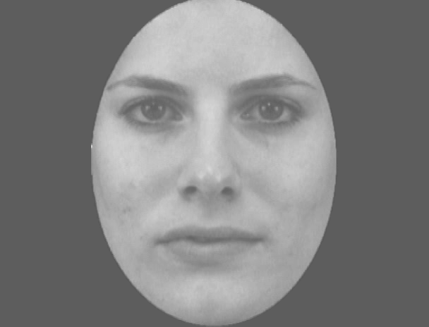

Slide 6
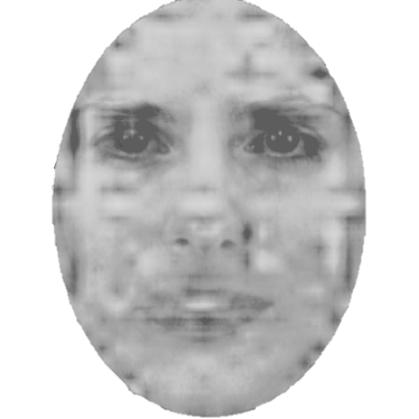

Slide 7
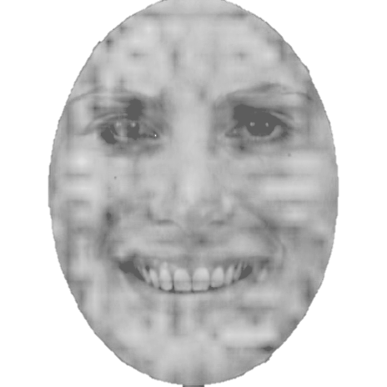

Slide 9
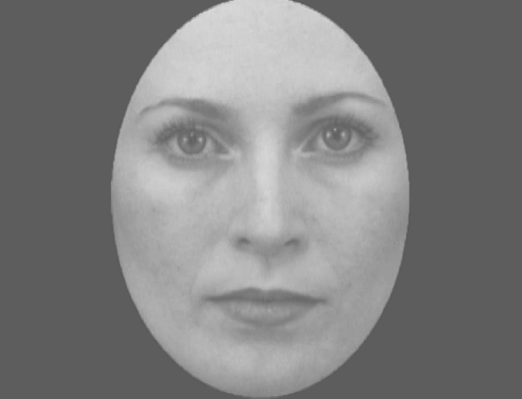

Slide 10
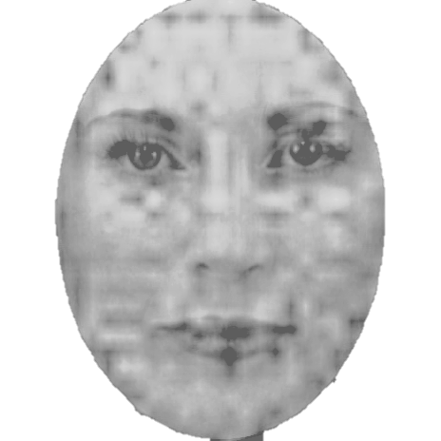

Slide 11
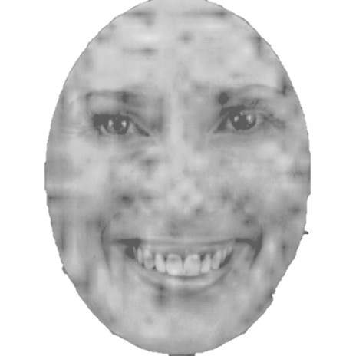

Slide 13
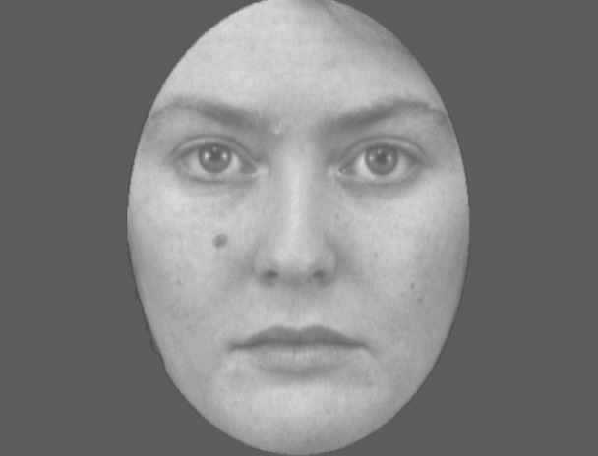

Slide 14
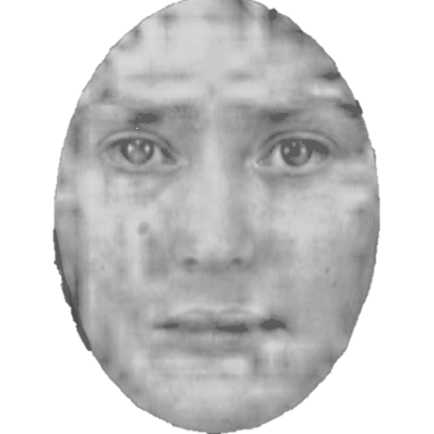

Slide 15
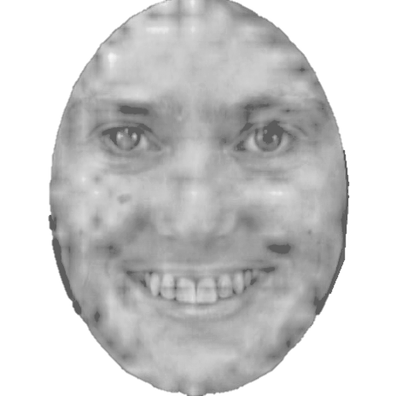

Slide 17
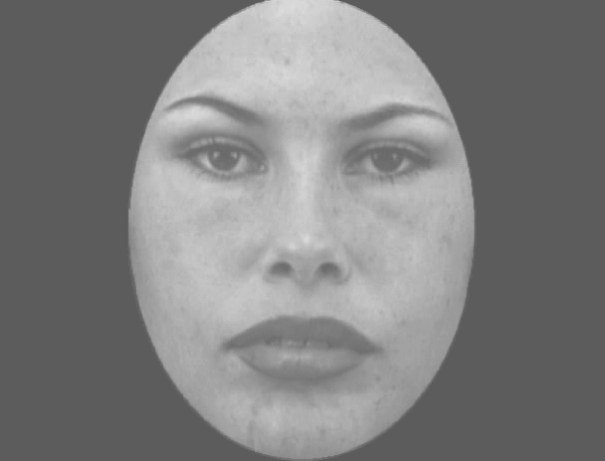

Slide 18
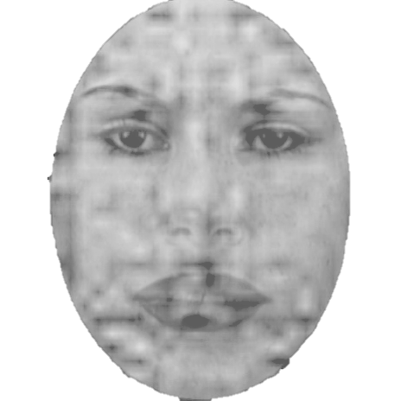

Slide 19
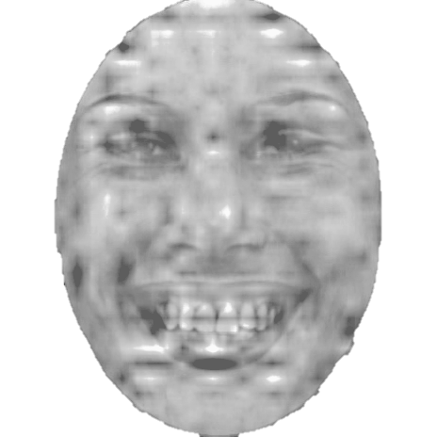

Slide 21
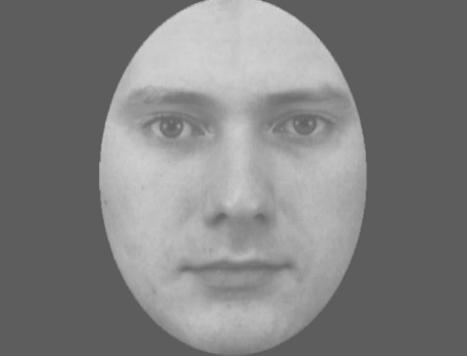

Slide 22
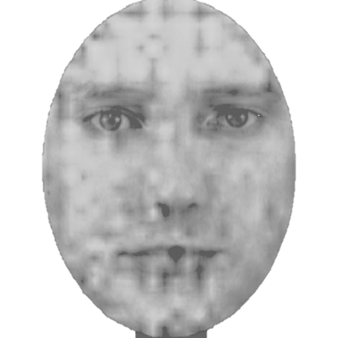

Slide 23
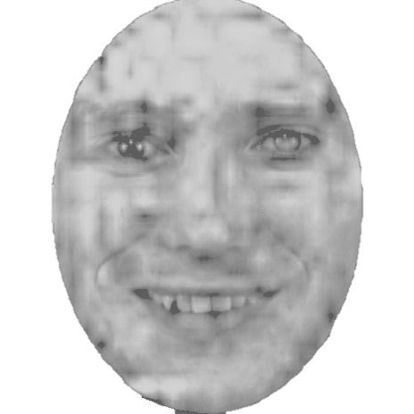

Slide 25
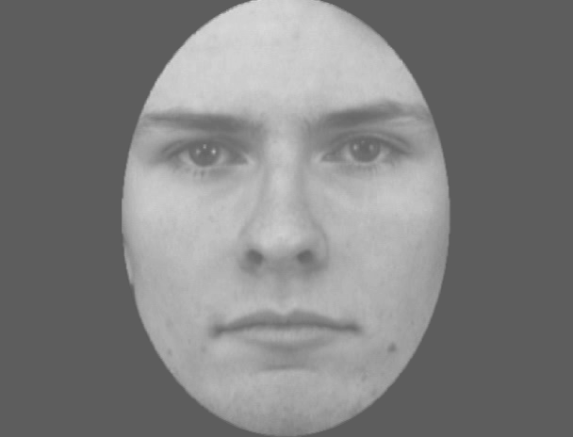

Slide 26
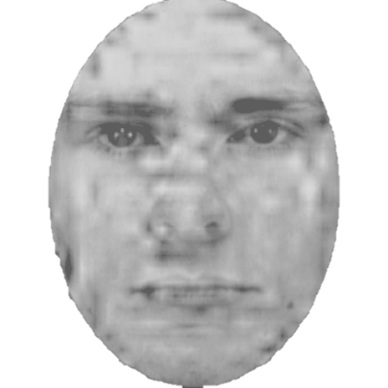

Slide 27
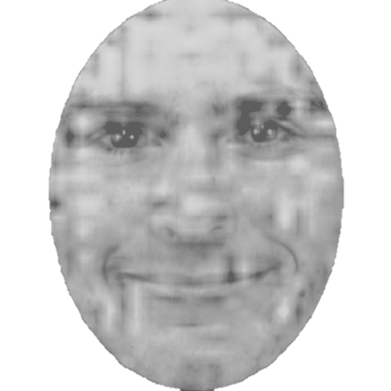

Slide 29
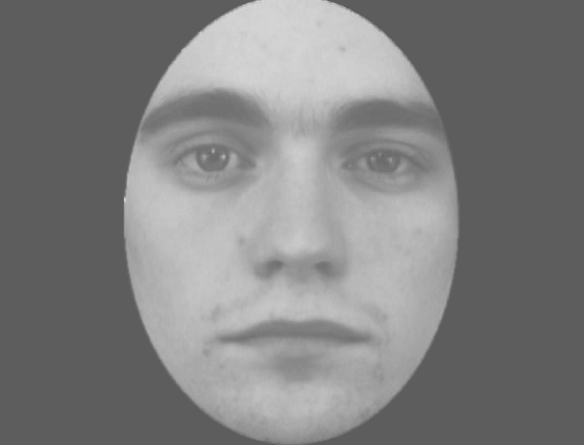

Slide 30
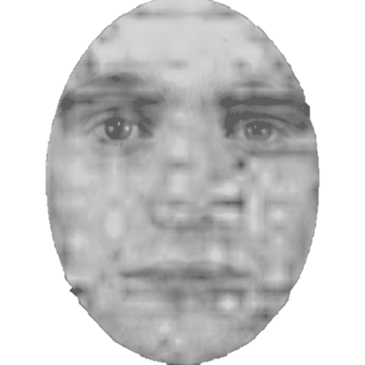

Slide 31
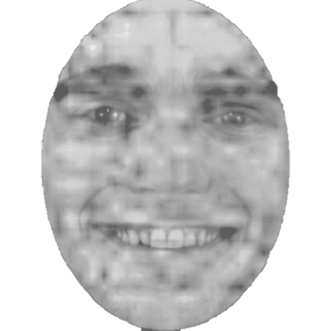

Slide 33
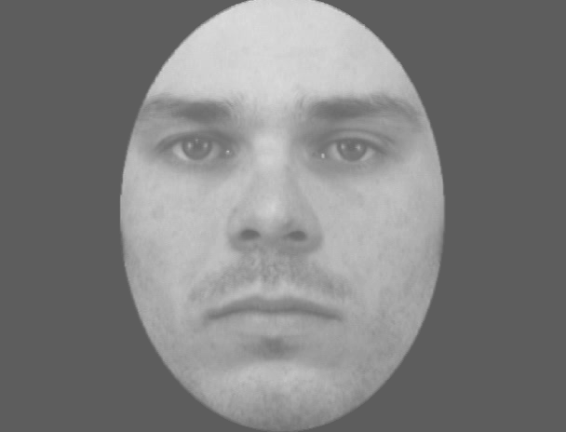

Slide 34
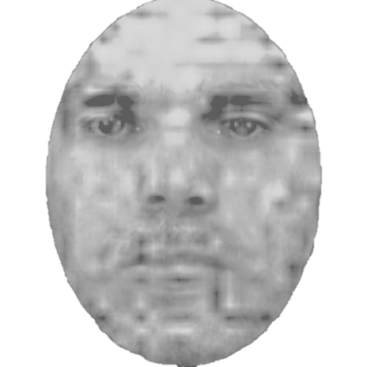

Slide 35
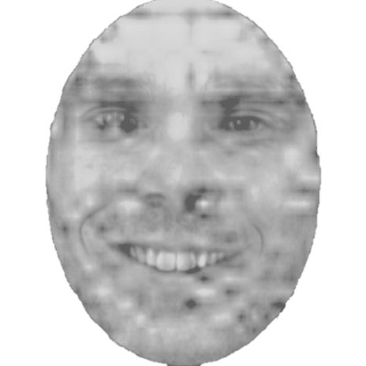

Slide 37
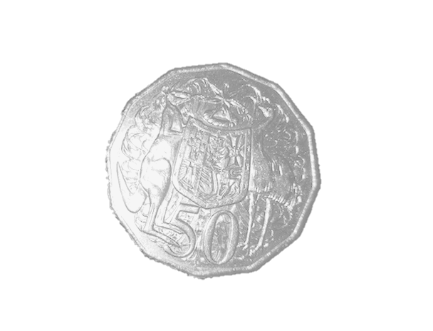

Slide 38


Slide 39
+

Slide 40
+ 1

Slide 41
- 1

