Slide 1
Social-Affective Prediction (SAP) Task

Slide 2
Practice Task Slides (12 trials)

Slide 3
Welcome to the Practice Round of the SAP task.
In the following you will be able to practice the SAP task. The instructions will be more detailed here than in the MRI. You can ask questions at any time!
This is the general setup of the task:
1. You will see a face
2. You are asked how likely this person is to smile back when receiving a smile
3. You are asked to smile or keep a neutral face and indicate that with a button press
4. You smile or keep a neutral face
5. You then see the face smiling back at you or staying neutral
6. You receive a point if you smiled and got a smile back or if the face stayed neutral when you also stayed neutral.
Your goal is to predict accurately, whether a face will smile back at you or not.

Slide 4
POINTS
If you predict accurately and smile at faces that smile back and stay neutral with faces that stay neutral in return, you will make points.
If you can reach 80 points you will earn an additional 5 AUD on top of the participation reimbursement.
If you reach 120 points you will earn an additional 5 AUDon top of the participation reimbursement and the 80-point bonus.

Slide 5
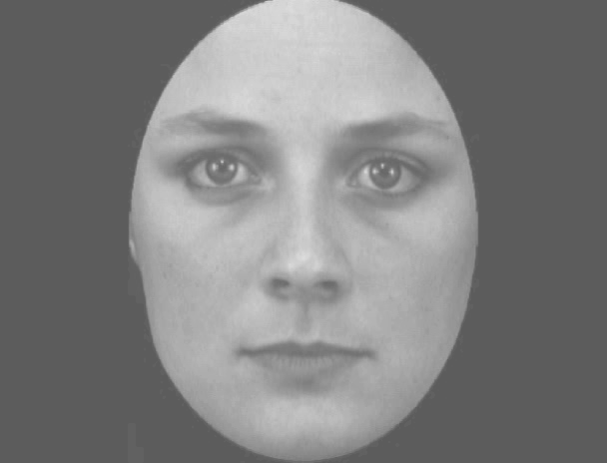

Slide 6
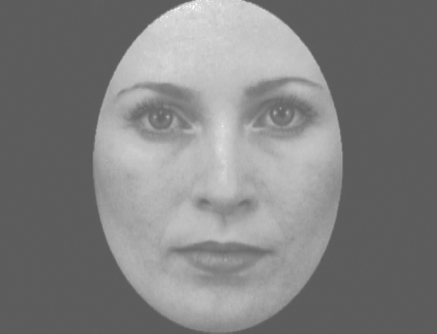

Slide 7
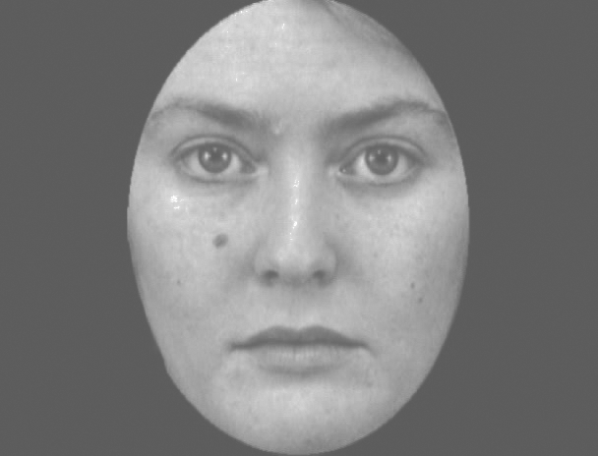

Slide 8
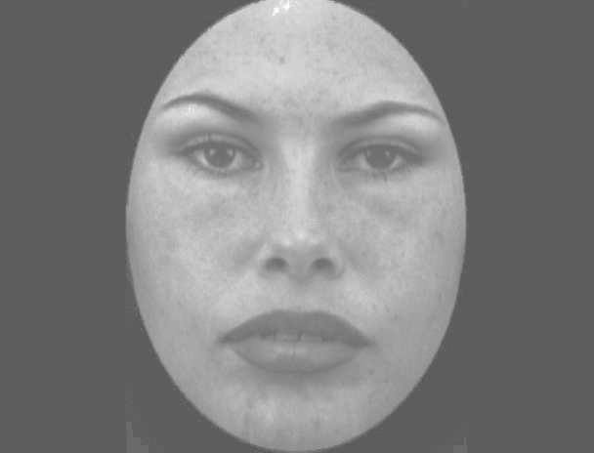

Slide 9
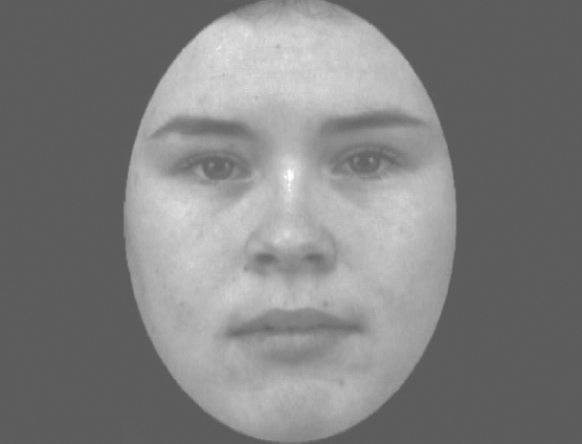

Slide 10
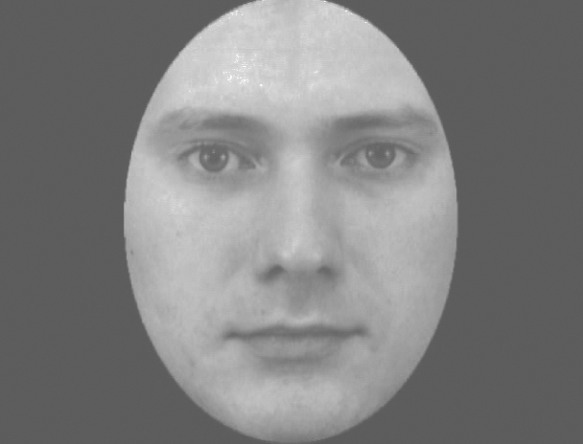

Slide 11
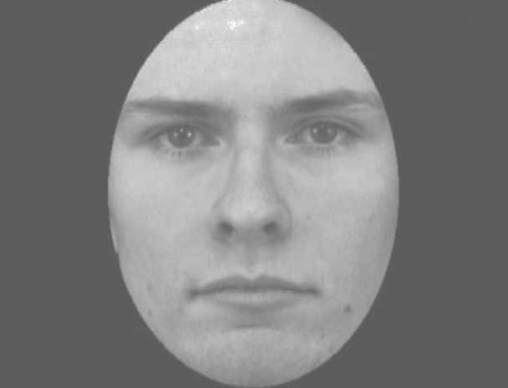

Slide 12
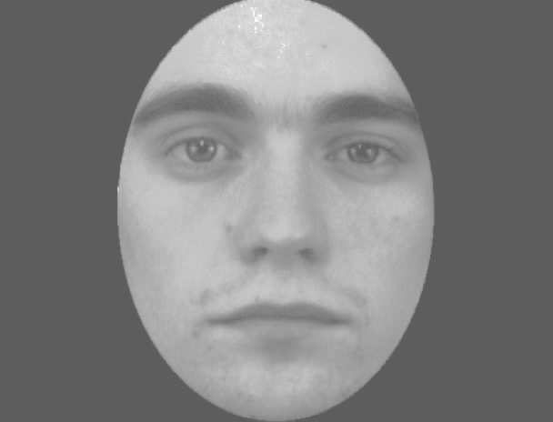

Slide 13
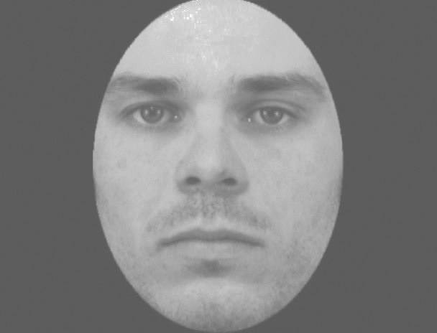

Slide 14
What’s this person’s Smiliness?
How likely is this person to smile back when receiving a smile?
Press ➡︎ to stop the sliding bar.

Slide 15
Do you choose to smile at this person and see if they smile back?
⬅ to start smiling and when you finished ➡︎ smiling.*
⬆︎ if you choose not to smile at this person.
* Indicating that you stopped is important in the MRI scanner because of how the MRI scanner works.

Slide 17
+

Slide 18
Practice Task Slides in scanner (4 trials)

Slide 19
Welcome to the Scanner Practice Round of the SAP task.
You are now getting a chance to practice the task in the scanner with the button box.
This is just so that you can get used to the setup with the button box and you laying down. You will see two faces here again. They will not be the same faces that you will interact with in the task later.
This practice will only involve 4 rounds.
If you have any questions, you can ask anytime during this short practice.

Slide 20
Main Task Slides

Slide 21
Welcome to the SAP task.
This is the SAP task that you have practiced already.
During the main task you cannot ask any questions. So if you have any questions, please ask now.
Because we are recording brain and physiological activity, please move as little as possible. If you move too much (incl. yawning, clenching your fists or yaw, wiggling your toes) the data cannot be used. So if you are uncomfortable, please let us know at this point. The data quality will be best if you are relaxed and still. Try not to tensen up any muscles, also keep your face relaxed when you are not asked to smile. ☺
Everytime you predict correctly and receive a congruent reaction (you smile – the face smiles or you stay neutral – the face stays neutral) you earn a point. If you collect 70 points you get an additional bonus of AUD 5, if you colledt 120 points you get a bonus of AUD 10.
The task is going to take ca. 15 minutes.

Slide 22
Welcome to the SAP task.
This is the SAP task that you have practiced already.
During the main task you cannot ask any questions. So if you have any questions, please ask now.
Everytime you predict correctly and receive a congruent reaction (you smile – the face smiles or you stay neutral – the face stays neutral) you earn a point. If you collect 20 points you get an additional bonus of AUD 5, if you collect 40 points you get a bonus of AUD 10.
The task is going to take ca. 20 minutes.

Slide 23
The SAP task is starting anytime now...

Slide 25
What’s this person’s smiliness?
Use the index finger to stop the sliding bar.

Slide 26
What’s their General Smiliness?
very unlikely……..……………|…………………………………very likely

Slide 27
Choose to smile: use index finger to start and ring finger when your face is neutral again.
Choose to stay neutral: indicate choice with middle finger.

Slide 28
[Participant indicates start with button press]

Slide 29
[Participant indicates skip with button press]

Slide 30
[Participant smiles indicates stop with button press]

Slide 32
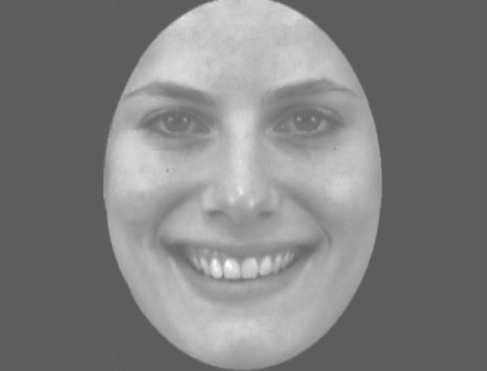

Slide 33
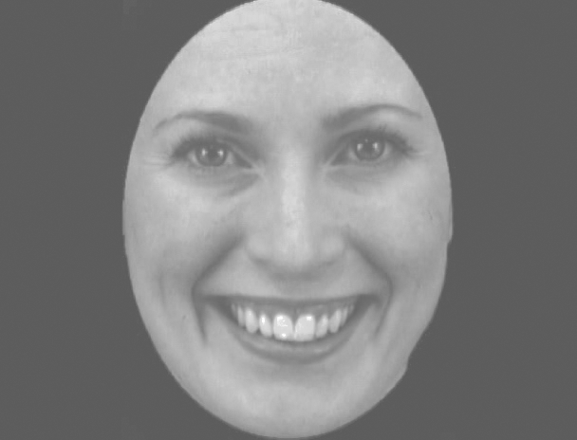

Slide 34
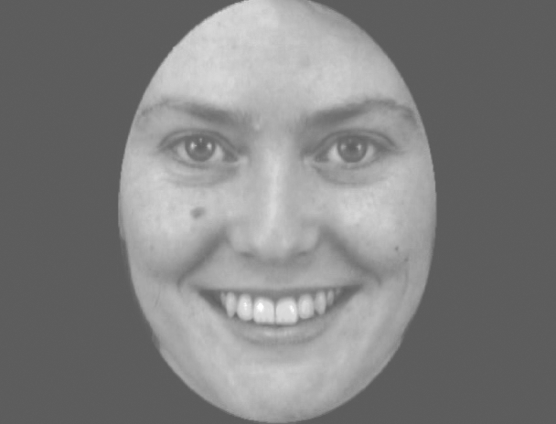

Slide 35
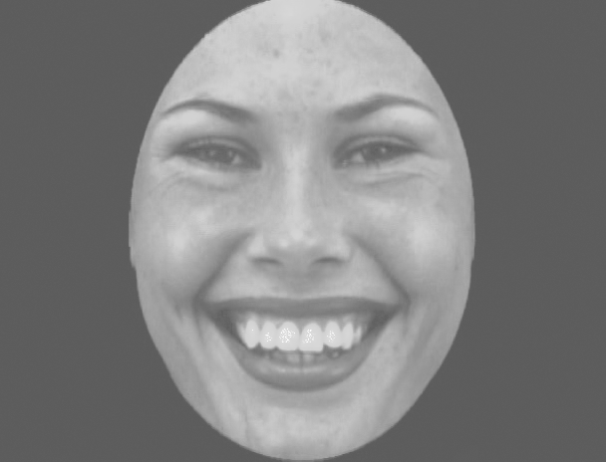

Slide 36
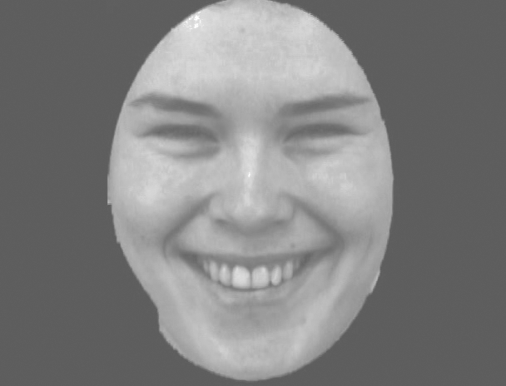

Slide 37
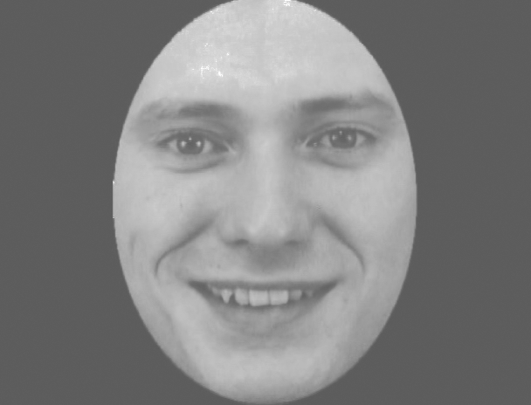

Slide 38
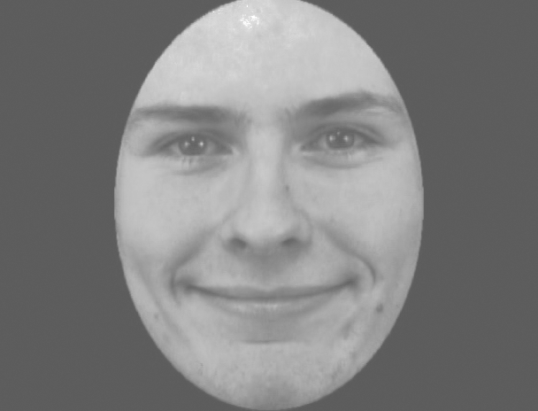

Slide 39
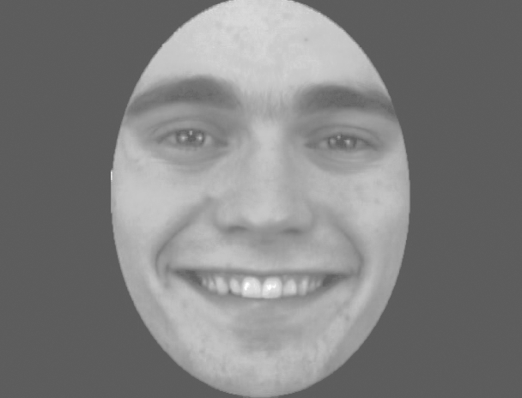

Slide 40
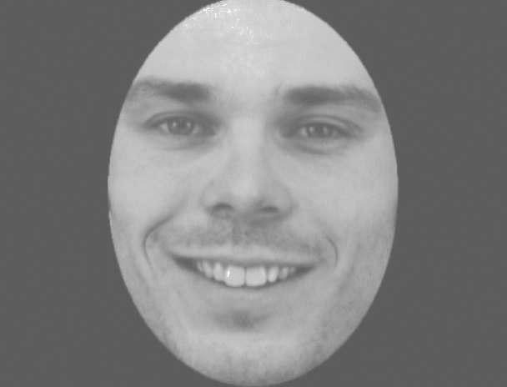

Slide 41
+

Slide 42
+ 1

Slide 43
- 1

