Slide 1
Social-Affective Prediction (SAP) Task

Slide 2
Practice Task Slides (12 trials)

Slide 3
Welcome to the practice round of the SAP task.
In the following you will be able to practice the SAP task. The instructions will be more detailed here than in the MRI. You can ask questions at any time!
This is the general setup of the task:
1. You will see a face
2. You are asked how likely this person is to smile back when receiving a smile
3. You are asked to smile or keep a neutral face and indicate that with a button press
4. You smile or keep a neutral face
5. You then see the face smiling back at you or staying neutral
Your goal is to predict accurately, whether a face will smile back at you or not.

Slide 4
POINTS
If you predict accurately and smile at faces that smile back and stay neutral with faces that don’t smile back you will make points.
If you can reach 50 points across all tasks you will earn an additional 5 AUD on top of the participation reimbursement.
If you reach 100 points across all tasks you will earn an additional 5 AUD on top of the participation reimbursement and the 50-point bonus.
After each task you will learn how many points you collected.

Slide 5
POINTS
If you predict accurately and smile at faces that smile back and stay neutral with faces that don’t smile back you will make points.
If you can reach 20 points you will earn an additional 5 AUD on top of the participation reimbursement.
If you reach 40 points you will earn an additional 5 AUD on top of the participation reimbursement and the 20-point bonus.
After the task you will learn how many points you collected.

Slide 6
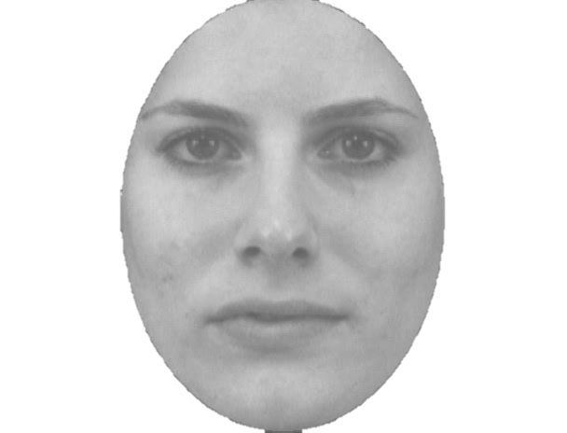

Slide 7
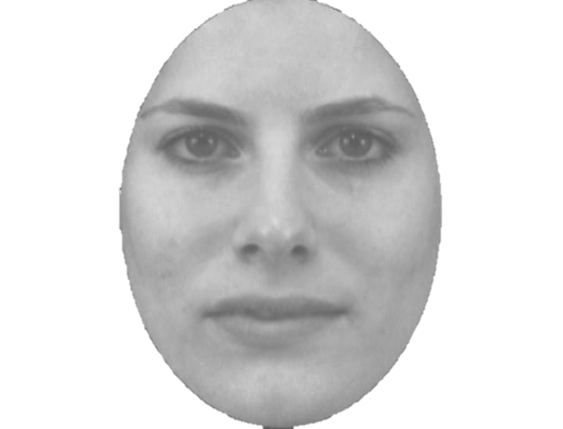

Slide 8
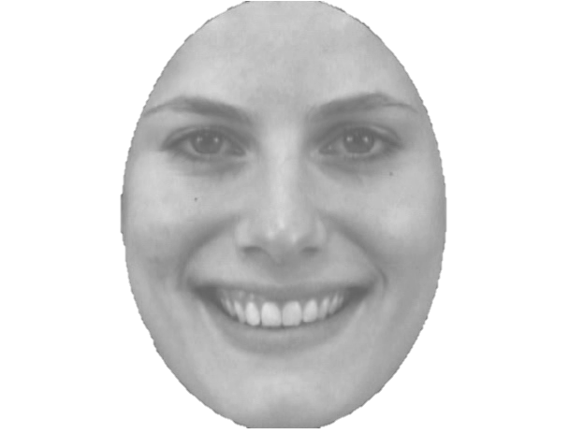

Slide 9
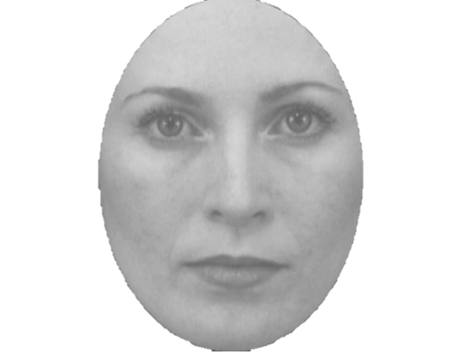

Slide 10
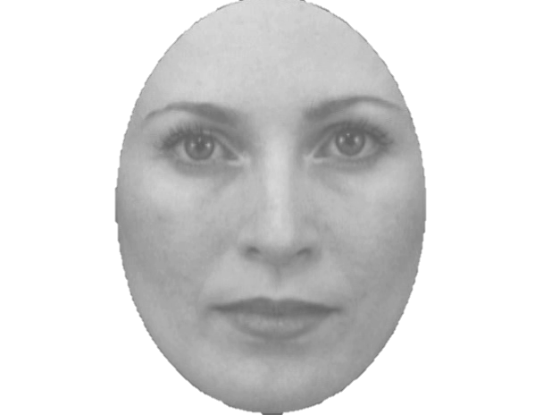

Slide 11
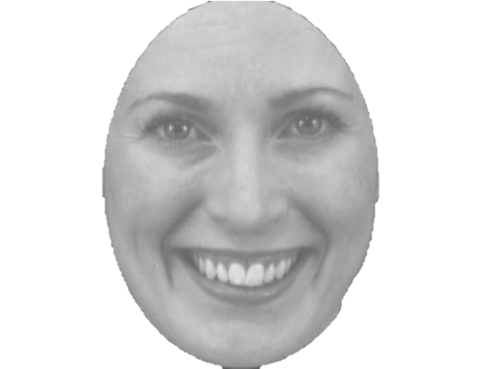

Slide 12
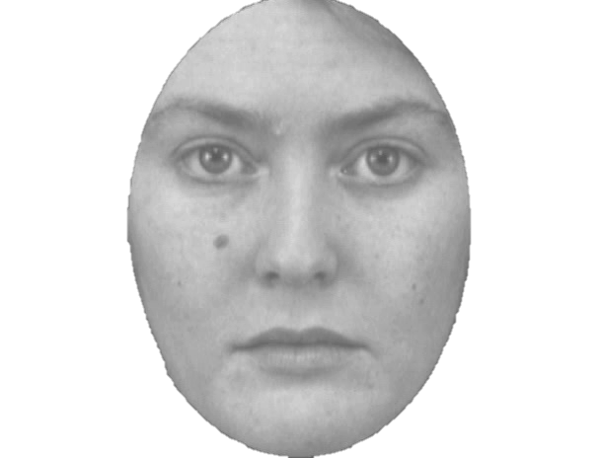

Slide 13


Slide 14
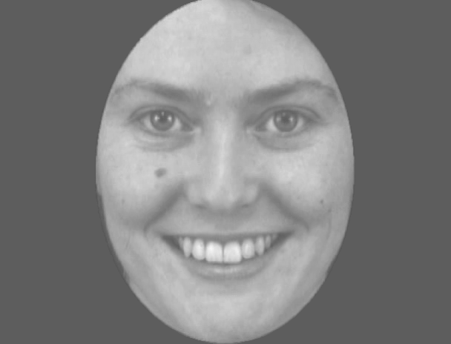

Slide 15
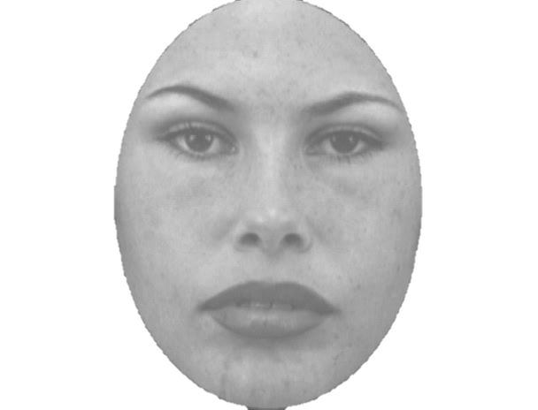

Slide 16
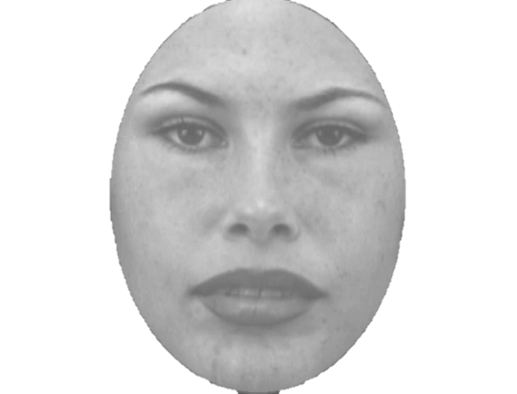

Slide 17
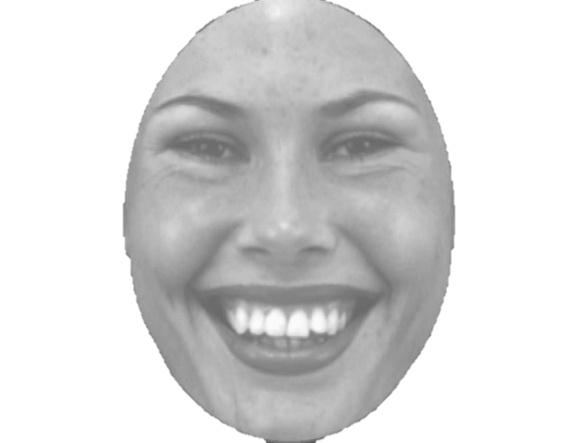

Slide 18
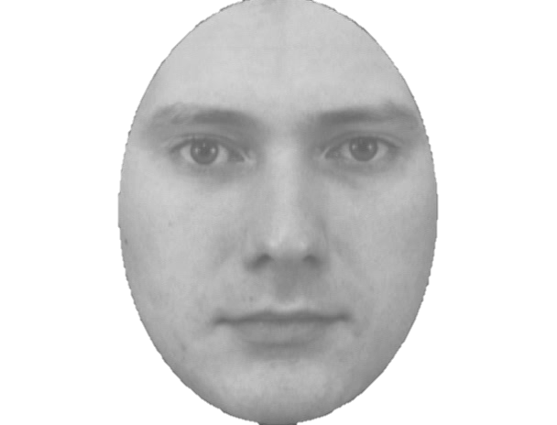

Slide 19
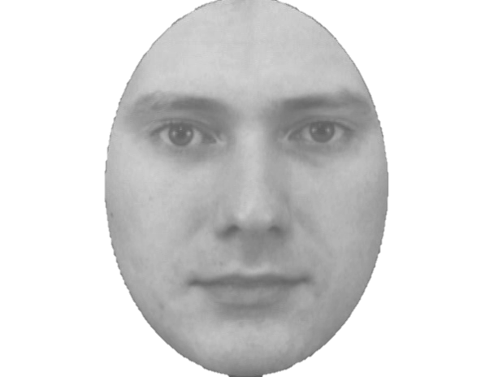

Slide 20
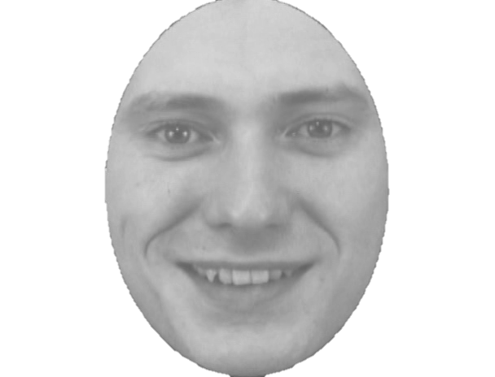

Slide 21
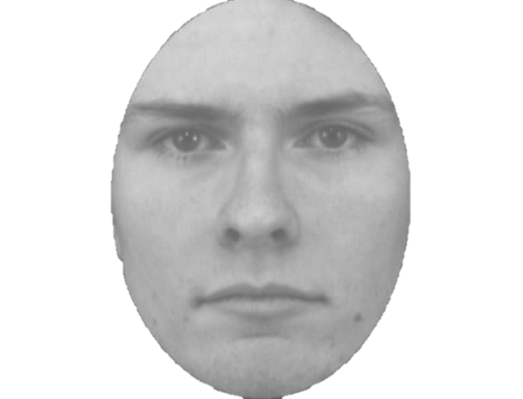

Slide 22
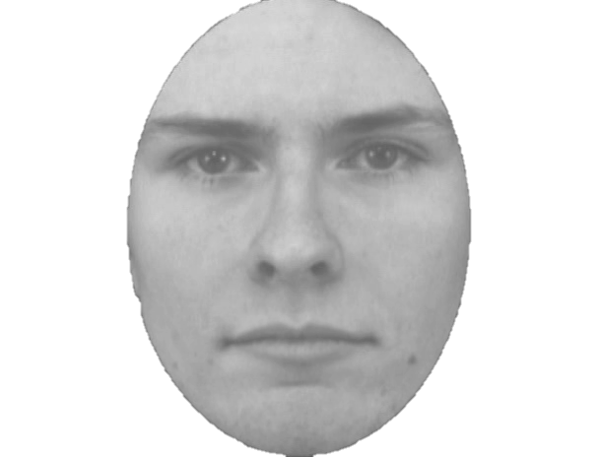

Slide 23
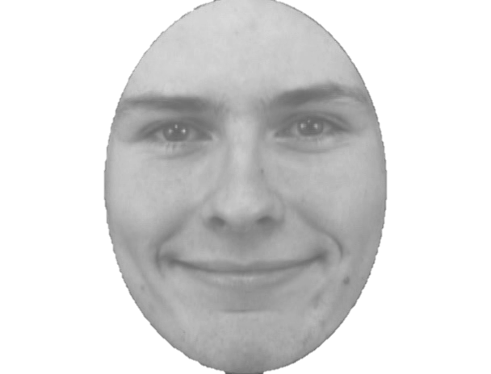

Slide 24
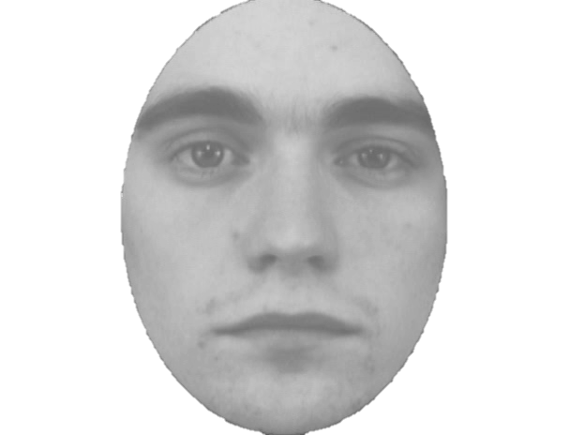

Slide 25
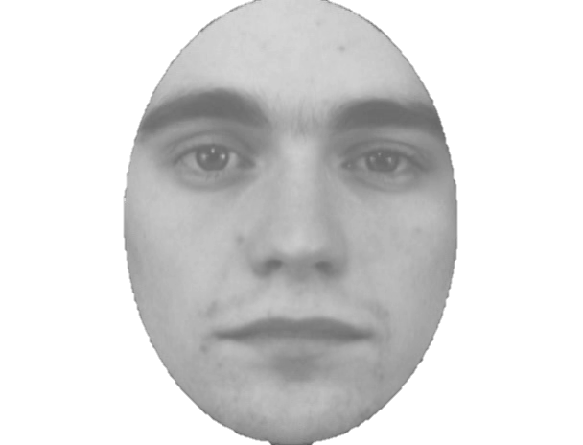

Slide 26
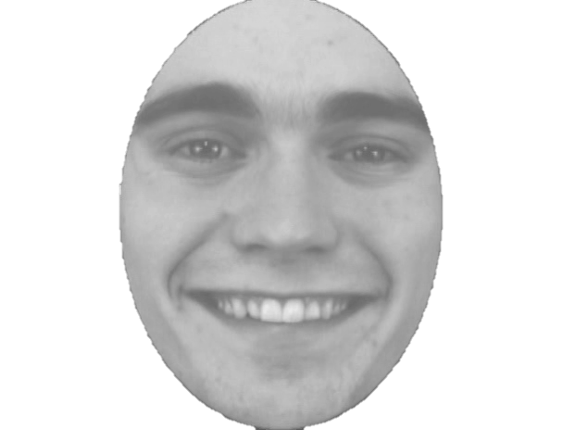

Slide 27
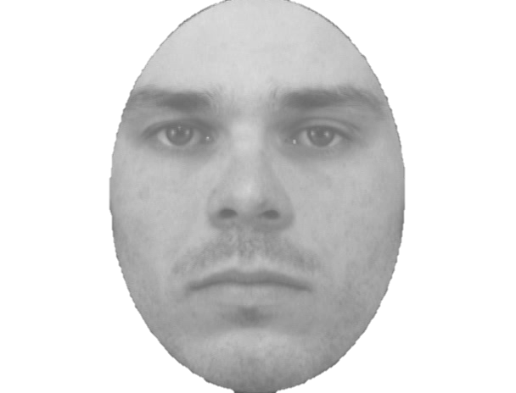

Slide 28
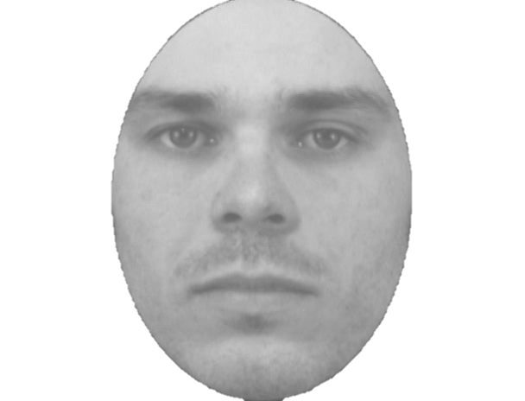

Slide 29
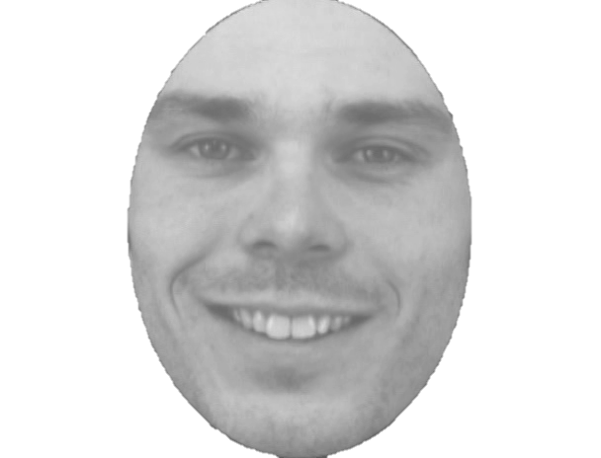

Slide 30
+

Slide 31
Practice Task Slides in scanner (4 trials)

Slide 32
Welcome to the scanner practice round of the SAP task.
You are now getting a chance to practice the task in the scanner with the button box.
This is just so that you can get used to the setup with the button box and you laying down. You will see two faces here again. They will not be the same faces that you will interact with in the task later.
This practice will only involve 4 rounds.
If you have any questions, you can ask anytime during this short practice.

Slide 33
Main Task Slides

Slide 34
Welcome to the SAP task.
This is the SAP task that you have practiced already.
During the task you cannot ask any questions. So if you have questions, please ask now.
Because we are recording brain and physiological activity, please move as little as possible. If you move too much (yawning, clenching your fists or yaw, wiggling your toes) the data cannot be used. So if you are uncomfortable, please let us know at this point.
The data quality will be best if you are relaxed and still. Try not to tensen up any muscles, also keep your face relaxed when you are not asked to smile. ☺
The task is going to take about 20 minutes.

Slide 35
The SAP task is starting anytime now...

Slide 36
+ 1

Slide 37
- 1

