Slide 1
Social-Affective Prediction (SAP) Control Task Egg Task

Slide 2
Practice Task Slides (12 trials)

Slide 3
Welcome to the Practice Round of the Egg task.
In this task you goal is to buy as many fresh eggs from the egg farmer for your store as possible. You want to get a good variety of eggs but some of them are more sensitive and get rotten more easily.
Because there are different sorts of eggs, you have to learn which ones are more likely to be rotten and which ones are more likely to stay fresh.
Try to collect as many eggs as possible.

Slide 4
POINTS
If an egg that you buy is rotten, you will loose a point. If you refrain from collecting an egg that would have been fresh however, you also loose a point. You gain points if you buy fresh eggs or correctly refuse rotten eggs offered by the farmer.
If you can reach 50 points you will earn an additional 5 AUD on top of the participation reimbursement.
If you reach 100 points you will earn an additional 5 AUDon top of the participation reimbursement and the 50-point bonus.

Slide 22
+

Slide 23
Practice Task Slides in scanner (4 trials)

Slide 24
Welcome to the Scanner Practice Round of the SAP task.
You are now getting a chance to practice the task in the scanner with the button box.
This is just so that you can get used to the setup with the button box and you laying down. You will see two faces here again. They will not be the same faces that you will interact with in the task later.
This practice will only involve 4 rounds.
If you have any questions, you can ask anytime during this short practice.

Slide 25
Main Task Slides

Slide 26
Welcome to the SAP task.
This is the SAP task that you have practiced already.
During the main task you cannot ask any questions. So if you have any questions, please ask now.
Because we are recording brain and physiological activity, please move as little as possible. If you move too much (incl. yawning, clenching your fists or yaw, wiggling your toes) the data cannot be used. So if you are uncomfortable, please let us know at this point. The data quality will be best if you are relaxed and still. Try not to tensen up any muscles, also keep your face relaxed when you are not asked to smile. ☺
Everytime you predict correctly and receive a congruent reaction (you smile – the face smiles or you stay neutral – the face stays neutral) you earn a point. If you collect 70 points you get an additional bonus of AUD 5, if you colledt 120 points you get a bonus of AUD 10.
The task is going to take ca. 15 minutes.

Slide 27
Welcome to the SAP task.
This is the SAP task that you have practiced already.
During the main task you cannot ask any questions. So if you have any questions, please ask now.
Everytime you predict correctly and receive a congruent reaction (you smile – the face smiles or you stay neutral – the face stays neutral) you earn a point. If you collect 20 points you get an additional bonus of AUD 5, if you collect 40 points you get a bonus of AUD 10.
The task is going to take ca. 20 minutes.

Slide 28
The SAP task is starting anytime now...

Slide 29
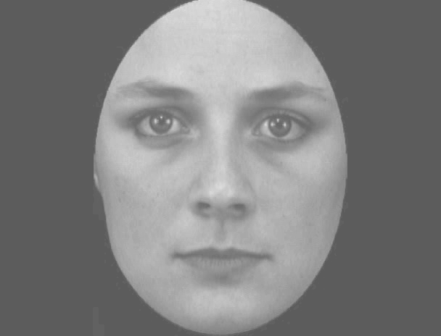

Slide 30
What’s this person’s smiliness?
Use the index finger to stop the sliding bar.

Slide 31
What’s their General Smiliness?
very unlikely……..……………|…………………………………very likely

Slide 32
Choose to smile: use index finger to start and ring finger when your face is neutral again.
Choose to stay neutral: indicate choice with middle finger.

Slide 33
[Participant indicates start with button press]

Slide 34
[Participant indicates skip with button press]

Slide 35
[Participant smiles indicates stop with button press]

Slide 37
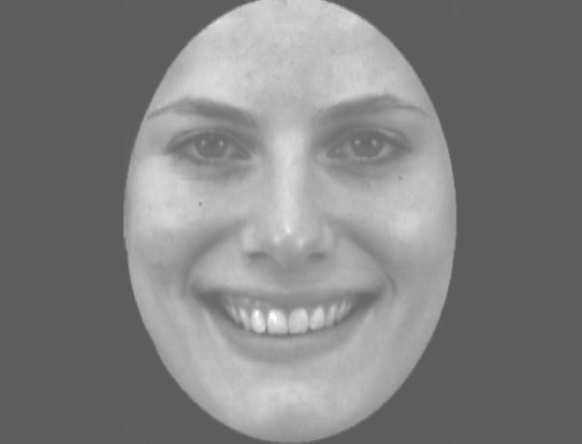

Slide 38
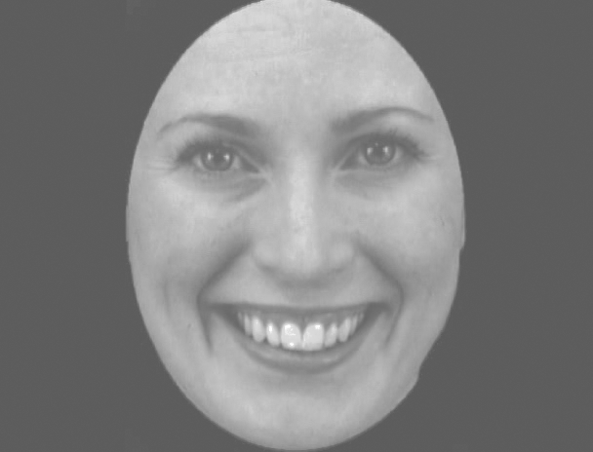

Slide 39
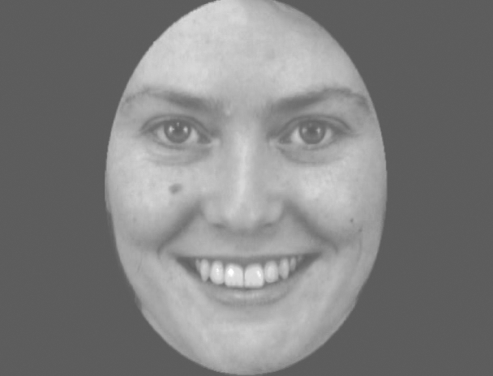

Slide 40
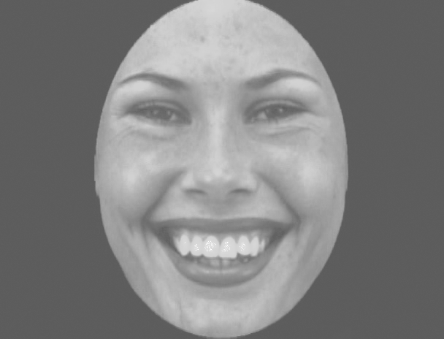

Slide 41
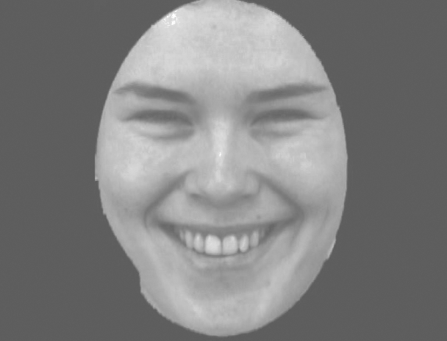

Slide 42
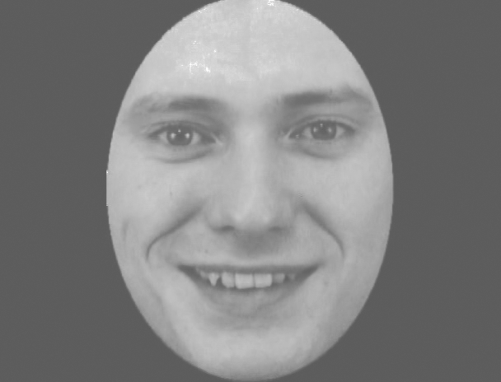

Slide 43
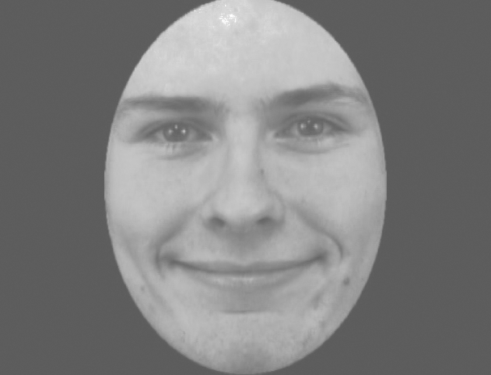

Slide 44
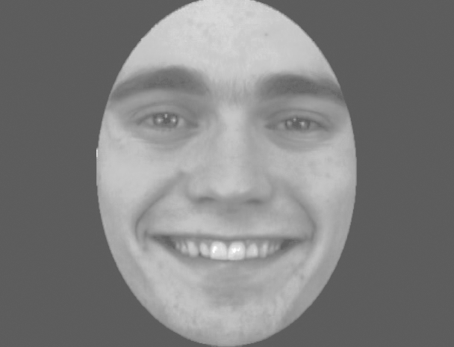

Slide 45
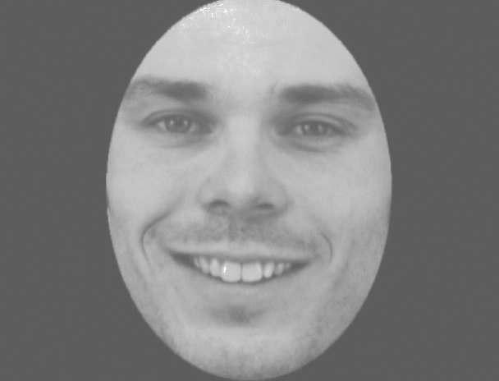

Slide 46
+

Slide 47
+ 1

Slide 48
- 1

