Slide 1
Social-Affective Prediction (SAP) Control Task Egg Task

Slide 2
Practice Task Slides (12 trials)

Slide 3
Welcome to the Egg task.
Your goal in this task is to buy as many fresh eggs from the egg farmer for your store as possible. You want to get a good variety of eggs but some of them are more sensitive and get rotten more easily. For good eggs you receive money, when you buy bad eggs you loose money.
Because there are different sorts of eggs, you have to learn which ones are more likely to be rotten and which ones are more likely to stay fresh.
Try to make as much profit as possible.

Slide 4
POINTS
If an egg that you buy is rotten, you will loose money and a point. If you refrain from collecting an egg that would have been fresh, you also loose a point. You gain points if you buy fresh eggs or correctly refuse rotten eggs offered by the farmer.
If you can reach 50 points across all tasks you will earn an additional 5 AUD on top of the participation reimbursement.
If you reach 100 points across all tasks you will earn an additional 5 AUD on top of the participation reimbursement and the 50-point bonus.
After each task you will learn how many points you accumulated.

Slide 5
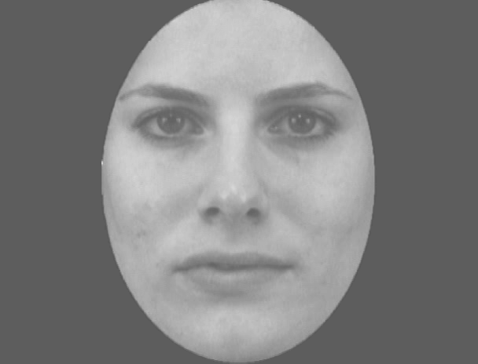

Slide 7
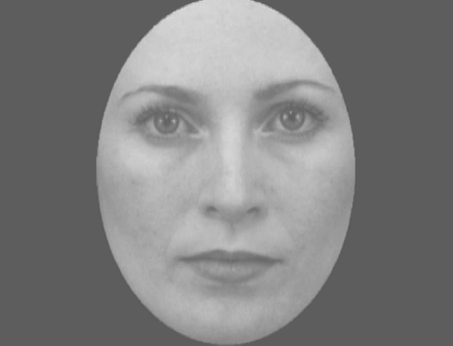

Slide 9
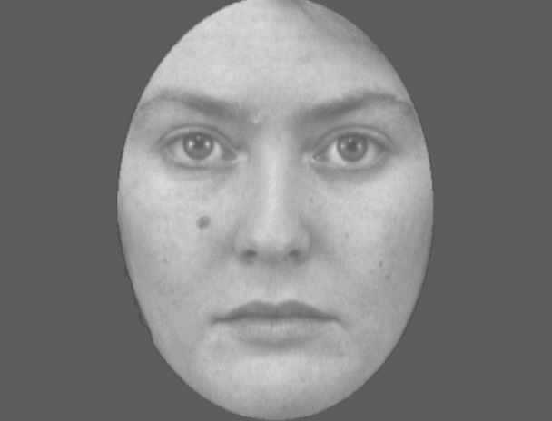

Slide 11
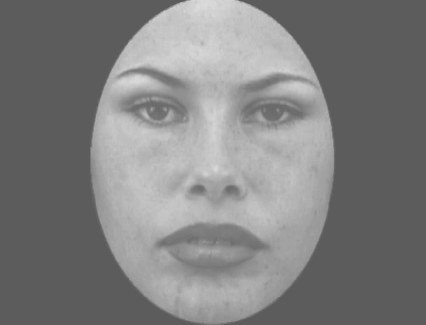

Slide 13
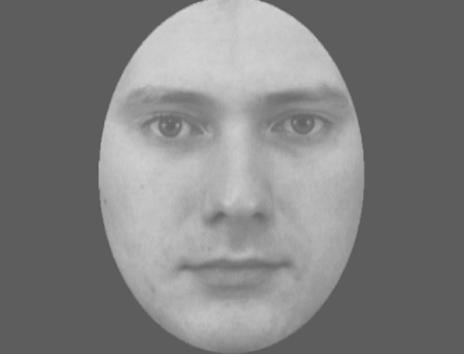

Slide 15
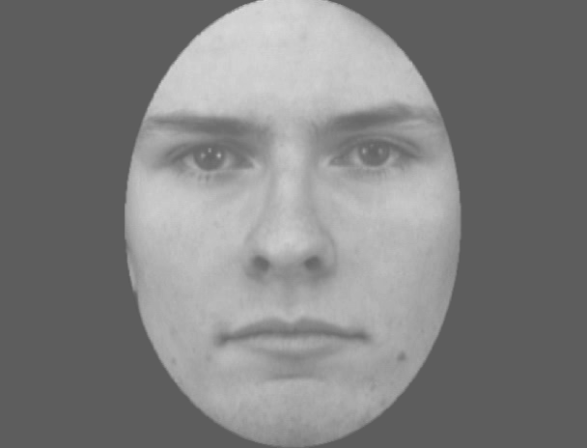

Slide 17
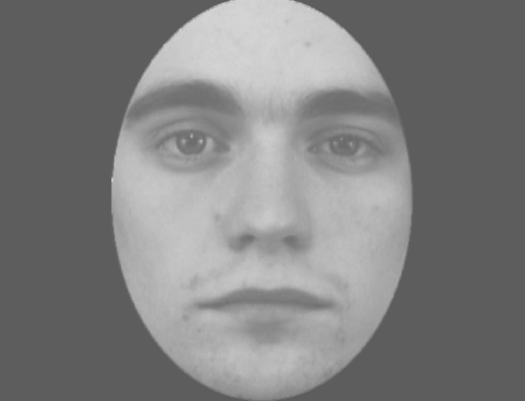

Slide 19
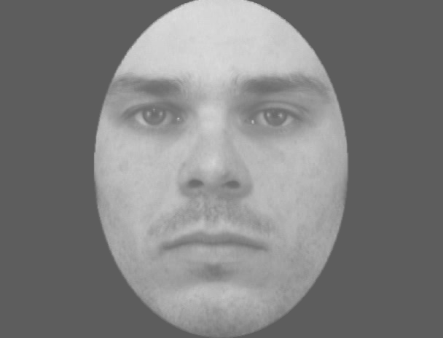

Slide 21
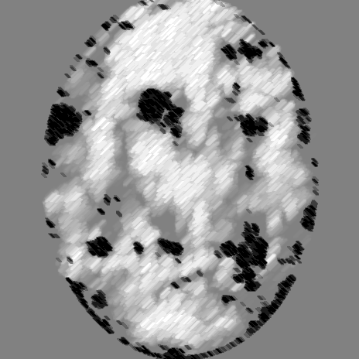

Slide 22
+

Slide 39
+ 1

Slide 40
- 1

