Slide 1
Transformers: Attention
An introduction

Slide 2

Why is attention important?
Attention is at the heart of all transformer models; in fact, “attention is all you need”
It’s probably the most unique part of transformers.

Slide 3
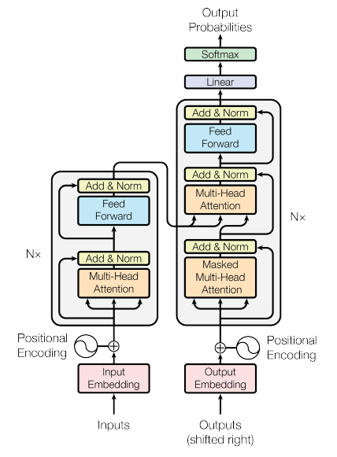
What is attention?
Attention is the concept of applying differing degrees of attention to an input sequence.
So, for sequence-to-sequence models, an output at timestep t considers more than the input at timestep t.
Greatly improves performance and reduces overhead

Slide 4
Attention and sequence-to-sequence layers
Attention is found most notably in sequence-to-sequence layers
A sequence-to-sequence layer is a neural network layer that takes as an input a sequence of elements and outputs another.
It is often used in language translation tasks, but the input can be pixels instead of words, so there’s a direct application in image processing as well.
Sequence-to-sequence layers can be causal (can only look backwards), or non-causual (forward and backwards). The need to “look around” is where attention comes in.
The goal is to provide an implementation which can be executed fast (in parallel) and allow for distant comparison of elements in a performant manner.

Slide 5
What came before attention? A brief history

Slide 6
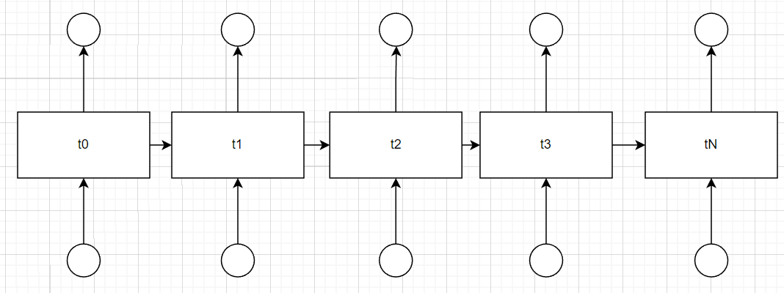
Two forms of sequence-to-sequence
The recurrent neural network ((Cho et al., 2014a) and (Sutskever et al., 2014))
Each timestep takes as input an embedding of some sort
Each timestep is responsible for creating an embedding

Slide 7
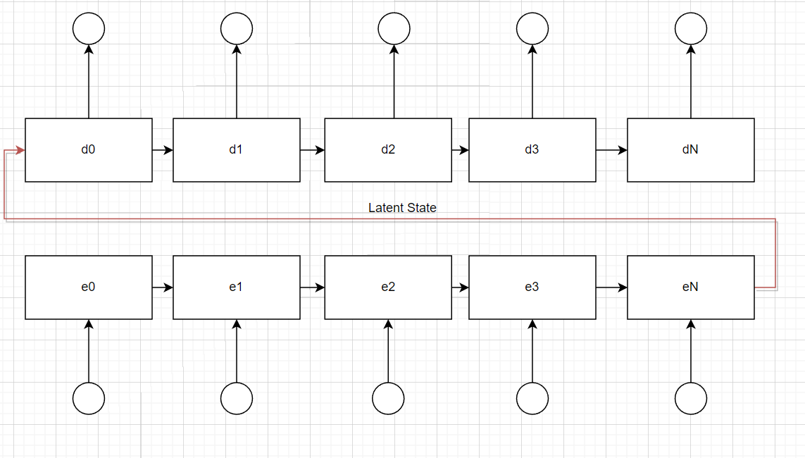
Two forms of sequence-to-sequence
Very sequential, poorly parallel
Single latent state handed from encoder to decoder – think human translator

Slide 8
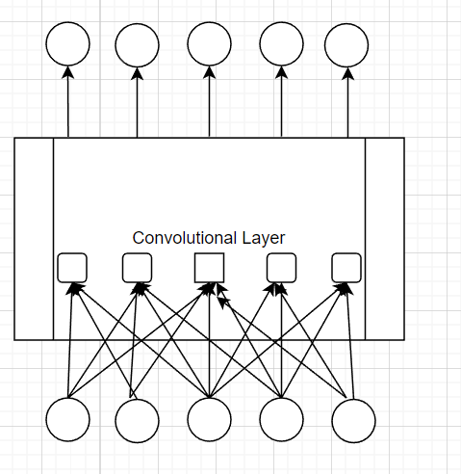
Two forms of sequence-to-sequence
Convolutional network (ConvS2S, ByteNET, etc)
Heavily parallel
No longer a single latent state

Slide 9
Two forms of sequence-to-sequence
Between different time steps: Increasing number of operations due to interconnections to relate distant elements
Linear # of operations for ConvS2S
Logarithmic # of operations for ByteNet

Slide 10
Attention to the rescue
https://arxiv.org/abs/1409.0473 (2016: Neural Machine Translation by Jointly Learning to Align and Translate)
Uses an RNN for the encoder and decoder
The encoder RNN bi-directional, whereas the decoder is forward-only
The decoder sources not only from its own latent state as it progresses, but also a weighted sum of each of the time steps of the encoder

Slide 11
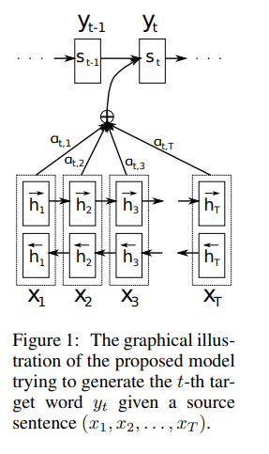

A visual
Note the bi-directional and forward-only components
Note how, at each timestep, the output isn’t considering just one input and a latent state, but all of the inputs.

Slide 12
Not all inputs are equal
The point is to apply weights to the inputs
In 2016: Neural Machine Translation by Jointly Learning to Align and Translate, the weighting coefficients were found using a single-layer, feed-forward network that was co-trained with the rest of the model
In practice this worked well, but problematic due to being a memory / computation hog

Slide 13
Attention is all you need
In 2017 a paper was released by Google showing that attention was powerful enough, and that one could dispense with RNNs and CNNs altogether,
The fundamental idea is that if the embedding is done well enough, then the simple dot product is good enough to produce a similarity metric between elements of the input sequence
How?
Highly parallelizable over RNNs, greatly reduced footprint over CNNs

Slide 14

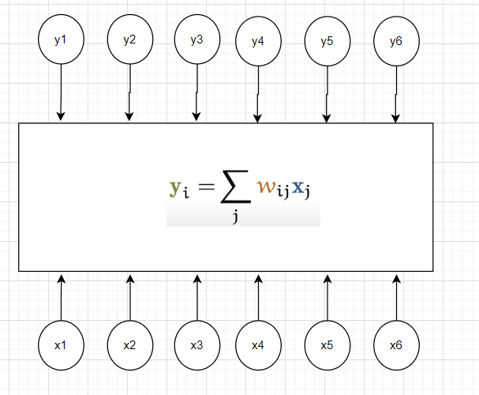
Scaled dot product
Note the weight matrix, w. This is used instead of a neural network for weighting.
In the most basic implementation, the weight matrix doesn’t even have to be learned (but is)

Slide 15
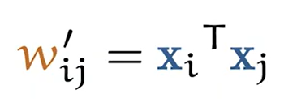
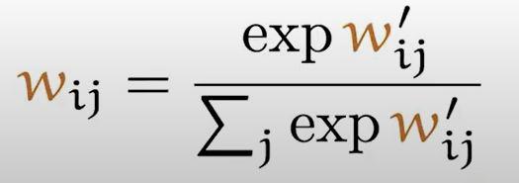
Scaled dot product
Each embedding vector is dotted with all others, this finds similarity
The dot product is then passed through a softmax operation to scale from 0 to 1, and to ensure each value is positive.
This produces the weight matrix

Slide 16

Some immediate problems
Since each embedding vector is dotted with all other vectors, it will also be dotted with itself (and therefore likely the largest). Typically, this isn’t a problem, but it’s not necessarily optimal.
There are no tunable or learnable parameters as of yet

Slide 17
Keys, values and queries: making things tunable
The paper introduces an alternate view of the embedding vectors depending on how they’re being used.
As the input vector it’s known as the “value”,
As the input vector being dotted against all other vectors it’s the “query”,
The “other vectors” are known as they “keys”
They take this naming scheme from databases, but it’s not entirely clear why.
Important, however, is we have three new labels for the same set of vectors

Slide 18
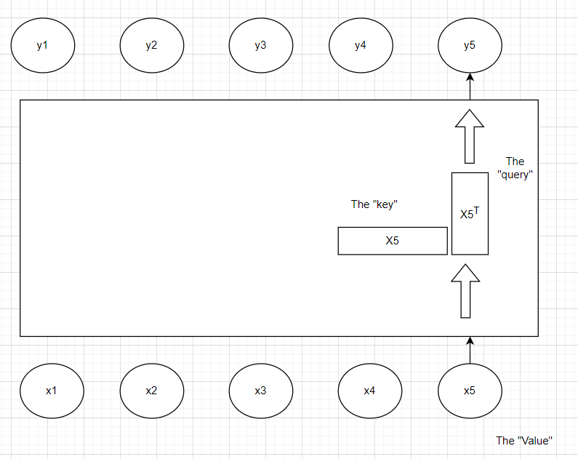
It looks like this
Note how the _same_ vector can be referred to using three different names
Why?

Slide 19
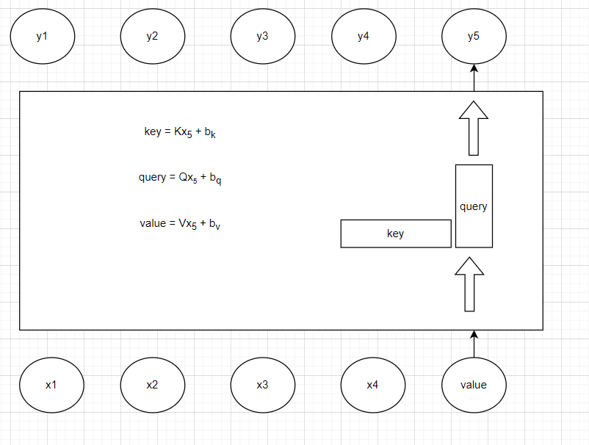
We can now add learnable weight matrices
Each form of x⁵ can now become a different vector
The matrices can be learned through back prop

Slide 20
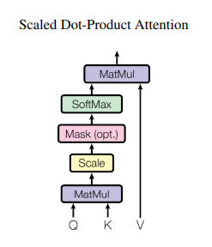
Scaled dot-product attention
Query and Key matrices are then dotted,
Scaled (to prevent vanishing gradients),
Softmax,
Final dotting with the Value matrix

Slide 21
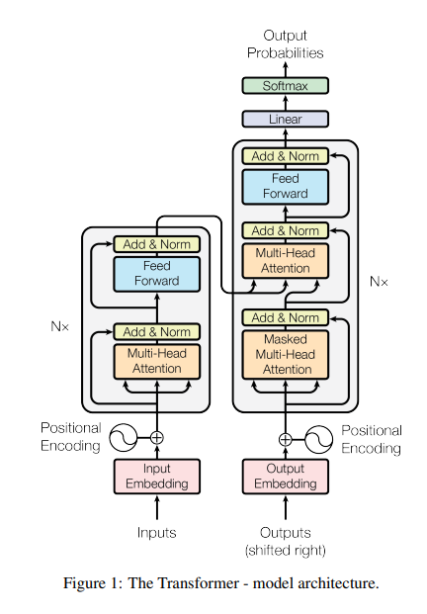
Next time
How are the matrices learned?
Multi-head attention
Transformers

