Slide 1

The Open Spectrum Revolution
AKA, Die Kitty Die!!!
Kevin Werbach
Supernova Group LLC
kevin@supernovagroup.net
Wireless Future Conference
Austin, TX
March 13, 2004

Slide 2

An Ocean of Capacity?
Why do we think spectrum is scarce?
  Radio waves don’t bounce off one another
  Devices are much smarter than in the 1920s
We make spectrum scarce through technical architectures and regulation
There is an alternative

Slide 3

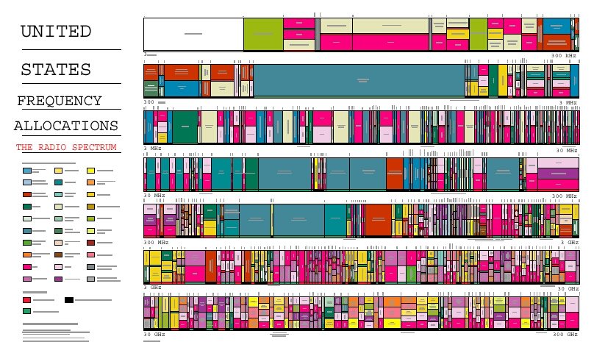
The Spectrum Fallacy
SPECTRUM


Slide 4

There is No Cat!
Albert Einstein’s
(probably apocryphal)
description of how
radio works.

Slide 5
The Real World
Radio Frequency (MHz)

Slide 6
THIS is “The Spectrum”!





















Slide 7
“Open Spectrum” Techniques
Not just technologies, but the opportunities, business models, and usage models they foster
Leverage the computational intelligence of today’s wireless devices
  Radios are becoming computers
  Greatest potential gain is from cooperation in and among radio systems
A paradigm shift in radio communications
  I call it the Radio Revolution (copies of NAF report available)
  Online at <http://www.spectrumpolicy.org>

Slide 8
WiFi is the Tip of the Iceberg
An “existence proof” for spectrum sharing
  Zero to $2 billion annual revenue in four years
  …which happened to be a tech depression everywhere else
Innovation is accelerating
  The old PC and Internet industry story, but it’s playing out in for the first time in wireless
Nonetheless, WiFi is a crummy technology
  You ain’t seen nothing yet!

Slide 9
Wideband Underlay
POWER
Noise floor
FREQUENCY

Slide 10
Agile/Cognitive Radio
TIME
FREQUENCY

Slide 11

Antenna Innovations
Directionality
Adaptiveness
Antenna diversity

Slide 12


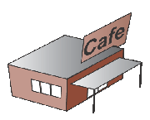




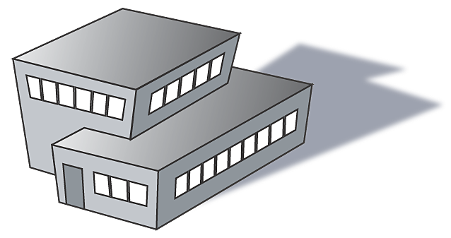

Mesh Networking
© 2003 SkyPilot Network

Slide 13
Implications
Vast expansion of effective capacity
No need for exclusive licenses
Potential for rapid and continuous innovation

Slide 14
So What?
Wireless is the foundation of massive industries, all of which have long assumed scarcity
The technological shift produces architectural and economic changes as well
  A different business model: user financing
  YOU are the network!
An open platform for content and applications
  Remember what happened the last time something like that appeared? (Hint: I’m talking about the Net)

Slide 15
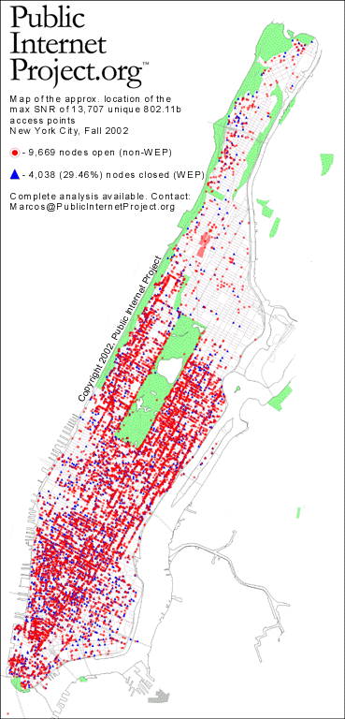
The Stealth Broadband Build-Out
...and remember,
WiFi is just the beginning!

Slide 16
So, what should we do about all this?
(I thought you’d never ask!)

Slide 17
We Don’t Need No Stinkin’ Licenses
Governments should look to create unlicensed “parks” wherever possible
  Unlicensed bands (900 MHz, 2.4 GHz, 5 GHz) have become the focal points of wireless investment and innovation
FCC ultra-wideband and broadcast band proceedings show potential for “underlays”
“Anything goes” bands at ultra-high frequencies
Broader authorizations for agile/cognitive radio

Slide 18

Supercommons









POWER




FREQUENCY
(Paper available at http://werbach.com/research/supercommons.pdf)

Slide 19
Rethinking Wireless Rights
All forms of wireless regulation actually define rights associated with certain equipment
  We regulate the devices, not the “spectrum”
Traditional government licensing is far too rigid and frequency-oriented
Any pre-determined restrictions on transmission create inefficient limits on the supercommons








Slide 20




Universal Transmission Privilege
Anyone can transmit:
  Anywhere
  Anytime
  In any way

Slide 21
Not Anarchy!
Can exist alongside the existing regime
Common law dispute resolution
  Tort-like duty of care, rather than exclusive rights
Safe harbors and backstops
  Technical standards
  Trademark concepts (publication and opposition)
  Physical localization
  Cognitive radio
  Insurance
Cooperation incentives for vendors and users

Slide 22
Why Not a Tort-Like Regime?

“To handle the problems arising because one person’s use of a sound or light wave may have effects upon others, we establish the right which people have to make sounds which others may hear or do things which others may see.” -- Ronald Coase

Slide 23

The Big Picture:
DECENTRALIZATION

Slide 24
The Great Transition
Music Industry
Peer to peer
Television
Tivo
Publishing
Weblogs
Client-server applications
Web services
Centralized directories
Federated identity
Circuit-switched telephony
VOIP
Licensed cellular
Unlicensed wireless

Slide 25
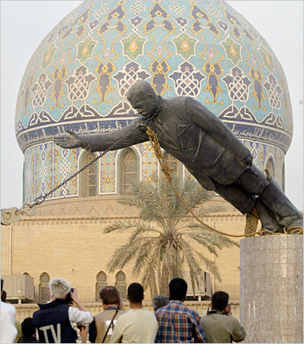
Centralized Power is Precarious

Slide 26

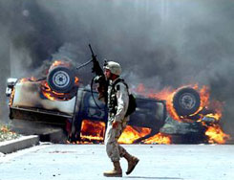
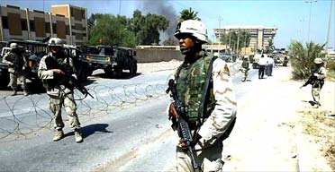
The New World Has Threats Too

Slide 27
An Ocean of Capacity
Can we handle the truth?

Slide 28

For More...
Email: kevin@werbach.com
Blog: http://werblog.com
Supernova Report: http://www.pulver.com/reports/supernova
Supernova 2004
  June 24-25, Santa Clara, CA
  http://www.supernova2004.com/

