Slide 1
Services On-Demand™
Patrick Grady
Founder / Chairman / CEO

Slide 2





Internet Outposts
Content
Catalogs
Services
Auctions
Search

Slide 3
Why Services?
Largest E-Commerce Opportunity
  60% of global $55 trillion economy
  Less than 10% of e-commerce
  Enterprise, SMB and consumer markets
  Purest Internet marketplace model
Killer App of “True” On-Demand
  High frequency
  Highly-personalized
  Localized
  Time-sensitive
  Entangled in day-to-day life and workflow

Slide 4
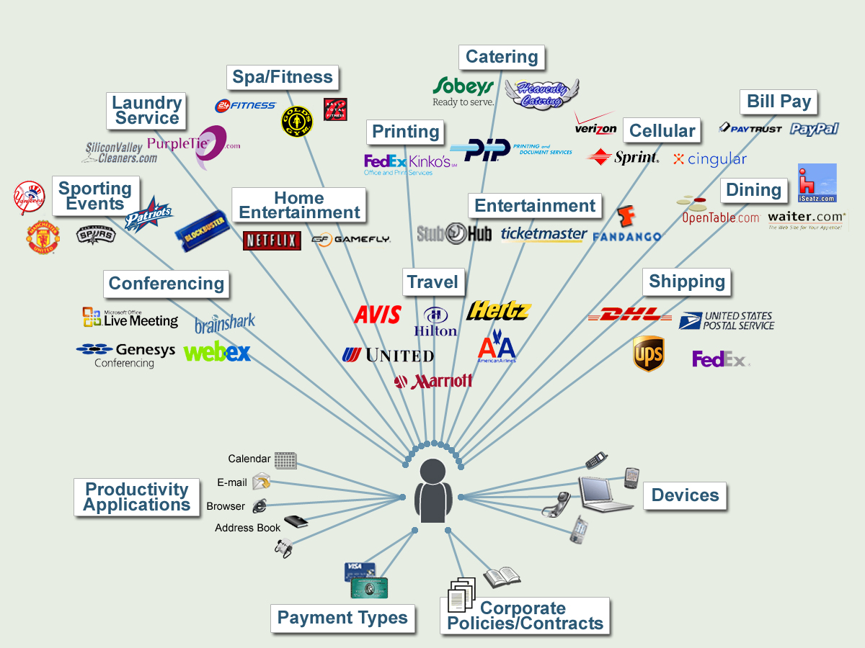
Services Today

Slide 5
After a Decade, Why No eBay of Services?
Complex Supplier Inventory
  Non-catalogable
  Time-based
  Localized
  Perishable
  Dynamic
Buyer’s Challenges
  Myriad dependencies
    Time, location, availability, third parties
  Time consuming
    Scores of web sites, phone calls, delays, cancellations, etc.

Slide 6
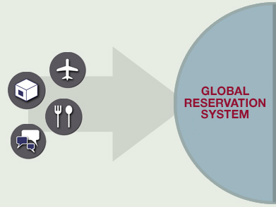
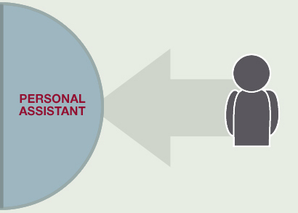
What’s Needed? A Radically Different Architecture
Suppliers: A Global Reservation System
  Horizontal and service agnostic
  Real-time system capable of handling ever-changing inventory
Buyers: A Personal Assistant
  Identity / Presence / Context
  Delivers “smart” services anytime, anywhere, via any device

Slide 7
Why Now?
Infrastructure That Can Be Leveraged
  Robust standalone products well along maturity and adoption curve
    WWW
    Applications
    Devices
    Groupware
    Bandwidth
    GPS / e911
Elegantly Leveraged and Unified Via Web Services
  Loosely-coupled
  Coarse-grained
  Asynchronous

Slide 8
Rearden Commerce Services Grid
Extensible Web Services-based On-Demand Platform
Services On-Demand Applications
Services Commerce Network
Intellectual Property
  Description, Discovery and Delivery of User-Centric Services
  Semantics, Ontologies and Orchestration of Web Services
Very Disruptive to Vertical Sites

Slide 9


Services On-Demand
© 2005

Slide 10
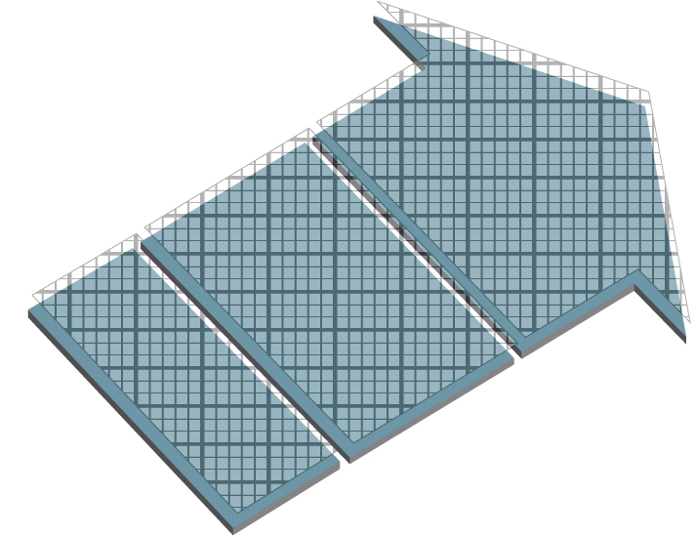
Services On-Demand
© 2005

Slide 11

Services On-Demand
© 2005

Slide 12
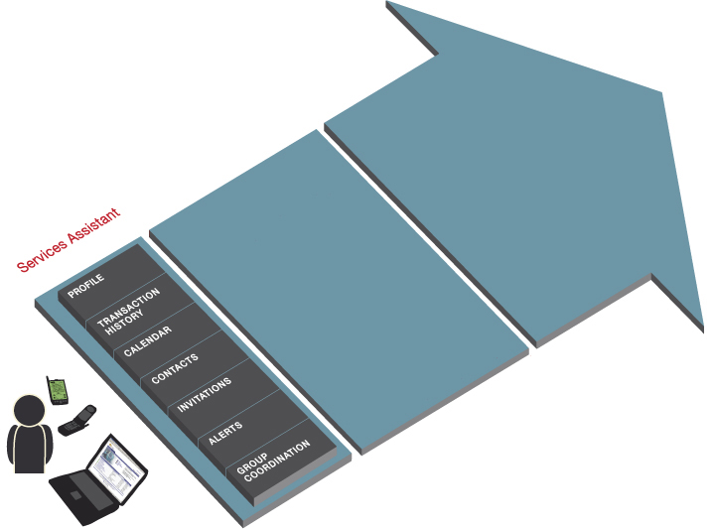
Services On-Demand
© 2005

Slide 13
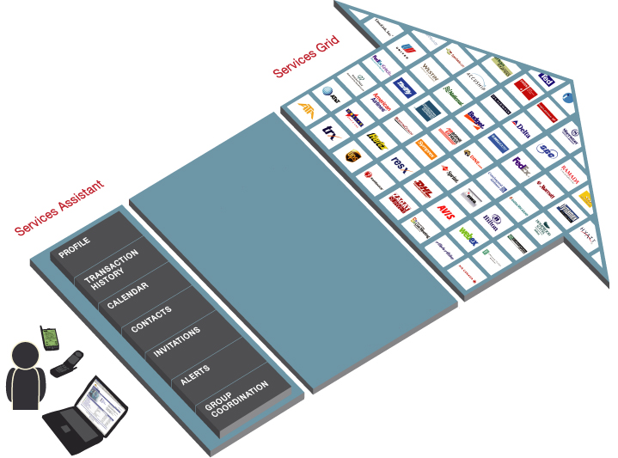
Services On-Demand
© 2005

Slide 14
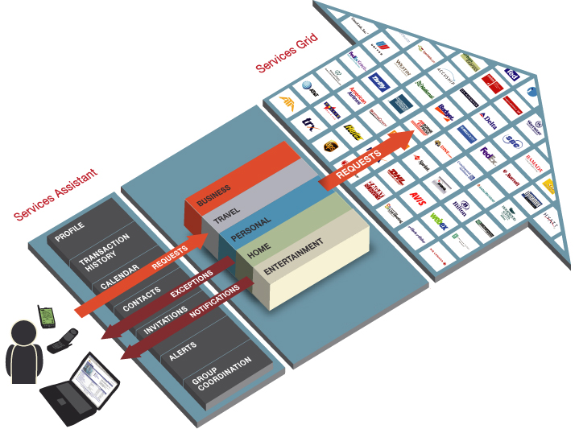
Services On-Demand
© 2005

Slide 15
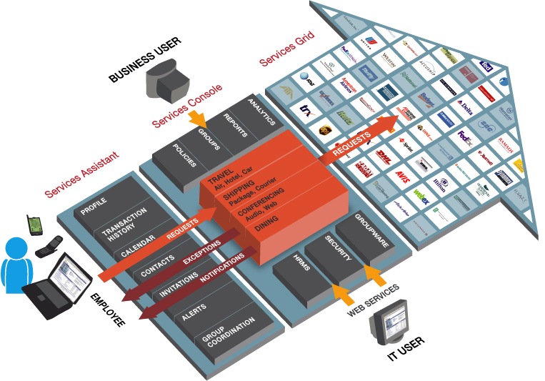
Rearden EBS (Employee Business Services)
© 2005

Slide 16
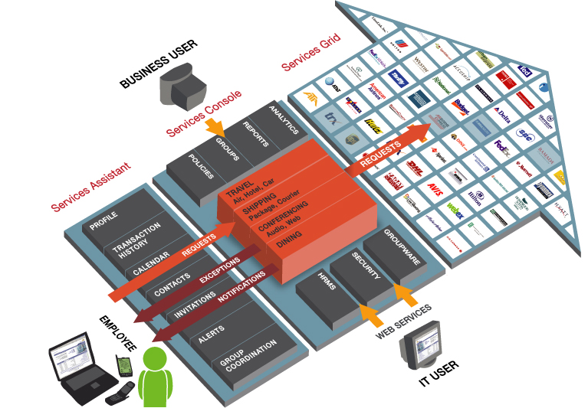
Rearden EBS (Employee Business Services)
© 2005

Slide 17
Why Employee Business Services First?
Large Market
  $471 Billion spent annually by U.S. corporations alone
Untapped
  48% of services spend not controlled by the procurement department
Huge ROI
  Savings of up to 20%
Ripe for Services Grid Optimization
  Stovepipes have led to low adoption and savings rates and high TCO
Network Effect / All Desktops
  Suppliers follow buyers; more valuable to buyers etc.
“Tighter controls
in services procurement resulting in just
1% of hard cost reductions would bring $15 billion in savings in the U.S. alone.”
- Aberdeen Group

Slide 18

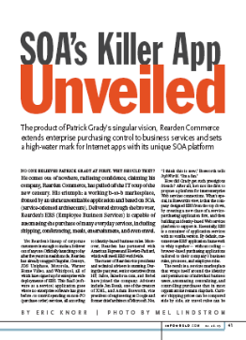




The Services Grid is Now Open
“(Rearden Commerce) is tackling one of technology’s most enduring and elusive goals: the creation of an electronic concierge for busy professionals.”
– The Wall Street Journal
“...is about to transform
business as we know it.”
– InfoWorld
“…it’s the ultimate employee productivity application.” – AMR
“It’s stunning to see so much of the potential of Web services rolled into one offering.”
– CIO Magazine
“Rearden Commerce sets a high-water mark
for Internet apps with its unique SOA platform.”
– InfoWorld
“The Rearden Commerce solution is game changing technology…
Rearden delivered the best service oriented architecture that my
team has encountered.” – VP of IT, Motorola

Slide 19
www.ReardenCommerce.com

